Slide 1
Section 3.4
Multiplication and Division with Mixed Numbers

Slide 2
Objectives
Multiply mixed numbers.
Find the area of a rectangle and triangle with fractions and mixed numbers.
Divide mixed numbers.

Slide 3
To Multiply Mixed Numbers
Procedure
Change each mixed number to an improper fraction.
Factor the numerator and denominator of each fraction, and then reduce and multiply.
Change the answer to a mixed number or leave it in fraction form. (The choice sometimes depends on what use is to be made of the answer.)

Slide 4
Example 1: Multiplying Mixed Numbers
Multiply:
Solution
Change each mixed number to an improper fraction,
then multiply the fractions.

Slide 5
Example 2: Multiplying and Reducing Mixed Numbers
Multiply and reduce to lowest terms:
Solution

Slide 6
Example 3: Multiplying and Reducing
Mixed Numbers
Multiply and reduce to lowest terms:
Solution

Slide 7
Example 4: Multiplying and Reducing
Mixed Numbers
Multiply and reduce to lowest terms:
Solution

Slide 8
Completion Example 5: Multiplying and Reducing
Mixed Numbers
Multiply and reduce to lowest terms:
Solution

Slide 9
Example 6: Finding Fractional Parts of Mixed Numbers
Find of
Solution
Remember, to find a fraction of a number means to multiply the number by the fraction.

Slide 10
Example 7: Finding Fractional Parts of Mixed Numbers
Find of
Solution

Slide 11
Example 8: Application: Finding the Area of a Rectangle
Linda is framing a rectangular poster that measures
inches long by inches wide. What is the area of the
glass needed to cover the poster?
Solution
Find the area of the rectangle by using the formula
A = lw.

Slide 12
Example 8: Application: Finding the Area of a Rectangle (cont.)
Thus, the area of the glass is (read “square inches”).
A = lw

Slide 13
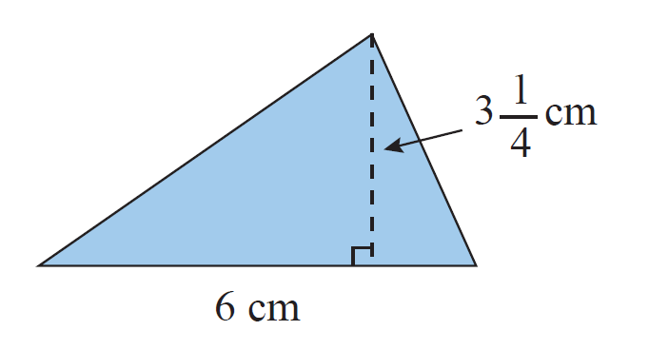
Example 9: Finding the Area of a Triangle
Find the area of the triangle with base 6 cm and height
Solution
The area can be found using the formula

Slide 14
Example 9: Finding the Area of a Triangle (cont.)
The area of the triangle is cm. (read “square centimeters”).

Slide 15
To Divide with Mixed Numbers
Procedure
Change each mixed number to an improper fraction.
Multiply by the reciprocal of the divisor.
Reduce, if possible.

Slide 16
Example 10: Dividing and Reducing Mixed Numbers
Divide and reduce to lowest terms:
Solution
Note that the divisor is and we
multiply by its reciprocal,

Slide 17
Example 11: Dividing and Reducing Mixed Numbers
Divide and reduce to lowest terms:
Solution:
First, change the mixed number to the improper fraction and then multiply by its reciprocal.

Slide 18
Completion Example 12: Dividing and Reducing Mixed Numbers
Divide and reduce to lowest terms:
Solution

Slide 19
Example 13: Application: Dividing Mixed Numbers
A landscaper has pounds of fertilizer available to
use for fertilizing trees. If he plans to use pounds of fertilizer on one tree, how many trees can he fertilize?
Solution
Step 1: READ: Read the problem carefully. We know the total amount of fertilizer he has and how much he plans to use on one tree.

Slide 20
Example 13: Application: Dividing Mixed Numbers (cont.)
Step 2: SET UP: To find the number of trees he can fertilize, divide the total amount of fertilizer by the amount to be used on one tree.
Step 3: SOLVE:
He can fertilize 41 trees.
= number of trees.

Slide 21
Example 13: Application: Dividing Mixed Numbers (cont.)
Step 4: CHECK: The landscaper is using less than 1 pound of fertilizer for each tree, which means he can fertilize more than 30 trees. So, 41 is a reasonable answer.

