Slide 1
Section 8.6
Graphing Linear Inequalities
in Two Variables

Slide 2
Objectives
Graph linear inequalities.
Use a graphing calculator to graph linear inequalities.

Slide 3
Graphing Linear Inequalities
Procedure
First, graph the boundary line (dashed if the inequality is < or >, solid if the inequality is ≤ or ≥).
Next, determine which side of the line to shade using one of the following methods.
Method 1
Test any one point obviously on one side of the line.

Slide 4
Graphing Linear Inequalities
Procedure (cont.)
If the test-point satisfies the inequality, shade the half-plane on that side of the line. Otherwise, shade the other half-plane.
Note: The point (0, 0), if it is not on the boundary line, is usually the easiest point to test.

Slide 5
Graphing Linear Inequalities
Procedure (cont.)
Method 2
Solve the inequality for y (assuming that the line is not vertical).
If the solution shows y < or y ≤, then shade the half-plane below the line.
If the solution shows y > or y ≥, then shade the half-plane above the line.

Slide 6
Graphing Linear Inequalities
Procedure (cont.)
Note: If the boundary line is vertical, then solve for x. If the solution shows x > or x ≥, then shade the half-plane to the right. If the solution shows x < or x ≤, then shade the half-plane to the left.
The shaded half-plane (and the line if it is solid) is the solution to the inequality.

Slide 7
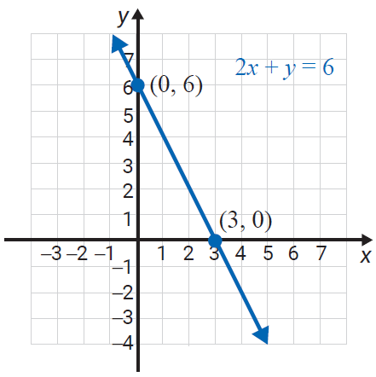
Example 1: Graphing Linear Inequalities
Graph the solution set to the inequality
Solution
Method 1 is used in this example.
Step 1: Graph the boundary line 2x + y = 6 as a solid line because the inequality is ≤ (less than or equal to).

Slide 8
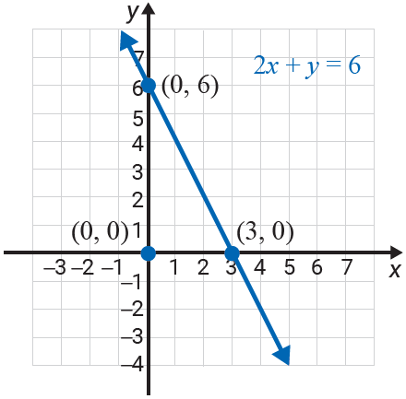
Example 1: Graphing Linear Inequalities (cont.)
Step 2: Test any point on one
side of the line. In this example, we have chosen (0, 0).
This is a true statement.

Slide 9
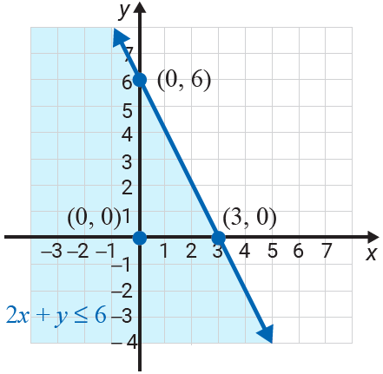
Example 1: Graphing Linear Inequalities (cont.)
Step 3: Shade the half-plane on the same side of the line as the point (0, 0). (The shaded half-plane and the boundary line is the solution set to the inequality.)

Slide 10
Example 2: Graphing Linear Inequalities
Graph the solution set to the inequality
Solution
Since the inequality is already solved for y, Method 2 is easy to apply.
Step 1: Graph the boundary line y = 2x as a dashed line because the inequality is >.

Slide 11
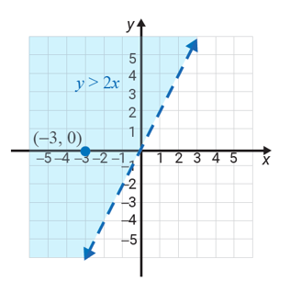
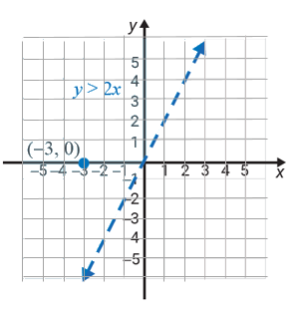
Example 2: Graphing Linear Inequalities (cont.)
Step 2: The solution shows >, so by Method 2, the graph consists of those points above the line. Shade the half-plane above the line.
Note: As a check, we see that the point (−3, 0) gives 0 > −6, a true statement. Thus we know we have shaded the correct half-plane.

Slide 12
Example 3: Graphing Linear Inequalities
Graph the half-plane that satisfies the inequality y > 1.
Solution
Again, the inequality is already solved for y and Method 2 is used.
Step 1: Graph the boundary line y = 1 as a dashed line because the inequality is >. (The boundary line is a horizontal line.)

Slide 13
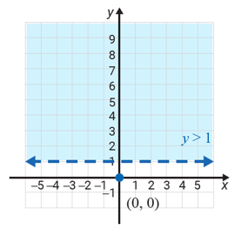
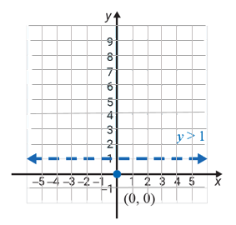
Example 3: Graphing Linear Inequalities (cont.)
Step 2: By Method 2, shade the half-plane above the line.

Slide 14
Example 4: Graphing Linear Inequalities
Graph the solution set to the inequality
Solution
The boundary line is a vertical line and Method 1 is used.
Step 1: Graph the boundary line x = 0 as a solid line because the inequality is ≤ (less than or equal to). Note that this is the y-axis.

Slide 15
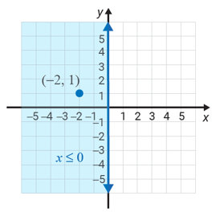
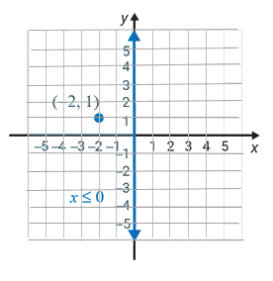
Example 4: Graphing Linear Inequalities (cont.)
Step 2: Test the point (−2, 1).
−2 ≤ 0
This statement is true.
Step 3: Shade the half-plane on the same side of the line as (−2, 1). This half-plane consists of the points with x-coordinates 0 or negative.

Slide 16

Example 5: Graphing Linear Inequalities Using a Calculator
Use a graphing calculator to graph the inequality
Solution
Step 1: Solving the inequality for y gives:
Step 2: Press the key and enter the function:
\Y₁ = −2X + 7.

Slide 17

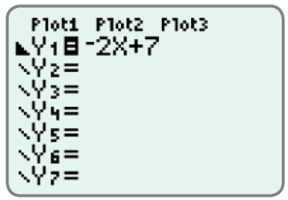
Example 5: Graphing Linear Inequalities Using a Calculator (cont.)
Step 3: Go to the \ and hit three times so
that the display appears as follows:

Slide 18

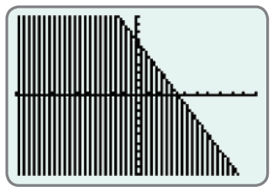
Example 5: Graphing Linear Inequalities Using a Calculator (cont.)
Step 4: Press and (using the standard
WINDOW settings) the following graph should appear on the display.

Slide 19
Example 6: Graphing Linear Inequalities Using a Calculator
Use a graphing calculator to graph the inequality −5x + 4y > −8.
Solution
Step 1: Solving the inequality for y gives:
Step 2: Press the key and enter the function:

Slide 20
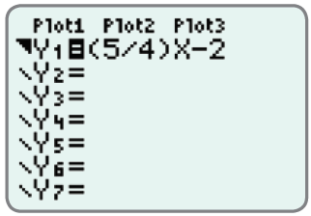
Example 6: Graphing Linear Inequalities Using a Calculator (cont.)
Step 3: Go to the \ and hit two times so
that the display appears as follows:

Slide 21
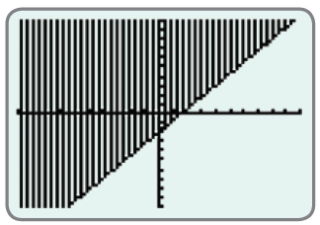
Example 6: Graphing Linear Inequalities Using a Calculator (cont.)
Step 4: Press and (using the standard
WINDOW settings) the following graph should appear on the display. (Note: The boundary line should actually be dotted.)

