Slide 1
Section 11.7
Applications: Quadratic Equations

Slide 2
Procedure: Attack Plan for Application Problems
Read the problem carefully at least twice.
Decide what is asked for and assign a variable or variable expression to the unknown quantities. It may help to organize a chart, table, or diagram relating all the information provided.
Form and then solve an equation that relates the information provided. (A formula of some type may be necessary.)
Check your solution with the wording of the problem to be sure it makes sense.

Slide 3
Example 1: Solving Quadratic Number Problems
One number is four more than another and the sum of their squares is 296. What are the numbers?
Solution
Let x = smaller number
and x + 4 = larger number.
Set the sum of their squares equal to 296 and solve the equation.

Slide 4
Example 1: Solving Quadratic Number Problems (cont.)
There are two sets of answers to the problem: 10 and 14 or −14 and −10.

Slide 5
Example 1: Solving Quadratic Number Problems (cont.)
Check

Slide 6
Example 2: Application: Solving Quadratic Equations
In an orange grove, there are 10 more trees in each row than there are rows. How many rows are there if there are 96 trees in the grove?
Solution
Let r = number of rows
and r + 10 = number of trees per row.
Set up the equation and solve.

Slide 7
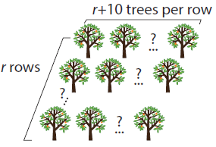
Example 2: Application: Solving Quadratic Equations (cont.)
While −16 is a solution to the equation, −16 does not fit the conditions of the problem and is discarded. You cannot have −16 rows.
Thus, there are 6 rows in the grove (6 ∙ 16 = 96 trees).

Slide 8
Example 3: Application: Solving Quadratic Equations
A rectangle has an area of 135 square meters and a perimeter of 48 meters. What are the dimensions of the rectangle?
Solution
The area of a rectangle is the product of its length and width (A = lw). The perimeter of a rectangle is given by P = 2l + 2w. Since the perimeter is 48 meters, then the length plus the width must be 24 meters (one half of the perimeter).

Slide 9
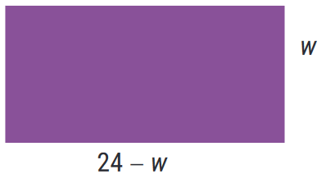
Example 3: Application: Solving Quadratic Equations (cont.)
Let w = width and 24 − w = length.
Set up an equation for the area and solve.
The dimensions are 9 meters by 15 meters (9 ∙ 15 = 135).

Slide 10
Example 4: Applications: Solving Quadratic Equations
A man wants to build a fence on three sides of a rectangular-shaped lot he owns. If 180 feet of fencing is needed and the area of the lot is 4000 square feet, what are the dimensions of the lot?
Solution
Let x = one of two equal sides and
180 − 2x = third side.

Slide 11
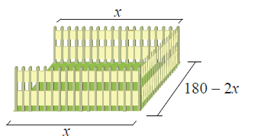
Example 4: Applications: Solving Quadratic Equations (cont.)
Set up an equation for the area and solve.

Slide 12
Example 4: Applications: Solving Quadratic Equations (cont.)
Thus, there are two possible answers: the lot is 50 feet by 80 feet or the lot is 40 feet by 100 feet.

Slide 13
Definition: Consecutive Integers
Integers are consecutive if each is 1 more than the previous integer. Three consecutive integers can be represented as n, n + 1, and n + 2.
For example, 5, 6, and 7.

Slide 14
Definition: Consecutive Even Integers
Even integers are consecutive if each is 2 more than the previous even integer. Three consecutive even integers can be represented as n, n + 2, and n + 4, where n is an even integer.
For example, 24, 26, and 28.

Slide 15
Definition: Consecutive Odd Integers
Odd integers are consecutive if each is 2 more than the previous odd integer. Three consecutive odd integers can be represented as n, n + 2, and n + 4, where n is an odd integer.
For example, 41, 43, and 45.

Slide 16
Note
Note that consecutive even and consecutive odd integers are represented in the same way. The value of the first integer n determines whether the remaining integers are even or odd.

Slide 17
Example 5: Consecutive Integers
Find two consecutive positive integers such that the sum of their squares is 265.
Solution
Let n = first integer.
Then, n + 1 = next consecutive integer.
Set up and solve the related equation.

Slide 18
Example 5: Consecutive Integers (cont.)

Slide 19
Example 5: Consecutive Integers (cont.)
Consider the solution n = −12. The next consecutive integer, n + 1, is −11. While it is true that the sum of their squares is 265, we must remember that the problem calls for positive consecutive integers. Therefore, we can only consider positive solutions. Hence, the two integers are 11 and 12.

Slide 20
Example 6: Consecutive Integers
Find three consecutive odd integers such that the product of the first and second is 68 more than the third.
Solution
Let n = first odd integer
and n + 2 = second consecutive odd integer
and n + 4 = third consecutive odd integer.
Set up and solve the related equation.

Slide 21
Example 6: Consecutive Integers (cont.)

Slide 22
Example 6: Consecutive Integers (cont.)
The three consecutive odd integers are −9, −7, and −5. Note that 8, 10, and 12 are even, and therefore cannot be considered a solution to the problem.

Slide 23
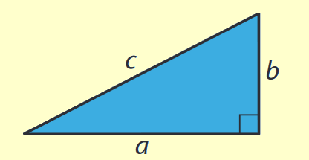
Theorem: The Pythagorean Theorem
In a right triangle, if c is the length of the hypotenuse and a and b are the lengths of the legs, then

Slide 24
Example 7: Application: The Pythagorean Theorem
A support wire is 25 feet long and stretches from a tree to a point on the ground. The point of attachment on the tree is 5 feet higher than the distance from the base of the tree to the point of attachment on the ground. How far up the tree is the point of attachment?
Solution
Let x = distance from base of tree to point of attachment on ground.
Then, x + 5 = height of point of attachment on tree.

Slide 25
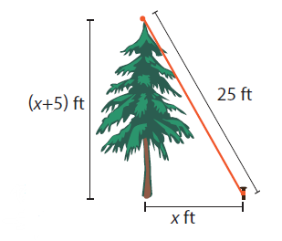
Example 7: Application: The Pythagorean Theorem (cont.)
By the Pythagorean Theorem, we have the following.

Slide 26
Example 7: Application: The Pythagorean Theorem (cont.)
Because distance must be positive, −20 is not a possible solution.
The solution is
Thus, the point of attachment is 20 feet up the tree.

