Slide 1
Section 12.8
Applications: Variation

Slide 2
Definition: Direct Variation
A variable quantity y varies directly as (or is directly proportional to) a variable x if there is a constant k such that
The constant k is called the constant of variation.

Slide 3
Example 1: Solving Using Direct Variation
If y varies directly as x, and y = 6 when x = 2, find y if
x = 6.
Solution
y = kx The general formula for direct variation
6 = 2k Substitute the known values and solve for k.
3 = k Use this value for k in the general formula.
So y = 3x. Thus, if x = 6, then y = 3 ∙ 6 = 18.

Slide 4
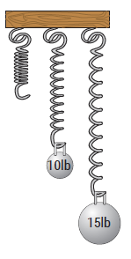
Example 2: Application: Solving Using Direct Variation
A spring will stretch a greater distance as more weight is placed on the end of it. The distance (d) the spring stretches varies directly as the weight (w) placed at the end of the spring. This is a property of springs studied in physics and is known as Hooke’s Law. If a weight of
10 lb stretches a certain spring 6 in., how far will the spring stretch with a weight of 15 lb?

Slide 5
Example 2: Application: Solving Using Direct Variation (cont.)
(Note: We assume that the weight is not so great as to break the spring.)
Solution
Because the two variables are directly proportional, the relationship can be indicated with the formula
d = k ∙ w,
Where d = distance the spring stretches in inches,
w = weight in lb, and
k = constant of variation.

Slide 6
Example 2: Application: Solving Using Direct Variation (cont.)
First, substitute the given information to find the value for k. (The value of k will depend on the particular spring. Springs made of different material or which are wound more tightly will have different values for k.)
d = k ∙ w
6 = k ∙ 10 Substitute the known values into the formula.
Use this value for k in the general formula.

Slide 7
Example 2: Application: Solving Using Direct Variation (cont.)
The spring will stretch 9 in. if a weight of 15 lb is placed at its end.

Slide 8
Definition: Inverse Variation
A variable quantity y varies inversely as (or is inversely proportional to) a variable x if there is a constant k such that
The constant k is called the constant of variation.

Slide 9
Example 3: Solving Using Inverse Variation
If y varies inversely as the cube of x, and y = −1 when x = 3, find y if x = −3.
Solution

Slide 10
Example 3: Solving Using Inverse Variation (cont.)

Slide 11
Example 4: Application: Solving Using Inverse Variation
The gravitational force (F) between an object and Earth is inversely proportional to the square of the distance (d) from the object to the center of Earth. Hence, we have the formula

Slide 12
Example 4: Application: Solving Using Inverse Variation (cont.)
(As the distance of an object from Earth becomes larger, the gravitational force exerted by Earth on the object becomes smaller.)
If an astronaut weighs 200 pounds on the surface of Earth, what will he weigh (to the nearest pound) 100 miles above Earth? Assume that the radius of Earth is 4000 miles.

Slide 13
Example 4: Application: Solving Using Inverse Variation (cont.)
Use scientific notation to make values simpler to work with in the calculations.

Slide 14
Example 4: Application: Solving Using Inverse Variation (cont.)
When the astronaut is 100 miles above Earth,
d = 4100 = 4.1 ××10³ miles. Then
That is, 100 miles above Earth, the astronaut will weigh about 190 pounds.

Slide 15
Example 5: Solving Using Joint Variation
If z varies jointly as x² and y, and z = 18 when x = 2 and y = 4, what is z when x = 4 and y = 3?
Solution

Slide 16
Example 5: Solving Using Joint Variation (cont.)
If x = 4 and y = 3, then

Slide 17
Example 6: Application: Solving Using Variation
The distance an object falls varies directly as the square of the time it falls (until it hits the ground and assuming little or no air resistance). If an object fell 64 feet in
2 seconds, how far would it have fallen by the end of
3 seconds?
Solution

Slide 18
Example 6: Application: Solving Using Variation (cont.)
The object would have fallen 144 feet in 3 seconds.

Slide 19
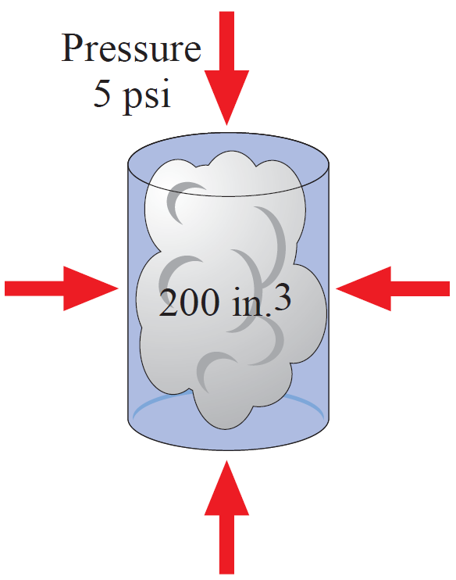
Example 7: Application: Solving Using Variation
The volume of a gas in a container varies inversely as the pressure on the gas. If a gas has a volume of 200 cubic inches under a pressure of 5 pounds per square inch, what will be its volume if the pressure is increased to 8 pounds per square inch?

Slide 20
Example 7: Application: Solving Using Variation (cont.)

Slide 21
Example 8: Application: Solving Using Variation
The safe load (L) of a wooden beam supported at both ends varies jointly as the width (w) and the square of the depth (d) and inversely as the length (l). A
3 in.-wide by 10 in.-deep beam that is 8 ft long supports a load of 9600 lb safely. What is the safe load of a beam of the same material that is 4 in. wide,
9 in. deep, and 12 ft long?

Slide 22
Example 8: Application: Solving Using Variation (cont.)

Slide 23
Example 8: Application: Solving Using Variation (cont.)

