Slide 1

Section 14.8
Solving Polynomial and Rational Inequalities

Slide 2
Procedure: Solving a Polynomial Inequality Algebraically
Arrange the terms so that one side of the inequality is 0.
Factor the polynomial expression, if possible, and find the points where each factor is 0. (Use the quadratic formula, if necessary.)
Mark each of these points on a number line. These are the interval endpoints.

Slide 3
Procedure: Solving a Polynomial Inequality Algebraically (cont.)
Test one point from each interval to determine the sign of the polynomial expression for all points in that interval.
The solution consists of those intervals where the test points satisfy the original inequality.
Use brackets for endpoints that are included in the solution and parentheses for endpoints that are not.

Slide 4
Example 1: Solving Polynomial Inequalities by Factoring
Solve the inequality by factoring and using a number line. Then, graph the solution set on a number line.
Solution
Set each factor equal to 0 to locate the interval endpoints.

Slide 5
Example 1: Solving Polynomial Inequalities by Factoring (cont.)
We want to determine where the product is positive. Test one point from each of the intervals to determine if the product is positive or negative in that interval.

Slide 6
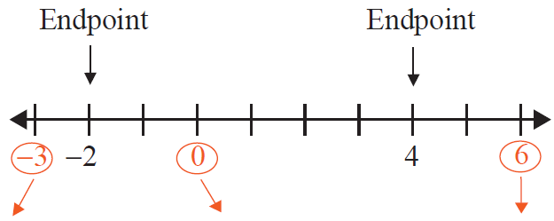
Example 1: Solving Polynomial Inequalities by Factoring (cont.)

Slide 7

Example 1: Solving Polynomial Inequalities by Factoring (cont.)
Graphically, the solution set is shown here.
The solution set can be written in two ways.
algebraic notation or interval notation

Slide 8
Example 2: Solving Polynomial Inequalities by Factoring
Solve the inequality by factoring and using a number line. Then, graph the solution set on a number line.
Solution
Set each factor equal to 0 to locate the interval endpoints.

Slide 9
Example 2: Solving Polynomial Inequalities by Factoring (cont.)
We want to determine where the product is negative or zero. Test one point from each of the intervals to determine if the product is positive or negative in that interval.

Slide 10
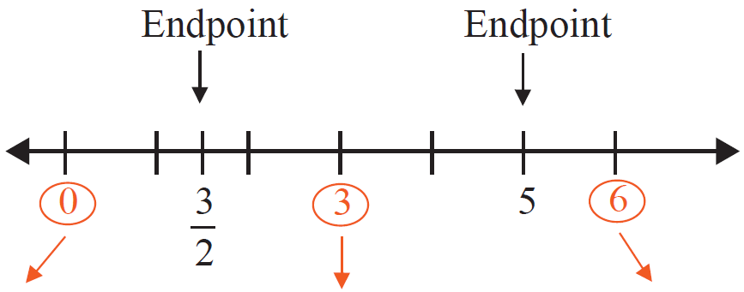
Example 2: Solving Polynomial Inequalities by Factoring (cont.)

Slide 11
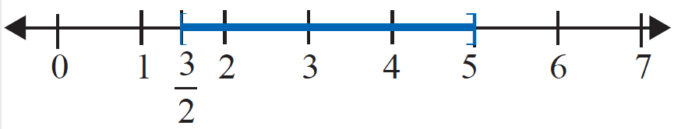
Example 2: Solving Polynomial Inequalities by Factoring (cont.)
The solution set includes both endpoints since the inequality (≤) includes 0.
The solution set can be written in two ways.
algebraic notation or interval notation

Slide 12
Example 3: Solving Polynomial Inequalities by Factoring
Solve the inequality by factoring and using a number line. Then, graph the solution set on a number line.
Solution

Slide 13
Example 3: Solving Polynomial Inequalities by Factoring (cont.)
Set each factor equal to 0 to locate the interval endpoints.
We want to determine where the product is negative. Test one point from each of the intervals to determine if the product is positive or negative in that interval.

Slide 14
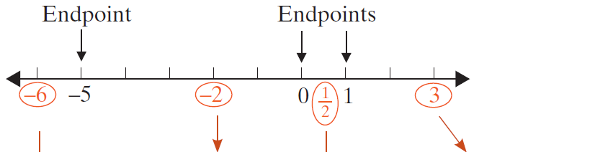
Example 3: Solving Polynomial Inequalities by Factoring (cont.)

Slide 15

Example 3: Solving Polynomial Inequalities by Factoring (cont.)

Slide 16

Example 3: Solving Polynomial Inequalities by Factoring (cont.)
Graphically, the solution set is shown here.
The solution set can be written in two ways.
algebraic notation or interval notation

Slide 17
Example 4: Solving Polynomial Inequalities Using the Quadratic Formula
Solve the inequality by using the quadratic formula and a number line. Then, graph the solution set on a number line.
Solution
The quadratic expression cannot be factored with integer coefficients. Use the quadratic formula and find the roots of the equation Then, use these roots as endpoints for the intervals. The test points can themselves be integers.

Slide 18
Example 4: Solving Polynomial Inequalities Using the Quadratic Formula (cont.)
The endpoints are

Slide 19
Example 4: Solving Polynomial Inequalities Using the Quadratic Formula (cont.)
We want to determine where the product is positive. Test one point from each interval.
Note: With a calculator, you can determine that

Slide 20
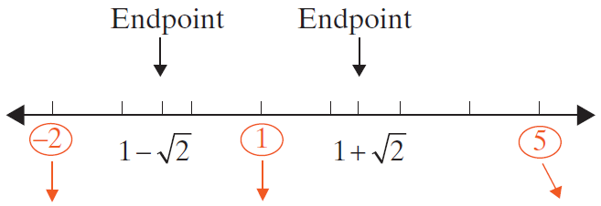
Example 4: Solving Polynomial Inequalities Using the Quadratic Formula (cont.)

Slide 21
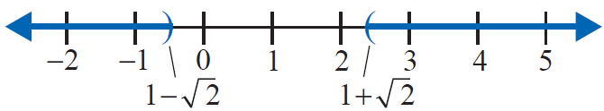
Example 4: Solving Polynomial Inequalities Using the Quadratic Formula (cont.)
Graphically, the solution set is shown here.
The solution set can be written in two ways.
algebraic notation or interval notation

Slide 22
Example 5: Solving Polynomial Inequalities Using the Quadratic Formula
Solve the inequality by using the quadratic formula and a number line. Then graph the solution set on a number line.
Solution
To find where use the quadratic formula.

Slide 23
Example 5: Solving Polynomial Inequalities Using the Quadratic Formula (cont.)
Since these values are nonreal, the polynomial is either always positive or always negative for all real values of x. Therefore, we only need to test one point. If that point satisfies the inequality, then the solution set is all real numbers. If it does not, then there is no solution. In this example, we test x = 0 because the polynomial is easy to evaluate for x = 0.

Slide 24

Example 5: Solving Polynomial Inequalities Using the Quadratic Formula (cont.)
Since the real number 0 satisfies the inequality, the solution set is all real numbers. In interval notation we write (−∞, ∞), and in algebraic notation we write Graphically, the solution set is shown here.

Slide 25
Procedure: Solving a Rational Inequality
Simplify the inequality so that one side is 0 and the other side has a single fraction with both the numerator and denominator in factored form.
Find the points that cause the factors in the numerator or in the denominator to be 0.
Mark each of these points on a number line. These are the interval endpoints.

Slide 26
Procedure: Solving a Rational Inequality (cont.)
Test one point from each interval to determine the sign of the rational expression for all points in that interval.
The solution consists of those intervals where the test points satisfy the original inequality.
Use brackets for endpoints that are included in the solution and parentheses for endpoints that are not.

Slide 27
Example 6: Solving Rational Inequalities
Solve the rational inequality and graph the solution set on a number line.
Solution
Set each factor in the numerator and the denominator equal to 0 to locate the interval endpoints.

Slide 28
Example 6: Solving Rational Inequalities (cont.)
We want to determine where the quotient is positive. Test one point from each of the intervals to determine if the quotient is positive or negative in that interval.

Slide 29
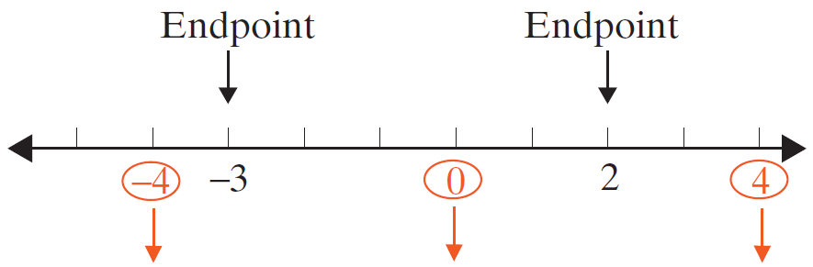
Example 6: Solving Rational Inequalities (cont.)

Slide 30

Example 6: Solving Rational Inequalities (cont.)
Graphically, the solution set is shown here.
The solution set can be written in two ways.
algebraic notation or interval notation

Slide 31
Example 7: Solving Rational Inequalities
Solve the rational inequality and graph the solution set on a number line.
Solution
For this inequality, we want to know where the quotient is negative. Using the graph and test points from Example 5, we know that

Slide 32
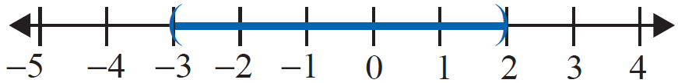
Example 7: Solving Rational Inequalities (cont.)
Graphically, the solution set is shown here.
The solution set can be written in two ways.
algebraic notation or interval notation

Slide 33
Example 8: Solving Rational Inequalities
Solve the following rational inequality.
Solution

Slide 34
Example 8: Solving Rational Inequalities (cont.)
Set each linear expression equal to 0 to find the interval endpoints.
We want to determine where the quotient is positive or zero. Test one point from each of the intervals to determine if the quotient is positive or negative in that interval.

Slide 35
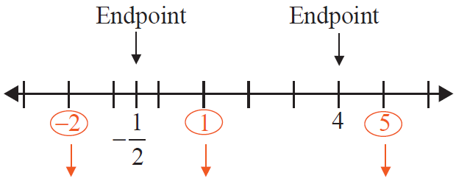
Example 8: Solving Rational Inequalities (cont.)

Slide 36
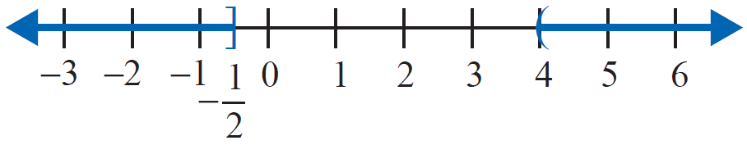
Example 8: Solving Rational Inequalities (cont.)
The solution set includes the endpoint since the
inequality (≥) includes 0. However, the endpoint 4 is not included in the solution set because the rational inequality is undefined (the denominator equals 0) when x = 4.
Graphically, the solution set is shown here.

Slide 37
Example 8: Solving Rational Inequalities (cont.)
The solution set can be written in two ways.
algebraic notation or interval notation

Slide 38
Procedure: Solving a Polynomial Inequality Using a Graphing Calculator
Arrange the terms so that one side of the inequality is 0.
Form a function by letting y = [the polynomial], and graph the function. Be sure to set the window so that all of the zeros are easily seen. This may be difficult if large numbers are involved.

Slide 39

Procedure: Solving a Polynomial Inequality Using a Graphing Calculator (cont.)
Use the CALC key ( ) and select zero to find (or approximate) the real zeros of the function, if there are any.
The values of x for which the y-values are above the x-axis satisfy y > 0.
The values of x for which the y-values are below the x-axis satisfy y < 0 .
4. Endpoints of intervals are included if the inequality includes 0, as in y ≥ 0 or y ≤ 0.

Slide 40
Example 9: Solving a Quadratic Inequality Using a Graphing Calculator
Use a graphing calculator to solve the quadratic inequality. Graph the solution set on a real number line.
Solution
This inequality was solved algebraically in Example 1. We repeat the solution here using a graphing calculator to show how the two methods are related.

Slide 41
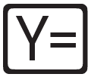
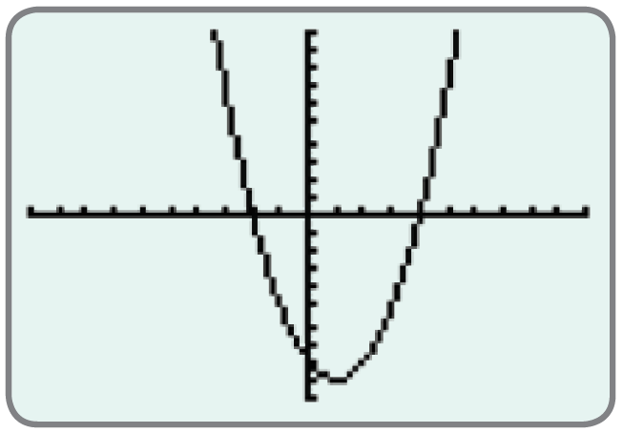

Example 9: Solving a Quadratic Inequality Using a Graphing Calculator (cont.)
Manipulate the inequality so that one side is 0.
Press and enter the function.
Press to graph the function.
The graph will appear as illustrated here. (In this case, the graph is a parabola.)

Slide 42

Example 9: Solving a Quadratic Inequality Using a Graphing Calculator (cont.)
Find the zeros (or estimate the zeros) as follows:
Step 1: Press CALC ( ).
Step 2: Press or choose zero.
Step 3: Follow the directions for moving the cursor to Left Bound?, Right Bound?, and Guess? for each point. (Press each time.)
Note: If there are no real zeros, then the graph will be entirely above or entirely below the x-axis. The solution is then dependent on the nature of the inequality. It will be either the empty set (no solution) or the entire set of real numbers (−∞, ∞).

Slide 43
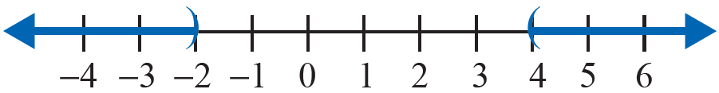
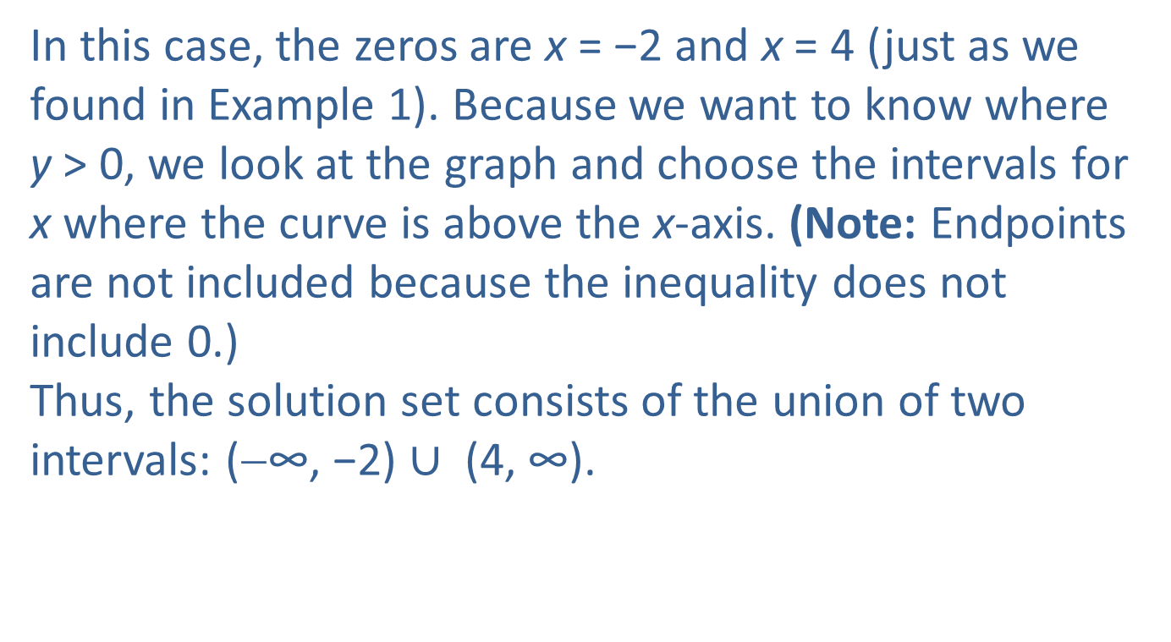
Example 9: Solving a Quadratic Inequality Using a Graphing Calculator (cont.)
In this case, the zeros are x = −2 and x = 4 (just as we found in Example 1). Because we want to know where y > 0, we look at the graph and choose the intervals for x where the curve is above the x-axis. (Note: Endpoints are not included because the inequality does not include 0.)
Thus, the solution set consists of the union of two intervals: (−∞, −2) $∪$ (4, ∞).

Slide 44
Example 10: Solving a Quadratic Inequality Using a Graphing Calculator
Use a graphing calculator to solve the quadratic inequality. Graph the solution set on a real number line.
Solution
Press and enter the function.
Press to graph the function.

Slide 45
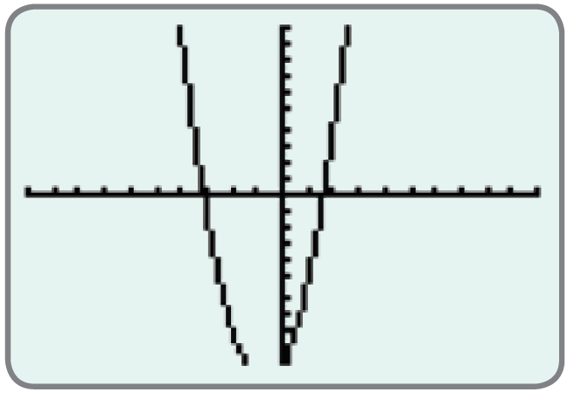
Example 10: Solving a Quadratic Inequality Using a Graphing Calculator (cont.)
The graph will appear as illustrated here. (In this case, the graph is a parabola.)

Slide 46
Example 10: Solving a Quadratic Inequality Using a Graphing Calculator (cont.)
Find the zeros (or estimate the zeros) as follows:
Step 1: Press CALC ( ).
Step 2: Press or choose zero.
Step 3: Follow the directions for moving the cursor to Left Bound?, Right Bound?, and Guess? for each point. (Press each time.)
In this case, the zeros are estimates: x ≈ −3.1085 and x ≈ 1.6085.

Slide 47
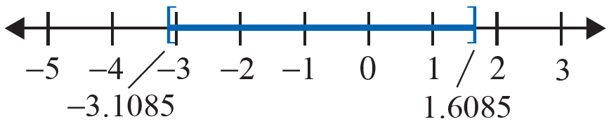
Example 10: Solving a Quadratic Inequality Using a Graphing Calculator (cont.)
Because we want to know where y ≤ 0 , we look at the graph and find the intervals for x where the curve is below the x-axis and include the endpoints because 0 is included in the inequality.
Thus, the solution set is the closed interval [−3.1085, 1.6085].

Slide 48
Example 11: Solving a Higher-Degree Polynomial Inequality Using a Graphing Calculator
Solve the third-degree polynomial inequality using a graphing calculator.
Solution
Press and enter the function.
Press to graph the function.

Slide 49
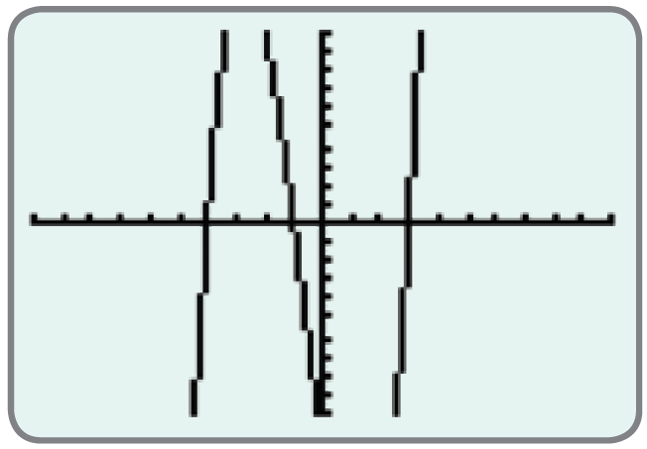
Example 11: Solving a Higher-Degree Polynomial Inequality Using a Graphing Calculator (cont.)
The graph will appear as illustrated here. (In this case, the graph is not a parabola.)

Slide 50
Example 11: Solving a Higher-Degree Polynomial Inequality Using a Graphing Calculator (cont.)
Find the zeros (or estimate the zeros) as follows:
Step 1: Press CALC ( ).
Step 2: Press or choose zero.
Step 3: Follow the directions for moving the cursor to Left Bound?, Right Bound?, and Guess? for each point. (Press each time.)
In this case, there are three zeros: x = −4, x = −1, and x = 3.

Slide 51
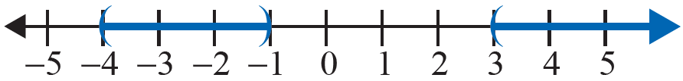
Example 11: Solving a Higher-Degree Polynomial Inequality Using a Graphing Calculator (cont.)
Because we want to know where y > 0, we look at the graph and find the intervals for x where the curve is above the x-axis. Do not include the endpoints because 0 is not included in the inequality.
Thus, the solution set is the union of two intervals:

