Slide 1
HAWKES LEARNING
Special Interest Politics
Notes:
In this lesson, titled Special Interest Politics, we’ll explore what special interest groups are and how they influence the political system.

Slide 2
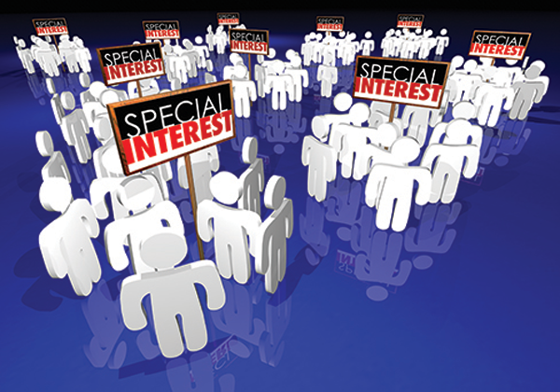
Special Interest Groups
Even though special interest groups are small, they have sway over political leaders because they are well-organized and focused on a particular issue.
Notes:
Even though special interest groups are small, they have sway over political leaders because they are well-organized and focused on a particular issue.

Slide 3
Introduction
Many political issues are of intense interest to a relatively small group.
For example, many U.S. drivers do not much care where their car tires were made—they just want good quality as inexpensively as possible.
Special interest politics can be broken down into three main areas: special interest groups, pork-barrel spending, and logrolling.
Notes:
Many political issues are of intense interest to a relatively small group. For example, many U.S. drivers do not much care where their car tires were made—they just want good quality as inexpensively as possible. Special interest politics can be broken down into three main areas: special interest groups, pork-barrel spending, and logrolling.

Slide 4




Special Interest Groups
Special interest groups are groups that are small in number relative to the nation but quite well-organized and focused on a specific issue.
A special interest group can pressure legislators to enact public policies that do not benefit society as a whole.
There are four main types of interest groups concerned with economic impact:
Business groups
Labor groups
Agricultural groups
Professional associations
Notes:
Special interest groups are groups that are small in number relative to the nation but quite well-organized and focused on a specific issue. A special interest group can pressure legislators to enact public policies that do not benefit society as a whole. There are four main types of interest groups concerned with economic impact: Business groups, Labor groups, Agricultural groups, Professional associations.

Slide 5
Example
In 2003, President Bush signed into law a substantial expansion of Medicare that helped the elderly pay for prescription drugs.
While there were about 40 million people over the age of 65 in the U.S. at the time, there was an equal amount who were uninsured.
Thanks to the lobbying of the American Association for Retired People, or AARP, the expensive Medicare expansion passed into law.
Nothing was done for the uninsured, presumably because they had no group to lobby for them.
Notes:
In 2003, President Bush signed into law a substantial expansion of Medicare that helped the elderly pay for prescription drugs. While there were about 40 million people over the age of 65 in the U.S. at the time (meaning they were eligible for Medicare), there was an equal amount of people who were uninsured. Thanks to the lobbying of the American Association for Retired People, or AARP, the expensive Medicare expansion passed into law. Nothing was done for the uninsured, presumably because they had no group to lobby for them.

Slide 6
Identifiable Winners, Anonymous Losers
Many economic policies produce gains whose beneficiaries are easily identifiable.
Costs can be partly or entirely shared by a large number who remain anonymous.
A democratic political system probably has a bias toward those who are identifiable.
Special interests are more likely to arise from a group that is easily identifiable.
Notes:
Many economic policies produce gains whose beneficiaries are easily identifiable. Costs can be partly or entirely shared by a large number who remain anonymous. A democratic political system probably has a bias toward those who are identifiable. Special interests are more likely to arise from a group that is easily identifiable.

Slide 7

Example
Policy blocks a specific import
Firms that would have competed with those imports
Consumers who would have preferred to purchase the imported products
Notes:
Policies that block imports will benefit the firms that would have competed with those imports—and workers at those firms—who are likely to be quite visible. Consumers who would have preferred to purchase the imported products and thus bear some costs of the protectionist policy are much less visible.

Slide 8
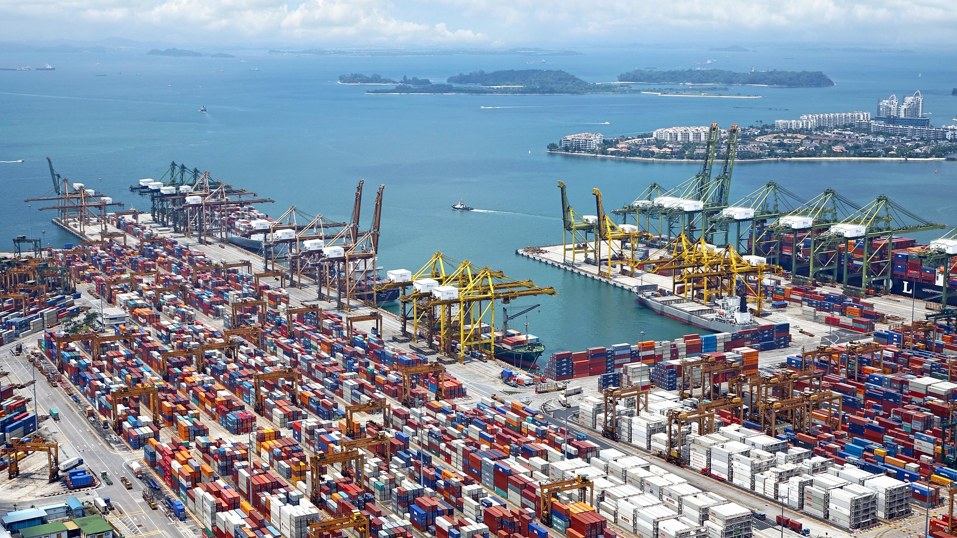
On Your Own
President Trump imposed tariffs on imported aluminum. Explain how this is an example of a policy with identifiable winners and anonymous losers.
HAWKES LEARNING
Notes:
President Trump imposed tariffs on imported aluminum. Explain how this is an example of a policy with identifiable winners and anonymous losers.

Slide 9
On Your Own
President Trump imposed tariffs on imported aluminum. Explain how this is an example of a policy with identifiable winners and anonymous losers.
The tariff on imported aluminum will help the domestic aluminum industry, but it will impose costs on U.S. consumers. The tariff will increase the price of aluminum. As a result, the price of any product in aluminum cans, such as soft drinks, will probably increase to cover the higher cost of the aluminum. Therefore, U.S. consumers of canned goods will pay for the tariff.
HAWKES LEARNING
Notes:
President Trump imposed tariffs on imported aluminum. Explain how this is an example of a policy with identifiable winners and anonymous losers. The tariff on imported aluminum will help the domestic aluminum industry, but it will impose costs on U.S. consumers. The tariff will increase the price of aluminum. As a result, the price of any product in aluminum cans, such as soft drinks, will probably increase to cover the higher cost of the aluminum. Therefore, U.S. consumers of canned goods will pay for the tariff.

Slide 10
Pork-Barrel Spending
Politicians have an incentive to ensure that they spend government money in their home state or district, where it will benefit their constituents in a direct and obvious way.
Pork-barrel spending is legislation that benefits mainly a single political district.
The benefits of pork-barrel spending are obvious and direct to local voters, while the costs are spread over the entire country.
Notes:
Politicians have an incentive to ensure that they spend government money in their home state or district, where it will benefit their constituents in a direct and obvious way. Pork-barrel spending is legislation that benefits mainly a single political district. The benefits of pork-barrel spending are obvious and direct to local voters, while the costs are spread over the entire country.

Slide 11
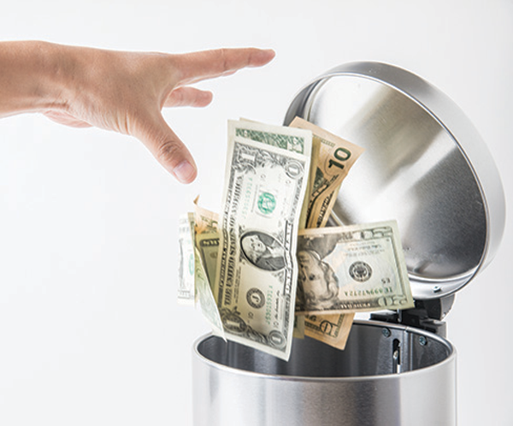
Pork-Barrel Spending
Pork-barrel spending is considered a waste of government funds because the spending adds up to massive amounts, and the benefits are typically limited to a small group of people.
Notes:
Pork-barrel spending is considered a waste of government funds because the spending adds up to massive amounts, and the benefits are typically limited to a small group of people.

Slide 12
Logrolling
Logrolling is an action in which a group of legislators agree to vote for a package of otherwise unrelated laws that they individually favor.
Logrolling can encourage pork-barrel spending.
For example, if one member of Congress suggests building a new bridge in their own district, the other members might oppose it.
However, if 51% of the legislators come together, they can pass a bill that includes a bridge or hospital for every one of their districts.
Notes:
Logrolling is an action in which a group of legislators agree to vote for a package of otherwise unrelated laws that they individually favor. Logrolling can encourage pork-barrel spending. For example, if one member of Congress suggests building a new bridge in their own district, the other members might oppose it. However, if 51% of the legislators come together, they can pass a bill that includes a bridge or hospital for every one of their districts.

Slide 13
Summary
Special interest politics arises when a relatively small group called a special interest group, each of whose members has a large interest in a political outcome, devotes considerable time and energy to lobbying for the group's preferred choice.
Meanwhile, the large majority, each of whose members has only a small interest in this issue, pays no attention.
We define pork-barrel spending as legislation whose benefits are concentrated on a single district, while the costs are spread widely over the country.
Logrolling refers to a situation in which two or more legislators agree to vote for each other's legislation, which can then encourage pork-barrel spending in many districts.
HAWKES LEARNING

Slide 14




HAWKES LEARNING

