Slide 1
HAWKES LEARNING
Adjusting Nominal Values to Real Values

Slide 2
Introduction
When examining economic statistics, it's crucial to know how the data was measured and if it's been distorted by inflation.
It's difficult to determine if a rise in GDP is due mainly to a rise in the overall level of prices or to a rise in quantities of goods produced.
The nominal value of any economic statistic means that we measure the statistic in terms of actual prices that exist at the time.
The real value refers to the same statistic after it has been adjusted for inflation.
HAWKES LEARNING
Notes:
When examining economic statistics, it's crucial to know how the data was measured and if it's been distorted by inflation. It's difficult to determine if a rise in GDP is due mainly to a rise in the overall level of prices or to a rise in quantities of goods produced. The nominal value of any economic statistic means that we measure the statistic in terms of actual prices that exist at the time. The real value refers to the same statistic after it has been adjusted for inflation.

Slide 3
Nominal and Real GDP
Nominal GDP is equal to the quantity of every good or service produced, multiplied by the price at which it was sold, summed up for all goods and services.
Real GDP is equal to nominal GDP divided by the price index, also known as the GDP deflator.
HAWKES LEARNING
Notes:
Nominal GDP is equal to the quantity of every good or service produced, multiplied by the price at which it was sold, summed up for all goods and services. Real GDP is equal to nominal GDP divided by the price index, aka the GDP deflator.

Slide 4


GDP Deflator
The GDP deflator is a price index measuring the average prices of all final goods and services included in the economy.
$$\text{GDP} \text{d}\text{eflator}\text{ = }\left(\frac{nominal GDP}{real GDP}\right)×100$$
$$\text{r}\text{eal} \text{GDP}\text{ = }\frac{\text{n}\text{ominal} \text{GDP}}{\text{p}\text{rice} \text{i}\text{ndex}\text{/}100}$$
HAWKES LEARNING
Notes:
Price index measuring the average prices of all final goods and services included in the economy. "GDP Deflator = "("Nominal GDP" /"Real GDP" )×100. "Real GDP = " "Nominal GDP" /("Price Index/" 100)

Slide 5
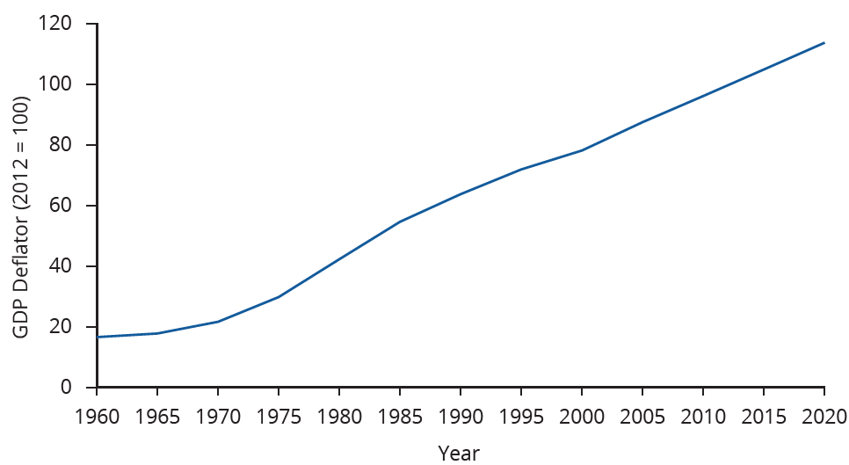

GDP Deflator
$$\text{GDP} \text{Deflator}\text{ = }(\frac{\text{Nominal} \text{GDP}}{\text{Real} \text{GDP}})×100$$
The GDP deflator from 1960 to 2020.
HAWKES LEARNING

Slide 6
The Role of the Base Year
Whenever you compute a statistic in real terms instead of nominal terms across a period of time, one year/period plays a special role.
We use the prices in the base year to compute the real statistic.
To calculate real GDP, we take the quantities of goods and services produced in each year and multiply them by their base year price.
HAWKES LEARNING
Notes:
Whenever you compute a statistic in real terms instead of nominal terms across a period of time, one year/period plays a special role. We use the prices in the base year to compute the real statistic. To calculate real GDP, we take the quantities of goods and services produced in each year and multiply them by their base year price.

Slide 7
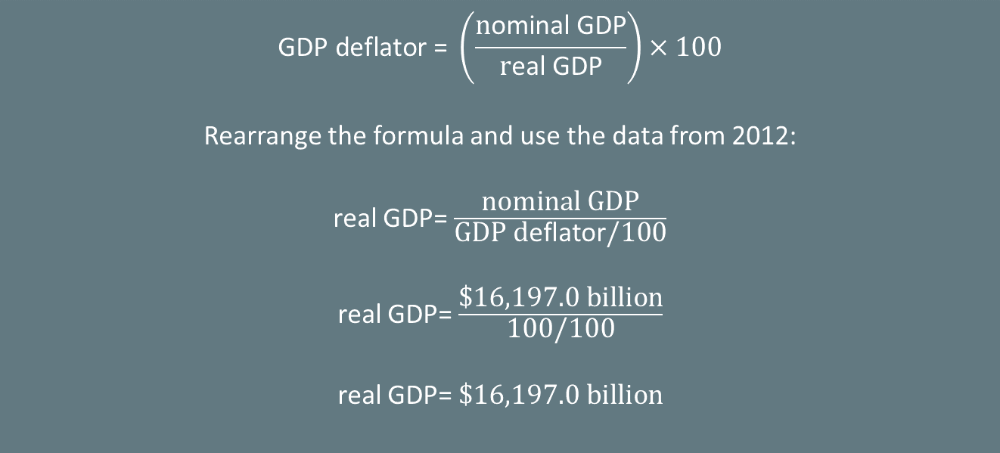
The Role of the Base Year
In this example, real GDP is constructed using prices that existed in 2012. Any year can be used as the base year. In 2012, the nominal GDP (in billions of dollars) was $16,197.0, and the price index was 100.
$$\text{GDP} \text{d}\text{eflator}\text{ = }\left(\frac{\text{n}\text{ominal} \text{GDP}}{\text{r}\text{eal} \text{GDP}}\right)×100$$
Rearrange the formula and use the data from 2012:
real GDP= $\frac{\text{nominal} \text{GDP}}{\text{GDP} \text{d}\text{eflator}\text{/100}}$
real GDP= $\frac{\text{\$16,197.0 }\text{billion}}{\text{100/100}}$
real GDP= $\text{\$}\text{16,197.0 }\text{billion}$
HAWKES LEARNING
Notes:
In this example, real GDP is constructed using prices that existed in 2012. Any year can be used as the base year. In 2012, the nominal GDP (in billions of dollars) was $16,197.0, and the price index was 100.

Slide 8
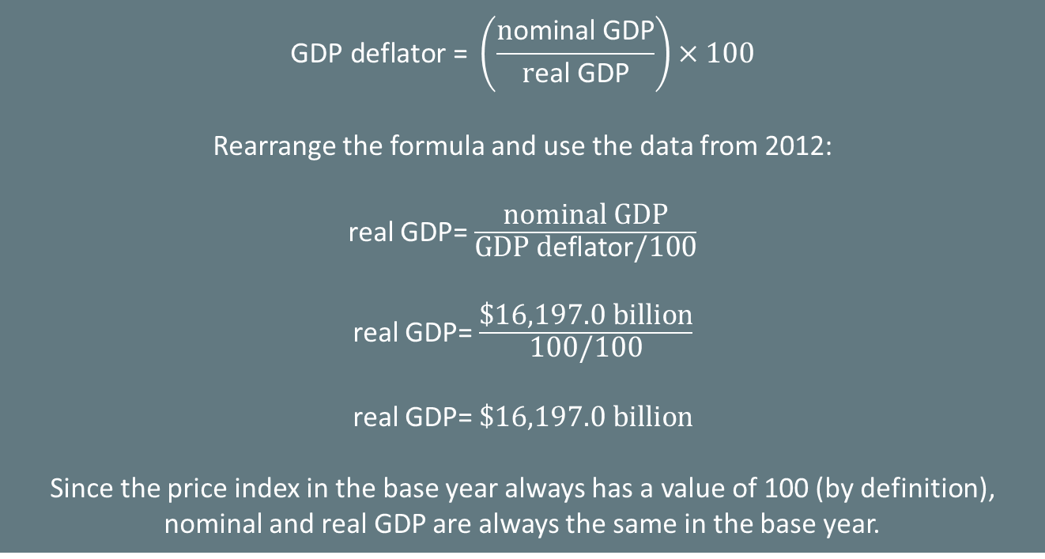
The Role of the Base Year
In this example, real GDP is constructed using prices that existed in 2012. Any year can be used as the base year. In 2012, the nominal GDP (in billions of dollars) was $16,197.0, and the price index was 100.
$$\text{GDP} \text{d}\text{eflator}\text{ = }\left(\frac{\text{n}\text{ominal} \text{GDP}}{\text{r}\text{eal} \text{GDP}}\right)×100$$
Rearrange the formula and use the data from 2012:
real GDP= $\frac{\text{nominal} \text{GDP}}{\text{GDP} \text{d}\text{eflator}\text{/100}}$
real GDP= $\frac{\text{\$16,197.0 }\text{billion}}{\text{100/100}}$
real GDP= $\text{\$}\text{16,197.0 }\text{billion}$
Since the price index in the base year always has a value of 100 (by definition), nominal and real GDP are always the same in the base year.
HAWKES LEARNING
Notes:
In this example, real GDP is constructed using prices that existed in 2012. Any year can be used as the base year. In 2012, the nominal GDP (in billions of dollars) was $16,197.0, and the price index was 100.

Slide 9
Nominal and Real GDP
As long as inflation is positive, real GDP should be less than nominal GDP in any year after the base year.
The value of nominal GDP is amplified by inflation.
As long as inflation is positive, real GDP should be greater than nominal GDP in any year before the base year.
Nominal and real GDP will be equal in the base year.
Notes:
As long as inflation is positive, real GDP should be less than nominal GDP in any year after the base year. The value of nominal GDP is amplified by inflation. As long as inflation is positive, real GDP should be greater than nominal GDP in any year before the base year. Nominal and real GDP will be equal in the base year.

Slide 10
Nominal and Real GDP
By converting nominal GDP to real GDP, we are better able to track GDP growth over time.
real GDP growth rate = $\frac{\text{(}\text{current} \text{year} \text{real} \text{GDP}\text{−}\text{base} \text{year} \text{real} \text{GDP}\text{)}}{\text{base} \text{year} \text{real} \text{GDP}}\text{×}\text{ 100}$
Real GDP is important because it is highly correlated with other measures of economic activity, like employment and unemployment.
HAWKES LEARNING
Notes:
By converting nominal GDP to real GDP, we are better able to track GDP growth over time. Real GDP growth rate= "(current year real GDP-base year GDP)" /"base year real GDP" "× 100“. Real GDP is important because it is highly correlated with other measures of economic activity, like employment and unemployment.

Slide 11
Nominal and Real GDP
The business cycle runs from the height of the economy to the lowest point and back to the peak.
A recession lasts from peak to trough.
An economic upswing lasts from trough to peak.
A longer and deeper decline is a depression.
HAWKES LEARNING
Notes:
The business cycle runs from the height of the economy to the lowest point and back to the peak. A recession lasts from peak to trough. An economic upswing lasts from trough to peak. A longer and deeper decline is a depression.

Slide 12

Real World Example
As history tells us, recessions come and go, and with them come ebbs and flows in the job market. Do you know people who lost their jobs due to a decline in real GDP? How did that impact them? How do you think you would react if this happened to you?
HAWKES LEARNING
Notes:
As history tells us, recessions come and go, and with them come ebbs and flows in the job market. Do you know people who lost their jobs due to a decline in real GDP? How did that impact them? How do you think you would react if this happened to you?

Slide 13
Summary
The nominal value of an economic statistic is the commonly announced value.
The real value is the value after adjusting for changes in inflation.
To convert nominal economic data from several different years into real, inflation-adjusted data, the starting point is to choose a base year arbitrarily and then use a price index to convert the measurements.
In the long term, U.S. real GDP has increased dramatically, but GDP has not increased by the same amount each year.
The speeding up and slowing down of GDP growth represents the business cycle with periods of economic highs and lows.
HAWKES LEARNING

Slide 14




HAWKES LEARNING

