Slide 1
HAWKES LEARNING
How Well GDP Measures the Well-Being of Society

Slide 2
Introduction
The level of gross domestic product (GDP) per capita captures some of what we mean by the phrase "standard of living."
While GDP focuses on production that is bought and sold in markets, standard of living includes all elements that affect people's well-being.
It is useful to identify some components of standard of living that are not accounted for in GDP.
HAWKES LEARNING
Notes:
The level of gross domestic product (GDP) per capita captures some of what we mean by the phrase "standard of living.“While GDP focuses on production that is bought and sold in markets, standard of living includes all elements that affect people's well-being. It is useful to identify some components of standard of living that are not accounted for in GDP.

Slide 3
Limitations of GDP as a Measure of the Standard of Living
GDP is unable to measure many factors that we would typically consider impactful to our standard of living.
While these factors might be quantifiable, they do not fall under the calculation of GDP.
They are sometimes byproducts of the produced goods and services that are included in GDP.
In other words, quality-of-life characteristics fall outside the scope of GDP.
HAWKES LEARNING
Notes:
GDP is unable to measure many factors that we would typically consider impactful to our standard of living. While these factors might be quantifiable, they do not fall under the calculation of GDP. They are sometimes byproducts of the produced goods and services that are included in GDP. In other words, quality-of-life characteristics fall outside the scope of GDP.

Slide 4
Societal Factors Not Included in GDP
Environmental cleanliness
Population health
Infant mortality rates
Air quality
HAWKES LEARNING
Notes:
While GDP includes what a country spends on environmental protection, health care, and education, it does not include actual levels of environmental cleanliness, health, infant mortality rates, and air quality.

Slide 5
Does a Rise in GDP Overstate or Understate the Rise in the Standard of Living?
Since GDP per capita does not fully capture the idea of standard of living, there is a concern that increases in GDP over time are illusory.
It is possible that while GDP is rising, the standard of living could be falling if factors not included in GDP, like human health, are worsening.
In some ways, the rise in GDP understates the actual rise in the standard of living.
For example, the typical work week for a U.S. worker has fallen over the last century from about sixty hours per week to less than forty.
Also, life expectancy and health have risen dramatically, and so has the average level of education.
HAWKES LEARNING
Notes:
Since GDP per capita does not fully capture the idea of standard of living, there is a concern that increases in GDP over time are illusory. It is possible that while GDP is rising, the standard of living could be falling if factors not included in GDP, like human health, are worsening. In some ways, the rise in GDP understates the actual rise in the standard of living. For example, the typical work week for a U.S. worker has fallen over the last century from about sixty hours per week to less than forty. Also, life expectancy and health have risen dramatically, and so has the average level of education.

Slide 6
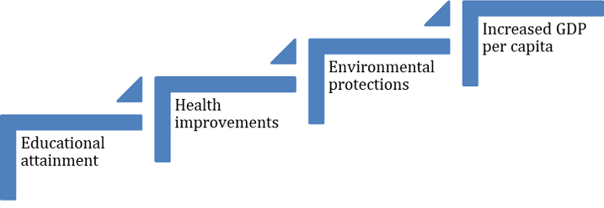
GDP Is Rough but Useful
A high level of GDP should not be the only goal of macroeconomic policy or government policy.
GDP does measure production well and does indicate when a country is materially better or worse off in terms of jobs and incomes.
HAWKES LEARNING
Notes:
A high level of GDP should not be the only goal of macroeconomic policy or government policy. GDP does measure production well and does indicate when a country is materially better or worse off in terms of jobs and incomes.

Slide 7

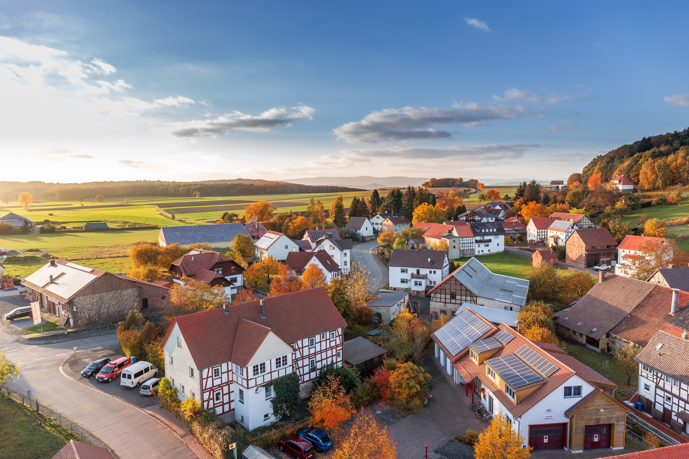
On Your Own
How would you assess the basic standard of living in your community? What indicators promote a strong standard? What do you see that points to a need for improvement?
HAWKES LEARNING
Notes:
How would you assess the basic standard of living in your community? What indicators promote a strong standard? What do you see that points to a need for improvement?

Slide 8
Summary
GDP is an index of a society's standard of living, but it is only a rough indicator.
GDP does not directly account for leisure, environmental quality, levels of health and education, activities conducted outside the market, changes in income inequality, increases in variety, increases in technology, or the positive/negative value society may place on certain types of output.
HAWKES LEARNING

Slide 9




HAWKES LEARNING

