Slide 1
HAWKES LEARNING
Patterns of Unemployment

Slide 2
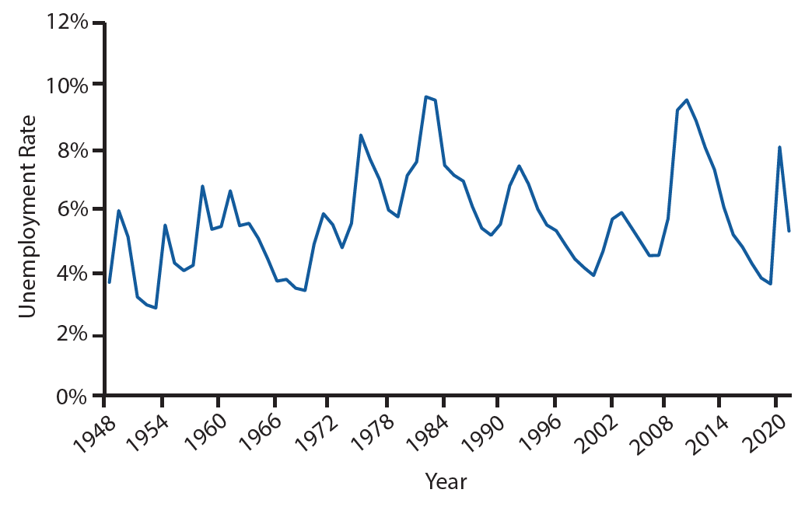
Introduction
The U.S. unemployment rate moves up and down as the economy moves in and out of recessions. However, over time, the unemployment rate seems to return to a range of 4%–6%. There does not seem to be a long-term trend toward the rate moving generally higher or lower.
HAWKES LEARNING
Notes:
The U.S. unemployment rate moves up and down as the economy moves in and out of recessions. However, over time, the unemployment rate seems to return to a range of 4–6%. There does not seem to be a long-term trend toward the rate moving generally higher or lower.

Slide 3

On Your Own
Unemployment trends vary based on factors like age, race, gender, schooling, environment, and more. Based on where you fall among these categories and demographics, do you feel confident that you will be able to find and keep a job in the market? Why or why not?
HAWKES LEARNING
Notes:
Unemployment trends vary based on factors like age, race, gender, schooling, environment, and more. Based on where you fall among these categories and demographics, do you feel confident that you will be able to find and keep a job in the market? Why or why not?

Slide 4
Patterns of Unemployment
Unemployment rates fluctuate over time and the fluctuations match fairly well with the economy's activity.
During periods of recession and depression, unemployment is higher.
During periods of economic growth, unemployment is lower.
Unemployment can dip relatively low, but it never falls below zero.
There is no significant upward or downward trend in the unemployment rate.
HAWKES LEARNING
Notes:
Unemployment rates fluctuate over time and the fluctuations match fairly well with the economy's activity. During periods of recession and depression, unemployment is higher. During periods of economic growth, unemployment is lower. Unemployment can dip relatively low, but it doesn’t dip below zero. There is no significant upward or downward trend in the unemployment rate.

Slide 5
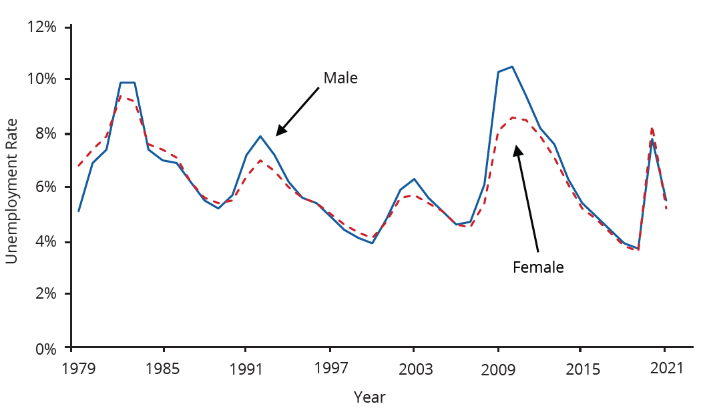
Patterns of Unemployment - Gender
Unemployment rates for men used to be lower than unemployment rates for women. However, in recent decades, the two rates have been very close, often with the unemployment rate for men somewhat higher, especially during and soon after the Great Recession.
Notes:
Unemployment rates for men used to be lower than unemployment rates for women. However, in recent decades, the two rates have been very close, often with the unemployment rate for men somewhat higher, especially during and soon after the Great Recession.

Slide 6
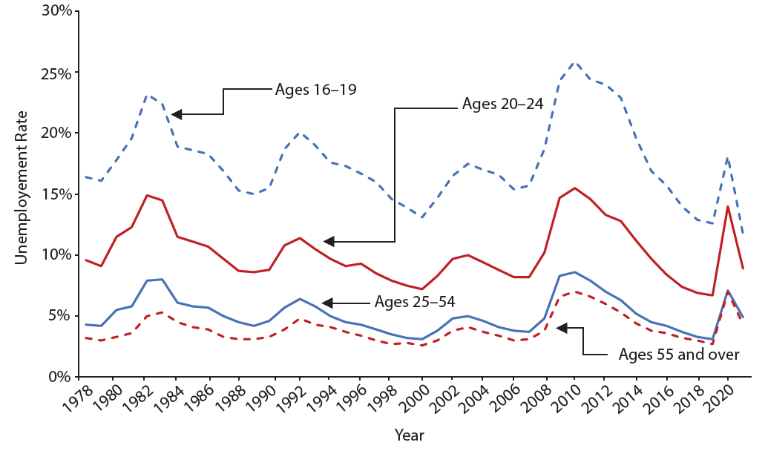
Patterns of Unemployment - Age
Unemployment rates are highest for the very young and become lower with age.
Notes:
Unemployment rates are highest for the very young and become lower with age.

Slide 7
Patterns of Unemployment - Age
Younger workers tend to have higher rates of unemployment, while middle-aged workers typically have lower rates of unemployment.
Middle-aged workers more heavily feel the responsibility of needing to have a job.
Younger workers move in and out of jobs more than middle-aged workers.
Elderly workers have extremely low rates of unemployment because those who have retired have exited the labor force.
HAWKES LEARNING
Notes:
Younger workers tend to have higher rates of unemployment, while middle-aged workers typically have lower rates of unemployment. Middle-aged workers more heavily feel the responsibility of needing to have a job. Younger workers move in and out of jobs more than middle-aged workers. Elderly workers have extremely low rates of unemployment because those who have retired have exited the labor force.

Slide 8
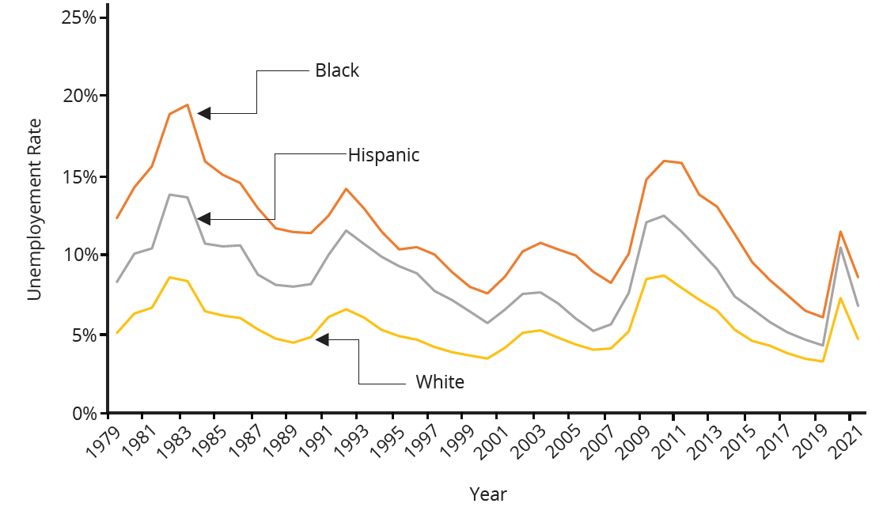
Patterns of Unemployment - Race
Although unemployment rates for all groups tend to rise and fall together, the unemployment rate for Blacks is typically about twice as high as for Whites, while the unemployment rate for Hispanics is in-between.
Notes:
Although unemployment rates for all groups tend to rise and fall together, the unemployment rate for blacks is typically about twice as high as for whites, while the unemployment rate for Hispanics is in-between.

Slide 9
Patterns of Unemployment - Education
Those with less education typically suffer higher unemployment rates.
Additional education usually offers better connections to the labor market and higher demand.
Unemployment by Level of Education, August 2022 (Source: BLS)
Level of Education | Unemployment Rate
Some high school, did not graduate | 6.2%
High school graduate | 4.2%
Some college or associate degree | 2.9%
Bachelor's degree and higher | 1.9%
Notes:
Those with less education typically suffer higher unemployment rates. Additional education usually offers better connections to the labor market and higher demand. Since low-skilled workers often have less attractive labor market opportunities, they may be less motivated to find jobs.

Slide 10
Patterns of Unemployment - Education
The BLS also provides information on the reasons for and duration of unemployment.
Reasons for Unemployment, 2021 (Source: BLS)
Reason | Percentage
New entrants | 6.0%
Re-entrants | 25.6%
Job leavers | 9.3%
Job losers: temporary | 18.3%
Job losers: non-temporary | 40.8%
Notes:
The BLS also provides information on the reasons for and duration of unemployment.

Slide 11
International Unemployment Comparisons
From an international perspective, the U.S. unemployment rate typically has looked a little better than average.
We need to treat cross-country comparisons of unemployment rates with care because each country has a unique labor market.
Comparing unemployment rates in high-income economies, like the United States, with low-income economies is very difficult.
One reason is that the statistical agencies in many poorer countries lack the resources and technical capabilities of the U.S. Census Bureau.
Many workers in low-income economies are engaged in short-term work, subsistence activities, and bartering.
HAWKES LEARNING
Notes:
From an international perspective, the U.S. unemployment rate typically has looked a little better than average. We need to treat cross-country comparisons of unemployment rates with care because each country has a unique labor market. Comparing unemployment rates in high-income economies, like the United States, with low-income economies is very difficult. One reason is that the statistical agencies in many poorer countries lack the resources and technical capabilities of the U.S. Census Bureau. Many workers in low-income economies are engaged in short-term work, subsistence activities, and bartering, not a long-term job.

Slide 12
Summary
The U.S. unemployment rate rises during periods of recession and depression but falls back to the range of 4% to 6% when the economy is strong.
The unemployment rate never falls to zero.
Despite enormous growth in the size of the U.S. population and labor force in the twentieth century, along with other major trends like globalization and new technology, the unemployment rate shows no long-term rising trend.
Unemployment rates differ by group; they are higher for Blacks and Hispanics than Whites; higher for the less educated than the more educated; and higher for the young than for the middle-aged.
Women's unemployment rates used to be higher than men's, but in recent years, men's and women's unemployment rates have been very similar.
HAWKES LEARNING

Slide 13




HAWKES LEARNING

