Slide 1
HAWKES LEARNING
What Causes Changes in Unemployment over the Short Run

Slide 2
Cyclical Unemployment
In the short run, the quantity of hours that the average person is willing to work for a given wage does not change much.
One primary determinant of firms' demand for labor is how they perceive the state of the macroeconomy.
Whether firms see the macroeconomy improving or slowing down determines the amount of labor demanded.
As the economy moves from expansion to recession and vice versa, it causes variation in unemployment called cyclical unemployment.
HAWKES LEARNING
Notes:
In the short-run, the quantity of hours that the average person is willing to work for a given wage does not change much. One primary determinant of firms' demand for labor is how they perceive the state of the macroeconomy. Whether firms see the macroeconomy improving or slowing down determines the amount of labor demanded. As the economy moves from expansion to recession and vice versa, it causes variation in unemployment called cyclical unemployment.

Slide 3
Why Wages Might Be Sticky Downward
Though wage increases may occur with relative ease, wage decreases are few and far between.
For low-skilled workers receiving the minimum wage, it is illegal to reduce wages.
For union workers operating under a multiyear contract, wage cuts might violate the contract and create a labor dispute or strike.
However, minimum wage and union contracts are not sufficient reasons why wages would be sticky downward for the entire U.S. economy.
Economists have several theories as to why wages might be sticky downward.
HAWKES LEARNING
Notes:
Though wage increases may occur with relative ease, wage decreases are few and far between. For low-skilled workers receiving the minimum wage, it is illegal to reduce wages. For union workers operating under a multiyear contract, wage cuts might violate the contract and create a labor dispute or strike. Minimum wage and union contracts are not sufficient reasons why wages would be sticky downward for the entire U.S. economy. Economists have several theories as to why wages might be sticky downward.

Slide 4

Real World Example
Can you think of a situation, in your current job or at a future prospect, where you would understand, and even support, the idea of your wage decreasing?
Now, consider the economic downturn that accompanied the COVID-19 pandemic. Many companies cut salaries or employee hours. What does this tell you about what was happening in the labor market?
HAWKES LEARNING
Notes:
Can you think of a situation, in your current job or at a future prospect, where you would understand, and even support, the idea of your wage decreasing? Explain your reasoning. Then, consider the economic downturn that accompanied the COVID-19 pandemic. Many companies cut salaries or employee hours. What does this tell you about what was happening in the labor market?

Slide 5
Sticky Downward Wages Theories
Adverse Selection of Wage Cuts
Implicit Contract
Efficiency Wage
Insider-Outsider Model
Relative Wage Coordination
HAWKES LEARNING

Slide 6
Implicit Contract Theory
Implicit Contract
Argument: Employers will try to keep wages from falling when the economy is weak and/or the firm is having trouble. The employee will not expect huge salary increases when the economy and/or firm is strong.
Reasoning against Wage Cuts: Acts as a form of insurance because employees have protection against wage declines in bad times but pay for that protection in good times. Firms are hesitant to cut wages because they do not want workers to feel betrayed and then work less or leave the firm.
HAWKES LEARNING
Notes:
Implicit Contract
Argument: Employers will try to keep wages from falling when the economy is weak and/or the firm is having trouble. The employee will not expect huge salary increases when the economy and/or firm is strong.
Reasoning against Wage Cuts: Acts as a form of insurance because employees have protection against wage declines in bad times but pay for that protection in good times. Firms are hesitant to cut wages because they do not want workers to feel betrayed and then work less or leave the firm.

Slide 7
Efficiency Wage Theory
Efficiency Wage
Argument: Workers' productivity depends on their pay, so employers find an incentive to pay their employees more than what the market dictates.
Reasoning against Wage Cuts: When firms offer wages based on productivity, employees are motivated to work harder and stay with their current employer.
By avoiding wage cuts, the employer minimizes the costs of hiring new employees and benefits from highly motivated employees.
HAWKES LEARNING
Notes:
Efficiency Wage
Argument: Workers' productivity depends on their pay, so employers find an incentive to pay their employees more than what the market dictates.
Reasoning against Wage Cuts: When firms offer wages based on productivity, employees are motivated to work harder and stay with their current employer.
By avoiding wage cuts, the employer minimizes the costs of hiring new employees and benefits from highly motivated employees.

Slide 8
Adverse Selection of Wage Cuts Argument
Adverse Selection of Wage Cuts
Argument: If an employer reacts to poor business conditions by reducing the wages of all workers, the best workers (those with employment alternatives) are more likely to leave and find work elsewhere.
Reasoning against Wage Cuts: If imposing wage cuts will cause the better employees to leave and find jobs elsewhere, the firm would be left with mediocre employees who would struggle to find another job. To cut expenses, firms are more likely to choose which workers to lay off or fire rather than cut wages for everyone.
HAWKES LEARNING
Notes:
Adverse Selection of Wage Cuts
Argument: If an employer reacts to poor business conditions by reducing the wages of all workers, the best workers (those with employment alternatives) are more likely to leave and find work elsewhere.
Reasoning against Wage Cuts: If imposing wage cuts will cause the better employees to leave and find jobs elsewhere, the firm would be left with mediocre employees who would struggle to find another job. To cut expenses, firms are more likely to choose which workers to lay off or fire rather than cut wages for everyone.

Slide 9
Insider-Outsider Model
Insider-Outsider Model
Argument: Those who work for firms are considered "insiders," and new employees, at least for some time, are "outsiders."
Reasoning against Wage Cuts: A firm depends on "insiders" to keep the organization running smoothly, be familiar with routine procedures, and train new employees. Cutting wages will cause insiders to look elsewhere for work or alienate them and damage the firm's productivity and prospects.
HAWKES LEARNING
Notes:
Insider-Outsider Model
Argument: Those who work for firms are considered "insiders," and new employees, at least for some time, are "outsiders.“
Reasoning against Wage Cuts: A firm depends on "insiders" to keep the organization running smoothly, be familiar with routine procedures, and train new employees. Cutting wages will cause insiders to look elsewhere for work or alienate them and damage the firm's productivity and prospects.

Slide 10
Relative Wage Coordination Argument
Relative Wage Coordination
Argument: A firm would have to cut wages across the board, which is hard to implement and may cause workers to compare pay cuts amongst themselves.
Reasoning against Wage Cuts: Workers confronted with the possibility of a wage cut will worry that colleagues will not experience proportionate cuts.
Workers fight hard against wage cuts because it means being worse off both financially and in relation to others.
HAWKES LEARNING
Notes:
Relative Wage Coordination
Argument: A firm would have to cut wages across the board, which is hard to implement and may cause workers to compare pay cuts amongst themselves. who work for firms are considered "insiders," and new employees, at least for some time, are "outsiders.“
Reasoning against Wage Cuts: Workers confronted with the possibility of a wage cut will worry that colleagues will not experience proportionate cuts.
Workers fight hard against wage cuts because it means being worse off both financially and in relation to others.

Slide 11
Sticky Downward Wages Theories
These theories are all subjects of debate, but all imply that wages will decline very slowly, if at all, even during tough times for the economy.
When wages are unlikely to fall, an excess supply of labor could occur, resulting in short- or long-run unemployment.
If the wage rate is stuck above the wage equilibrium, unemployment occurs because businesses can’t afford to hire.
With a rising demand for labor, wages rise; with a falling demand for labor and sticky wages, unemployment is higher.
HAWKES LEARNING
Notes:
These theories are all subjects of debate, but all imply that wages will decline very slowly, if at all, even during tough times for the economy. When wages are unlikely to fall, an excess supply of labor could occur, resulting in short- or long-run unemployment. If the wage rate is stuck above the wage equilibrium, unemployment occurs because businesses can’t afford to hire. With a rising demand for labor, wages rise; with a falling demand for labor and sticky wages, unemployment is higher.

Slide 12
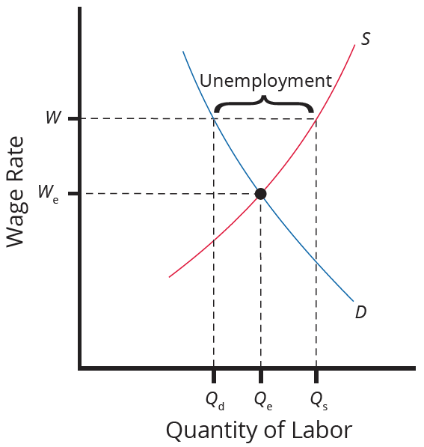
Sticky Downward Wages Theories
Because the wage rate is stuck at W, above the equilibrium, the number of those who want jobs (Q_{s}) is greater than the number of job openings (Q_{d}). The result is unemployment, shown by the bracket in the figure.
HAWKES LEARNING
Notes:
Because the wage rate is stuck at W, above the equilibrium, the number of those who want jobs (Qs) is greater than the number of job openings (Qd). The result is unemployment, shown by the bracket in the figure.

Slide 13
Summary
Cyclical unemployment rises and falls with the business cycle.
In a labor market with flexible wages, wages will adjust so that the quantity of labor demanded always equals the quantity supplied at the equilibrium wage.
Economists have proposed many theories for why wages are not flexible and instead may adjust only in a "sticky" way, especially when it comes to downward adjustments.
These theories include implicit contracts, the efficiency wage theory, adverse selection of wage cuts, the insider-outsider model, and relative wage coordination.
HAWKES LEARNING

Slide 14




HAWKES LEARNING

