Slide 1
HAWKES LEARNING
The Pros and Cons of Trade Deficits and Surpluses

Slide 2
Introduction
Because flows of trade always involve flows of financial payments, flows of international trade and international financial capital are the same.
Conventional wisdom often holds that borrowing money is foolish and that wise countries should always rely on their own resources.
Borrowing at certain times can also make sound economic sense.
For both individuals and countries, there is no economic merit in a policy of abstaining from participation in financial capital markets.
HAWKES LEARNING
Notes:
Because flows of trade always involve flows of financial payments, flows of international trade and international financial capital are the same. Conventional wisdom often holds that borrowing money is foolish and that wise countries should always rely on their own resources. Borrowing at certain times can also make sound economic sense. For both individuals and countries, there is no economic merit in a policy of abstaining from participation in financial capital markets.

Slide 3
When to Borrow Money
An individual can borrow for a college education that will increase productivity and wages in the future, allowing the borrower to repay.
A business can borrow in order to buy a machine that will increase output, productivity, and profits.
A nation can borrow foreign financial capital, which it can invest in ways that will increase the nation's economic growth in the future.
HAWKES LEARNING
Notes:
An individual can borrow for a college education that will increase productivity and wages in the future, allowing the borrower to repay. A business can borrow in order to buy a machine that will increase output, productivity, and profits. A nation can borrow foreign financial capital, which it can invest in ways that will increase the nation's economic growth in the future.

Slide 4
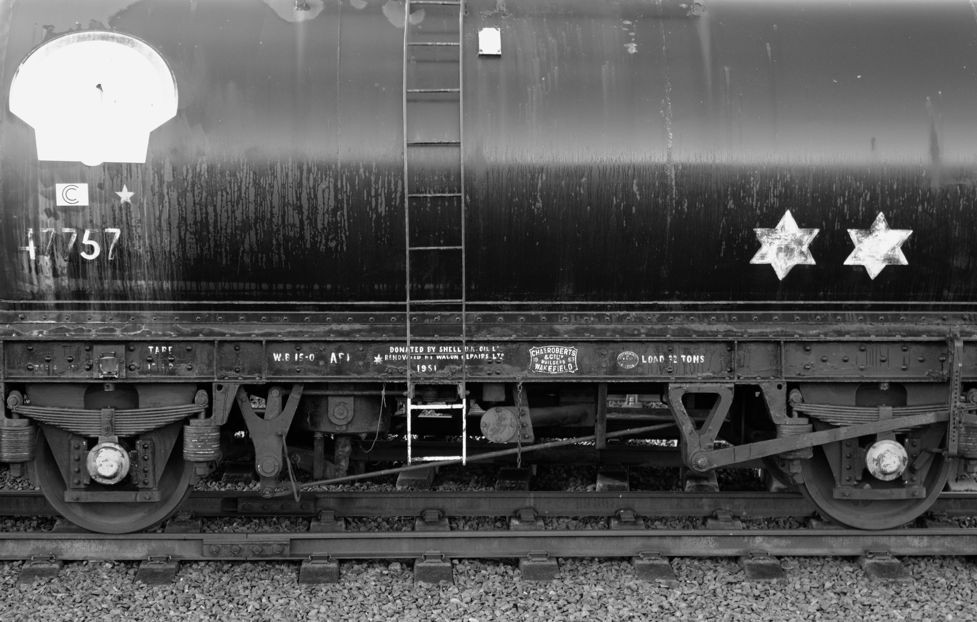
Real World Example
One vivid example of a country that borrowed heavily from abroad, invested wisely, and did perfectly well is the U.S. during the nineteenth century. The United States ran a trade deficit in forty of the forty-five years between 1831 and 1875, which meant that it was importing capital from abroad over that time. However, that financial capital was mostly invested in projects, like railroads, that brought a substantial economic payoff.
HAWKES LEARNING
Notes:
One vivid example of a country that borrowed heavily from abroad, invested wisely, and did perfectly well is the U.S. during the nineteenth century. The United States ran a trade deficit in forty of the forty-five years between 1831 and 1875, which meant that it was importing capital from abroad over that time. However, that financial capital was mostly invested in projects, like railroads, that brought a substantial economic payoff.

Slide 5
Potential Consequences of Borrowing
Some countries have run large trade deficits, borrowed heavily in global capital markets, and ended up in trouble.
Borrowed funds from foreign countries may not be invested in ways that lead to increased productivity.
Money borrowed from other nations may flow out unexpectedly.
HAWKES LEARNING
Notes:
Some countries have run large trade deficits, borrowed heavily in global capital markets, and ended up in trouble. Borrowed funds from foreign countries may not be invested in ways that lead to increased productivity. Money borrowed from other nations may flow out unexpectedly.

Slide 6
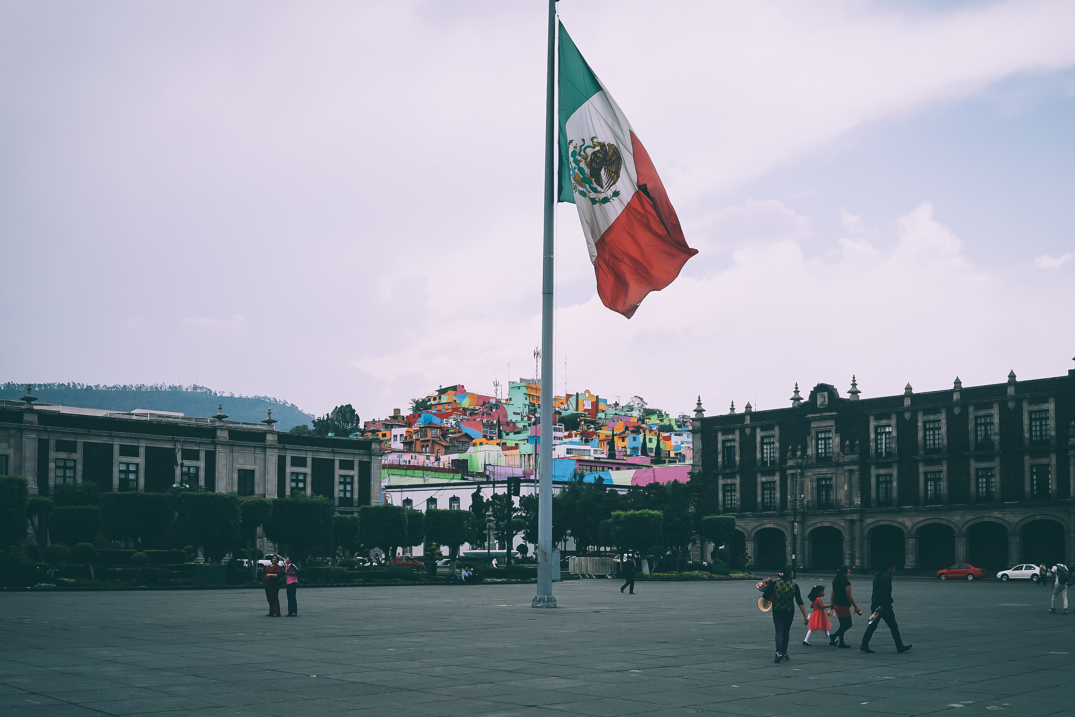
Real World Example
Several of Latin America's large economies, including Mexico and Brazil, ran large trade deficits and borrowed heavily from abroad in the 1970s, but the inflow of financial capital did not boost productivity sufficiently. When economic conditions shifted during the 1980s, these countries faced great difficulty in repaying the money they had borrowed.
HAWKES LEARNING
Notes:
Several of Latin America's large economies, including Mexico and Brazil, ran large trade deficits and borrowed heavily from abroad in the 1970s, but the inflow of financial capital did not boost productivity sufficiently. When economic conditions shifted during the 1980s, these countries faced great difficulty in repaying the money they had borrowed.

Slide 7
Are Trade Surpluses Always Good?
While a trade deficit is not always harmful, there is no guarantee that running a trade surplus will bring robust economic health.
For example, Germany and Japan ran substantial trade surpluses in the late 1990s and early 2000s.
Regardless of their persistent trade surpluses, both Japan and Germany have experienced occasional recessions.
In addition, neither country has had especially robust annual growth in recent years.
HAWKES LEARNING
Notes:
While a trade deficit is not always harmful, there is no guarantee that running a trade surplus will bring robust economic health. For example, Germany and Japan ran substantial trade surpluses in the late 1990s and early 2000s. Regardless of their persistent trade surpluses, both Japan and Germany have experienced occasional recessions. In addition, neither country has had especially robust annual growth in recent years.

Slide 8
Summary
Trade surpluses are no guarantee of economic health.
Trade deficits are no guarantee of economic weakness.
Trade deficits and trade surpluses can work out well or poorly, depending on whether or not a government wisely invests the corresponding flows of financial capital.
HAWKES LEARNING

Slide 9




HAWKES LEARNING

