Slide 1
HAWKES LEARNING
Building a Model of Aggregate Demand and Aggregate Supply

Slide 2
Introduction
In macroeconomics, models are important for analyzing macro issues and problems.
How is the rate of economic growth connected to changes in the unemployment rate?
Is there a reason why unemployment and inflation seem to move in opposite directions?
How do aggregate supply and aggregate demand interact to reach a macroeconomic equilibrium?
How will shifts in aggregate demand or aggregate supply affect the equilibrium?
HAWKES LEARNING
Notes:
In macroeconomics, models are important for analyzing macro issues and problems. How is the rate of economic growth connected to changes in the unemployment rate? Is there a reason why unemployment and inflation seem to move in opposite directions? How do aggregate supply and aggregate demand interact to reach a macroeconomic equilibrium? How will shifts in aggregate demand or aggregate supply affect the equilibrium?

Slide 3
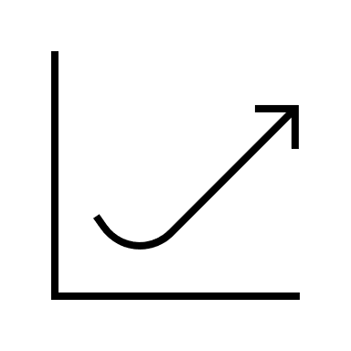


Introduction
This chapter also relates the model of aggregate supply and aggregate demand to the three concerns of economic policy:
Growth
Unemployment
Inflation
HAWKES LEARNING
Notes:
This chapter also relates the model of aggregate supply and aggregate demand to the three concerns of economic policy: Growth, Unemployment, & Inflation

Slide 4
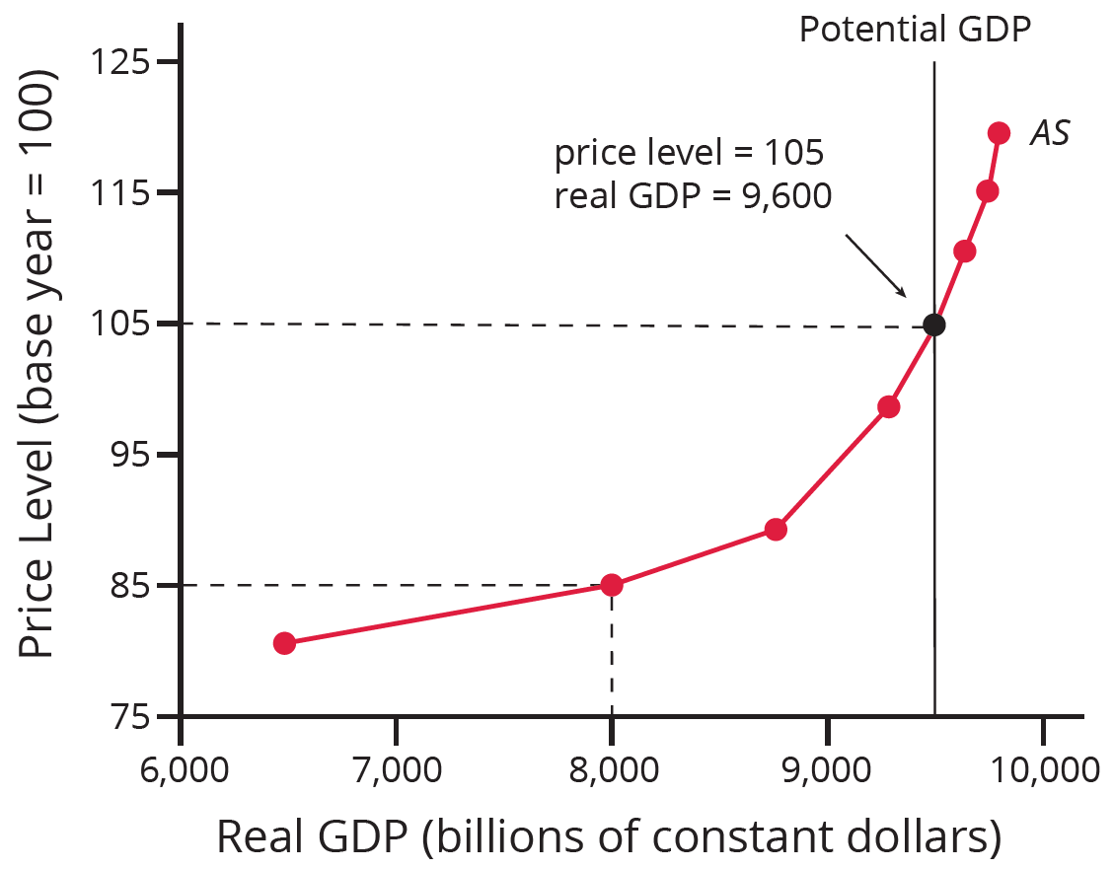
Building a Model of Aggregate Demand and Aggregate Supply
To build a useful macroeconomic model, we need a model that indicates what determines total supply and total demand for the economy and how total demand and total supply interact at the macroeconomic level. We call this the aggregate demand/aggregate supply (AD/AS) model.
HAWKES LEARNING

Slide 5
The Aggregate Supply Curve and Potential GDP
For businesses, profits are determined by the prices of outputs and inputs, such as labor and raw materials.
Businesses make decisions about what quantity to supply based on the profits they expect to earn.
Aggregate supply (AS) refers to the total quantity of output (i.e. real GDP) firms will produce and sell.
The aggregate supply curve shows the total quantity of output that firms will produce and sell at each price level.
HAWKES LEARNING
Notes:
For businesses, profits are determined by the prices of outputs and inputs, such as labor and raw materials. Businesses make decisions about what quantity to supply based on the profits they expect to earn. Aggregate supply (AS) refers to the total quantity of output (i.e. real GDP) firms will produce and sell. The aggregate supply curve shows the total quantity of output that firms will produce and sell at each price level.

Slide 6
Aggregate Supply Curve
Horizontal axis: real GDP, or the level of GDP adjusted for inflation
Vertical axis: price level, or the average prices of all goods and services produced in the economy
As the price level rises, real GDP rises because the price level is for final goods and services, not intermediate goods and services or production inputs.
HAWKES LEARNING
Notes:
Horizontal axis: Real GDP, or the level of GDP adjusted for inflation. Vertical axis: Price level, or the average prices of all goods and services produced in the economy. As price levels rise, real GDP rises because the price level is for final goods and services, not intermediate goods and services or production inputs.

Slide 7
Aggregate Supply Curve
The aggregate supply curve shows a positive short-run relationship between price level and real GDP.
Potential GDP or long-run aggregate supply (LRAS) curve: maximum amount of real GDP an economy can produce by fully employing its existing levels of labor, physical capital, technology, and legal institutions; shows no relationship between price level of output and real GDP in the long run
HAWKES LEARNING
Notes:
The aggregate supply curve shows a positive short-run relationship between price level and real GDP. Potential GDP or long-run aggregate supply (LRAS) curve: maximum amount of real GDP an economy can produce by fully employing its existing levels of labor, physical capital, technology, and legal institutions; shows no relationship between price level of output and real GDP in the long run

Slide 8
Leftward Portion of the AS Curve
At the far left of the AS curve, the level of output in the economy is far below potential GDP.
At these relatively low levels of output, levels of unemployment are high, and many factories have shut down or are running part-time.
In this situation, a relatively small increase in the prices of the outputs that businesses sell (while assuming no rise in input prices) can encourage a considerable surge in the quantity of aggregate supply.
Notes:
At the far left of the AS curve, the level of output in the economy is far below potential GDP. At these relatively low levels of output, levels of unemployment are high, and many factories have shut down or are running part-time. In this situation, a relatively small increase in the prices of the outputs that businesses sell (while assuming no rise in input prices) can encourage a considerable surge in the quantity of aggregate supply.

Slide 9
Rightward Portion of the AS Curve
At the far right of the AS curve, the curve becomes nearly vertical.
At this quantity, higher prices for outputs cannot encourage additional output.
Even if firms want to expand output, the inputs of labor and machinery in the economy are fully employed.
At potential GDP, machines and factories are running at capacity, and the unemployment rate is relatively low.
For this reason, potential GDP is sometimes also called full-employment GDP.
Notes:
At the far right of the AS curve, the curve becomes nearly vertical. At this quantity, higher prices for outputs cannot encourage additional output. Even if firms want to expand output, the inputs of labor and machinery in the economy are fully employed. At potential GDP, machines and factories are running at capacity, and the unemployment rate is relatively low. For this reason, potential GDP is sometimes also called full-employment GDP.

Slide 10
Aggregate Demand Curve
Aggregate demand (AD) refers to the amount of total spending on domestic goods and services in an economy.
It includes all four components of demand: consumption, investment, government spending, and net exports.
This demand is determined by multiple factors, but one of them is the price level.
The aggregate demand curve shows the total spending on domestic goods and services at each price level.
HAWKES LEARNING
Notes:
Aggregate demand (AD) refers to the amount of total spending on domestic goods and services in an economy. It includes all four components of demand: consumption, investment, government spending, and net exports. This demand is determined by multiple factors, but one of them is the price level. The aggregate demand curve shows the total spending on domestic goods and services at each price level.

Slide 11
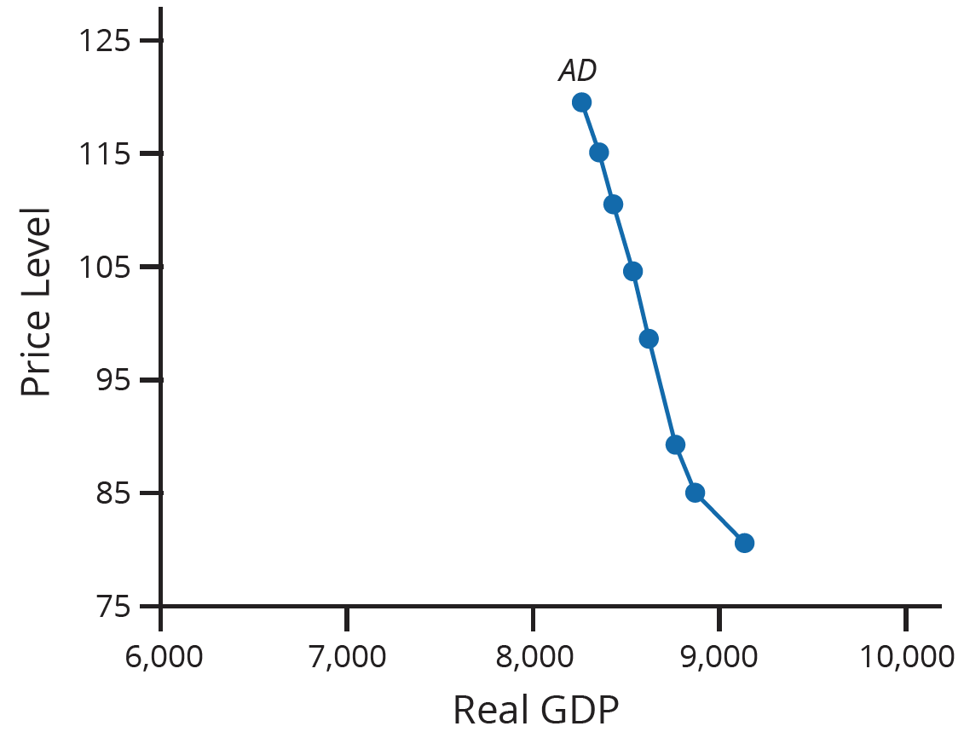
Aggregate Demand Curve
Horizontal axis: real GDP
Vertical axis: price level
The AD curve slopes down, which shows that increases in the price level of outputs lead to a lower quantity of total spending.
There are several reasons the AD curve slopes downward: the wealth effect, the interest rate effect, and the foreign price effect.
HAWKES LEARNING
Notes:
Horizontal axis: real GDP. Vertical axis: price level. The AD curve slopes down, which shows that increases in price level of outputs lead to a lower quantity of total spending. There are several reasons the AD curve slopes downward: wealth effect, interest rate effect, and foreign price effect.

Slide 12
Reasons the AD Curve Slopes Downward
Wealth effect: as the price level increases, the buying power of savings and other assets that people have will diminish, eaten away (to some extent) by inflation
Interest rate effect: as the prices of outputs rise, the same purchases will take more money or credit to accomplish
Foreign price effect: if prices rise in the U.S. while remaining fixed in other countries, goods in the U.S. will be relatively more expensive compared to goods in the rest of the world
HAWKES LEARNING
Notes:
Wealth effect: as price level increases, buying power of savings and other assets that people have will diminish, eaten away by inflation
Interest rate effect: as prices of outputs rise, the same purchases will take more money or credit to accomplish
Foreign price effect: if prices rise in the U.S. while remaining fixed in other countries, goods in the U.S. will be relatively more expensive compared to goods in rest of the world

Slide 13

On Your Own
Suppose that you have saved $5,000 for a down payment on a new Volkswagen, which, until recently, was priced at $25,000. Because of tariffs on cars imported from the European Union, the price of the Volkswagen is now $30,000. Explain how you would be affected by the wealth effect and the interest rate effect.
HAWKES LEARNING
Notes:
Suppose that you have saved $5,000 for a down payment on a new Volkswagen, which, until recently, was priced at $25,000. Because of tariffs on cars imported from the European Union, the price of the Volkswagen is now $30,000. Explain how you would be affected by the wealth effect and the interest rate effect.

Slide 14
On Your Own
Suppose that you have saved $5,000 for a down payment on a new Volkswagen, which, until recently, was priced at $25,000. Because of tariffs on cars imported from the European Union, the price of the Volkswagen is now $30,000. Explain how you would be affected by the wealth effect and the interest rate effect.
Initially, the $5,000 down payment would cover $5,000/$25,000=20% of the purchase price. After the price increase, the down payment covers only $5,000/$30,000=16.7% of the purchase price. This is an example of the wealth effect, which says that as prices go up, the buying power of a constant amount of money will decrease. The interest rate effect is that as prices are higher, consumers and businesses must borrow more to pay for purchases. In this case, with the $5,000 down payment, the original amount to finance was $20,000. After the price increase, $25,000 must be financed. The increase in demand for loans will increase interest rates, making borrowing more expensive.
HAWKES LEARNING
Notes:
Suppose that you have saved $5,000 for a down payment on a new Volkswagen, which, until recently, was priced at $25,000. Because of tariffs on cars imported from the European Union, the price of the Volkswagen is now $30,000. Explain how you would be affected by the wealth effect and the interest rate effect.
Initially, the $5,000 down payment would cover $5,000/$25,000=20% of the purchase price. After the price increase, the down payment covers only $5,000/$30,000=16.7% of the purchase price. This is an example of the wealth effect, which says that as prices go up, the buying power of a constant amount of money will decrease. The interest rate effect is that as prices are higher, consumers and businesses must borrow more to pay for purchases. In this case, with the $5,000 down payment, the original amount to finance was $20,000. After the price increase, $25,000 must be financed. The increase in demand for loans will increase interest rates, making borrowing more expensive.

Slide 15
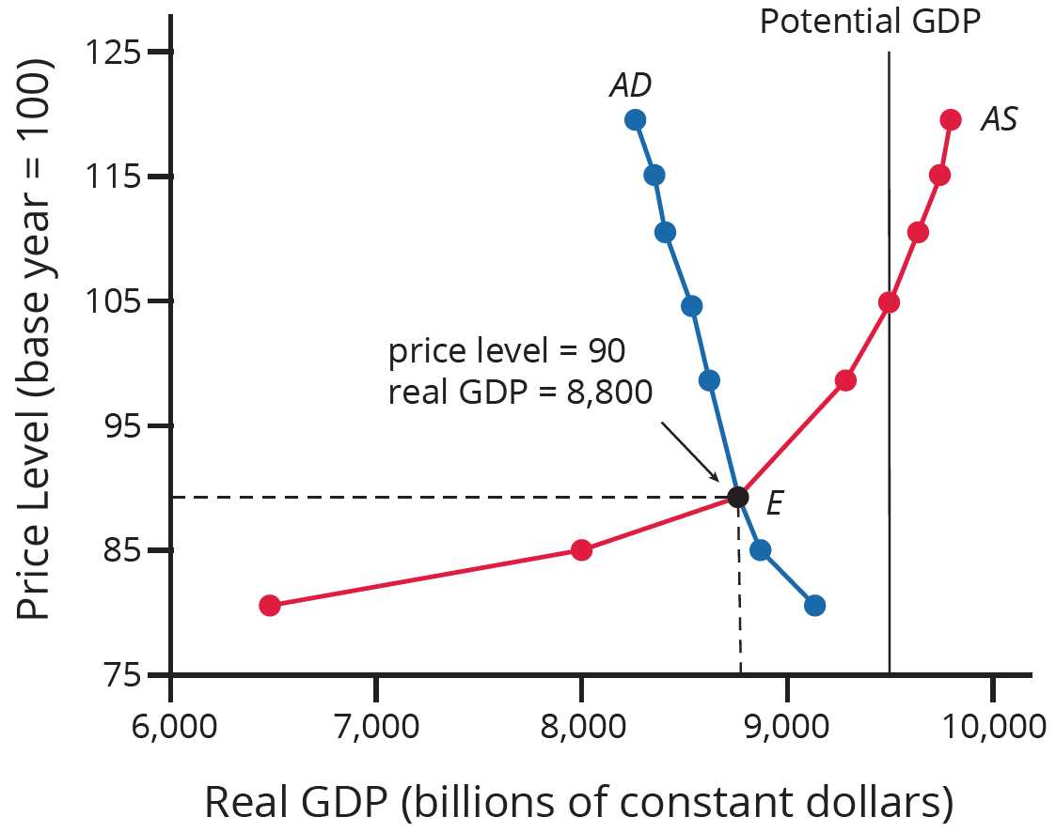
AD/AS Model
The intersection of the AS and AD curves shows the equilibrium level of real GDP and the equilibrium price level in the economy.
At a relatively low price level for output, firms have little incentive to produce, although consumers would be willing to purchase a large quantity of output.
As the price level rises, aggregate supply rises and aggregate demand falls until the equilibrium point is reached.
HAWKES LEARNING
Notes:
The intersection of the AS and AD curves shows the equilibrium level of real GDP and the equilibrium price level in the economy. At a relatively low price level for output, firms have little incentive to produce, although consumers would be willing to purchase a large quantity of output. As the price level rises, aggregate supply rises and aggregate demand falls until the equilibrium point is reached.

Slide 16
Summary
The upward-sloping short-run aggregate supply (SRAS) curve shows the positive relationship between the price level and the level of real GDP in the short run.
Aggregate supply (AS) slopes up because when the price level for outputs increases, while the price level of inputs remains fixed, the opportunity for additional profits encourages more production.
The downward-sloping aggregate demand (AD) curve shows the relationship between the price level for outputs and the quantity of total spending in the economy.
HAWKES LEARNING

Slide 17




HAWKES LEARNING

