Slide 1
HAWKES LEARNING
Keynesian Policy and the Keynesian Perspective on Market Forces

Slide 2
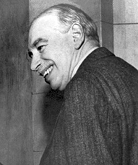
Introduction
Keynesian policy argues that economic fluctuations can be controlled by appropriate government responses.
HAWKES LEARNING
Notes:
Keynesian policy argues that economic fluctuations can be controlled by appropriate government responses.

Slide 3
Keynesian Solutions
Keynesian macroeconomics argues that the solution to a recession is expansionary fiscal policy, such as tax cuts that stimulate consumption and investment or direct increases in government spending that would shift the AD curve to the right.
Keynes stated that the government should preferably spend money on things like housing, roads, and other amenities.
A depression should not be a time to argue about the specifics of government spending programs, but rather a time to pump up AD enough to lift the economy to potential GDP.
HAWKES LEARNING
Notes:
Keynesian macroeconomics argues that the solution to a recession is expansionary fiscal policy, such as tax cuts that stimulate consumption and investment or direct increases in government spending that would shift the AD curve to the right. Keynes stated that the government should preferably spend money on things like housing, roads, and other amenities. A depression should not be a time to argue about the specifics of government spending programs, but rather a time to pump up AD enough to lift the economy to potential GDP.

Slide 4
Keynesian Solutions
When the economy is operating above potential GDP, contractionary fiscal policy should be implemented.
The result is downward pressure on the price level, mitigating potential inflation, and very little reduction in output.
Too little AD brings unemployment, while too much AD brings inflationary pressures.
HAWKES LEARNING
Notes:
When the economy is operating above potential GDP, contractionary fiscal policy should be implemented. The result is downward pressure on the price level, mitigating potential inflation, and very little reduction in output. Too little AD brings unemployment, while too much AD brings inflationary pressures.

Slide 5
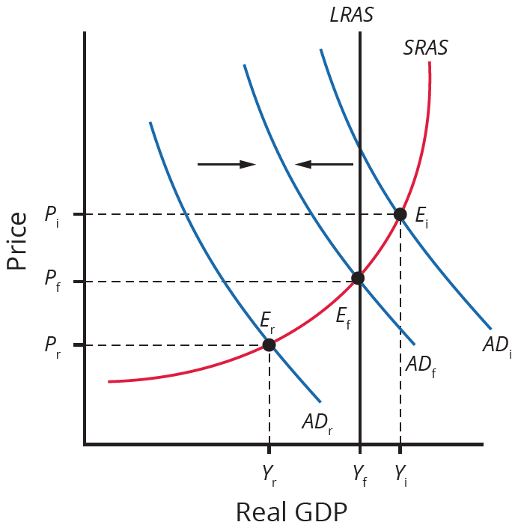
Keynesian Solutions
If an economy is in recession, with equilibrium at E_{r}, the Keynesian response would be to enact policies that shift AD to the right, from AD_{r} toward AD_{f}.
If an economy is experiencing inflationary pressures, with equilibrium at E_{i}, the Keynesian response would be to enact policies that shift AD to the left, from AD_{i} toward AD_{f}.
Notes:
If an economy is in recession, with equilibrium at E_{r}, the Keynesian response would be to enact policies that shift AD to the right, from AD_{r} toward AD_{f}. If an economy is experiencing inflationary pressures, with equilibrium at E_{i}, the Keynesian response would be to enact policies that shift AD to the left, from AD_{i} toward AD_{f}.

Slide 6
The Keynesian Perspective on Market Forces
Ever since the birth of Keynesian economics in the 1930s, controversy has simmered regarding the role of the government in the economy.
After the Great Depression, many people became more aware of vulnerabilities within the market-oriented economic system.
Some supporters of Keynesian economics advocated a high degree of government planning in all parts of the economy.
Keynes believed that government should ensure overall levels of AD that are sufficient for an economy to reach full employment.
This task does not imply that the government should attempt to set prices and wages throughout the economy, nor take over and manage large corporations or entire industries directly.
HAWKES LEARNING
Notes:
Ever since the birth of Keynesian economics in the 1930s, controversy has simmered regarding the role of the government in the economy. After the Great Depression, many people became more aware of vulnerabilities within the market-oriented economic system. Some supporters of Keynesian economics advocated a high degree of government planning in all parts of the economy. Keynes believed that government should ensure overall levels of AD that are sufficient for an economy to reach full employment. This task does not imply that the government should attempt to set prices and wages throughout the economy, nor take over and manage large corporations or entire industries directly.

Slide 7
Practical Questions about Keynesian Policy
Can government economists accurately identify potential GDP?
Is an increase in AD better achieved by a tax cut or an increase in government spending?
Given the inevitable delays and uncertainties as the government makes policies into law, is it reasonable to expect that the government can implement Keynesian economics?
Is fixing a recession as simple as pumping up aggregate demand?
Notes:
Can government economists accurately identify potential GDP?
Is an increase in AD better achieved by a tax cut or an increase in government spending?
Given the inevitable delays and uncertainties as the government makes policies into law, is it reasonable to expect that the government can implement Keynesian economics?
Is fixing a recession as simple as pumping up aggregate demand?

Slide 8

On Your Own
When the economy is in a recession due to insufficient aggregate demand, should expansionary fiscal policy be an increase in government spending or an individual income tax cut? Explain how each would increase aggregate demand and how you would respond to each.
Notes:
When the economy is in a recession due to insufficient aggregate demand, should expansionary fiscal policy be an increase in government spending or an individual income tax cut? Explain how each would increase aggregate demand and how you would respond to each.

Slide 9
On Your Own
When the economy is in a recession due to insufficient aggregate demand, should expansionary fiscal policy be an increase in government spending or an individual income tax cut? Explain how each would increase aggregate demand and how you would respond to each.
An increase in government spending for goods and services is a direct increase in aggregate demand. You would be directly affected by government spending if it resulted in you being hired for a government
job or the spending was for a good that you produced. In the case of an individual income tax cut, you would be directly affected with more income to spend. However, you might use the tax cut to pay off debt rather than increase your consumption of goods and services. Because all individuals won’t choose to spend the tax cut, its impact on aggregate demand would be smaller than an increase in government spending of an equal amount.
Notes:
When the economy is in a recession due to insufficient aggregate demand, should expansionary fiscal policy be an increase in government spending or an individual income tax cut? Explain how each would increase aggregate demand and how you would respond to each.
An increase in government spending for goods and services is a direct increase in aggregate demand. You would be directly affected by government spending if it resulted in you being hired for a government
job or the spending was for a good that you produced. In the case of an individual income tax cut, you would be directly affected with more income to spend. However, you might use the tax cut to pay off debt rather than increase your consumption of goods and services. Because all individuals won’t choose to spend the tax cut, its impact on aggregate demand would be smaller than an increase in government spending of an equal amount.

Slide 10
Summary
The Keynesian solution to a recession is expansionary fiscal policy enacted by the government.
The Keynesian solution to inflationary pressures brought about by the economy operating above potential GDP is contractionary fiscal policy.
The full extent of the government’s role in the economy is a subject of debate.

Slide 11




HAWKES LEARNING

