Slide 1
HAWKES LEARNING
The Building Blocks of Neoclassical Analysis

Slide 2
Argument for Long-Term Analysis
Extreme situations, such as the 1930s Great Depression, the 2008-2009 Great Recession, or the COVID-19 recession are often subjects of wide economic discussion.
To understand the historical economy, the long term needs to be analyzed.
The unemployment rate has fluctuated from around 3%–11% historically, but typically returns to around 5%–5.5%.
From a long-run perspective, the economy always adjusts back to a specific range of unemployment, decreasing the significance of short-run situations like recessions.
HAWKES LEARNING
Notes:
Extreme situations, such as the 1930s Great Depression, the 2008-2009 Great Recession, or the COVID-19 recession are often subjects of wide economic discussion. To understand the historical economy, the long term needs to be analyzed. The unemployment rate has fluctuated from around 3%–11% historically, but typically returns to around 5%–5.5%. From a long-run perspective, the economy always adjusts back to a specific range of unemployment, decreasing the significance of short-run situations like recessions.

Slide 3
Neoclassical Introduction
The name neoclassical implies a "new" version of the "old" classical model of the economy.
The classical view holds that short-term fluctuations in economic activity will quickly adjust back to full employment and will not need the help of government intervention.
The neoclassical stance is a very “hands-off” approach to economics.
The severe impact of the Great Depression changed a lot of this thinking, increasing the popularity of Keynesian analysis.
HAWKES LEARNING
Notes:
The name neoclassical implies a "new" version of the "old" classical model of the economy. The classical view holds that short-term fluctuations in economic activity will quickly adjust back to full employment and will not need the help of government intervention. The neoclassical stance is a very “hands-off” approach to economics. The severe impact of the Great Depression changed a lot of this thinking, increasing the popularity of Keynesian analysis.

Slide 4
Components of Neoclassical Analysis
Neoclassical perspective: in the long run, the economy will fluctuate around its potential GDP and natural rate of unemployment.
Potential GDP determines the economy's size.
Wages and prices will adjust in a flexible manner, so the economy will adjust back to its potential-GDP level of output.
The government should focus more on long-term growth and controlling inflation than on worrying about recessions and cyclical unemployment.
HAWKES LEARNING
Notes:
Neoclassical perspective: in the long run, the economy will fluctuate around its potential GDP and natural rate of unemployment. Potential GDP determines the economy's size. Wages and prices will adjust in a flexible manner, so the economy will adjust back to its potential-GDP level of output. The government should focus more on long-term growth and controlling inflation than on worrying about recessions and cyclical unemployment.

Slide 5
The Importance of Potential GDP in the Long Run
Over the long run, the level of potential GDP determines the size of real GDP.
When economists talk about potential GDP, they are referring to the level of output achievable when all resources are fully employed.
While the unemployment rate in labor markets will never be zero, full employment in the labor market refers to zero cyclical unemployment.
When the economy is operating with zero cyclical unemployment, economists say that the economy is at the natural rate of unemployment or at full employment.
HAWKES LEARNING
Notes:
Over the long run, the level of potential GDP determines the size of real GDP. When economists talk about potential GDP, they are referring to the level of output achievable when all resources are fully employed. While the unemployment rate in labor markets will never be zero, full employment in the labor market refers to zero cyclical unemployment. When the economy is operating with zero cyclical unemployment, economists say that the economy is at the natural rate of unemployment or at full employment.

Slide 6
GDP Growth
Economists compare actual or real GDP against potential GDP to determine how well the economy is performing.
GDP growth includes increases and investment in physical capital per person, human capital per person, and advances in technology.
Physical capital per person refers to the amount and type of machinery and equipment available to help people get work done.
Human capital per person refers to the accumulated skills and education of each worker.
HAWKES LEARNING
Notes:
Economists compare actual or real GDP against potential GDP to determine how well the economy is performing. GDP growth includes increases and investment in physical capital per person, human capital per person, and advances in technology. Physical capital per person refers to the amount and type of machinery and equipment available to help people get work done. Human capital per person refers to the accumulated skills and education of each worker.

Slide 7

Human Capital
In 1900, only about one-eighth of the U.S. population had completed high school, and just one person in forty had completed a four-year college degree. By 2019, more than 90% of Americans had a high school degree, and over 36% also had a four-year college degree. Human capital per person has increased dramatically in the U.S.
HAWKES LEARNING
Notes:
In 1900, only about one-eighth of the U.S. population had completed high school, and just one person in forty had completed a four-year college degree. By 2019, more than 90% of Americans had a high school degree, and over 36% also had a four-year college degree. Human capital per person has increased dramatically in the U.S.

Slide 8
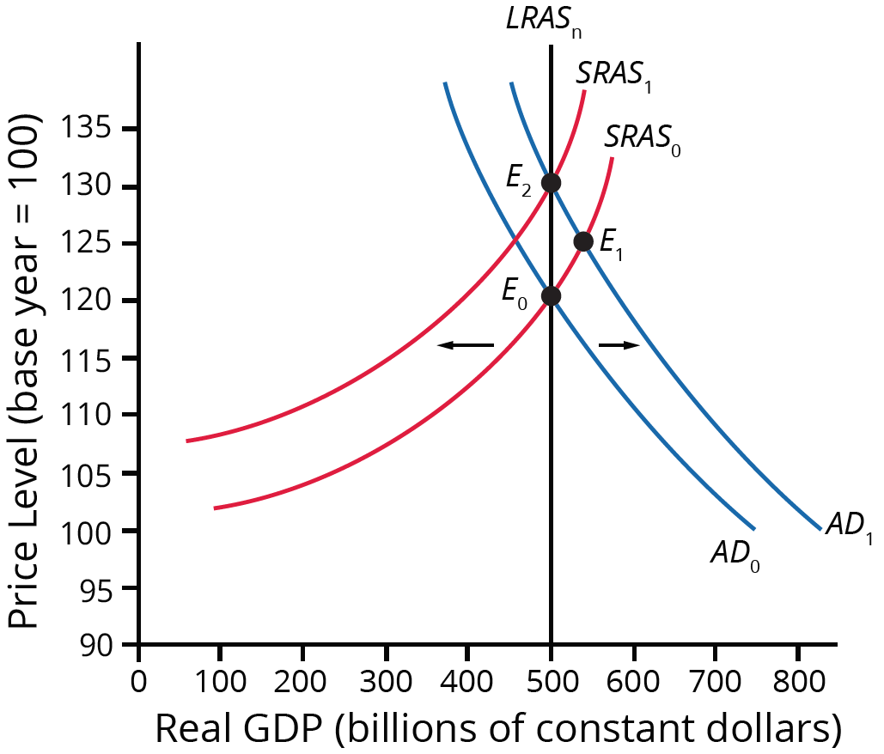
Role of Flexible Prices
Wages are flexible over time.
In the long-run, the economy will fluctuate around LRAS, or potential GDP.
When economic output rises above potential GDP, the level of unemployment falls, there is a labor shortage, the increased demand for labor will drive up wages, and the equilibrium will return to the LRAS.
Both substitution bias and quality/new goods bias tend to overstate the negative impact of inflation on consumers.
HAWKES LEARNING
Notes:
Wages are flexible over time. In the long-run, the economy will fluctuate around LRAS, or potential GDP. When economic output rises above potential GDP, the level of unemployment falls, there is a labor shortage, the increased demand for labor will drive up wages, and the equilibrium will return to the LRAS.

Slide 9
Speed of Economic Adjustment
Neoclassical analysis argues that wage and price adjustments are quite rapid.
Rational expectations: people form the most accurate possible expectations about the future that they can.
Adaptive expectations: people look at past experiences and gradually adapt their beliefs and behaviors as circumstances change.
Rational expectations fit neoclassical analysis more; adaptive expectations fit Keynesian analysis more.
HAWKES LEARNING
Notes:
Neoclassical analysis argues that wage and price adjustments are quite rapid. Rational expectations: people form the most accurate possible expectations about the future that they can. Adaptive expectations: people look at past experiences and gradually adapt their beliefs and behaviors as circumstances change. Rational expectations fit neoclassical analysis more; adaptive expectations fit Keynesian analysis more.

Slide 10
Summary
The neoclassical viewpoint argues that the economy will adjust back to its potential GDP level of output through flexible price levels.
The neoclassical perspective views the LRAS curve as vertical and that, in the long run, the economy will fluctuate around this level of potential GDP.
The rational expectations perspective argues that people have all the information they need about economic events, and as a result, economic adjustments will happen very quickly.
In the adaptive expectations theory, people have limited economic information, making economic adjustments happen slowly.
HAWKES LEARNING

Slide 11




HAWKES LEARNING

