Slide 1
HAWKES LEARNING
Federal Deficits and the National Debt

Slide 2
Introduction
The annual budget deficit or surplus is the difference between the government's tax revenue and spending over a fiscal year.
A fiscal year starts October 1 and ends September 30 of the next year.
budget deficit or surplus = tax revenue − government spending
Notes:
The annual budget deficit or surplus is the difference between the government's tax revenue and spending over a fiscal year. A fiscal year starts October 1 and ends September 30 of the next year. budget deficit or surplus=tax revenue−government spending

Slide 3
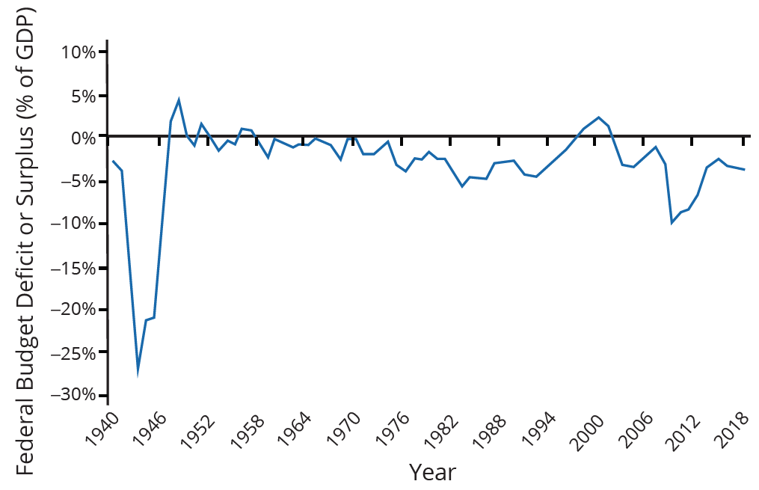
Pattern of Annual Federal Budget Deficits & Surpluses
The federal government has run budget deficits for decades. The budget was briefly in surplus following World War II and in the late 1990s before heading into deficit again in the first decade of the 2000s. There were especially deep deficits during World War II and the 2008–2009 recession.
Notes:
The annual budget deficit or surplus is the difference between the government's tax revenue and spending over a fiscal year. A fiscal year starts October 1 and ends September 30 of the next year. budget deficit or surplus=tax revenue−government spending

Slide 4
Debt-to-GDP Ratio
Another useful way to view the budget deficit is through the prism of accumulated debt rather than annual deficits.
The national debt refers to the total amount that the government has borrowed over time.
In contrast, the budget deficit refers to how much the government has borrowed in one particular year.
Notes:
Another useful way to view the budget deficit is through the prism of accumulated debt rather than annual deficits. The national debt refers to the total amount that the government has borrowed over time. In contrast, the budget deficit refers to how much the government has borrowed in one particular year.

Slide 5
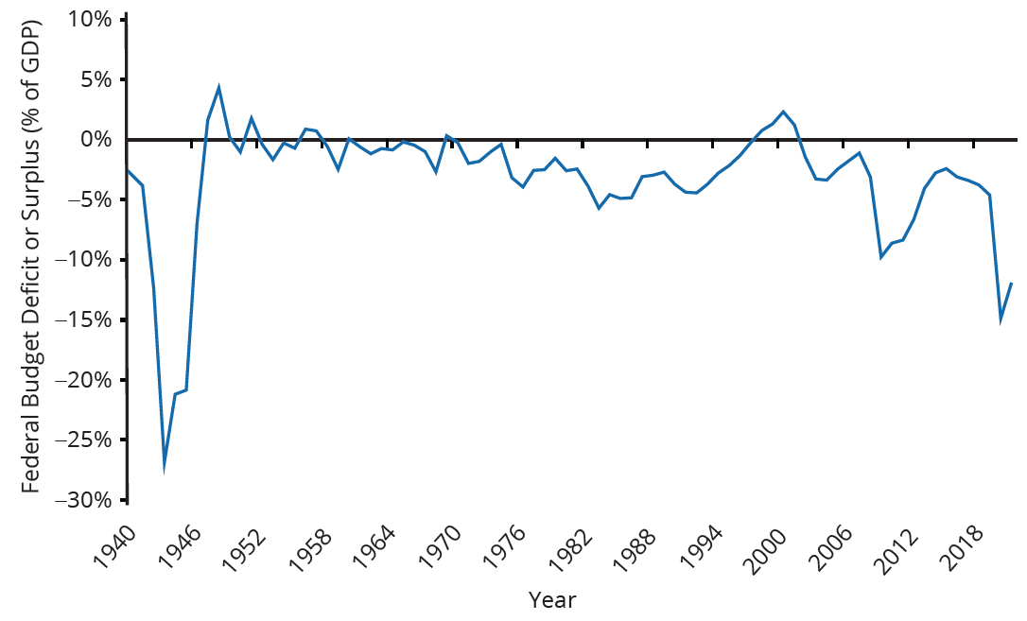
Federal Deficits
The federal government has run budget deficits for decades. There were especially deep deficits during World War II, the 2008-2009 recession, and the COVID-19 recession.
Notes:
The federal government has run budget deficits for decades. There were especially deep deficits during World War II, the 2008-2009 recession, and the COVID-19 recession.

Slide 6
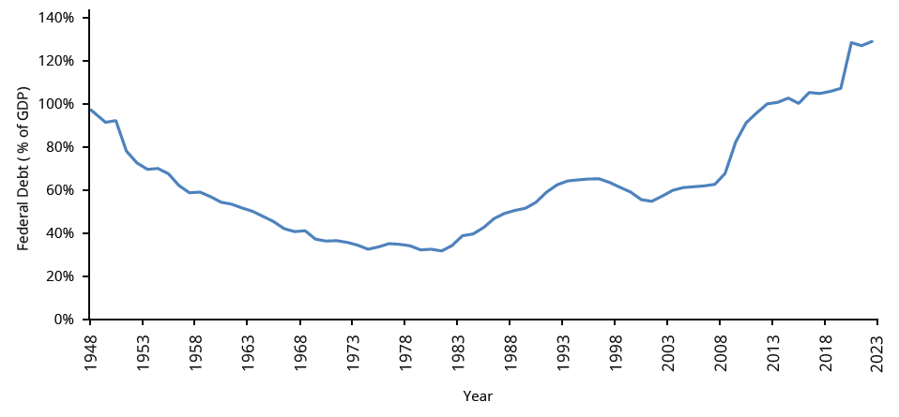
Debt-to-GDP Ratio
Until the 1970s, the debt-to-GDP ratio revealed a relatively clear pattern of federal borrowing. The graph shows the following trends:
During World War II, there were large deficits, so the debt-to-GDP ratio was high.
The debt-to-GDP ratio decreased from the 1950s to the 1970s but began to increase in the 1980s due to large deficits.
Budget surpluses reduced the ratio between 1998 and 2001.
Since 2002, large deficits, especially during the 2008–2009 recession and the COVID-19 pandemic, caused the ratio to increase.
Notes:
Until the 1970s, the debt-to-GDP ratio revealed a relatively clear pattern of federal borrowing. The graph in the previous slide shows the following trends:
During World War II, there were large deficits, so the debt-to-GDP ratio was high. The debt-to-GDP ratio decreased from the 1950s to the 1970s. The ratio began to increase in the 1980s due to large deficits. Budget surpluses reduced the ratio between 1998 and 2001. Since 2002, large deficits, especially during the 2008–2009 recession and the COVID-19 pandemic, caused the ratio to increase.

Slide 7

On Your Own
What is the difference between the national debt and a budget deficit?
Notes:
What is the difference between the national debt and a budget deficit?

Slide 8
On Your Own
What is the difference between the national debt and a budget deficit?
When the federal government runs a deficit, it must sell Treasury bonds to make up the difference between spending programs and tax revenues. The dollar value of all the outstanding Treasury bonds on which the federal government owes money is equal to the national debt.
Notes:
What is the difference between the national debt and a budget deficit? When the federal government runs a deficit, it must sell Treasury bonds to make up the difference between spending programs and tax revenues. The dollar value of all the outstanding Treasury bonds on which the federal government owes money is equal to the national debt.

Slide 9
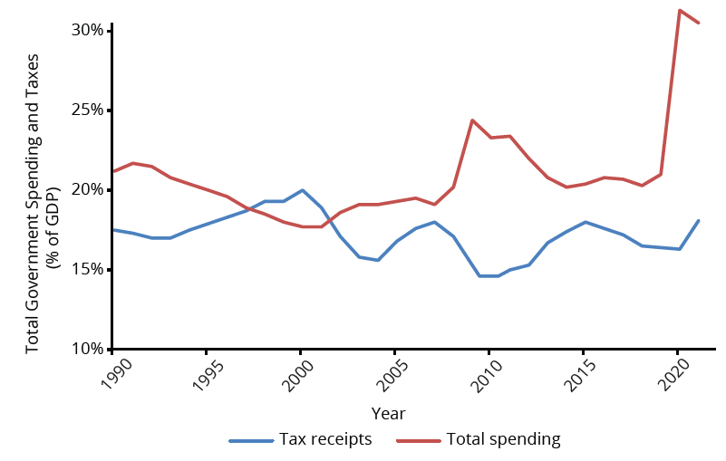
The Path from Deficits to Surpluses to Deficits
Why did the budget deficits suddenly turn to surpluses from 1998 to 2001, and why did the surpluses return to deficits in 2002? Why did the deficit become so large after 2007 and 2020? The following figure suggests some answers:
Notes:
Why did the budget deficits suddenly turn to surpluses from 1998 to 2001, and why did the surpluses return to deficits in 2002? Why did the deficit become so large after 2007? The following figure suggests some answers:

Slide 10
The Path from Deficits to Surpluses to Deficits
Government spending as a share of GDP declined steadily through the 1990s as a result of the decrease in spending on national defense and the lowering of interest rates by the federal government.
Federal tax collections increased substantially in the late 1990s, jumping from 18.1% of GDP in 1994 to 20.8% in 2000; powerful economic growth in the late 1990s fueled the boom in taxes.
At the same time, government spending on transfer payments—such as unemployment benefits, foods stamps, and welfare—declined with more people working.
In the 2000s, recessions in 2001 and 2008 led to lower tax revenues and tax cuts.
Starting in 2010, the first of the baby boomer generation started to retire.
Notes:
Government spending as a share of GDP declined steadily through the 1990s as a result of the decrease in spending on national defense and the lowering of interest rates by the federal Government spending as a share of GDP declined steadily through the 1990s as a result of the decrease in spending on national defense and the lowering of interest rates by the federal government. Federal tax collections increased substantially in the late 1990s, jumping from 18.1% of GDP in 1994 to 20.8% in 2000; powerful economic growth in the late 1990s fueled the boom in taxes. At the same time, government spending on transfer payments—such as unemployment benefits, foods stamps, and welfare—declined with more people working. In the 2000s, recessions in 2001 and 2008 led to lower tax revenues and tax cuts. Starting in 2010, the first of the baby boomer generation started to retire.

Slide 11
Summary
For most of the twentieth century, the U.S. government took on debt during wartime and then paid down that debt slowly in peacetime.
However, it took on quite substantial debts in peacetime in the 1980s and early '90s, had a brief period of budget surpluses from 1998 to 2001, then returned to annual budget deficits since 2002, with very large deficits in the recession of 2008 and 2009 and in the COVID-19 recession.
A budget deficit or budget surplus is measured annually.
Total government debt or national debt is the sum of budget deficits and budget surpluses over time.

Slide 12




HAWKES LEARNING

