Slide 1
HAWKES LEARNING
Automatic Stabilizers

Slide 2
Introduction
Federal fiscal policy includes discretionary fiscal policy, when the government passes a law that explicitly changes tax or spending levels.
Changes in tax and spending levels can also occur automatically due to automatic stabilizers.
Automatic stabilizers are programs that are already laws that stimulate aggregate demand (AD) in a recession and hold down AD in a potentially inflationary boom, like unemployment insurance or food stamps.
Notes:
Federal fiscal policy includes discretionary fiscal policy, when the government passes a law that explicitly changes tax or spending levels. Changes in tax and spending levels can also occur automatically due to automatic stabilizers. Automatic stabilizers are programs that are already laws that stimulate aggregate demand (AD) in a recession and hold down AD in a potentially inflationary boom, like unemployment insurance or food stamps.

Slide 3
Counterbalancing an Economic Boom
AD can rise sharply, causing the equilibrium to occur at an output level above potential GDP, causing inflationary pressures.
The policy prescription in this setting would be a dose of contractionary fiscal policy, implemented through some combination of higher taxes and lower spending.
To some extent, both changes happen automatically.
On the tax side, a rise in AD means that workers and firms earn more, increasing tax payments.
On the spending side, a rise in AD means lower unemployment and fewer layoffs, meaning there will be a less need for unemployment benefits, welfare, and other programs in the social safety net.
HAWKES LEARNING
Notes:
AD can rise sharply, causing the equilibrium to occur at an output level above potential GDP, causing inflationary pressures. The policy prescription in this setting would be a dose of contractionary fiscal policy, implemented through some combination of higher taxes and lower spending. To some extent, both changes happen automatically. On the tax side, a rise in AD means that workers and firms earn more, increasing tax payments. On the spending side, a rise in AD means lower unemployment and fewer layoffs, meaning there will be a less need for unemployment benefits, welfare, and other programs in the social safety net.

Slide 4
Counterbalancing a Recession
If AD were to fall sharply so that a recession occurs, the prescription would be for expansionary fiscal policy: some mix of tax cuts and spending increases.
Higher unemployment and a weaker economy overall would cause the government to increase spending on social safety net programs.
For example, in 2009 and 2020, the stimulus packages included extensions in the time allowed to collect unemployment insurance.
The automatic stabilizers react to a weakening of AD with expansionary fiscal policy and a strengthening of aggregate demand with contractionary fiscal policy, just as the AD/AS analysis suggests.
HAWKES LEARNING
Notes:
If AD were to fall sharply so that a recession occurs, the prescription would be for expansionary fiscal policy: some mix of tax cuts and spending increases. Higher unemployment and a weaker economy overall would cause the government to increase spending on social safety net programs. For example, in 2009 and 2020, the stimulus packages included extensions in the time allowed to collect unemployment insurance. The automatic stabilizers react to a weakening of AD with expansionary fiscal policy and a strengthening of aggregate demand with contractionary fiscal policy, just as the AD/AS analysis suggests.

Slide 5
The Cyclically Adjusted Budget Deficit or Surplus
Each year, the nonpartisan Congressional Budget Office calculates the cyclically adjusted budget (or the standardized employment budget).
This budget is what the budget deficit or surplus would be if the economy were producing at potential GDP.
At potential GDP, people who look for work find jobs in a reasonable period of time, and businesses make normal profits, with the result that both workers and businesses earn more and pay more taxes.
In effect, the cyclically adjusted budget deficit eliminates the impact of the automatic stabilizers.
HAWKES LEARNING
Notes:
Each year, the nonpartisan Congressional Budget Office calculates the cyclically adjusted budget (or the standardized employment budget). This budget is what the budget deficit or surplus would be if the economy were producing at potential GDP. At potential GDP, people who look for work find jobs in a reasonable period of time, and businesses make normal profits, with the result that both workers and businesses earn more and pay more taxes. In effect, the cyclically adjusted budget deficit eliminates the impact of the automatic stabilizers.

Slide 6
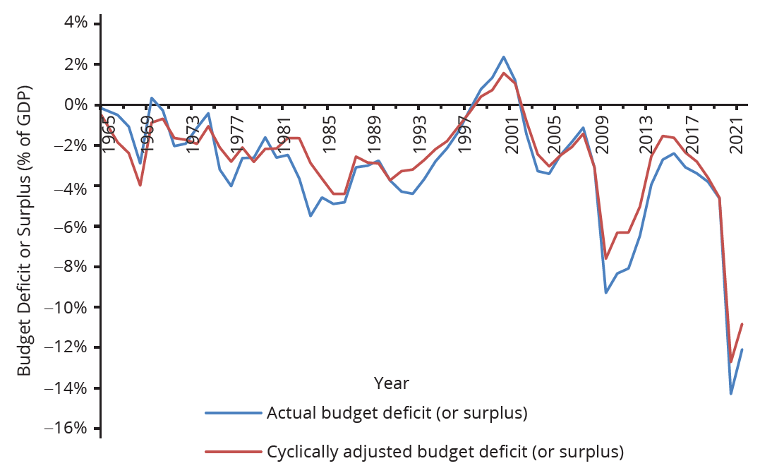
The Cyclically Adjusted Budget Deficit or Surplus
When the economy is in recession, the cyclically adjusted budget deficit is less than the actual budget deficit because the economy is below potential GDP, and the automatic stabilizers are reducing taxes and increasing spending. When the economy is performing extremely well, the cyclically adjusted budget deficit (or surplus) is higher than the actual budget deficit (or surplus) because the economy is producing around potential GDP, so the automatic stabilizers are increasing taxes and reducing the need for government spending.
HAWKES LEARNING
Notes:
When the economy is in recession, the cyclically adjusted budget deficit is less than the actual budget deficit because the economy is below potential GDP, and the automatic stabilizers are reducing taxes and increasing spending. When the economy is performing extremely well, the cyclically adjusted budget deficit (or surplus) is higher than the actual budget deficit (or surplus) because the economy is producing around potential GDP, so the automatic stabilizers are increasing taxes and reducing the need for government spending.

Slide 7
The Cyclically Adjusted Budget Deficit or Surplus
In recession years, like the early 1990s, 2001, 2009, or 2020, the cyclically adjusted budget deficit is smaller than the actual deficit.
During recessions, the automatic stabilizers tend to increase the budget deficit, so if the economy was instead at full employment, the deficit would be reduced by cutting taxes or increasing government spending.
In the late 1990s, the cyclically adjusted budget surplus was lower than the actual budget surplus.
The gap between the cyclically adjusted budget deficit or surplus and the actual budget deficit or surplus shows the impact of the automatic stabilizers.
HAWKES LEARNING
Notes:
In recession years, like the early 1990s, 2001, 2009, or 2020, the cyclically adjusted budget deficit is smaller than the actual deficit. During recessions, the automatic stabilizers tend to increase the budget deficit, so if the economy was instead at full employment, the deficit would be reduced by cutting taxes or increasing government spending. In the late 1990s, the cyclically adjusted budget surplus was lower than the actual budget surplus. The gap between the cyclically adjusted budget deficit or surplus and the actual budget deficit or surplus shows the impact of the automatic stabilizers.

Slide 8
Automatic Stabilizers
Automatic stabilizers occur quickly.
Lower wages mean that a lower amount of taxes is withheld from paychecks right away.
Higher unemployment or poverty means that government spending in those areas rises as quickly as people apply for benefits.
However, while the automatic stabilizers offset some shifts in aggregate demand, they do not offset all or even most of them.
Automatic stabilizers, like shock absorbers in a car, can be useful if they reduce the impact of the worst bumps, even if they do not eliminate the bumps altogether.
HAWKES LEARNING
Notes:
Automatic stabilizers occur quickly. Lower wages mean that a lower amount of taxes is withheld from paychecks right away. Higher unemployment or poverty means that government spending in those areas rises as quickly as people apply for benefits. However, while the automatic stabilizers offset some shifts in aggregate demand, they do not offset all or even most of them. Automatic stabilizers, like shock absorbers in a car, can be useful if they reduce the impact of the worst bumps, even if they do not eliminate the bumps altogether.

Slide 9

On Your Own
Chances are you will be or are currently paying taxes. How do you feel knowing that your tax contributions will increase during times of recession? Are you happy to help aid the country in this way or do you find it frustrating?
HAWKES LEARNING
Notes:
Chances are you will be or are currently paying taxes. How do you feel knowing that your tax contributions will increase during times of recession? Are you happy to help aid the country in this way or do you find it frustrating?

Slide 10
Summary
Fiscal policy is conducted through discretionary fiscal policy, which is when the government enacts taxation or spending changes in response to economic events, or through automatic stabilizers, which are taxing and spending mechanisms that shift in response to economic events without any further legislation.
The cyclically adjusted budget is the calculation of what the budget deficit or budget surplus would have been in a given year if the economy had been producing at its potential GDP.
Many economists and politicians criticize the use of fiscal policy for a variety of reasons, including concerns over time lags, the impact on interest rates, and fiscal policy's inherently political nature.

Slide 11




HAWKES LEARNING

