Slide 1
HAWKES LEARNING
Practical Problems with Discretionary Fiscal Policy

Slide 2
Introduction
In the early 1960s, many economists believed that the problem of the business cycle, unemployment, and inflation were all but solved.
The U.S. economy faced several significant recessions in the 1960s, ‘70s, and ‘80s, showing that the problems of macroeconomic policy were not entirely solved.
As economists began to explore these problems, they identified several issues that make discretionary fiscal policy more difficult than previously believed during the optimism of the 1960s.
Notes:
In the early 1960s, many economists believed that the problem of the business cycle, unemployment, and inflation were all but solved. The U.S. economy faced several significant recessions in the 1960s, 70s, and 80s, showing that the problems of macroeconomic policy were not entirely solved. As economists began to explore these problems, they identified several issues that make discretionary fiscal policy more difficult than previously believed during the optimism of the 1960s.

Slide 3
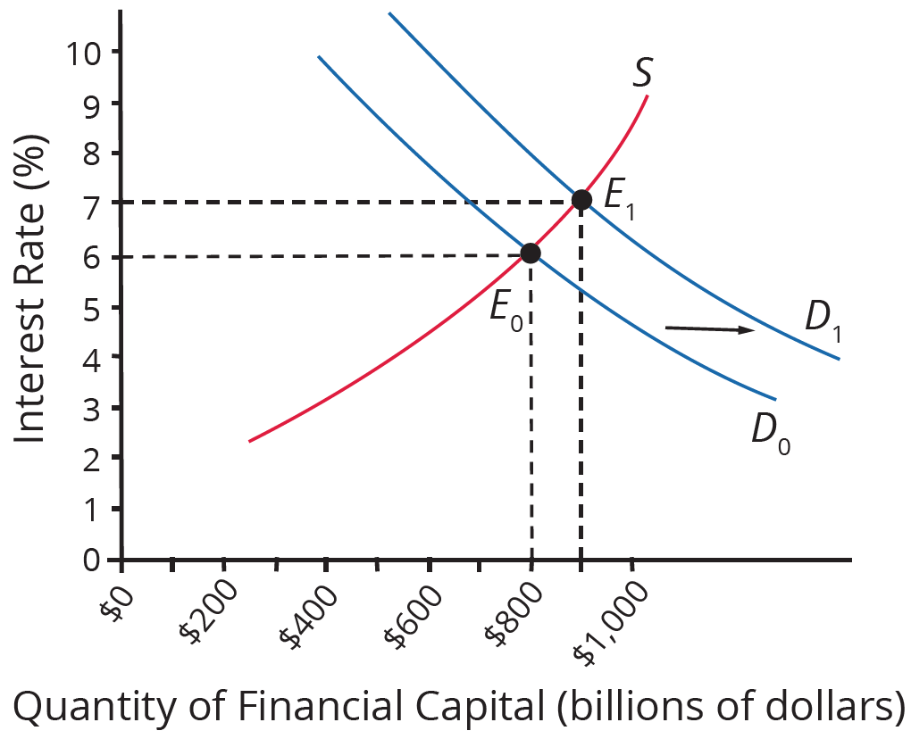
Fiscal Policy and Interest Rates
Fiscal policy affects both aggregate demand and interest rates.
An increase in government budget deficits shifts the demand for financial capital rightward.
An increase in budget deficits by 1% of GDP will cause an increase of roughly 0.5% to 1% in the interest rate.
Notes:
Fiscal policy affects both aggregate demand and interest rates. An increase in government budget deficits shifts the demand for financial capital rightward. An increase in budget deficits by 1% of GDP will cause an increase of roughly ½% to 1% in the interest rate.

Slide 4
Fiscal Policy and Interest Rates
Expansionary fiscal policy, through tax cuts and increased government spending, is intended to increase aggregate demand.
If expansionary fiscal policy also increases interest rates, firms and households are discouraged from borrowing and spending, which reduces aggregate demand.
Even if the effect of expansionary fiscal policy is not completely offset, fiscal policy can still end up less powerful than was originally expected; We refer to this as crowding out.
If expansionary fiscal policy is to work as intended, the government must coordinate fiscal and monetary policy.
Notes:
Expansionary fiscal policy, through tax cuts and increased government spending, is intended to increase aggregate demand. If expansionary fiscal policy also increases interest rates, firms and households are discouraged from borrowing and spending, which reduces aggregate demand. Even if the effect of expansionary fiscal policy is not completely offset, fiscal policy can still end up less powerful than was originally expected. We refer to this as crowding out. If expansionary fiscal policy is to work as intended, the government must coordinate fiscal and monetary policy.

Slide 5
Long and Variable Time Lags
The government can change monetary policy multiple times a year, but it takes a substantially longer time to enact fiscal policy.
Recognition Lag: time it takes to determine that a recession has occurred
Legislative Lag: time it takes to pass a bill
Implementation Lag: time it takes to start projects after a bill is passed
HAWKES LEARNING
Notes:
The government can change monetary policy multiple times a year, but it takes a substantially longer time to enact fiscal policy.
Recognition Lag: time it takes to determine that a recession has occurred
Legislative Lag: time it takes to pass a bill
Implementation Lag: time it takes to start projects after a bill is passed

Slide 6
Temporary and Permanent Fiscal Policy
A temporary tax cut or spending increase will last only for a year or two and then revert to its original level.
A permanent tax cut or spending increase is expected to stay in place for the foreseeable future.
The appropriate policy may be an expansionary fiscal policy with large budget deficits during a recession and a contractionary fiscal policy with budget surpluses when the economy is growing.
If both policies are explicitly temporary, they will have a less powerful effect than a permanent policy.
Notes:
A temporary tax cut or spending increase will last only for a year or two and then revert to its original level. A permanent tax cut or spending increase is expected to stay in place for the foreseeable future. The appropriate policy may be an expansionary fiscal policy with large budget deficits during a recession and a contractionary fiscal policy with budget surpluses when the economy is growing. If both policies are explicitly temporary, they will have a less powerful effect than a permanent policy.

Slide 7

On Your Own
How would you react if the government announced a tax cut that would only last one year? What about if the government announced a permanent tax cut? Consider the different policies that were enacted during the COVID-19 pandemic to help ease the economic implications of the virus. Do you think the time frames of the policies had an impact on their effects?
Notes:
How would you react if the government announced a tax cut that would only last one year? What about if the government announced a permanent tax cut? Consider the different policies that were enacted during the COVID-19 pandemic to help ease the economic implications of the virus. Do you think the time frames of the policies had an impact on their effects?

Slide 8
Timespan of Economic Change
When an economy begins to recover from a recession, it does not immediately revert to its state from before the start of the recession.
The economy's internal structure has evolved and changed, and the process of recovery can take time.
Fiscal policy can increase demand, but the process of structural economic change—the expansion of a new set of industries and the movement of workers—inevitably takes a long time.
Notes:
When an economy begins to recover from a recession, it does not immediately revert to its state from before the start of the recession. The economy's internal structure has evolved and changed, and the process of recovery can take time. Fiscal policy can increase demand, but the process of structural economic change, the expansion of a new set of industries and the movement of workers, inevitably takes a long time.

Slide 9
The Limitations of Fiscal Policy
Fiscal policy can help an economy that is producing below its potential GDP to expand aggregate demand so that it produces closer to potential GDP, thus lowering unemployment.
However, fiscal policy cannot help an economy produce at an output level above potential GDP without causing inflation.
At this point, unemployment becomes so low that workers become scarce, and wages rise rapidly.
Notes:
Fiscal policy can help an economy that is producing below its potential GDP to expand aggregate demand so that it produces closer to potential GDP, thus lowering unemployment. However, fiscal policy cannot help an economy produce at an output level above potential GDP without causing inflation. At this point, unemployment becomes so low that workers become scarce, and wages rise rapidly.

Slide 10
Political Realties and Discretionary Fiscal Policy
It proves difficult to explain to politicians how countercyclical fiscal policy, that runs against the tide of the business cycle, should work.
Countercyclical policy says that an economic boom should be an appropriate time for keeping taxes high and restraining spending.
Politicians tend to prove less willing to hear the message that in good economic times, they should propose tax increases and spending limits.
From a political viewpoint, sometimes it simply just looks better to maintain a booming economic climate.
Notes:
It proves difficult to explain to politicians how countercyclical fiscal policy, that runs against the tide of the business cycle, should work. Countercyclical policy says that an economic boom should be an appropriate time for keeping taxes high and restraining spending. Politicians tend to prove less willing to hear the message that in good economic times, they should propose tax increases and spending limits. From a political viewpoint, sometimes it simply just looks better to maintain a booming economic climate.

Slide 11
Summary
Because fiscal policy affects the quantity of money the government borrows in financial capital markets, it affects not only AD but also interest rates.
If an expansionary fiscal policy also causes higher interest rates, firms and households are discouraged from borrowing and spending, reducing AD in a situation called crowding out.
Given the uncertainties over interest rate effects, time lags (implementation lag, legislative lag, and recognition lag), temporary and permanent policies, and unpredictable political behavior, many economists and knowledgeable policy makers have concluded that discretionary fiscal policy is a blunt instrument and better used only in extreme situations.

Slide 12




HAWKES LEARNING

