Slide 1
HAWKES LEARNING
Improving Countries' Standards of Living

Slide 2
Standard of Living
Jobs are created in economies that grow.
Economic growth is built on the foundation of productivity improvements.
Increases in productivity are the result of greater human and physical capital and technology, all interacting in a market-driven economy.
The CPI is subject to two types of bias: substitution bias and quality/new goods bias.
In the pursuit of modern economic growth, countries and regions start at different levels of GDP.
Both substitution bias and quality/new goods bias tend to overstate the negative impact of inflation on consumers.
HAWKES LEARNING
Notes:
Jobs are created in economies that grow. Economic growth is built on the foundation of productivity improvements. Increases in productivity are the result of greater human and physical capital and technology, all interacting in a market-driven economy. In the pursuit of modern economic growth, countries and regions start at different levels of GDP.

Slide 3
Growth Policies for High-Income Countries
The main challenge for economic growth in high-income countries is the push for a more educated workforce that can create, invest in, and apply new technologies.
The goal of growth-oriented public policy is to shift the aggregate supply curve to the right.
High-income countries recognize that growth is best maintained in a stable, market-oriented economic climate.
The CPI is subject to two types of bias: substitution bias and quality/new goods bias.
These countries use monetary policy to keep inflation low and stable and minimize the risk of exchange rate fluctuations, while also encouraging domestic and international competition.
Both substitution bias and quality/new goods bias tend to overstate the negative impact of inflation on consumers.
HAWKES LEARNING
Notes:
The main challenge for economic growth in high-income countries is the push for a more educated workforce that can create, invest in, and apply new technologies. The goal of growth-oriented public policy is to shift the aggregate supply curve to the right. High-income countries recognize that growth is best maintained in a stable, market-oriented economic climate. These countries use monetary policy to keep inflation low and stable and minimize the risk of exchange rate fluctuations, while also encouraging domestic and international competition.

Slide 4
Problems with Growth in High-Income Countries
Starting in 2008, many high-income countries were more focused on the short term than the long term.
The governments of some of these countries began running very large budget deficits as part of expansionary fiscal policy.
The central banks ran highly expansionary monetary policies, with near zero interest rates.
The CPI is subject to two types of bias: substitution bias and quality/new goods bias.
Though these policies did help the economies of these countries in the short term, the transition to a more long-term and sustainable focus has proven a difficult transition.
Both substitution bias and quality/new goods bias tend to overstate the negative impact of inflation on consumers.
HAWKES LEARNING
Notes:
Starting in 2008, many high-income countries were more focused on the short term than the long term. The governments of some of these countries began running very large budget deficits as part of expansionary fiscal policy. The central banks ran highly expansionary monetary policies, with near zero interest rates. Though these policies did help the economies of these countries in the short term, the transition to a more long-term and sustainable focus has proven a difficult transition.

Slide 5
The Four Asian Tigers
One of the world's recent economic success stories began with a group known as the Four Asian Tigers: South Korea, Singapore, Taiwan, and Hong Kong.
These economies maintained high growth rates and rapid export-led industrialization, which allowed them to converge with high-income countries.
The economic growth of the Tigers has averaged around 5.5% real per-capita growth for several decades.
The CPI is subject to two types of bias: substitution bias and quality/new goods bias.
Both substitution bias and quality/new goods bias tend to overstate the negative impact of inflation on consumers.
In the 1980s, countries like China and India began to show signs of convergence as well.
HAWKES LEARNING
Notes:
One of the world's recent economic success stories began with a group known as the Four Asian Tigers: South Korea, Singapore, Taiwan, and Hong Kong. These economies maintained high growth rates and rapid export-led industrialization, which allowed them to converge with high-income countries. The economic growth of the Tigers has averaged around 5.5% real per-capita growth for several decades. In the 1980s, countries like China and India began to show signs of convergence as well.

Slide 6
Growth Policies for Middle-Income Countries
The underlying causes of rapid growth rates have been higher savings and investment in physical capital, investments in human capital, investments in technology, and freedom for market forces.
China and the Tigers have been among some of the highest savers in the world, often saving one-third or more of GDP.
They had policies that supported investment in human capital, focusing on encouraging math and science education.
The CPI is subject to two types of bias: substitution bias and quality/new goods bias.
Middle-income countries have done well in dismantling legacies of government economic controls that hindered economic growth.
Both substitution bias and quality/new goods bias tend to overstate the negative impact of inflation on consumers.
HAWKES LEARNING
Notes:
The underlying causes of rapid growth rates have been higher savings and investment in physical capital, investments in human capital, investments in technology, and freedom for market forces. China and the Tigers have been among some of the highest savers in the world, often saving one-third or more of GDP. They had policies that supported investment in human capital, focusing on encouraging math and science education. Middle-income countries have done well in dismantling legacies of government economic controls that hindered economic growth.

Slide 7
Growth Policies for Low-Income Countries
Many low-income economies are located in sub-Saharan Africa, the former Soviet Bloc, and parts of Central and South America.
Macroeconomic policies for low-income economies are vastly different from those for high-income economies.
The World Bank has made it a priority to combat poverty and raise income levels in these countries, but political instability has proven a major obstacle.
The CPI is subject to two types of bias: substitution bias and quality/new goods bias.
People in these countries live on less than $710 a year, meaning money is immediately spent on necessities and that saving is often not an option.
Both substitution bias and quality/new goods bias tend to overstate the negative impact of inflation on consumers.
HAWKES LEARNING
Notes:
Many low-income economies are located in sub-Saharan Africa, the former Soviet Bloc, and parts of Central and South America. Macroeconomic policies for low-income economies are vastly different for those of high-income economies. The World Bank has made it a priority to combat poverty and raise income levels in these countries, but political instability has proven a major obstacle. People in these countries live on less than $710 a year, meaning money is immediately spent on necessities like food and that saving is often not an option.

Slide 8
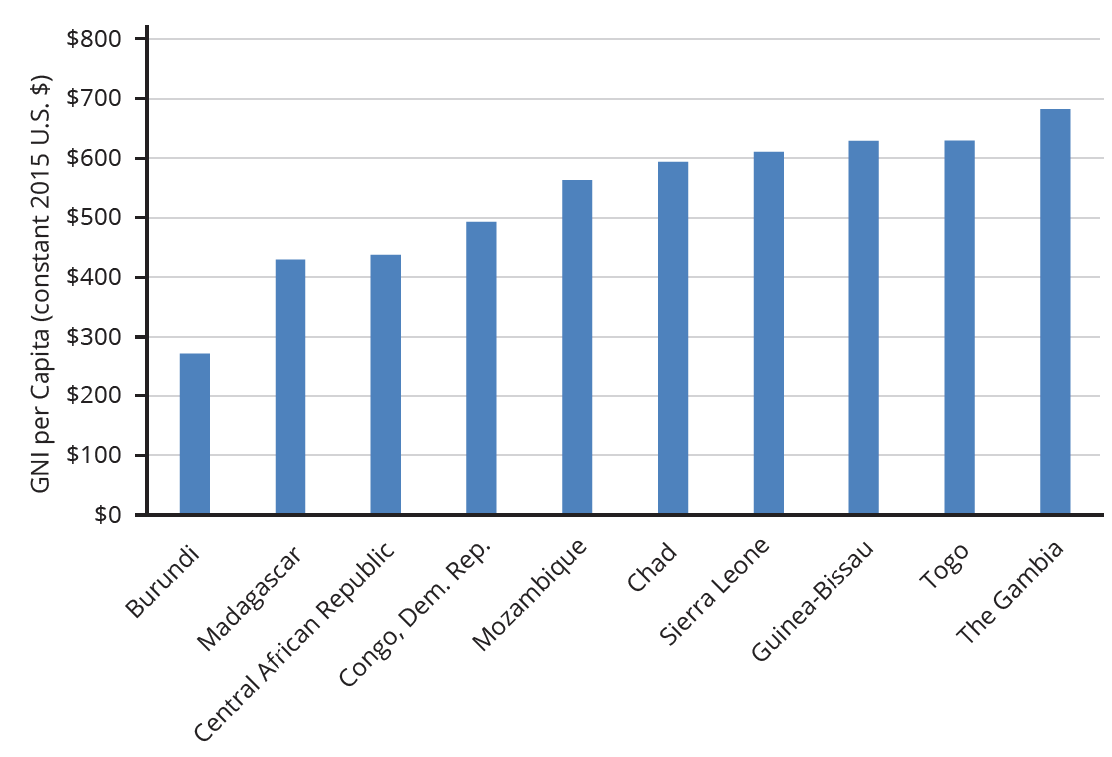
Growth Policies for Low-Income Countries
This bar chart shows the ten lowest-income countries in 2020 as measured by GNI per capita.
HAWKES LEARNING
Notes:
This bar chart shows the ten lowest-income countries in 2020 as measured by GNI per capita.

Slide 9
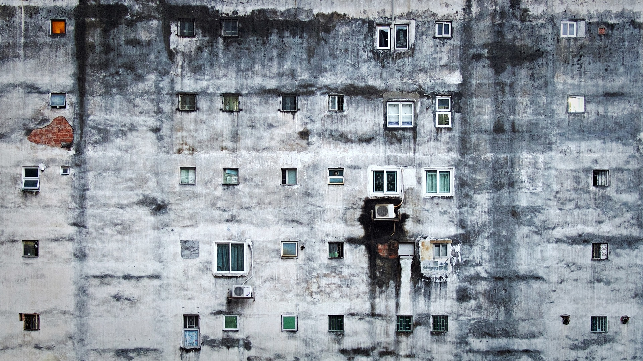
On Your Own
If you were working for the World Bank, how would you combat poverty and raise overall income levels? What pushback might your plans receive? How would you change your policies or respond to criticism?
HAWKES LEARNING
Notes:
If you were working for the World Bank, how would you combat poverty and raise overall income levels? What pushback might your plans receive? How would you change your policies or respond to criticism?

Slide 10
Summary
The fundamentals of economic growth are the same in every country: improvements in human capital, physical capital, and technology, all interacting in a market-oriented economy.
High-income countries tend to focus on developing and using new technology.
Middle-income countries tend to focus on increasing human capital and becoming more connected to technology and global markets.
Low-income and/or economically challenged countries have many health and human development needs and often struggle with political instability.
HAWKES LEARNING

Slide 11




HAWKES LEARNING

