Slide 1
HAWKES LEARNING
Order of Operations
Principles of Economics
Notes:
Hi everyone. Today we are going to talk about the order of operations.

Slide 2

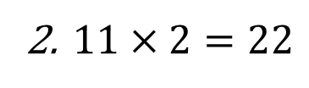
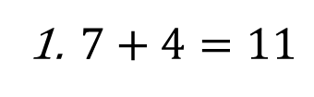
Introduction
What is $7+4×2$?
It is incorrect to simply work left to right as follows:
$7+4=11$
$11×2=22$
The order of operations is the set of rules that determine the order in which mathematical operations are performed.
Notes:
To introduce this topic, let’s look at a simple algebraic expression: 7 plus 4 times 2. It turns out that it is incorrect simply to work through the expression starting at the left and working to the right as though you were reading the expression. If you did this, the first part of the expression, 7 plus 4, would give you 11. Then, if you took 11 and multiplied it by 2, you would end up with 22. We need to understand the order of operations, which is the set of rules that determine the order in which mathematical operations are performed, in order to get the correct answer to this expression.

Slide 3

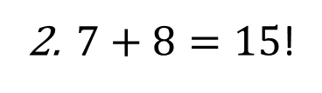
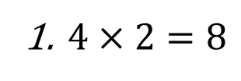
Introduction cont’d
Correct Calculation
What is $7+4×2$?
$4×2=8$
$7+8=15$!
Notes:
So, what is the correct order in which to work through this expression? It turns out the multiplication has precedence over addition, so we actually multiply 4 by 2 first to replace those numbers with an 8. Then, we add 7 and 8 to get 15.

Slide 4
Rules for Order of Operations
Simplify within grouping symbols, starting from the innermost grouping outward
Grouping symbols are parentheses ( ) or brackets [ ]
Evaluate any exponents
Moving from left to right, perform any multiplication or division in the order they appear
Moving from left to right, perform any addition or subtraction in the order they appear
Notes:
Here are the four rules that determine the order of operations. First, you have to simplify within grouping symbols, starting from the innermost grouping outward (in case you have nested groupings). As a reminder, grouping symbols are parentheses or brackets. Second, you have to evaluate any exponents. Third, moving from left to right, perform any multiplication or division in the order they appear. Finally, again moving from left to right, perform and addition or subtraction in the order they appear.

Slide 5
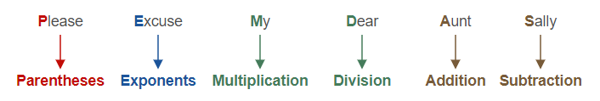
Rules for Order of Operations cont’d
Mnemonic: PEMDAS
Notes:
Here is a mnemonic that might help you remember the order of operations. It is PEMDAS, which is short for “Please excuse my dear Aunt Sally.” Notice that the P in “please” stands for parentheses. The E in “excuse” stands for exponents. The M in “my” stands for multiplication. The D in “dear” stands for division. The A in “Aunt” stands for addition. And finally, the S in “Sally” stands for subtraction.

Slide 6
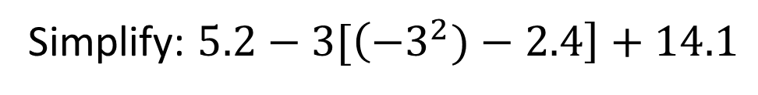
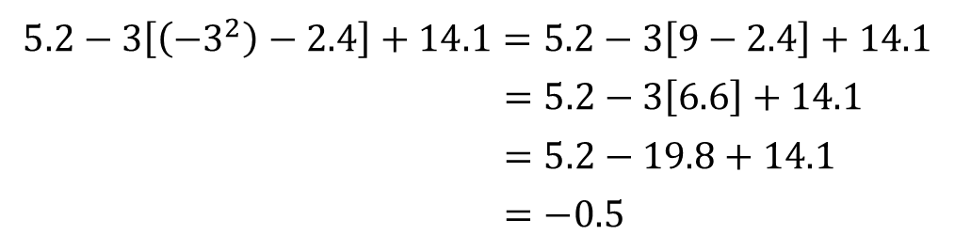
Example
Simplify: $5.2−3[\left({−3}^{2})−2.4\right]+14.1$
Solution:
$$5.2−3\left[\left({−3}^{2}\right)−2.4\right]+14.1=5.2−3\left[9−2.4\right]+14.1$$
$=5.2−3\left[6.6\right]+14.1$
$=5.2−19.8+14.1$
$=−0.5$
Exponents
Subtract within parentheses
Multiply
Add and subtract
Notes:
Now, let’s work through an example. It’s a somewhat complicated expression, but let’s go through our steps. First, we are supposed to simplify within grouping symbols, so we look inside the set of parentheses and start by evaluating the exponent negative 3 raised to the second power. Then, we subtract 2.4 from 9, which finishes our evaluation with the parentheses, leaving 6.6 within the parentheses. The next order of operations is multiplication and/or division, so we evaluate 3 times 6.6, which gives us 19.9. The final step is to perform addition and subtraction, moving from left to right, and when we have finished that, we get the answer to the expression, which is negative 0.5.

Slide 7


Using a Calculator
Some calculators are programmed to follow the rules for order of operations.
Check your calculator: what is $7+4×2$?
If your calculator shows 15, then your calculator is programmed to follow the order of operations properly.
If your calculator shows 22, then you need to enter numbers carefully to insure the proper order of operations.
Some calculators have parentheses ( ) or brackets [ ] to help.
Notes:
Now, many of you probably will use a calculator to figure out mathematical expressions, especially if you have bigger numbers or decimals in an expression. So, it turns out that many calculators are actually programmed to follow the order of operations automatically, in which case you would not have to worry about them yourself. To check to see if your calculator is programmed to following the order of operations, simply evaluate the expression from the beginning of the lesson: 7 plus 4 times 2. If your calculator shows 15, then your calculator is programmed for the order of operations, and you can use it entering expressions from left to right without having to worry. If your calculator shows 22, then it is not programmed to follow the order of operations, and you have to make sure that you evaluate your expression following the proper rules. Many calculators have parentheses or bracket keys, which can help you make sure you enter the operations in the proper order. Good luck!

Slide 8




HAWKES LEARNING

