Slide 1
HAWKES LEARNING
Linear Equations
Principles of Economics
Notes:
Linear Equations. By the end of this lesson, you will be able to solve various equations involving fractions, decimals, and parentheses and calculate multiple variables with substitution.

Slide 2

Simplify
Linear Equations
$$ax+b=cd+d$$
Notes:
To solve linear equations of the most general form, ax + b = cx + d, the objective is to get the variable on one side of the equation by itself with a coefficient of positive one.

Slide 3
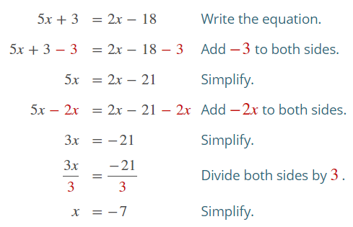
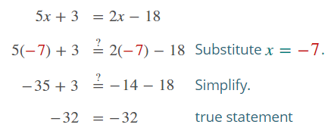
Simplify cont’d
Notes:
To solve for the value of x in 5x + 3 = 2x – 18, we must add -3 to both sides, simplify, then add negative 2x to both sides, simplify, divide both sides by 3, then simplify to find that x is equal to -7. We can double check and plug in -7 in the original equation and find that both sides equal -32. That procedure is similar for decimals.

Slide 4
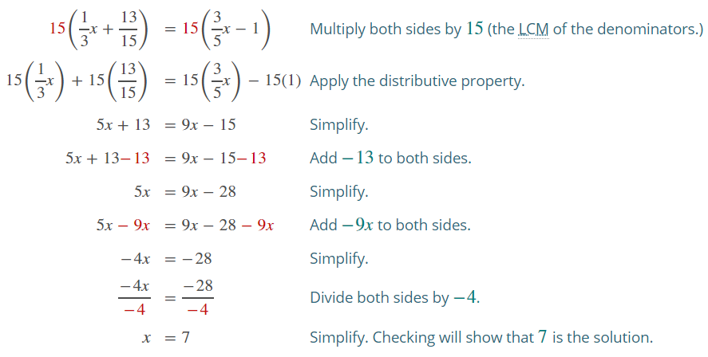
Fractions
Notes:
For fractions, the procedure is similar, but there is an extra step to make the fractions more manageable. In this case, multiply both sides by 15, the least common multiple of the denominator. Then, apply the distributive property, simplify, then add -13 to both sides. Simplify and add -9x to both sides. Simplify and divide both sides by -4, making x equal 7.

Slide 5
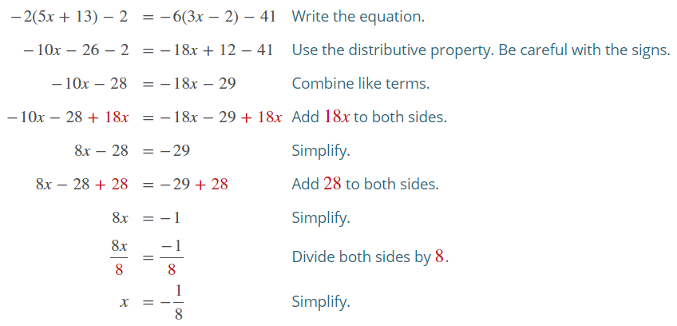
Parentheses
Notes:
When parentheses are involved, we must use the distributive property and be aware of the signs. Combine like terms and add 18x to both sides. Simplify and add 28 to both sides. Simplify and divide both sides by 8. Simplify to find the value of x is -1/8.

Slide 6
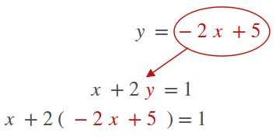
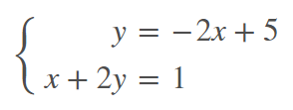
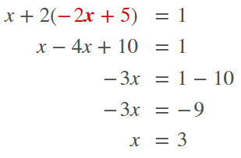
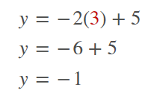
Multiple Variables: Substitution
1.
2.
3.
4.
Notes:
When equations have multiple variables, we must use substitution to calculate the value of both variables. For example, y= -2x + 5 and x + 2y = 1. The first equation is already solved for y, so we can plug it into the second equation, making the equation x + 2 times -2x + 5 in parentheses equals 1. With the distributive property to open up the parentheses, we are able to simplify and find that x equals 3. We can then plug in 3 into the y equation to find the value of y is -1. Now, you are able solve various equations involving fractions, decimals, and parentheses and calculate multiple variables with substitution.

Slide 7




HAWKES LEARNING

