Slide 1
HAWKES LEARNING
Economic Theories, Models, and Systems
Principles of Economics
Notes:
Economists see the world differently than others. They go behind the scenes and beneath the surface to find out why people make the choices we make.

Slide 2
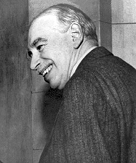
Introduction
One of the most influential economists in modern times was John Maynard Keynes. He famously wrote, “[Economics] is a method rather than a doctrine, an apparatus of the mind, a technique of thinking, which helps its possessor to draw correct conclusions.”
Notes:
One of the most influential economists in modern times was John Maynard Keynes. He famously wrote, “[Economics] is a method rather than a doctrine, an apparatus of the mind, a technique of thinking, which helps its possessor to draw correct conclusions.”

Slide 3
Thinking Like Economists
A theory is a simplified representation of how two or more variables interact with each other.
The purpose of a theory is to take a complex, real-world issue and simplify it down to its essentials.
A theory is a more abstract representation, while a model is a more applied or empirical representation.
We use models to test theories, but for this course we will use the terms interchangeably.
Notes:
A theory is a simplified representation of how two or more variables interact with each other. The purpose of a theory is to take a complex, real-world issue and simplify it down to its essentials. A theory is a more abstract representation, while a model is a more applied or empirical representation. We use models to test theories, but for this course we will use the terms interchangeably.

Slide 4
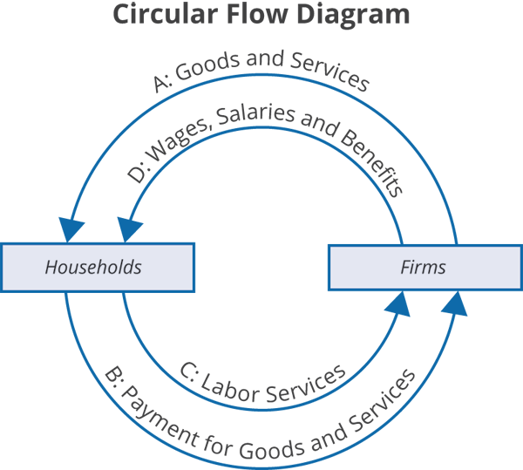
Circular Flow Diagram
Notes:
A good economic model to start with is the Circular Flow Diagram. This model describes how a large economy like the U.S. works between two groups – households and firms – to produce $20 trillion in goods and services each year.
The two groups are represented in small boxes, and the arrows describe the direction that economic activity flows. At the Top in “A”, Firms sell Goods and Services to Households, which then pay the firms in “B” at the bottom.
To make all the Goods and Services, Firms rely on Households to provide labor, noted as C, and the Firms, in turn, pay for those Factors of Production with the “Wages, Salaries and Benefits” shown in “D”.
This simple model describes both our theory of how Markets work and can be used to show how money moves through the economy. When you buy groceries or get a hair cut for $20, you receive these Goods and Services (A) and then pay for them in “B”. But to get those groceries or hair cut, someone had to offer their Labor Services (C) to the firms… and the firms had to pay them Wages (in “D”) to get you what you need.

Slide 5
Economic Systems
There are at least three ways that societies organize an economy.
Traditional economies organize their economic affairs the way they have always done (i.e. according to tradition).
In a command economy, economic effort is devoted to goals passed down from a ruler or ruling class.
In a market economy, decision-making is decentralized.
Notes:
There are at least three ways that societies organize an economy. Traditional economies organize their economic affairs the way they have always done (i.e. according to tradition). In a command economy, economic effort is devoted to goals passed down from a ruler or ruling class. In a market economy, decision-making is decentralized.

Slide 6


Traditional Economies
Traditional economies are the oldest economic system and are used in parts of Asia, Africa, and South America.
In traditional economies, occupations stay in the family, and most families are farmers who grow the crops using traditional methods.
Because tradition drives the way of life, there is little economic progress or development.
Notes:
Traditional economies are the oldest economic system and are used in parts of Asia, Africa, and South America. In traditional economies, occupations stay in the family, and most families are farmers who grow the crops using traditional methods. Because tradition drives the way of life, there is little economic progress or development.

Slide 7

Command Economies
In a command economy, economic effort is devoted to goals passed down from a ruler or ruling class.
Ancient Egypt was a good example: a large part of economic life was devoted to building pyramids.
In a command economy, the government decides what goods and services will be produced and what prices it will charge for them.
Notes:
In a command economy, economic effort is devoted to goals passed down from a ruler or ruling class. Ancient Egypt was a good example: a large part of economic life was devoted to building pyramids. In a command economy, the government decides what goods and services will be produced and what prices it will charge for them.

Slide 8
Market Economies
Although command economies have a very centralized structure for economic decisions, market economies are very decentralized.
A market is an institution that brings together buyers and sellers of goods or services, who may be either individuals or businesses.
The New York Stock Exchange is a prime example of a market which brings buyers and sellers together.
Market economies are based on private enterprise: private individuals own and operate the means of production (resources and businesses). Businesses supply goods and services based on demand.
Notes:
Although command economies have a very centralized structure for economic decisions, market economies are very decentralized. A market is an institution that brings together buyers and sellers of goods or services, who may be either individuals or businesses. The New York Stock Exchange is a prime example of a market which brings buyers and sellers together. Market economies are based on private enterprise: private individuals own and operate the means of production (resources and businesses). Businesses supply goods and services based on demand.

Slide 9
On Your Own
Suppose you are creating a new smartphone app. Your idea is to set up the parameters for a new society in which players can create, build, conquer, sell, and make purchases. Would you set up the new society to be a traditional economy, a command economy, or a market-oriented economy? Why? Which type do you think would make the most enjoyable game?
HAWKES LEARNING
Notes:
Suppose you are creating a new smartphone app. Your idea is to set up the parameters for a new society in which players can create, build, conquer, sell, and make purchases. Would you set up the new society to be a traditional economy, a command economy, or a market-oriented economy? Why? Which type do you think would make the most enjoyable game?

Slide 10
Mixed Economies
Most economies in the real world are mixed; they combine elements of command and market (and even traditional) systems.
The U.S. economy is positioned toward the market-oriented end of the spectrum.
Many countries in Europe and Latin America, while primarily market-oriented, have a greater degree of government involvement in economic decisions than the U.S. economy.
China and Russia, while over the past several decades have moved more in the direction of having a market-oriented system, remain closer to the command economy end of the spectrum.
Notes:
Most economies in the real world are mixed; they combine elements of command and market (and even traditional) systems. The U.S. economy is positioned toward the market-oriented end of the spectrum. Many countries in Europe and Latin America, while primarily market-oriented, have a greater degree of government involvement in economic decisions than the U.S. economy. China and Russia, while over the past several decades have moved more in the direction of having a market-oriented system, remain closer to the command economy end of the spectrum.

Slide 11
Regulations
Markets and government regulations are always entangled.
There is no such thing as an absolutely free market.
Regulations define the "rules of the game" in the economy.
The degree of regulation increases from economies that are primarily market-oriented to those that are primarily command-oriented.
Notes:
Markets and government regulations are always entangled. There is no such thing as an absolutely free market. Regulations define the "rules of the game" in the economy. The degree of regulation increases from economies that are primarily market-oriented to those that are primarily command-oriented.

Slide 12

Globalization
Globalization is the trend in which buying and selling in markets have increasingly crossed national borders.
Improvements in shipping and innovations in computing and telecommunications have contributed to globalization.
Notes:
Globalization is the trend in which buying and selling in markets have increasingly crossed national borders. Improvements in shipping and innovations in computing and telecommunications have contributed to globalization.

Slide 13
Trade
Exports are the goods and services that are produced domestically and sold abroad.
Imports are the goods and services that are produced abroad and then sold domestically.
Gross domestic product (GDP) measures the size of total production in an economy.
Thus, the ratio of exports divided by GDP measures what share of a country's total economic production is sold in other countries.
Notes:
Exports are the goods and services that are produced domestically and sold abroad. Imports are the goods and services that are produced abroad and then sold domestically. Gross domestic product (GDP) measures the size of total production in an economy. Thus, the ratio of exports divided by GDP measures what share of a country's total economic production is sold in other countries.

Slide 14
Summary
Economists analyze problems differently than other disciplinary experts do.
The main tools economists use are economic theories or models.
We can organize societies as traditional, command, or market-oriented economies.
The last few decades have seen globalization evolve as a result of growth in commercial and financial networks that cross national borders, making businesses and workers from different economies increasingly interdependent.
HAWKES LEARNING

Slide 15




HAWKES LEARNING

