Slide 1
HAWKES LEARNING
Drawing the Poverty Line
Principles of Economics
Notes:
By the end of this lesson, you will be able to explain economic inequality, explain how the poverty line is determined, and analyze the U.S. poverty rate over time.

Slide 2
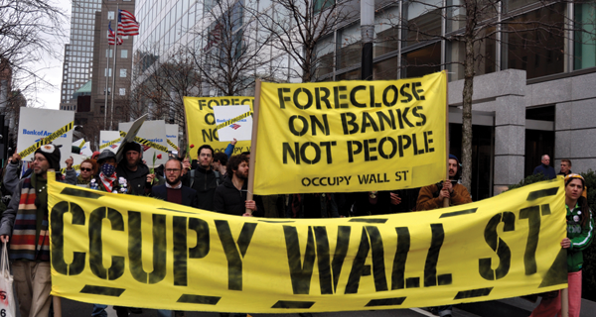
Public Goods
On September 17, 2011, Occupy Wall Street began in New York City's Wall Street financial district. Protesters argued that the concentration of wealth among the richest 1% in the United States was both economically unsustainable and inequitable, and it needed to be changed.
Notes:
On September 17, 2011, Occupy Wall Street began in New York City's Wall Street financial district. Protesters argued that the concentration of wealth among the richest 1% in the United States was both economically unsustainable and inequitable, and it needed to be changed.

Slide 3
Poverty and Economic Inequality
Comparisons of high and low incomes raise two different issues: economic inequality and poverty.
Poverty refers to the situation of an individual being below a certain level of income they need for a basic standard of living.
The poverty line is the level of income needed for a basic standard of living.
Income inequality compares the share of the total income (or wealth) in society that different groups receive.
Notes:
Comparisons of high and low incomes raise two different issues: economic inequality and poverty. Poverty refers to the situation of an individual being below a certain level of income they need for a basic standard of living. The poverty line is the level of income needed for a basic standard of living. Income inequality compares the share of the total income (or wealth) in society that different groups receive.

Slide 4
Mollie Orshansky
In the United States, the official definition of the poverty line traces back to Mollie Orshansky.
In 1963, Orshansky published an article called "Children of the Poor" in the Social Security Bulletin.
Orshansky found that the average family spent one-third of its income on food.
She then proposed that the poverty line be the amount required to buy an adequate diet, given the size of the family, multiplied by three.
Notes:
In the United States, the official definition of the poverty line traces back to Mollie Orshansky. In 1963, Orshansky published an article called "Children of the Poor" in the Social Security Bulletin. Orshansky found that the average family spent one-third of its income on food. She then proposed that the poverty line be the amount required to buy an adequate diet, given the size of the family, multiplied by three.

Slide 5
Poverty Rate
The poverty rate is the percentage of the population below the poverty line in any given year.
Poverty rates are relatively low for whites, the elderly, the well-educated, and male-headed households.
Poverty rates for females, Hispanics, and African Americans are much higher.
While other races have a higher percentage of individuals living in poverty, most people in the U.S. living in poverty are white.
Notes:
The poverty rate is the percentage of the population below the poverty line in any given year. Poverty rates are relatively low for whites, the elderly, the well-educated, and male-headed households. Poverty rates for females, Hispanics, and African Americans are much higher than for whites. While other races have a higher percentage of individuals living in poverty, most people in the U.S. living in poverty are white.

Slide 6
On Your Own
A country's population is 800 million, and 250 million are below the poverty line.
What is the poverty rate? Express your answer as a percentage.
HAWKES LEARNING
Notes:
A country's population is 800 million, and 250 million are below the poverty line.
What is the poverty rate? Express your answer as a percentage.

Slide 7
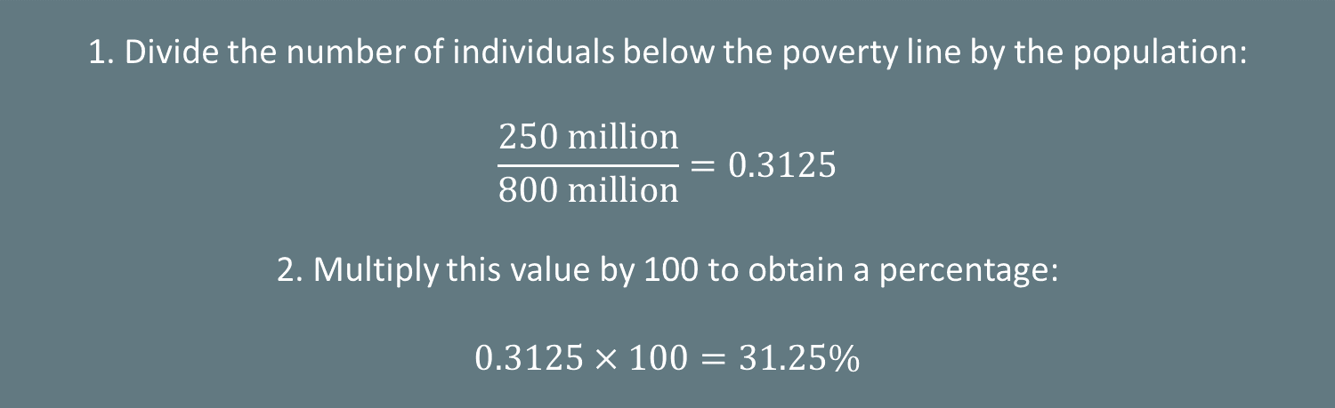
On Your Own
A country's population is 800 million, and 250 million are below the poverty line.
What is the poverty rate? Express your answer as a percentage.
1. Divide the number of individuals below the poverty line by the population:
$$\frac{250 million}{800 million}=0.3125$$
2. Multiply this value by 100 to obtain a percentage:
$$0.3125×100=31.25\%$$
Notes:
1. Divide the number of individuals below the poverty line by the population:
250/800=0.3125
2. Multiply this value by 100 to obtain a percentage:
0.3125×100=31.25%

Slide 8
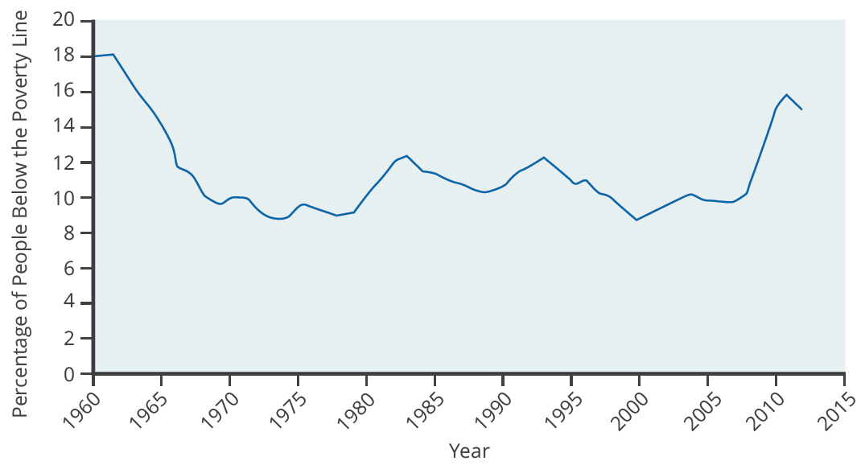
Poverty Rate
The poverty rate fell dramatically during the 1960s, rose in the early 1980s and early 1990s, and, after declining in the 1990s through mid-2000s, rose to 15.9% in 2011, which is close to the 1960 levels. In 2013, the poverty rate dropped slightly to 14.5%.
Notes:
The poverty rate fell dramatically during the 1960s, rose in the early 1980s and early 1990s, and, after declining in the 1990s through mid-2000s, rose to 15.9% in 2011, which is close to the 1960 levels. In 2013, the poverty rate dropped slightly to 14.5%.

Slide 9
Questions on Poverty
In a vast country like the United States, should there be a national poverty line?
The median household income for a family of four was $102,552 in New Jersey and $57,132 in Mississippi in 2013.
Should the government adjust the poverty line to account for the value of government programs?
Any poverty line will be somewhat arbitrary, and it is useful to have a poverty line whose basic definition does not change much over time.
Government statisticians at the U.S. Census Bureau have ongoing research programs to address questions like these.
Notes:
In a vast country like the United States, should there be a national poverty line? The median household income for a family of four was $102,552 in New Jersey and $57,132 in Mississippi in 2013. Should the government adjust the poverty line to account for the value of low-income assistance programs? Any poverty line will be somewhat arbitrary, and it is useful to have a poverty line whose basic definition does not change much over time. Government statisticians at the U.S. Census Bureau have ongoing research programs to address questions like these.

Slide 10
On Your Own
In your opinion, what are some factors that keep people in poverty? What ideas do you have for changing the poverty problem?
HAWKES LEARNING
Notes:
In your opinion, what are some factors that keep people in poverty? What ideas do you have for changing the poverty problem?

Slide 11
Summary
Wages are influenced by supply and demand in labor markets, which can lead to very low incomes for some people and very high incomes for others.
Poverty applies to the condition of people who cannot afford the necessities of life while income inequality refers to the disparity between those with higher and lower incomes.
The poverty rate is what percentage of the population lives below the poverty line, which the amount of income that it takes to purchase the necessities of life determines.
Choosing a poverty line will always be somewhat controversial.
HAWKES LEARNING

Slide 12




HAWKES LEARNING

