Slide 1
HAWKES LEARNING
Government Policies to Reduce Income Inequality
Principles of Economics
Notes:
There will always be some level of income inequality in a society, and that’s not necessarily a bad thing. But how much should there be is a constant question. In this lesson, titled “Government Policies to Reduce Income Inequality,” we’ll explore the different levels and how government can intervene.

Slide 2
Introduction
No society should expect or desire complete equality of income at a given point in time for a number of reasons.
Most workers receive low earnings in their first few jobs, higher earnings later in life, and then lower earnings after retirement.
Thus, a society with people of varying ages will have a certain amount of income inequality.
Also, people's preferences and desires differ.
Some are willing to work long hours to have income for large houses, fast cars and computers, luxury vacations, etc.
Notes:
No society should expect or desire complete equality of income at a given point in time for a number of reasons. Most workers receive low earnings in their first few jobs, higher earnings later in life, and then lower earnings after retirement. Thus, a society with people of varying ages will have a certain amount of income inequality. Also, people's preferences and desires differ. Some are willing to work long hours to have income for large houses, fast cars and computers, luxury vacations, etc.

Slide 3
Redistribution
Redistribution means taking income from those with higher incomes and providing income to those with lower incomes.
Policies that provide support for the poor include the welfare program, TANF, the earned income tax credit, SNAP, and Medicaid.
If a reduction in inequality is desired, these programs could receive additional funding.
The federal income tax, which is a progressive tax system designed so that the rich pay a higher percent in income taxes, funds these programs.
Notes:
Redistribution means taking income from those with higher incomes and providing income to those with lower incomes. Policies that provide support for the poor include the welfare program, TANF, the earned income tax credit, SNAP, and Medicaid. If a reduction in inequality is desired, these programs could receive additional funding. The federal income tax, which is a progressive tax system designed so that the rich pay a higher percent in income taxes, funds these programs.

Slide 4
Effective Income Tax
The effective income tax is the percentage of total taxes paid divided by total income.
The typical pattern is that people with higher incomes pay a higher average share of their income in federal income taxes.
Notes:
The effective income tax is the percentage of total taxes paid divided by total income. The typical pattern is that people with higher incomes pay a higher average share of their income in federal income taxes.

Slide 5
Ladder of Opportunity
Economic inequality is perhaps most troubling when it is not the result of effort or talent but instead is determined by the circumstances under which a child grows up.
Public policies like improved day care, preschool programs, college loans and grants, and adult re-training classes are examples of expanding access to opportunity.
Choosing which policies will work can get political, and not all of them will succeed.
Notes:
Economic inequality is perhaps most troubling when it is not the result of effort or talent but instead is determined by the circumstances under which a child grows up. Sometimes income inequality isn’t based on talent or effort but on circumstance. Public policies like improved day care, preschool programs, college loans and grants, and adult re-training classes are examples of expanding access to opportunity. Choosing which policies will work can get political, and not all of them will succeed.

Slide 6
Inheritance Tax
There is always a debate about inheritance taxes. Why should people who have saved up a substantial nest egg not be able to give their money to their children and grandchildren?
In particular, it would seem un-American if children were unable to inherit a family business or family home.
Alternatively, many Americans are more comfortable with inequality resulting from high-income people who earned their money by starting innovative new companies than they are with inequality resulting from high-income people who have inherited money from rich parents.
The U.S. does have an estate tax—a tax imposed on the value of an inheritance—which suggests a willingness to limit how much wealth one can pass on as an inheritance.
Notes:
There is always a debate about inheritance taxes. Why should people who have saved up a substantial nest egg not be able to give their money to their children and grandchildren? In particular, it would seem un-American if children were unable to inherit a family business or family home. The U.S. does have an estate tax—a tax imposed on the value of an inheritance—which suggests a willingness to limit inheritance.

Slide 7
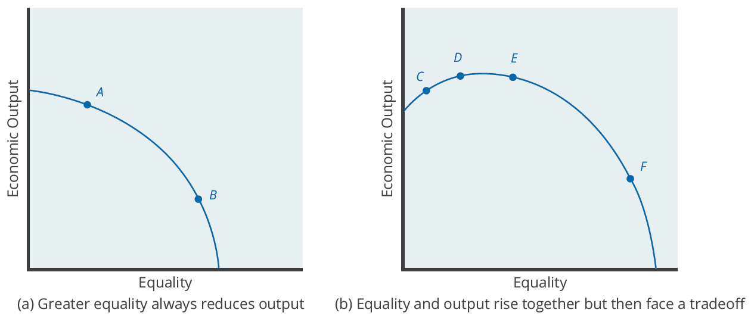
The Tradeoff between Incentives and Income Equality
Society faces a tradeoff where any attempt to move toward greater equality, like moving from choice A to B, involves a reduction in economic output. At some point, too aggressive a push for equality will tend to reduce economic output, like the shift from E to F. A healthy balance is difficult to achieve.
Notes:
There is always a tradeoff between incentives for economic output and income inequality. If taken to extremes, policies to reduce inequality can negatively affect incentives for economic output. For example, if you guarantee a certain income, it could reduce the incentive to work. But, these extreme outcomes are a more pessimistic viewpoint.

Slide 8
On Your Own
This lesson presents three government policies that can be used to reduce income inequality: redistribution through progressive income tax, building a ladder of opportunities, and inheritance taxes. Assuming that you favor making the distribution of income more equal, which of these policies do you think would be most effective? Why?
Notes:
This lesson presents three government policies that can be used to reduce income inequality: redistribution through progressive income tax, building a ladder of opportunities, and inheritance taxes. Assuming that you favor making the distribution of income more equal, which of these policies do you think would be most effective? Why?

Slide 9
On Your Own
This lesson presents three government policies that can be used to reduce income inequality: redistribution through progressive income tax, building a ladder of opportunities, and inheritance taxes. Assuming that you favor making the distribution of income more equal, which of these policies do you think would be most effective? Why?
Redistribution: It seems fair to many that those with the ability to pay more taxes should pay a higher percentage of their income in tax than those with very low incomes.
Ladder of Opportunity: It seems fair to ensure that everyone, especially those that are disadvantaged at birth by having been born to low-income parents, is given the opportunity to reach the American Dream of achieving a better standard of living through hard work.
Inheritance Taxes: It seems fair to tax people who inherit money from rich parents rather than those who have earned wages and salaries through hard work and risk-taking, especially since estate taxes are applied only to large estates of more than $5.43 million.

Slide 10
Summary
Policies that can affect the level of economic inequality include redistribution between rich and poor, making it easier for people to climb the ladder of opportunity, and estate taxes, which are taxes on inheritances.
Pushing too aggressively for economic equality can run the risk of decreasing economic incentives.
However, a moderate push for economic equality can increase economic output, both through methods like improved education and by building a base of political support for market forces.
HAWKES LEARNING

Slide 11




HAWKES LEARNING

