Slide 1
HAWKES LEARNING
Voter Participation and Costs of Elections
Principles of Economics
Notes:
In this lesson, called Voter Participation and Costs of Elections, we’ll look at how these two factors can affect the outcomes and aftermath of elections.

Slide 2
Introduction
Just as markets can face issues that lead to undesirable outcomes, a democratic system of government can also make mistakes.
A democratic system can enact policies that do not benefit society as a whole.
Also, a democratic system can fail to enact policies that would have benefited society as a whole.
This chapter discusses some practical difficulties of democracy from an economic viewpoint.
Notes:
Just as markets can face issues that lead to undesirable outcomes, a democratic system of government can also make mistakes. A democratic system can enact policies that do not benefit society as a whole. Also, a democratic system can fail to enact policies that would have benefited society as a whole. This chapter discusses some practical difficulties of democracy from an economic viewpoint.

Slide 3

Voter Participation in Presidential Elections
United States
Germany, Spain, and France
55–65%
75–80%
Notes:
The United States has a lower voting participation rate than several other democratic countries. In the last few decades, only 55 to 65 percent of voting age citizens have voted in elections in the U.S. In countries like Germany, France, and Spain, that number is between 75 and 80 percent.

Slide 4
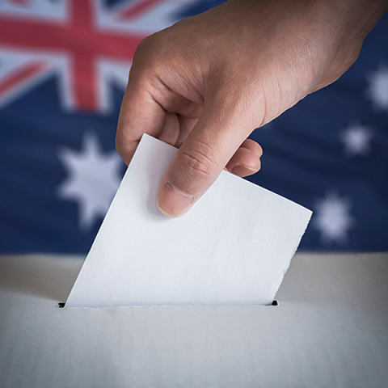
Voter Participation
Voting is legally required in some countries.
Notes:
The following countries have laws that require voting:
Australia, Belgium, Italy, Greece, Turkey, Singapore, most Latin American nations

Slide 5
Why Do People Not Vote?
Economists have suggested why a utility-maximizing person might rationally decide not to vote or not care about an election.
The Board of Elections measures the margin of victory in hundreds, thousands, or even millions of votes.
A rational voter will recognize that one vote is extremely unlikely to make a difference.
The theory of rational ignorance holds that people will not vote if the costs of becoming informed and voting is too high or they feel their vote will not be decisive in the election.
Notes:
Economists have suggested why a utility-maximizing person might rationally decide not to vote or not care about an election. The Board of Elections measures the margin of victory in hundreds, thousands, or even millions of votes. A rational voter will recognize that one vote is extremely unlikely to make a difference. The theory of rational ignorance holds that people will not vote if the costs of voting is too high or they feel their vote will not be decisive.

Slide 6

Spending
2016 Presidential Election
$6.8 billion spent
Notes:
Spending is a big part of elections. In the 2016 presidential election, a total of 6.8 billion dollars was spent. Critics say raising that money entangles politicians with special interest groups, and some would prefer a system where spending was restricted.

Slide 7
Breaking Down the Numbers
$6.8 billion =
1/25 of 1% of overall U.S. economy in 2016
1/10 of 1% of overall U.S. economy in 2016
Notes:
But, how much restriction should there be? That 2016 spending was about one-twenty-fifth of one percent of the U.S. economy that year, and only one-tenth of one percent of total government spending programs. In other words, it’s a pretty small percentage of both.

Slide 8
Who Votes?
Research on voting behavior has indicated that people who are more settled or "connected" to society vote more frequently.
According to the Washington Post, more married people vote than single people.
Those with a job vote more than the unemployed.
Those who report that they know their neighbors and talk to them are more likely to vote than socially isolated people.
Those with a higher income and level of education are also more likely to vote.
Notes:
Research on voting behavior has indicated that people who are more settled or "connected" to society vote more frequently. According to the Washington Post, more married people vote than single people. Those with a job vote more than the unemployed. Those who report that they know their neighbors and talk to them are more likely to vote than socially isolated people. Those with a higher income and level of education are also more likely to vote.

Slide 9

Who Votes?
Politicians typically target their campaigns at people who are most likely to vote.
Notes:
Politicians typically target their campaigns at people who are most likely to vote.

Slide 10
Future Turnout
Proposals to Increase Turnout
Make it easier to register to vote
Keep polls open for more hours
Move Election Day to the weekend
Notes:
While there have been proposals to increase turnout, including making registering to vote easier, keeping polls open longer, and moving election day to the weekend, they have not been adopted. Some states have made moves that critics say reduces voting even further.

Slide 11
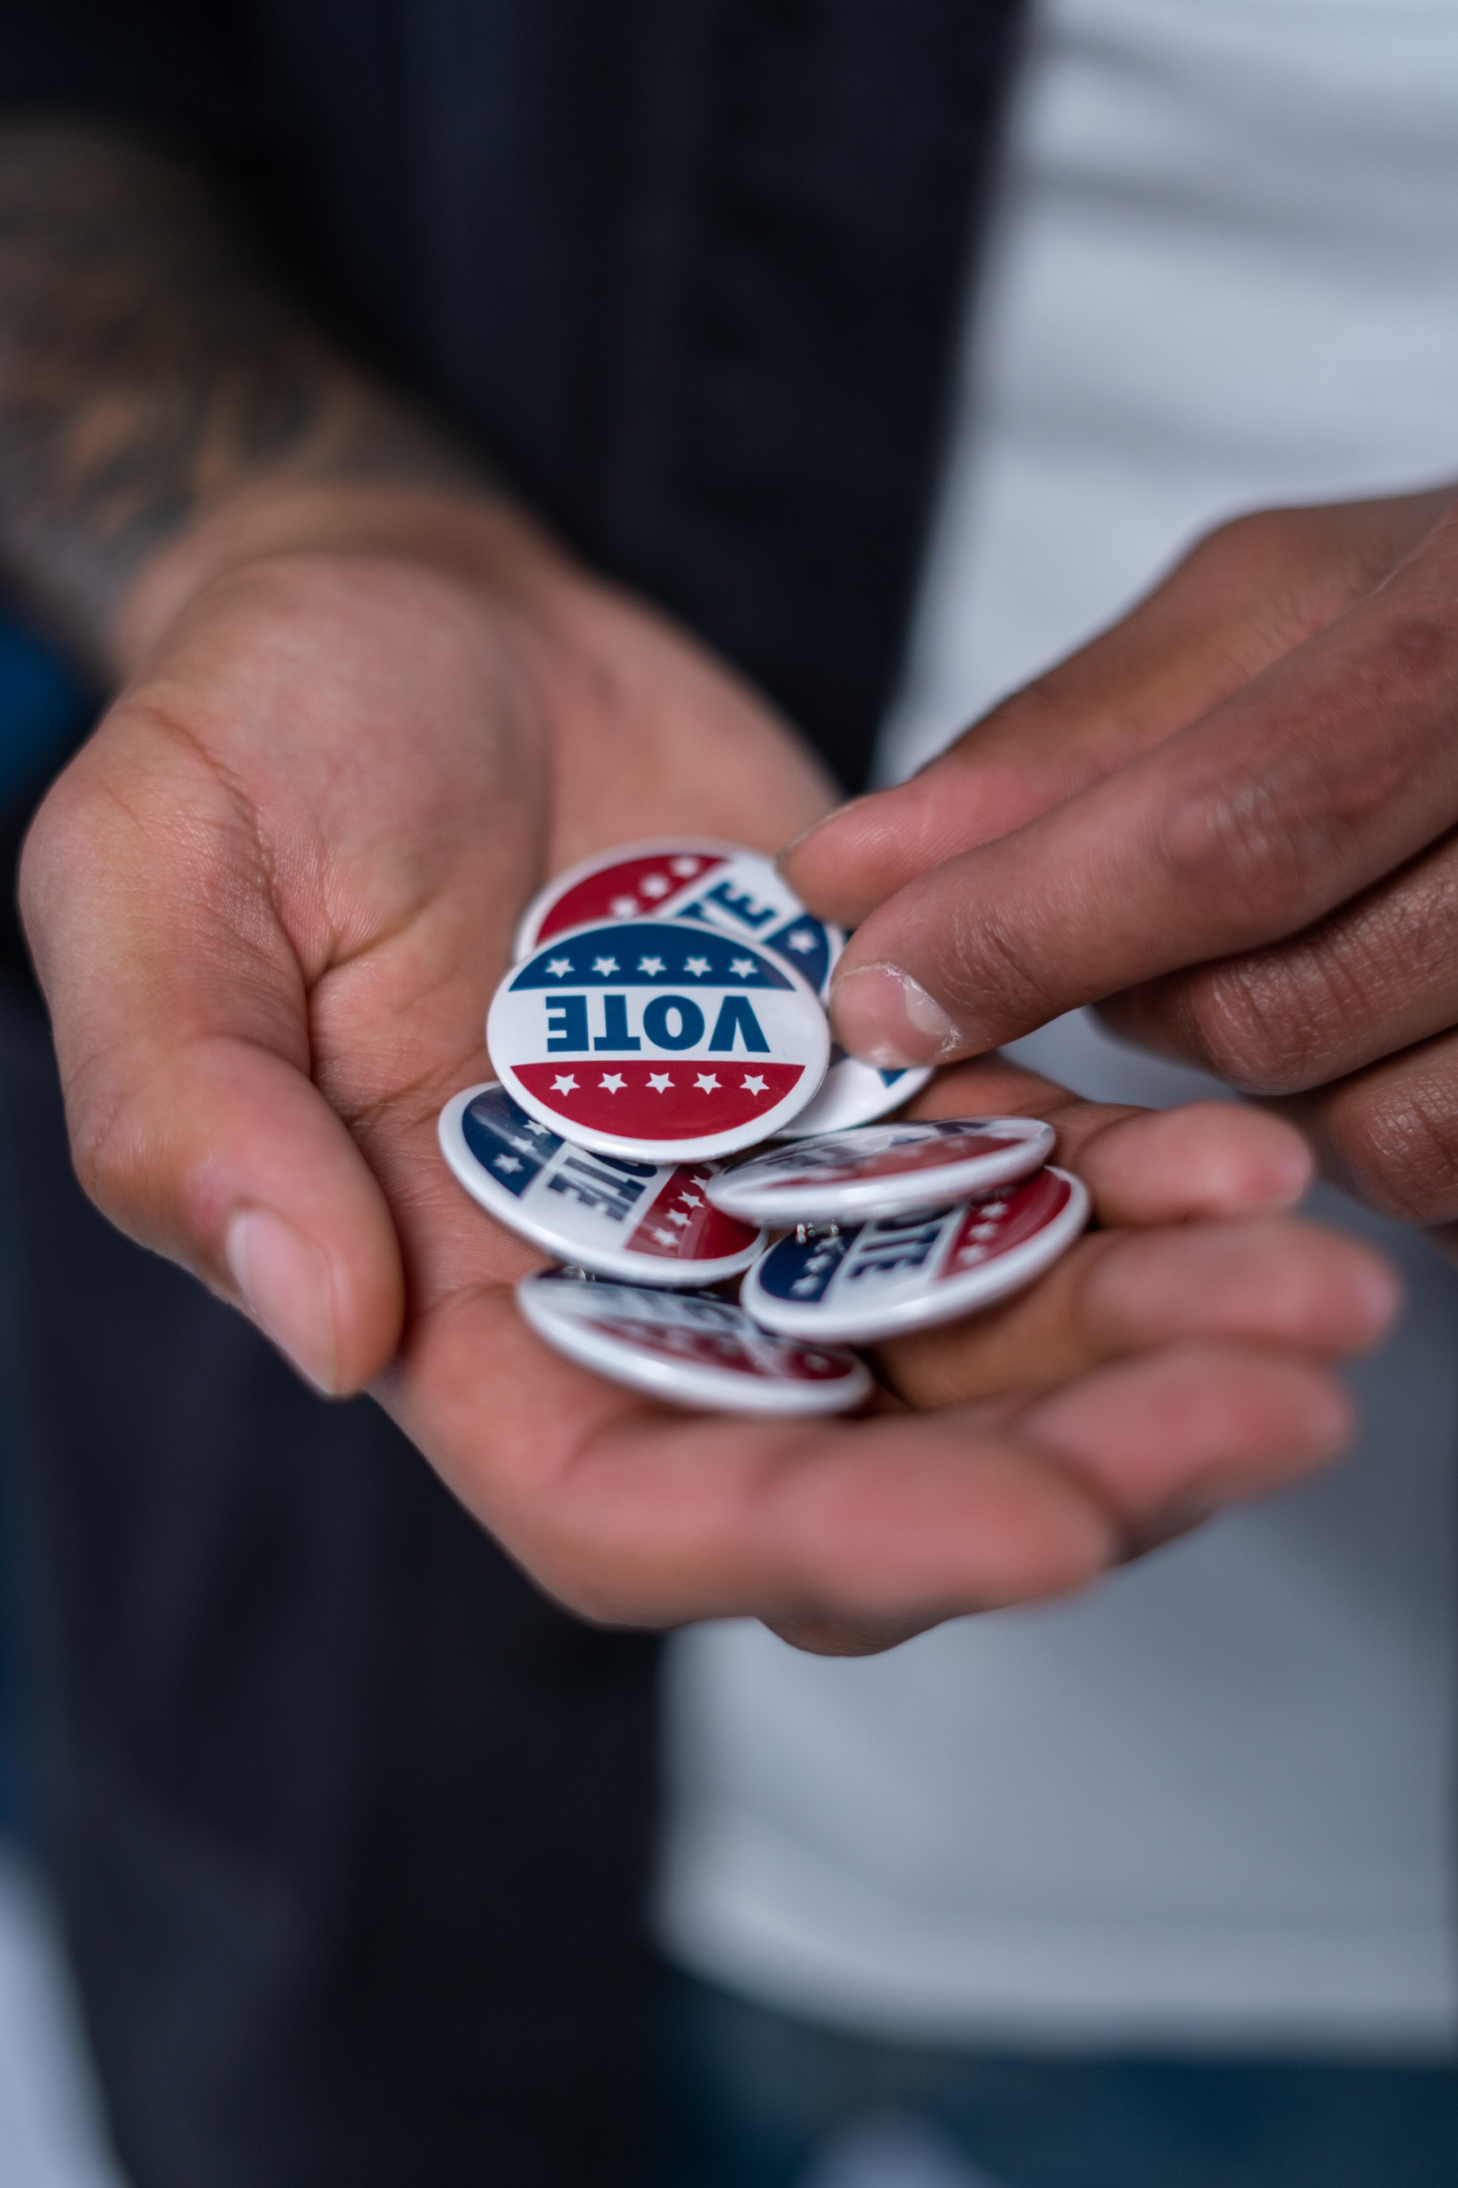
On Your Own
Are you likely to vote in the next election? Why or why not?
HAWKES LEARNING
Notes:
Are you likely to vote in the next election? Why or why not?

Slide 12
Summary
The theory of rational ignorance says voters will recognize that their single vote is extremely unlikely to influence the outcome of an election.
As a consequence, they will choose to remain uninformed about issues and not vote.
This theory helps explain why voter turnout is so low in the United States.
HAWKES LEARNING

Slide 13




HAWKES LEARNING

