Slide 1
HAWKES LEARNING
Trade Balances and Flows of Financial Capital
Principles of Economics

Slide 2
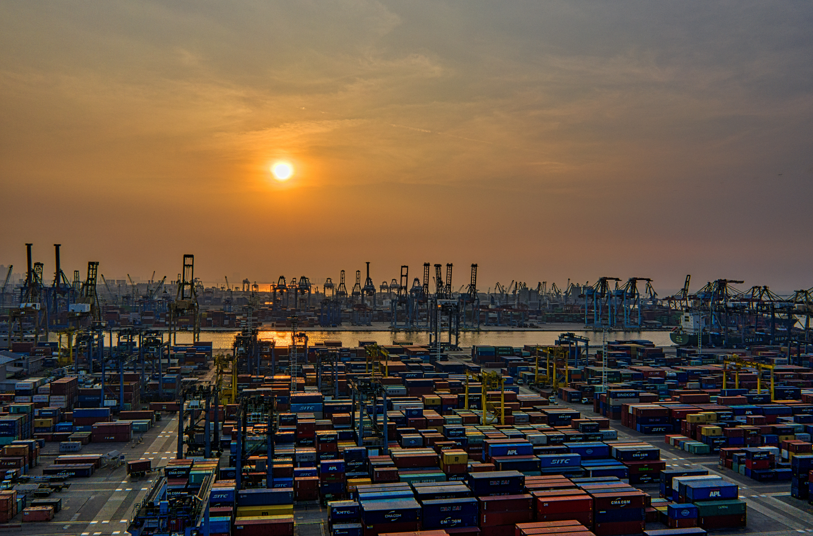

On Your Own
Is a trade deficit bad? Is a trade surplus good? Why do you think so?
HAWKES LEARNING
Notes:
Is a trade deficit bad? Is a trade surplus good? Why do you think so?

Slide 3
A Two-Person Economy: Robinson Crusoe and Friday
1. Crusoe and Friday trade goods and services. Perhaps Crusoe catches fish and trades them to Friday for coconuts. Because each trade is voluntary, both Crusoe and Friday must feel that they are receiving fair value for what they are giving so that trade is balanced.
2. One day, Crusoe approaches Friday with a proposition. Crusoe wants to dig ditches for an irrigation system for his garden, but this project will not leave him much time to fish and gather coconuts for food. He proposes that Friday supplies him with a certain number of fish and coconuts for several months. After that, he'll repay Friday with the extra produce he'll be able to grow in his garden.
3. If Friday accepts this offer, there is a trade imbalance. For several months, Friday will have a trade surplus: he will export more (to Crusoe) than he will import. Conversely, Crusoe will have a trade deficit because he will import more (from Friday) than he will export.
Notes:
1. Crusoe and Friday trade goods and services. Perhaps Crusoe catches fish and trades them to Friday for coconuts. Because each trade is voluntary, both Crusoe and Friday must feel that they are receiving fair value for what they are giving so that trade is balanced. Neither person experiences a trade deficit or a trade surplus.
2. One day, Crusoe approaches Friday with a proposition. Crusoe wants to dig ditches for an irrigation system for his garden, but this project will not leave him much time to fish and gather coconuts for food. He proposes that Friday supplies him with a certain number of fish and coconuts for several months. After that, he'll repay Friday with the extra produce he'll be able to grow in his irrigated garden.
3. If Friday accepts this offer, there is a trade imbalance. For several months, Friday will have a trade surplus: he will export more (to Crusoe) than he will import. Conversely, Crusoe will have a trade deficit because he will import more (from Friday) than he will export.

Slide 4

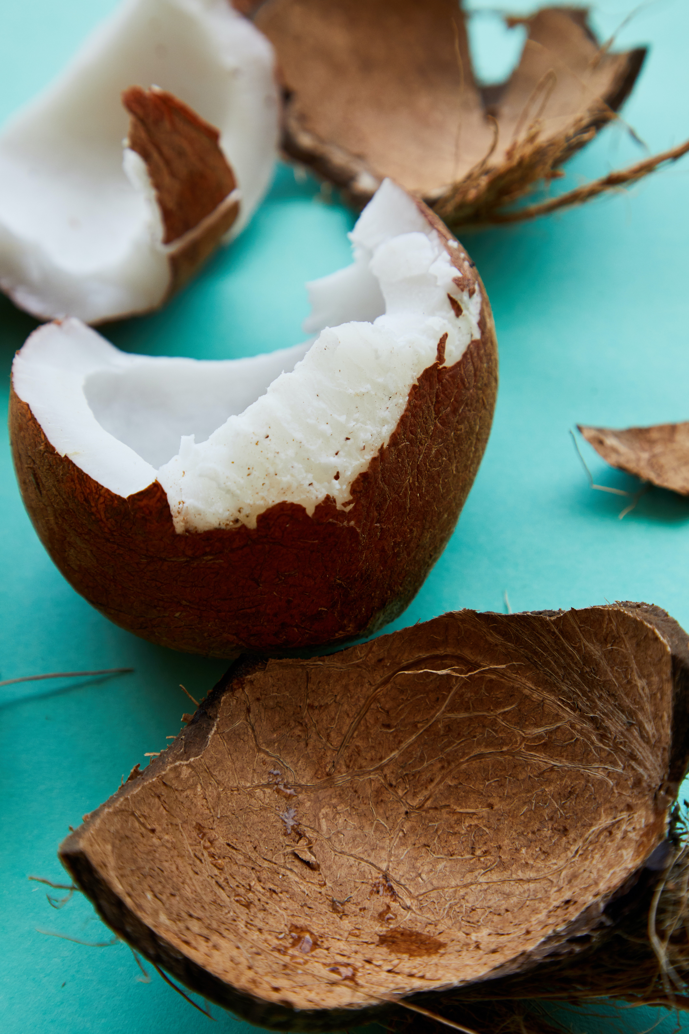
On Your Own
Now that you have considered the Robinson Crusoe example, answer the following questions again:
Is a trade deficit bad? Is a trade surplus good? Why do you think so?
HAWKES LEARNING
Notes:
Is a trade deficit bad? Is a trade surplus good? Why do you think so?

Slide 5
A Two-Person Economy: Robinson Crusoe and Friday
In this or any other voluntary market transaction, if both parties agree to the transaction, they both may be better off.
If Crusoe's irrigation system isn't built or doesn't improve his garden enough to pay Friday back, the agreement will have to be renegotiated.
The size of Friday's trade surplus is exactly the amount he is lending. The size of Crusoe's trade deficit is exactly the amount he has borrowed.
In international trade, a trade surplus results in an outflow of financial capital, and a trade deficit results in an inflow of financial capital.
HAWKES LEARNING
Notes:
In this or any other voluntary market transaction, if both parties agree to the transaction, they both may be better off. If Crusoe's irrigation system isn't built or doesn't improve his garden enough to pay Friday back, the agreement will have to be renegotiated. The size of Friday's trade surplus is exactly the amount he is lending and the size of Crusoe's trade deficit is exactly the amount he has borrowed. In international trade, a trade surplus results in an outflow of financial capital, and a trade deficit results in an inflow of financial capital.

Slide 6
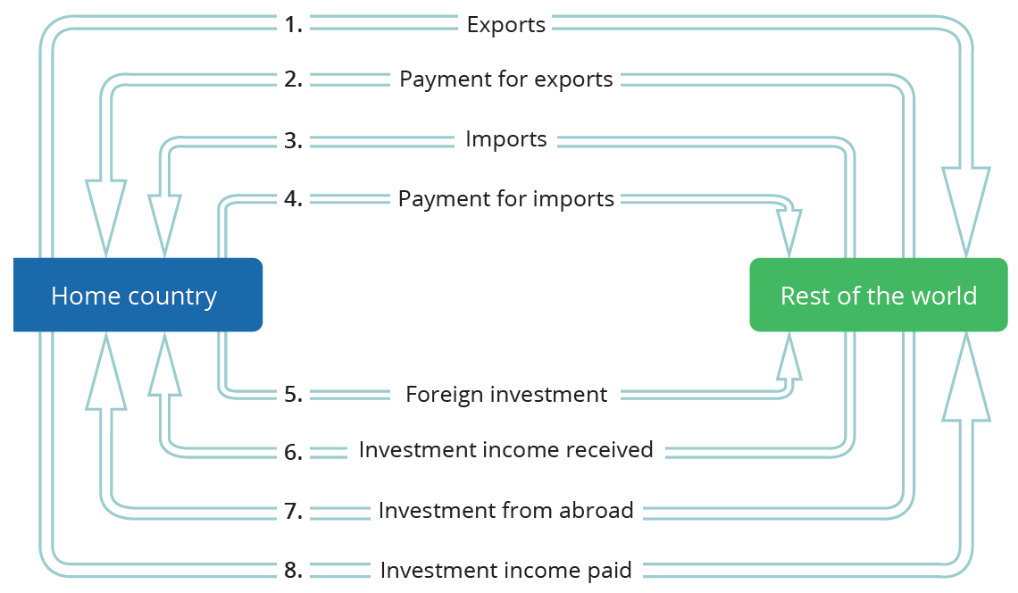
The Balance of Trade as the Balance of Payments
Economists sometimes describe the balance of trade as the balance of payments.
Each category of the current account balance involves a corresponding flow of payments between a country and the rest of the world economy.
Notes:
Economists sometimes describe the balance of trade as the balance of payments. Each category of the current account balance involves a corresponding flow of payments between a country and the rest of the world economy.

Slide 7
The Balance of Trade as the Balance of Payments
A current account deficit means that a country is a net borrower from abroad.
A positive current account balance means a country is a net lender to the rest of the world.
A trade surplus means an overall outflow of financial investment capital as domestic investors put their funds abroad.
A deficit in the current account balance is exactly equal to the overall or net inflow of foreign investment capital from abroad.
Notes:
A current account deficit means that a country is a net borrower from abroad. A positive current account balance means a country is a net lender to the rest of the world. A trade surplus means an overall outflow of financial investment capital as domestic investors put their funds abroad. A deficit in the current account balance is exactly equal to the overall or net inflow of foreign investment capital from abroad.

Slide 8
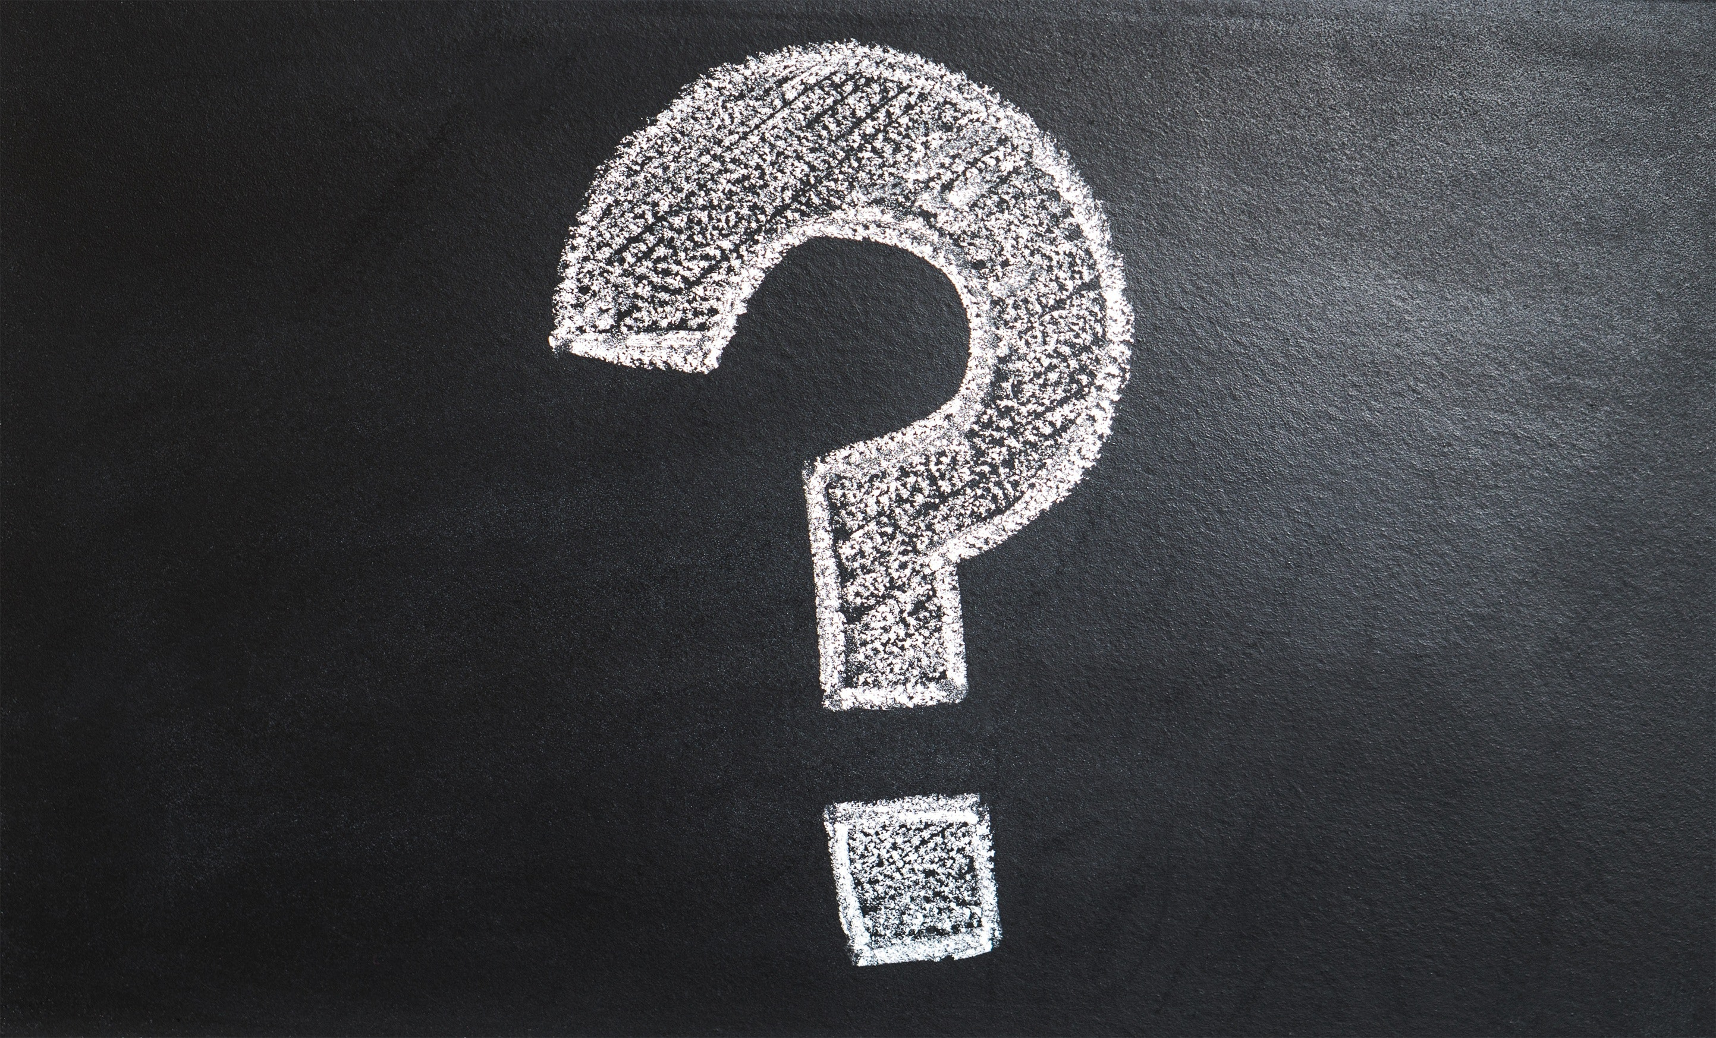
On Your Own
Imagine you are the president of the United States, and you plan to turn the U.S. trade deficit into a surplus. At the same time, you want to increase the net inflow of financial capital to the U.S. from other countries. Is it possible to achieve both of your goals? If not, which goal do you think is more important for the nation to achieve? Explain.
Notes:
Imagine you are the president of the United States, and you plan to turn the U.S. trade deficit into a surplus. At the same time, you want to increase the net inflow of financial capital to the U.S. from other countries. Is it possible to achieve both of your goals? If not, which goal do you think is more important for the nation to achieve? Explain.
It is not possible to have a current account surplus and a net inflow of foreign funds at the same time. A trade surplus is accompanied by a net outflow of funds from the U.S. to other countries. Answers will vary for the second part of the question.

Slide 9
Summary
International flows of goods and services are closely connected to the international flows of financial capital.
A current account deficit means that—after taking all the flows of payments from goods, services, and income together—the country is a net borrower from the rest of the world.
A current account surplus is the opposite and means the country is a net lender to the rest of the world.
HAWKES LEARNING

Slide 10




HAWKES LEARNING

