Slide 1
HAWKES LEARNING
Shifts in Aggregate Supply
Principles of Economics

Slide 2
Introduction
The original equilibrium in the aggregate supply/aggregate demand diagram will shift to a new equilibrium if the AS or AD curve shifts.
This lesson discusses two important factors that can lead to shifts of the AS curve: productivity growth and changes in input prices.
HAWKES LEARNING
Notes:
The original equilibrium in the aggregate supply/aggregate demand (AD/AS) diagram will shift to a new equilibrium if the AS or AD curve shifts. This lesson discusses two of the most important factors that can lead to shifts of the AS curve: productivity growth and changes in input prices.

Slide 3
How Productivity Growth Shifts the Aggregate Supply Curve
Productivity growth is the most important factor that shifts the AS curve in the long run.
Productivity is how much output can be produced with a given quantity of labor. One measure is output per worker (GDP per capita).
Over time, productivity grows so that the same quantity of labor can produce more output.
Historically, real growth in GDP per capita in an advanced economy like the U.S. has averaged about 2%–3% per year.
HAWKES LEARNING
Notes:
Productivity growth is the most important factor that shifts the AS curve in the long run. Productivity: how much output can be produced with a given quantity of labor; one measure: output per worker (GDP per capita). Over time, productivity grows so that the same quantity of labor can produce more output. Historically, real growth in GDP per capita in an advanced economy like the U.S. has averaged about 2–3% per year.

Slide 4
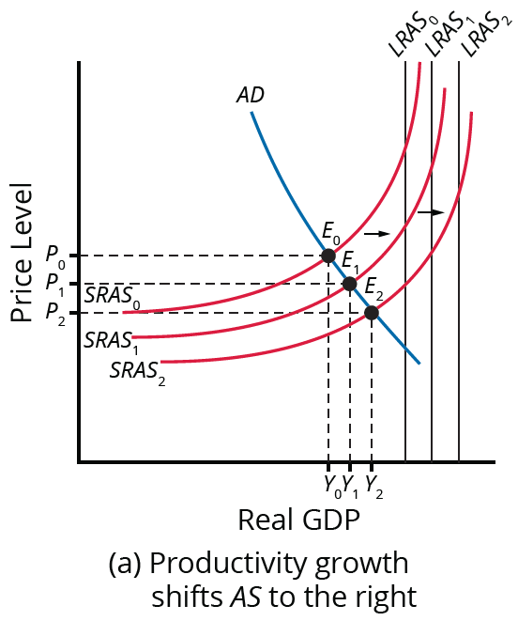
How Productivity Growth Shifts the Aggregate Supply Curve
Higher productivity shifts the short-run aggregate supply (SRAS) curve to the right.
With improved productivity, businesses can produce a greater quantity of output at every price level.
Full employment corresponds to a higher level of GDP, so the long-run aggregate supply (LRAS) curve also shifts to the right.
HAWKES LEARNING
Notes:
Higher productivity shifts the short-run aggregate supply (SRAS) curve to the right. With improved productivity, businesses can produce a greater quantity of output at every price level. With increased productivity, workers can produce more GDP. Full employment corresponds to a higher level of GDP, so the long-run aggregate supply (LRAS) curve, also shifts to the right.

Slide 5
How Productivity Growth Shifts the Aggregate Supply Curve
If aggregate demand remains unchanged, a rightward shift of the SRAS curve will result in greater real GDP and downward pressure on the price level.
If the shift of the SRAS curve is from gains in productivity growth, the effect will be relatively small over a few months or even years.
A nation’s production possibility frontier is fixed in the short run but shifts right in the long run.
HAWKES LEARNING
Notes:
If aggregate demand remains unchanged, a rightward shift of the SRAS curve will result in greater real GDP and downward pressure on the price level. If the shift of the SRAS curve is from gains in productivity growth, the effect will be relatively small over a few months or even years. A nation’s production possibility frontier is fixed in the short run but shifts right in the long run.

Slide 6
How Changes in Input Prices Shift the Aggregate Supply Curve
Higher prices for inputs used across the entire economy have a macroeconomic impact on aggregate supply.
Examples of widely used inputs include labor and energy products.
Increases in the prices of such inputs will cause the SRAS curve to shift left.
This means that at each price level for outputs, a higher price for inputs will discourage production.
Notes:
Higher prices for inputs used across the entire economy have a macroeconomic impact on aggregate supply. Examples of widely used inputs include labor and energy products. Increases in the prices of such inputs will cause the SRAS curve to shift left. This means that at each price level for outputs, a higher price for inputs will discourage production.

Slide 7
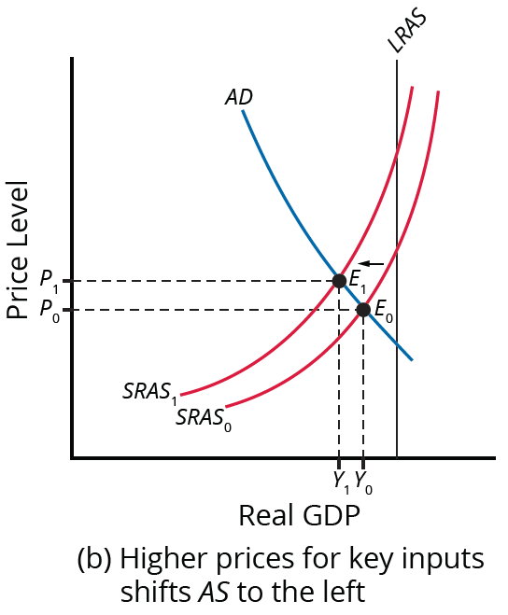
How Changes in Input Prices Shift the Aggregate Supply Curve
The increased input price level moves the equilibrium to the left, as the SRAS curve moves to the left.
This will have bad effects: reduced GDP or recession, higher unemployment, and an inflated price level.
For example, in the 1970s, this pattern of a leftward shift of SRAS leading to a stagnant economy with high unemployment and inflation was nicknamed stagflation.
HAWKES LEARNING

Slide 8
How Changes in Input Prices Shift the Aggregate Supply Curve
A decline in the price of a key input like oil will shift the SRAS curve right, providing an incentive for more production at every price level.
For example, from 1985 to 1986, the average price of crude oil fell by almost half, from $24 a barrel to $12.
Two other key inputs that may shift the SRAS curve are the cost of labor (wages) and the cost of imported goods used as inputs.
In these cases, too, the lesson is that lower prices for inputs cause SRAS to shift right, while higher prices cause it to shift back to the left.
HAWKES LEARNING
Notes:
A decline in the price of a key input like oil will shift the SRAS curve right, providing an incentive for more production at every price level. For example, from 1985 to 1986, the average price of crude oil fell by almost half, from $24 a barrel to $12. Two other key inputs that may shift the SRAS curve are the cost of labor (wages) and the cost of imported goods used as inputs. In these cases, too, the lesson is that lower prices for inputs cause SRAS to shift right, while higher prices cause it to shift back to the left.

Slide 9
Other Supply Shocks
Input Goods
Labor Market
Example: an unexpected early freeze could destroy crops and that shock would shift the AS curve to the left; fewer crops available at any given price
Example: an overseas war that requires a large number of workers to cease their ordinary production to go fight; both SRAS and LRAS would shift left
or
HAWKES LEARNING

Slide 10

On Your Own
If the government decided to provide health insurance for all citizens, regardless of age, how would this likely affect aggregate supply, output, and prices?
HAWKES LEARNING
Notes:
If the government decided to provide health insurance for all citizens, regardless of age, how would this likely affect aggregate supply, output, and prices?

Slide 11
On Your Own
If the government decided to provide health insurance for all citizens, regardless of age, how would this likely affect aggregate supply, output, and prices?
If the government provided health insurance, this would reduce input costs for employers since health insurance costs are a large part of the cost of labor. A decrease in input costs will shift the aggregate supply curve to the right, increasing output and decreasing prices.
HAWKES LEARNING
Notes:
If the government decided to provide health insurance for all citizens, regardless of age, how would this likely affect aggregate supply, output, and prices?
If the government provided health insurance, this would reduce input costs for employers since health insurance costs are a large part of the cost of labor. A decrease in input costs will shift the aggregate supply curve to the right, increasing output and decreasing prices.

Slide 12
Summary
The aggregate demand/aggregate supply (AD/AS) diagram shows how aggregate demand and aggregate supply interact.
The intersection of the AD and AS curves shows the equilibrium output and price level in the economy.
The aggregate supply curve will shift right as productivity increases.
If the AS curve shifts left, stagflation occurs, which is the combination of lower output, higher unemployment, and higher inflation.
If AS shifts right, a combination of lower inflation, higher output, and lower unemployment is possible.
HAWKES LEARNING

Slide 13




HAWKES LEARNING

