Slide 1
HAWKES LEARNING
The Policy Implications of the Neoclassical Perspective
Principles of Economics

Slide 2
Neoclassical Viewpoints and Policy
Neoclassical economists do not believe government stimulation of AD will have a good outcome.
The neoclassical viewpoint holds the economy will correct itself and that a Keynesian stabilization policy will only accelerate the process.
However, neoclassical economists believe it takes the government months or years to properly adjust to AD changes.
Some neoclassical economists even think that the business cycles we observe are due in large part to flawed government policy.
HAWKES LEARNING
Notes:
Neoclassical economists do not believe government stimulation of AD will have a good outcome. The neoclassical viewpoint holds the economy will correct itself and that a Keynesian stabilization policy will only accelerate the process. However, neoclassical economists believe it takes the government months or years to properly adjust to AD changes. Some neoclassical economists even think that the business cycles we observe are due in large part to flawed government policy.

Slide 3
The Neoclassical Phillips Curve Tradeoff
The upward-sloping short-run aggregate supply (SRAS) curve implies a downward-sloping Phillips curve; thus, there is a tradeoff between inflation and unemployment in the short run.
By contrast, a neoclassical long-run aggregate supply (LRAS) curve will imply a vertical shape for the Phillips curve, indicating no long-run tradeoff between inflation and unemployment.
HAWKES LEARNING
Notes:
The upward-sloping short-run aggregate supply (SRAS) curve implies a downward-sloping Phillips curve; thus, there is a tradeoff between inflation and unemployment in the short run. By contrast, a neoclassical long-run aggregate supply (LRAS) curve will imply a vertical shape for the Phillips curve, indicating no long-run tradeoff between inflation and unemployment.

Slide 4
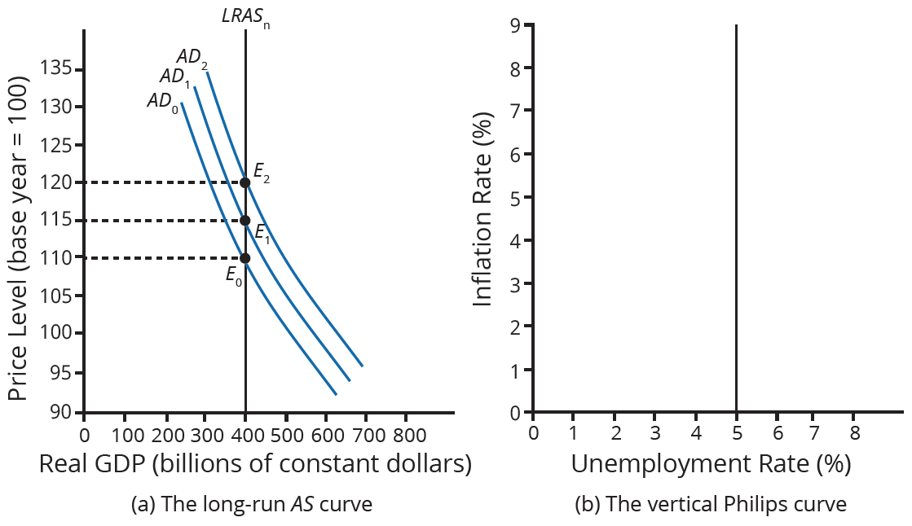
The Neoclassical Phillips Curve Tradeoff
With a vertical LRAS curve, shifts in AD do not alter output but do lead to changes in price. Because output is unchanged, all unemployment will be due to the natural rate of unemployment.
Both substitution bias and quality/new goods bias tend to overstate the negative impact of inflation on consumers.
HAWKES LEARNING
Notes:
With a vertical LRAS curve, shifts in AD do not alter output but do lead to changes in price. Because output is unchanged, all unemployment will be due to the natural rate of unemployment.

Slide 5
Long-Run Phillips Curve
The unemployment rate on the long-run Phillips curve will be the natural rate of unemployment.
Since the long-run Phillips curve is vertical, the natural rate of unemployment is consistent with all different rates of inflation.
Milton Friedman said, "There is always a temporary tradeoff between inflation and unemployment; there is no permanent tradeoff."
HAWKES LEARNING
Notes:
The unemployment rate on the long-run Phillips curve will be the natural rate of unemployment. Since the long-run Phillips curve is vertical, the natural rate of unemployment is consistent with all different rates of inflation. Milton Friedman said, "There is always a temporary tradeoff between inflation and unemployment; there is no permanent tradeoff."

Slide 6
Fighting Unemployment or Inflation?
Economists divide unemployment into both cyclical unemployment and the natural rate of unemployment.
Cyclical unemployment results from the business cycle, while the natural rate of unemployment is always present.
The neoclassical view minimizes the concern surrounding cyclical unemployment, a short-run occurrence.
The neoclassical view of unemployment tends to focus on how the government can adjust public policy to reduce the natural rate of unemployment.
HAWKES LEARNING
Notes:
Economists divide unemployment into both cyclical unemployment and natural unemployment. Cyclical unemployment results from the business cycle, while the natural rate of unemployment is always present. The neoclassical view minimizes the concern surrounding cyclical unemployment, a short-run occurrence. The neoclassical view of unemployment tends to focus on how the government can adjust public policy to reduce the natural rate of unemployment.

Slide 7
Fighting Recession or Encouraging Long-Term Growth?
The economy will rebound out of a recession or eventually contract during an expansion because prices and wage rates are flexible.
The key policy question for neoclassicals is how to promote growth of potential GDP.
Neoclassicals view human capital, physical capital, and technology as the keys to long-run productivity growth.
Neoclassicals believe a stable economic environment fosters economic growth, while "fine-tuning" the economy is not as effective.
Notes:
The economy will rebound out of a recession or eventually contract during an expansion because prices and wage rates are flexible. The key policy question for neoclassicals is how to promote growth of potential GDP. Neoclassicals view human capital, physical capital, and technology as the keys to long-run productivity growth. Neoclassicals believe a stable economic environment fosters economic growth, while "fine-tuning" the economy is not as effective.

Slide 8

On Your Own
Neoclassical economists believe that it is more important to put an economy’s interest on long-term growth rather than on fighting recessions. Since economic growth depends on the growth rate of long-term productivity, explain specific ways in which you would promote long-run economic growth in today’s economy.
HAWKES LEARNING
Notes:
Neoclassical economists believe that it is more important to put an economy’s interest on long-term growth than on fighting recessions. Since economic growth depends on the growth rate of long-term productivity, explain specific ways in which you would promote long-run economic growth in today’s economy.

Slide 9
Summary
Recessions will fade in a few years, and long-term growth will ultimately determine the standard of living.
The natural rate of unemployment holds more importance than cyclical unemployment.
There is no social benefit to inflation, as it will not increase real GDP.
A vertical AS curve, where the quantity of output is consistent with many different price levels, implies a vertical Phillips curve.
Both substitution bias and quality/new goods bias tend to overstate the negative impact of inflation on consumers.
HAWKES LEARNING

Slide 10




HAWKES LEARNING

