Slide 1
HAWKES LEARNING
Macroeconomic Effects of Exchange Rates
Principles of Economics

Slide 2
Introduction
A central bank will be concerned about the exchange rate for two main reasons:
  Movements of the exchange rate will affect aggregate demand in an economy.
  Frequent and substantial fluctuations of the exchange rate can disrupt international trade and cause problems in a nation's banking system.
    This may contribute to an unsustainable balance of trade and large inflows of international financial capital. This can set up the economy for a deep recession if international investors decide to move their money to another country.
Notes:
A central bank will be concerned about the exchange rate for two main reasons:
Movements of the exchange rate will affect aggregate demand in an economy.
Frequent and substantial fluctuations of the exchange rate can disrupt international trade and cause problems in a nation's banking system.
This may contribute to an unsustainable balance of trade and large inflows of international financial capital. This can set up the economy for a deep recession if international investors decide to move their money to another country.

Slide 3
Exchange Rates, Aggregate Demand, and Aggregate Supply
Foreign trade typically involves incurring the costs of production in one currency while receiving revenues from sales in another currency.
Movements of exchange rates can have a powerful effect on incentives to export and import and, consequently, on aggregate demand in the economy as a whole.
Since increased exports bring more money into an economy and increased imports take money out of an economy, it can be tempting to conclude that exports are good for the economy and imports are bad.
However, this perspective overlooks the role of exchange rates.
Notes:
Foreign trade typically involves incurring the costs of production in one currency while receiving revenues from sales in another currency. Movements of exchange rates can have a powerful effect on incentives to export and import and, consequently, on AD in the economy. Since increased exports bring more money into an economy and increased imports take money out of an economy, it can be tempting to conclude that exports are good and imports are bad. However, this perspective overlooks the role of exchange rates.

Slide 4
Impact of Exchange Rates Example
If an American consumer buys a Japanese car for USD 20,000 instead of an American car for USD 30,000, it may be tempting to argue that the American economy has lost out, but this may not be the case.
The Japanese company will have to convert those dollars to yen to pay workers and operate factories.
Whoever buys those dollars will have to use them to purchase American goods and services, so the money comes back into the American economy.
At the same time, the consumer saves money by buying a less expensive import and can use their extra money elsewhere in the economy.
Notes:
If an American consumer buys a Japanese car for USD 20,000 instead of an American car for USD 30,000, it may be tempting to argue that the American economy has lost out, but this may not be the case. The Japanese company will have to convert those dollars to yen to pay workers and operate factories. Whoever buys those dollars will have to use them to purchase American goods and services, so the money comes back into the American economy. At the same time, the consumer saves money by buying a less expensive import and can use their extra money elsewhere in the economy.

Slide 5
Fluctuations of Exchange Rates
Exchange rates can fluctuate a great deal in the short run.
For example, the Indian rupee (INR) moved from INR 39 per USD 1 in February 2008 to INR 51 in March 2009. This was more than a one-fourth decline in the rupee’s value in foreign exchange markets.
Even two economically developed, neighboring economies can see significant movements of exchange rates over a few years.
Notes:
Exchange rates can fluctuate a great deal in the short run. For example, the Indian rupee (INR) moved from INR 39 per USD 1 in February 2008 to INR 51 in March 2009. This was more than a one-fourth decline in the rupee’s value in foreign exchange markets. Even two economically developed, neighboring economies can see significant movements of exchange rates over a few years.

Slide 6
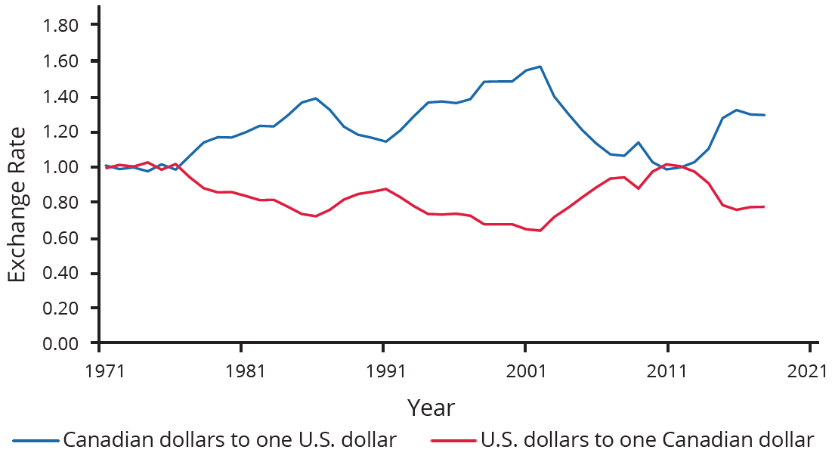
Example of Fluctuating Exchange Rates
Exchange rates tend to fluctuate substantially, even between bordering countries, such as the United States and Canada.
Notes:
Exchange rates tend to fluctuate substantially, even between bordering countries, such as the United States and Canada. Exchange rates can fluctuate a great deal in the short run.

Slide 7
Fluctuations of Exchange Rates
One of the most economically destructive effects of exchange rate fluctuations can happen through the banking system.
Financial institutions measure most international loans in a few large currencies, like U.S. dollars, European euros, and Japanese yen.
In countries that do not use these currencies, banks often borrow funds in one of these currencies and then lend in their own domestic currency.
This process of borrowing in a foreign currency and lending in a domestic currency can work well as long as the exchange rate does not shift.
Notes:
One of the most economically destructive effects of exchange rate fluctuations can happen through the banking system. Financial institutions measure most international loans in a few large currencies, like U.S. dollars, European euros, and Japanese yen. In countries that do not use these currencies, banks often borrow funds in one of these currencies and then lend in their own domestic currency. This process of borrowing in a foreign currency and lending in a domestic currency can work well as long as the exchange rate does not shift.

Slide 8
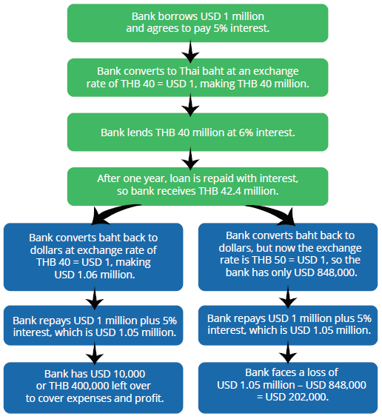
Problems with Fluctuations of Exchange Rates
Suppose a bank in Thailand borrows USD 1 million and converts the dollars to its domestic currency, baht (THB), at a rate of THB 40 per USD 1.
The bank then lends the baht to a Thai firm.
The firm repays the loan in baht, which the bank converts back to U.S. dollars to pay off its original loan.
If the dollar weakens and the baht strengthens, the bank makes a profit. If the dollar strengthens and the baht weakens, the bank faces a loss.

Slide 9

On Your Own
Suppose that the cost of producing an SUV for an American firm is USD 20,000. It sells the SUV in Mexico for MXN 500,000. Calculate the profit for the American firm if the exchange rate is MXN 20 = USD 1 and then if the dollar appreciates to MXN 30. What effect will the stronger dollar have on exports for this firm?
Notes:
Suppose that the cost of producing an SUV for an American firm is USD 20,000. It sells the SUV in Mexico for MXN 500,000. Calculate the profit for the American firm if the exchange rate is MXN 20 = USD 1 and then if the dollar appreciates to MXN 30. What effect will the stronger dollar have on exports for this firm?

Slide 10
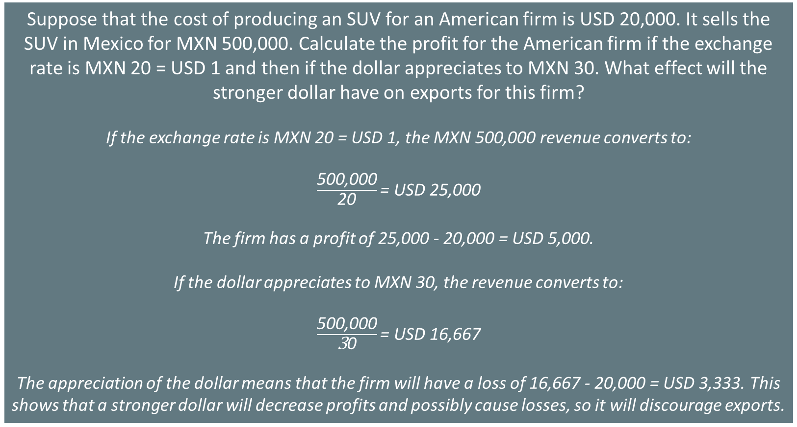
On Your Own
Suppose that the cost of producing an SUV for an American firm is USD 20,000. It sells the SUV in Mexico for MXN 500,000. Calculate the profit for the American firm if the exchange rate is MXN 20 = USD 1 and then if the dollar appreciates to MXN 30. What effect will the stronger dollar have on exports for this firm?
If the exchange rate is MXN 20 = USD 1, the MXN 500,000 revenue converts to:
$\frac{\text{500,000}}{\text{20}}\text{= }\text{USD}\text{ 25,000 }$
The firm has a profit of 25,000 - 20,000 = USD 5,000.
If the dollar appreciates to MXN 30, the revenue converts to:
$\frac{\text{500,000}}{\text{3}\text{0}}\text{= }\text{USD}\text{ 16,667 }$
The appreciation of the dollar means that the firm will have a loss of 16,667 - 20,000 = USD 3,333. This shows that a stronger dollar will decrease profits and possibly cause losses, so it will discourage exports.
Notes:
Suppose that the cost of producing an SUV for an American firm is USD 20,000. It sells the SUV in Mexico for MXN 500,000. Calculate the profit for the American firm if the exchange rate is MXN 20 = USD 1 and then if the dollar appreciates to MXN 30. What effect will the stronger dollar have on exports for this firm?

Slide 11
Summing Up Public Policy and Exchange Rates
Every nation would prefer a stable exchange rate to facilitate international trade and reduce the degree of risk and uncertainty.
A nation may sometimes want a weaker exchange rate to stimulate AD and reduce a recession or a stronger exchange rate to fight inflation.
Rapid movements from a weak to a strong exchange rate may cripple a country’s export industries.
Rapid movements from a strong to a weak exchange rate can cripple a country’s banking sector.
Every shift of an exchange rate—whether stronger or weaker, fixed or changing—represents potential tradeoffs.
Notes:
Every nation would prefer a stable exchange rate to facilitate international trade and reduce the degree of risk and uncertainty. A nation may sometimes want a weaker exchange rate to stimulate AD and reduce a recession or a stronger exchange rate to fight inflation. Rapid movements from a weak to a strong exchange rate may cripple a country’s export industries. Rapid movements from a strong to a weak exchange rate can cripple a country’s banking sector. Every shift of an exchange rate—whether stronger or weaker, fixed or changing—represents potential tradeoffs.

Slide 12
Summary
A central bank will be concerned about the exchange rate for several reasons:
  Exchange rates affect imports and exports and thus aggregate demand in the economy.
  Fluctuations in exchange rates may cause difficulties for many firms, but especially for banks. The exchange rate may accompany unsustainable flows of international financial capital.
  Rapid movements from a weak to a strong exchange rate may cripple a country’s export industries.
  Rapid movements from a strong to a weak exchange rate can cripple a country’s banking sector.
HAWKES LEARNING

Slide 13




HAWKES LEARNING

