Slide 1
HAWKES LEARNING
Changes in Equilibrium Price and Quantity:
The Four-Step Process
Principles of Economics
Notes:
By the end of this lesson, you’ll be able to identify and graph equilibrium price and quantity through the four-step process and graph and contrast shifts and slides along demand and supply curves.

Slide 2
Four-Step Process
Consider an economic event, like something that affects demand or supply. How does this economic event affect equilibrium price and quantity? The question can be analyzed using the four-step process.
Step 1: Draw a demand and supply model before the economic change occurs. Find the initial equilibrium values for price and quantity.
Step 3: Decide whether the economic change increases or decreases demand or supply. Draw the new demand or supply curve.
Step 4: Identify the new equilibrium price and quantity, and compare the original equilibrium to the new equilibrium.
Step 2: Decide whether the economic change you are analyzing affects demand or supply.
Notes:
Consider an economic event, like something that affects demand or supply. How does this economic event affect equilibrium price and quantity? The question can be analyzed using the four-step process. Step 1: Draw a demand and supply model before the economic change occurs. Find the initial equilibrium values for price and quantity. Step 2: Decide whether the economic change you are analyzing affects demand or supply. Step 3: Decide whether the economic change increases or decreases demand or supply. Draw the new demand or supply curve. Step 4: Identify the new equilibrium price and quantity, and compare the original equilibrium to the new equilibrium.

Slide 3
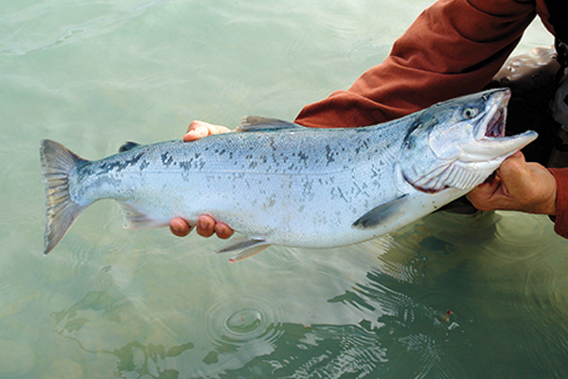
On Your Own
Assume that during a particular summer, weather conditions are perfect for salmon fishing. The rivers and oceans are healthy, allowing salmon to thrive. The ocean stayed calm during fishing season, so commercial fishing operations did not lose many days to bad weather. Using the four-step process, explain how climate conditions affect the quantity and price of salmon.

Slide 4
On Your Own
Step 1: Draw a demand and supply model to illustrate the market for salmon in the year before the good weather conditions began.
Step 2: Did the economic event affect supply or demand?
Step 3: Was the effect on supply an increase or a decrease?
Step 4: Compare the new equilibrium price and quantity to the original equilibrium.

Slide 5
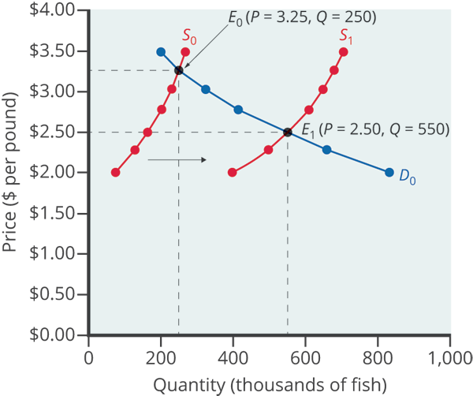
Four-Step Process
Good weather is an example of a natural condition that affects supply, not demand.
Good weather is a change in natural conditions that increases the quantity supplied at any given price, shifting the supply curve rightward.
Given the rightward shift in supply, equilibrium quantity increases while equilibrium price decreases.

Slide 6
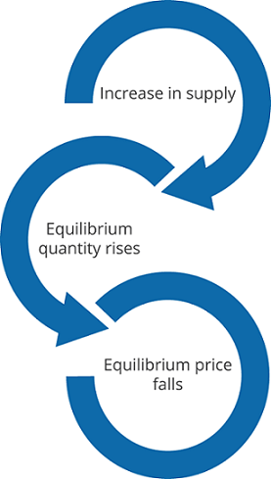
Four-Step Process
In short, good weather conditions increased the supply of salmon.
The result was a higher equilibrium quantity of salmon bought and sold in the market at a lower price.
If something like poor water quality decreased the salmon population, the exact opposite would be true.

Slide 7
The Interconnections and Speed of Adjustment in Real Markets
In the real world, many factors that affect demand and supply can change all at once.
For example, the demand for cars might increase because of rising incomes, and it might decrease because of rising gasoline prices.
Likewise, the supply of cars might increase because of innovative new technologies, and it might decrease as a result of regulations.
An economist sorts out all interconnected events by assuming ceteris paribus for each and combining the analyses to see the net effect.
Notes:
In the real world, many factors that affect demand and supply can change all at once. For example, the demand for cars might increase because of rising incomes and population, and it might decrease because of rising gasoline prices (a complementary good). Likewise, the supply of cars might increase because of innovative new technologies that reduce the cost of car production, and it might decrease as a result of new government regulations requiring the installation of costly pollution-control technology. An economist sorts out all interconnected events by assuming ceteris paribus for each and combining the analyses to see the net effect.

Slide 8

Effects of Simultaneous Changes in Demand and Supply
The U.S. Postal Service is facing difficult challenges. Compensation for postal workers tends to increase most years due to cost-of-living increases. At the same time, increasingly more people are using email, text, and other digital message forms, such as Facebook and Twitter, to communicate with friends and others. What does this suggest about the continued viability of the Postal Service?

Slide 9
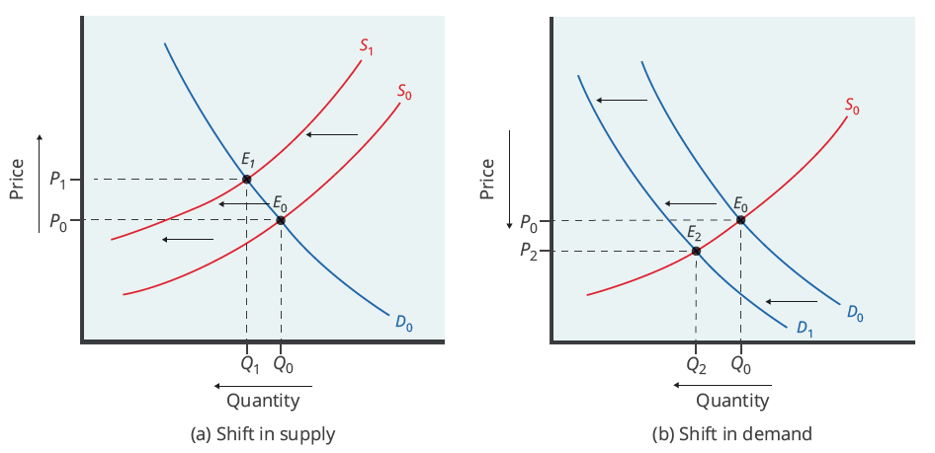
Effects of Simultaneous Changes in Demand and Supply
(a) Higher labor compensation causes a leftward shift in the supply curve, a decrease in the equilibrium quantity, and an increase in the equilibrium price. (b) A change in tastes away from postal services causes a leftward shift in the demand curve, a decrease in the equilibrium quantity, and a decrease in the equilibrium price.

Slide 10
Real-World Discussion
During the summer months, the price of gasoline often increases. This is usually because more people are on vacation and travel more at this time of the year. Summer is also a time when hurricanes occur and interfere with the operation of oil wells in the Gulf of Mexico. The combination of an increase in demand and a decrease in supply results in higher prices for gasoline.
Can you think of an example of changes in demand and/or supply that has affected the price of products that you buy?
Notes:
During the summer months, the price of gasoline often increases. This is usually because more people are on vacation and travel more at this time of the year. Summer is also a time when hurricanes occur and interfere with the operation of oil wells in the Gulf of Mexico. The combination of an increase in demand and a decrease in supply results in higher prices for gasoline.
Can you think of an example of changes in demand and/or supply that has affected the price of products that you buy?

Slide 11
Summary
When using the supply and demand framework to think about how an event will affect the equilibrium price and quantity, proceed through four steps:
Step 1: Draw a demand and supply model before the economic change occurs. Find the initial equilibrium values for price and quantity.
Step 3: Decide whether the economic change increases or decreases demand or supply. Draw the new demand or supply curve.
Step 4: Identify the new equilibrium price and quantity, and compare the original equilibrium to the new equilibrium.
Step 2: Decide whether the economic change you are analyzing affects demand or supply.
HAWKES LEARNING

Slide 12




HAWKES LEARNING

