Slide 1
HAWKES LEARNING
Fiscal Policy and the Trade Balance
Principles of Economics

Slide 2
Budget Deficit and Trade Deficit
A net inflow of foreign financial investment always accompanies a trade deficit, while a net outflow of financial investment always accompanies a trade surplus.
A higher level of imports, so long as exports remain fixed, will create a larger trade deficit.
If the U.S. purchases more imported goods, foreign countries use those dollars to invest in the U.S., leading to an inflow of foreign investment.
The CPI is subject to two types of bias: substitution bias and quality/new goods bias.
Both substitution bias and quality/new goods bias tend to overstate the negative impact of inflation on consumers.
A trade deficit often accompanies a budget deficit.
HAWKES LEARNING
Notes:
Net inflow of foreign financial investment always accompanies a trade deficit, while net outflow of financial investment always accompanies a trade surplus. A higher level of imports, so long as exports remain fixed, will create a larger trade deficit. If the U.S. purchases more imported goods, foreign countries use those dollars to invest in the U.S., leading to an inflow of foreign investment. A trade deficit often accompanies a budget deficit.

Slide 3
Twin Deficits
In the 1980s, economists and newspaper articles often referred to twin deficits as the budget deficit and trade deficit both grew substantially.
From 1981 to 1985, the federal budget deficit increased from 2.4% of GDP to 5.2%, while the trade deficit increased from 0.2% to 2.7%.
During this time, the inflow of foreign investment capital matched the increase in government borrowing, making the government budget deficit and trade deficit move together.
The CPI is subject to two types of bias: substitution bias and quality/new goods bias.
The budget and trade deficit do not always move together because the other components of the national saving and investment identity often change as well.
Both substitution bias and quality/new goods bias tend to overstate the negative impact of inflation on consumers.
HAWKES LEARNING
Notes:
In the 1980s, economists and newspaper articles often referred to twin deficits as the budget deficit and trade deficit both grew substantially. From 1981 to 1985, the federal budget deficit increased from 2.4% of GDP to 5.2%, while the trade deficit increased from 0.2% to 2.7%. During this time, the inflow of foreign investment capital matched the increase in government borrowing, making the government budget deficit and trade deficit move together. The budget and trade deficit do not always move together because the other components of the national saving and investment identity often change as well.

Slide 4
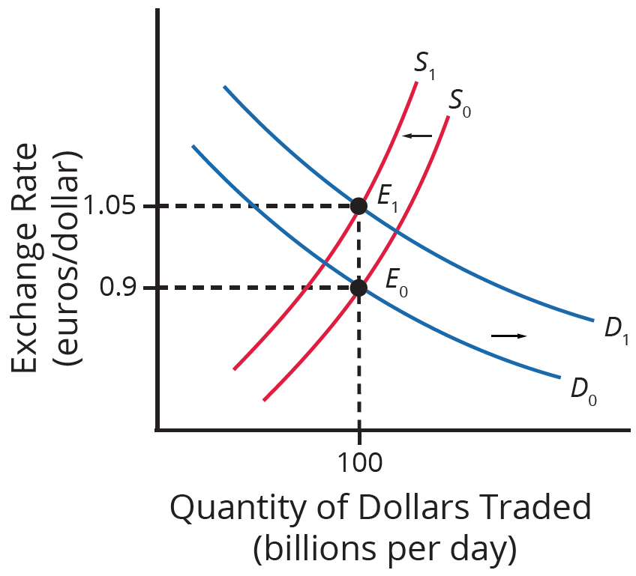
Exchange Rates
Exchange rates can also help explain why budget deficits are linked to trade deficits.
Suppose the budget deficit rises and the U.S. issues Treasury bonds to finance the deficit.
International investors will demand more dollars and supply fewer dollars.
The equilibrium exchange rate in the market for dollars increases.
The result is a trade deficit or a reduced trade surplus.
HAWKES LEARNING
Notes:
Budget deficit rises, U.S. issues Treasury bonds to finance deficit
International investors demand more dollars and supply fewer dollars
Equilibrium exchange rate in the market for dollars increases
Causes trade deficit or reduced trade surplus

Slide 5
Problems with Excessive Borrowing
It can be said that interest rates drive the exchange rate appreciation.
A budget deficit can:
Increase domestic interest rate
Attract inflow of foreign financial capital
Appreciate the value of the dollar
Cause Americans to buy fewer foreign bonds, supplying fewer dollars
Increase demand for domestic financial capital
Create a larger trade deficit (or a reduced trade surplus)
A larger budget deficit can lead to a larger trade deficit, but the connection is not always one to one.
HAWKES LEARNING
Notes:
It can be said that interest rates drive the exchange rate appreciation; a budget deficit can: increase domestic interest rate, attract inflow of foreign financial capital, appreciate the value of the dollar, cause Americans to buy fewer foreign bonds, supplying fewer dollars, increase demand for domestic financial capital, and create a larger trade deficit. A larger budget deficit can lead to a larger trade deficit, but the connection is not always one to one.

Slide 6
From Budget Deficit to Economic Crisis: Turkey
In the early 2000s, Turkey often borrowed dollars to finance budget deficits, leading to high levels of inflation.
In 2002, when investors from other countries withdrew their funds, the supply of the Turkish lira increased, causing it to depreciate.
Loans in dollars from the U.S. became more expensive for Turkish banks to repay due to the lira depreciating.
The CPI is subject to two types of bias: substitution bias and quality/new goods bias.
Many Turkish banks then went bankrupt, causing a large decrease in aggregate demand and a recession.
Both substitution bias and quality/new goods bias tend to overstate the negative impact of inflation on consumers.
HAWKES LEARNING
Notes:
In the early 2000s, Turkey often borrowed dollars to finance budget deficits, leading to high levels of inflation. In 2002, when investors from other countries withdrew their funds, the supply of the Turkish lira increased, causing it to depreciate in value. Loans in dollars from the U.S. became more expensive for Turkish banks to repay due to the lira depreciating. Many Turkish banks then went bankrupt, causing a large decrease in aggregate demand and a recession.

Slide 7

On Your Own
Imagine the U.S. dollar depreciates overnight. How would this affect your daily consumption? Would you decide to invest or save more? How will this affect the economy in the long run?
The CPI is subject to two types of bias: substitution bias and quality/new goods bias.
Both substitution bias and quality/new goods bias tend to overstate the negative impact of inflation on consumers.
HAWKES LEARNING
Notes:
Imagine the U.S. dollar depreciates overnight. How would this affect your daily consumption? Would you decide to invest or save more? How will this affect the economy in the long run?

Slide 8
Addressing Trade Imbalances
When the inflow of foreign investment capital is from foreign investors making long-term direct investments in firms, there may be no reason for concern.
The danger arises when foreign investment is not funding long-term physical capital investment but instead funding short-term portfolio investment in government bonds.
Foreign financial investors are on alert for any reason to fear a decrease in the exchange rate or a failure of repayment.
The CPI is subject to two types of bias: substitution bias and quality/new goods bias.
Reducing a nation's budget deficit is not always successful in reducing its trade deficit because other elements of the national saving and investment identity may change instead.
Both substitution bias and quality/new goods bias tend to overstate the negative impact of inflation on consumers.
HAWKES LEARNING
Notes:
When the inflow of foreign investment capital is from foreign investors making long-term direct investments in firms, there may be no reason for concern. The danger arises when foreign investment is not funding long-term physical capital investment but instead funding short-term portfolio investment in government bonds. Foreign financial investors are on alert for any reason to fear a decrease in the exchange rate or a failure of repayment. Reducing a nation's budget deficit is not always successful in reducing its trade deficit because other elements of the national saving and investment identity may change instead.

Slide 9
Summary
A sustained pattern of large budget deficits over time can lead to macroeconomic problems.
The budget and trade deficit do not always move together because the other components of the national saving and investment identity can change as well.
Large budget deficits can lead to inflation, recession, and financial crises.
When foreign investment funds short-term portfolio investments in government bonds rather than long-term physical capital improvements, trade imbalances are riskier.
HAWKES LEARNING

Slide 10




HAWKES LEARNING

