Slide 1
HAWKES LEARNING
International Trade and Its Effects on Jobs, Wages, and Working Conditions
Principles of Economics
Notes:
By the end of this lesson, you will be able to discuss how international trade influences the job market; analyze the opportunity cost of protectionism; and explain how international trade impacts wages, labor standards, and working conditions.

Slide 2
Imports
Imports
May cause fewer jobs, lower wages, or poor working conditions
Notes:
Imports affect workers in several different ways: fewer jobs, lower wages, or poor working conditions. The hidden opportunity cost of using protectionism to save jobs in one industry is jobs sacrificed in other industries.

Slide 3
Fewer Jobs?
In the early 1990s, the United States was negotiating the North American Free Trade Agreement (NAFTA) with Mexico.
NAFTA was an agreement that reduced tariffs, import quotas, and nontariff barriers to trade between the U.S., Mexico, and Canada.
For the next six years, the United States economy had some of the most rapid job growth and low unemployment in its history.
Those who feared that open trade with Mexico would lead to a dramatic decrease in jobs were proven wrong.
Notes:
In the early 1990s, the United States was negotiating the North American Free Trade Agreement (NAFTA) with Mexico. NAFTA was an agreement that reduced tariffs, import quotas, and nontariff barriers to trade between the U.S., Mexico, and Canada. For the next six years, the United States economy had some of the most rapid job growth and low unemployment in its history. Those who feared that open trade with Mexico would lead to a dramatic decrease in jobs were proven wrong.

Slide 4
Opportunity Cost of Protectionism
Protectionism saves jobs in the specific industry being protected but, for two reasons, it costs jobs in other unprotected industries.
If consumers are paying higher prices to the protected industry, they inevitably have less money to spend on goods from other industries, so jobs are lost in those other industries.
If a firm sells the protected product to other firms so that other firms must now pay a higher price for a key input, those firms will lose sales to foreign producers who do not need to pay the higher price. Lost sales translate into lost jobs.
The hidden opportunity cost of using protectionism to save jobs in one industry is jobs sacrificed in other industries.
Notes:
Protectionism saves jobs in the specific industry being protected but, for two reasons, it costs jobs in other unprotected industries. If consumers are paying higher prices to the protected industry, they inevitably have less money to spend on goods from other industries, so jobs are lost in those other industries. If a firm sells the protected product to other firms so that other firms must now pay a higher price for a key input, those firms will lose sales to foreign producers who do not need to pay the higher price. Lost sales translate into lost jobs. The hidden opportunity cost of using protectionism to save jobs in one industry is jobs sacrificed in other industries.

Slide 5

Opportunity Cost of Protectionism
Saving a job through protectionism can be very expensive. A study from 2002 compiled evidence that showed using protectionism to save an average job in the textile and apparel industry would cost $199,000 per job saved.
Notes:
Saving a job through protectionism can be very expensive. A study from 2002 compiled evidence that showed using protectionism to save an average job in the textile and apparel industry would cost $199,000 per job saved.

Slide 6
Opportunity Cost of Protectionism
Why does it cost so much to save jobs through protectionism? The basic reason is that not all the extra money that consumers pay because of tariffs or quotas goes to save jobs. For example, if the government imposes tariffs on steel imports so that steel buyers pay a higher price, U.S. steel companies might do the following:
Earn greater profits
Buy more equipment
Pay bigger bonuses to managers
Give pay raises to existing employees
Avoid firing some additional workers
Notes:
Why does it cost so much to save jobs through protectionism? The basic reason is that not all the extra money that consumers pay because of tariffs or quotas goes to save jobs. For example, if the government imposes tariffs on steel imports so that steel buyers pay a higher price, U.S. steel companies might do the following: Earn greater profits. Buy more equipment. Pay bigger bonuses to managers. Give pay raises to existing employees. Avoid firing some additional workers

Slide 7
Trade and Wages
Even if trade does not reduce the number of jobs, it could affect wages.
It is important to separate issues about the average wage level from issues about whether trade will hurt the wages of certain workers.
Because trade raises the amount that an economy can produce, it will also cause the average level of wages in an economy to rise.
By contrast, barriers to trade will reduce the average level of wages in an economy.
Even if trade increases the overall wage level, it will still benefit some workers and hurt others.
Notes:
Even if trade does not reduce the number of jobs, it could affect wages. It is important to separate issues about the average wage level from issues about whether trade will hurt the wages of certain workers. Because trade raises the amount that an economy can produce, it will also cause the average level of wages in an economy to rise. By contrast, barriers to trade will reduce the average level of wages in an economy. Even if trade increases the overall wage level, it will still benefit some workers and hurt others.

Slide 8
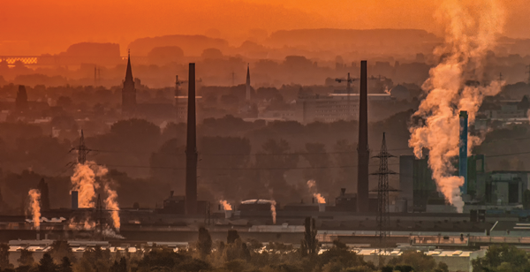
Labor Standards and Working Conditions
Labor conditions can vary widely across countries.
Notes:
Labor conditions can vary widely across countries.

Slide 9
Labor Standards and Working Conditions
Workers in many low-income countries around the world labor under conditions that would be illegal in America. Workers in the following countries often make less than the minimum wage in the U.S.:
China
Thailand
Brazil
South Africa
Poland
Notes:
Workers in many low-income countries around the world labor under conditions that would be illegal in America. Workers in the following countries often make less than the minimum wage in the U.S.: China, Thailand, Brazil, South Africa, Poland

Slide 10
Labor Standards and Working Conditions
In the United States, the minimum wage is $7.25 per hour.
A typical wage in many low-income countries might be more like $7.25 per day or (often) less.
Working conditions in low-income countries may be extremely unpleasant or unsafe.
In the worst cases, production may involve child labor or workers who are treated like slaves.
Notes:
In the United States, the minimum wage is $7.25 per hour. A typical wage in many low-income countries might be more like $7.25 per day or (often) less. Working conditions in low-income countries may be extremely unpleasant or unsafe. In the worst cases, production may involve child labor or workers who are treated like slaves.

Slide 11
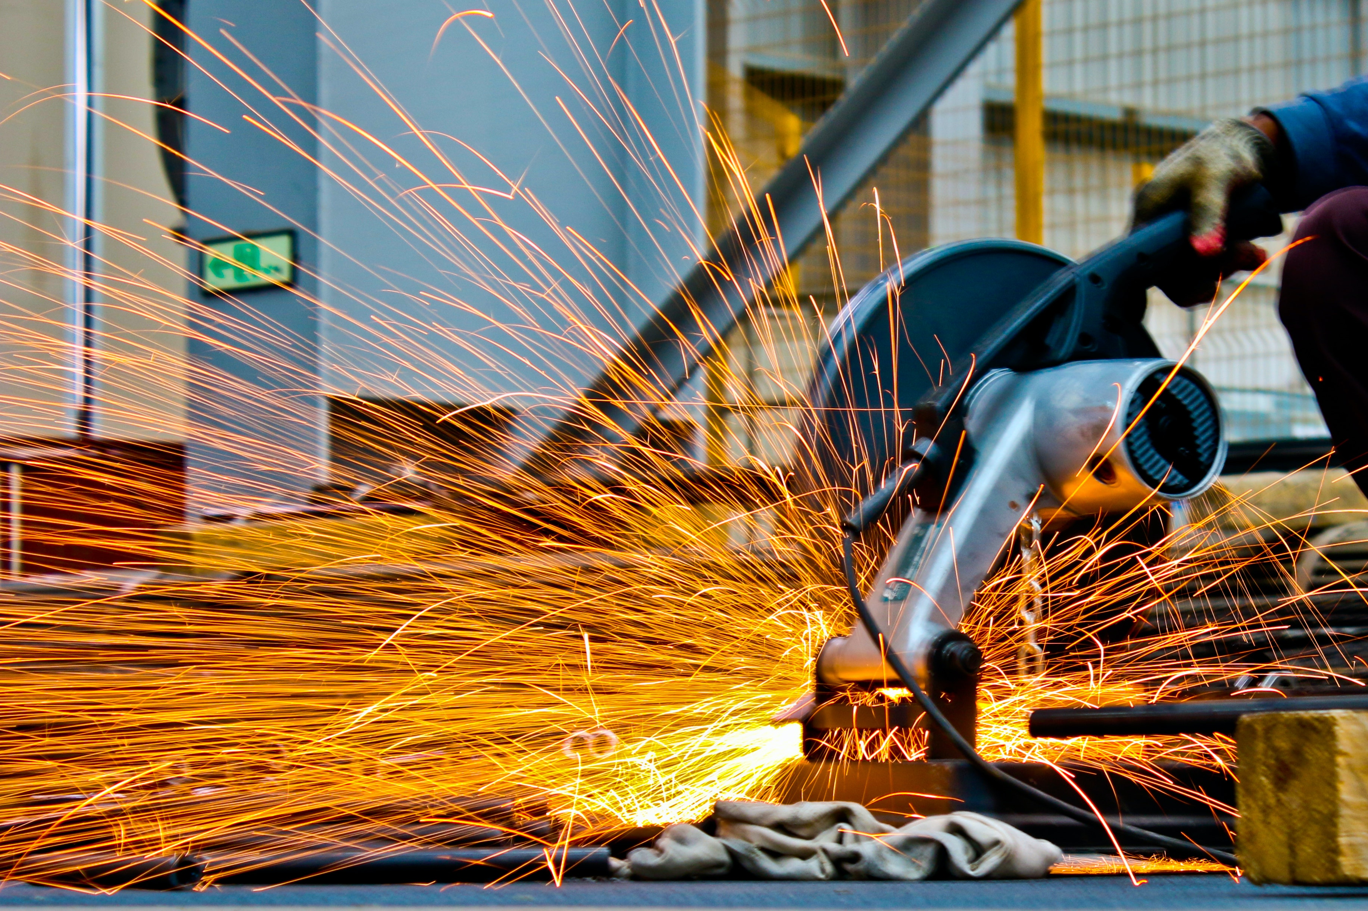
Real World Example
President Trump imposed tariffs on imported steel in order to “bring back jobs to the U.S. steel industry.” Do you think tariffs achieved this goal? Why or why not?
HAWKES LEARNING
Notes:
President Trump imposed tariffs on imported steel in order to “bring back jobs to the U.S. steel industry.” Do you think tariffs achieve this goal? Why or why not?

Slide 12
Summary
As international trade increases, it contributes to a shift in jobs away from industries where that economy does not have a comparative advantage and toward industries where it does have a comparative advantage.
The degree to which trade affects labor markets has much to do with the structure of the labor market in that country and the adjustment process in other industries.
Global trade should raise the average level of wages by increasing productivity, however, this increase in average wages may include both gains to workers in certain jobs and industries and losses to others.
Low wages and long working hours in poor countries are unpleasant to think about, but for people in low-income parts of the world, it may well be the best option open to them.
HAWKES LEARNING

Slide 13




HAWKES LEARNING

