Slide 1
HAWKES LEARNING
Arguments in Support of Restricting Imports
Principles of Economics
Notes:
By the end of this lesson, you will be able to explain and analyze various arguments that are in support of restricting imports; explain dumping; and evaluate the significance of countries’ perceptions on the benefits of growing trade.

Slide 2
Introduction
Protectionism requires domestic consumers of a product to pay higher prices to benefit domestic producers of that product.
Countries that institute protectionist policies lose the economic gains achieved through comparative advantage, specialized learning, and economies of scale.
With these overall costs in mind, let us now consider, one by one, a number of arguments that support restricting imports.
Notes:
Protectionism requires domestic consumers of a product to pay higher prices to benefit domestic producers of that product. Countries that institute protectionist policies lose the economic gains achieved through comparative advantage, specialized learning, and economies of scale. With these overall costs in mind, let us now consider, one by one, a number of arguments that support restricting imports.

Slide 3

Infant Industry Argument
The infant industry argument for protectionism is to block imports for a limited time to give the infant industry time to mature before it starts competing on equal terms in the global economy.
Notes:
The infant industry argument for protectionism is to block imports for a limited time to give the infant industry time to mature before it starts competing on equal terms in the global economy.

Slide 4

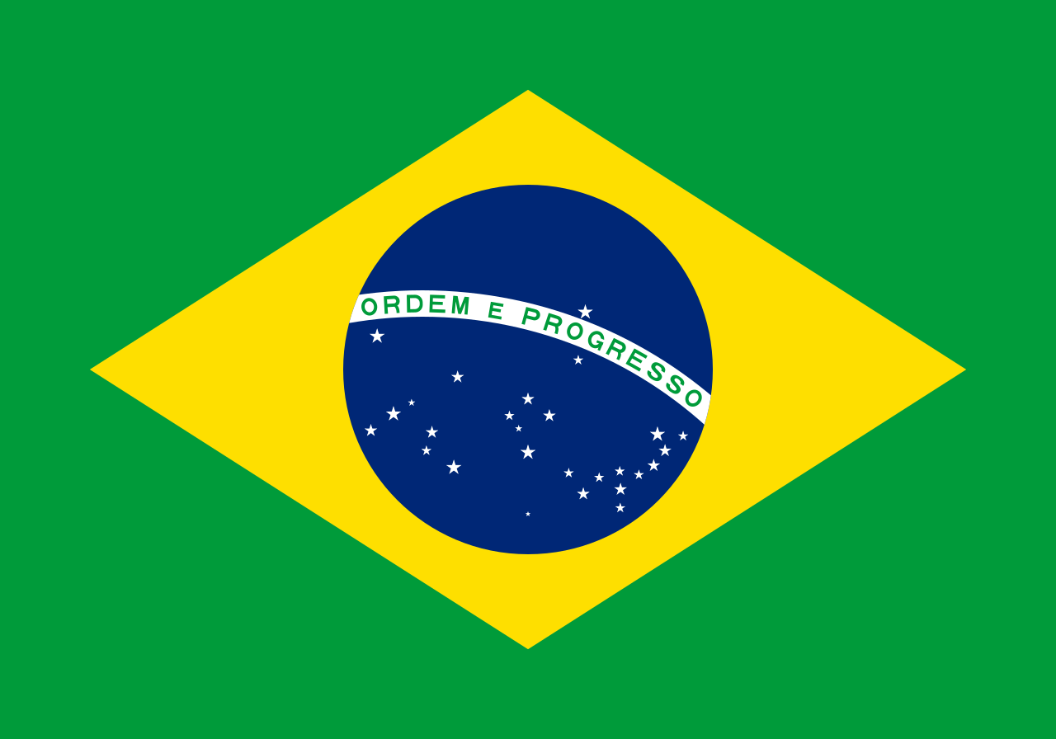
Brazil’s Computer Infant Industry
In an attempt to establish its computer industry in the global economy, Brazil largely barred imports of computer products for several decades. However, by the mid-1980s, due to lack of international competition, Brazil had a backward and out-of-date industry, typically lagging behind world standards for price and performance by three to five years.
Notes:
In many countries, infant industries have gone from babyhood to senility and obsolescence without ever having reached the profitable maturity stage. As one example, Brazil treated its computer industry as an infant industry from the late 1970s until about 1990. In an attempt to establish its computer industry in the global economy, Brazil largely barred imports of computer products for several decades. However, by the mid-1980s, due to lack of international competition, Brazil had a backward and out-of-date industry, typically lagging behind world standards for price and performance by three to five years. Brazilians were unable to benefit from up-to-date computers and phased out its infant industry policy for the computer industry.

Slide 5
The Anti-Dumping Argument
Dumping refers to selling goods below their cost of production.
Anti-dumping laws block imports that are sold below the cost of production by imposing tariffs that increase the price of these imports to reflect their cost of production.
Anti-dumping complaints rose from about 100 cases per year in the late 1980s to about 200 new cases each year by the late 2000s.
Notes:
Dumping refers to selling goods below their cost of production. Anti-dumping laws block imports that are sold below the cost of production by imposing tariffs that increase the price of these imports to reflect their cost of production. Anti-dumping complaints rose from about 100 cases per year in the late 1980s to about 200 new cases each year by the late 2000s.

Slide 6
Why Might Dumping Occur?
This question has two possible answers: one innocent and one more sinister.
The innocent explanation is that demand and supply set market prices, not the cost of production.
When a local store has a going-out-of-business sale, for example, it may sell goods below the cost of production.
The sinister explanation is that dumping is part of a long-term strategy.
Foreign firms sell goods at prices below the cost of production, and once U.S. competition is driven out, they then raise prices.
Notes:
This question has two possible answers: one innocent and one more sinister. The innocent explanation is that demand and supply set market prices, not the cost of production. When a local store has a going-out-of-business sale, for example, it may sell goods below the cost of production. The sinister explanation is that dumping is part of a long-term strategy. Foreign firms sell goods at prices below the cost of production, and once U.S. competition is driven out, they then raise prices.

Slide 7
Should Anti-Dumping Cases Be Limited?
In terms of economic theory, the case for anti-dumping laws is weak.
In a market governed by demand and supply, the government does not guarantee that firms will be able to make a profit.
After all, low prices are difficult for producers but benefit consumers.
Although there are cases in which foreign producers have driven out domestic firms, there are zero documented cases of jacked up prices.
Foreign producers typically continue competing hard against each other and providing low prices to consumers.
Notes:
In terms of economic theory, the case for anti-dumping laws is weak. In a market governed by demand and supply, the government does not guarantee that firms will be able to make a profit. After all, low prices are difficult for producers but benefit consumers. Although there are cases in which foreign producers have driven out domestic firms, there are zero documented cases of jacked up prices. Foreign producers typically continue competing hard against each other and providing low prices to consumers.

Slide 8

Real World Example
In 2004, the U.S. accused Canada of dumping lumber. What does this mean, and what effect would dumping have on the U.S. lumber market?
HAWKES LEARNING
Notes:
In 2004, the U.S. accused Canada of dumping lumber. What does this mean, and what effect would dumping have on the U.S. lumber market?

Slide 9
Real World Example
In 2004, the U.S. accused Canada of dumping lumber. What does this mean, and what effect would dumping have on the U.S. lumber market?
Dumping means that the Canadians were accused of selling lumber at a price below its average cost of production. If the price was low enough and the dumping continued for a long period of time, it could drive U.S. lumber companies out of business. Then with less competition from U.S. lumber companies, the Canadian lumber companies could increase the price of lumber imported to the U.S. However, the ability of the Canadian lumber companies to increase price would be limited by competition from lumber companies in places other than the U.S.
HAWKES LEARNING
Notes:
In 2004, the U.S. accused Canada of dumping lumber. What does this mean, and what effect would dumping have on the U.S. lumber market? Dumping means that the Canadians were accused of selling lumber at a price below its average cost of production. If the price was low enough and the dumping continued for a long period of time, it could drive U.S. lumber companies out of business. Then with less competition from U.S. lumber companies, the Canadian lumber companies could increase the price of lumber imported to the U.S. However, the ability of the Canadian lumber companies to increase price would be limited by competition from lumber companies in places other than the U.S.

Slide 10
The Environmental Protection Argument
The potential for global trade to affect the environment has become controversial.
If free trade meant the destruction of life itself, even economists would convert to protectionism.
While globalization can pose environmental dangers, with safeguards in place, we can minimize the environmental impacts of trade.
High-income countries typically have relatively strict environmental standards, while lower-income countries do not.
Notes:
The potential for global trade to affect the environment has become controversial. If free trade meant the destruction of life itself, even economists would convert to protectionism. While globalization can pose environmental dangers, with safeguards in place, we can minimize the environmental impacts of trade. High-income countries typically have relatively strict environmental standard, while lower-income countries do not.

Slide 11
The Race-to-the-Bottom Scenario
Profit-seeking companies shift their production from countries with strong environmental standards to countries with weak standards.
Countries may reduce their environmental standards to attract multinational firms, which, after all, provide jobs and economic clout.
Global production becomes concentrated in countries where firms can pollute the most, and environmental laws "race to the bottom."
Although the race-to-the-bottom scenario sounds plausible, it does not appear to describe reality.
Notes:
Profit-seeking companies shift their production from countries with strong environmental standards to countries with weak standards. Countries may reduce their environmental standards to attract multinational firms, which, after all, provide jobs and economic clout. Global production becomes concentrated in countries where firms can pollute the most, and environmental laws "race to the bottom.“ Although the race-to-the-bottom scenario sounds plausible, it does not appear to describe reality.

Slide 12
Pressuring Low-Income Countries for Higher Environmental Standards
The threat of blocking international trade can pressure lower-income countries into adopting stronger environmental standards.
However, it would be undemocratic for the well-fed citizens of high-income countries to dictate to the ill-fed citizens of low-income countries what domestic policies and priorities they must adopt or how they should balance environmental goals against other priorities.
If high-income countries want stronger environmental standards in low-income countries, they don’t have to threaten protectionism.
For example, high-income countries could pay for anti-pollution equipment in low-income countries or help pay for national parks.
Notes:
The threat of blocking international trade can pressure lower-income countries into adopting stronger environmental standards. It would be undemocratic for the well-fed citizens of high-income countries to dictate to the ill-fed citizens of low-income countries. If high-income countries want stronger environmental standards in low-income countries, they don’t have to threaten protectionism. For example, high-income countries could pay for anti-pollution equipment in low-income countries or help pay for national parks.

Slide 13
The Unsafe Consumer Products Argument
One argument for shutting out certain imported products is that they are unsafe for consumers.
Consumer rights groups have warned that the WTO would require nations to reduce their health and safety standards for imports.
However, the WTO says it allows countries to set their own standards and “Regulations must be based on science…And they should not be arbitrarily or unjustifiably discriminate between countries where identical or similar conditions prevail.”
It is improper to impose one set of health and safety standards for domestically produced goods but different standards for imports.
Notes:
One argument for shutting out certain imported products is that they are unsafe for consumers. Consumer rights groups have warned that the WTO would require nations to reduce their health and safety standards for imports. It is improper to impose one set of health and safety standards for domestically produced goods but different standards for imports.

Slide 14
The National Interest Argument
Some argue that a nation should not depend too heavily on other countries for supplies of certain key products, such as oil.
On closer consideration, this argument for protectionism proves rather weak.
As an example, in the U.S., oil provides about 36% of all the energy, and 25% of the oil used in the United States economy is imported.
When disruptions in the Middle East have sharply raised the price of oil, the effects have been felt across the U.S. economy.
This is not, however, a very convincing argument for restricting oil imports.
Notes:
Some argue that a nation should not depend too heavily on other countries for supplies of certain key products, such as oil. On closer consideration, this argument for protectionism proves rather weak. As an example, in the U.S., oil provides about 36% of all the energy, and 25% of the oil used in the United States economy is imported. When disruptions in the Middle East have sharply raised the price of oil, the effects have been felt across the U.S. economy. This is not, however, a very convincing argument for restricting oil imports.

Slide 15
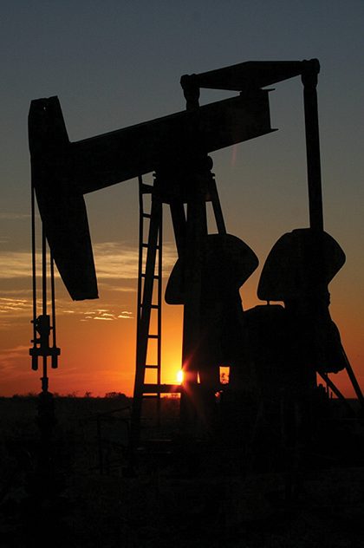
The National Interest Argument
If the United States needs to be protected from a possible cutoff of foreign oil, a more reasonable strategy would be to import 100% of the petroleum supply now and save U.S. domestic oil resources for when or if the foreign supply is cut off.
It does not make sense to argue that because oil is highly important to the United States economy, the United States should shut out oil imports and use up its domestic supplies more quickly.
Notes:
If the United States needs to be protected from a possible cutoff of foreign oil, a more reasonable strategy would be to import 100% of the petroleum supply now and save U.S. domestic oil resources for when or if the foreign supply is cut off. It does not make sense to argue that because oil is highly important to the United States economy, the United States should shut out oil imports and use up its domestic supplies more quickly.

Slide 16

On Your Own
Suppose consumers in the U.S. find out that cutting trees to get the wood used in outdoor furniture imported from Brazil is depleting the Amazon rainforest at an alarming rate. What can the U.S. do to end this practice?
HAWKES LEARNING
Notes:
Suppose consumers in the U.S. find out that cutting trees to get the wood used in outdoor furniture imported from Brazil is depleting the Amazon rainforest at an alarming rate. What can the U.S. do to end this practice?

Slide 17
On Your Own
Suppose consumers in the U.S. find out that cutting trees to get the wood used in outdoor furniture imported from Brazil is depleting the Amazon rainforest at an alarming rate. What can the U.S. do to end this practice?
The U.S. could restrict imports of the outdoor furniture from Brazil with tariffs or quotas. Less severe policies include helping to fund studies on the impact of damage to the rainforest and national parks to protect the forest.
HAWKES LEARNING
Notes:
Suppose consumers in the U.S. find out that cutting trees to get the wood used in outdoor furniture imported from Brazil is depleting the Amazon rainforest at an alarming rate. What can the U.S. do to end this practice? The U.S. could restrict imports of the outdoor furniture from Brazil with tariffs or quotas. Less severe policies include helping to fund studies on the impact of damage to the rainforest and national parks to protect the forest.

Slide 18
Summary
There are a number of arguments that support restricting imports based around industry and competition, environmental concerns, and issues of safety and security.
The infant industry argument for protectionism is that small domestic industries need to be temporarily nurtured and protected from foreign competition for a time so that they can grow into strong competitors.
Arguments against dumping (which is setting prices below the cost of production to drive competitors out of the market) often simply seem to be a convenient excuse for imposing protectionism.
Low-income countries typically have lower environmental standards than high-income countries because they are more worried about immediate basics, such as food, education, and health care.
HAWKES LEARNING

Slide 19




HAWKES LEARNING

