Slide 1
HAWKES LEARNING
Production in the Short Run
Principles of Economics
Notes:
Today we will look at production in the short run.

Slide 2
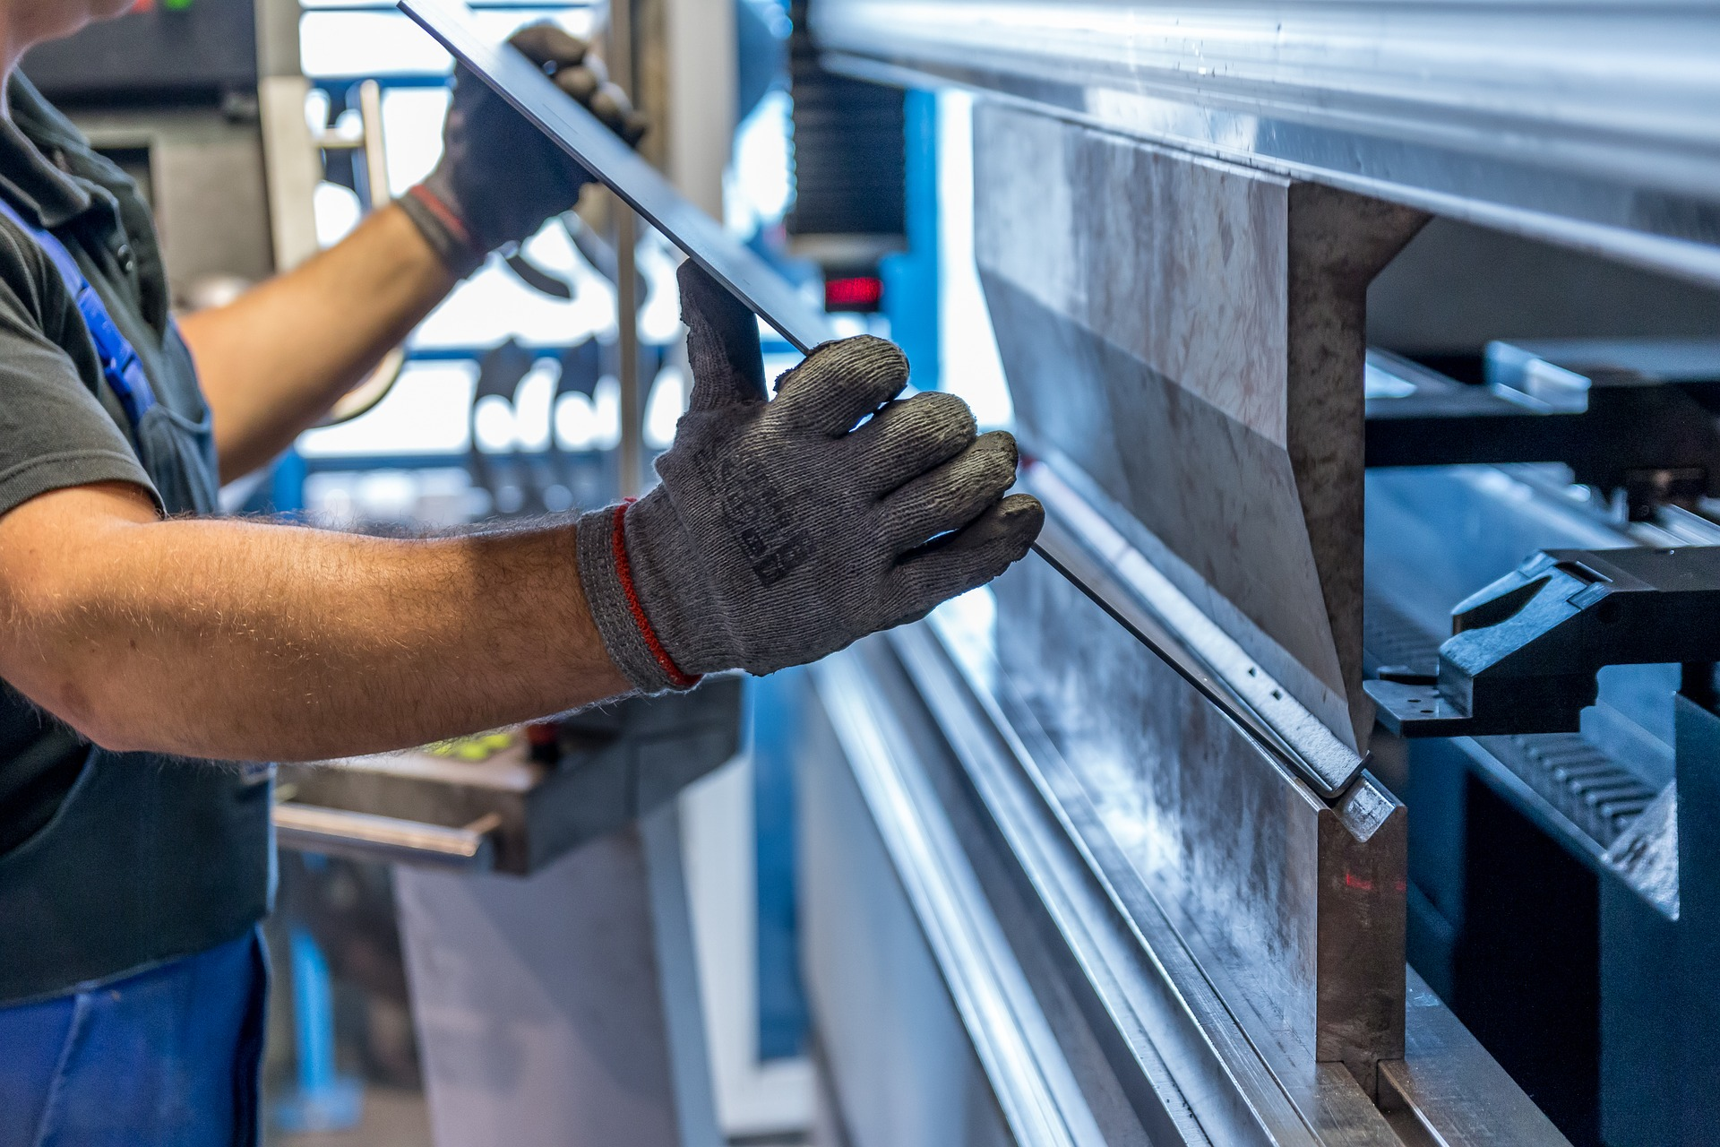
Production in the Short Run
In the short run, there are many factors a firm must consider in order for production to run smoothly. This lesson will focus on the relationship between the quantity of output a firm produces and the cost of producing that output.
Notes:
In the short run, there are many factors a firm must consider in order for production to run smoothly. This lesson will focus on the relationship between the quantity of output a firm produces and the cost of producing that output.

Slide 3
Factors of Supply
Recall that "output" is another word for "supply". Some factors of supply curves are listed below.
Cost of inputs- As the costs of inputs rise, the cost for the supply will also increase.
Technology- As technology improves, firms may be able to produce more at a faster rate, which will decrease the cost of supply.
Opportunity Costs- Associated with the cost of supply by factoring in what a firm gives up to produce the current product.
Expectations- Can change supply during different seasons, like expecting more pumpkins during Halloween.
Notes:
Recall that "output" is another word for "supply." Some factors of supply curves are listed below. Cost of inputs- As the costs of inputs rise, the cost for the supply will also increase. Technology- As technology improves, firms may be able to produce more at a faster rate, also decreasing the cost of supply. Opportunity Costs- Associated with the cost of supply by factoring in what a firm gives up to produce the current product. Expectations- Change supply during different seasons, like expecting more pumpkins during Halloween.

Slide 4
Production
Production is the process a firm uses to transform inputs into outputs.
Inputs include things like labor, capital, and raw materials while output is the goods or services a firm wishes to sell.
For example, a pizzaiolo uses tomatoes, spices, and water in order to make pizza sauce.
Notes:
Production is the process a firm uses to transform inputs into outputs. Inputs include things like labor, capital, and raw materials while the output is the goods or services a firm wishes to sell. For example, a pizzaiolo uses tomatoes, spices, and water in order to make pizza sauce.

Slide 5
Factors of Production
Economists divide factors of production into several categories.
Natural Resources (Land and Raw Materials)
Labor
Capital
Technology
Entrepreneurship
Notes:
Economists divide factors of production into several categories: natural resources (land and raw materials), labor, capital, technology, and entrepreneurship.

Slide 6

Pizza Making
Consider pizza making. What are the inputs (or factors of production) in the production process for running a pizza shop successfully?
Notes:
Consider pizza making. What are the inputs (or factors of production) in the production process for running a pizza shop successfully?

Slide 7
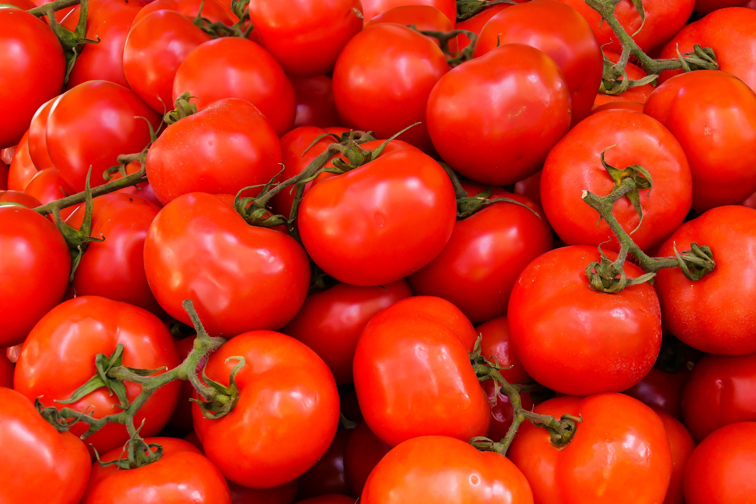
Natural Resources (Land and Raw Materials) (NR)
The ingredients for the pizza are raw materials. These include the flour, yeast, and water for the dough; the tomatoes, herbs, and water for the sauce; the cheese; and the toppings. In addition, the wood or gas used to heat the oven and the electricity used in the establishment would be included.
Notes:
The ingredients for the pizza are raw materials. These include the flour, yeast, and water for the dough; the tomatoes, herbs, and water for the sauce; the cheese; and the toppings. In addition, the wood or gas used to heat the oven and the electricity used in the establishment would be included.

Slide 8
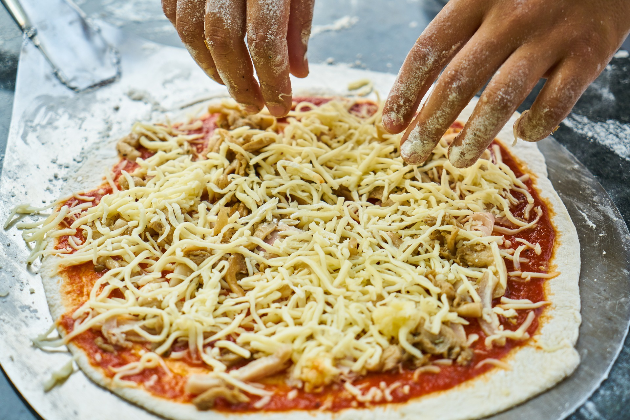
Labor (L)
Labor means human effort, both physical and mental. The pizzaiolo was the primary example of labor here. He or she needs to be strong enough to roll out the dough and to insert and retrieve the pizza from the oven, but he or she also needs to know how to make the pizza, how long it cooks in the oven, and a myriad of other aspects of pizza-making.
Notes:
Labor means human effort, both physical and mental. The pizzaiolo was the primary example of labor here. He or she needs to be strong enough to roll out the dough and to insert and retrieve the pizza from the oven, but he or she also needs to know how to make the pizza, how long it cooks in the oven, and a myriad of other aspects of pizza-making.

Slide 9

Capital (K)
When economists uses the term capital, they mean physical capital: the machines, equipment, and buildings that one uses to produce the product. In the case of pizza, the capital includes the peel, the oven, the building, and any other necessary equipment (for example, tables and chairs).
Notes:
When economists uses the term capital, they mean physical capital: the machines, equipment, and buildings that one uses to produce the product. In the case of pizza, the capital includes the peel, the oven, the building, and any other necessary equipment (for example, tables and chairs).

Slide 10
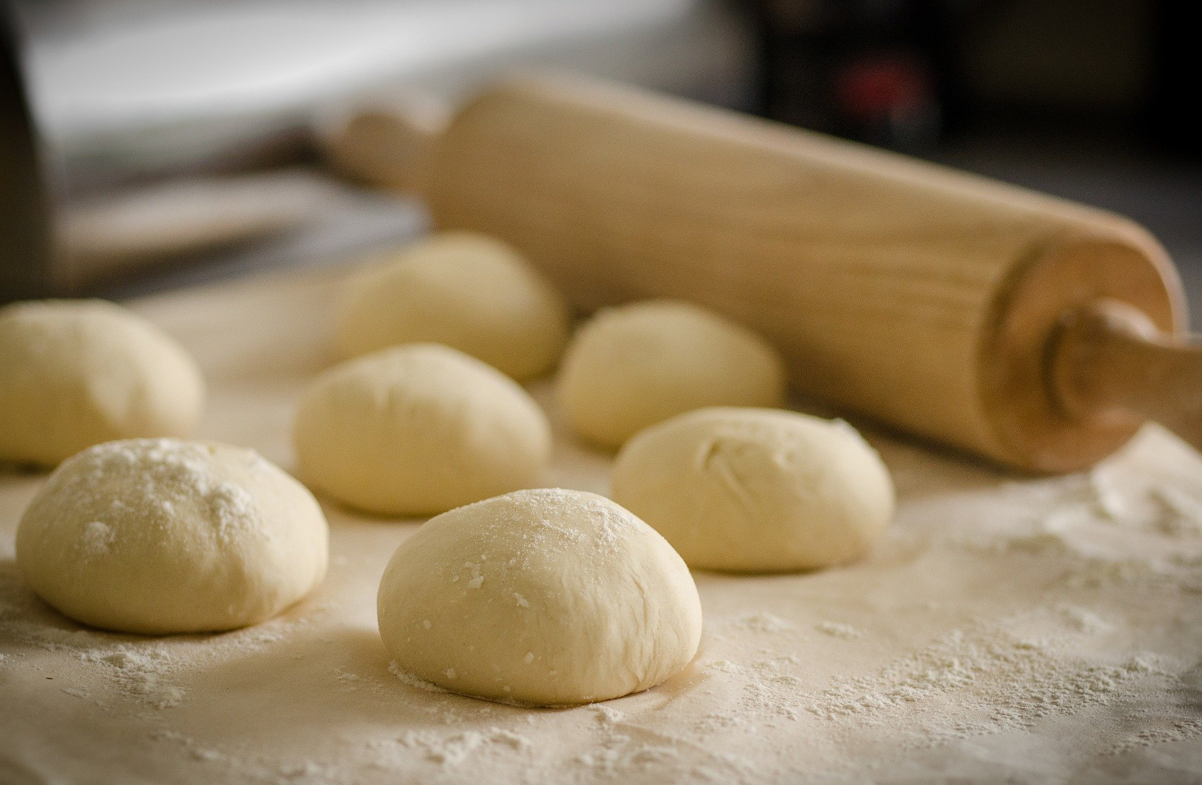
Technology (t)
Technology refers to the process or processes for producing the product. How does the pizzaiolo combine ingredients to make pizza? How hot should the oven be? Should the restaurant make its own dough, sauce, cheese, toppings, or should it buy them?
Notes:
Technology refers to the process or processes for producing the product. How does the pizzaiolo combine ingredients to make pizza? How hot should the oven be? Should the restaurant make its own dough, sauce, cheese, toppings, or should it buy them?

Slide 11

Entrepreneurship (E)
Production involves many decisions and much knowledge, even for something as simple as pizza. Who makes those decisions? Ultimately, it is the entrepreneur: the person who creates the business, whose idea it is to combine the inputs to produce the outputs.
Notes:
Production involves many decisions and much knowledge, even for something as simple as pizza. Who makes those decisions? Ultimately, it is the entrepreneur: the person who creates the business, whose idea it is to combine the inputs to produce the outputs.

Slide 12

The Production Function
The production function is a mathematical expression or equation that explains the relationship between inputs and outputs.
The production function gives the answer to the question, "How much output can the firm produce given different amounts of inputs?"
$$Q=f\left[NR, L, K, t, E\right]$$
Notes:
The production function is a mathematical expression or equation that explains the relationship between inputs and outputs. The production function gives the answer to the question, "How much output can the firm produce given different amounts of inputs?"

Slide 13
Inputs
Inputs can be described as either fixed or variable.
Fixed inputs are those that can't easily be increased or decreased in a short period of time, like a pizza parlor’s building.
Variable inputs are those that can easily be increased or decreased in a short period of time, like ingredients for a pizza.
Notes:
Inputs can be described as either fixed or variable. Fixed inputs are those that can't easily be increased or decreased in a short period of time, like a pizza parlor’s building. Variable inputs are those that can easily be increased or decreased in a short period of time, like ingredients for a pizza.

Slide 14

Cobb-Douglas Production Function
Economists often use a shortened version of the production function called the Cobb-Douglas production function.
The Cobb-Douglas production function simplifies output as a function of labor (L) and capital (K).
$$Q=f\left[L, K\right]$$
inputs
production function
output (Q)
Notes:
Economists often use a shortened version of the production function called the Cobb-Douglas production function. The Cobb-Douglas production function simplifies output as a function of labor (L) and capital (K). This makes it easier to see the production process as inputs going into a production function, leading to output.

Slide 15
Short Run vs. Long Run
Economists differentiate between short- and long-run production.
The short run is the period of time during which at least some factors of production are fixed.
The long run is the period of time during which all factors are variable.
For example, a restaurant changing ingredients is feasible during the short run, but moving buildings is only feasible in the long run.
Notes:
Economists differentiate between short- and long-run production. The short run is the period of time during which at least some factors of production are fixed. The long run is the period of time during which all factors are variable. For example, a restaurant changing ingredients is feasible during the short run, but moving buildings is only feasible in the long run.

Slide 16


Production in the Short Run
Since, by definition, capital is fixed in the short run, the production function becomes:
$$Q=f[L,K]$$
or
$$Q=f[L]$$

Slide 17
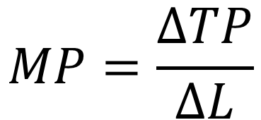
Marginal Product
Output is also called total product, which means the amount of output produced with a given amount of labor and a fixed amount of capital.
Increasing the amount of labor will often increase total product, as more workers can produce more output.
Marginal product of labor is the additional output of one more worker.
$$MP=\frac{ΔTP}{ΔL}$$
Notes:
Output is also called total product, which means the amount of output produced with a given amount of labor and a fixed amount of capital. Increasing the amount of labor will often increase total product, as more workers can produce more output. Marginal product is the additional output of one more worker.

Slide 18
On Your Own
Consider the following table:
Dog walkers hired (L) | 1 | 2 | 3 | 4
Dogs walked (TP) | 10 | 15 | 16 | 16
Calculate the marginal product of dogs walked by hiring a second dog walker.
Notes:
Calculate the marginal product of dogs walked by hiring a second dog walker.

Slide 19
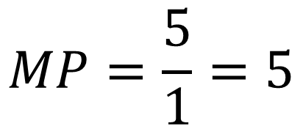
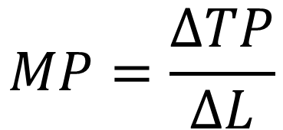
On Your Own
Dog walkers hired (L) | 1 | 2 | 3 | 4
Dogs walked (TP) | 10 | 15 | 16 | 16
$$MP=\frac{ΔTP}{ΔL}$$
$$MP=\frac{5}{1}=5$$
Hiring a second dog walker increases the total number of dogs walked from 10 to 15, indicating a marginal product of 5.
Notes:
Hiring a second dog walker increases the total number of dogs walked from 10 to 15, indicating a marginal product of 5.

Slide 20
Law of Diminishing Marginal Productivity
Sooner or later, additional workers will have decreasing marginal product.
This is called the law of diminishing marginal productivity, and it's a characteristic of production in the short run.
Diminishing marginal productivity is very similar to the concept of diminishing marginal utility.
If a pizza shop has one oven, adding additional workers will eventually lead to “too many cooks in the kitchen”, hindering productivity.
Notes:
Sooner or later additional workers will have decreasing marginal product. This is called the Law of Diminishing Marginal Product, and it's a characteristic of production in the short run. Diminishing marginal productivity is very similar to the concept of diminishing marginal utility.
If a pizza shop has one oven, adding additional workers will eventually lead to “too many cooks in the kitchen”, hindering productivity.

Slide 21
Summary
Production is the process a firm uses to transform inputs (e.g. labor, capital, raw materials, etc.) into outputs.
It is not possible to vary fixed inputs (e.g. capital) in a short period of time.
In the short run, the only way to change output is to change the variable inputs (e.g. labor).
Marginal product of labor is the additional output a firm obtains by employing more labor in production.
At some point, employing additional labor leads to diminishing marginal productivity, meaning the additional output obtained is less than for the previous increment to labor.
HAWKES LEARNING
Notes:
Production is the process a firm uses to transform inputs (e.g. labor, capital, raw materials, etc.) into outputs.
It is not possible to vary fixed inputs (e.g. capital) in a short period of time.
In the short run, the only way to change output is to change the variable inputs (e.g. labor).
Marginal product of labor is the additional output a firm obtains by employing more labor in production.
At some point, employing additional labor leads to diminishing marginal productivity, meaning the additional output obtained is less than for the previous increment to labor.

Slide 22




HAWKES LEARNING

