Slide 1
HAWKES LEARNING
Costs in the Short Run
Principles of Economics

Slide 2
Factors of Production and Factor Payments
A firm's production function tells us how much output the firm will produce with given amounts of inputs.
It also tells us how many inputs the firm needs to produce a given quantity of output, which is what we need to determine total cost.
For every factor of production (or input), there is an associated factor payment.
Factor payments are what the firm pays for the use of the factors of production.
From the firm's perspective, factor payments are costs, while from the owner of each factor's perspective, factor payments are income.
Notes:
A firm's production function tells us how much output the firm will produce with given amounts of inputs. It also tells us how many inputs the firm needs to produce a given quantity of output, which is what we need to determine total cost. For every factor of production (or input), there is an associated factor payment. Factor payments are what the firm pays for the use of the factors of production. From the firm's perspective, factor payments are costs, while from the owner of each factor's perspective, factor payments are income.

Slide 3
Factor Payments
The typical factors of production considered by economists all have associated factor payments.
Factor of Production | Factor Payment
Raw materials | Price of raw materials
Land or buildings | Rent
Labor | Wages or salaries
Capital | Interest
Entrepreneurship | Profit
Notes:
The typical factors of production considered by economists all have associated factor payments. Raw materials are associate with the price of raw materials, land or buildings are associated with rent, labor is associated with wages or salaries, capital is associated with interest, and entrepreneurship is associated with profit.

Slide 4
Profit
Profit is the residual, what's left over from revenues after the firm pays all the other costs.
While it may seem odd to treat profit as a "cost," it is what entrepreneurs earn for taking the risk of starting a business.
Notes:
Profit is the residual, what's left over from revenues after the firm pays all the other costs. While it may seem odd to treat profit as a "cost," it is what entrepreneurs earn for taking the risk of starting a business.

Slide 5
Cost Function
A cost function is a mathematical expression or equation that shows the cost of producing different levels of output.
Cost increases as the firm produces higher quantities of output.
Q | 1 | 2 | 3 | 4
Cost | $32.50 | $44 | $52 | $90
Notes:
A cost function is a mathematical expression or equation that shows the cost of producing different levels of output. Cost increases as the firm produces higher quantities of output.

Slide 6

Average and Marginal Costs
The cost of producing a firm's output depends on how much labor and physical capital the firm uses.
Average cost is total cost divided by the quantity of output produced and is viewed as the most intuitive way to measure per-unit costs.
If average cost is the cost of the average unit of output produced, marginal cost is the cost of each individual unit produced.
More formally, marginal cost is the cost of producing one more unit of output.
Mathematically, marginal cost is the change in total cost divided by the change in output: $MC=\frac{∆TC}{∆Q}$
Notes:
The cost of producing a firm's output depends on how much labor and physical capital the firm uses. Average cost is total cost divided by the quantity of output produced and is viewed as the most intuitive way to measure per-unit costs. If average cost is the cost of the average unit of output produced, marginal cost is the cost of each individual unit produced. More formally, marginal cost is the cost of producing one more unit of output. Mathematically, marginal cost is the change in total cost divided by the change in output: $MC=\frac{∆TC}{∆Q}$

Slide 7


Marginal Cost: Example
Suppose a barbershop decides to increase the number of haircuts it gives per day from 40 to 60 haircuts. It costs the barbershop $320 to provide 40 haircuts and $400 to provide 60 haircuts.
Calculate the marginal cost of each additional haircut.
Step 1:
$$∆TC=\$400−\$320=\$80$$
Step 2:
$$∆Q=60 haircuts−40 haircuts=20 haircuts$$
$$\frac{∆TC}{∆Q}=\frac{\$80}{20 haircuts}=\$4 per additional haircut$$
Step 3:
Notes:
For example, a barbershop decides to increase the number of haircuts they give per day from 40 to 60 haircuts. It costs the barbershop $320 to provide 40 haircuts and $400 to provide 60 haircuts.
Since the number of haircuts to be given increased, the total cost would increase from $320 to $400. The marginal cost of an increase in the quantity of haircuts is found by taking the new total cost of $400 and subtracting the original total cost of $320 to find an $80 change in total cost.
You would then divide this $80 change by the change in number of haircuts, which is 20. You find that the marginal cost of increasing the output from 40 haircuts to 60 haircuts is $4 per haircut.

Slide 8
Fixed and Variable Costs
Total cost is the sum of fixed costs and variable costs.
Fixed costs are the costs of the fixed inputs (e.g. capital).
Because fixed inputs do not change in the short run, fixed costs are expenditures that do not change regardless of the level of production.
Variable costs are the costs of the variable inputs (e.g. labor).
The only way to increase or decrease output is by increasing or decreasing the variable inputs.
Notes:
Total cost is the sum of fixed costs and variable costs. Fixed costs are the costs of the fixed inputs (e.g. capital). Because fixed inputs do not change in the short run, fixed costs are expenditures that do not change regardless of the level of production. Variable costs are the costs of the variable inputs (e.g. labor). The only way to increase or decrease output is by increasing or decreasing the variable inputs.

Slide 9
Fixed and Variable Costs
Short-run total cost is comprised of fixed cost and variable cost.
Fixed cost does not vary with output; typically, it’s capital-related costs.
Variable cost changes as output increases; typically, it’s the cost of the variable input, labor.
Notes:
Short-run total cost is comprised of fixed cost and variable cost. Fixed cost does not vary with output; typically, it’s capital-related costs. Variable cost changes as output increases; typically, it’s the cost of the variable input, labor.

Slide 10
Diminishing Marginal Productivity
As production increases, total cost and variable costs rise.
While variable costs may initially increase at a decreasing rate, at some point they begin increasing at an increasing rate.
This is caused by diminishing marginal productivity.
As a firm adds more workers, the advantage of each additional worker is less since the specialization of labor can only go so far.
For example, "too many cooks in the kitchen“ refers to the diminished returns from adding additional workers to a confined kitchen.
Notes:
As production increases, total cost and variable costs rise. While variable costs may initially increase at a decreasing rate, at some point they begin increasing at an increasing rate. This is caused by diminishing marginal productivity. As a firm adds more workers, the advantage of each additional worker is less since the specialization of labor can only go so far. For example, "too many cooks in the kitchen“ refers to the diminished returns from adding additional workers to a confined kitchen.

Slide 11
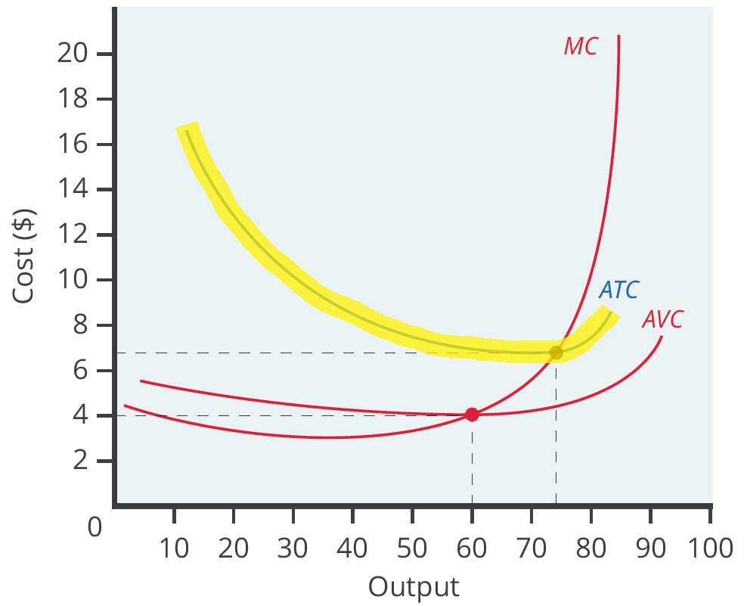
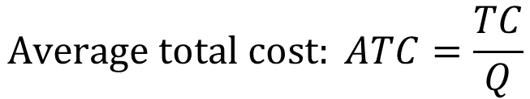
Average Total Cost
Average total cost (sometimes referred to simply as average cost) is total cost divided by the quantity of output.
Average cost curves are typically U-shaped, starting off relatively high because at low levels of output, total costs are dominated by the fixed costs.
Average total cost declines as the fixed costs are spread over an increasing quantity of output.
$$Average total cost: ATC=\frac{TC}{Q}$$
Notes:
Average total cost (sometimes referred to simply as average cost) is total cost divided by the quantity of output. Average cost curves are typically U-shaped, starting off relatively high because at low levels of output, total costs are dominated by the fixed cost. Average total cost declines as the fixed costs are spread over an increasing quantity of output.

Slide 12
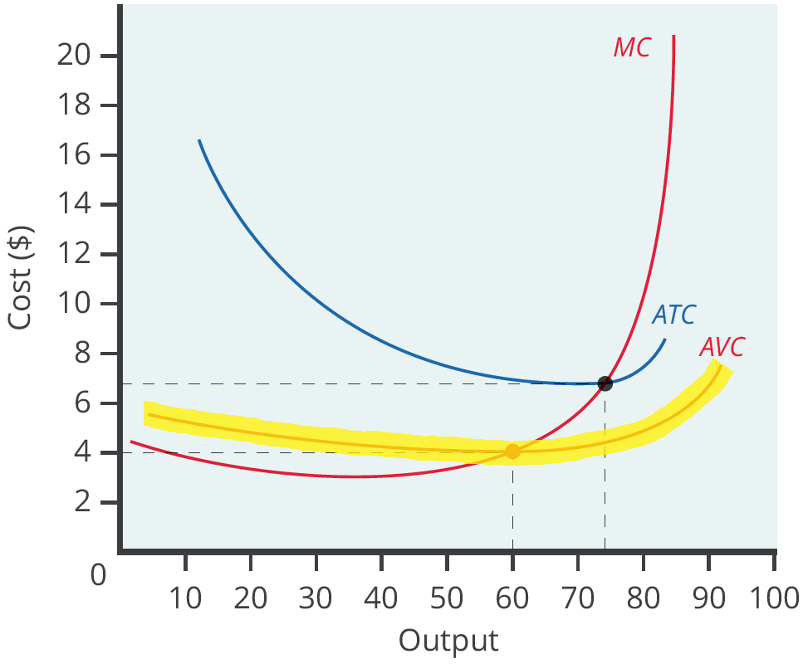
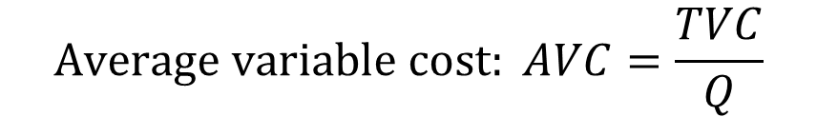
Average Variable Cost
Average variable cost is found by taking the total variable cost and dividing by the quantity of output.
Average variable costs do not include the fixed costs of production, meaning the curve always lies below the average total cost curve.
As output increases, fixed costs have less of an impact on the average total cost, which allows the average variable cost to sneak closer to the average cost.
$$Average variable cost: AVC=\frac{TVC}{Q}$$
Notes:
Average variable cost is found by taking the variable cost and dividing by the quantity of output. Average variable costs do not include the fixed costs of production, meaning the curve always lies below the average total cost curve. As output increases, fixed costs have less of an impact on the average total cost, which allows the average variable cost to sneak closer to the average cost.

Slide 13
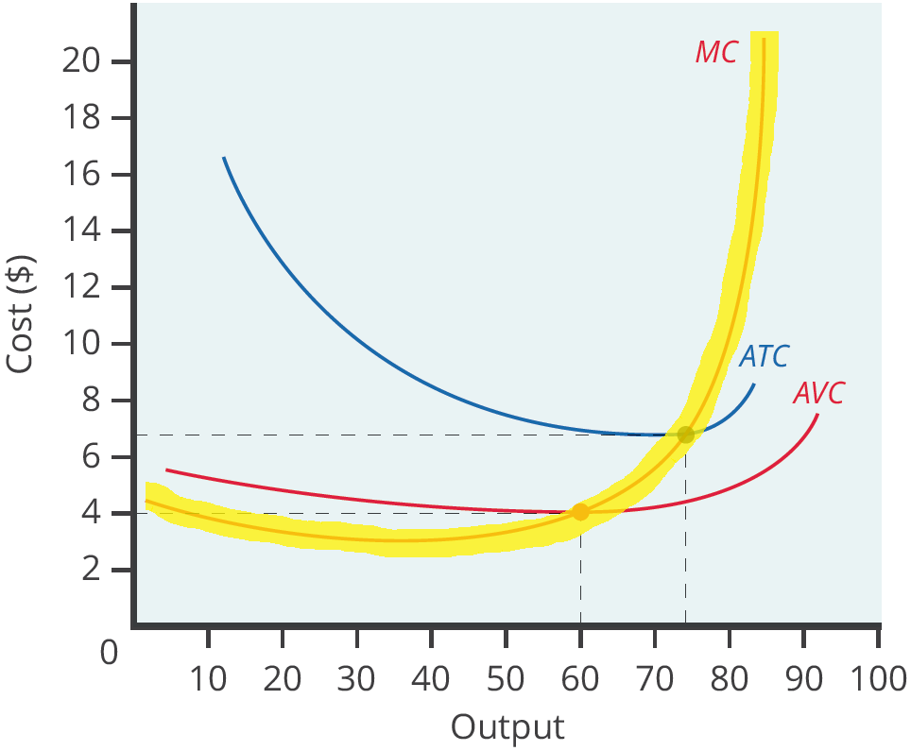
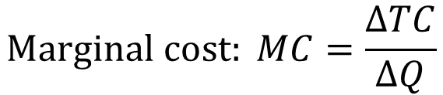
Marginal Cost Curve
Marginal cost is calculated by taking the change in total cost and dividing it by the change in quantity.
The marginal cost curve is generally upward-sloping because diminishing marginal returns implies that additional units are more costly to produce.
The marginal cost curve intersects the average total cost curve at its minimum point.
$$Marginal cost: MC=\frac{ΔTC}{ΔQ}$$
Notes:
Marginal cost is calculated by taking the change in total cost and dividing it by the change in quantity. The marginal cost curve is generally upward-sloping because diminishing marginal returns implies that additional units are more costly to produce. The marginal cost curve intersects the average total cost curve at its minimum point.

Slide 14

Real-World Discussion
Suppose your company has produced its first unit of output. When output is 1, the fixed cost is $40, and the variable cost is $5. What is the total cost? What is the average variable cost? What is
the average total cost? What is the marginal cost?
Notes:
Suppose your company has produced its first unit of output. When output is 1, the fixed cost is $40, and the variable cost is $5. What is the total cost? What is the average variable cost? What is the average total cost? What is the marginal cost?

Slide 15
Real-World Discussion
Suppose your company has produced its first unit of output. When output is 1, the fixed cost is $40, and the variable cost is $5. What is the total cost? What is the average variable cost? What is
the average total cost? What is the marginal cost?
total cost = $40 + $5 = $45
average variable cost = $5/1 = $5
average total cost = $45/1 = $45
marginal cost = $45/1 = $45
Notes:
Suppose your company has produced its first unit of output. When output is 1, the fixed cost is $40, and the variable cost is $5. What is the total cost? What is the average variable cost? What is
the average total cost? What is the marginal cost?
Total Cost = $40 + $5 = $45
Average Variable Cost= $5/1=$5
Average Total Cost= $45/1=$45
Marginal Cost=$45/1=$45

Slide 16
Lessons from Alternative Measures of Costs
Breaking down total costs into fixed cost, marginal cost, average total cost, and average variable cost is useful because each statistic offers its own insights for the firm.
Whatever the firm's level of output, total revenue must exceed total costs if it is to earn a profit.
Typically, a firm should ignore sunk costs since they have already spent the money and cannot make any changes.
Because variable costs can be changed, they convey information about a firm's ability to cut costs and the extent to which costs may increase.
Notes:
Breaking down total costs into fixed cost, marginal cost, average total cost, and average variable cost is useful because each statistic offers its own insights for the firm. Whatever the firm's level of output, total revenue must exceed total costs if it is to earn a profit. Typically, a firm should ignore sunk costs since they have already spent the money and cannot make any changes. Because variable costs can be changed, they convey information about a firm's ability to cut costs and the extent to which costs may increase.

Slide 17

Success of a Firm
Average cost tells a firm whether it can earn profits given the current price in the market.
Dividing profit by the quantity of output produced gives average profit, also known as the firm's profit margin.
$$average profit=\frac{profit}{quantity produced}$$
Notes:
Average cost tells a firm whether it can earn profits given the current price in the market. Dividing profit by the quantity of output produced gives average profit, also known as the firm's profit margin. A high profit margin is important to a firm’s success.

Slide 18
Summary
For every input (e.g. labor), there is an associated factor payment (e.g. wages and salaries).
In a short-run perspective, we can divide a firm's total cost into fixed cost, which a firm must incur before producing any output, and variable costs, which the firm incurs in the act of producing.
We calculate marginal cost by taking the change in total cost (or the change in variable cost, which will be the same thing) and dividing it by the change in output for each possible change in output.
We calculate average total cost by taking total cost and dividing by total output at each different level of output.
We calculate average variable cost by taking total variable cost and dividing by the total output at each level of output.
HAWKES LEARNING

Slide 19




HAWKES LEARNING

