Slide 1
Section 0.10
Preparing for a Final Math Exam

Slide 2
Since math concepts build on one another, a final exam in math is not one you can study for in a night or even a day or two.
To pull all the concepts together for the semester, you should plan to start one or two weeks ahead of time.

Slide 3
Before You Start Preparing for the Exam
​What is the date, time, and location of the exam?
Check your syllabus for the final exam time and location. If it’s not on your syllabus, your instructor should announce this information in class.

Slide 4
Before You Start Preparing for the Exam (cont.)
​Is there a time limit on the exam?
If you experience test anxiety on timed tests, be sure to speak to your professor about it and see if you can receive accommodations.

Slide 5
Before You Start Preparing for the Exam (cont.)
​​Will you be able to use a formula sheet, calculator, and/or scrap paper on the exam?
If you are not allowed to use a formula sheet, you should write down important formulas and memorize them.
If you cannot use a calculator on the exam, be sure to practice doing calculations by hand.

Slide 6
A Week Before the Exam
​Decide where to study for the exam and with whom.
If you are studying with others, be prepared:
Make sure the group is small and that the people in the group are motivated to study.
Plan to have snacks and water with you for energy and to avoid having to delay studying.
Be sure and take small breaks every hour or two.

Slide 7
A Week Before the Exam (cont.)
​Organize your class notes and any flash cards.
Highlight the vocabulary in your notes.
Create a formula sheet to use on the exam, if the professor allows.
If not, then you can use the formula sheet to memorize the formulas.

Slide 8
A Week Before the Exam (cont.)
​Start studying for the exam.
Don’t spend a lot of time reviewing material you already know.
Go over the most difficult material or material that you don’t understand so you can ask questions about it.
Review old exams and work through any questions you missed.

Slide 9
3 Days Before the Exam
​Make yourself a practice test consisting of the problem types. Don’t necessarily put the questions in the order that the professor covered them in class.
​Ask your instructor or classmates any questions that you have about the practice test so that you have time to go back and review the material you are having difficulty with.

Slide 10
The Night Before the Exam
​Make sure you have all the supplies you will need to take the exam: formula sheet and calculator, if allowed, scratch paper, plain and colored pencils, highlighter, erasers, graph paper, extra batteries, etc.
​If you won’t be allowed to use your formula sheet, review it to make sure you know all the formulas. Right before going to bed, review your notes and study materials, but do not stay up all night to “cram.”
​Go to bed early and get a good night’s sleep.

Slide 11
The Day of the Exam
​Get up with plenty of time to get to your exam without rushing. Eat a good breakfast and don’t drink too much caffeine, which can make you anxious.
​Review your notes, flash cards, and formula sheet again, if you have time.
​Get to class early so you can be organized and mentally prepared.

Slide 12
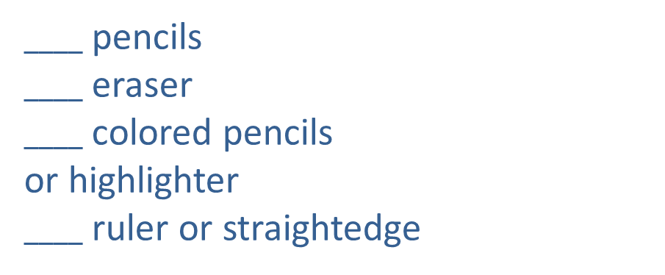
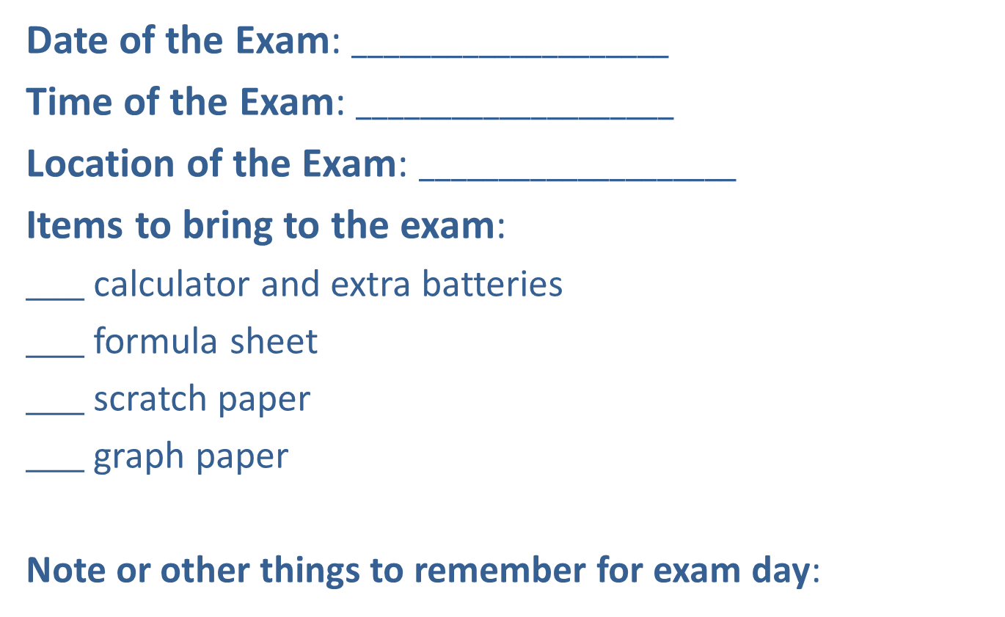
Checklist for the Exam
Date of the Exam:$____________________$
Time of the Exam: $____________________$
Location of the Exam: $____________________$
Items to bring to the exam:
$____$ calculator and extra batteries
$____$ formula sheet
$____$ scratch paper
$____$ graph paper
Note or other things to remember for exam day:
$____$ pencils
$____$ eraser
$____$ colored pencils
or highlighter
$____$ ruler or straightedge

Slide 13
During the Exam
​Put your name at the top of your exam immediately.
Do what is called a “brain drain” or “data dump.”
​Read the directions carefully.
Make sure you have answered the questions being asked.
Check your solutions as you go.
Don’t forget to attach your scratch work to your exam when you turn it in for potential partial credit.

Slide 14
During the Exam (cont.)
​Skim the questions on the exam, marking the ones you know how to do immediately. Do these first.
Note any questions that have a higher point value. Do these next.
​If you get to a problem you don’t know how to do, skip it for the end.

Slide 15
During the Exam (cont.)
​For multiple choice questions, try the following:
Work the problem first before looking at the answer choices.
If your answer is not one of the choices, then review your math work.
Work backwards to see if any of them work in the problem.
See if you can eliminate any of the answer choices and make an educated guess.
Mark the problem to come back to later when you review the exam.

Slide 16
During the Exam (cont.)
​Once you have an answer for all the problems,
review the entire exam,
try working the problems differently and comparing the results,
check your solutions, and
do not worry about finishing early.

