Slide 1

Section 2.R.3
Evaluating Radicals

Slide 2
Objectives
Evaluate square roots.
Evaluate cube roots.
Use a calculator to evaluate square and cube roots.

Slide 3
Radical Terminology
Definition
The symbol is called a radical sign.
The number under the radical sign is called the radicand.
The complete expression, such as is called a radical or radical expression.

Slide 4
Square Root
Definition
If a is a nonnegative real number, then
is the principal square root of a,
and
is the negative square root of a.

Slide 5
Perfect Squares and Square Roots
Notes
Square roots of negative numbers are not real
numbers. For example, is not a real number. There is no real number whose square is −4.

Slide 6
Example 1: Evaluating Square Roots
Because
we have
and

Slide 7
Example 2: Evaluating Square Roots

Slide 8
Example 3: Estimating Square Roots
A calculator will give rounded to the
nearest ten-thousandth. Check that this is a reasonable
estimate.
Solution
Because 25 < 30 < 36, we have and
The approximation 5.4772 is between 5
and 6 and is reasonable.
Another approach is to square as follows:

Slide 9
Cube Root
Definition
If a is a real number, then is the cube root of a.

Slide 10
Example 4: Evaluating Cube Roots
The cube root of a negative number is a real number and is negative.

Slide 11
Cube Roots
Attention!
In the cube root expression the number 3 is called the index. In a square root expression such as the index is understood to be 2 and is not written. Expressions with square roots and cube roots (as well as other roots) are called radical expressions.

Slide 12

Example 5: Evaluating Radical Expressions with a Calculator
The following radical expressions are evaluated by
using a TI-84 Plus graphing calculator. In each example
the steps (or keys to press) are shown. The TI-84 Plus
gives answers rounded to nine decimal places. You may
choose (through the key) to have answers rounded to fewer than nine places.

Slide 13


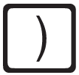

Example 5: Evaluating Radical Expressions with a Calculator (cont.)
Solution
Step 1: Press to get the square root symbol
Step 2: Enter and the right-hand parenthesis .
(Note: When the symbol appears, it will appear with a left-hand parenthesis. You should press the right-hand parenthesis to close the square root operation.)
Step 3: Press .

Slide 14
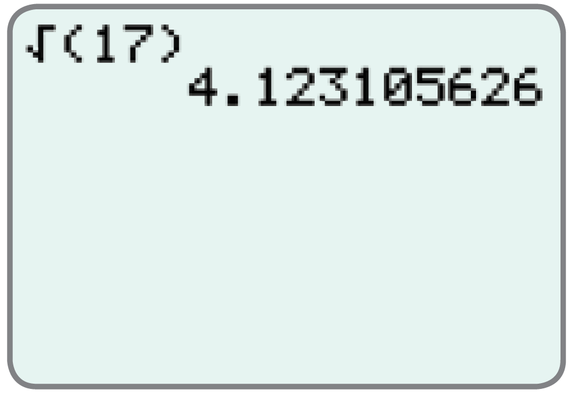
Example 5: Evaluating Radical Expressions with a Calculator (cont.)
The display will appear as follows:

Slide 15





Example 5: Evaluating Radical Expressions with a Calculator (cont.)
Solution
Step 1: Press . (Note: The followed by indicates the cube root to the calculator. That is, the 3 takes the place of x in the expression )
Step 2: Enter the left-hand parenthesis , then
, and then finally the right hand parenthesis .
Step 3: Press .

Slide 16
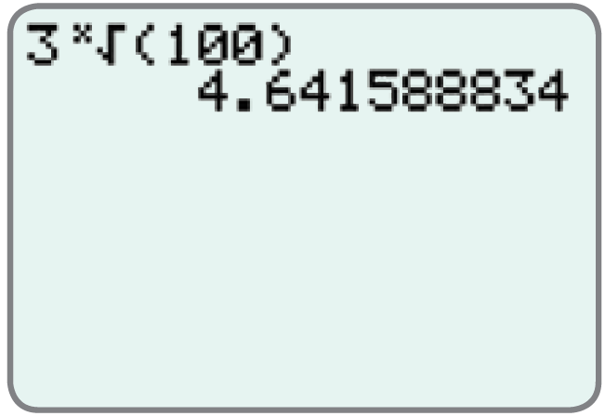
Example 5: Evaluating Radical Expressions with a Calculator (cont.)
The display will appear as follows.

Slide 17

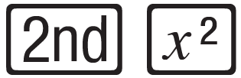

Example 5: Evaluating Radical Expressions with a Calculator (cont.)
Note: This expression represents 3 times
Solution
Step 1: Enter .
Step 2: Press . (This gives the symbol.)
Step 3: Enter and the right-hand parenthesis .
Step 4: Press .

Slide 18
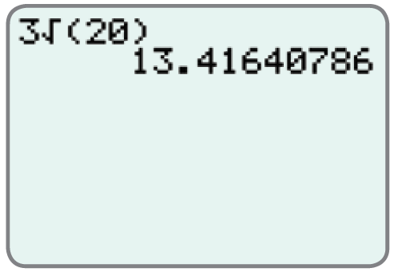
Example 5: Evaluating Radical Expressions with a Calculator (cont.)
The display will appear as follows.

