Slide 1
Section 6.R.1
Rules for Exponents

Slide 2
Objectives
Use the product rule for exponents.
Simplify expressions that contain the exponent 0.
Use the quotient rule for exponents.
Simplify expressions that contain negative exponents.
Use a graphing calculator to evaluate exponential expressions.

Slide 3
The Product Rule for Exponents
Properties
If a is a nonzero real number and m and n are integers, then
In words, to multiply powers with the same base, keep the base and add the exponents.

Slide 4
The Product Rule
Notes
Reminder about the exponent 1: if a variable or constant has no exponent written, the exponent is understood to be 1.
For example,
In general, for any real number a,

Slide 5
Example 1: Using the Product Rule for Exponents
Use the product rule for exponents to simplify the following expressions.
Solution
d.
e.
Keep the base and add the exponents.
This expression cannot be simplified.
The bases are not the same.

Slide 6
Example 1: Using the Product Rule for Exponents (cont.)
Note that the base stays 4.
That is, the bases are not multiplied.
Note that the base stays 2.
That is, the bases are not multiplied.

Slide 7
Example 2: Using the Product Rule for Exponents
Use the product rule for exponents when simplifying the following expressions.
Solution
Apply the commutative property of multiplication. Then, multiply the coefficients 2 and 3 and add the exponents 2 and 9.

Slide 8
Example 2: Using the Product Rule for Exponents (cont.)
Coefficients −3 and −4
are multiplied and exponents 3 and 3
are added.
Coefficients −6 and 8 are multiplied and exponents on each variable are added.

Slide 9
The Exponent 0
Definition
If a is a nonzero real number, then
a⁰ = 1.
The expression 0⁰ is undefined.

Slide 10
The Exponent 0
Attention!
Throughout this text, unless specifically stated otherwise, we will assume that the bases of exponents are nonzero.

Slide 11
Example 3: Evaluating The Exponent 0
Simplify the following expressions using the rule for 0 as an exponent.
b. c.
Solution

Slide 12
Quotient Rule for Exponents
Properties
If a is a nonzero real number and m and n are integers, then
In words, to divide two powers with the same base, keep the base and subtract the exponents. (Subtract the denominator exponent from the numerator exponent.)

Slide 13
Example 4: Using the Quotient Rule for Exponents
Use the quotient rule for exponents to simplify the following expressions.
b. c.
Solution
Keep the base and subtract the exponents.

Slide 14
Example 4: Using the Quotient Rule for Exponents (cont.)
Note how this example shows another way
to justify the idea that a⁰ = 1. Since the numerator and denominator are the same and not 0, it makes sense that the fraction is equal to 1.

Slide 15
Example 5: Dividing Terms with Coefficients
Use the quotient rule for exponents when simplifying the following expressions.
b.
Solution
Coefficients 15 and 3 are divided and exponents 15 and 3 are subtracted.

Slide 16
Example 5: Dividing Terms with Coefficients (cont.)
b.
Coefficients 20 and 2 are divided and exponents on each variable are subtracted.

Slide 17
Rule for Negative Exponents
Properties
If a is a nonzero real number and n is an integer, then

Slide 18
Example 6: Negative Exponents
Use the rule for negative exponents to simplify each expression so that it contains only positive exponents.
b. c.
Solution

Slide 19
Example 6: Negative Exponents (cont.)
Here we use the product rule first and then the rule
for negative exponents.

Slide 20
Negative Exponents
Notes
There is nothing wrong with negative exponents. In fact, negative exponents are preferred in some courses in mathematics and science. However, so that all answers are the same, in this course we will consider expressions to be simplified if:
all exponents are positive and
each base appears only once.

Slide 21
Example 7: Combining Rules for Exponents
Simplify each expression so that it contains only positive exponents.
Solution
b.
c.
d.
e.
Use the product rule with positive and negative exponents.

Slide 22
Example 7: Combining Rules for
Exponents (cont.)
Use the quotient rule with positive and negative exponents.
Use the quotient rule with negative
exponents.
Subtract a negative number.
Use the rule for negative exponents.

Slide 23
Example 7: Combining Rules for
Exponents (cont.)

Slide 24
Example 7: Combining Rules for
Exponents (cont.)
(Note: Notice that the negative exponent relates only to the variable x, not to the number 10.)

Slide 25
Negative Exponents
Attention!
Using the Quotient Rule
Regardless of the size of the exponents or whether they are positive or negative, the following single subtraction rule can be used with the quotient rule.
(numerator exponent − denominator exponent)
This subtraction will always lead to the correct answer.

Slide 26
Summary of the Rules for Exponents
Properties
For any nonzero real number a and integers m and n:
The exponent 1: a = a¹
The exponent 0: a⁰ = 1
The product rule: a^{m} · a^{n} = a^{m + n}
The quotient rule:
Negative exponents:

Slide 27

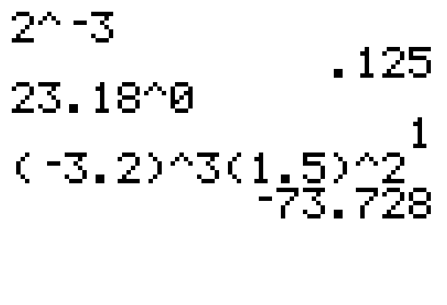

Example 8: Evaluating Exponential Expressions
Use a graphing calculator to evaluate each expression.
Solution
The following solutions show how
the caret key is used to
indicate exponents. Be careful to
use the negative sign key
(and not the minus sign key) for
negative numbers and negative
b.
c.

Slide 28
Example 8: Evaluating Exponential Expressions (cont.)
exponents. Use parentheses as they are given in the expression being evaluated.

