Slide 1
Section 7.R.2
Similar and Congruent Triangles

Slide 2
Objectives
Classify a triangle by its sides and angles.
Know the properties of similar triangles.
Know the properties of congruent triangles.

Slide 3
Classifying Triangles
Note
The line segment with endpoints A and B is indicated by placing a bar over the letters, as in The length of the segment is indicated by writing only the letters, as in AB.

Slide 4
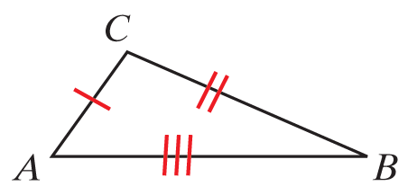
Triangles Classified by Sides
Definition (Note: In the figures, sides with equal length are indicated by the same number of slash marks.)
Name | Property | Example
Scalene | No two sides have equal lengths. | ∆ABC is scalene since no two sides have equal lengths.

Slide 5
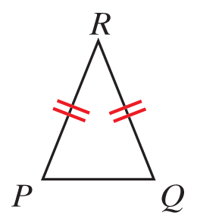
Triangles Classified by Sides
Definition (cont.)
Isosceles | At least two sides have equal lengths. | ∆PQR is isosceles since PR = QR.

Slide 6
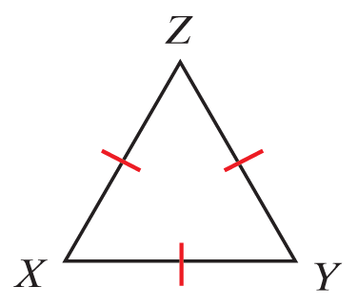
Triangles Classified by Sides
Definition (cont.)
Equilateral | All three sides have equal lengths. | ∆XYZ is equilateral since XY = XZ = YZ

Slide 7
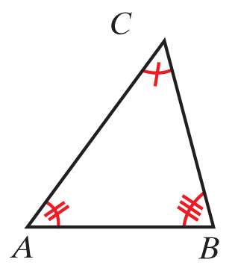
Triangles Classified by Angles
Definition
Name | Property | Example
Acute | All three angles are acute. | are all acute so ∆ABC is acute.

Slide 8
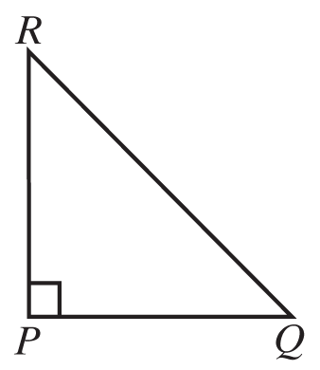
Triangles Classified by Angles
Definition (cont.)
Right | One angle is a right angle. | so ∆PRQ is a right triangle.

Slide 9
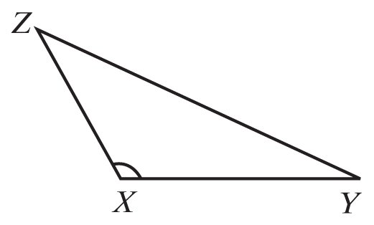
Triangles Classified by Angles
Definition (cont.)
Obtuse | One angle is obtuse. | is obtuse so ∆XYZ is an obtuse triangle.

Slide 10
Three Properties of Triangles
Properties
In a triangle:
The sum of the measures of the angles is 180°.
The sum of the lengths of any two sides must be greater than the length of the third side.
Longer sides are opposite angles with larger measures.

Slide 11
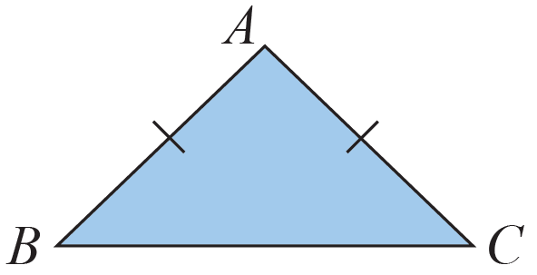
Example 1: Classifying a Triangle by Its Sides
InΔ∆ABC below, AB = AC. What kind of triangle isΔ∆ABC?
Solution
∆ABC is isosceles because two sides have equal lengths.

Slide 12
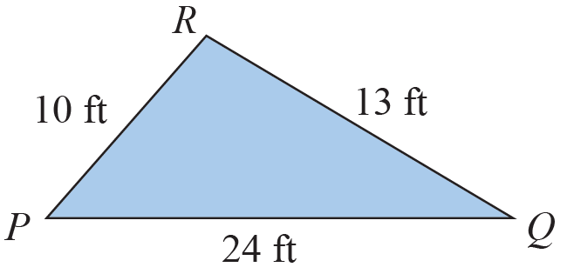
Example 2: Determining Whether a Triangle Exists
∆PQR was drawn and then the lengths of the sides were labeled as shown in the figure. Explain why the labels cannot be correct.

Slide 13
Example 2: Determining Whether a Triangle Exists (cont.)
The labels cannot be correct because PR + QR = 10 ft + 13 ft = 23 ft and PQ = 24 ft, which is greater than the sum of the other two sides. In a triangle, the sum of the lengths of any two sides must be greater than the length of the third side.

Slide 14
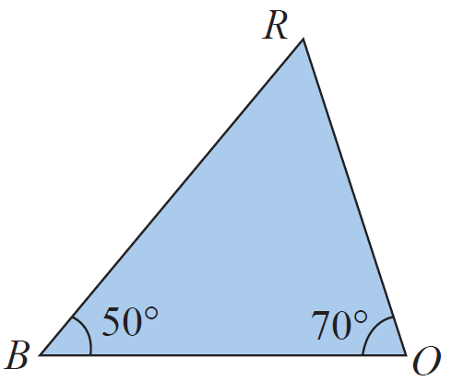
Example 3: Analyzing Triangles
In ∆BOR below, and
What is
Which side is opposite
Which sides include
Is ∆BOR a right triangle? Why or why not?

Slide 15
Example 3: Analyzing Triangles (cont.)
Solutions
The sum of the measures of the angles must be 180°.
Since
is opposite
and include
∆BOR is not a right triangle because none of the angles is a right angle.

Slide 16
Similar Triangles
Definition
In similar triangles, the corresponding angles have the same measure. (We say that the corresponding angles are congruent.)
In similar triangles, the lengths of the corresponding sides are proportional.

Slide 17
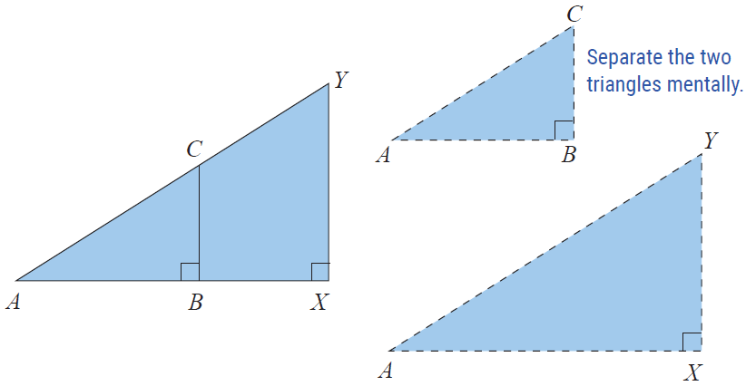
Example 4: Determining Whether Triangles are Similar
Given the two triangles ΔABC and ΔAXY with
(as shown in the figure)
determine whether or not ΔABC ∼ ΔAXY.

Slide 18
Example 4: Determining Whether Triangles are Similar (cont.)
Solution
We can show that the corresponding angles are congruent as follows:
Because they are the same angle.
Because both are right angles (90°).
Because the sum of the measures of the angles in each triangle must be 180°.
Therefore the corresponding angles are congruent, and the triangles are similar.

Slide 19
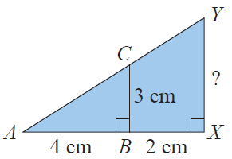
Example 5: Finding Unknown Values Using Similar Triangles
Refer to the figure to the right. If AB = 4 cm, BX = 2 cm, and BC = 3 cm, find XY.
Solution
From Example 1 we know that ΔABC ∼ ΔAXY: therefore, the lengths of their corresponding sides are proportional. Since and are corresponding sides and and are corresponding sides, (they are opposite congruent angles) the following proportion is true:

Slide 20
Example 5: Finding Unknown Values Using Similar Triangles (cont.)
Note that, AX = AB + BX = 4cm + 2cm = 6 cm.
Thus,

Slide 21
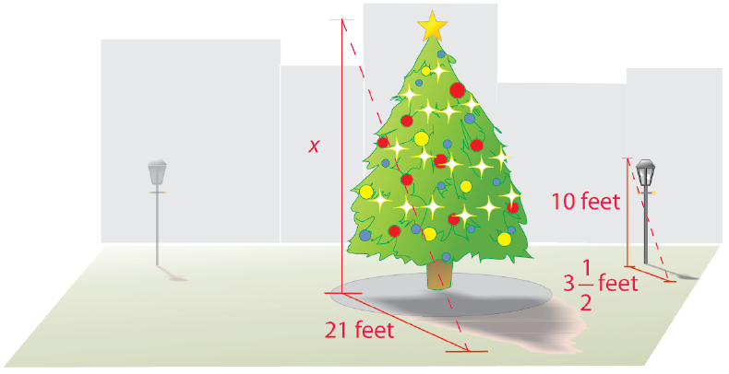
Example 6: Application Finding Unknown Values Using Similar Triangles
A very tall, magnificently decorated, tree was on display in an outside patio area at the mall during the month before Christmas. Joann knew that the height of a nearby lamppost was 10 feet. At 2 p.m. on a Tuesday afternoon,
she measured the shadow of the lamppost to be feet
long and the shadow of the tree to be 21 feet long. With her understanding of similar triangles, Joann was able to calculate the height of the tree. What was the height of the tree?

Slide 22
Example 6: Application Finding Unknown Values Using Similar Triangles (cont.)
Solution
By letting x represent the height of the tree, Joann set up and solved the following proportion.

Slide 23
Example 6: Application Finding Unknown Values Using Similar Triangles (cont.)
The tree was 60 feet tall.

Slide 24
Properties of Congruent Triangles
Properties
Two triangles are congruent if:
The corresponding angles have the same measure.
The lengths of corresponding sides are equal.

Slide 25
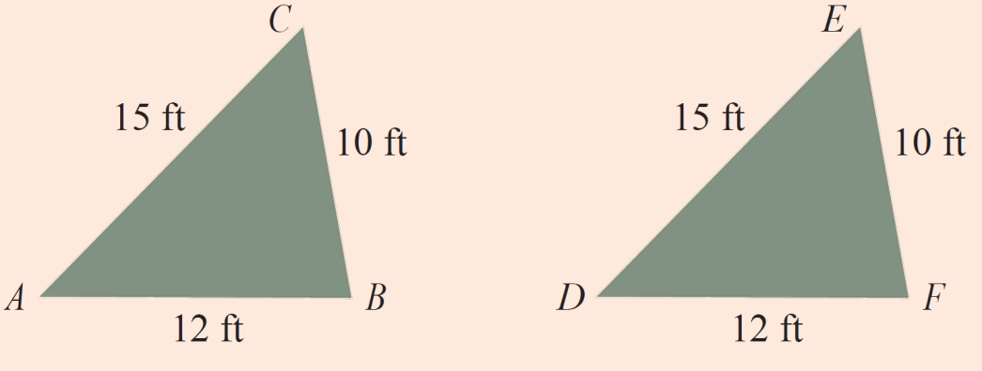
Determining Congruent Triangles
Definition
Side-Side-Side (SSS)
If two triangles are such that the lengths of the three sides of one triangle are equal to the lengths of corresponding sides of the other triangle, then the two triangles are congruent.
Triangle ABC is congruent to triangle DFE by SSS.

Slide 26
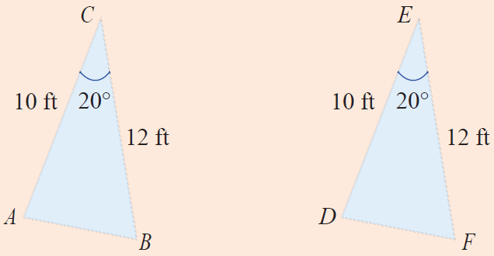
Determining Congruent Triangles
Definition (cont.)
Side-Angle-Side (SAS)
If two triangles are such that the lengths of two sides of one triangle equal the lengths of corresponding sides of the other triangle and the angles included between the sides are congruent, then the two triangles are congruent.
Triangle ABC is congruent to triangle DFE by SAS.

Slide 27
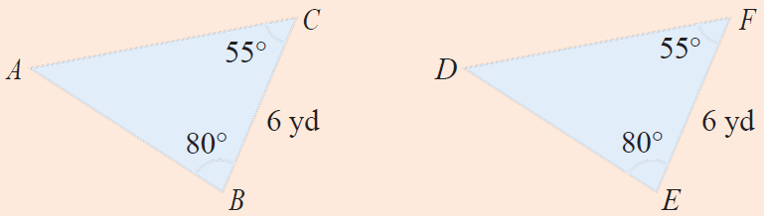
Determining Congruent Triangles
Definition (cont.)
Angle-Side-Angle (ASA)
If two triangles are such that two angles in one triangle are congruent to two angles in the other triangle and the lengths of the sides included between the angles are equal, then the two triangles are congruent.
Triangle ABC is congruent to triangle DEF by ASA.

Slide 28
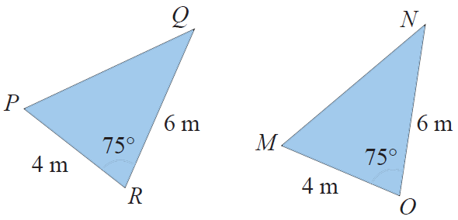
Example 7: Determining Whether Triangles are Congruent
Determine whether triangles
PQR and MNO are congruent.
Solution
From the figure we see that PR = MO = 4, QR = NO = 6, and m∠R = m∠O = 75. As ∠R and ∠O are included between the pairs of equal-lengthed sides, the two triangles are congruent by SAS (Side-Angle-Side).

