Slide 1
Section 1.1
Real Numbers and Algebraic Expressions

Slide 2
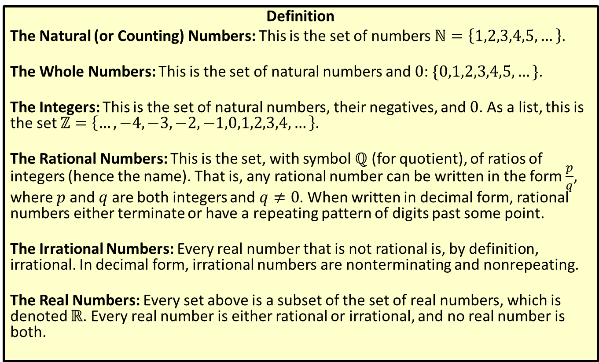
Types of Real Numbers
Definition
The Natural (or Counting) Numbers: This is the set of numbers $ℕ=\left\{1,2,3,4,5,…\right\}$.
The Whole Numbers: This is the set of natural numbers and 0: $\{0,1,2,3,4,5,…\}$.
The Integers: This is the set of natural numbers, their negatives, and 0. As a list, this is the set $ℤ=\left\{…,−4,−3,−2,−1,0,1,2,3,4,…\right\}$.
The Rational Numbers: This is the set, with symbol $ℚ$ (for quotient), of ratios of integers (hence the name). That is, any rational number can be written in the form $\frac{p}{q}$, where $p$ and $q$ are both integers and $q≠0$. When written in decimal form, rational numbers either terminate or have a repeating pattern of digits past some point.
The Irrational Numbers: Every real number that is not rational is, by definition, irrational. In decimal form, irrational numbers are nonterminating and nonrepeating.
The Real Numbers: Every set above is a subset of the set of real numbers, which is denoted $ℝ$. Every real number is either rational or irrational, and no real number is both.

Slide 3
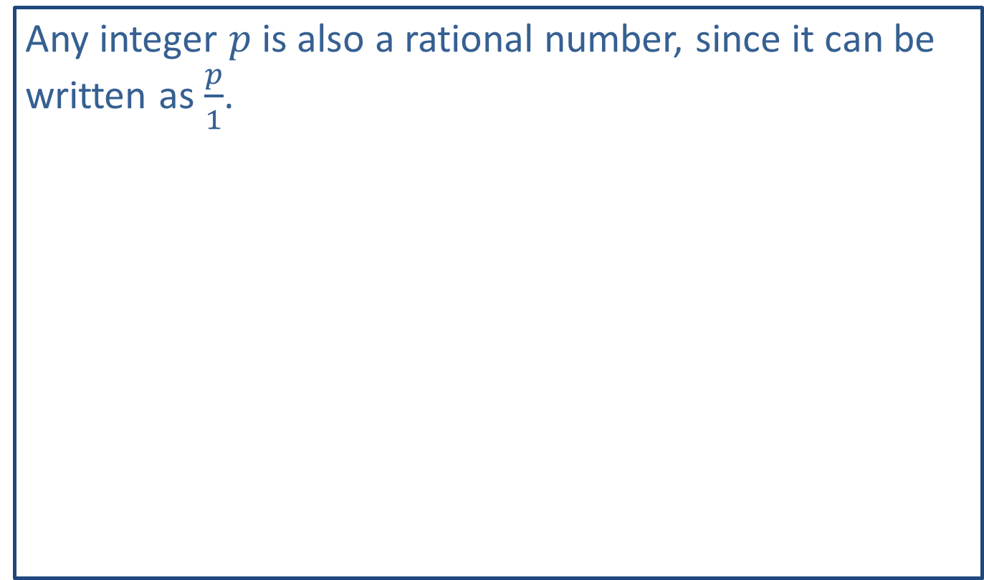
Note:
Any integer $p$ is also a rational number, since it can be written as $\frac{p}{1}$.

Slide 4
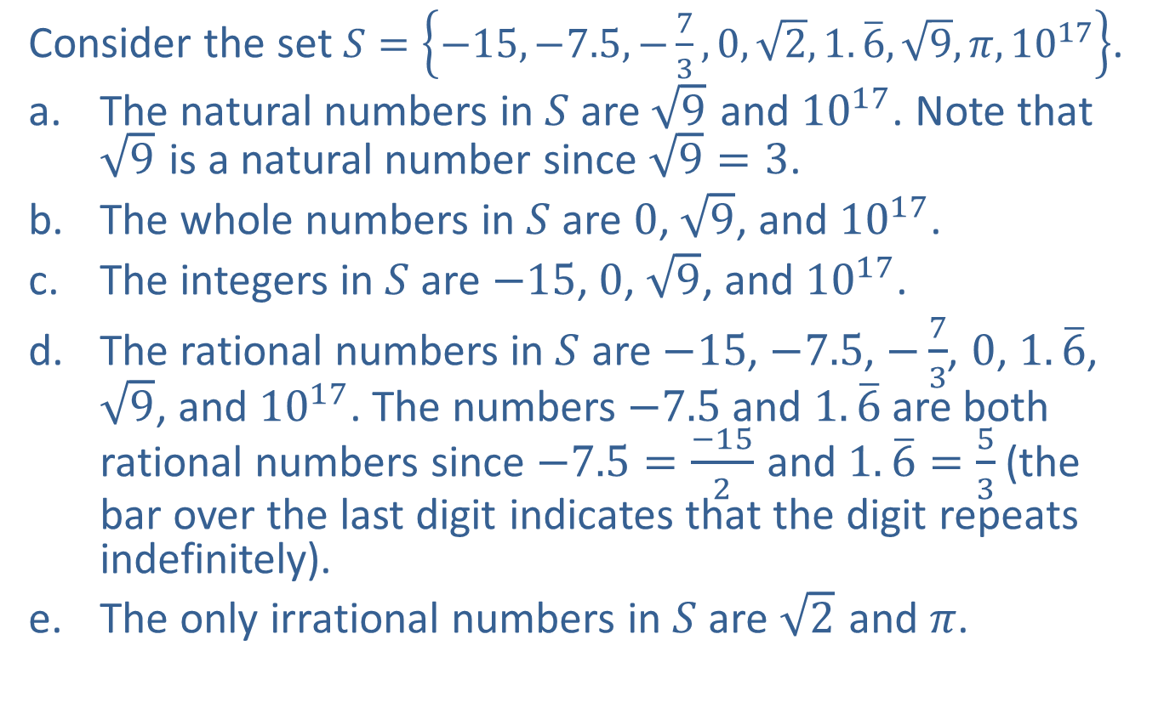
Example 1: Types of Real Numbers
Consider the set $S=\left\{−15,−7.5,−\frac{7}{3},0,\sqrt{2},1.\overline{6},\sqrt{9},π,{10}^{17}\right\}$.
​The natural numbers in $S$ are $\sqrt{9}$ and ${10}^{17}$. Note that $\sqrt{9}$ is a natural number since $\sqrt{9}=3$.
​The whole numbers in $S$ are 0, $\sqrt{9}$, and ${10}^{17}$.
​The integers in $S$ are $−15$, 0, $\sqrt{9}$, and ${10}^{17}$.
​The rational numbers in $S$ are $−15$, $−7.5$, $−\frac{7}{3}$, $0$, $1.\overline{6}$, $\sqrt{9}$, and ${10}^{17}$. The numbers $−7.5$ and $1.\overline{6}$ are both rational numbers since $−7.5=\frac{−15}{2}$ and $1.\overline{6}=\frac{5}{3}$ (the bar over the last digit indicates that the digit repeats indefinitely).
​The only irrational numbers in $S$ are $\sqrt{2}$ and $π$.

Slide 5
Example 2: Drawing the Real Number Line
We choose which portion of the real number line to show and the physical length that represents one unit based on the numbers that we wish to plot.
​If we want to plot the numbers 101, 106, and 107, we might construct the graph below.
​
Figure 3

Slide 6
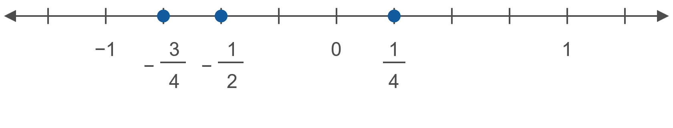

Example 2: Drawing the Real Number Line (cont.)
​If we want to plot the numbers $−\frac{3}{4}$, $−\frac{1}{2}$, and $\frac{1}{4}$, we might make the unit interval longer.
​
Figure 4

Slide 7
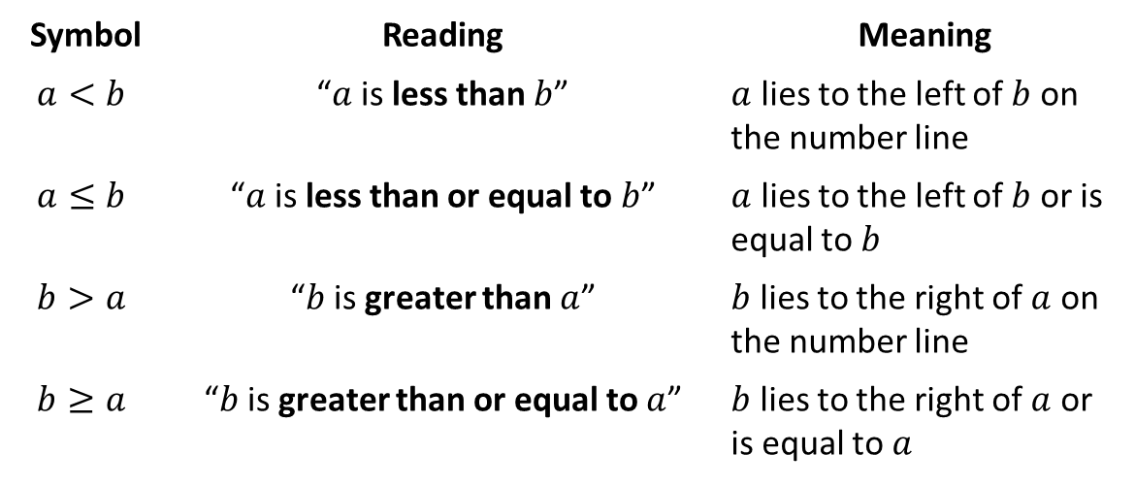

Inequality Symbols (Order)
Definition
The two symbols $<$ and $>$ are called strict inequality signs, while the symbols $≤$ and $≥$ are nonstrict inequality signs.
Symbol | Reading | Meaning
$$a<b$$ | “$a$ is less than $b$” | $a$ lies to the left of $b$ on the number line
$$a≤b$$ | “$a$ is less than or equal to $b$” | $a$ lies to the left of $b$ or is equal to $b$
$$b>a$$ | “$b$ is greater than $a$” | $b$ lies to the right of $a$ on the number line
$$b≥a$$ | “$b$ is greater than or equal to $a$” | $b$ lies to the right of $a$ or is equal to $a$

Slide 8
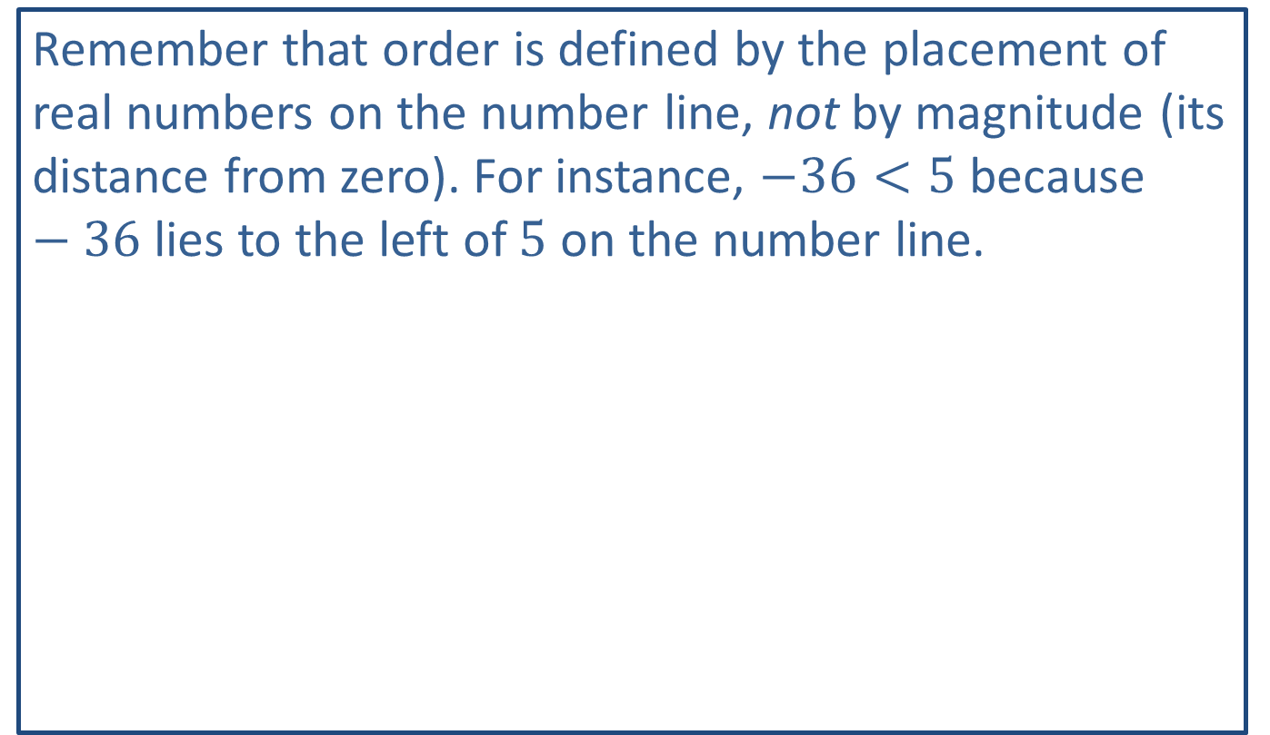
CAUTION!
Remember that order is defined by the placement of real numbers on the number line, not by magnitude (its distance from zero). For instance, $−36<5$ because $−36$ lies to the left of 5 on the number line.

Slide 9
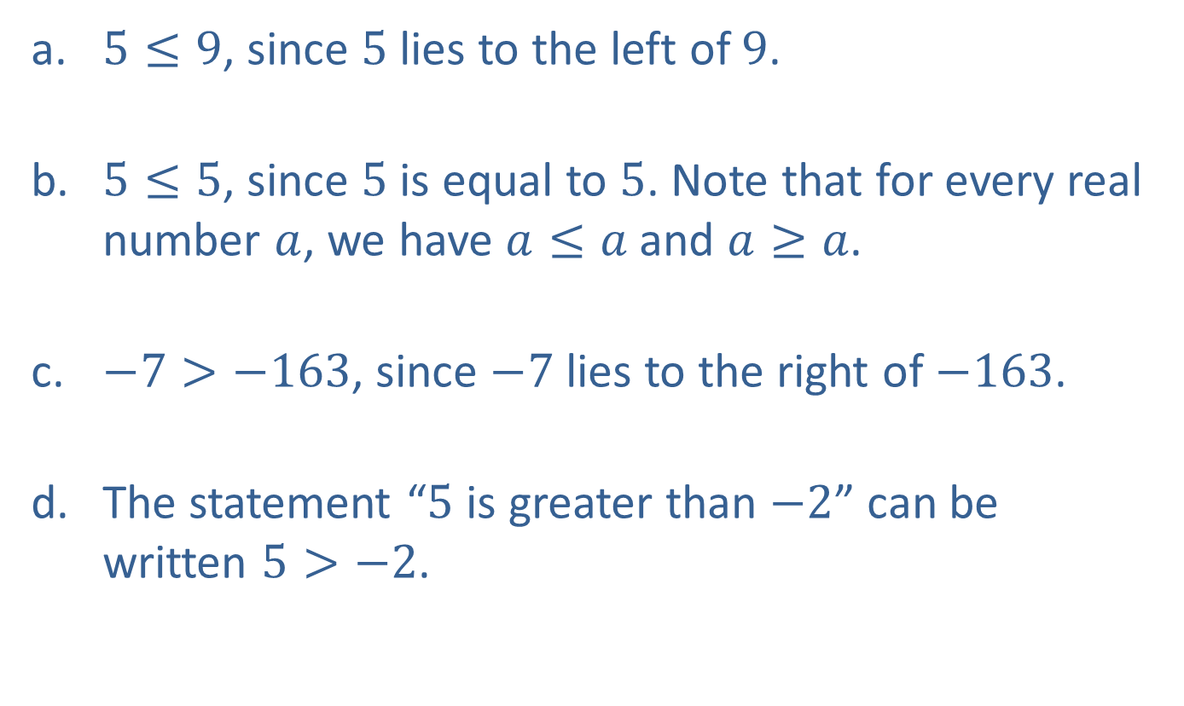
Example 3: Working with Order
​$5≤9$, since 5 lies to the left of 9.
​$5≤5$, since 5 is equal to 5. Note that for every real number $a$, we have $a≤a$ and $a≥a$.
​$−7>−163$, since $−7$ lies to the right of $−163$.
​The statement “5 is greater than $−2$” can be written $5>−2$.

Slide 10
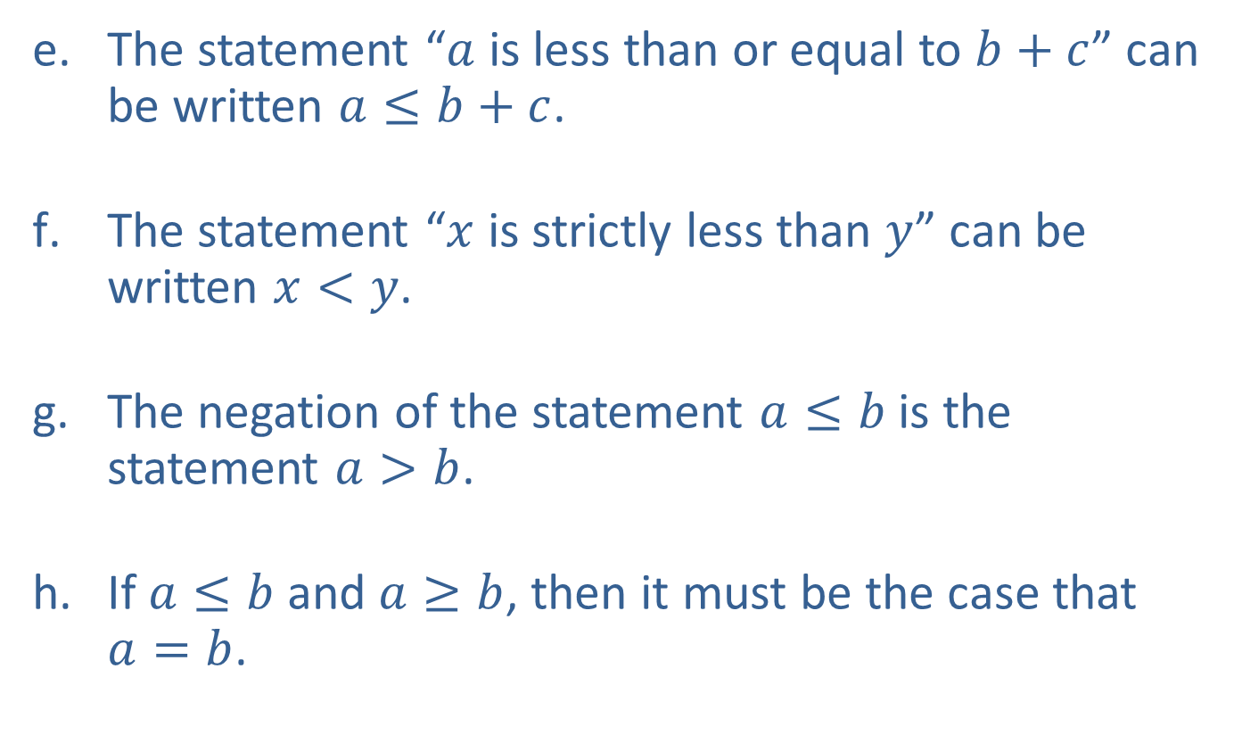
Example 3: Working with Order (cont.)
​The statement “$a$ is less than or equal to $b+c$” can be written $a≤b+c$.
​The statement “$x$ is strictly less than $y$” can be written $x<y$.
​The negation of the statement $a≤b$ is the statement $a>b$.
​If $a≤b$ and $a≥b$, then it must be the case that $a=b$.

Slide 11
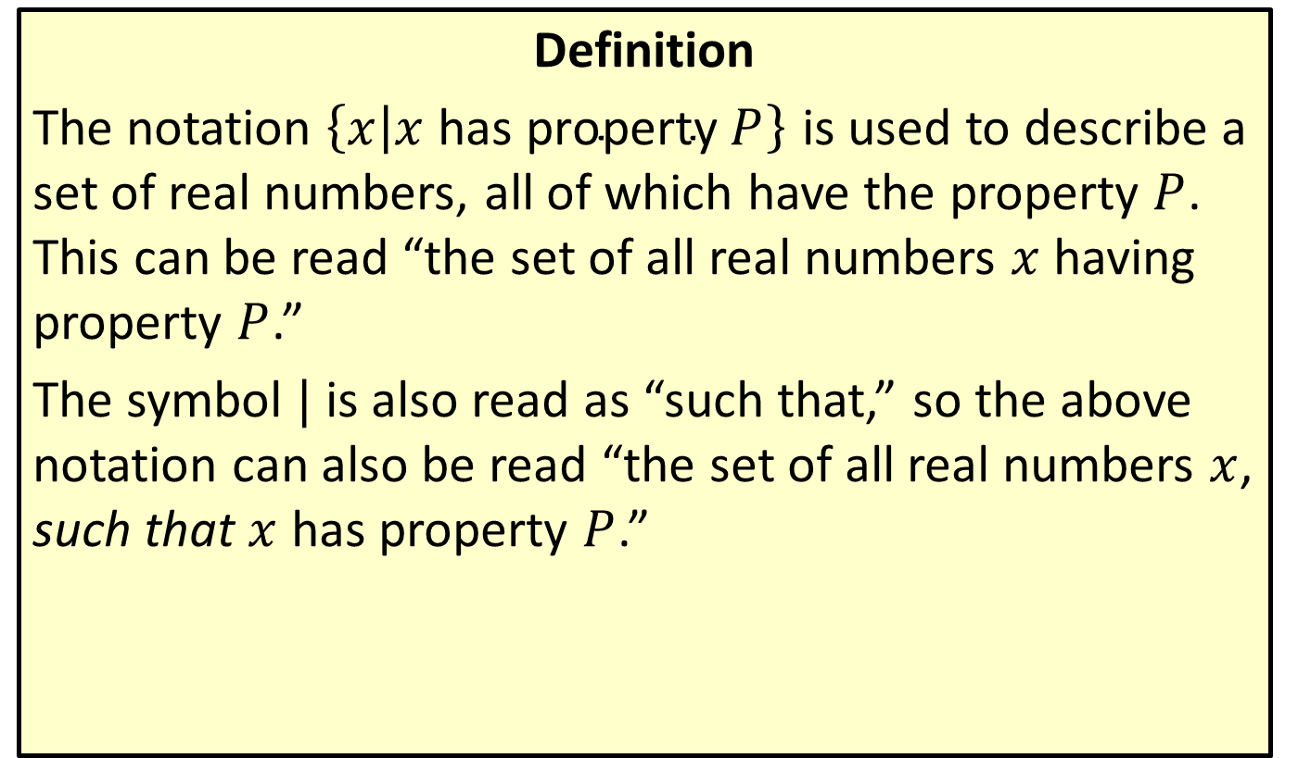
Set-Builder Notation
Definition
The notation $\left\{x | x \text{has} \text{property} P\right\}$ is used to describe a set of real numbers, all of which have the property $P$. This can be read “the set of all real numbers $x$ having property $P$.”
The symbol | is also read as “such that,” so the above notation can also be read “the set of all real numbers $x$, such that $x$ has property $P$.”

Slide 12
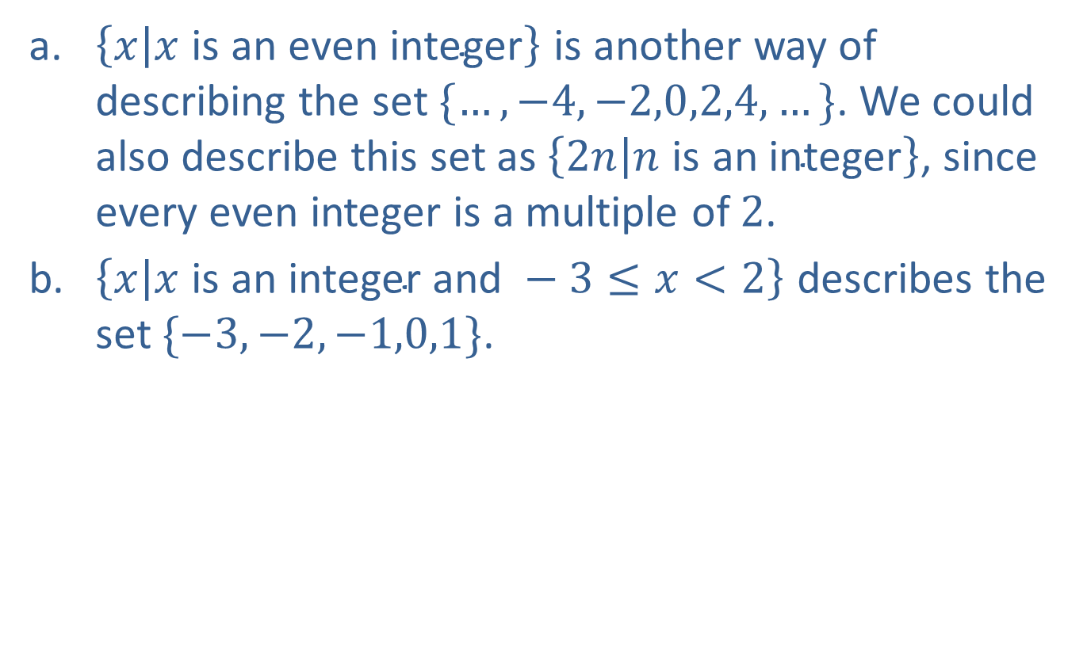
Example 4: Set-Builder Notation
​$\left\{x | x \text{is} \text{an} \text{even} \text{integer}\right\}$ is another way of describing the set $\{…,−4,−2,0,2,4,…\}$. We could also describe this set as $\left\{2n | n \text{is} \text{an} \text{integer}\right\}$, since every even integer is a multiple of 2.
​$\left\{x | x \text{is} \text{an} \text{integer} \text{and} −3≤x<2\right\}$ describes the set $\{−3,−2,−1,0,1\}$.

Slide 13
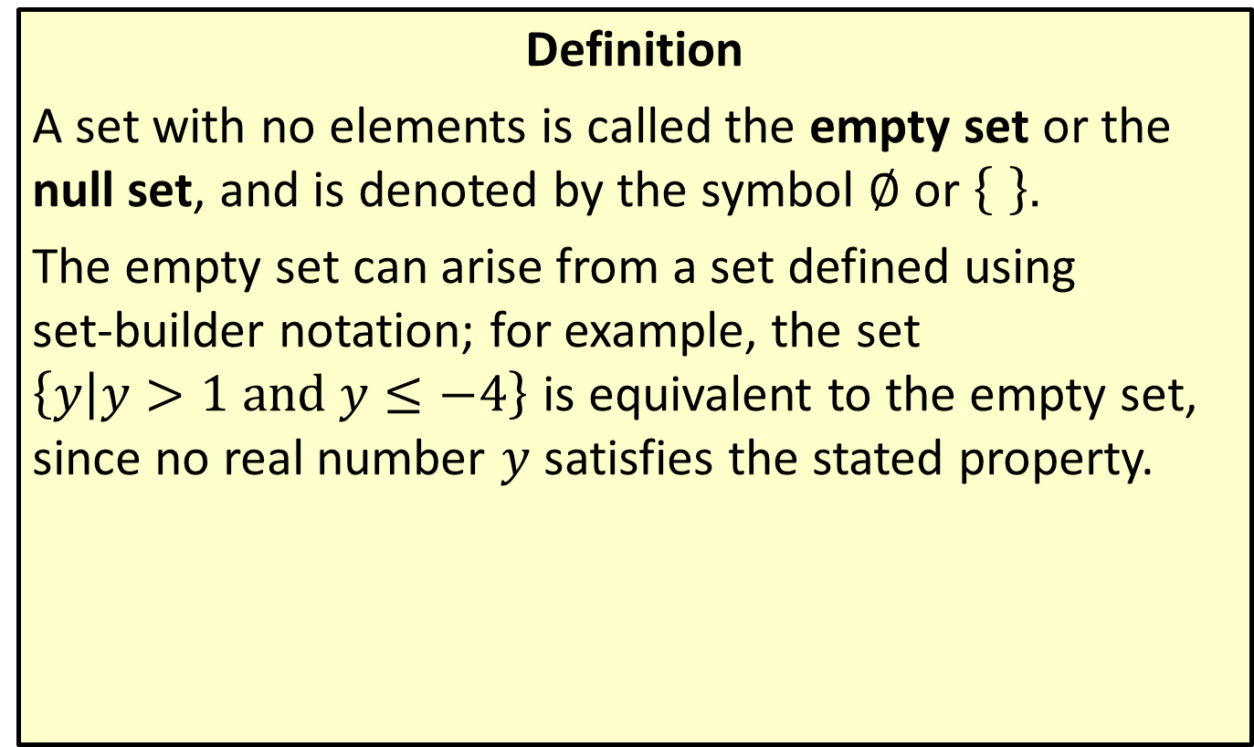
The Empty Set
Definition
A set with no elements is called the empty set or the null set, and is denoted by the symbol $∅$ or ..
The empty set can arise from a set defined using set-builder notation; for example, the set $\left\{y | y>1 and y≤−4\right\}$ is equivalent to the empty set, since no real number $y$ satisfies the stated property.

Slide 14
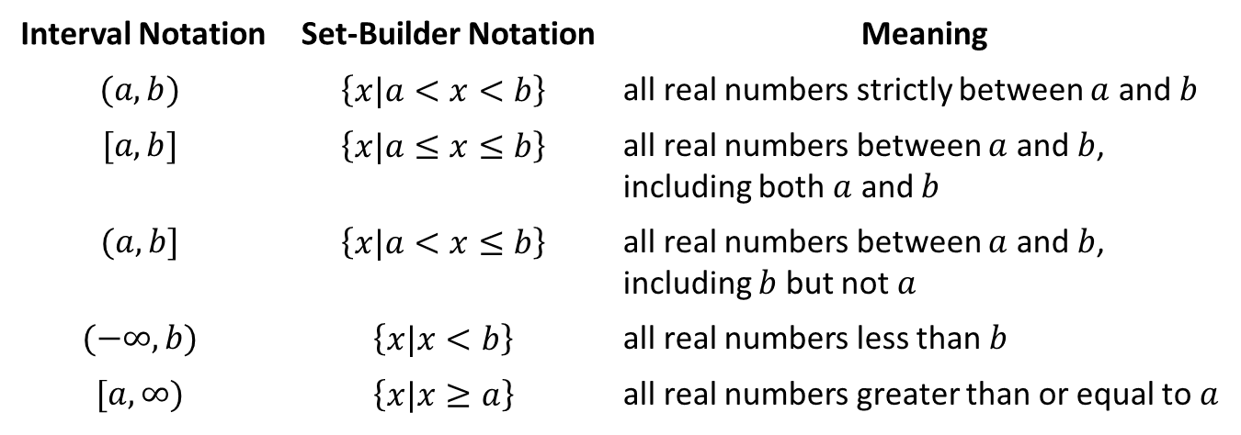
Interval Notation
Definition
Interval Notation | Set-Builder Notation | Meaning
$$(a,b)$$ | $$\left\{x|a<x<b\right\}$$ | all real numbers strictly between $a$ and $b$
$$[a,b]$$ | $$\left\{x|a≤x≤b\right\}$$ | all real numbers between $a$ and $b$, including both $a$ and $b$
$$(a,b]$$ | $$\left\{x|a<x≤b\right\}$$ | all real numbers between $a$ and $b$, including $b$ but not $a$
$$(−∞,b)$$ | $$\left\{x|x<b\right\}$$ | all real numbers less than $b$
$$[a,∞)$$ | $$\left\{x|x≥a\right\}$$ | all real numbers greater than or equal to $a$

Slide 15
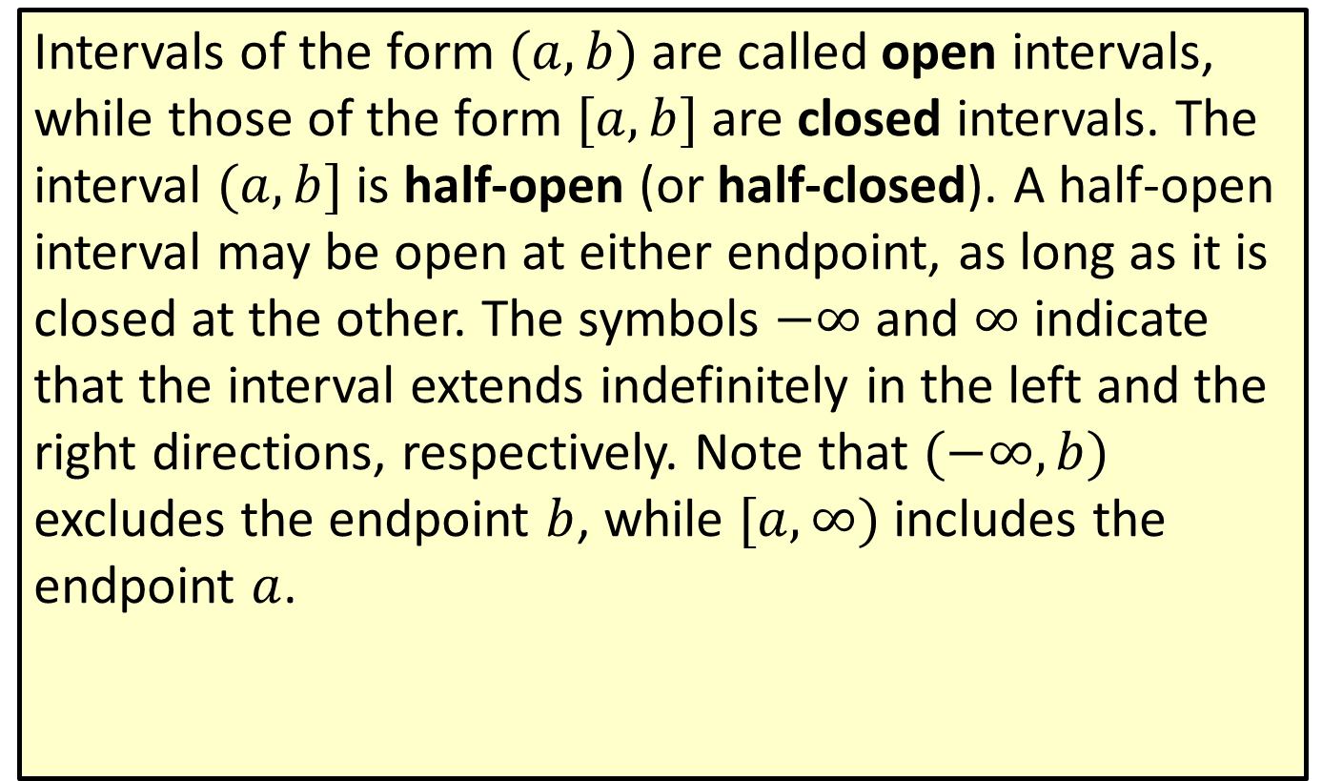
Interval Notation (cont.)
Intervals of the form $(a,b)$ are called open intervals, while those of the form $[a,b]$ are closed intervals. The interval $(a,b]$ is half-open (or half-closed). A half-open interval may be open at either endpoint, as long as it is closed at the other. The symbols $−∞$ and $∞$ indicate that the interval extends indefinitely in the left and the right directions, respectively. Note that $(−∞,b)$ excludes the endpoint $b$, while $[a,∞)$ includes the endpoint $a$.

Slide 16
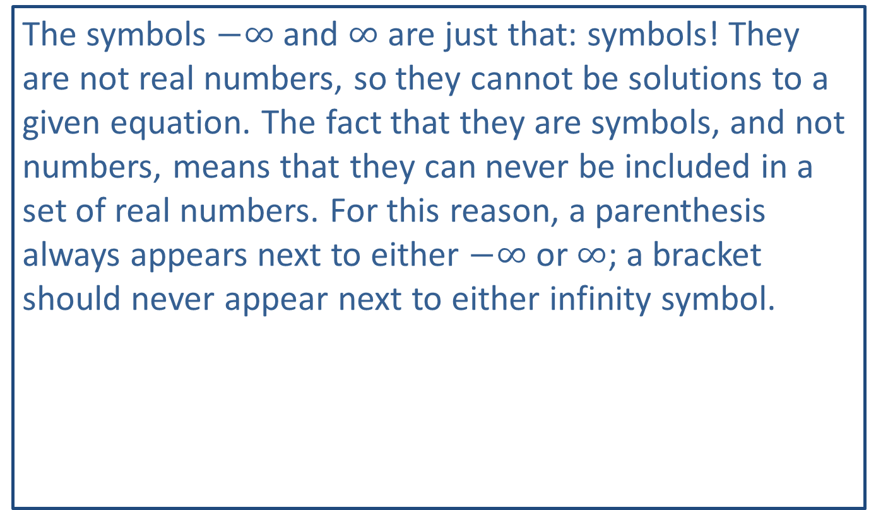
CAUTION!
The symbols $−∞$ and $∞$ are just that: symbols! They are not real numbers, so they cannot be solutions to a given equation. The fact that they are symbols, and not numbers, means that they can never be included in a set of real numbers. For this reason, a parenthesis always appears next to either $−∞$ or $∞$; a bracket should never appear next to either infinity symbol.

Slide 17
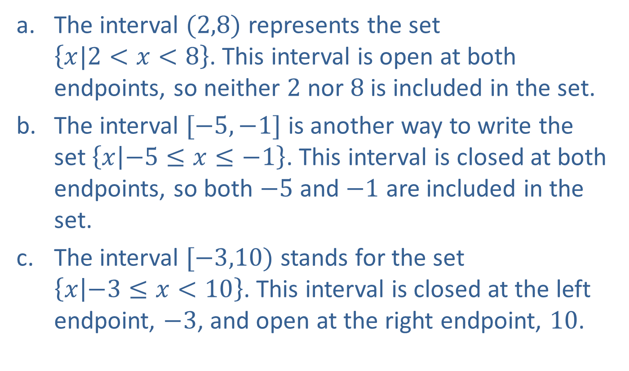
Example 5: Intervals of Real Numbers
​The interval $(2,8)$ represents the set $\left\{x|2<x<8\right\}$. This interval is open at both endpoints, so neither 2 nor 8 is included in the set.
​The interval $[−5,−1]$ is another way to write the set $\left\{x | −5≤x≤−1\right\}$. This interval is closed at both endpoints, so both $−5$ and $−1$ are included in the set.
​The interval $[−3,10)$ stands for the set $\left\{x | −3≤x<10\right\}$. This interval is closed at the left endpoint, $−3$, and open at the right endpoint, 10.

Slide 18
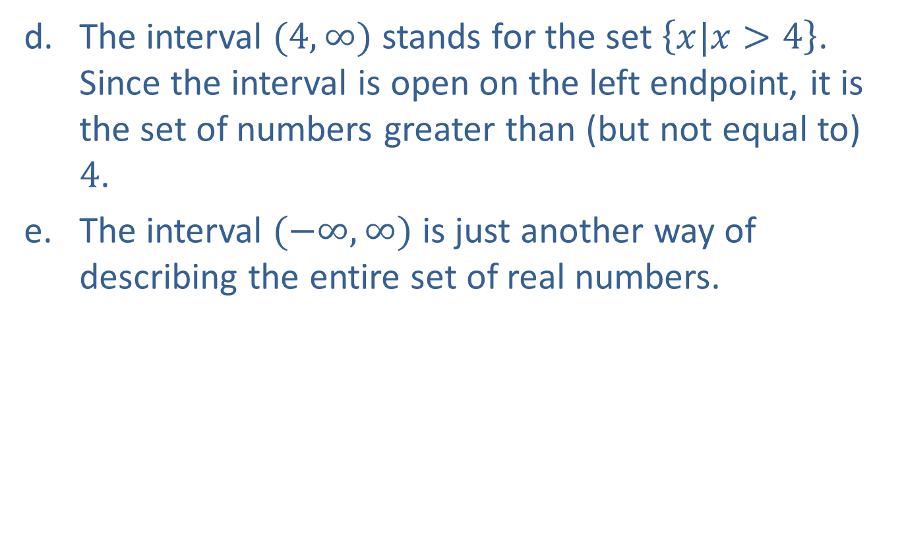
Example 5: Intervals of Real Numbers (cont.)
​The interval $(4,∞)$ stands for the set $\left\{x|x>4\right\}$. Since the interval is open on the left endpoint, it is the set of numbers greater than (but not equal to) 4.
​The interval $(−∞,∞)$ is just another way of describing the entire set of real numbers.

Slide 19
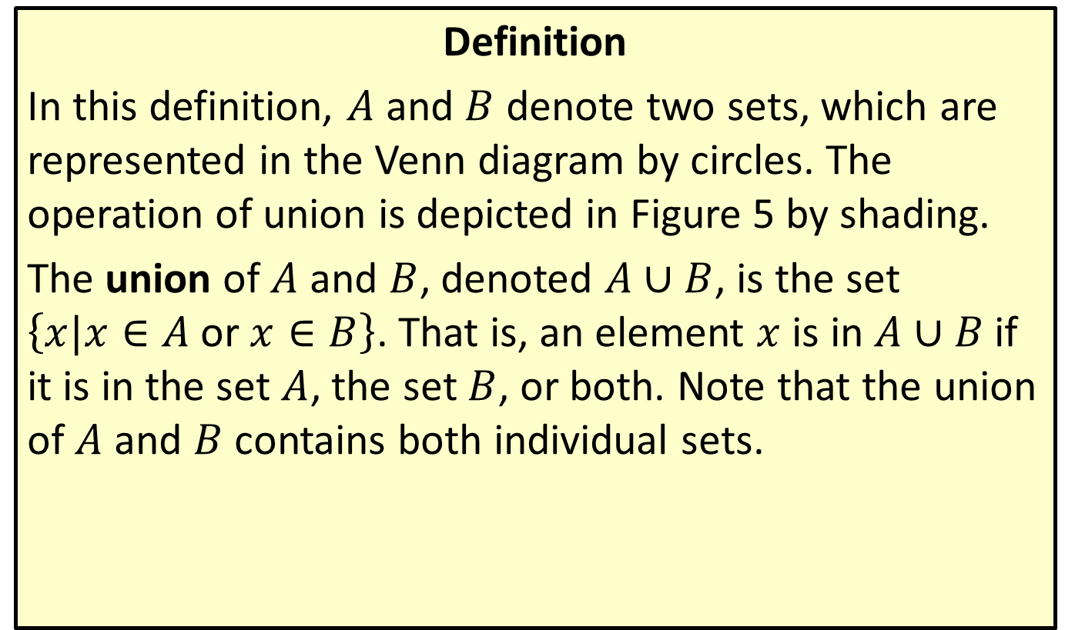
Union
Definition
In this definition, $A$ and $B$ denote two sets, which are represented in the Venn diagram by circles. The operation of union is depicted in Figure 5 by shading.
The union of $A$ and $B$, denoted $A∪B$, is the set $\left\{x|x∈A \text{or} x∈B\right\}$. That is, an element $x$ is in $A∪B$ if it is in the set $A$, the set $B$, or both. Note that the union of $A$ and $B$ contains both individual sets.

Slide 20
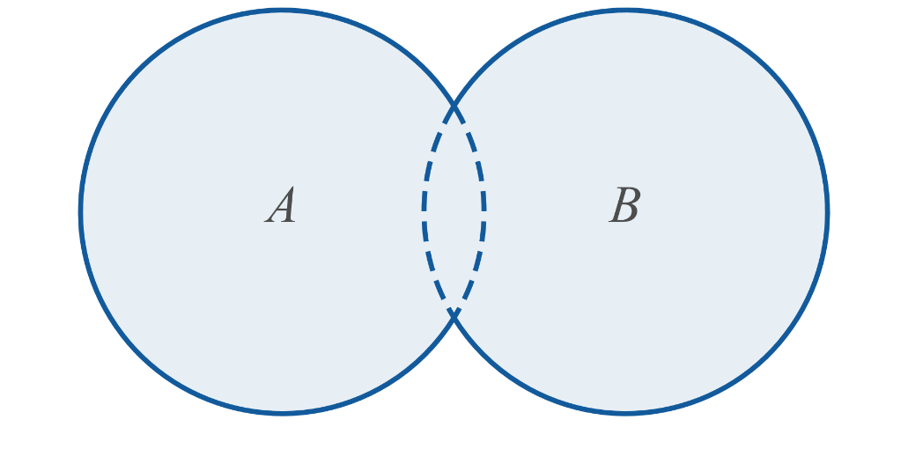
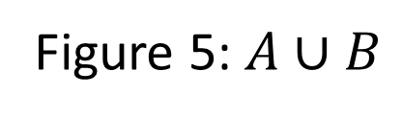
Union (cont.)
Figure 5: $A∪B$

Slide 21
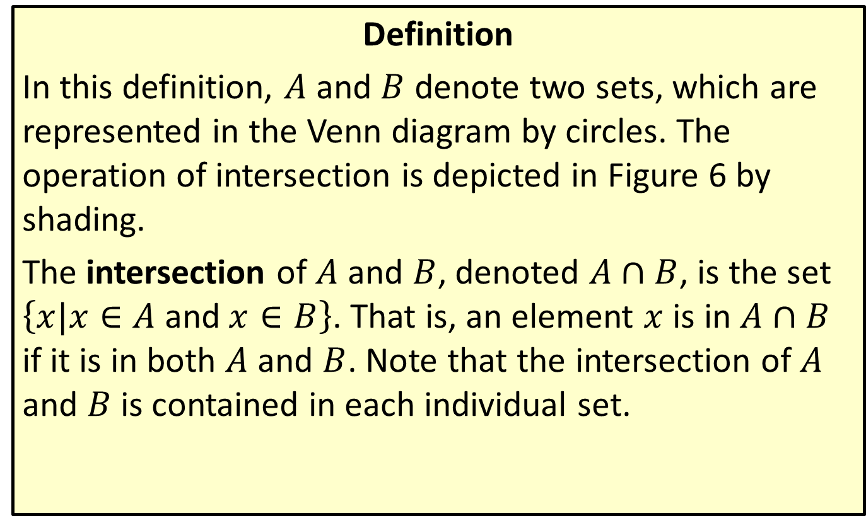
Intersection
Definition
In this definition, $A$ and $B$ denote two sets, which are represented in the Venn diagram by circles. The operation of intersection is depicted in Figure 6 by shading.
The intersection of $A$ and $B$, denoted $A∩B$, is the set $\left\{x|x∈A \text{and} x∈B\right\}$. That is, an element $x$ is in $A∩B$ if it is in both $A$ and $B$. Note that the intersection of $A$ and $B$ is contained in each individual set.

Slide 22
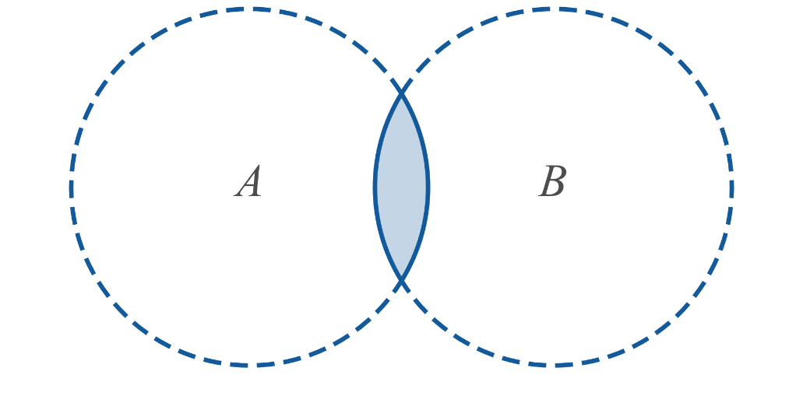
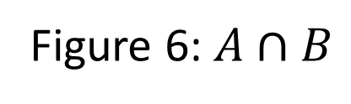
Intersection (cont.)
Figure 6: $A∩B$

Slide 23

Example 6: Union and Intersection of Intervals
Simplify the following set expressions.
​$\left(−2,4\right]∪\left[0,9\right]$
​$\left(−2,4\right]∩\left[0,9\right]$
​$\left[3,4\right)∩\left(4,9\right)$
​$\left(−∞,4\right]∪\left(−1,∞\right)$

Slide 24
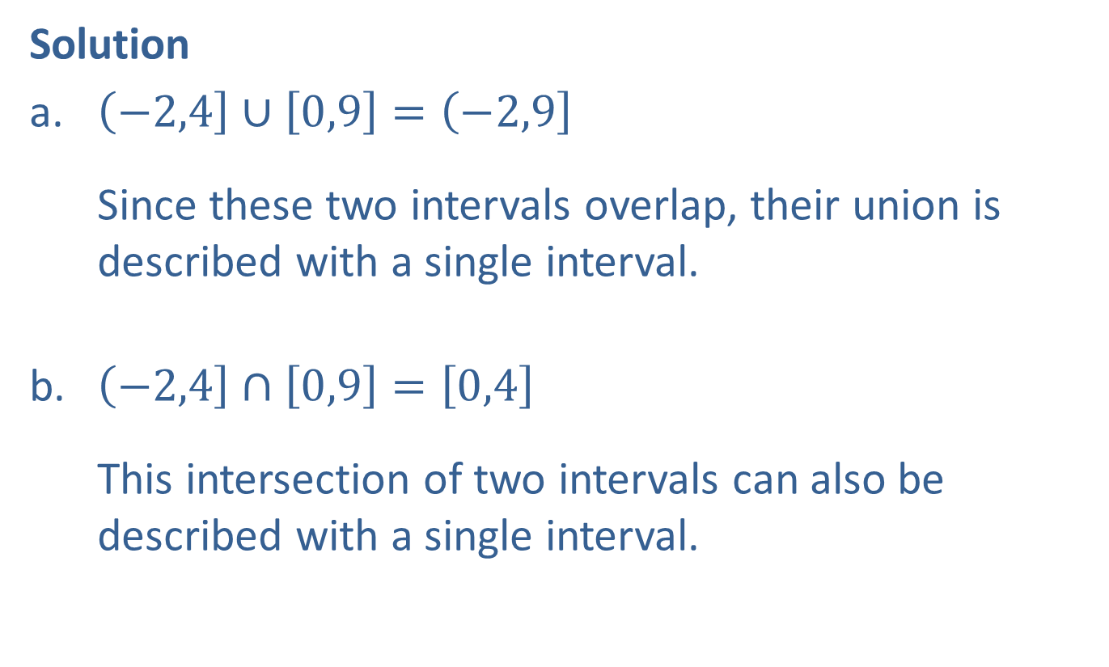
Example 6: Union and Intersection of Intervals (cont.)
Solution
​$\left(−2,4\right]∪\left[0,9\right]=\left(−2,9\right]$ Since these two intervals overlap, their union is described with a single interval.
​$\left(−2,4\right]∩\left[0,9\right]=\left[0,4\right]$ This intersection of two intervals can also be described with a single interval.

Slide 25
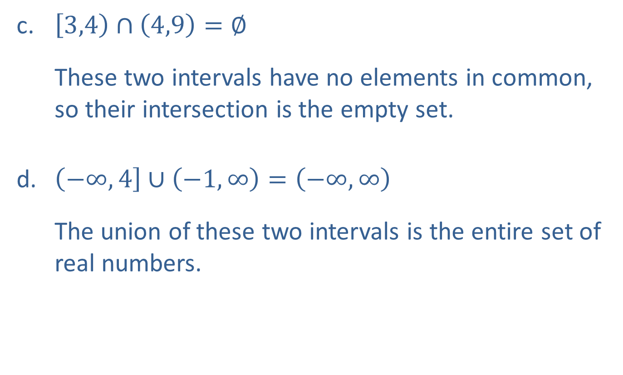
Example 6: Union and Intersection of Intervals (cont.)
​$\left[3,4\right)∩\left(4,9\right)=∅$ These two intervals have no elements in common, so their intersection is the empty set.
​$\left(−∞,4\right]∪\left(−1,∞\right)=\left(−∞,∞\right)$ The union of these two intervals is the entire set of real numbers.

Slide 26

Example 7: Union and Intersection
Simplify the following set expressions.
​$\left\{1,2\right\}∪\left\{0,3\right\}$
​$\left\{x,y,z\right\}∩\left\{w,x\right\}$
​$ℤ∪ℝ$
​$ℤ∩ℝ$

Slide 27
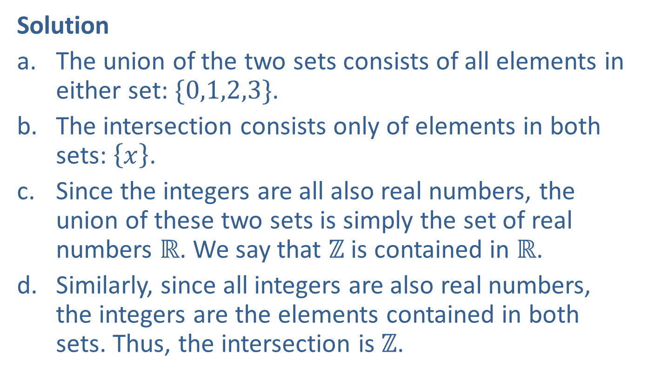
Example 7: Union and Intersection (cont.)
Solution
​The union of the two sets consists of all elements in either set: $\{0,1,2,3\}$.
​The intersection consists only of elements in both sets: $\left\{x\right\}$.
​Since the integers are all also real numbers, the union of these two sets is simply the set of real numbers $ℝ$. We say that $ℤ$ is contained in $ℝ$.
​Similarly, since all integers are also real numbers, the integers are the elements contained in both sets. Thus, the intersection is $ℤ$.

Slide 28
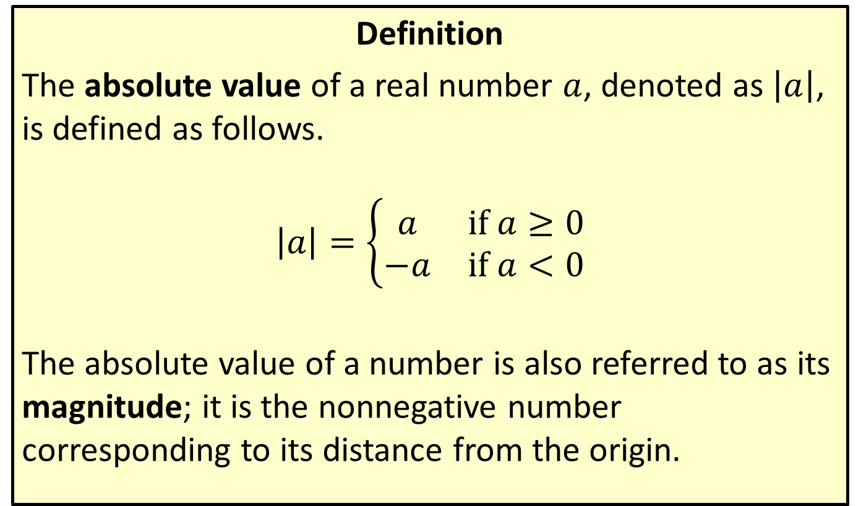
Absolute Value
Definition
The absolute value of a real number $a$, denoted as $\left|a\right|$, is defined as follows.
$$\left|a\right|=\left\{\begin{matrix}a & \text{if} a≥0 \\ −a & \text{if} a<0\end{matrix}\right.$$
The absolute value of a number is also referred to as its magnitude; it is the nonnegative number corresponding to its distance from the origin.

Slide 29
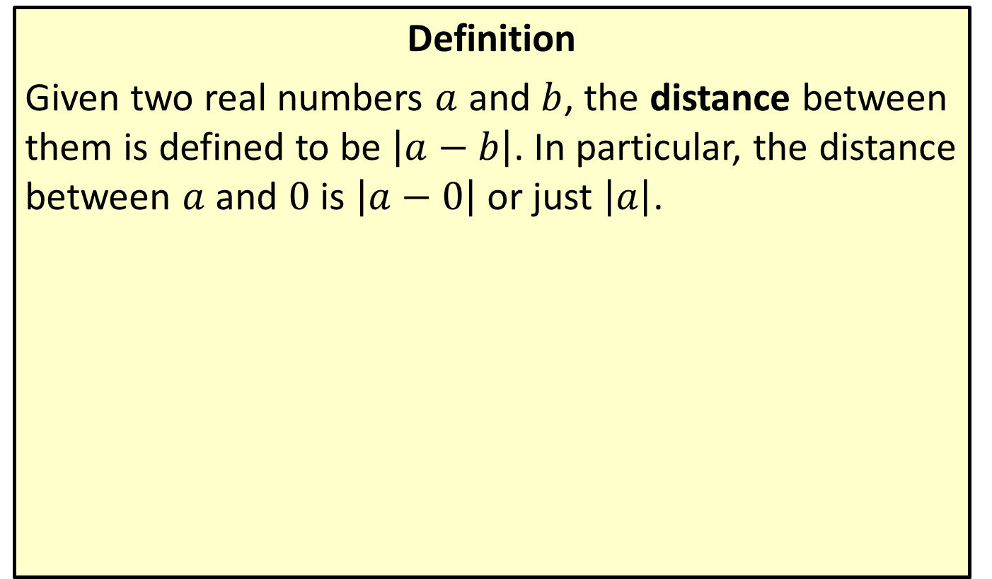
Distance on the Real Number Line
Definition
Given two real numbers $a$ and $b$, the distance between them is defined to be $\left|a−b\right|$. In particular, the distance between $a$ and 0 is $\left|a−0\right|$ or just $\left|a\right|$.

Slide 30

Example 8: Absolute Value
​$\left|17−3\right|=\left|3−17\right|=14$ $17$ and 3 are 14 units apart.
​$\left|−π\right|=\left|π\right|=π$ Both $−π$ and $π$ are $π$ units from 0.
​$\frac{\left|7\right|}{7}=\frac{7}{7}=1$
​$\frac{\left|−7\right|}{−7}=\frac{7}{−7}=−1$

Slide 31
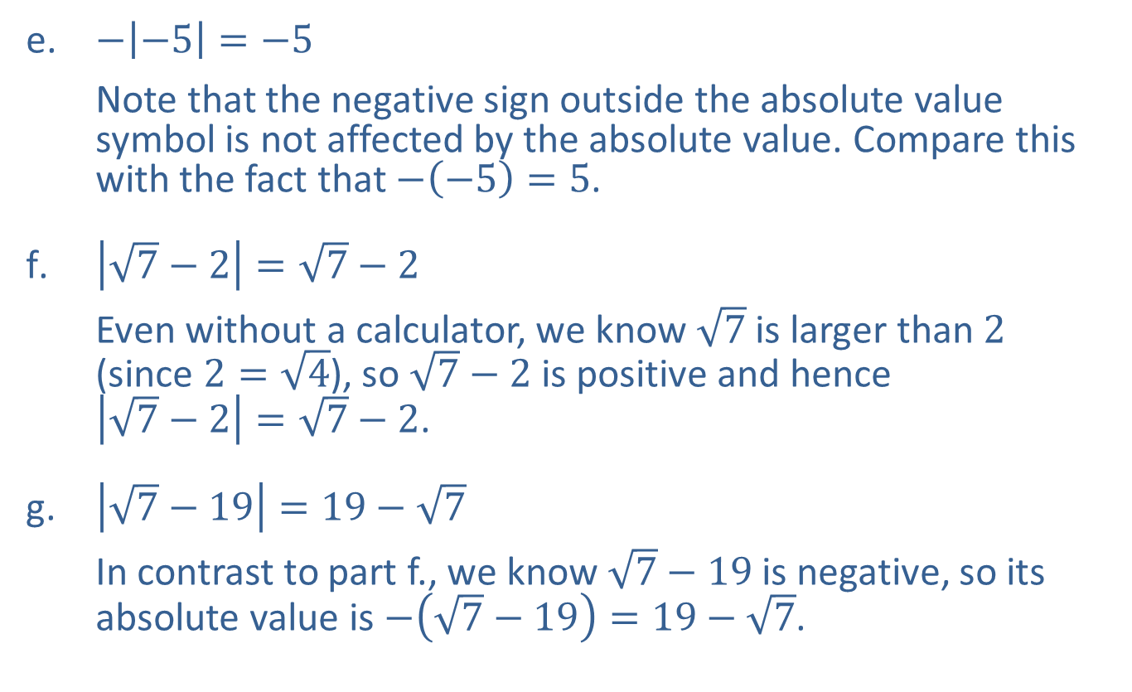
Example 8: Absolute Value (cont.)
​$−\left|−5\right|=−5$ Note that the negative sign outside the absolute value symbol is not affected by the absolute value. Compare this with the fact that $−\left(−5\right)=5$.
​$\left|\sqrt{7}−2\right|=\sqrt{7}−2$ Even without a calculator, we know $\sqrt{7}$ is larger than 2 (since $2=\sqrt{4}$), so $\sqrt{7}−2$ is positive and hence $\left|\sqrt{7}−2\right|=\sqrt{7}−2$.
​$\left|\sqrt{7}−19\right|=19−\sqrt{7}$ In contrast to part f., we know $\sqrt{7}−19$ is negative, so its absolute value is $−\left(\sqrt{7}−19\right)=19−\sqrt{7}$.

Slide 32
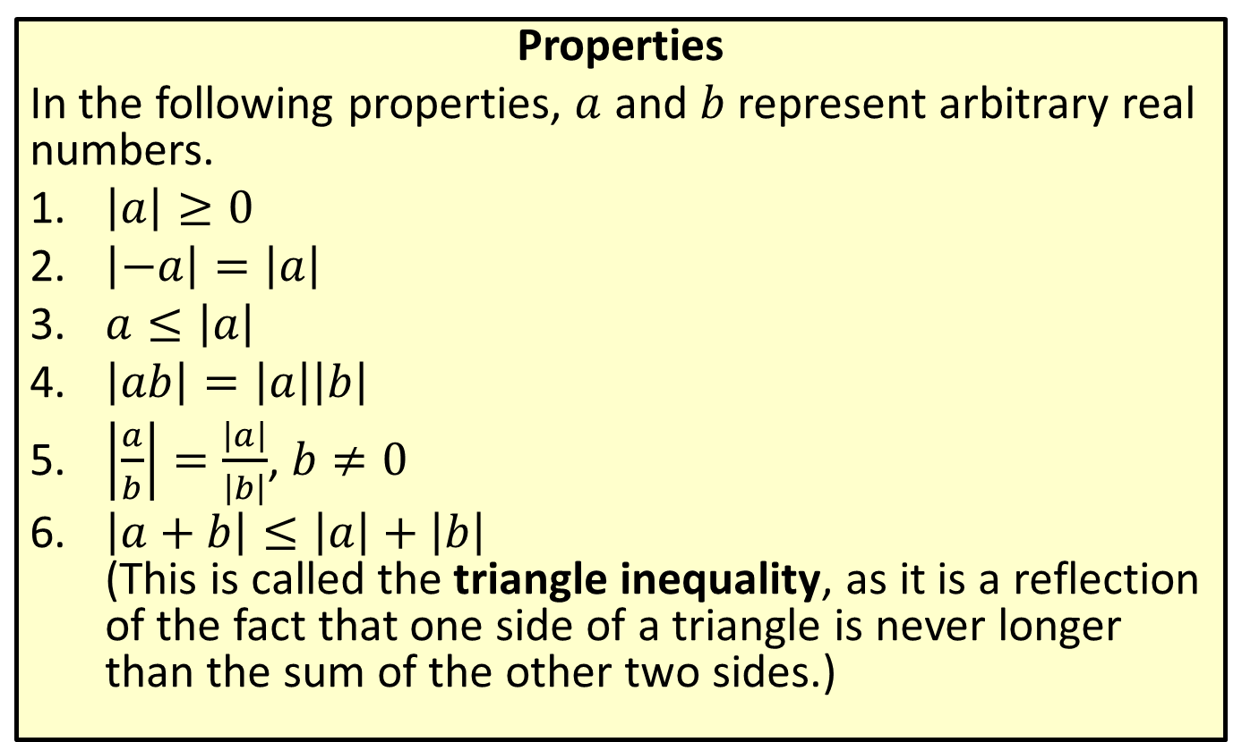
Properties of Absolute Value
Properties
In the following properties, $a$ and $b$ represent arbitrary real numbers.
​$\left|a\right|≥0$
​$\left|−a\right|=\left|a\right|$
​$a≤\left|a\right|$
​$\left|ab\right|=\left|a\right|\left|b\right|$
​$\left|\frac{a}{b}\right|=\frac{\left|a\right|}{\left|b\right|}$, $b≠0$
​$\left|a+b\right|≤\left|a\right|+\left|b\right|$ (This is called the triangle inequality, as it is a reflection of the fact that one side of a triangle is never longer than the sum of the other two sides.)

Slide 33

Example 9: Using Absolute Value Properties
​$\left|\left(−3\right)\left(5\right)\right|=\left|−15\right|=15=\left|−3\right|\left|5\right|$
​$1=\left|−3+4\right|≤\left|−3\right|+\left|4\right|=7$
​$7=\left|−3−4\right|≤\left|−3\right|+\left|−4\right|=7$
​$\left|\frac{−3}{7}\right|=\frac{\left|−3\right|}{\left|7\right|}=\frac{3}{7}$

Slide 34
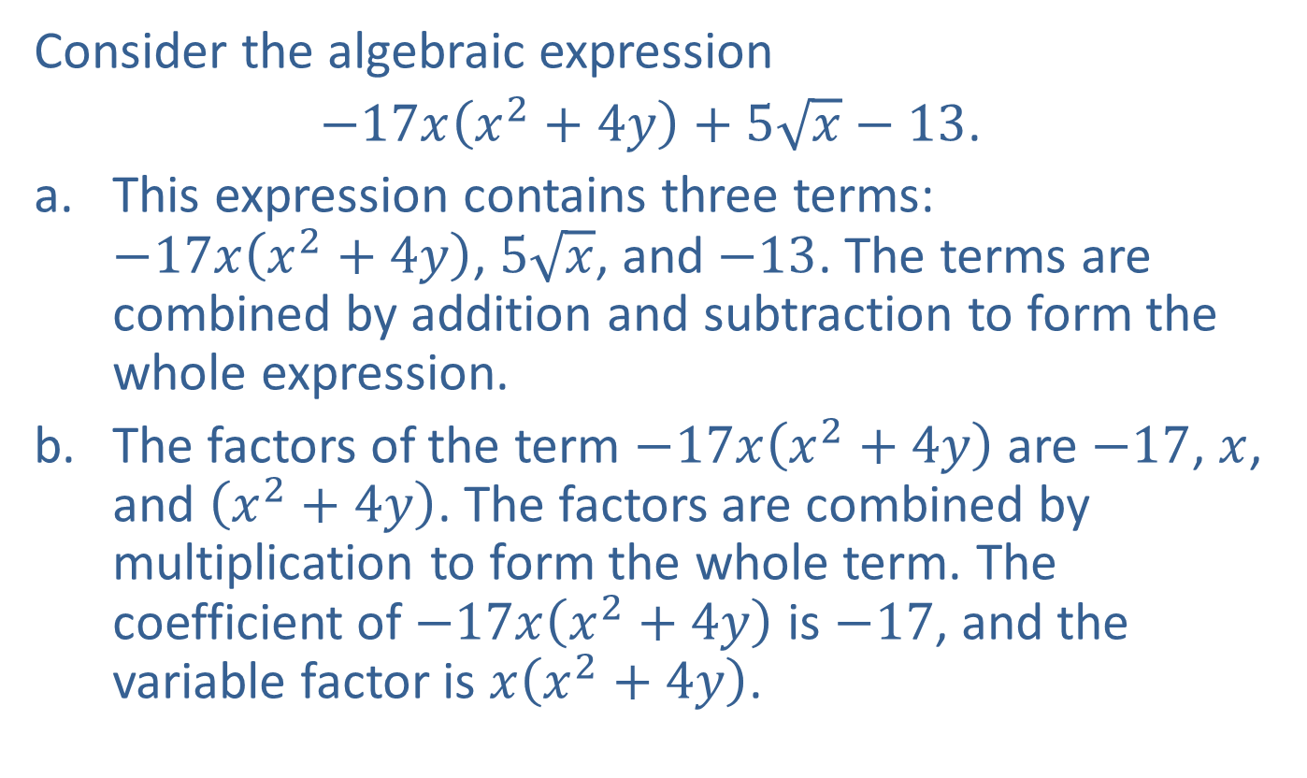
Example 10: Terminology of Algebraic Expressions
Consider the algebraic expression
$−17x\left(x^{2}+4y\right)+5\sqrt{x}−13$.
​This expression contains three terms: $−17x\left(x^{2}+4y\right)$, $5\sqrt{x}$, and $−13$. The terms are combined by addition and subtraction to form the whole expression.
​The factors of the term $−17x\left(x^{2}+4y\right)$ are $−17$, $x$, and $\left(x^{2}+4y\right)$. The factors are combined by multiplication to form the whole term. The coefficient of $−17x\left(x^{2}+4y\right)$ is $−17$, and the variable factor is $x\left(x^{2}+4y\right)$.

Slide 35

Example 11: Evaluating Algebraic Expressions
Evaluate the following algebraic expressions.
​$5x^{3}−16$ for $x=4$
​$−3x^{2}−2\left(x+y\right)$ for $x=−2$ and $y=3$

Slide 36
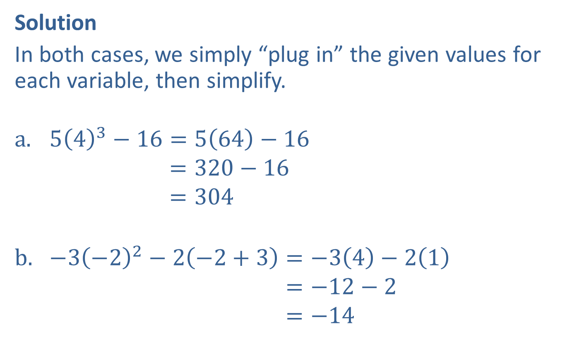
Example 11: Evaluating Algebraic Expressions (cont.)
Solution
In both cases, we simply “plug in” the given values for each variable, then simplify.
$5{\left(4\right)}^{3}−16=5\left(64\right)−16$
543−16=320−16543−16=304
$−3{\left(−2\right)}^{2}−2\left(−2+3\right)=−3\left(4\right)−2\left(1\right)$
−3−22−2−2+3=−12−2−3−22−2−2+3=−14

Slide 37
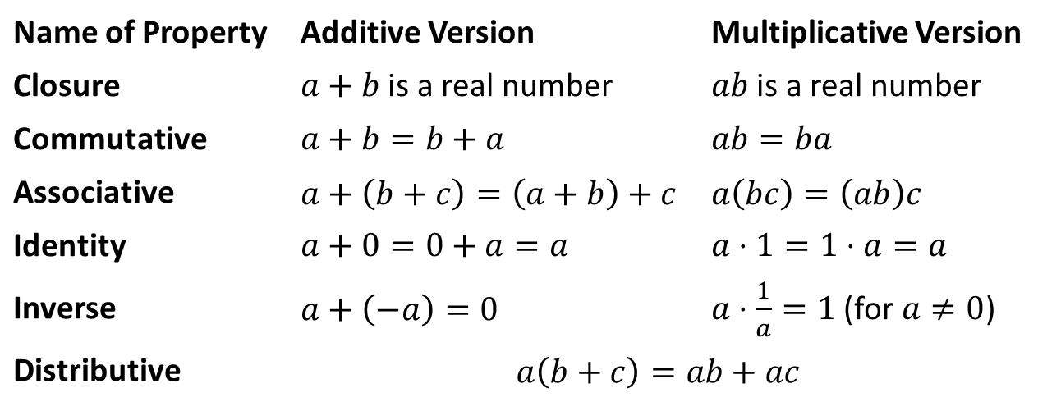

Field Properties
Properties
In the following properties, $a$, $b$, and $c$ represent arbitrary real numbers. The first five properties apply to addition and multiplication, while the last combines the two.
Name of Property | Additive Version | Multiplicative Version
Closure | $a+b$ is a real number | $ab$ is a real number
Commutative | $$a+b=b+a$$ | $$ab=ba$$
Associative | $$a+\left(b+c\right)=\left(a+b\right)+c$$ | $$a\left(bc\right)=\left(ab\right)c$$
Identity | $$a+0=0+a=a$$ | $$a⋅1=1⋅a=a$$
Inverse | $$a+\left(−a\right)=0$$ | $a⋅\frac{1}{a}=1$ (for $a≠0$)
Distributive | $$a\left(b+c\right)=ab+ac$$

Slide 38
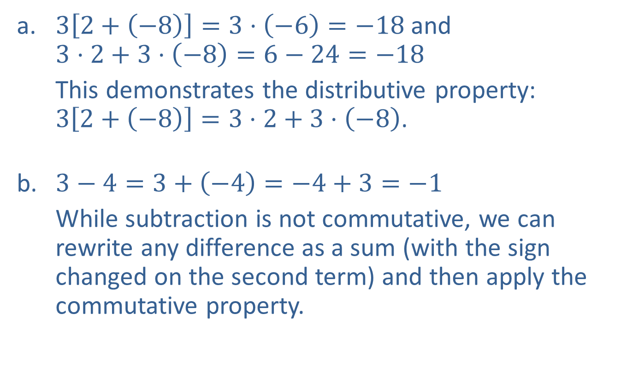
Example 12: Using the Field Properties
​$3\left[2+\left(−8\right)\right]=3⋅\left(−6\right)=−18$ and $3⋅2+3⋅\left(−8\right)=6−24=−18$
​This demonstrates the distributive property: $3\left[2+\left(−8\right)\right]=3⋅2+3⋅\left(−8\right)$.
​$3−4=3+\left(−4\right)=−4+3=−1$
​While subtraction is not commutative, we can rewrite any difference as a sum (with the sign changed on the second term) and then apply the commutative property.
​

Slide 39
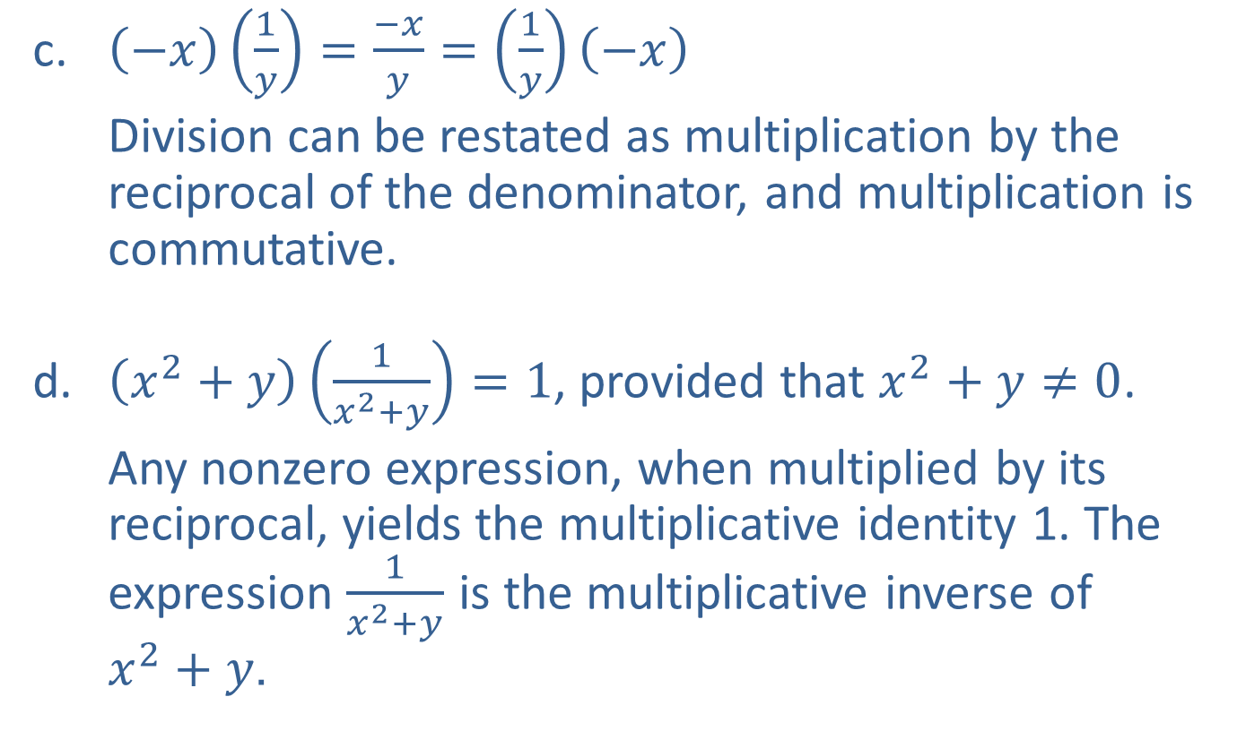
Example 12: Using the Field Properties (cont.)
​$\left(−x\right)\left(\frac{1}{y}\right)=\frac{−x}{y}=\left(\frac{1}{y}\right)\left(−x\right)$
​Division can be restated as multiplication by the reciprocal of the denominator, and multiplication is commutative.
​$\left(x^{2}+y\right)\left(\frac{1}{x^{2}+y}\right)=1$, provided that $x^{2}+y≠0$.
​Any nonzero expression, when multiplied by its reciprocal, yields the multiplicative identity 1. The expression $\frac{1}{x^{2}+y}$ is the multiplicative inverse of $x^{2}+y$.

Slide 40

Example 13: Visualizing the Distributive Property
Consider the equation $a\left(b+c\right)=ab+ac$, which demonstrates the distributive property. We can represent the equation geometrically to understand why the distributive property works.

Slide 41
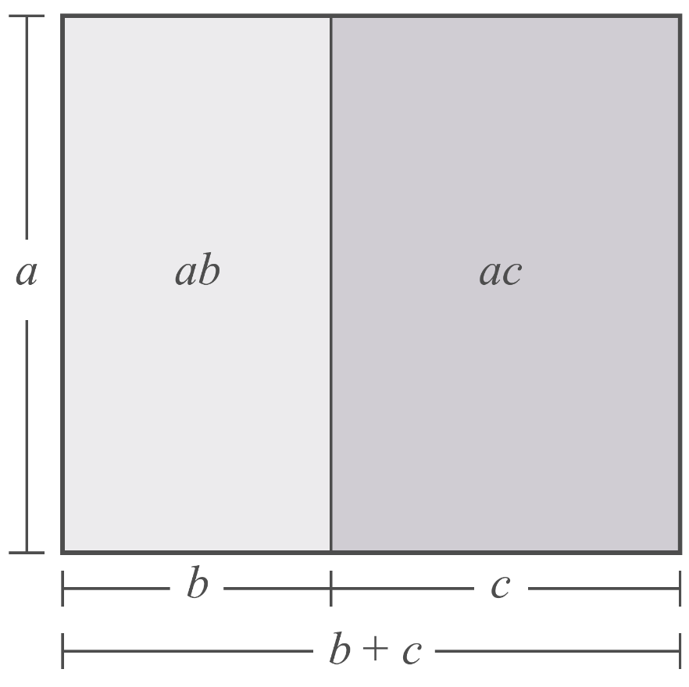
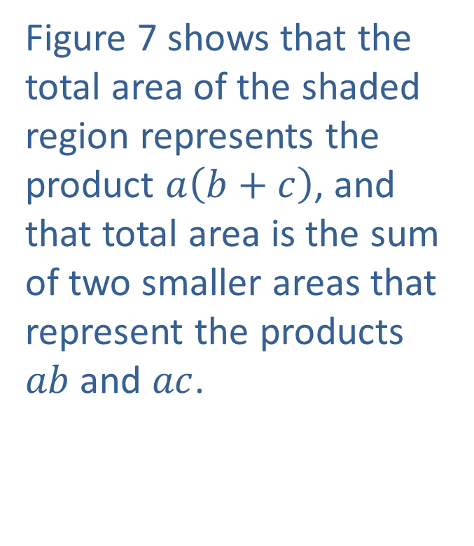
Example 13: Visualizing the Distributive Property (cont.)
Figure 7 shows that the total area of the shaded region represents the product $a\left(b+c\right)$, and that total area is the sum of two smaller areas that represent the products $ab$ and $ac$.
Figure 7

Slide 42
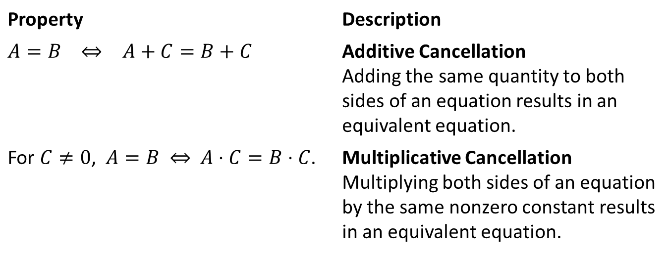

Cancellation Properties
Properties
In the following properties, $A$, $B$, and $C$ represent algebraic expressions. The symbol ⇔ can be read as “if and only if” or “is equivalent to.”
Property | Description
​$A=B$ ⇔ $A+C=B+C$ | Additive Cancellation Adding the same quantity to both sides of an equation results in an equivalent equation.
For $C≠0$, $A=B$ ⇔ $A⋅C=B⋅C$. | Multiplicative Cancellation Multiplying both sides of an equation by the same nonzero constant results in an equivalent equation.

Slide 43
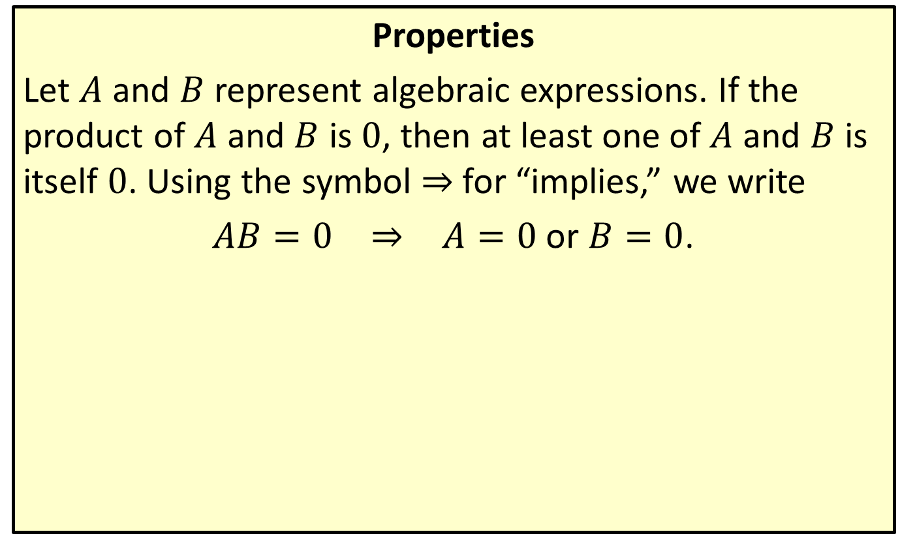
Zero-Factor Property
Properties
Let $A$ and $B$ represent algebraic expressions. If the product of $A$ and $B$ is 0, then at least one of $A$ and $B$ is itself 0. Using the symbol ⇒ for “implies,” we write
$AB=0$ ⇒ $A=0$ or $B=0$.

Slide 44
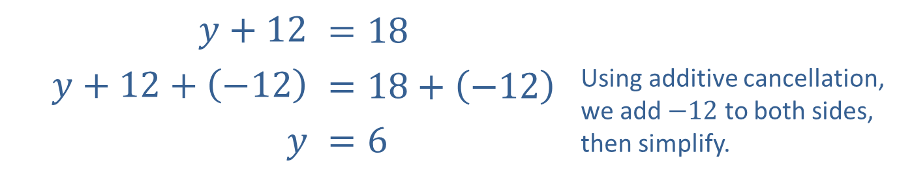

Example 14: Using the Cancellation and Zero-Factor Properties
​$y+12$ | $$=18$$
​$y+12+\left(−12\right)$ | ​$=18+\left(−12\right)$ | Using additive cancellation, we add $−12$ to both sides, then simplify.
$$y$$ | ​$=6$
This shows that the equation $y+12=18$ is equivalent to the equation $y=6$.

Slide 45


Example 14: Using the Cancellation and Zero-Factor Properties (cont.)
​$−6x$ | ​$=30$
​$−6x\left(−\frac{1}{6}\right)$ | ​$=30\left(−\frac{1}{6}\right)$ | Using multiplicative cancellation, we multiply both sides by $−\frac{1}{6}$, then simplify.
$$x$$ | ​$=−5$
​ Alternatively, dividing both sides by $−6$ yields the same result. Thus, the equation $−6x=30$ is equivalent to $x=−5$. We can see how cancellation properties can help us solve equations for variables.

Slide 46

Example 14: Using the Cancellation and Zero-Factor Properties (cont.)
​Multiplying both sides of the equation $x^{2}−x=2$ by 0 leads to the equation $0=0$, a true statement. However, these two equations are not equivalent!
​While replacing $x$ in the first equation by $−1$ or 2 leads to a true statement, any other value for $x$ leads to a false statement. By contrast, the equation $0=0$, is true for all values of $x$, as there is no $x$ in the equation to replace with a number. This example illustrates why we must multiply both sides of an equation by a nonzero quantity to apply multiplicative cancellation.

Slide 47

Example 14: Using the Cancellation and Zero-Factor Properties (cont.)
​The equation $\left(x−y\right)\left(x+y\right)=0$ means that $x−y=0$ or $x+y=0$, by the Zero-Factor Property. Remember that the only way for a product of two (or more) factors to be 0 is for at least one of the factors to be 0 itself. For instance, in this example it might be that both $x−y=0$ and $x+y=0$. If $x=0$ and $y=0$, this is indeed the case.

