Slide 1
Section 1.2
Properties of Exponents and Radicals

Slide 2
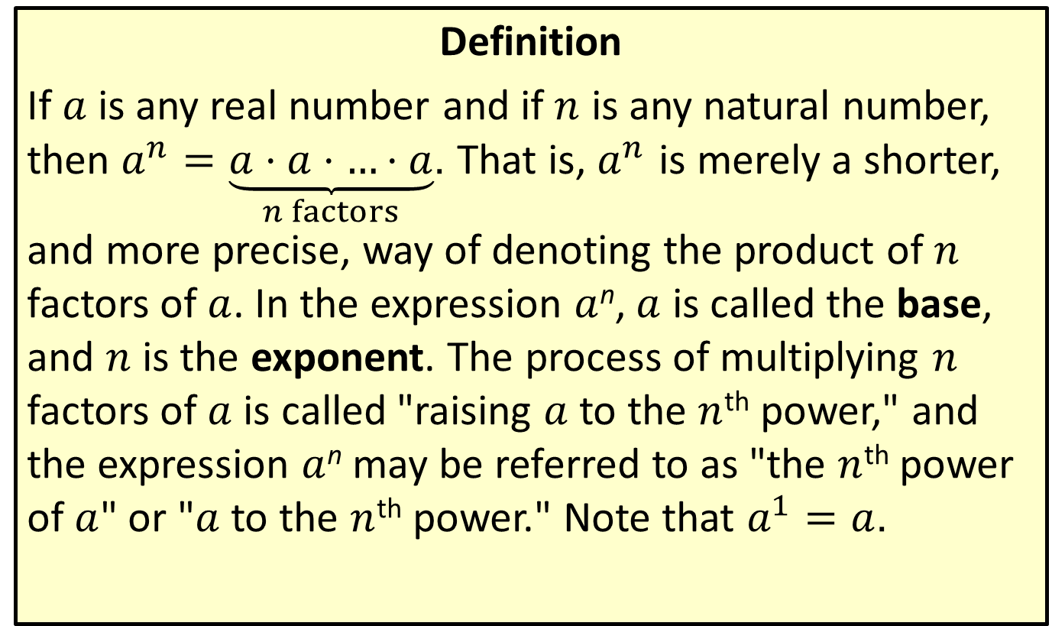
Natural Number Exponents
Definition
If $a$ is any real number and if $n$ is any natural number, then $a^{n}=\underset{n factors}{\underbrace{a⋅a⋅…⋅a}}$. That is, $a^{n}$ is merely a shorter, and more precise, way of denoting the product of $n$ factors of $a$. In the expression $a$^{n}, $a$ is called the base, and $n$ is the exponent. The process of multiplying $n$ factors of $a$ is called "raising $a$ to the $n$^{th} power," and the expression $a$^{n} may be referred to as "the $n$^{th} power of $a$" or "$a$ to the $n$^{th} power." Note that $a^{1}=a$.

Slide 3
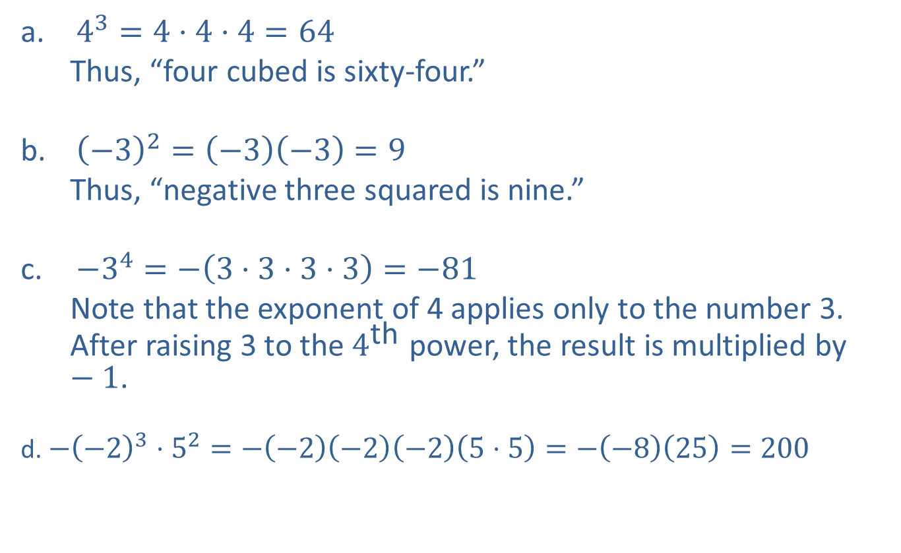
Example 1: Using Natural Number Exponents
​$4^{3}=4⋅4⋅4=64$
Thus, “four cubed is sixty-four.”
​${\left(−3\right)}^{2}=\left(−3\right)\left(−3\right)=9$
Thus, “negative three squared is nine.”
​$−3^{4}=−\left(3⋅3⋅3⋅3\right)=−81$
Note that the exponent of 4 applies only to the number 3. After raising 3 to the $4^{\text{th}}$ power, the result is multiplied by $−1$.
d. $−{\left(−2\right)}^{3}⋅5^{2}=−\left(−2\right)\left(−2\right)\left(−2\right)\left(5⋅5\right)=−\left(−8\right)\left(25\right)=200$
​

Slide 4
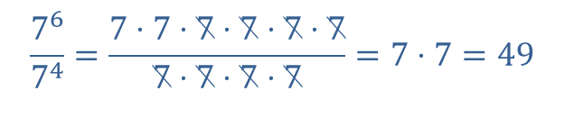
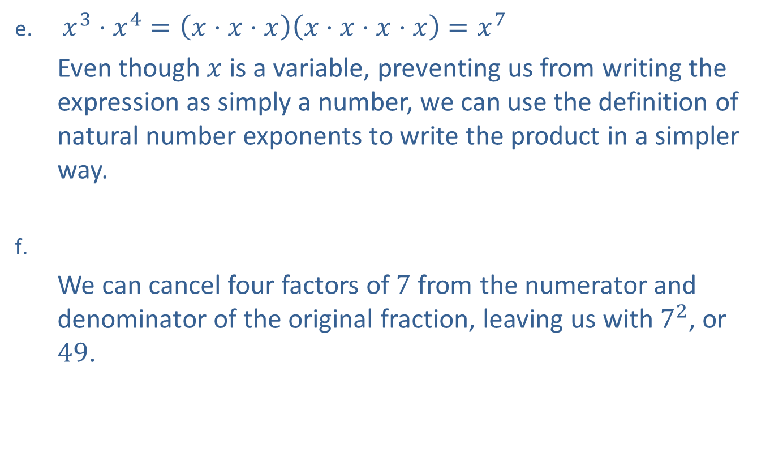
Example 1: Using Natural Number Exponents (cont.)
​$x^{3}⋅x^{4}=\left(x⋅x⋅x\right)\left(x⋅x⋅x⋅x\right)=x^{7}$
Even though $x$ is a variable, preventing us from writing the expression as simply a number, we can use the definition of natural number exponents to write the product in a simpler way.
​
We can cancel four factors of 7 from the numerator and denominator of the original fraction, leaving us with $7^{2}$, or 49.
$$\frac{7^{6}}{7^{4}}=\frac{7⋅7⋅7⋅7⋅7⋅7}{7⋅7⋅7⋅7}=7⋅7=49$$

Slide 5
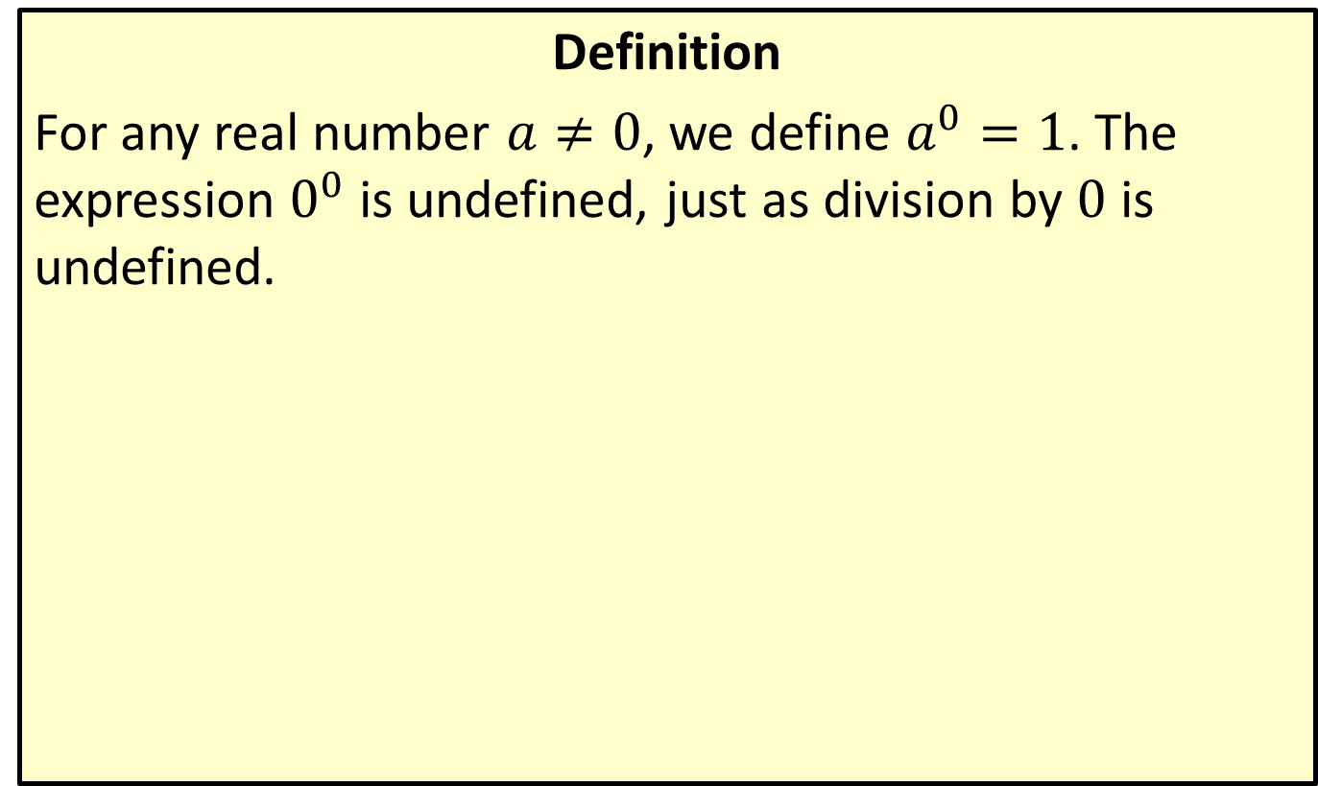
0 as an Exponent
Definition
For any real number $a≠0$, we define $a^{0}=1$. The expression $0^{0}$ is undefined, just as division by 0 is undefined.

Slide 6
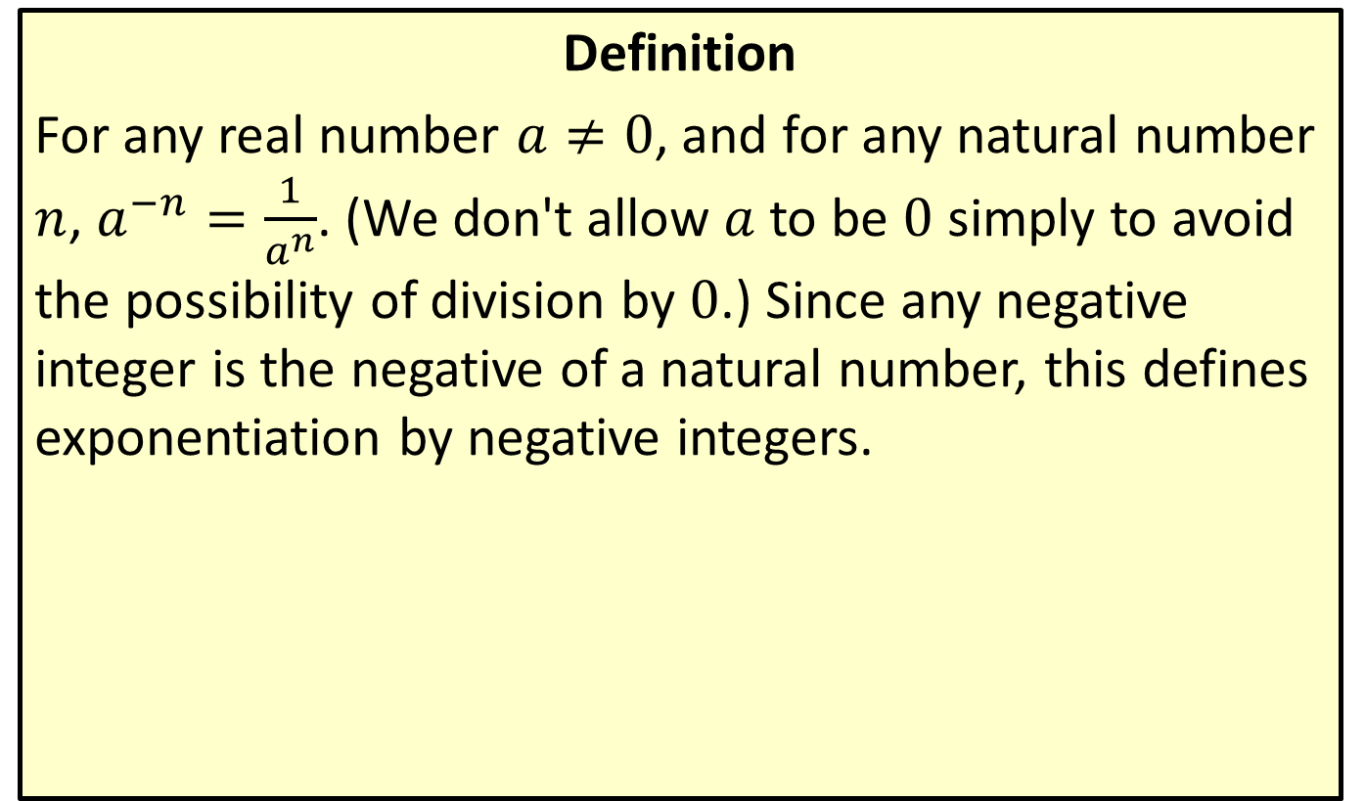
Negative Integer Exponents
Definition
For any real number $a≠0$, and for any natural number $n$, $a^{−n}=\frac{1}{a^{n}}$. (We don't allow $a$ to be 0 simply to avoid the possibility of division by 0.) Since any negative integer is the negative of a natural number, this defines exponentiation by negative integers.

Slide 7
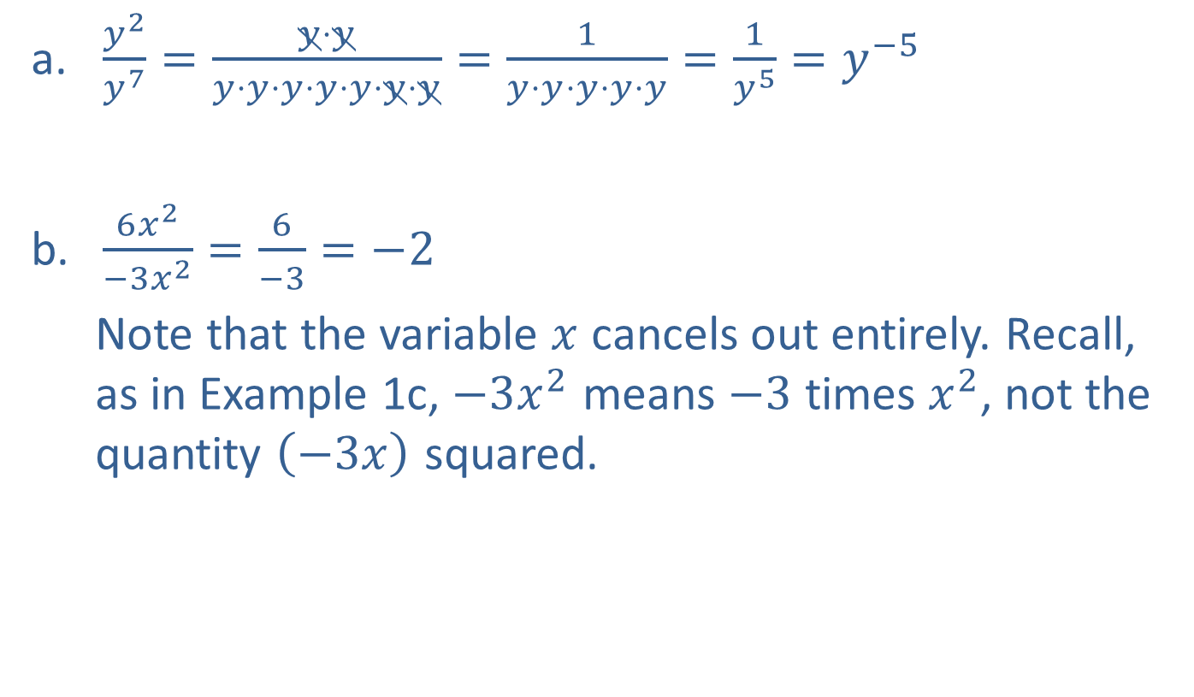
Example 2: Simplifying Exponents
​$\frac{y^{2}}{y^{7}}=\frac{y⋅y}{y⋅y⋅y⋅y⋅y⋅y⋅y}=\frac{1}{y⋅y⋅y⋅y⋅y}=\frac{1}{y^{5}}=y^{−5}$
​$\frac{6x^{2}}{−3x^{2}}=\frac{6}{−3}=−2$
Note that the variable $x$ cancels out entirely. Recall, as in Example 1c, $−3x^{2}$ means $−3$ times $x^{2}$, not the quantity $\left(−3x\right)$ squared.
​

Slide 8

Example 2: Simplifying Exponents (cont.)
c. ​ $5^{0}⋅5^{−3}=5^{0−3}=5^{−3}=\frac{1}{125}$
Note that $5^{0}=1$, as does $a^{0}$ for any $a≠0$.
​$\frac{1}{t^{−3}}=\frac{1}{\frac{1}{t^{3}}}=1⋅\frac{t^{3}}{1}=t^{3}$
​${\left(x^{2}y\right)}^{3}=\left(x^{2}y\right)\left(x^{2}y\right)\left(x^{2}y\right)=x^{2}⋅x^{2}⋅x^{2}⋅y⋅y⋅y=x^{6}y^{3}$

Slide 9
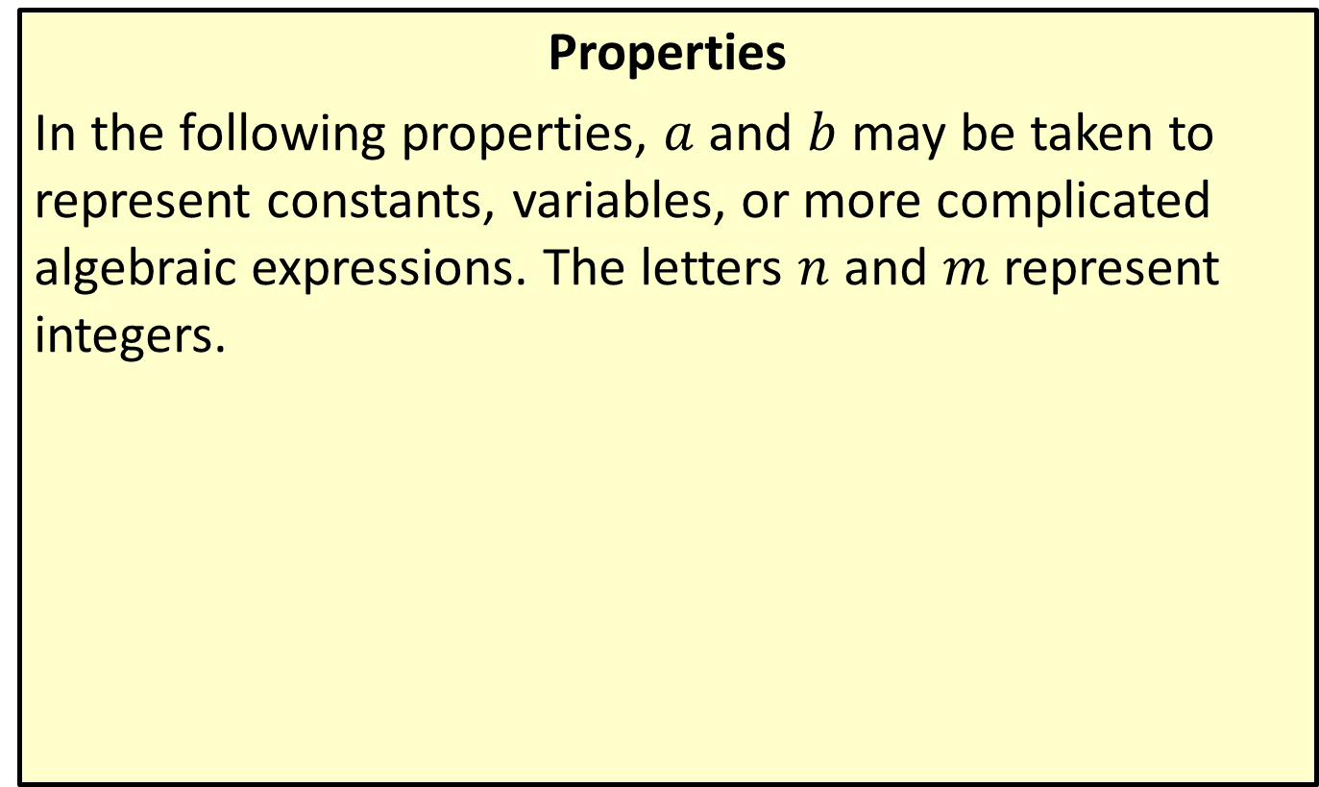
Properties of Exponents
Properties
In the following properties, $a$ and $b$ may be taken to represent constants, variables, or more complicated algebraic expressions. The letters $n$ and $m$ represent integers.

Slide 10
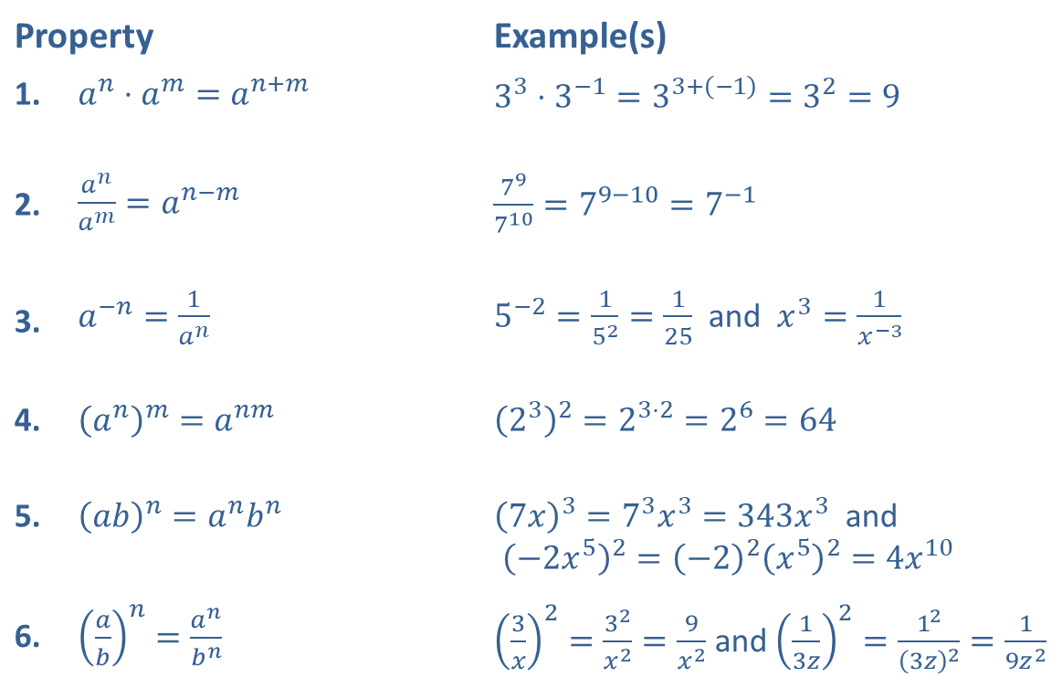
Properties of Exponents (cont.)
Property |  | Example(s)
1. | ​$a^{n}⋅a^{m}=a^{n+m}$ | ​$3^{3}⋅3^{−1}=3^{3+\left(−1\right)}=3^{2}=9$
2. | ​$\frac{a^{n}}{a^{m}}=a^{n−m}$ | ​$\frac{7^{9}}{7^{10}}=7^{9−10}=7^{−1}$
3. | ​$a^{−n}=\frac{1}{a^{n}}$ | ​$5^{−2}=\frac{1}{5^{2}}=\frac{1}{25}$ and $x^{3}=\frac{1}{x^{−3}}$
4. | ​${\left(a^{n}\right)}^{m}=a^{nm}$ | ​${\left(2^{3}\right)}^{2}=2^{3⋅2}=2^{6}=64$
5. | ​${\left(ab\right)}^{n}=a^{n}b^{n}$ | ​${\left(7x\right)}^{3}=7^{3}x^{3}=343x^{3}$ and ${\left(−2x^{5}\right)}^{2}={\left(−2\right)}^{2}{\left(x^{5}\right)}^{2}=4x^{10}$
6. | ​${\left(\frac{a}{b}\right)}^{n}=\frac{a^{n}}{b^{n}}$ | ​${\left(\frac{3}{x}\right)}^{2}=\frac{3^{2}}{x^{2}}=\frac{9}{x^{2}}$ and ${\left(\frac{1}{3z}\right)}^{2}=\frac{1^{2}}{{\left(3z\right)}^{2}}=\frac{1}{9z^{2}}$

Slide 11
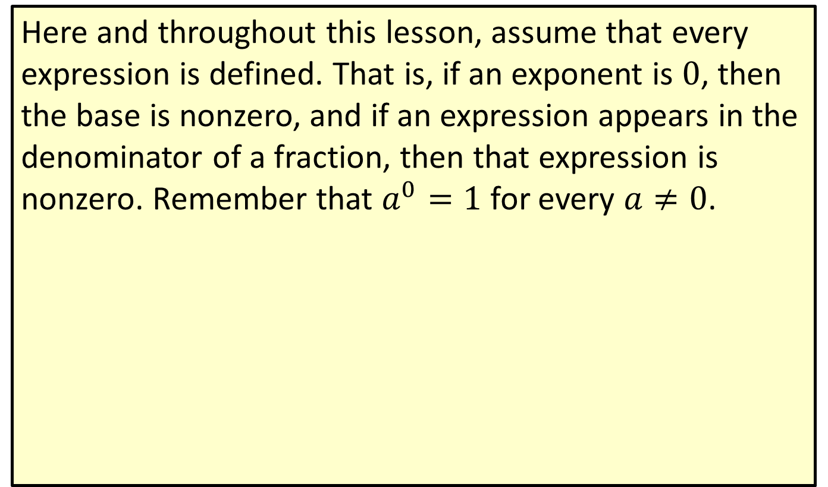
Properties of Exponents (cont.)
Here and throughout this lesson, assume that every expression is defined. That is, if an exponent is 0, then the base is nonzero, and if an expression appears in the denominator of a fraction, then that expression is nonzero. Remember that $a^{0}=1$ for every $a≠0$.

Slide 12
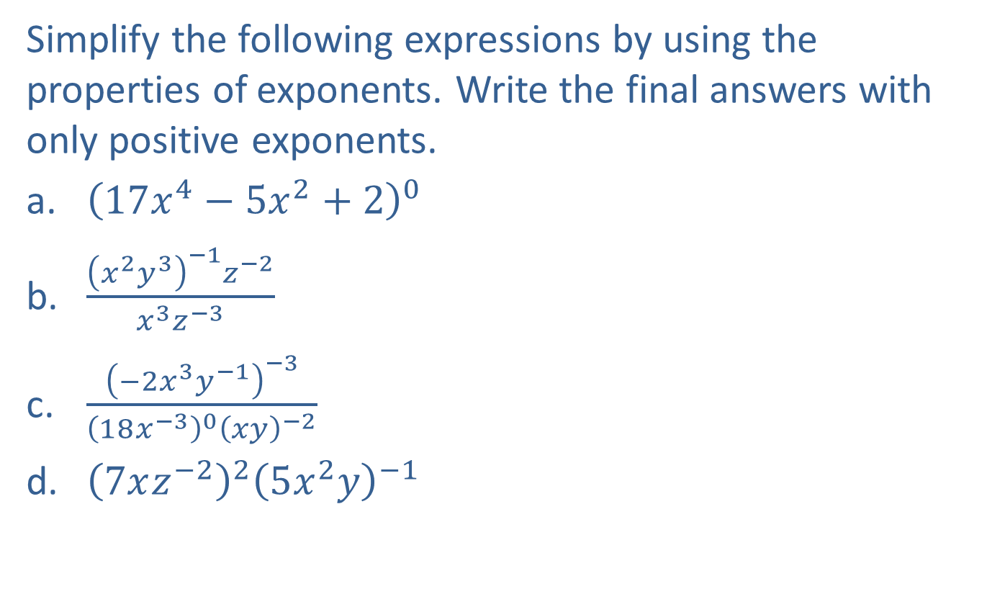
Example 3: Using Properties of Exponents
Simplify the following expressions by using the properties of exponents. Write the final answers with only positive exponents.
​${\left(17x^{4}−5x^{2}+2\right)}^{0}$
​$\frac{{\left(x^{2}y^{3}\right)}^{−1}z^{−2}}{x^{3}z^{−3}}$
​$\frac{{\left(−2x^{3}y^{−1}\right)}^{−3}}{{\left(18x^{−3}\right)}^{0}{\left(xy\right)}^{−2}}$
​${\left(7xz^{−2}\right)}^{2}{\left(5x^{2}y\right)}^{−1}$

Slide 13
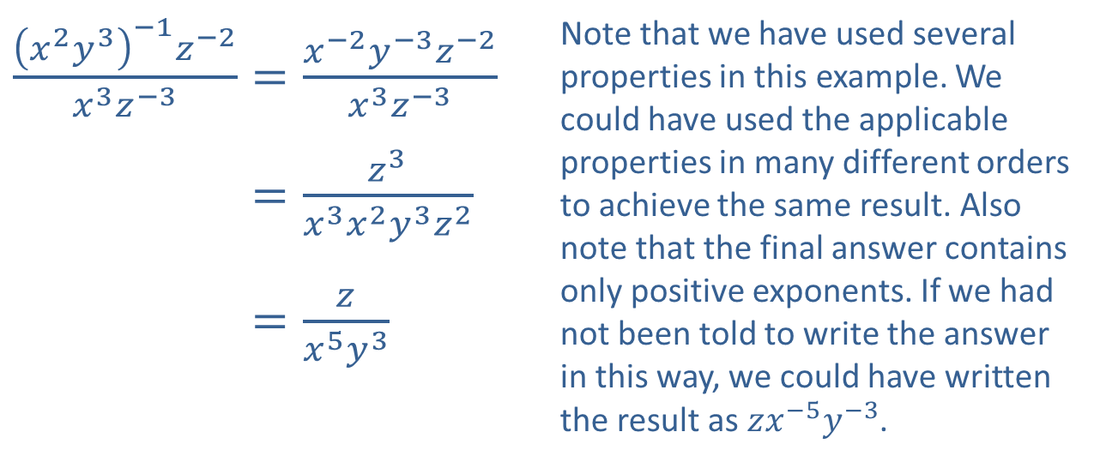

Example 3: Using Properties of Exponents (cont.)
Solution
​${\left(17x^{4}−5x^{2}+2\right)}^{0}=1$
Any nonzero expression with an exponent of 0 is 1.
​
​$\frac{{\left(x^{2}y^{3}\right)}^{−1}z^{−2}}{x^{3}z^{−3}}=\frac{x^{−2}y^{−3}z^{−2}}{x^{3}z^{−3}}$ | Note that we have used several properties in this example. We could have used the applicable properties in many different orders to achieve the same result. Also note that the final answer contains only positive exponents. If we had not been told to write the answer in this way, we could have written the result as $zx^{−5}y^{−3}$.
​𝑥2𝑦3−1𝑧−2𝑥3𝑧−3=𝑧3𝑥3𝑥2𝑦3𝑧2
​𝑥2𝑦3−1𝑧−2𝑥3𝑧−3=𝑧𝑥5𝑦3

Slide 14
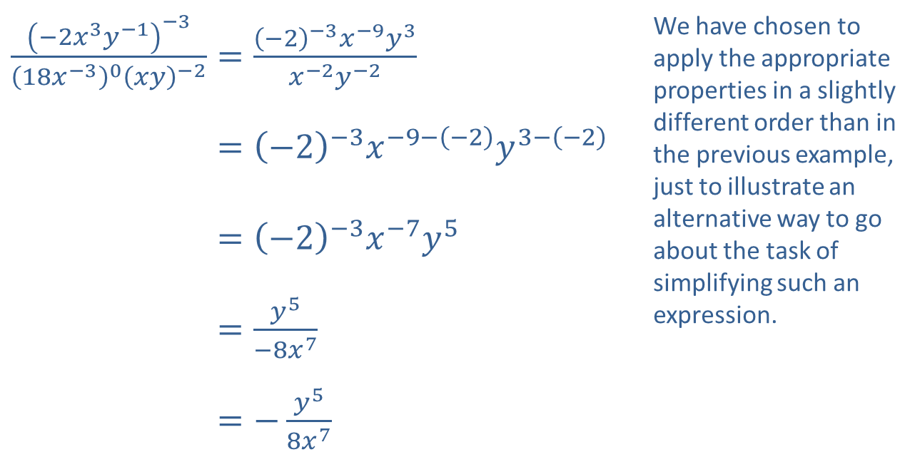
Example 3: Using Properties of Exponents (cont.)
​$\frac{{\left(−2x^{3}y^{−1}\right)}^{−3}}{{\left(18x^{−3}\right)}^{0}{\left(xy\right)}^{−2}}=\frac{{\left(−2\right)}^{−3}x^{−9}y^{3}}{x^{−2}y^{−2}}$ | We have chosen to apply the appropriate properties in a slightly different order than in the previous example, just to illustrate an alternative way to go about the task of simplifying such an expression.
​−2𝑥3𝑦−1−318𝑥−30𝑥𝑦−2=−2−3𝑥−9−−2𝑦3−−2
​−2𝑥3𝑦−1−318𝑥−30𝑥𝑦−2=−2−3𝑥−7𝑦5
​−2𝑥3𝑦−1−318𝑥−30𝑥𝑦−2=𝑦5−8𝑥7
​−2𝑥3𝑦−1−318𝑥−30𝑥𝑦−2=−𝑦58𝑥7
c. ​

Slide 15
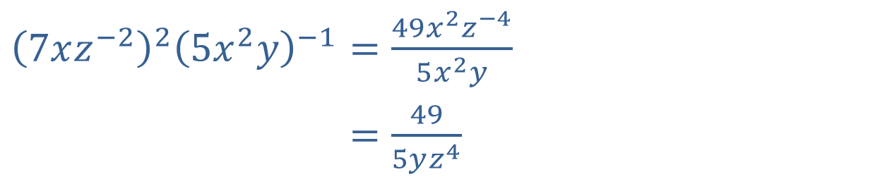
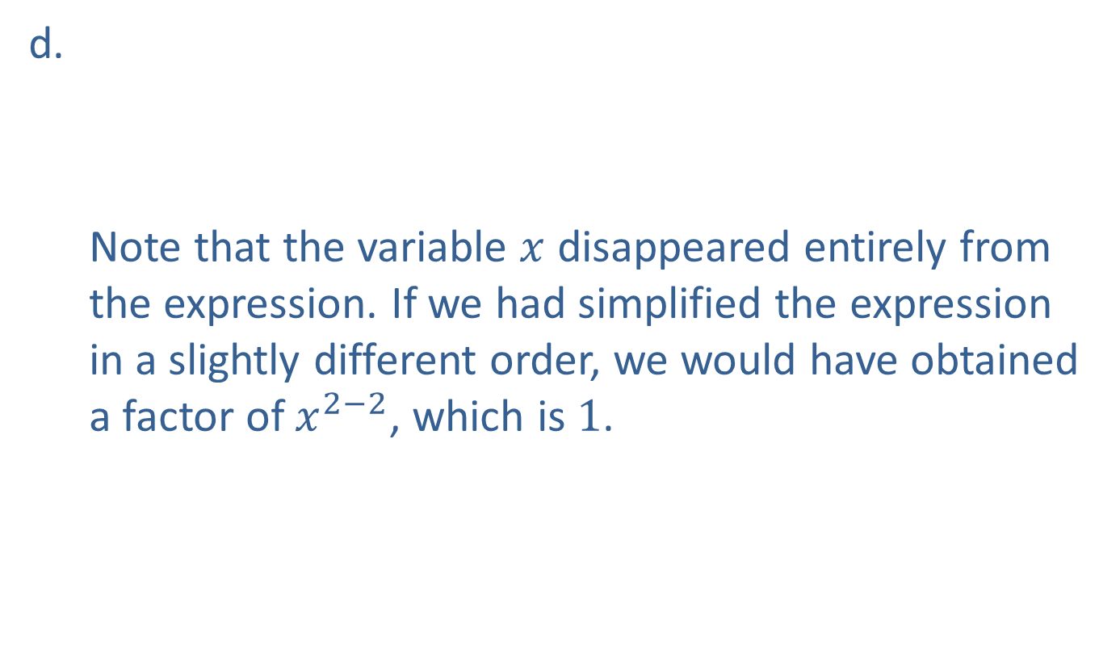
Example 3: Using Properties of Exponents (cont.)
​${\left(7xz^{−2}\right)}^{2}{\left(5x^{2}y\right)}^{−1}=\frac{49x^{2}z^{−4}}{5x^{2}y}$
​7𝑥𝑧−225𝑥2𝑦−1=495𝑦𝑧4
d.
Note that the variable $x$ disappeared entirely from the expression. If we had simplified the expression in a slightly different order, we would have obtained a factor of $x^{2−2}$, which is 1.
​

Slide 16
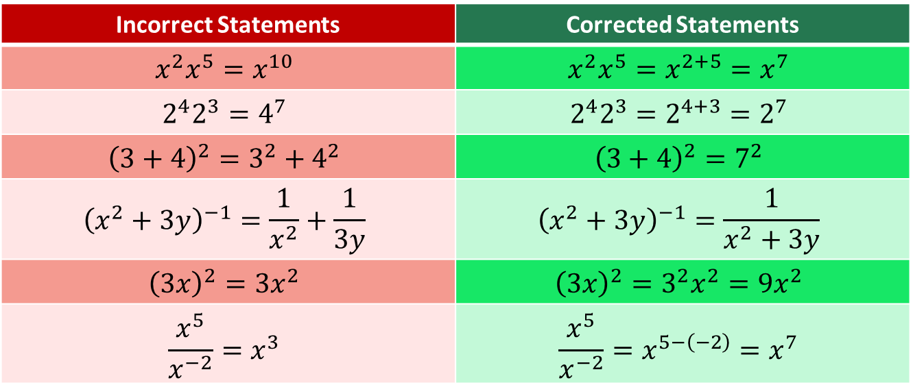
CAUTION!
Many common errors result from forgetting the exact forms of the properties of exponents, as shown below.
Incorrect Statements | Corrected Statements
$$x^{2}x^{5}=x^{10}$$ | $$x^{2}x^{5}=x^{2+5}=x^{7}$$
$$2^{4}2^{3}=4^{7}$$ | $$2^{4}2^{3}=2^{4+3}=2^{7}$$
$${\left(3+4\right)}^{2}=3^{2}+4^{2}$$ | $${\left(3+4\right)}^{2}=7^{2}$$
$${\left(x^{2}+3y\right)}^{−1}=\frac{1}{x^{2}}+\frac{1}{3y}$$ | $${\left(x^{2}+3y\right)}^{−1}=\frac{1}{x^{2}+3y}$$
$${\left(3x\right)}^{2}=3x^{2}$$ | $${\left(3x\right)}^{2}=3^{2}x^{2}=9x^{2}$$
$$\frac{x^{5}}{x^{−2}}=x^{3}$$ | $$\frac{x^{5}}{x^{−2}}=x^{5−\left(−2\right)}=x^{7}$$

Slide 17
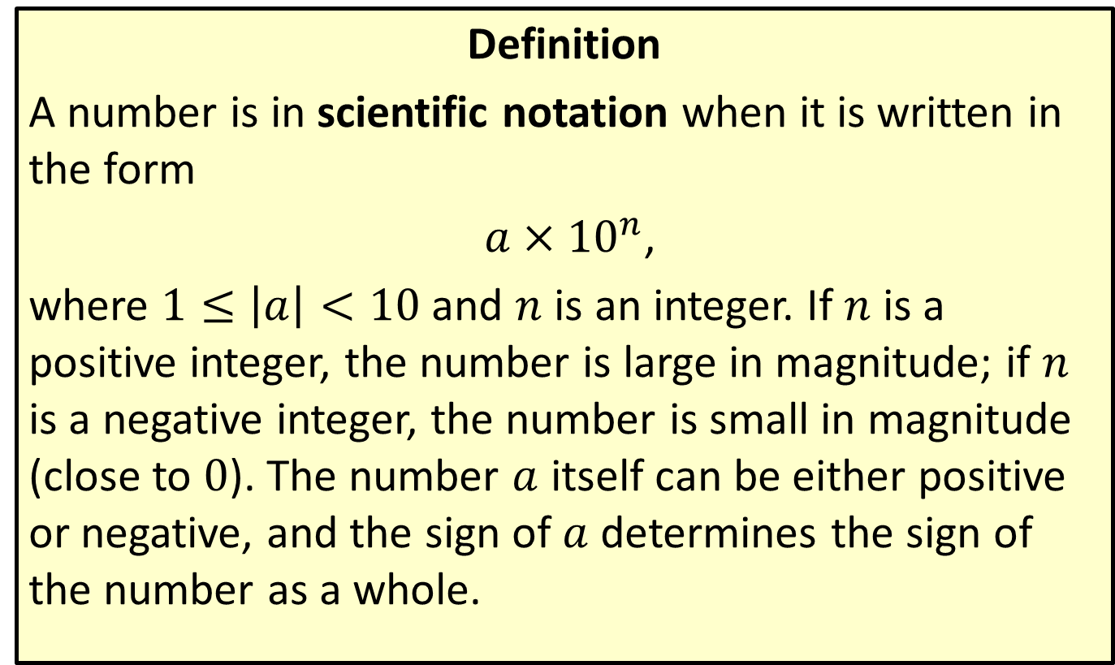
Scientific Notation
Definition
A number is in scientific notation when it is written in the form
$a×{10}^{n}$,
where $1≤\left|a\right|<10$ and $n$ is an integer. If $n$ is a positive integer, the number is large in magnitude; if $n$ is a negative integer, the number is small in magnitude (close to 0). The number $a$ itself can be either positive or negative, and the sign of $a$ determines the sign of the number as a whole.

Slide 18
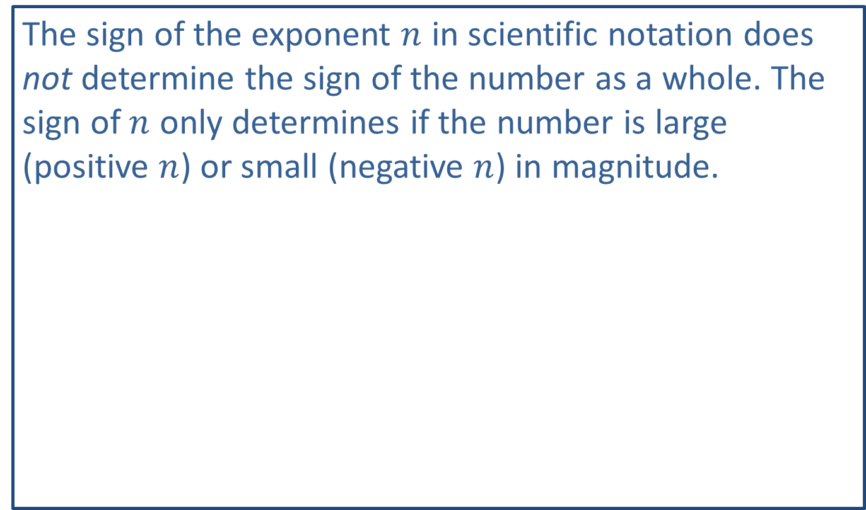
CAUTION!
The sign of the exponent $n$ in scientific notation does not determine the sign of the number as a whole. The sign of $n$ only determines if the number is large (positive $n$) or small (negative $n$) in magnitude.

Slide 19
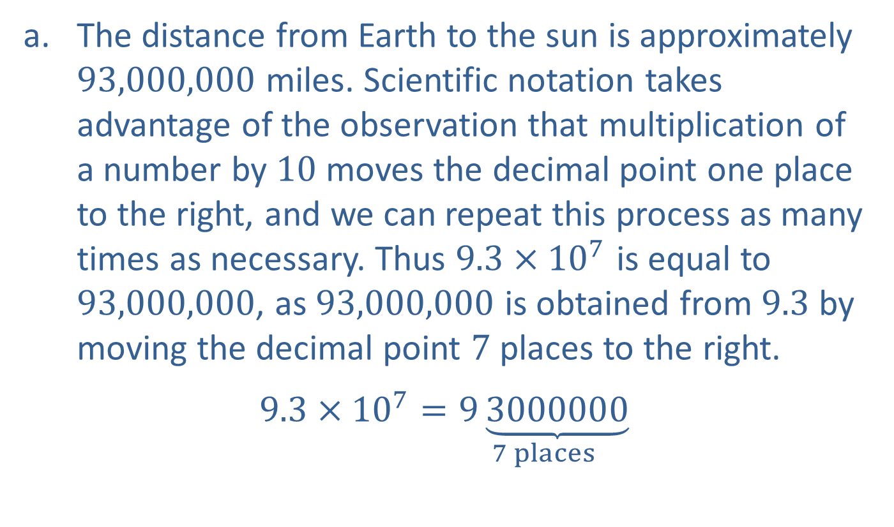
Example 4: Using Scientific Notation
​The distance from Earth to the sun is approximately 93,000,000 miles. Scientific notation takes advantage of the observation that multiplication of a number by 10 moves the decimal point one place to the right, and we can repeat this process as many times as necessary. Thus $9.3×{10}^{7}$ is equal to 93,000,000, as 93,000,000 is obtained from 9.3 by moving the decimal point 7 places to the right.
​$9.3×{10}^{7}=\underset{7 places}{9\underbrace{3000000}}$
​

Slide 20
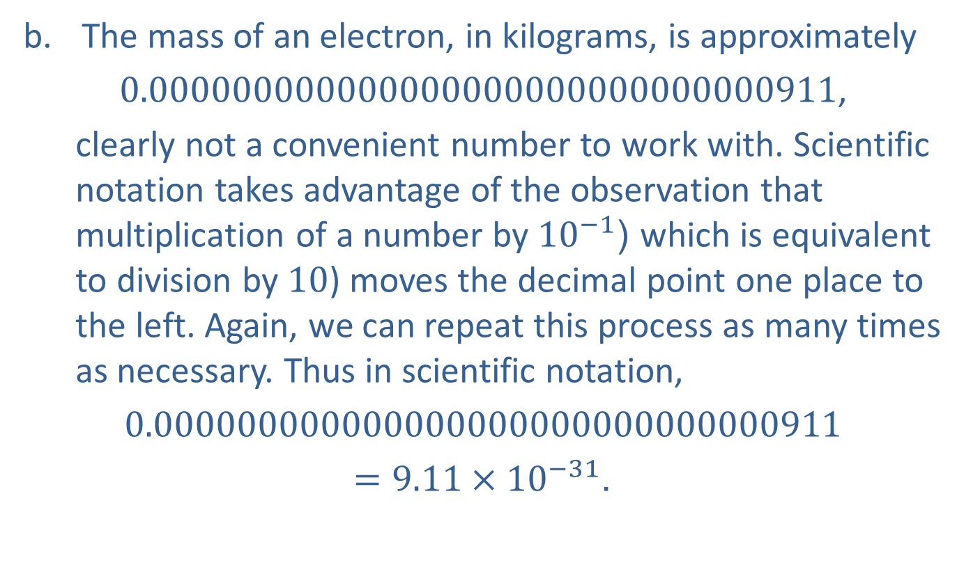
Example 4: Using Scientific Notation (cont.)
​The mass of an electron, in kilograms, is approximately
​0.000000000000000000000000000000911,
clearly not a convenient number to work with. Scientific notation takes advantage of the observation that multiplication of a number by ${10}^{−1}$ (which is equivalent to division by 10) moves the decimal point one place to the left. Again, we can repeat this process as many times as necessary. Thus in scientific notation,
​$0.000000000000000000000000000000911$
$=9.11×{10}^{−31}$.

Slide 21

Example 4: Using Scientific Notation (cont.)
​The speed of light in a vacuum is approximately $3×{10}^{8}$ meters per second. In standard (nonscientific) notation, this number is written as 300,000,000.

Slide 22
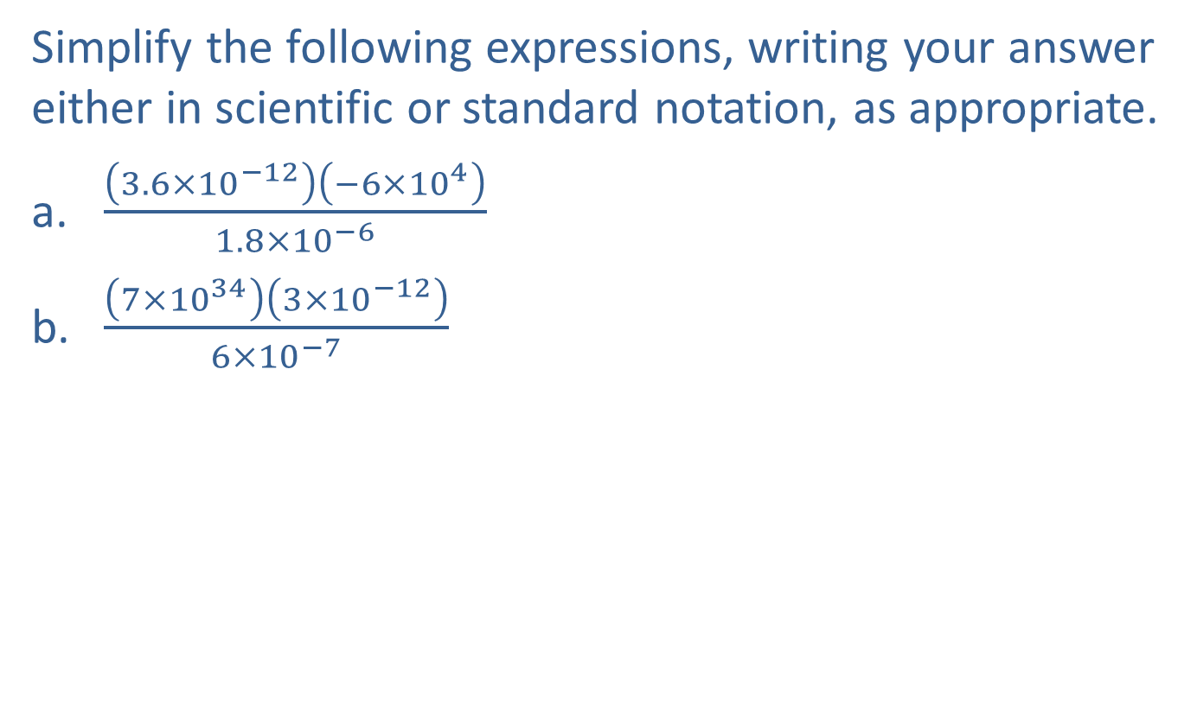
Example 5: Simplifying Expressions with Scientific Notation
Simplify the following expressions, writing your answer either in scientific or standard notation, as appropriate.
​$\frac{\left(3.6×{10}^{−12}\right)\left(−6×{10}^{4}\right)}{1.8×{10}^{−6}}$
​$\frac{\left(7×{10}^{34}\right)\left(3×{10}^{−12}\right)}{6×{10}^{−7}}$

Slide 23
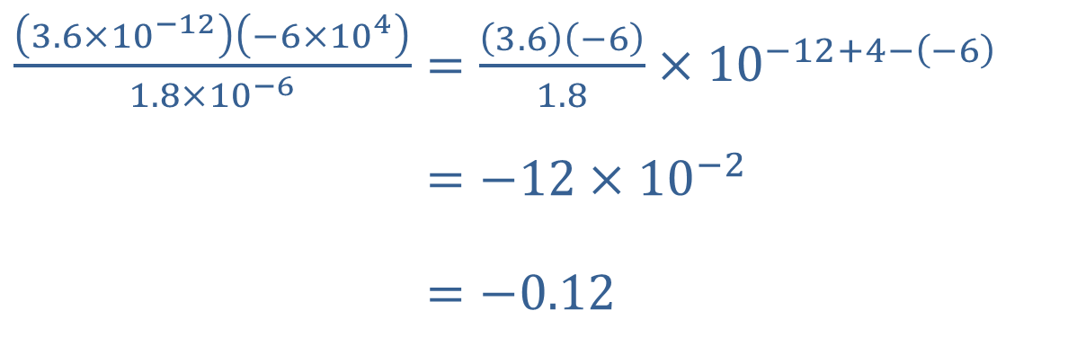

Example 5: Simplifying Expressions with Scientific Notation (cont.)
Solution
​
We have written the final answer in standard notation (as it is not inconvenient to do so). Note that in scientific notation, it would be written as $−1.2×{10}^{−1}$.
​$\frac{\left(3.6×{10}^{−12}\right)\left(−6×{10}^{4}\right)}{1.8×{10}^{−6}}=\frac{\left(3.6\right)\left(−6\right)}{1.8}×{10}^{−12+4−\left(−6\right)}$
​3.6×10−12−6×1041.8×10−6=−12×10−2
​3.6×10−12−6×1041.8×10−6=−0.12

Slide 24
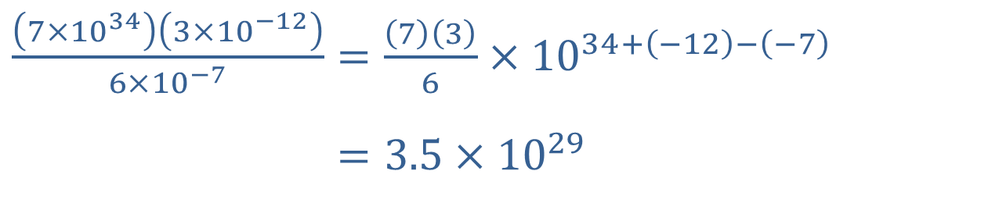
Example 5: Simplifying Expressions with Scientific Notation (cont.)
​$\frac{\left(7×{10}^{34}\right)\left(3×{10}^{−12}\right)}{6×{10}^{−7}}=\frac{\left(7\right)\left(3\right)}{6}×{10}^{34+\left(−12\right)−\left(−7\right)}$
​7×10343×10−126×10−7=3.5×1029
​
This answer is best written in scientific notation.

Slide 25
Example 6: Using Geometric Formulas
Find formulas for each of the following:
​The surface area of a box
​The surface area of a soup can
​The volume of a birdbath in the shape of half of a sphere
​The volume of a gold ingot whose shape is a right trapezoidal cylinder

Slide 26
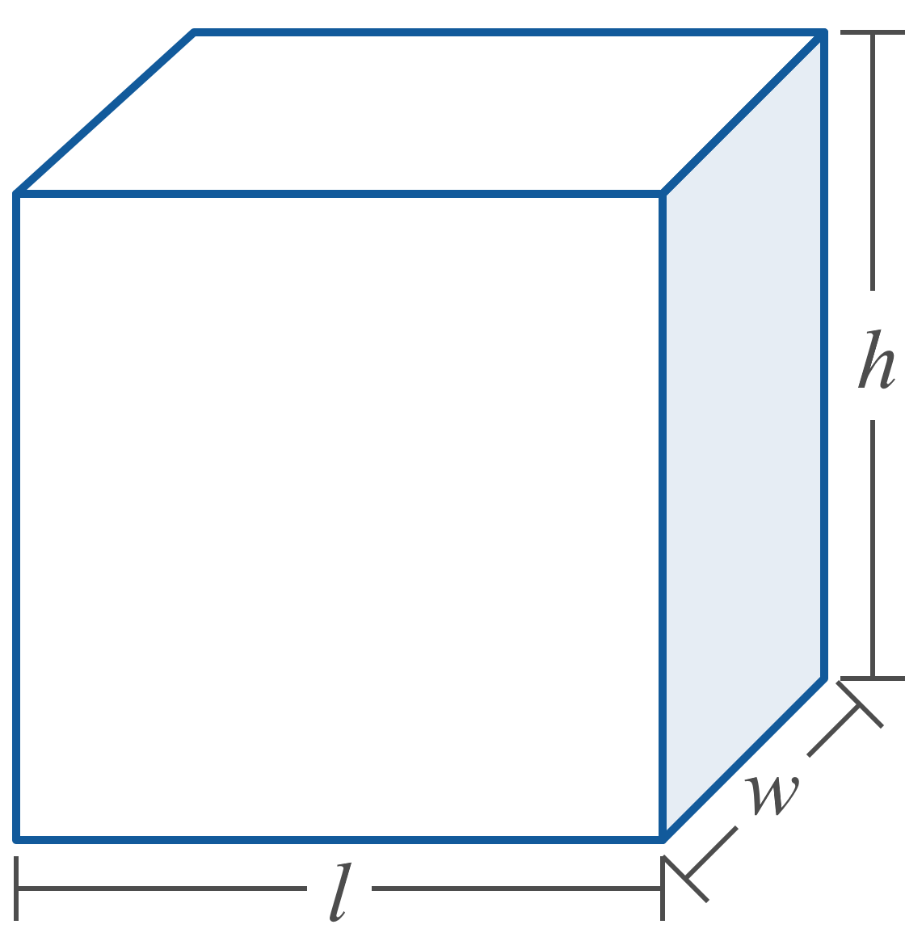
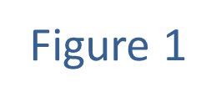
Example 6: Using Geometric Formulas (cont.)

Slide 27
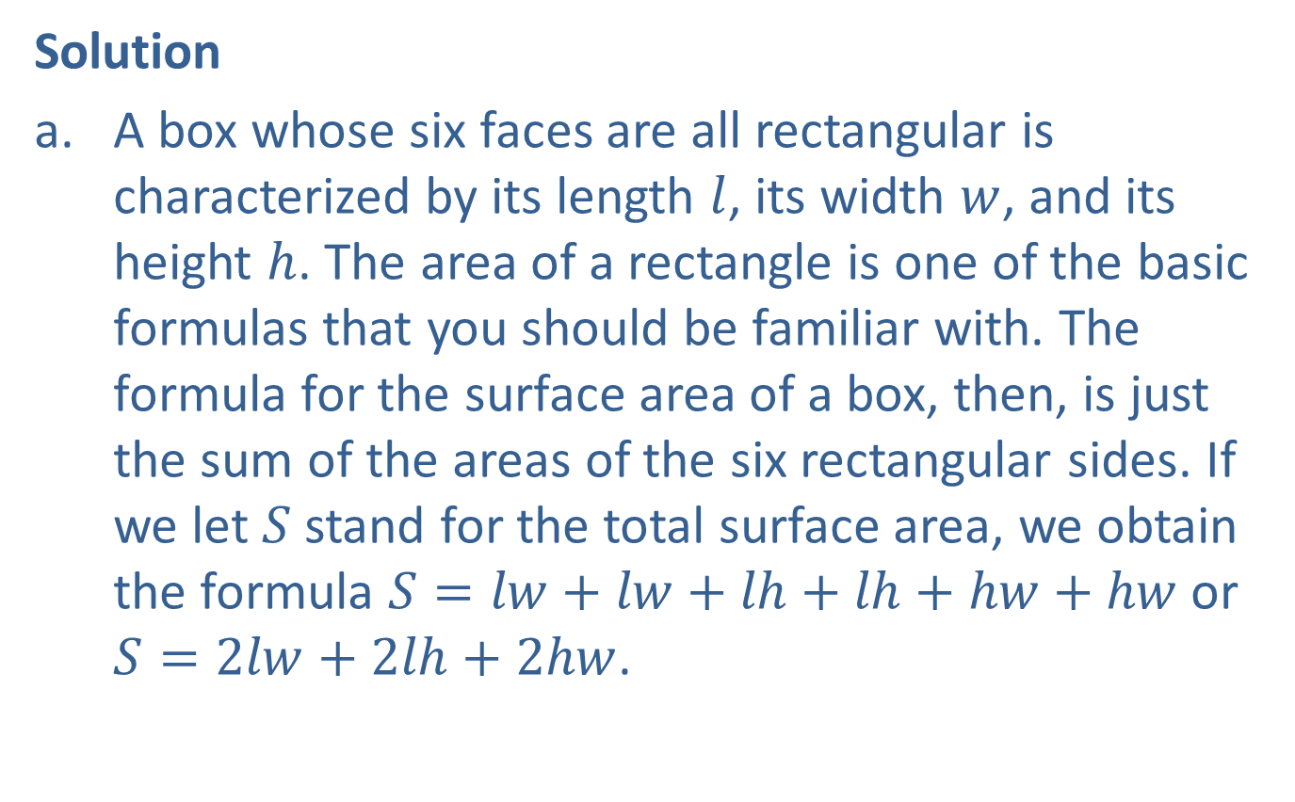
Example 6: Using Geometric Formulas (cont.)
Solution
​A box whose six faces are all rectangular is characterized by its length $l$, its width $w$, and its height $h$. The area of a rectangle is one of the basic formulas that you should be familiar with. The formula for the surface area of a box, then, is just the sum of the areas of the six rectangular sides. If we let $S$ stand for the total surface area, we obtain the formula $S=lw+lw+lh+lh+hw+hw$ or $S=2lw+2lh+2hw$.
​

Slide 28
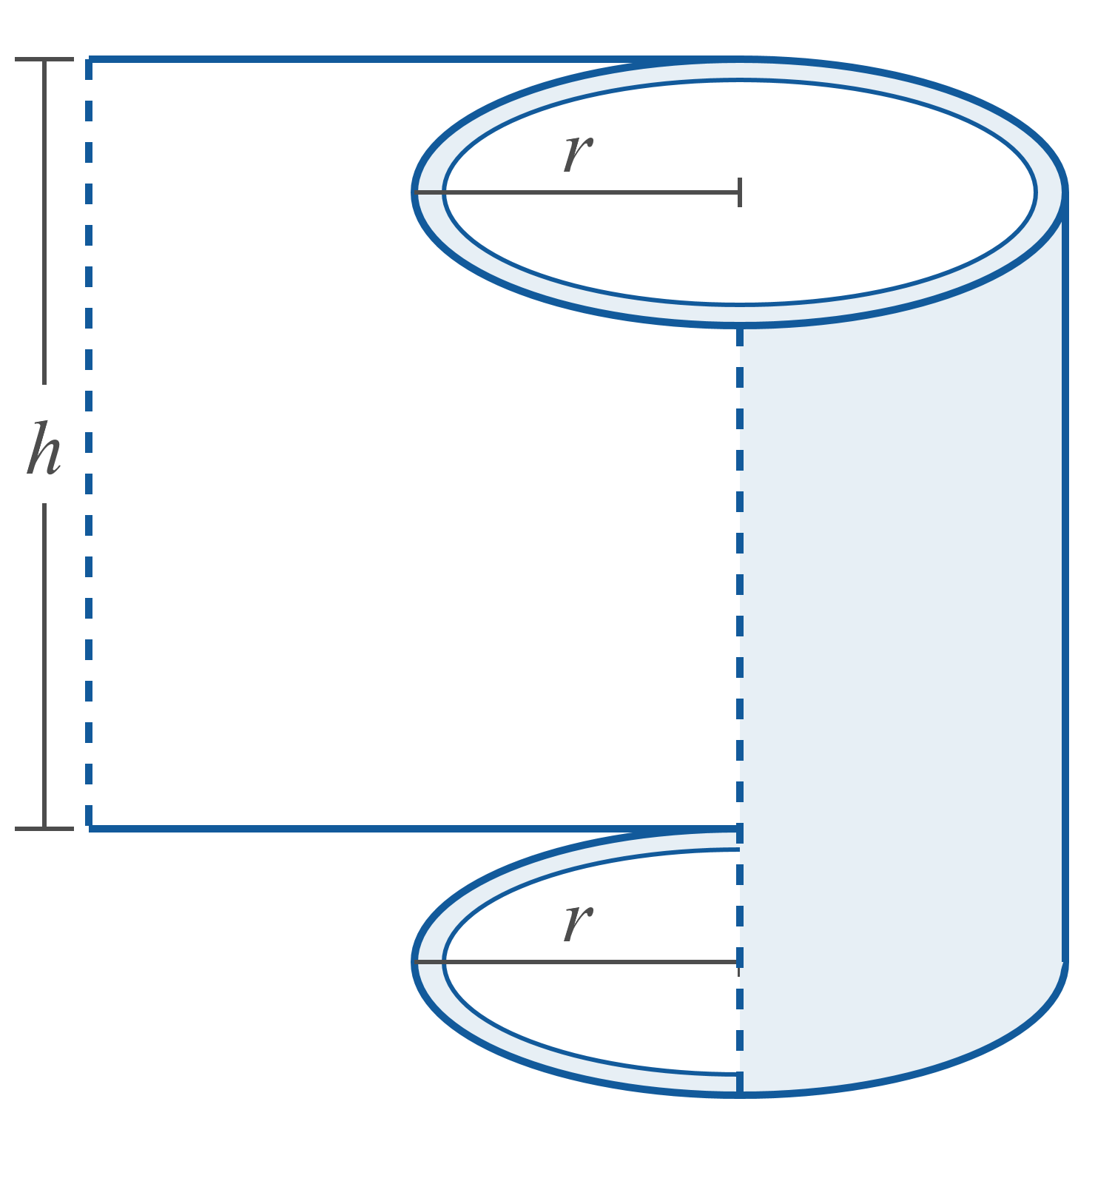
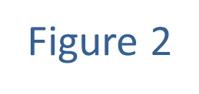
Example 6: Using Geometric Formulas (cont.)

Slide 29
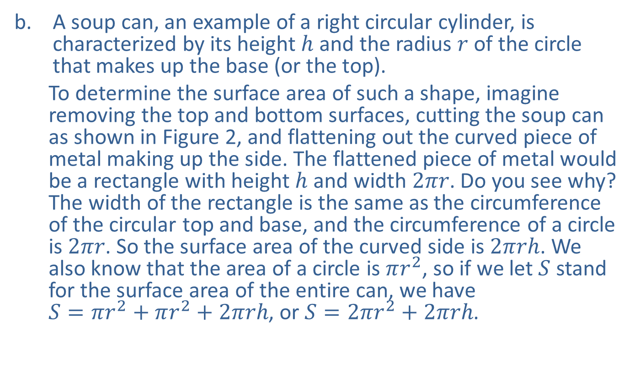
Example 6: Using Geometric Formulas (cont.)
​A soup can, an example of a right circular cylinder, is characterized by its height $h$ and the radius $r$ of the circle that makes up the base (or the top).
To determine the surface area of such a shape, imagine removing the top and bottom surfaces, cutting the soup can as shown in Figure 2, and flattening out the curved piece of metal making up the side. The flattened piece of metal would be a rectangle with height $h$ and width $2πr$. Do you see why? The width of the rectangle is the same as the circumference of the circular top and base, and the circumference of a circle is $2πr$. So the surface area of the curved side is $2πrh$. We also know that the area of a circle is $πr^{2}$, so if we let $S$ stand for the surface area of the entire can, we have $S=πr^{2}+πr^{2}+2πrh$, or $S=2πr^{2}+2πrh$.
​

Slide 30
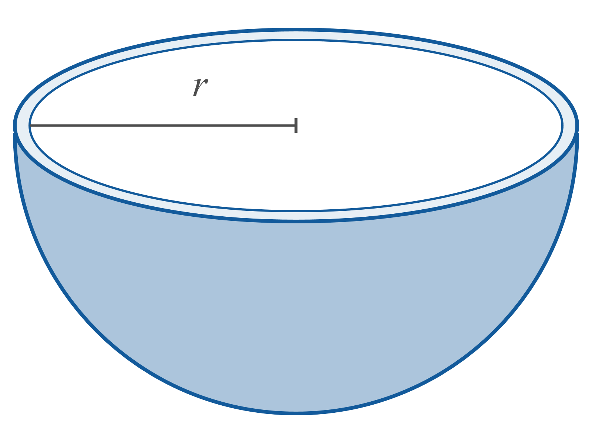
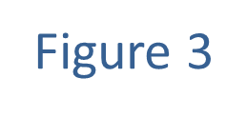
Example 6: Using Geometric Formulas (cont.)

Slide 31
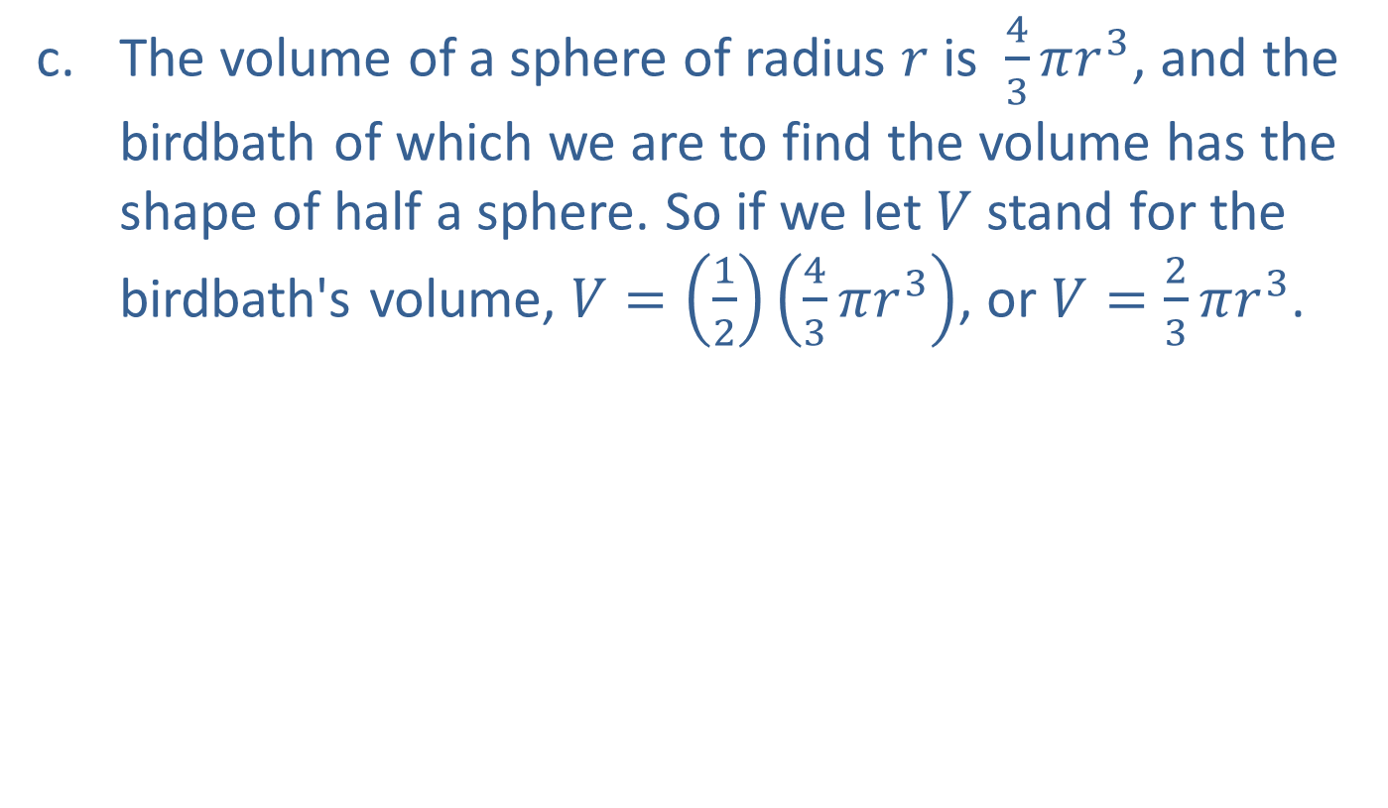
Example 6: Using Geometric Formulas (cont.)
​The volume of a sphere of radius $r$ is $\frac{4}{3}πr^{3}$, and the birdbath of which we are to find the volume has the shape of half a sphere. So if we let $V$ stand for the birdbath's volume, $V=\left(\frac{1}{2}\right)\left(\frac{4}{3}πr^{3}\right)$, or $V=\frac{2}{3}πr^{3}$.
​

Slide 32
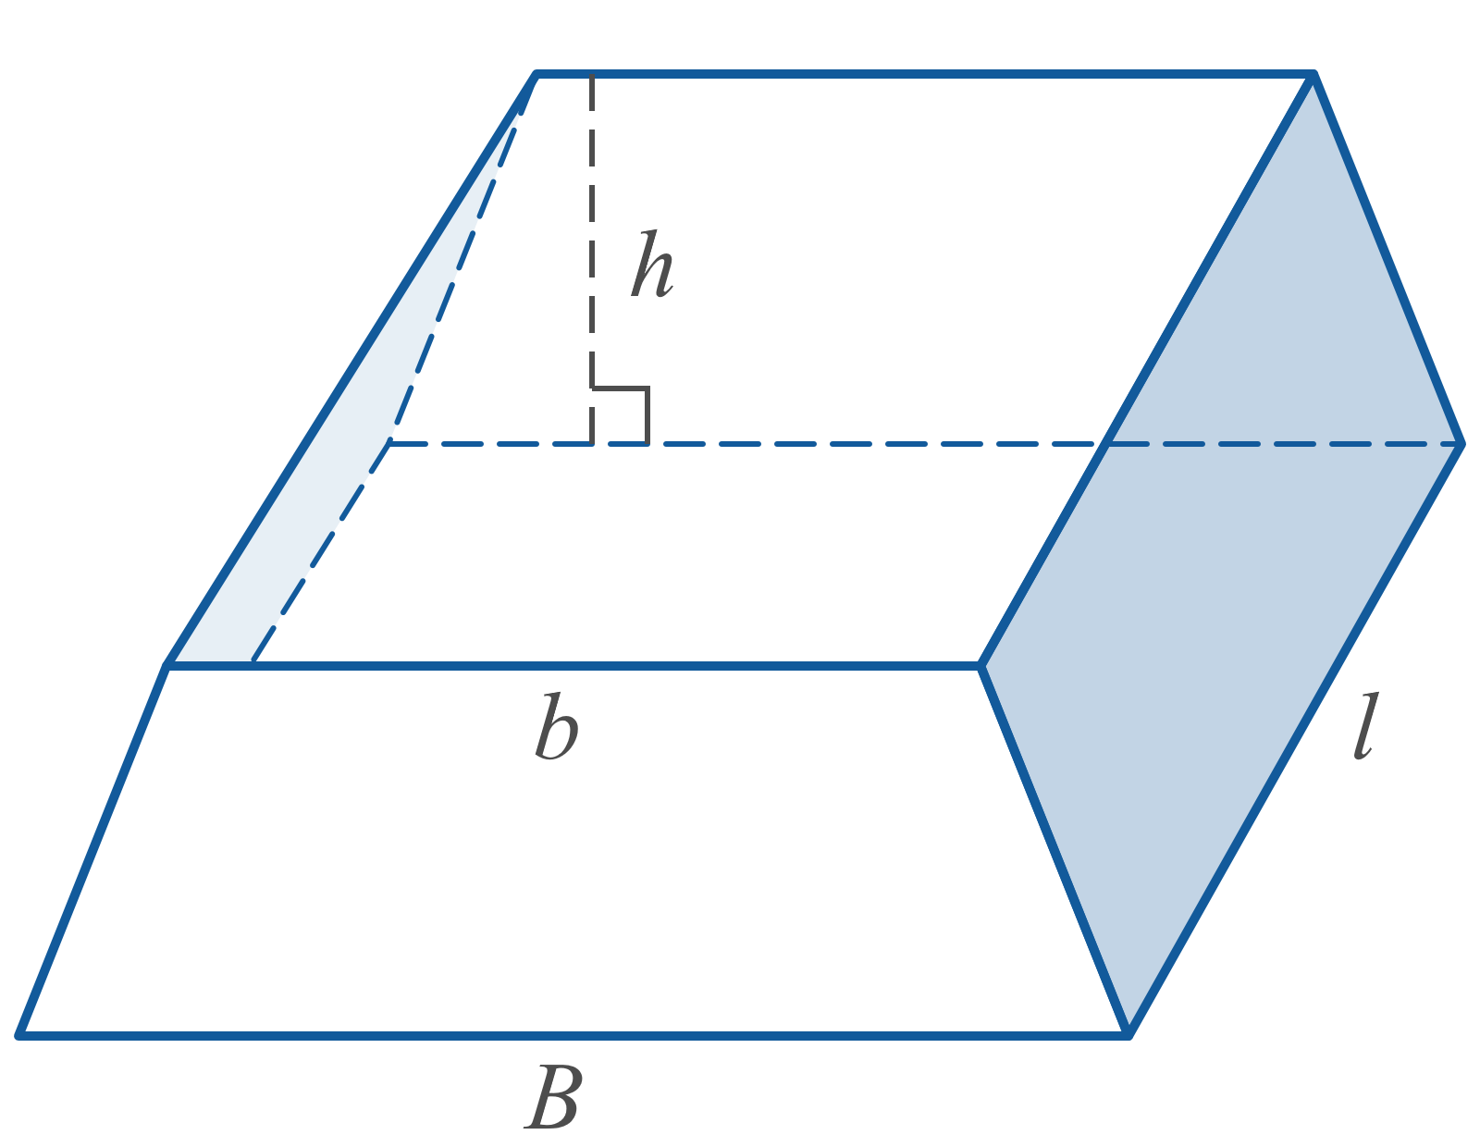
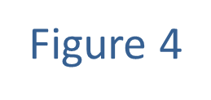
Example 6: Using Geometric Formulas (cont.)

Slide 33
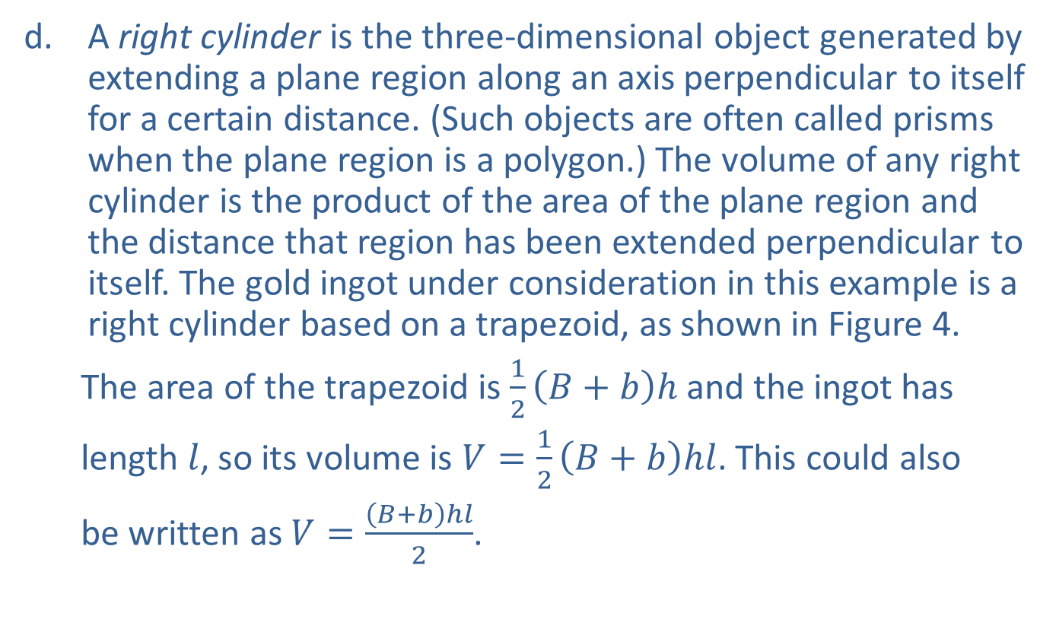
Example 6: Using Geometric Formulas (cont.)
​A right cylinder is the three-dimensional object generated by extending a plane region along an axis perpendicular to itself for a certain distance. (Such objects are often called prisms when the plane region is a polygon.) The volume of any right cylinder is the product of the area of the plane region and the distance that region has been extended perpendicular to itself. The gold ingot under consideration in this example is a right cylinder based on a trapezoid, as shown in Figure 4.
The area of the trapezoid is $\frac{1}{2}\left(B+b\right)h$ and the ingot has
length $l$, so its volume is $V=\frac{1}{2}\left(B+b\right)hl$. This could also
be written as $V=\frac{\left(B+b\right)hl}{2}$.
​

Slide 34
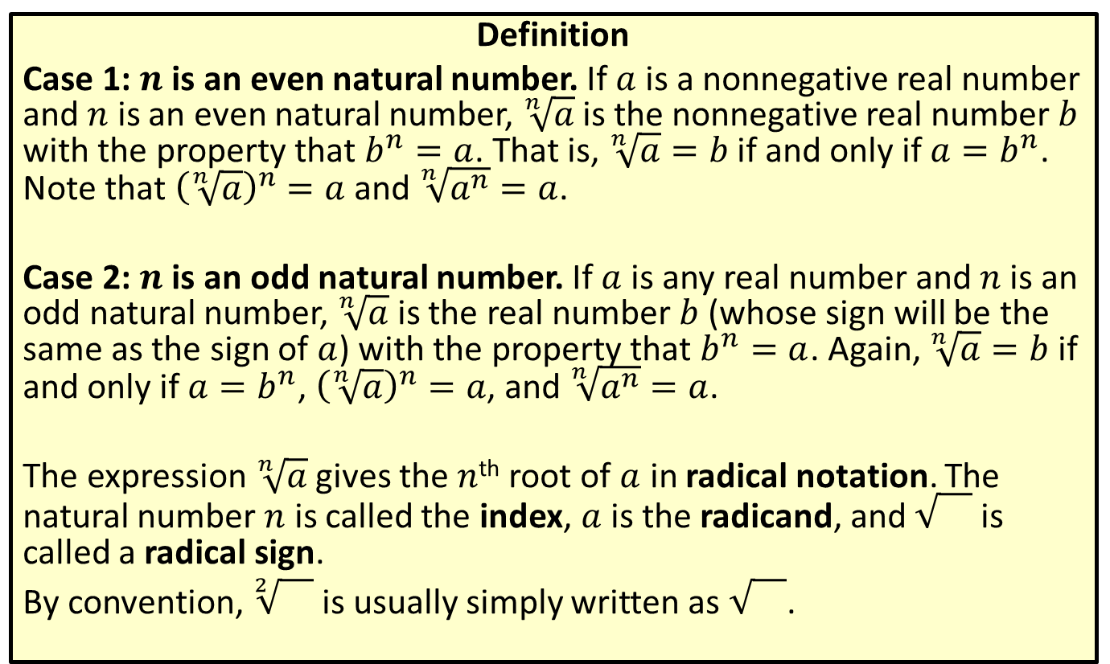
Radical Notation
Definition
Case 1: $n$ is an even natural number. If $a$ is a nonnegative real number and $n$ is an even natural number, $\sqrt[n]{a}$ is the nonnegative real number $b$ with the property that $b^{n}=a$. That is, $\sqrt[n]{a}=b$ if and only if $a=b^{n}$. Note that ${\left(\sqrt[n]{a}\right)}^{n}=a$ and $\sqrt[n]{a^{n}}=a$.
Case 2: $n$ is an odd natural number. If $a$ is any real number and $n$ is an odd natural number, $\sqrt[n]{a}$ is the real number $b$ (whose sign will be the same as the sign of $a$) with the property that $b^{n}=a$. Again, $\sqrt[n]{a}=b$ if and only if $a=b^{n}$, ${\left(\sqrt[n]{a}\right)}^{n}=a$, and $\sqrt[n]{a^{n}}=a$.
The expression $\sqrt[n]{a}$ gives the $n$^{th} root of $a$ in radical notation. The natural number $n$ is called the index, $a$ is the radicand, and is called a radical sign.
By convention, $\sqrt[2]{}$ is usually simply written as .

Slide 35
Perfect Powers
Definition
A perfect square is an integer equal to the square of another integer. The square root of a perfect square is always an integer.
A perfect cube is an integer equal to the cube of another integer. The cube root of a perfect cube is always an integer.

Slide 36
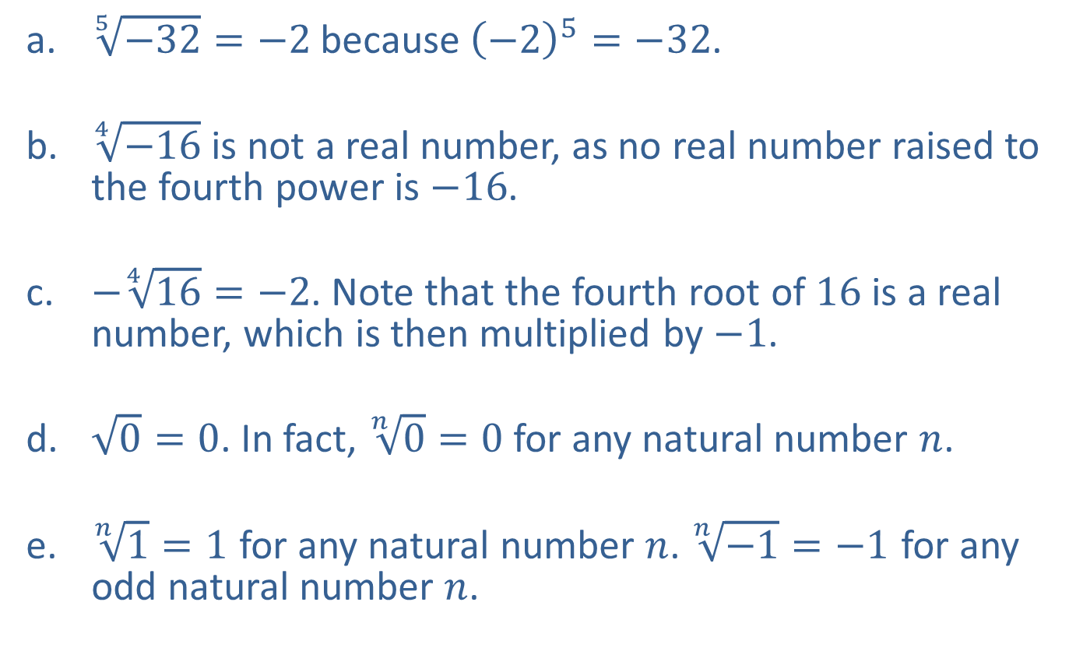
Example 7: Using Radical Notation
​$\sqrt[5]{−32}=−2$ because ${\left(−2\right)}^{5}=−32$.
​$\sqrt[4]{−16}$ is not a real number, as no real number raised to the fourth power is $−16$.
​$−\sqrt[4]{16}=−2$. Note that the fourth root of 16 is a real number, which is then multiplied by $−1$.
​$\sqrt{0}=0$. In fact, $\sqrt[n]{0}=0$ for any natural number $n$.
​​$\sqrt[n]{1}=1$ for any natural number $n$. $\sqrt[n]{−1}=−1$ for any odd natural number $n$.

Slide 37
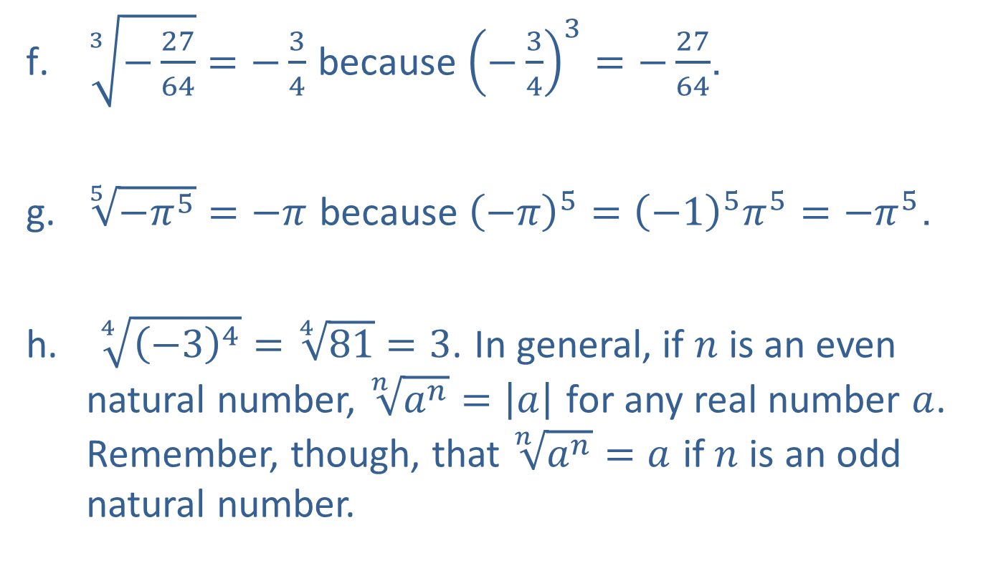
Example 7: Using Radical Notation (cont.)
​$\sqrt[3]{−\frac{27}{64}}=−\frac{3}{4}$ because ${\left(−\frac{3}{4}\right)}^{3}=−\frac{27}{64}$.
​$\sqrt[5]{−π^{5}}=−π$ because ${\left(−π\right)}^{5}={\left(−1\right)}^{5}π^{5}=−π^{5}$.
$\sqrt[4]{{\left(−3\right)}^{4}}=\sqrt[4]{81}=3$. In general, if $n$ is an even natural number, $\sqrt[n]{a^{n}}=\left|a\right|$ for any real number $a$. Remember, though, that $\sqrt[n]{a^{n}}=a$ if $n$ is an odd natural number.

Slide 38
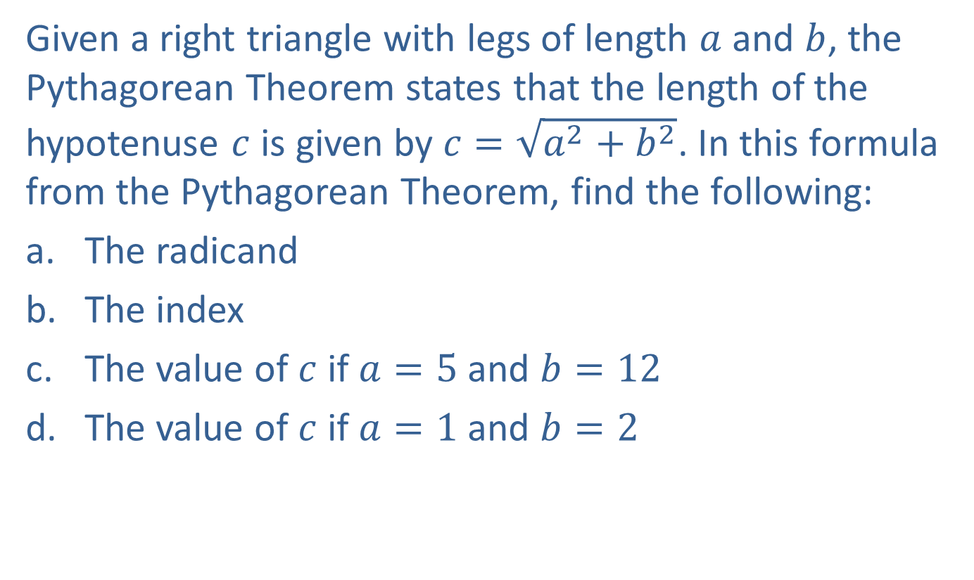
Example 8: Using Radical Notation
Given a right triangle with legs of length $a$ and $b$, the Pythagorean Theorem states that the length of the hypotenuse $c$ is given by $c=\sqrt{a^{2}+b^{2}}$. In this formula from the Pythagorean Theorem, find the following:
​The radicand
​The index
​The value of $c$ if $a=5$ and $b=12$
​The value of $c$ if $a=1$ and $b=2$

Slide 39

Example 8: Using Radical Notation (cont.)
Solution
​The radicand is the quantity beneath the radical sign, $a^{2}+b^{2}$.
​Because no index is indicated, the index is 2.
​

Slide 40
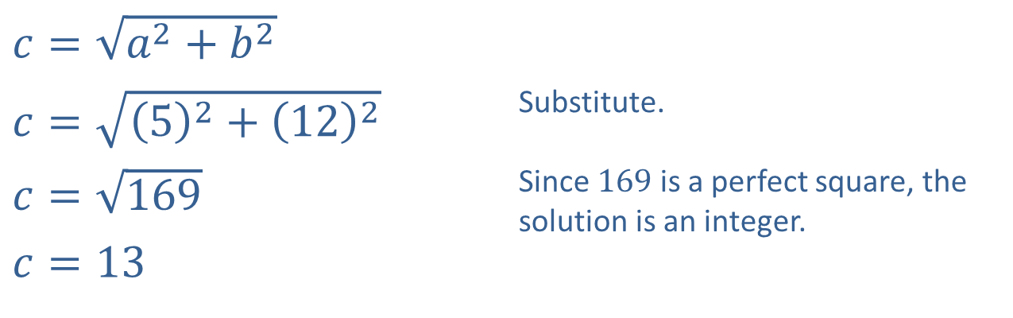
Example 8: Using Radical Notation (cont.)
​$c=\sqrt{a^{2}+b^{2}}$
​$c=\sqrt{{\left(5\right)}^{2}+{\left(12\right)}^{2}}$ | Substitute.
​$c=\sqrt{169}$ | Since 169 is a perfect square, the solution is an integer.
​$c=13$
c. ​

Slide 41
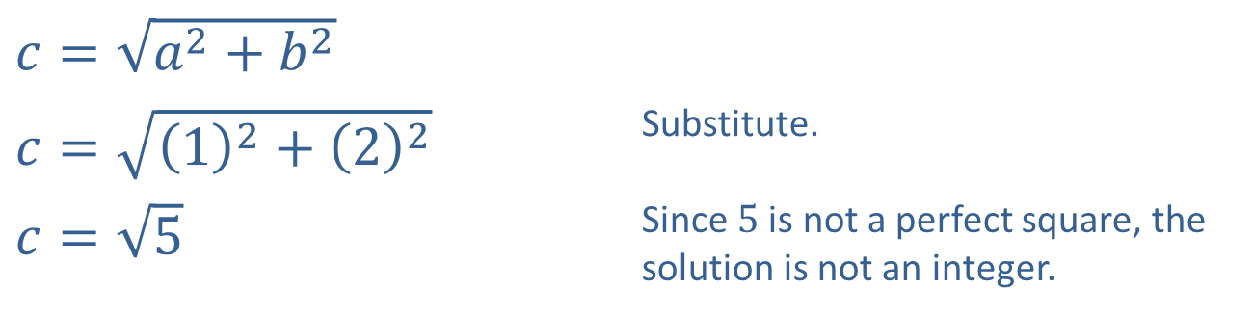
Example 8: Using Radical Notation (cont.)
​$c=\sqrt{a^{2}+b^{2}}$
​$c=\sqrt{{\left(1\right)}^{2}+{\left(2\right)}^{2}}$ | Substitute.
​$c=\sqrt{5}$ | Since 5 is not a perfect square, the solution is not an integer.
​

Slide 42
Simplified Radical Form
Definition
A radical expression is in simplified form when the following conditions are met:
​The radicand contains no factor with an exponent greater than or equal to the index of the radical.
​The radicand contains no fractions.
​The denominator, if there is one, contains no radical.
​The greatest common factor of the index and any exponent occurring in the radicand is 1. That is, the index and any exponent in the radicand have no common factor other than 1.

Slide 43
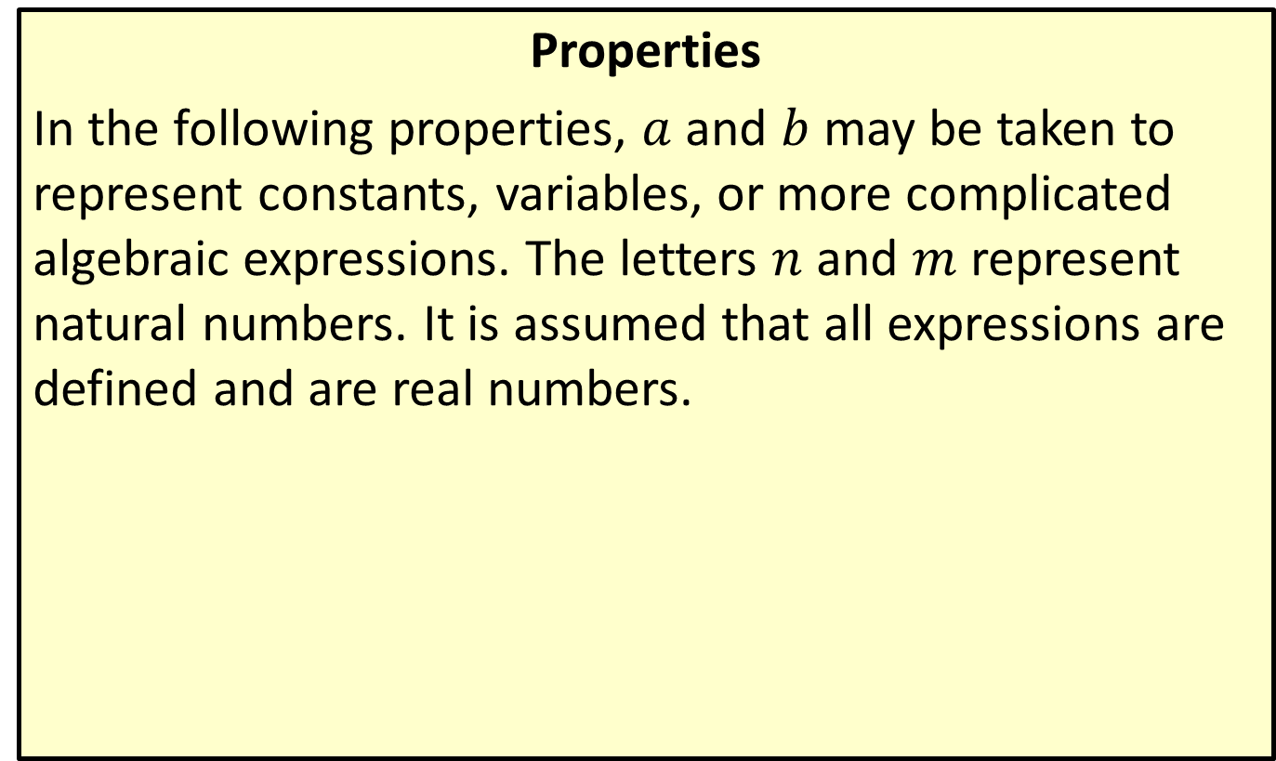
Properties of Radicals
Properties
In the following properties, $a$ and $b$ may be taken to represent constants, variables, or more complicated algebraic expressions. The letters $n$ and $m$ represent natural numbers. It is assumed that all expressions are defined and are real numbers.

Slide 44
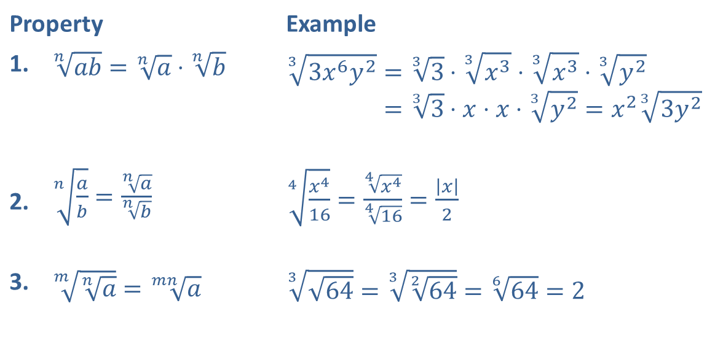
Properties of Radicals (cont.)
Property |  | Example
1. | ​$\sqrt[n]{ab}=\sqrt[n]{a}⋅\sqrt[n]{b}$ | 33𝑥6𝑦2=33⋅3𝑥3⋅3𝑥3⋅3𝑦233𝑥6𝑦2=33⋅𝑥⋅𝑥⋅3𝑦2=𝑥233𝑦2
2. | ​$\sqrt[n]{\frac{a}{b}}=\frac{\sqrt[n]{a}}{\sqrt[n]{b}}$ | ​$\sqrt[4]{\frac{x^{4}}{16}}=\frac{\sqrt[4]{x^{4}}}{\sqrt[4]{16}}=\frac{\left|x\right|}{2}$
3. | ​$\sqrt[m]{\sqrt[n]{a}}=\sqrt[mn]{a}$ | ​$\sqrt[3]{\sqrt{64}}=\sqrt[3]{\sqrt[2]{64}}=\sqrt[6]{64}=2$

Slide 45

Example 9: Simplifying Radical Expressions
Simplify the following radical expressions.
​$\sqrt[3]{−16x^{8}y^{4}}$
​$\sqrt{8z^{6}}$
​$\sqrt[3]{\frac{72x^{2}}{y^{3}}}$

Slide 46
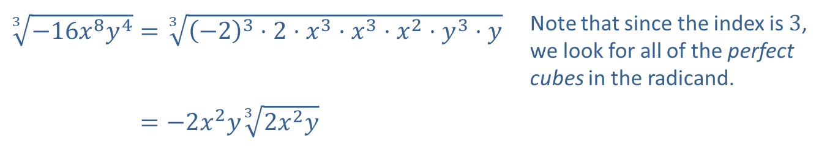
Example 9: Simplifying Radical Expressions (cont.)
Solution
​
​$\sqrt[3]{−16x^{8}y^{4}}=\sqrt[3]{{\left(−2\right)}^{3}⋅2⋅x^{3}⋅x^{3}⋅x^{2}⋅y^{3}⋅y}$ | Note that since the index is 3, we look for all of the perfect cubes in the radicand.
​3−16𝑥8𝑦4=−2𝑥2𝑦32𝑥2𝑦

Slide 47

Example 9: Simplifying Radical Expressions (cont.)
​$\sqrt{8z^{6}}=\sqrt{2^{2}⋅2⋅{\left(z^{3}\right)}^{2}}$ | Remember that $\sqrt[n]{a^{n}}=\left|a\right|$ if $n$ is even, so absolute value signs are necessary around the factor of $z^{3}$.
​8𝑧6=2𝑧32
​8𝑧6=2𝑧32
​

Slide 48

Example 9: Simplifying Radical Expressions (cont.)
​$\sqrt[3]{\frac{72x^{2}}{y^{3}}}=\frac{\sqrt[3]{8⋅9⋅x^{2}}}{\sqrt[3]{y^{3}}}$
​372𝑥2𝑦3=239𝑥2𝑦 | All perfect cubes have been brought out from under the radical, and the denominator has been rationalized.
​

Slide 49

CAUTION!
As with the properties of exponents, many mistakes arise from forgetting the properties of radicals. One common error, for instance, is to rewrite $\sqrt{a+b}$ as $\sqrt{a}+\sqrt{b}$. These two expressions are not equal! To convince yourself of this, evaluate the two expressions with actual constants in place of $a$ and $b$. For example, note that $5=\sqrt{9+16}≠\sqrt{9}+\sqrt{16}=7$.

Slide 50

Example 10: Rationalizing the Denominator
Simplify the following radical expressions.
​$\sqrt[5]{\frac{−4x^{6}}{8y^{2}}}$
​$\frac{4}{\sqrt{7}+\sqrt{3}}$
​$\frac{−\sqrt{5x}}{5−\sqrt{x}}$

Slide 51

Example 10: Rationalizing the Denominator (cont.)
Solution
​
​$\sqrt[5]{\frac{−4x^{6}}{8y^{2}}}=\frac{\sqrt[5]{−4x⋅x^{5}}}{\sqrt[5]{8y^{2}}}$ | The first step is to simplify the numerator and denominator and determine what the denominator must be multiplied by in order to eliminate the radical. Remember to multiply the numerator by the same factor.
​5−4𝑥68𝑦2=−𝑥 54𝑥523𝑦2⋅522𝑦3522𝑦3
​5−4𝑥68𝑦2=−𝑥 516𝑥𝑦3525𝑦5
​5−4𝑥68𝑦2=−𝑥 516𝑥𝑦32𝑦

Slide 52

Example 10: Rationalizing the Denominator (cont.)
​$\frac{4}{\sqrt{7}+\sqrt{3}}=\left(\frac{4}{\sqrt{7}+\sqrt{3}}\right)\left(\frac{\sqrt{7}−\sqrt{3}}{\sqrt{7}−\sqrt{3}}\right)$ | Again, we have multiplied the fraction by 1, but this time we multiply the numerator and denominator by the conjugate radical of the original denominator.
​47+3=47−37−3
​47+3=47−34
​47+3=7−3
​

Slide 53

Example 10: Rationalizing the Denominator (cont.)
​$\frac{−\sqrt{5x}}{5−\sqrt{x}}=\left(\frac{−\sqrt{5x}}{5−\sqrt{x}}\right)\left(\frac{5+\sqrt{x}}{5+\sqrt{x}}\right)$ | In this example, the original denominator is the sum of 5 and $−\sqrt{x}$, so the conjugate radical of the denominator is $5+\sqrt{x}$.
​−5𝑥5−𝑥=−55𝑥−5𝑥225−𝑥 | Note that in simplifying the term $−\sqrt{5x^{2}}$, we can simply write $−x\sqrt{5}$ instead of $−\left|x\right|\sqrt{5}$, since the original expression is not real if $x$ is negative.
​−5𝑥5−𝑥=−55𝑥−𝑥525−𝑥
​

Slide 54

Example 11: Rationalizing the Numerator
Rationalize the numerator of the fraction $\frac{\sqrt{4x}−\sqrt{6y}}{2x−3y}$.

Slide 55

Example 11: Rationalizing the Numerator (cont.)
Solution
​$\frac{\sqrt{4x}−\sqrt{6y}}{2x−3y}=\left(\frac{\sqrt{4x}−\sqrt{6y}}{2x−3y}\right)\left(\frac{\sqrt{4x}+\sqrt{6y}}{\sqrt{4x}+\sqrt{6y}}\right)$ | We begin by multiplying the numerator and denominator by the conjugate radical of the numerator. Note that we could have simplified the term $\sqrt{4x}$ first, but this would not have altered the work in any substantial way, and the final answer would be the same.
​4𝑥−6𝑦2𝑥−3𝑦=4𝑥−6𝑦2𝑥−3𝑦4𝑥+6𝑦
​4𝑥−6𝑦2𝑥−3𝑦=22𝑥−3𝑦2𝑥−3𝑦2𝑥+6𝑦
​4𝑥−6𝑦2𝑥−3𝑦=22𝑥+6𝑦

Slide 56

Example 12: Combining Radical Expressions
Combine the radical expressions, if possible.
​$−3\sqrt{8x^{5}}+\sqrt{18x}$
​$\sqrt[3]{54x^{3}}+\sqrt{50x^{2}}$
​$\sqrt{\frac{1}{12}}−\sqrt{\frac{25}{48}}$

Slide 57

Example 12: Combining Radical Expressions (cont.)
Solution
​
​$−3\sqrt{8x^{5}}+\sqrt{18x}=−3\sqrt{2^{2}⋅2⋅x^{4}⋅x}+\sqrt{2⋅3^{2}⋅x}$ | We begin by simplifying the radicals.
​−38𝑥5+18𝑥=−6𝑥22𝑥+32𝑥 | Note that upon simplification, the two radicals have the same index and the same radicand. Also note that the absolute value bars around the factor of $x^{2}$ are unnecessary, since $x^{2}$ is always nonnegative.
​−38𝑥5+18𝑥=−6𝑥22𝑥+32𝑥
​−38𝑥5+18𝑥=−6𝑥2+32𝑥

Slide 58

Example 12: Combining Radical Expressions (cont.)
​
​$\sqrt[3]{54x^{3}}+\sqrt{50x^{2}}=\sqrt[3]{2⋅3^{3}⋅x^{3}}+\sqrt{2⋅5^{2}⋅x^{2}}$ | Upon simplification, the radicands are the same, but the indices are not. We have written the radicals in simplest form, but they cannot be combined.
​354𝑥3+50𝑥2=3𝑥32+5𝑥2

Slide 59

Example 12: Combining Radical Expressions (cont.)
​$\sqrt{\frac{1}{12}}−\sqrt{\frac{25}{48}}=\frac{1}{\sqrt{2^{2}⋅3}}−\frac{\sqrt{5^{2}}}{\sqrt{4^{2}⋅3}}$ | The first step, again, is to simplify the radicals. Note that both denominators are being rationalized in the second step.
​112−2548=123⋅33−543⋅33
​112−2548=234⋅3−5⋅34⋅3 | The first fraction must be multiplied by $\frac{2}{2}$ in order to get a common denominator.
​112−2548=−3312=−34 | After subtracting, the fraction can be reduced.
​

Slide 60

Rational Number Exponents
Definition
Meaning of $a^{\frac{1}{n}}$: If $n$ is a natural number and if $\sqrt[n]{a}$ is a real number, then $a^{\frac{1}{n}}=\sqrt[n]{a}$.
Meaning of $a^{\frac{m}{n}}$: If $m$ and $n$ are natural numbers with $n≠0$, if $m$ and $n$ have no common factors greater than 1, and if $\sqrt[n]{a}$ is a real number, then $a^{\frac{m}{n}}=\sqrt[n]{a^{m}}={\left(\sqrt[n]{a}\right)}^{m}$. Either $\sqrt[n]{a^{m}}$ or ${\left(\sqrt[n]{a}\right)}^{m}$ can be used to evaluate $a^{\frac{m}{n}}$, as they are equal. $a^{\frac{−m}{n}}$ is defined to be $\frac{1}{a^{\frac{m}{n}}}$.

Slide 61

Example 13: Simplifying Expressions
Simplify each of the following expressions, writing your answer using the same notation as the original expression.
​${27}^{\frac{−2}{3}}$
​$\sqrt[9]{−8x^{6}}$
​${\left(5x^{2}+3\right)}^{\frac{8}{3}}{\left(5x^{2}+3\right)}^{\frac{−2}{3}}$
​$\sqrt[5]{\sqrt[3]{x^{2}}}$
​$\frac{5x−y}{{\left(5x−y\right)}^{\frac{−1}{3}}}$

Slide 62

Example 13: Simplifying Expressions (cont.)
Solution
​
​${27}^{\frac{−2}{3}}={\left({27}^{\frac{1}{3}}\right)}^{−2}$ | The only task here is to evaluate the expression. We could also have begun by nothing that ${27}^{\frac{−2}{3}}={\left({27}^{−2}\right)}^{\frac{1}{3}}$, but this would have made the calculations much more tedious.
​27−23=3−2
​27−23=132
​27−23=19

Slide 63

Example 13: Simplifying Expressions (cont.)
b. ​
​$\sqrt[9]{−8x^{6}}=−\sqrt[9]{2^{3}x^{6}}$ | To begin, the only factor that can be brought out from under the radical is $−1$, but we can still simplify the expression by reducing the exponents and index. Note that we switched to exponential form temporarily in doing this.
​9−8𝑥6=−239𝑥69
​9−8𝑥6=−213𝑥23
​9−8𝑥6=−32𝑥2

Slide 64


Example 13: Simplifying Expressions (cont.)
c. Since the bases are the same, we only have to apply the property $a^{n}{a^{m}}=a^{n+m}$.
​${\left(5x^{2}+3\right)}^{\frac{8}{3}}{\left(5x^{2}+3\right)}^{\frac{−2}{3}}={\left(5x^{2}+3\right)}^{\left(\frac{8}{3}\right)+\left(\frac{−2}{3}\right)}$
​5𝑥2+3835𝑥2+3−23=5𝑥2+363
​5𝑥2+3835𝑥2+3−23=5𝑥2+32

Slide 65

Example 13: Simplifying Expressions (cont.)
d. ​Use the property stating $\sqrt[m]{\sqrt[n]{a}}=\sqrt[mn]{a}$ to simplify this expression.
$\sqrt[5]{\sqrt[3]{x^{2}}}=\sqrt[15]{x^{2}}$

Slide 66


Example 13: Simplifying Expressions (cont.)
e. We use the property $\frac{a^{n}}{a^{m}}=a^{n−m}$ to simplify this expression.
​$\frac{5x−y}{{\left(5x−y\right)}^{\frac{−1}{3}}}={\left(5x−y\right)}^{1−\left(\frac{−1}{3}\right)}$
​5𝑥−𝑦5𝑥−𝑦−13=5𝑥−𝑦43

Slide 67

Example 14: Simplifying Radical Expressions
​Simplify the expression $\sqrt[4]{x^{2}}$.
​Write $\sqrt[3]{2}⋅\sqrt{3}$ as a single radical.

Slide 68

Example 14: Simplifying Radical Expressions (cont.)
Solution
​
​$\sqrt[4]{x^{2}}={\left(x^{2}\right)}^{\frac{1}{4}}$ | We might be tempted to write $\sqrt[4]{x^{2}}$ as simply $\sqrt{x}$, but note that $\sqrt[4]{x^{2}}$ is defined for all real numbers $x$, while $\sqrt{x}$ is defined only for nonnegative real numbers. We can rectify this disparity by first making sure the radicand is nonnegative.
​4𝑥2=𝑥12
​4𝑥2=|𝑥|

Slide 69

Example 14: Simplifying Radical Expressions (cont.)
​$\sqrt[3]{2}⋅\sqrt{3}=2^{\frac{1}{3}}⋅3^{\frac{1}{2}}$ | We can make use of the property $a^{n}b^{n}={\left(ab\right)}^{n}$ if we can first make the exponents equal. We do so by finding the least common denominator of $\frac{1}{3}$ and $\frac{1}{2}$, writing both fractions with this common denominator, and then making use of the property $a^{nm}={\left(a^{n}\right)}^{m}$.
​32⋅3=226⋅336
​32⋅3=22163316
​32⋅3=416⋅2716
​32⋅3=10816
​32⋅3=6108
​

