Slide 1
Section 1.3
Polynomials and Factoring

Slide 2
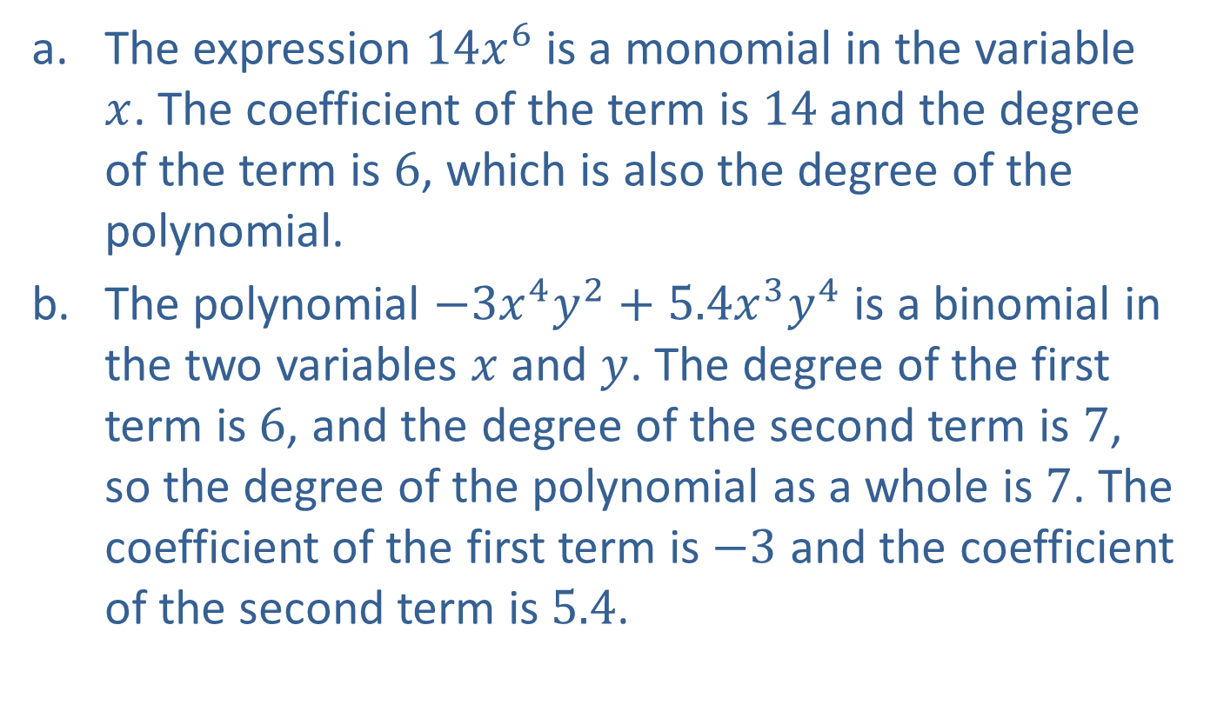
Example 1: Polynomial Expressions
​The expression $14x^{6}$ is a monomial in the variable $x$. The coefficient of the term is 14 and the degree of the term is 6, which is also the degree of the polynomial.
​The polynomial $−3x^{4}y^{2}+5.4x^{3}y^{4}$ is a binomial in the two variables $x$ and $y$. The degree of the first term is 6, and the degree of the second term is 7, so the degree of the polynomial as a whole is 7. The coefficient of the first term is $−3$ and the coefficient of the second term is 5.4.

Slide 3
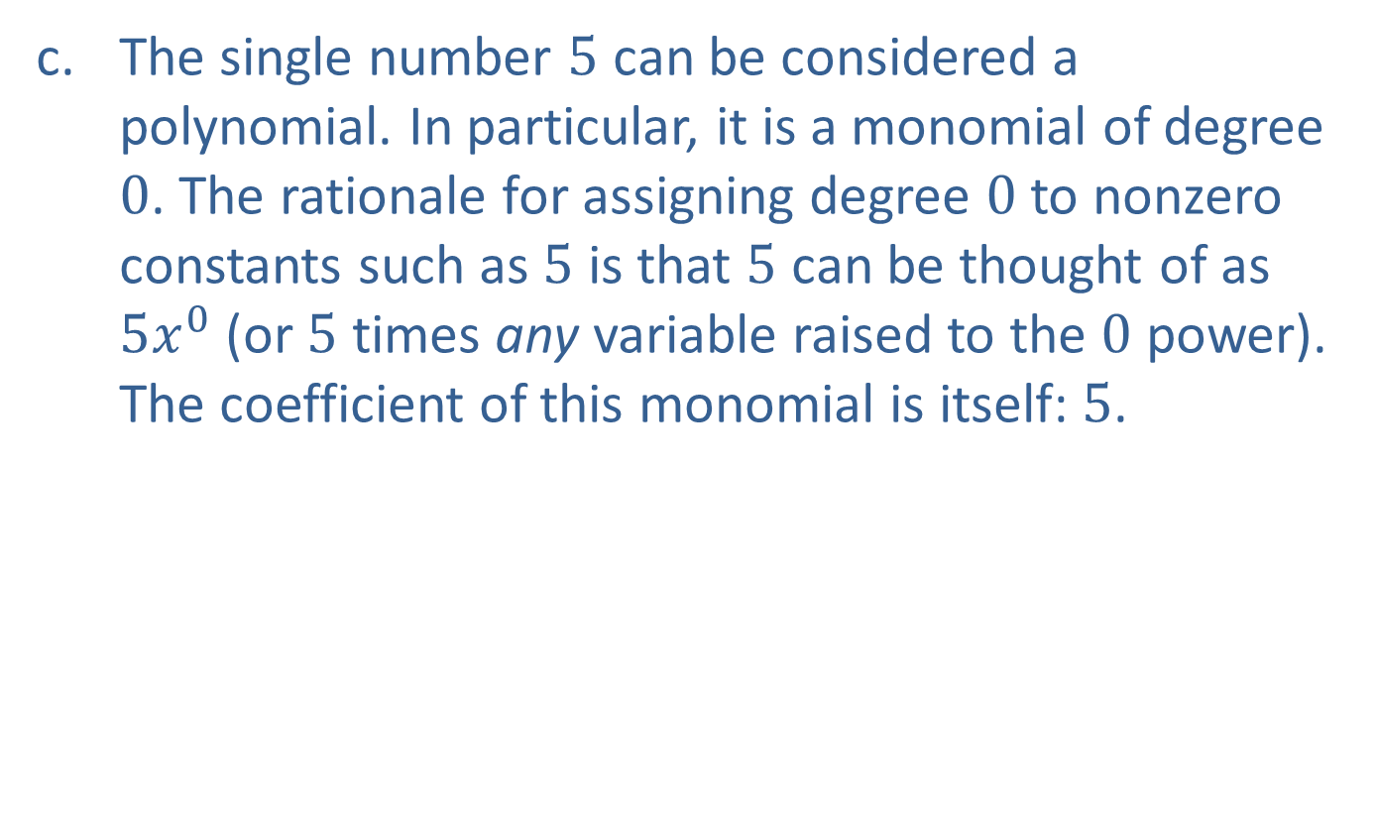
Example 1: Polynomial Expressions (cont.)
​The single number 5 can be considered a polynomial. In particular, it is a monomial of degree 0. The rationale for assigning degree 0 to nonzero constants such as 5 is that 5 can be thought of as $5x^{0}$ (or 5 times any variable raised to the 0 power). The coefficient of this monomial is itself: 5.

Slide 4
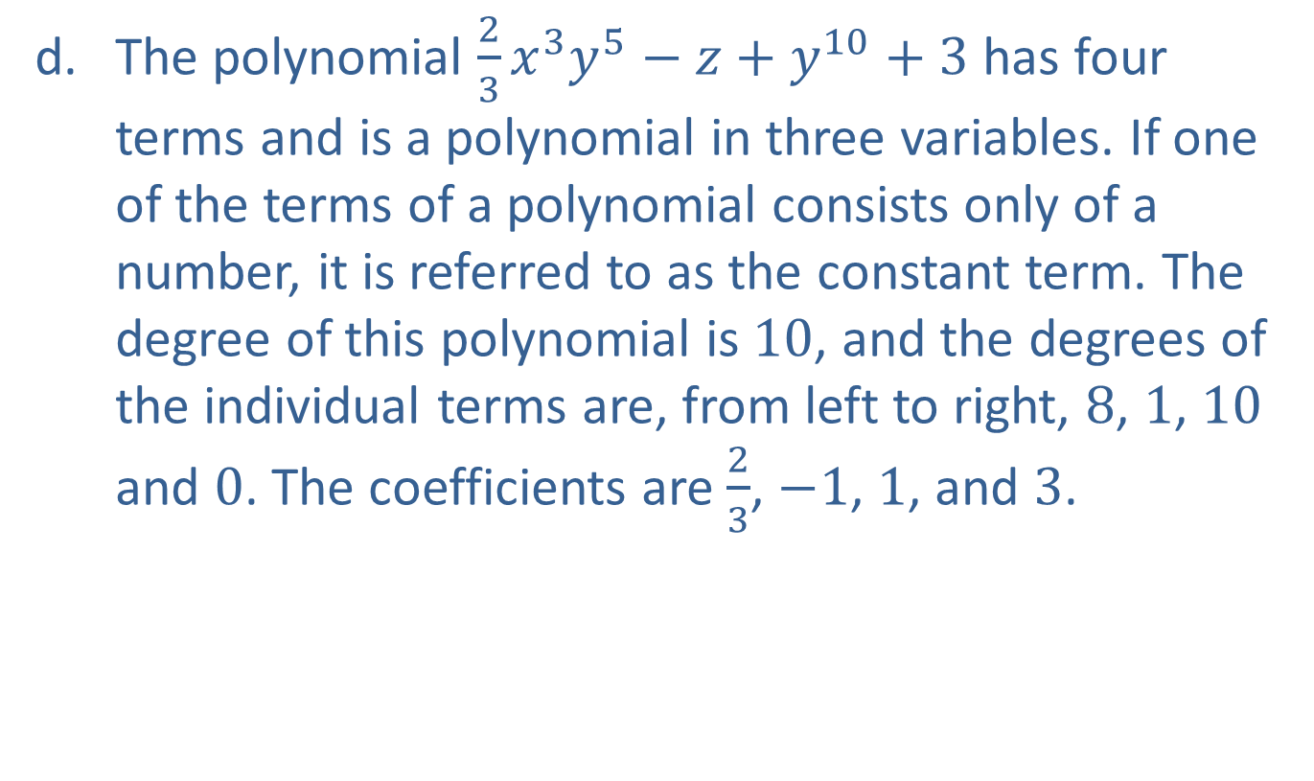
Example 1: Polynomial Expressions (cont.)
​The polynomial $\frac{2}{3}x^{3}y^{5}−z+y^{10}+3$ has four terms and is a polynomial in three variables. If one of the terms of a polynomial consists only of a number, it is referred to as the constant term. The degree of this polynomial is 10, and the degrees of the individual terms are, from left to right, 8, 1, 10 and 0. The coefficients are $\frac{2}{3}$, $−1$, 1, and 3.

Slide 5
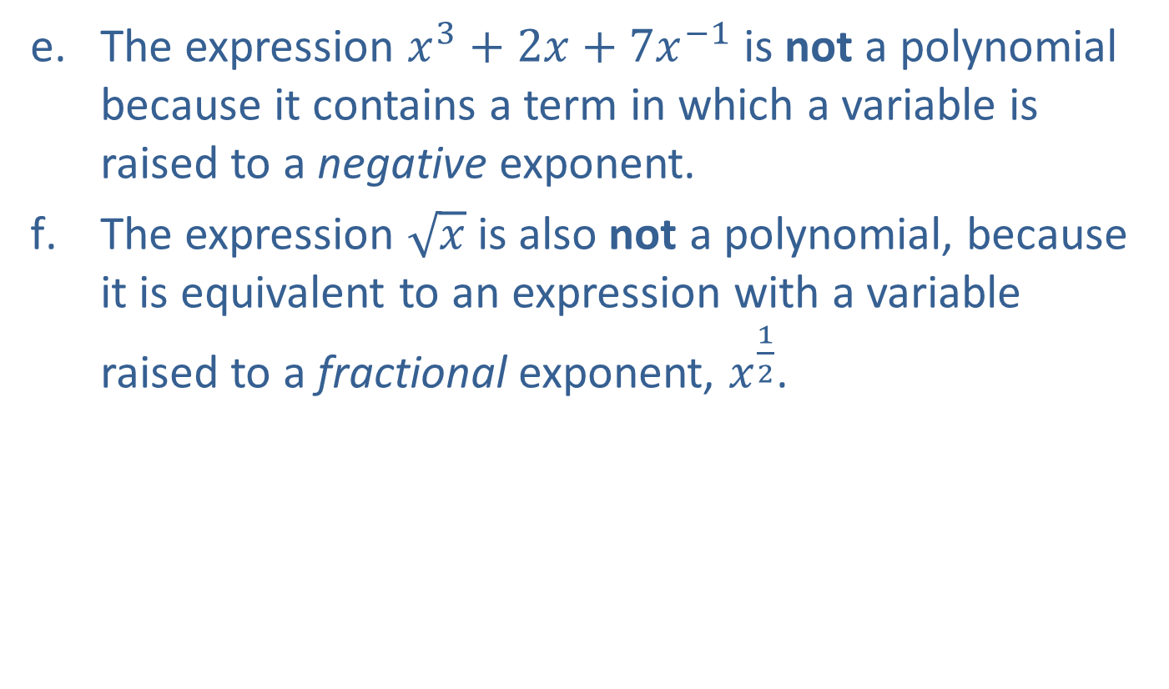
Example 1: Polynomial Expressions (cont.)
​The expression $x^{3}+2x+7x^{−1}$ is not a polynomial because it contains a term in which a variable is raised to a negative exponent.
​The expression $\sqrt{x}$ is also not a polynomial, because it is equivalent to an expression with a variable raised to a fractional exponent, $x^{\frac{1}{2}}$.

Slide 6
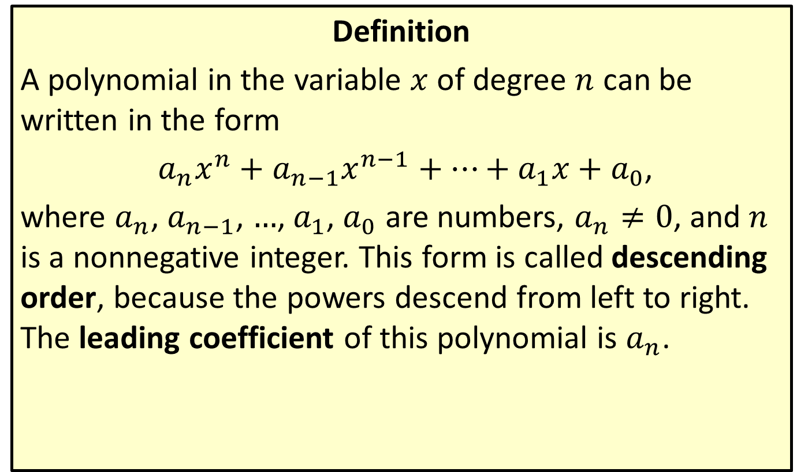
Polynomials of a Single Variable
Definition
A polynomial in the variable $x$ of degree $n$ can be written in the form
$a_{n}x^{n}+a_{n−1}x^{n−1}+…+a_{1}x+a_{0}$,
where $a_{n}$, $a_{n−1}$, …, $a_{1}$, $a_{0}$ are numbers, $a_{n}≠0$, and $n$ is a nonnegative integer. This form is called descending order, because the powers descend from left to right. The leading coefficient of this polynomial is $a_{n}$.

Slide 7

Example 2: Adding and Subtracting Polynomials
Add or subtract the polynomials, as indicated.
​$\left(2x^{3}y−3y+z^{2}x\right)+\left(3y+z^{2}−3xz^{2}+4\right)$
​$\left(4ab^{3}−b^{3}c\right)−\left(4−b^{3}c\right)$

Slide 8
Note:
The first step is always to identify and group like terms. The like terms are then combined using the distributive property.

Slide 9
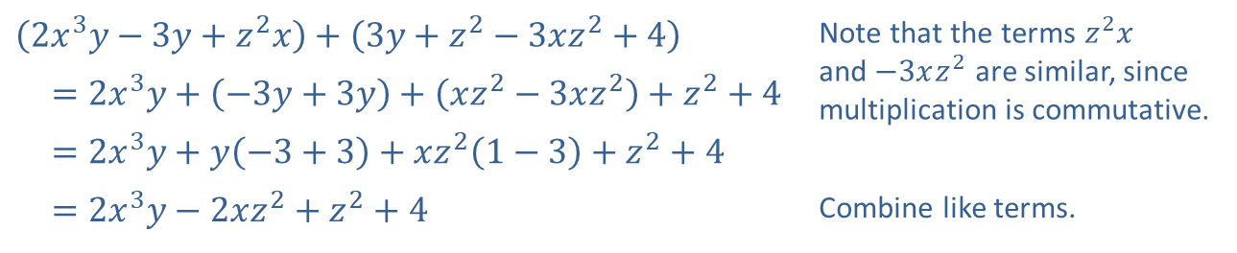
Example 2: Adding and Subtracting Polynomials (cont.)
Solution
​
​$\left(2x^{3}y−3y+z^{2}x\right)+\left(3y+z^{2}−3xz^{2}+4\right)$ | Note that the terms $z^{2}x$ and $−3xz^{2}$ are similar, since multiplication is commutative.
​ $=2x^{3}y+\left(−3y+3y\right)+\left(xz^{2}−3xz^{2}\right)+z^{2}+4$
​ $=2x^{3}y+y\left(−3+3\right)+xz^{2}\left(1−3\right)+z^{2}+4$
​ $=2x^{3}y−2xz^{2}+z^{2}+4$ | Combine like terms.

Slide 10
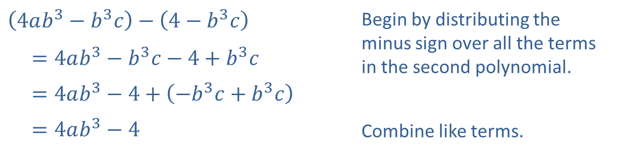
Example 2: Adding and Subtracting Polynomials (cont.)
​
​$\left(4ab^{3}−b^{3}c\right)−\left(4−b^{3}c\right)$ | Begin by distributing the minus sign over all the terms in the second polynomial.
​ $=4ab^{3}−b^{3}c−4+b^{3}c$
​ $=4ab^{3}−4+\left(−b^{3}c+b^{3}c\right)$
​ $=4ab^{3}−4$ | Combine like terms.

Slide 11

Example 3: Multiplying Polynomials
Multiply the polynomials, as indicated.
​$\left(2x^{2}y−z^{3}\right)\left(4+3z−3xy\right)$
​$\left(3ab−a^{2}\right)\left(ab+a^{2}\right)$

Slide 12
Note:
We use the distributive property first, and multiply each term of the first polynomial by each term of the second.

Slide 13
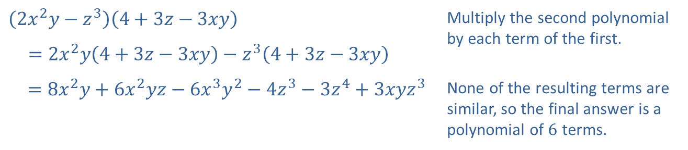
Example 3: Multiplying Polynomials (cont.)
Solution
​
​$\left(2x^{2}y−z^{3}\right)\left(4+3z−3xy\right)$ | Multiply the second polynomial by each term of the first.
​ $=2x^{2}y\left(4+3z−3xy\right)−z^{3}\left(4+3z−3xy\right)$
​$=8x^{2}y+6x^{2}yz−6x^{3}y^{2}−4z^{3}−3z^{4}+3xyz^{3}$ | None of the resulting terms are similar, so the final answer is a polynomial of 6 terms.

Slide 14
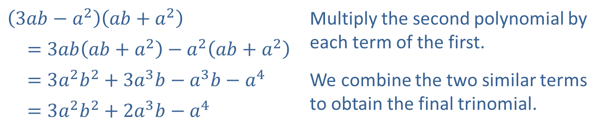
Example 3: Multiplying Polynomials (cont.)
​
​$\left(3ab−a^{2}\right)\left(ab+a^{2}\right)$ | Multiply the second polynomial by each term of the first.
​ $=3ab\left(ab+a^{2}\right)−a^{2}\left(ab+a^{2}\right)$
​ $=3a^{2}b^{2}+3a^{3}b−a^{3}b−a^{4}$ | We combine the two similar terms to obtain the final trinomial.
​ $=3a^{2}b^{2}+2a^{3}b−a^{4}$

Slide 15
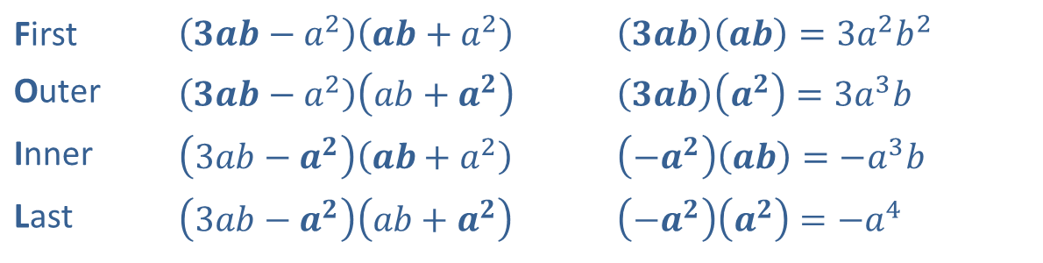

Example 4: The FOIL Method
When a binomial is multiplied by another binomial, as in Example 3b, the acronym FOIL is commonly used as a reminder of the four necessary products. Again consider the product $\left(3ab−a^{2}\right)\left(ab+a^{2}\right)$. Each letter represents a pair of terms to multiply.
First | ​$\left(3ab−a^{2}\right)\left(ab+a^{2}\right)$ | ​$\left(3ab\right)\left(ab\right)=3a^{2}b^{2}$
Outer | ​$\left(3ab−a^{2}\right)\left(ab+a^{2}\right)$ | ​$\left(3ab\right)\left(a^{2}\right)=3a^{3}b$
Inner | ​$\left(3ab−a^{2}\right)\left(ab+a^{2}\right)$ | ​$\left(−a^{2}\right)\left(ab\right)=−a^{3}b$
Last | ​$\left(3ab−a^{2}\right)\left(ab+a^{2}\right)$ | ​$\left(−a^{2}\right)\left(a^{2}\right)=−a^{4}$

Slide 16
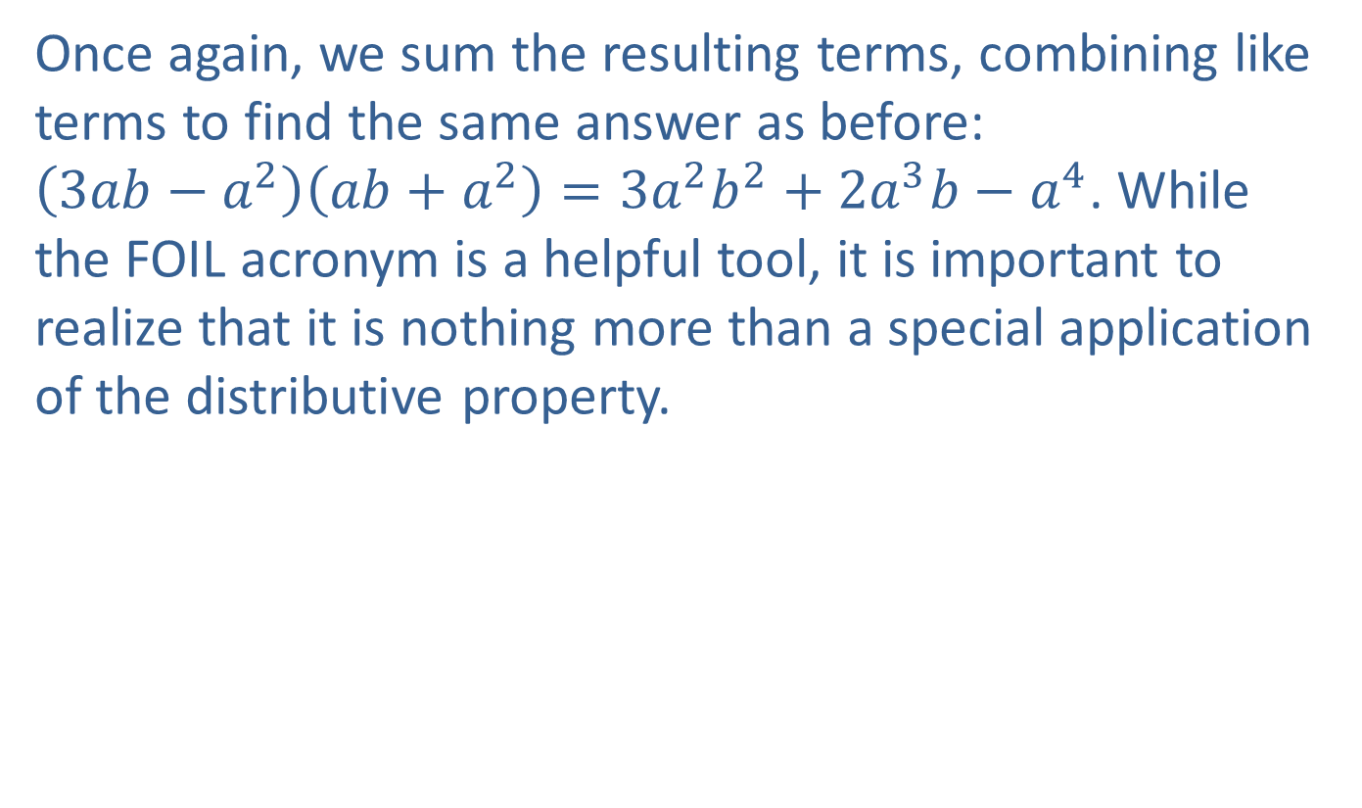
Example 4: The FOIL Method (cont.)
Once again, we sum the resulting terms, combining like terms to find the same answer as before:
$\left(3ab−a^{2}\right)\left(ab+a^{2}\right)=3a^{2}b^{2}+2a^{3}b−a^{4}$. While the FOIL acronym is a helpful tool, it is important to realize that it is nothing more than a special application of the distributive property.

Slide 17
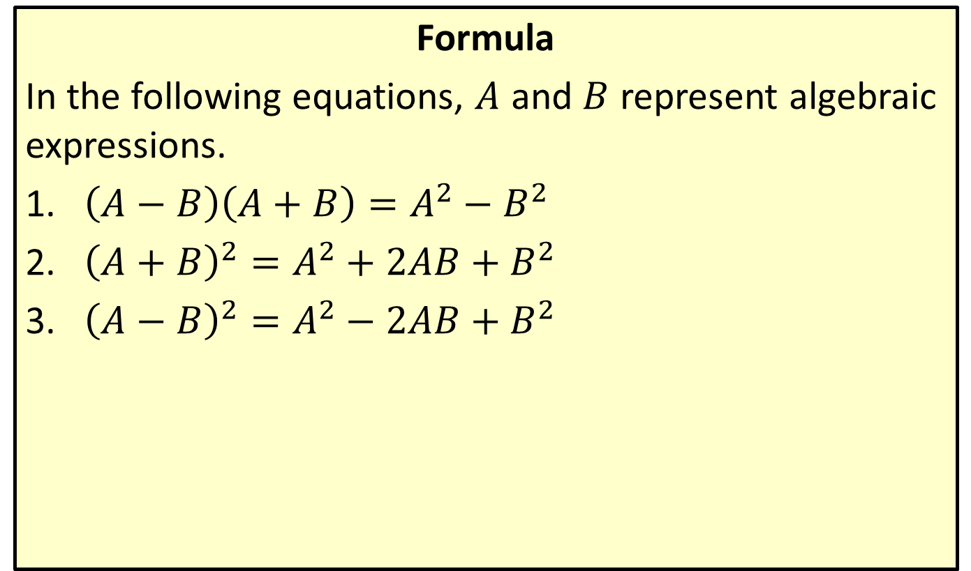
Special Product Formulas
Formula
In the following equations, $A$ and $B$ represent algebraic expressions.
​$\left(A−B\right)\left(A+B\right)=A^{2}−B^{2}$
​${\left(A+B\right)}^{2}=A^{2}+2AB+B^{2}$
​${\left(A−B\right)}^{2}=A^{2}−2AB+B^{2}$

Slide 18

Example 5: Using Special Product Formulas
Use a special product formula to perform the indicated operations.
​${\left(2x−y\right)}^{2}$
​$\left(\sqrt{x}−\sqrt{y}\right)\left(\sqrt{x}+\sqrt{y}\right)$

Slide 19
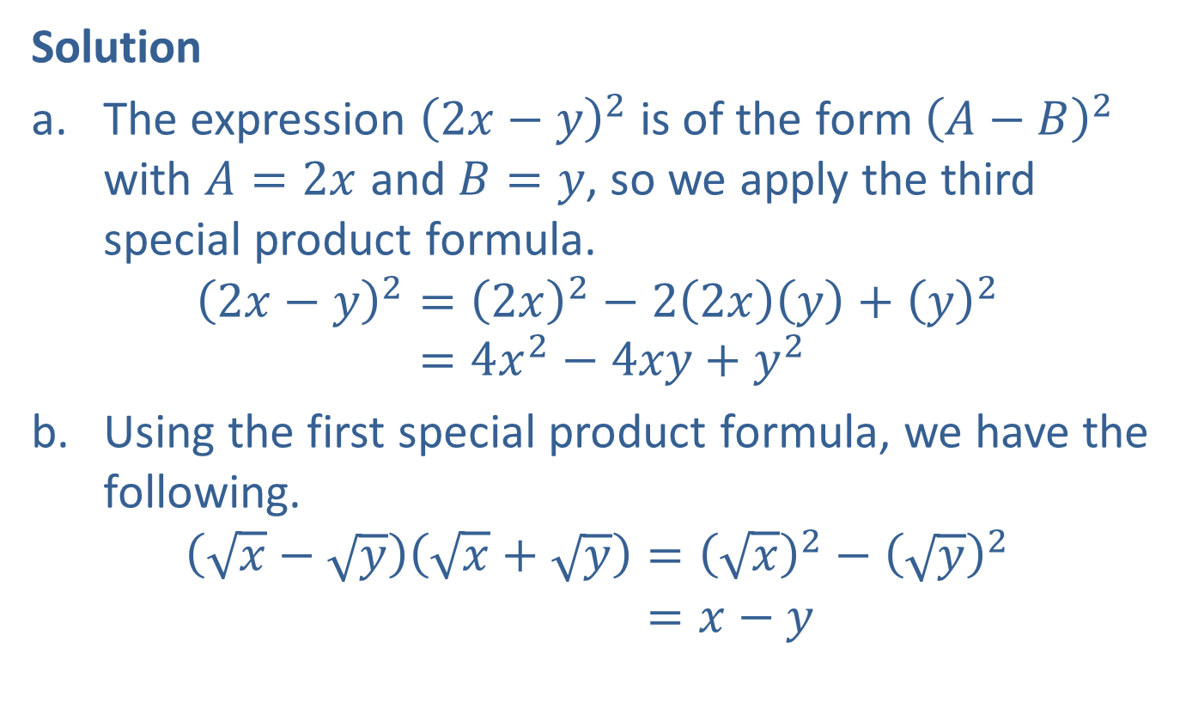
Example 5: Using Special Product Formulas (cont.)
Solution
​The expression ${\left(2x−y\right)}^{2}$ is of the form ${\left(A−B\right)}^{2}$ with $A=2x$ and $B=y$, so we apply the third special product formula.
2𝑥−𝑦2=2𝑥2−22𝑥𝑦+𝑦22𝑥−𝑦2=4𝑥2−4𝑥𝑦+𝑦2
​Using the first special product formula, we have the following.
𝑥−𝑦𝑥+𝑦=𝑥2−𝑦2𝑥−𝑦𝑥+𝑦=𝑥−𝑦

Slide 20
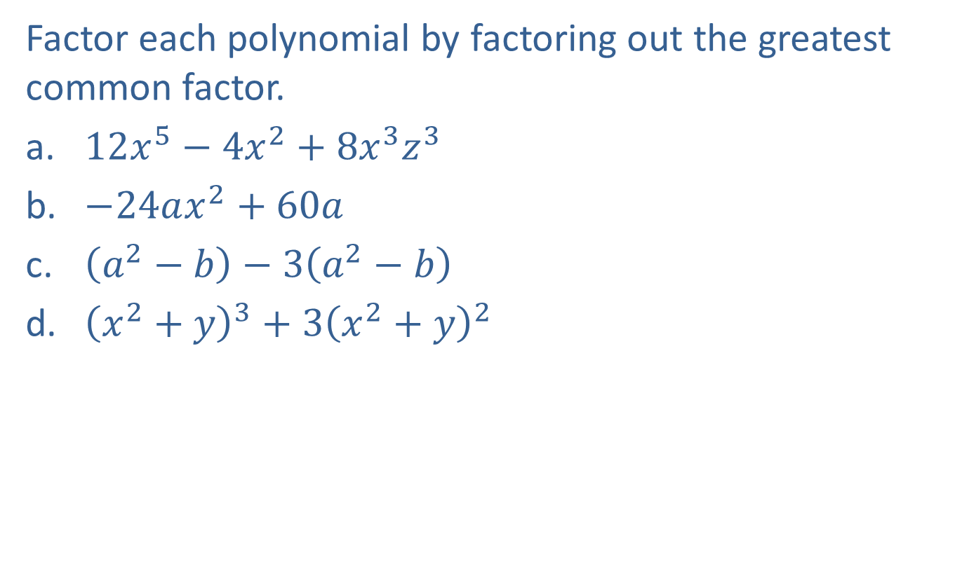
Example 6: Factoring Out the Greatest Common Factor
Factor each polynomial by factoring out the greatest common factor.
​$12x^{5}−4x^{2}+8x^{3}z^{3}$
​$−24ax^{2}+60a$
​$\left(a^{2}−b\right)−3\left(a^{2}−b\right)$
​${\left(x^{2}+y\right)}^{3}+{3\left(x^{2}+y\right)}^{2}$

Slide 21
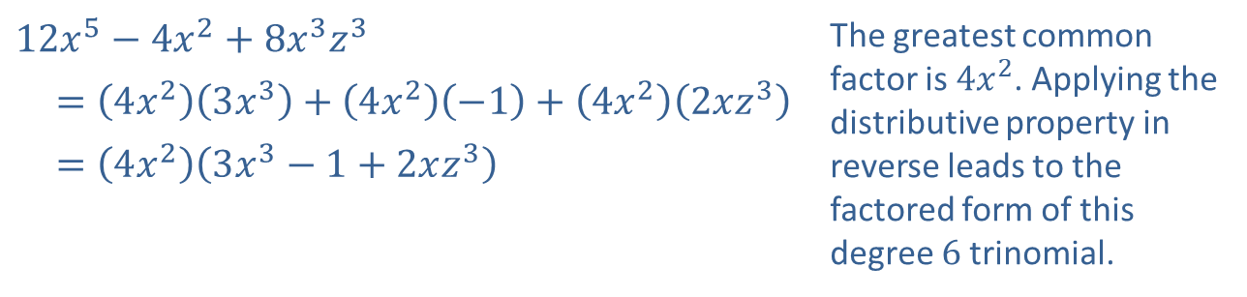
Example 6: Factoring Out the Greatest Common Factor (cont.)
Solution
​
​$12x^{5}−4x^{2}+8x^{3}z^{3}$ | The greatest common factor is $4x^{2}$. Applying the distributive property in reverse leads to the factored form of this degree 6 trinomial.
​ $=\left(4x^{2}\right)\left(3x^{3}\right)+\left(4x^{2}\right)\left(−1\right)+\left(4x^{2}\right)\left(2xz^{3}\right)$
​ $=\left(4x^{2}\right)\left(3x^{3}−1+2xz^{3}\right)$

Slide 22
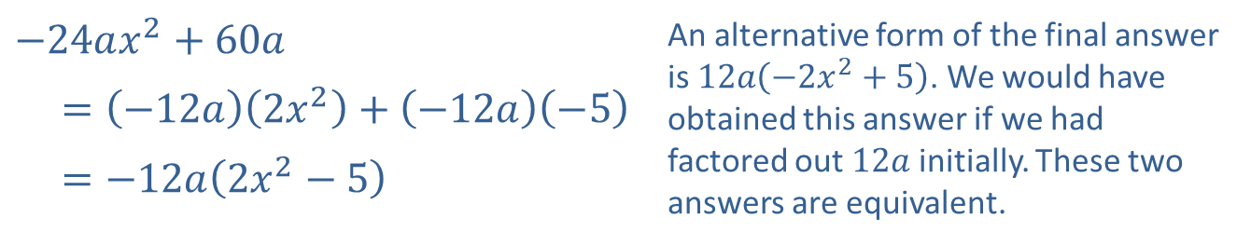
Example 6: Factoring Out the Greatest Common Factor (cont.)
​
​$−24ax^{2}+60a$ | An alternative form of the final answer is $12a\left(−2x^{2}+5\right)$. We would have obtained this answer if we had factored out $12a$ initially. These two answers are equivalent.
​ $=\left(−12a\right)\left(2x^{2}\right)+\left(−12a\right)\left(−5\right)$
​ $=−12a\left(2x^{2}−5\right)$

Slide 23
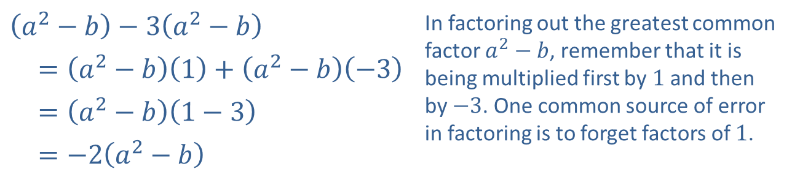
Example 6: Factoring Out the Greatest Common Factor (cont.)
​
​$\left(a^{2}−b\right)−3\left(a^{2}−b\right)$ | In factoring out the greatest common factor $a^{2}−b$, remember that it is being multiplied first by 1 and then by $−3$. One common source of error in factoring is to forget factors of 1.
​ $=\left(a^{2}−b\right)\left(1\right)+\left(a^{2}−b\right)\left(−3\right)$
​ $=\left(a^{2}−b\right)\left(1−3\right)$
​ $=−2\left(a^{2}−b\right)$

Slide 24
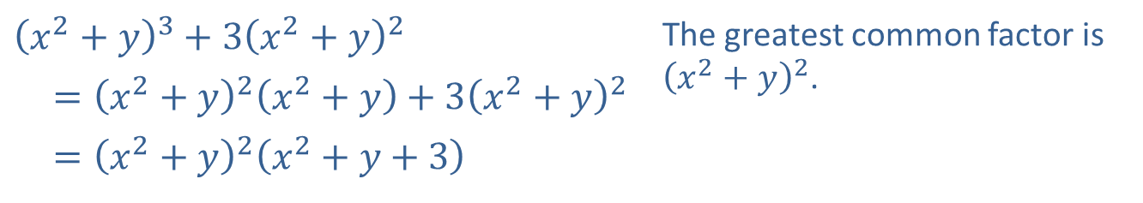
Example 6: Factoring Out the Greatest Common Factor (cont.)
​
​${\left(x^{2}+y\right)}^{3}+{3\left(x^{2}+y\right)}^{2}$ | The greatest common factor is ${\left(x^{2}+y\right)}^{2}$.
​ $={\left(x^{2}+y\right)}^{2}\left(x^{2}+y\right)+3{\left(x^{2}+y\right)}^{2}$
​ $={\left(x^{2}+y\right)}^{2}\left(x^{2}+y+3\right)$

Slide 25

Example 7: Factoring by Grouping
Factor each polynomial by grouping.
​$6x^{2}−y+2x−3xy$
​$ax−ay−bx+by$
​$4x−2x^{2}−2x^{3}+x^{4}$

Slide 26
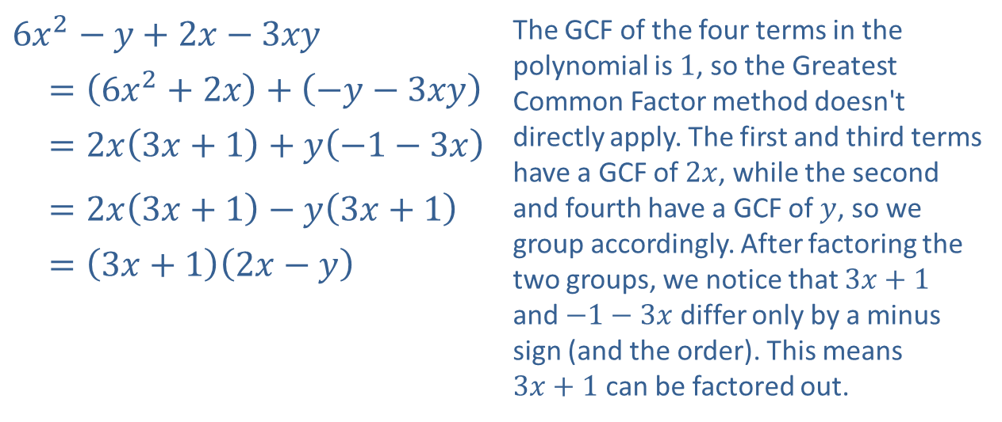
Example 7: Factoring by Grouping (cont.)
Solution
​
​$6x^{2}−y+2x−3xy$ | The GCF of the four terms in the polynomial is 1, so the Greatest Common Factor method doesn't directly apply. The first and third terms have a GCF of $2x$, while the second and fourth have a GCF of $y$, so we group accordingly. After factoring the two groups, we notice that $3x+1$ and $−1−3x$ differ only by a minus sign (and the order). This means $3x+1$ can be factored out.
​$=\left(6x^{2}+2x\right)+\left(−y−3xy\right)$
​ $=2x\left(3x+1\right)+y\left(−1−3x\right)$
​ $=2x\left(3x+1\right)−y\left(3x+1\right)$
​ $=\left(3x+1\right)\left(2x−y\right)$

Slide 27
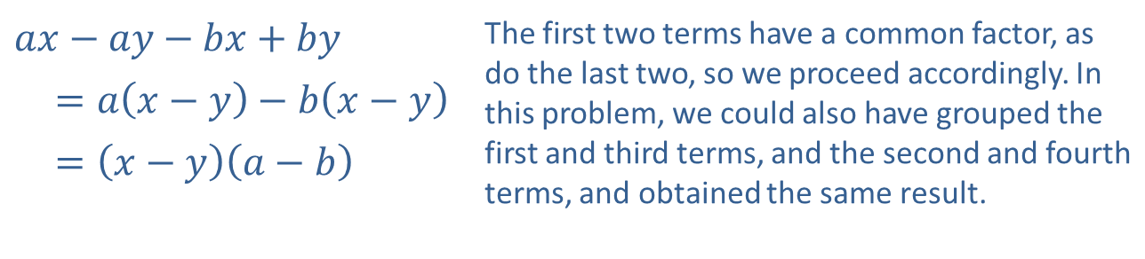
Example 7: Factoring by Grouping (cont.)
​
​$ax−ay−bx+by$ | The first two terms have a common factor, as do the last two, so we proceed accordingly. In this problem, we could also have grouped the first and third terms, and the second and fourth terms, and obtained the same result.
​ $=a\left(x−y\right)−b\left(x−y\right)$
​ $=\left(x−y\right)\left(a−b\right)$

Slide 28
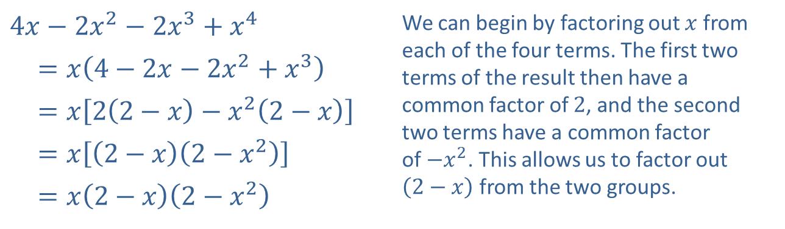
Example 7: Factoring by Grouping (cont.)
​
​$4x−2x^{2}−2x^{3}+x^{4}$ | We can begin by factoring out $x$ from each of the four terms. The first two terms of the result then have a common factor of 2, and the second two terms have a common factor of $−x^{2}$. This allows us to factor out $\left(2−x\right)$ from the two groups.
​ $=x\left(4−2x−2x^{2}+x^{3}\right)$
​ $=x\left[2\left(2−x\right)−x^{2}\left(2−x\right)\right]$
​ $=x\left[\left(2−x\right)\left(2−x^{2}\right)\right]$
​ $=x\left(2−x\right)\left(2−x^{2}\right)$

Slide 29
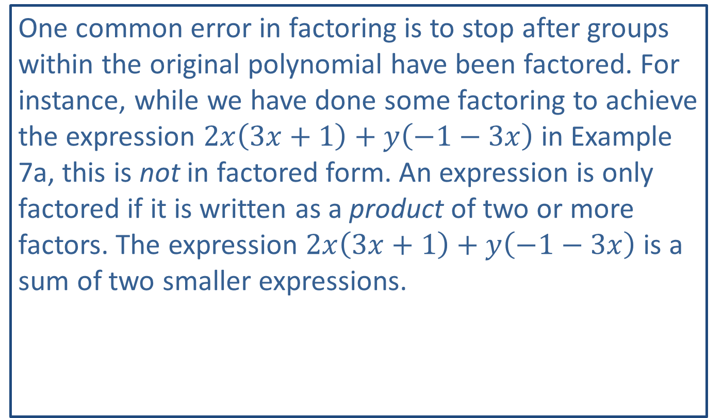
CAUTION!
One common error in factoring is to stop after groups within the original polynomial have been factored. For instance, while we have done some factoring to achieve the expression $2x\left(3x+1\right)+y\left(−1−3x\right)$ in Example 7a, this is not in factored form. An expression is only factored if it is written as a product of two or more factors. The expression $2x\left(3x+1\right)+y\left(−1−3x\right)$ is a sum of two smaller expressions.

Slide 30
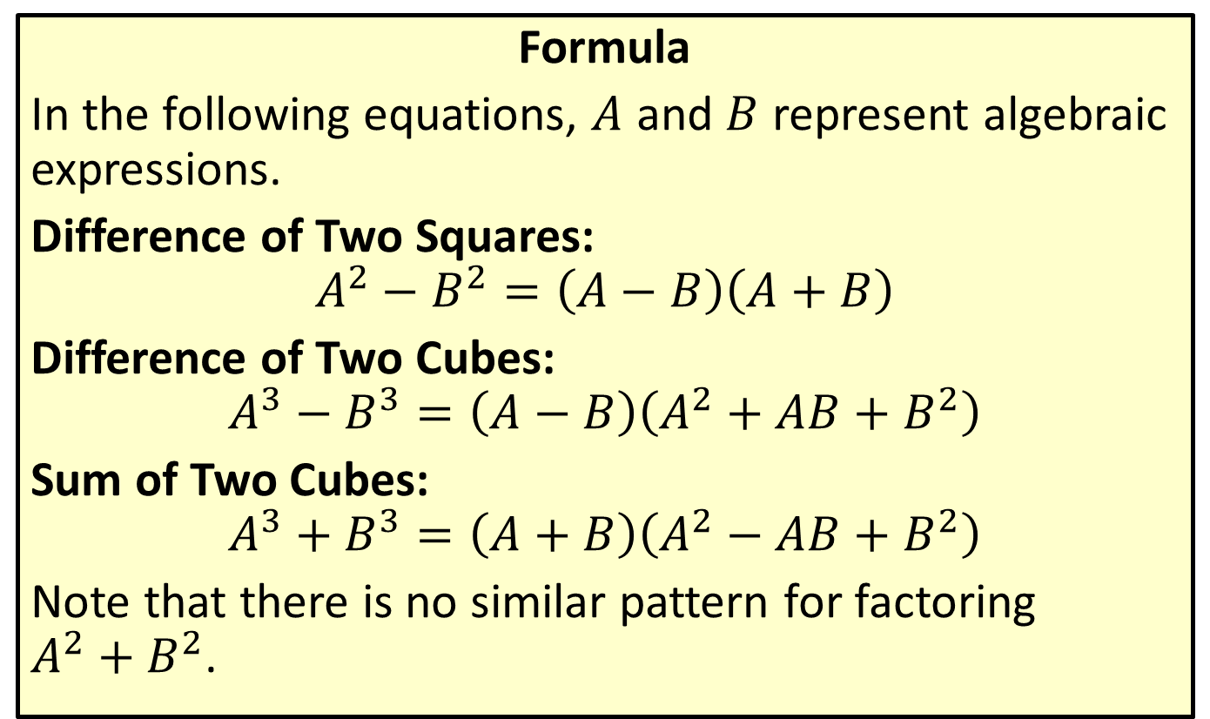
Factoring Special Binomials
Formula
In the following equations, $A$ and $B$ represent algebraic expressions.
Difference of Two Squares:
$$A^{2}−B^{2}=\left(A−B\right)\left(A+B\right)$$
Difference of Two Cubes:
$$A^{3}−B^{3}=\left(A−B\right)\left(A^{2}+AB+B^{2}\right)$$
Sum of Two Cubes:
$$A^{3}+B^{3}=\left(A+B\right)\left(A^{2}−AB+B^{2}\right)$$
Note that there is no similar pattern for factoring
$A^{2}+B^{2}$.

Slide 31

Example 8: Factoring Special Binomials
Use the special factoring patterns to factor the following binomials.
​$49x^{2}−9y^{6}$
​$27a^{6}b^{12}+c^{3}$
​$125y^{3}−8z^{3}$
​$64−{\left(x+y\right)}^{3}$

Slide 32
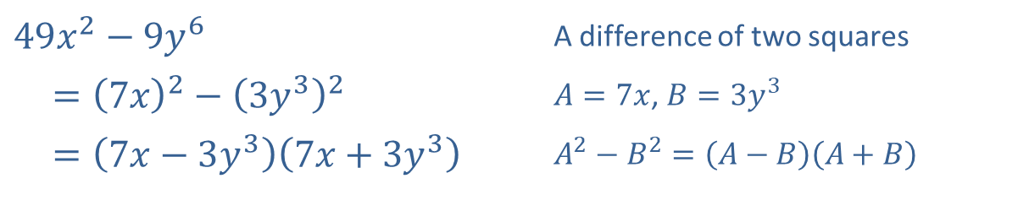
Example 8: Factoring Special Binomials (cont.)
Solution
​
​$49x^{2}−9y^{6}$ | A difference of two squares
​$={\left(7x\right)}^{2}−{\left(3y^{3}\right)}^{2}$ | $A=7x$, $B=3y^{3}$
​ $=\left(7x−3y^{3}\right)\left(7x+3y^{3}\right)$ | $A^{2}−B^{2}=\left(A−B\right)\left(A+B\right)$

Slide 33
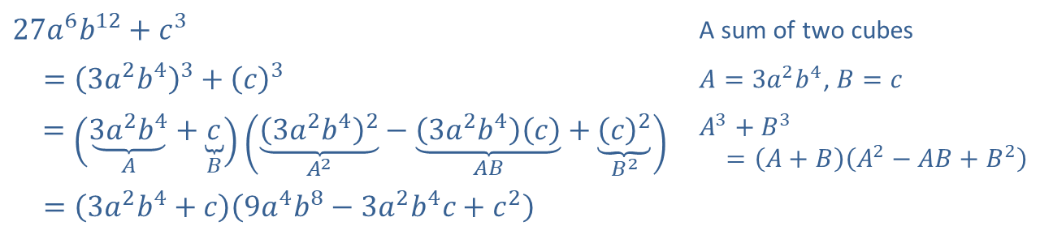
Example 8: Factoring Special Binomials (cont.)
​
​$27a^{6}b^{12}+c^{3}$ | A sum of two cubes
​ $={\left(3a^{2}b^{4}\right)}^{3}+{\left(c\right)}^{3}$ | $A=3a^{2}b^{4}$, $B=c$
$=\left(\underset{A}{\underbrace{3a^{2}b^{4}}}+\underset{B}{\underbrace{c}}\right)\left(\underset{A^{2}}{\underbrace{{\left(3a^{2}b^{4}\right)}^{2}}}−\underset{AB}{\underbrace{\left(3a^{2}b^{4}\right)\left(c\right)}}+\underset{B^{2}}{\underbrace{{\left(c\right)}^{2}}}\right)$ | $A^{3}+B^{3}$ $=\left(A+B\right)\left(A^{2}−AB+B^{2}\right)$
​ $=\left(3a^{2}b^{4}+c\right)\left(9a^{4}b^{8}−3a^{2}b^{4}c+c^{2}\right)$

Slide 34
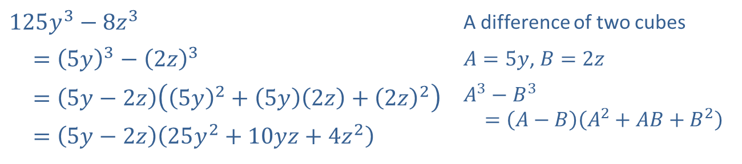
Example 8: Factoring Special Binomials (cont.)
​
​$125y^{3}−8z^{3}$ | A difference of two cubes
​ $={\left(5y\right)}^{3}−{\left(2z\right)}^{3}$ | $A=5y$, $B=2z$
​ $=\left(5y−2z\right)\left({\left(5y\right)}^{2}+\left(5y\right)\left(2z\right)+{\left(2z\right)}^{2}\right)$ | $A^{3}−B^{3}$ $=\left(A−B\right)\left(A^{2}+AB+B^{2}\right)$
​ $=\left(5y−2z\right)\left(25y^{2}+10yz+4z^{2}\right)$

Slide 35
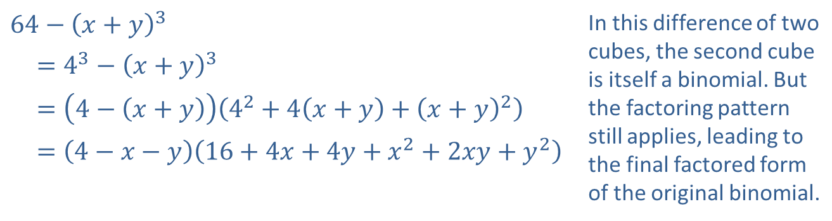
Example 8: Factoring Special Binomials (cont.)
​
​$64−{\left(x+y\right)}^{3}$ | In this difference of two cubes, the second cube is itself a binomial. But the factoring pattern still applies, leading to the final factored form of the original binomial.
​$=4^{3}−{\left(x+y\right)}^{3}$
​ $=\left(4−\left(x+y\right)\right)\left(4^{2}+4\left(x+y\right)+{\left(x+y\right)}^{2}\right)$
​ $=\left(4−x−y\right)\left(16+4x+4y+x^{2}+2xy+y^{2}\right)$

Slide 36
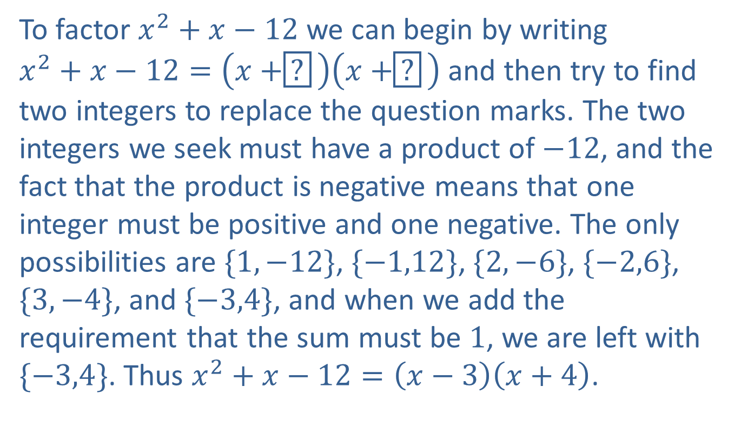
Example 9: Factoring a Trinomial
To factor $x^{2}+x−12$ we can begin by writing
$x^{2}+x−12=\left(x+\boxed{?}\right)\left(x+\boxed{?}\right)$ and then try to find two integers to replace the question marks. The two integers we seek must have a product of $−12$, and the fact that the product is negative means that one integer must be positive and one negative. The only possibilities are $\{1,−12\}$, $\{−1,12\}$, $\{2,−6\}$, $\{−2,6\}$, $\{3,−4\}$, and $\{−3,4\}$, and when we add the requirement that the sum must be 1, we are left with $\{−3,4\}$. Thus $x^{2}+x−12=\left(x−3\right)\left(x+4\right)$.

Slide 37
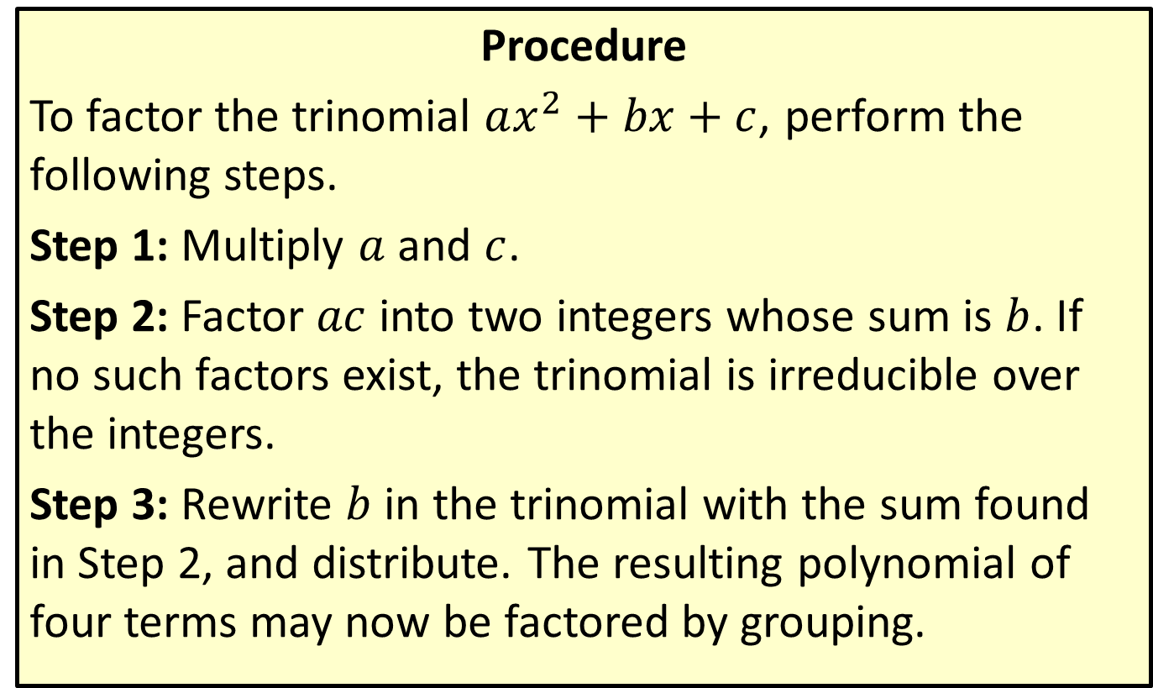
Factoring a Trinomial by Grouping
Procedure
To factor the trinomial $ax^{2}+bx+c$, perform the following steps.
Step 1: Multiply $a$ and $c$.
Step 2: Factor $ac$ into two integers whose sum is $b$. If no such factors exist, the trinomial is irreducible over the integers.
Step 3: Rewrite $b$ in the trinomial with the sum found in Step 2, and distribute. The resulting polynomial of four terms may now be factored by grouping.

Slide 38
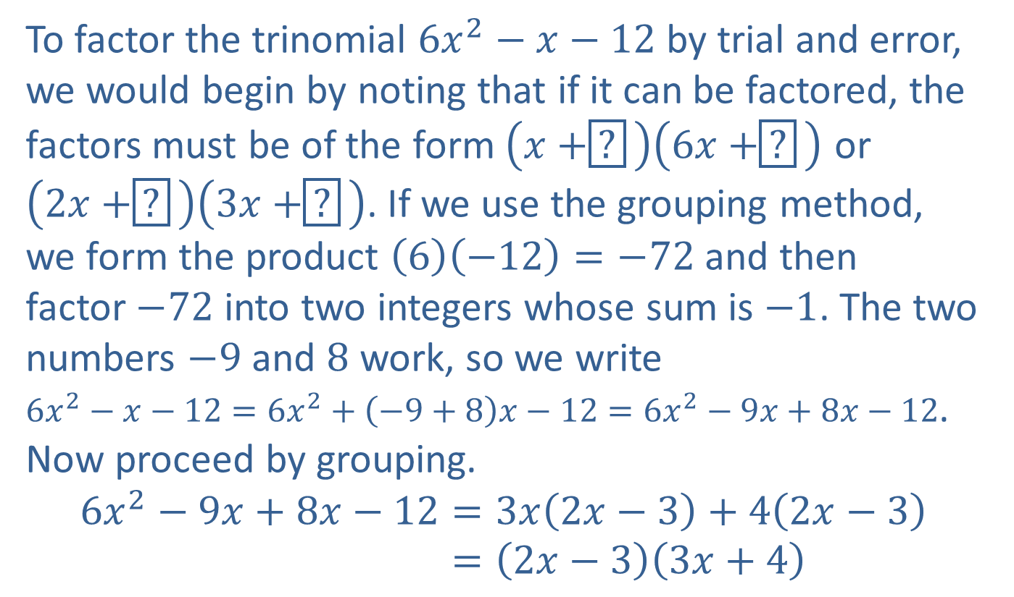
Example 10: Factoring a Trinomial by Grouping
To factor the trinomial $6x^{2}−x−12$ by trial and error, we would begin by noting that if it can be factored, the factors must be of the form $\left(x+\boxed{?}\right)\left(6x+\boxed{?}\right)$ or
$\left(2x+\boxed{?}\right)\left(3x+\boxed{?}\right)$. If we use the grouping method, we form the product $\left(6\right)\left(−12\right)=−72$ and then
factor $−72$ into two integers whose sum is $−1$. The two numbers $−9$ and 8 work, so we write
$6x^{2}−x−12=6x^{2}+\left(−9+8\right)x−12=6x^{2}−9x+8x−12$. Now proceed by grouping.
6𝑥2−9𝑥+8𝑥−12=3𝑥2𝑥−3+42𝑥−36𝑥2−9𝑥+8𝑥−12=2𝑥−33𝑥+4

Slide 39
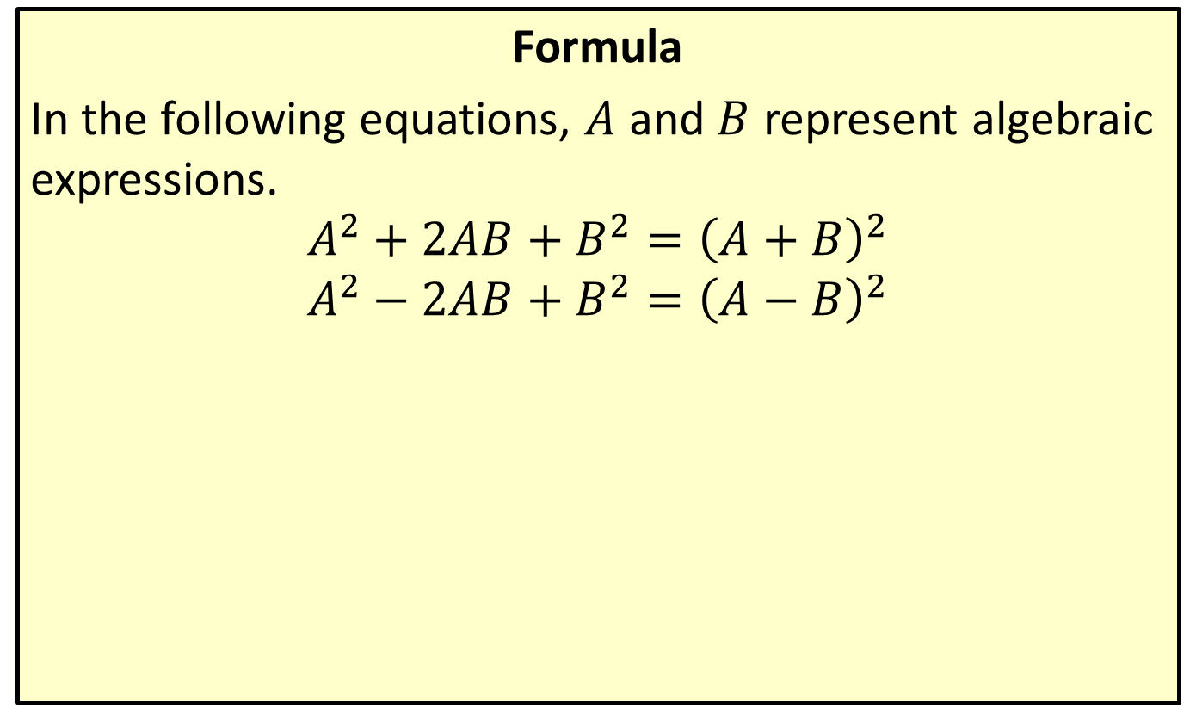
Perfect Square Trinomials
Formula
In the following equations, $A$ and $B$ represent algebraic expressions.
$$A^{2}+2AB+B^{2}={\left(A+B\right)}^{2}$$
$$A^{2}−2AB+B^{2}={\left(A−B\right)}^{2}$$

Slide 40

Example 11: Perfect Square Trinomials
Factor the algebraic expression $x^{2}+10x+25$.

Slide 41
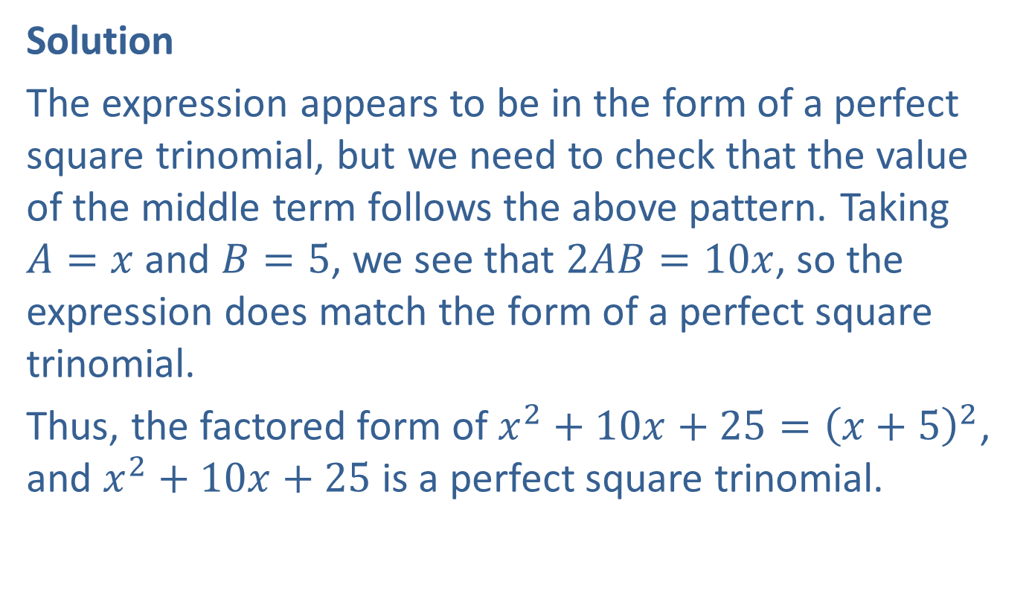
Example 11: Perfect Square Trinomials (cont.)
Solution
The expression appears to be in the form of a perfect square trinomial, but we need to check that the value of the middle term follows the above pattern. Taking $A=x$ and $B=5$, we see that $2AB=10x$, so the expression does match the form of a perfect square trinomial.
Thus, the factored form of $x^{2}+10x+25={\left(x+5\right)}^{2}$, and $x^{2}+10x+25$ is a perfect square trinomial.

Slide 42

Example 12: Factoring Expressions with Noninteger Rational Exponents
Factor each of the following algebraic expressions.
​$3x^{−\frac{2}{3}}−6x^{\frac{1}{3}}+3x^{\frac{4}{3}}$
​${\left(x−1\right)}^{\frac{1}{2}}−{\left(x−1\right)}^{−\frac{1}{2}}$

Slide 43
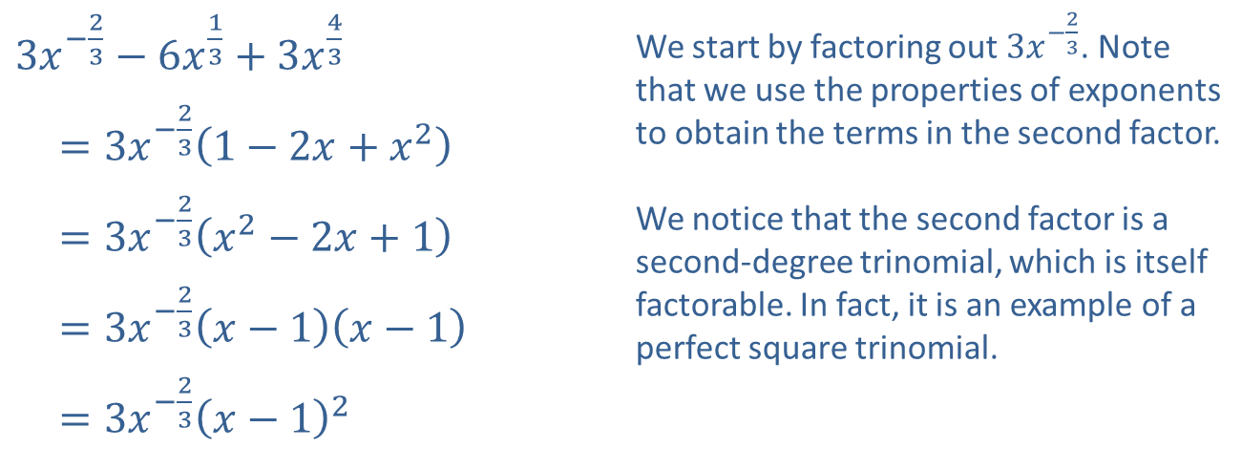
Example 12: Factoring Expressions with Noninteger Rational Exponents (cont.)
Solution
​
​$3x^{−\frac{2}{3}}−6x^{\frac{1}{3}}+3x^{\frac{4}{3}}$ | We start by factoring out $3x^{−\frac{2}{3}}$. Note that we use the properties of exponents to obtain the terms in the second factor. We notice that the second factor is a second-degree trinomial, which is itself factorable. In fact, it is an example of a perfect square trinomial.
​ $=3x^{−\frac{2}{3}}\left(1−2x+x^{2}\right)$
​ $=3x^{−\frac{2}{3}}\left(x^{2}−2x+1\right)$
​ $=3x^{−\frac{2}{3}}\left(x−1\right)\left(x−1\right)$
​ $=3x^{−\frac{2}{3}}{\left(x−1\right)}^{2}$

Slide 44
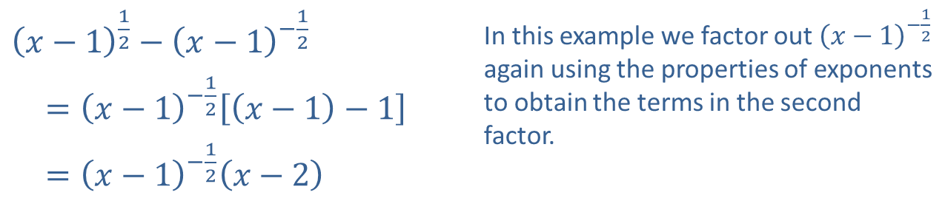
Example 12: Factoring Expressions with Noninteger Rational Exponents (cont.)
​${\left(x−1\right)}^{\frac{1}{2}}−{\left(x−1\right)}^{−\frac{1}{2}}$ | In this example we factor out ${\left(x−1\right)}^{−\frac{1}{2}}$ again using the properties of exponents to obtain the terms in the second factor.
​ $={\left(x−1\right)}^{−\frac{1}{2}}\left[\left(x−1\right)−1\right]$
​ $={\left(x−1\right)}^{−\frac{1}{2}}\left(x−2\right)$
​

