Slide 1
Section 1.8
Polynomial and Polynomial-Like Equations in One Variable

Slide 2
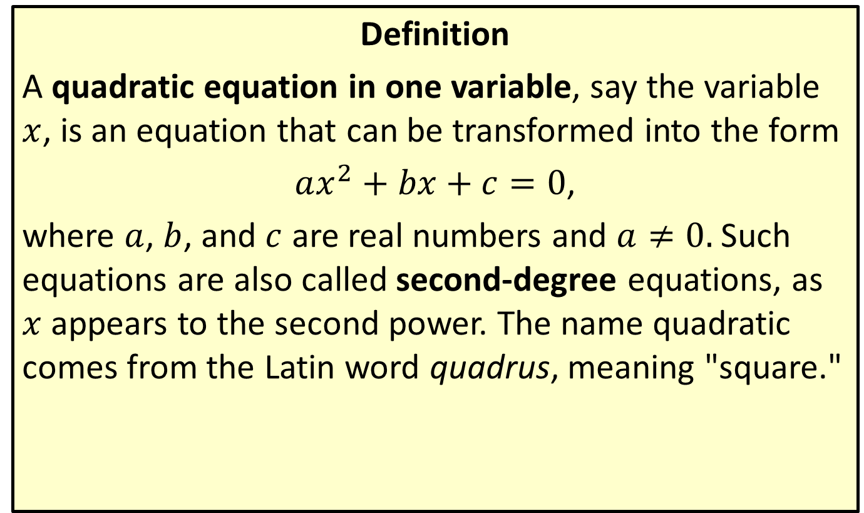
Quadratic Equations
Definition
A quadratic equation in one variable, say the variable $x$, is an equation that can be transformed into the form
$ax^{2}+bx+c=0$,
where $a$, $b$, and $c$ are real numbers and $a≠0.$ Such equations are also called second-degree equations, as $x$ appears to the second power. The name quadratic comes from the Latin word quadrus, meaning "square."

Slide 3

Example 1: Solving Quadratic Equations by Factoring
Solve the quadratic equations by factoring.
​$x^{2}+\frac{5x}{2}=\frac{3}{2}$
​$s^{2}+9=6s$
​$5x^{2}+10x=0$

Slide 4
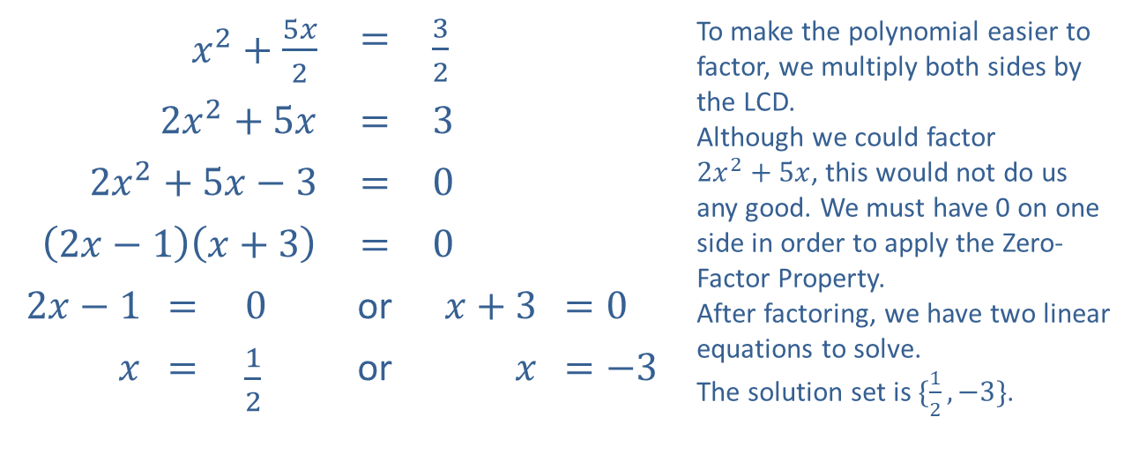
Example 1: Solving Quadratic Equations by Factoring (cont.)
Solution
​
​$x^{2}+\frac{5x}{2}$ |  |  | ​​$=$ | ​$\frac{3}{2}$ |  | To make the polynomial easier to factor, we multiply both sides by the LCD. Although we could factor $2x^{2}+5x$, this would not do us any good. We must have 0 on one side in order to apply the Zero-Factor Property. After factoring, we have two linear equations to solve. The solution set is $\{\frac{1}{2},−3\}$.
​$2x^{2}+5x$ |  |  | ​​$=$ | ​$3$
​$2x^{2}+5x−3$ |  |  | ​​$=$ | ​$0$
​$\left(2x−1\right)\left(x+3\right)$ |  |  | ​​$=$ | ​$0$
​$2x−1$ | ​​$=$ | ​$0$ | or | ​$x+3$ | ​$=0$
$$x$$ | ​​$=$ | ​$\frac{1}{2}$ | or | $$x$$ | ​​$=−3$

Slide 5
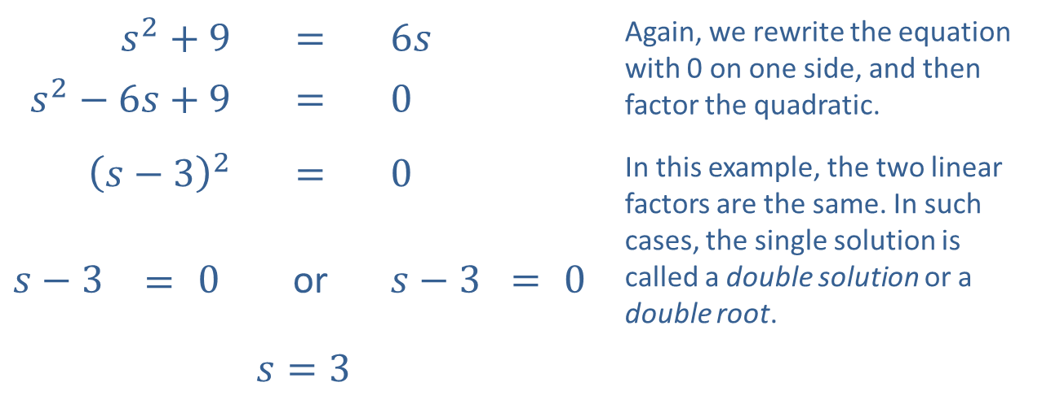
Example 1: Solving Quadratic Equations by Factoring (cont.)
​
​$s^{2}+9$ |  |  | ​$=$ | ​$6s$ |  |  | Again, we rewrite the equation with 0 on one side, and then factor the quadratic.
​$s^{2}−6s+9$ |  |  | ​$=$ | ​$0$
​${\left(s−3\right)}^{2}$ |  |  | ​$=$ | ​$0$ |  |  | In this example, the two linear factors are the same. In such cases, the single solution is called a double solution or a double root.
​$s−3$ | $$=$$ | ​$0$ | or | ​$s−3$ | $=$ | ​$0$
 |  |  | ​$s=3$

Slide 6
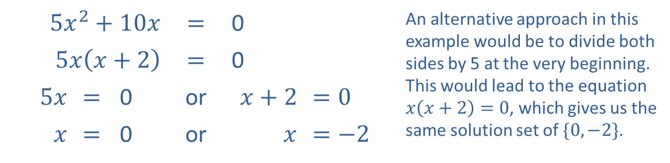
Example 1: Solving Quadratic Equations by Factoring (cont.)
​
​$5x^{2}+10x$ |  |  | ​$=$ | ​0 |  | An alternative approach in this example would be to divide both sides by 5 at the very beginning. This would lead to the equation $x\left(x+2\right)=0$, which gives us the same solution set of $\{0,−2\}$.
​$5x\left(x+2\right)$ |  |  | ​$=$ | ​0
​$5x$ | ​$=$ | ​0 | or | ​$x+2$ | ​$=0$
$x$ | ​$=$ | ​0 | or | $$x$$ | ​$=−2$

Slide 7

Example 2: Perfect Square Quadratic Equations
Solve the quadratic equations by taking square roots.
​${\left(2x+3\right)}^{2}=8$
​${\left(x−5\right)}^{2}+4=0$

Slide 8
Note:
In the factoring method, we move all terms to one side. Here, we isolate a term that is squared, ideally with only a constant on the other side.

Slide 9
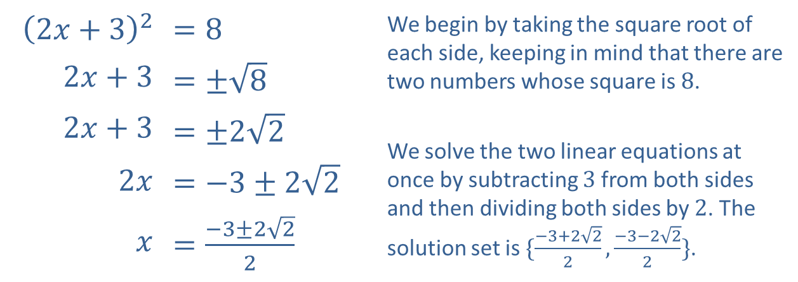
Example 2: Perfect Square Quadratic Equations (cont.)
Solution
​
​${\left(2x+3\right)}^{2}$ | ​$=8$ | We begin by taking the square root of each side, keeping in mind that there are two numbers whose square is 8.
​$2x+3$ | ​$=±\sqrt{8}$
​$2x+3$ | ​$=±2\sqrt{2}$ | We solve the two linear equations at once by subtracting 3 from both sides and then dividing both sides by 2. The solution set is $\{\frac{−3+2\sqrt{2}}{2},\frac{−3−2\sqrt{2}}{2}\}$.
​$2x$ | ​$=−3±2\sqrt{2}$
$x$ | ​$=\frac{−3±2\sqrt{2}}{2}$

Slide 10
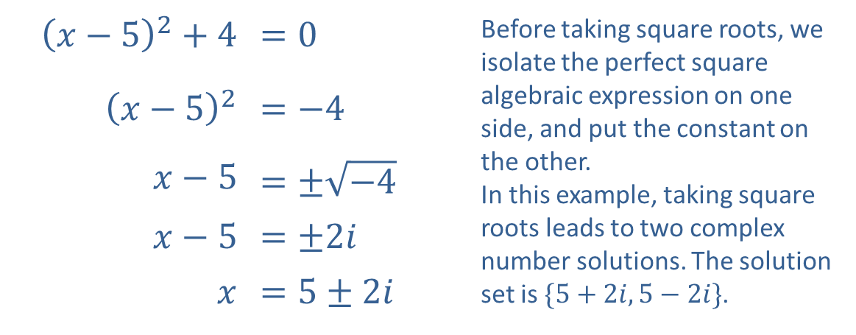
Example 2: Perfect Square Quadratic Equations (cont.)
​
​${\left(x−5\right)}^{2}+4$ | ​$=0$ | Before taking square roots, we isolate the perfect square algebraic expression on one side, and put the constant on the other. In this example, taking square roots leads to two complex number solutions. The solution set is $\{5+2i,5−2i\}$.
​${\left(x−5\right)}^{2}$ | ​$=−4$
​$x−5$ | ​$=±\sqrt{−4}$
​$x−5$ | ​$=±2i$
$x$ | ​$=5±2i$

Slide 11
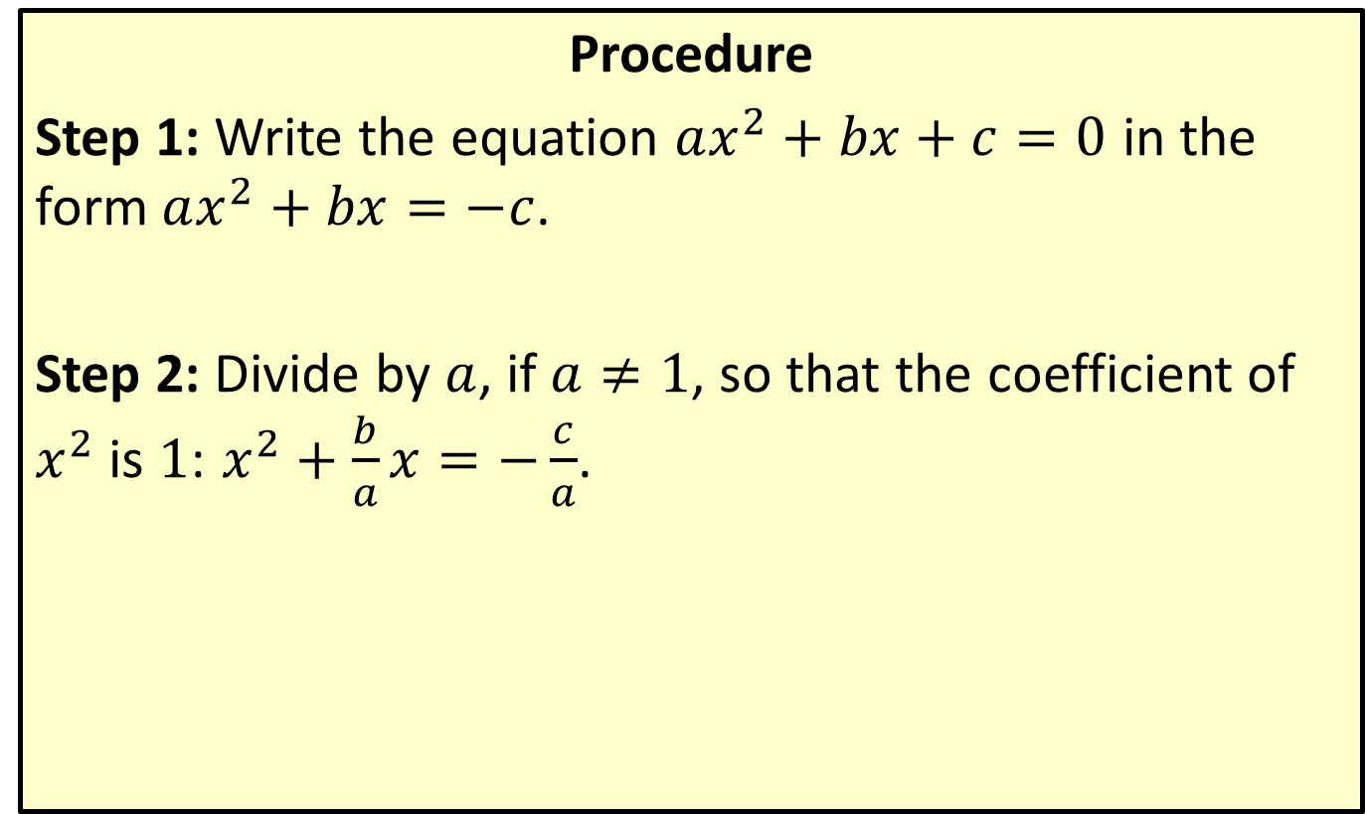
Completing the Square
Procedure
Step 1: Write the equation $ax^{2}+bx+c=0$ in the form $ax^{2}+bx=−c$.
Step 2: Divide by $a$, if $a≠1$, so that the coefficient of $x^{2}$ is $1$: $x^{2}+\frac{b}{a}x=−\frac{c}{a}$.

Slide 12
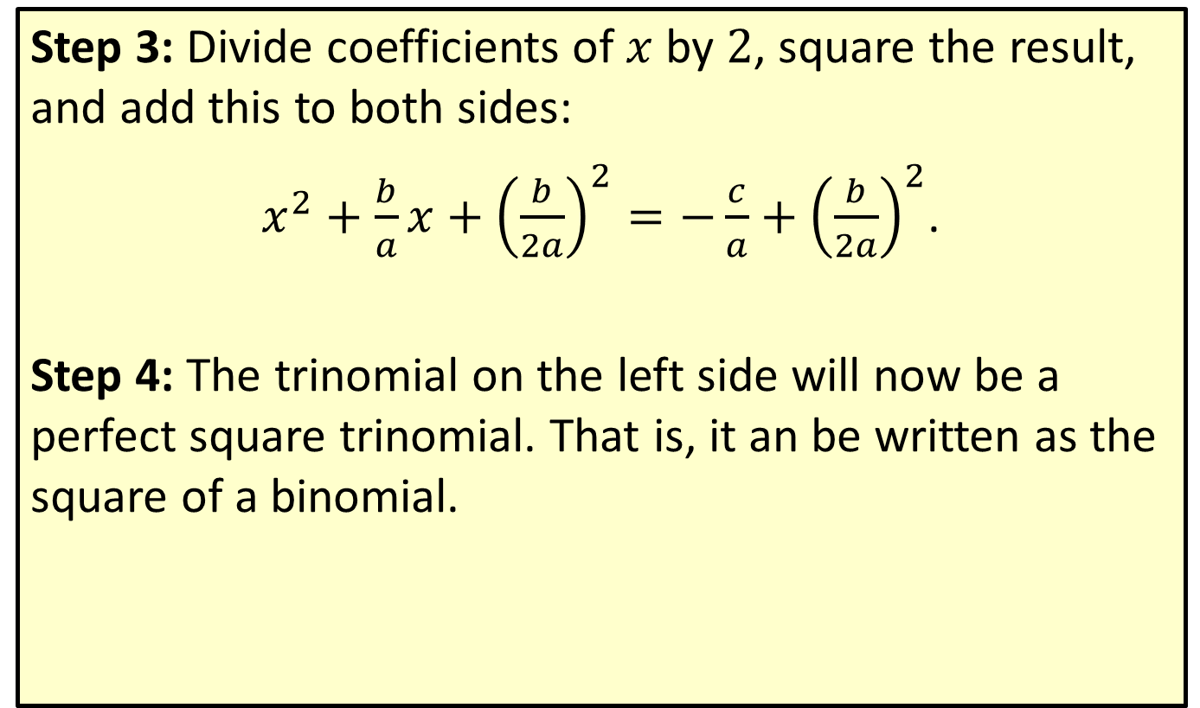
Completing the Square (cont.)
Step 3: Divide coefficients of $x$ by $2$, square the result, and add this to both sides:
$x^{2}+\frac{b}{a}x+{\left(\frac{b}{2a}\right)}^{2}=−\frac{c}{a}+{\left(\frac{b}{2a}\right)}^{2}$.
Step 4: The trinomial on the left side will now be a perfect square trinomial. That is, it an be written as the square of a binomial.

Slide 13

Example 3: Completing the Square
Solve the quadratic equations by completing the square.
​$x^{2}−2x−6=0$
​$9x^{2}+3x=2$

Slide 14
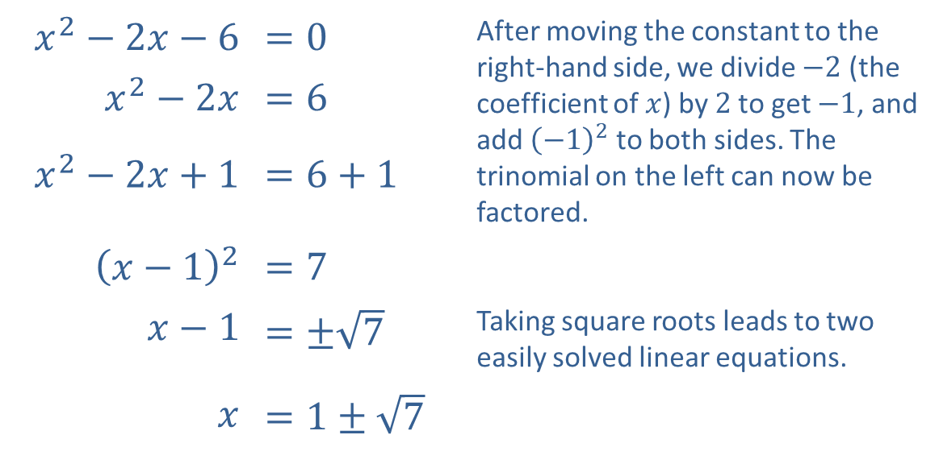
Example 3: Completing the Square (cont.)
Solution
​
​$x^{2}−2x−6$ | ​$=0$ | After moving the constant to the right-hand side, we divide $−2$ (the coefficient of $x$) by 2 to get $−1$, and add ${\left(−1\right)}^{2}$ to both sides. The trinomial on the left can now be factored.
​$x^{2}−2x$ | ​$=6$
​$x^{2}−2x+1$ | ​$=6+1$
​${\left(x−1\right)}^{2}$ | ​$=7$
​$x−1$ | ​$=±\sqrt{7}$ | Taking square roots leads to two easily solved linear equations.
$x$ | ​$=1±\sqrt{7}$

Slide 15
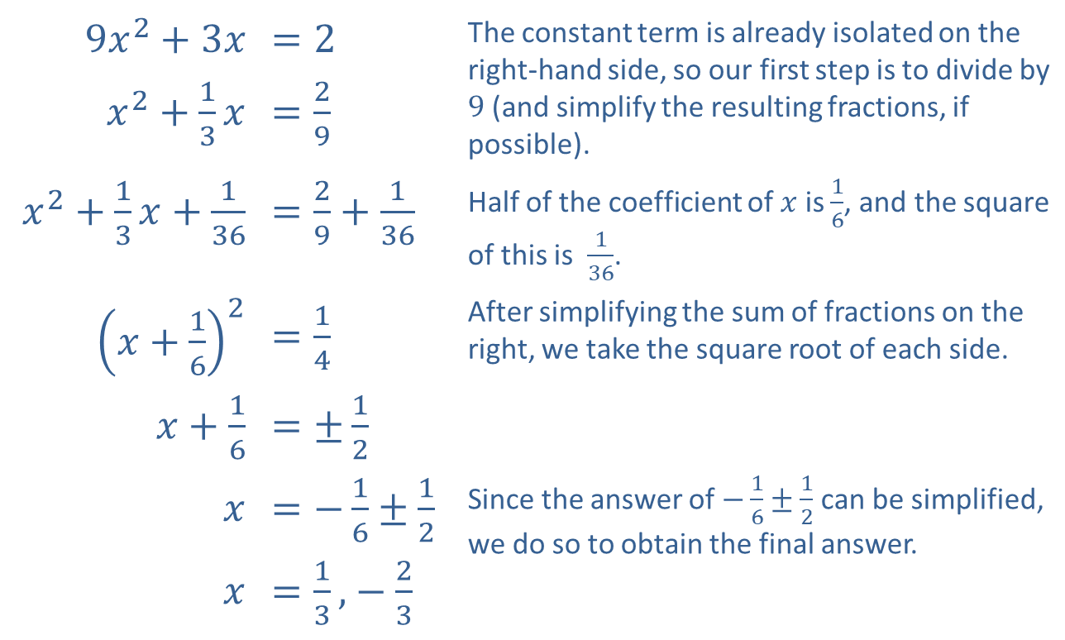
Example 3: Completing the Square (cont.)
​
​$9x^{2}+3x$ | ​$=2$ | The constant term is already isolated on the right-hand side, so our first step is to divide by 9 (and simplify the resulting fractions, if possible).
​$x^{2}+\frac{1}{3}x$ | ​$=\frac{2}{9}$
​$x^{2}+\frac{1}{3}x+\frac{1}{36}$ | ​$=\frac{2}{9}+\frac{1}{36}$ | Half of the coefficient of $x$ is $\frac{1}{6}$, and the square of this is $\frac{1}{36}$.
​${\left(x+\frac{1}{6}\right)}^{2}$ | ​$=\frac{1}{4}$ | After simplifying the sum of fractions on the right, we take the square root of each side.
​$x+\frac{1}{6}$ | ​$=±\frac{1}{2}$
$$x$$ | ​$=−\frac{1}{6}±\frac{1}{2}$ | Since the answer of $−\frac{1}{6}±\frac{1}{2}$ can be simplified, we do so to obtain the final answer.
$$x$$ | ​$=\frac{1}{3}\text{,}−\frac{2}{3}$

Slide 16
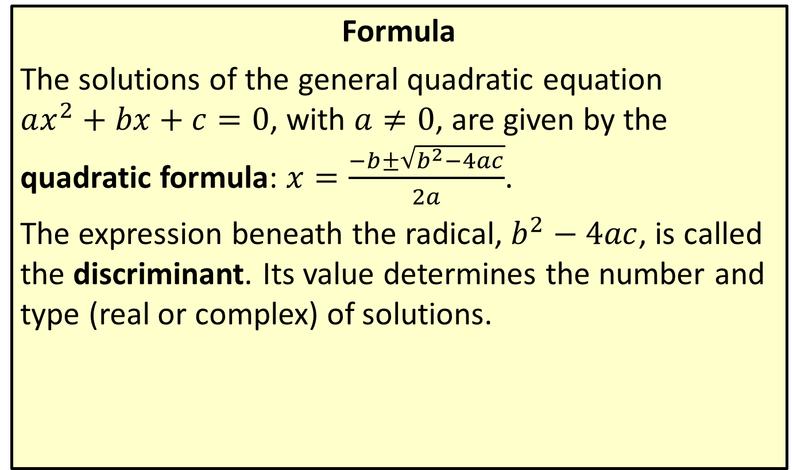
The Quadratic Formula
Formula
The solutions of the general quadratic equation $ax^{2}+bx+c=0$, with $a≠0$, are given by the quadratic formula: $x=\frac{−b±\sqrt{b^{2}−4ac}}{2a}$.
The expression beneath the radical, $b^{2}−4ac$, is called the discriminant. Its value determines the number and type (real or complex) of solutions.

Slide 17
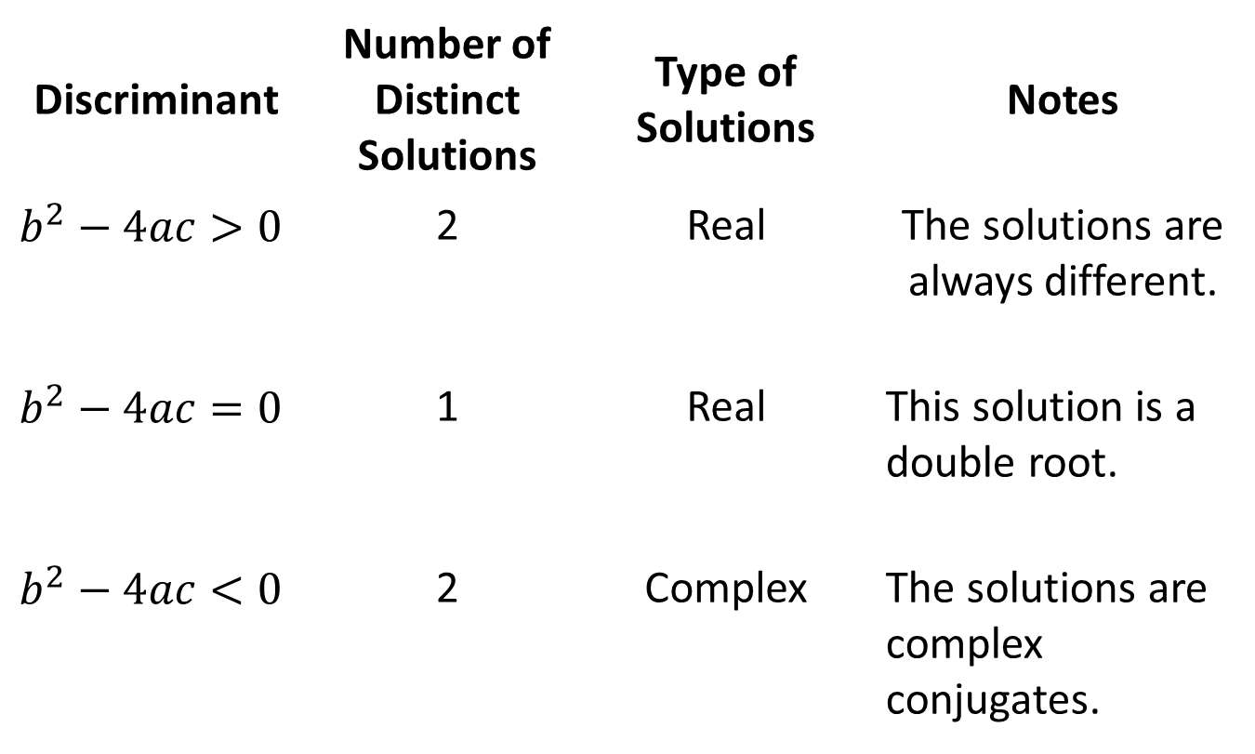
The Quadratic Formula (cont.)
Discriminant | Number of Distinct Solutions | Type of Solutions | Notes
$$b^{2}−4ac>0$$ | 2 | Real | The solutions are always different.
$$b^{2}−4ac=0$$ | 1 | Real | This solution is a double root.
$$b^{2}−4ac<0$$ | 2 | Complex | The solutions are complex conjugates.

Slide 18

Example 4: Using the Quadratic Formula
Solve the quadratic equations by using the quadratic formula.
​$8x^{2}−4x=1$
​$t^{2}+6t+13=0$

Slide 19
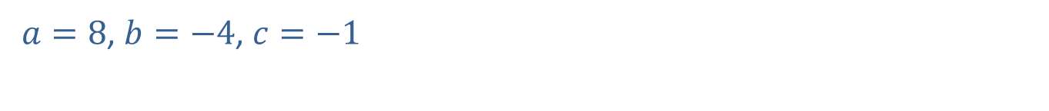
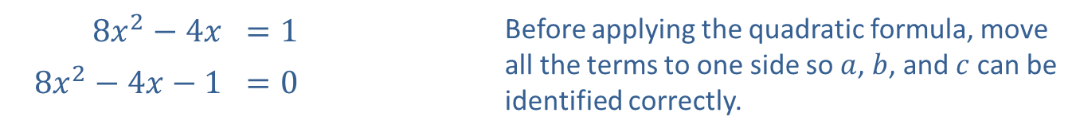
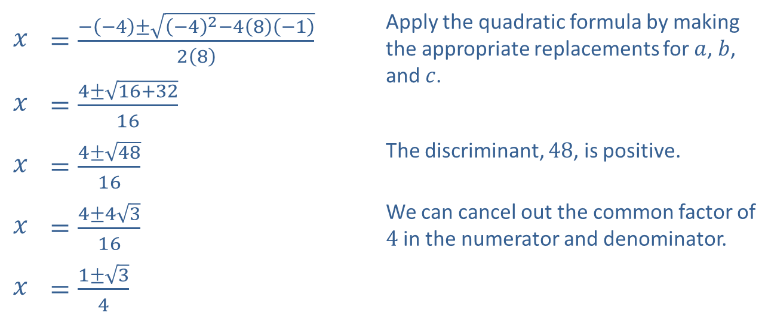
Example 4: Using the Quadratic Formula (cont.)
Solution
​
​$8x^{2}−4x$ | ​$=1$ | Before applying the quadratic formula, move all the terms to one side so $a$, $b$, and $c$ can be identified correctly.
​$8x^{2}−4x−1$ | ​$=0$
​$a=8$, $b=−4$, $c=−1$
​
$$x$$ | ​$=\frac{−\left(−4\right)±\sqrt{{\left(−4\right)}^{2}−4\left(8\right)\left(−1\right)}}{2\left(8\right)}$ | Apply the quadratic formula by making the appropriate replacements for $a$, $b$, and $c$.
$$x$$ | ​$=\frac{4±\sqrt{16+32}}{16}$
$$x$$ | ​$=\frac{4±\sqrt{48}}{16}$ | The discriminant, 48, is positive.
$$x$$ | ​$=\frac{4±4\sqrt{3}}{16}$ | We can cancel out the common factor of 4 in the numerator and denominator.
$$x$$ | ​$=\frac{1±\sqrt{3}}{4}$

Slide 20

Example 4: Using the Quadratic Formula (cont.)
​Thus, the solutions are $x=\frac{1+\sqrt{3}}{4}$ and $x=\frac{1−\sqrt{3}}{4}$; two unique, real solutions.
​

Slide 21
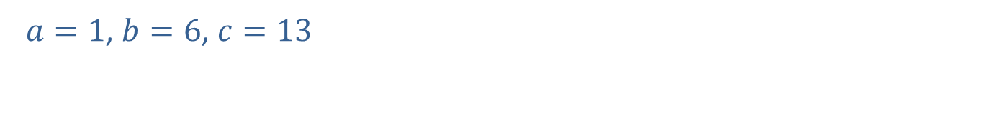
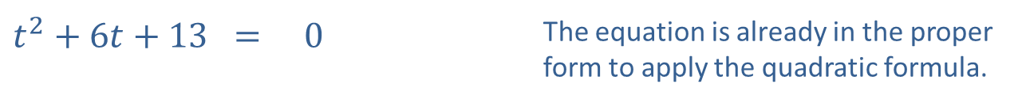
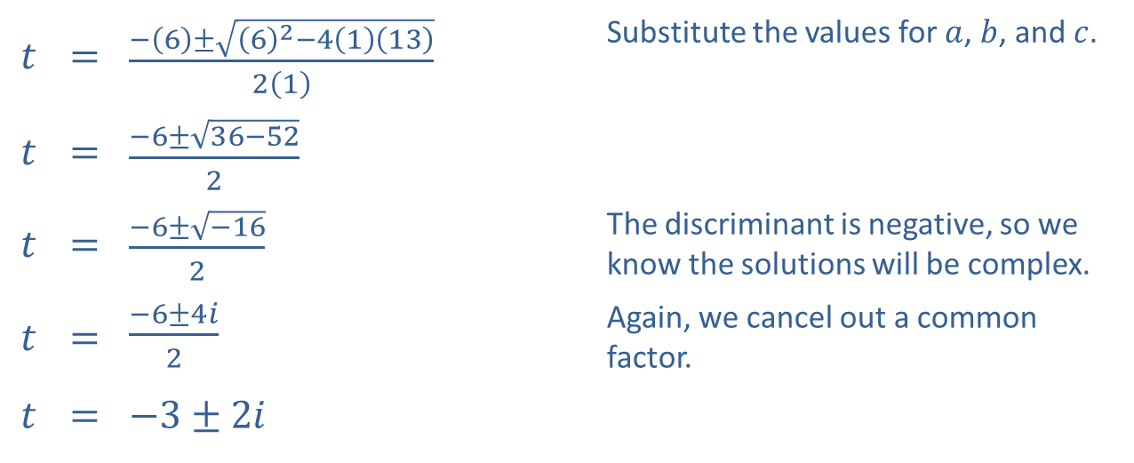
Example 4: Using the Quadratic Formula (cont.)
​
​$t^{2}+6t+13$ | ​= | ​0 | The equation is already in the proper form to apply the quadratic formula.
​$a=1$, $b=6$, $c=13$
​
$$t$$ | ​= | ​$\frac{−\left(6\right)±\sqrt{{\left(6\right)}^{2}−4\left(1\right)\left(13\right)}}{2\left(1\right)}$ | Substitute the values for $a$, $b$, and $c$.
$$t$$ | ​= | ​$\frac{−6±\sqrt{36−52}}{2}$
$$t$$ | ​= | ​$\frac{−6±\sqrt{−16}}{2}$ | The discriminant is negative, so we know the solutions will be complex.
$$t$$ | ​= | ​$\frac{−6±4i}{2}$ | Again, we cancel out a common factor.
$$t$$ | ​= | ​$−3±2i$

Slide 22

Example 4: Using the Quadratic Formula (cont.)
​Thus, the solutions are $t=−3+2i$ and $t=−3−2i$; two complex conjugate solutions.

Slide 23
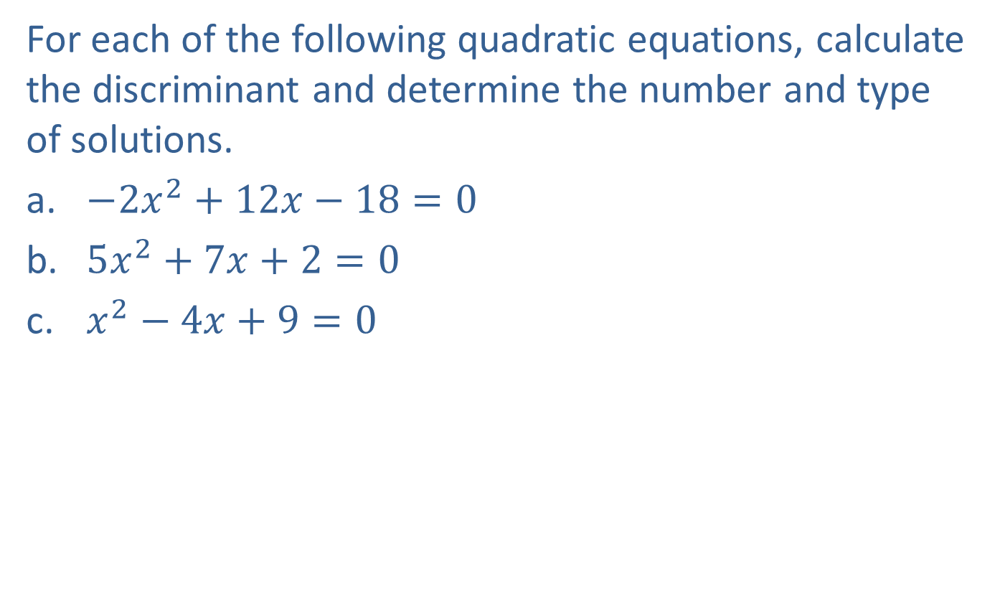
Example 5: The Discriminant
For each of the following quadratic equations, calculate the discriminant and determine the number and type of solutions.
​$−2x^{2}+12x−18=0$
​$5x^{2}+7x+2=0$
​$x^{2}−4x+9=0$

Slide 24
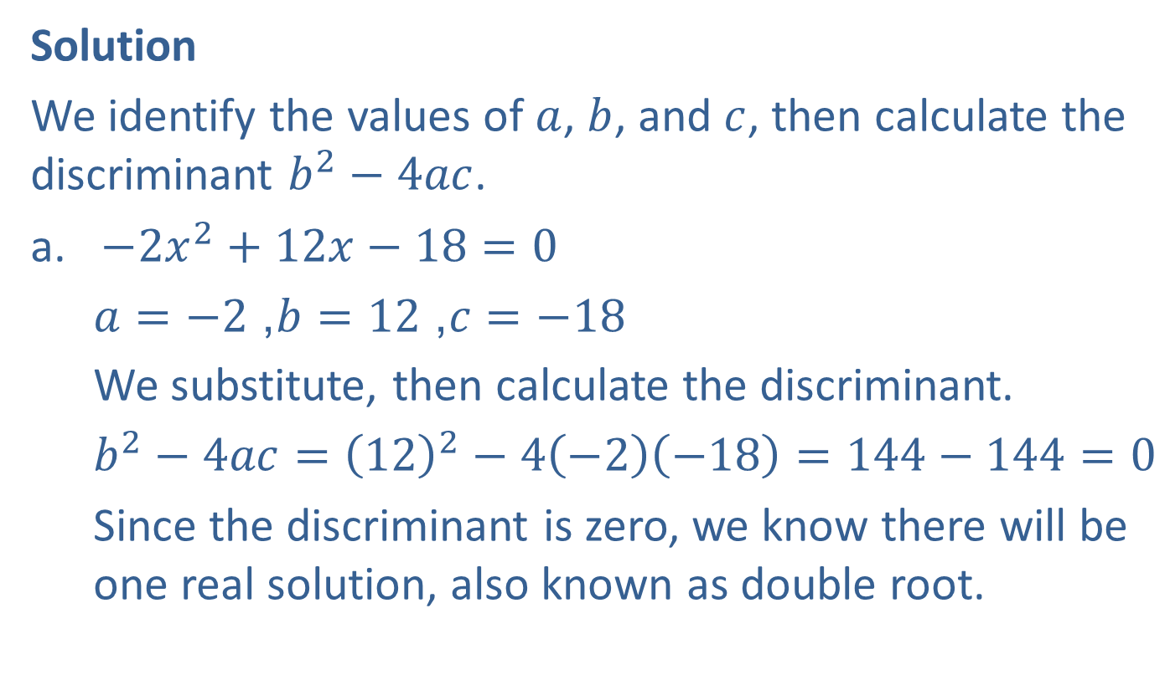
Example 5: The Discriminant (cont.)
Solution
We identify the values of $a$, $b$, and $c$, then calculate the discriminant $b^{2}−4ac$.
​$−2x^{2}+12x−18=0$
$a=−2$, $b=12$, $c=−18$
​We substitute, then calculate the discriminant.
​$b^{2}−4ac={\left(12\right)}^{2}−4\left(−2\right)\left(−18\right)=144−144=0$
Since the discriminant is zero, we know there will be one real solution, also known as double root.

Slide 25

Example 5: The Discriminant (cont.)
​$5x^{2}+7x+2=0$
​$a=5$, $b=7$, $c=2$
​$b^{2}−4ac={\left(7\right)}^{2}−4\left(5\right)\left(2\right)=49−40=9$
This time, the discriminant is positive, so there are two distinct real solutions.

Slide 26

Example 5: The Discriminant (cont.)
​$x^{2}−4x+9=0$
$a=1$, $b=−4$, $c=9$
$$b^{2}−4ac={\left(−4\right)}^{2}−4\left(1\right)\left(9\right)=16−36=−20$$
The discriminant is negative, so the equation has two complex conjugate solutions.

Slide 27
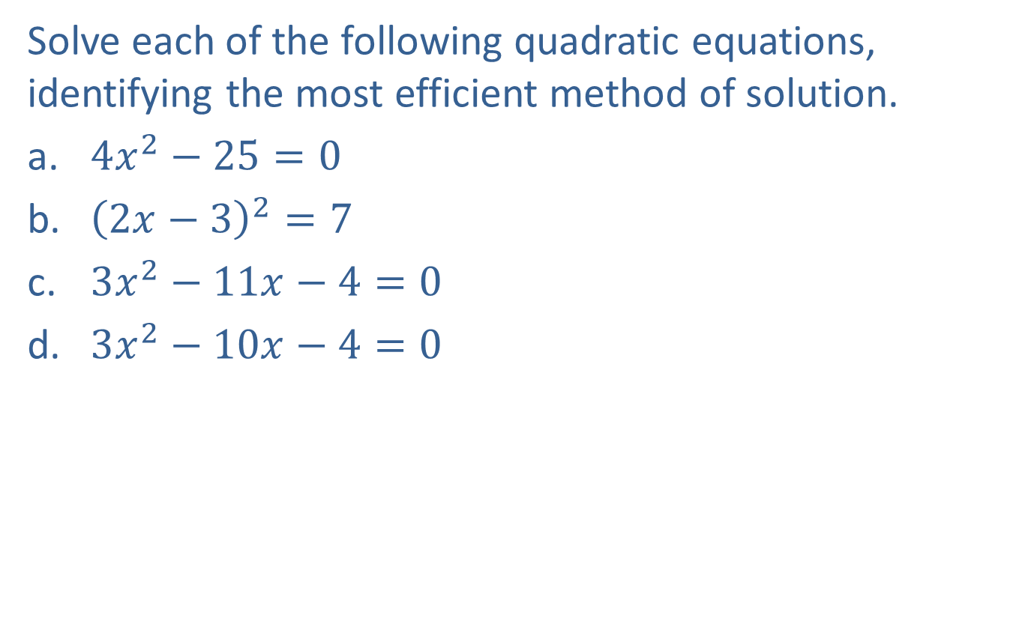
Example 6: Methods of Solving Quadratic Equations
Solve each of the following quadratic equations, identifying the most efficient method of solution.
​$4x^{2}−25=0$
​${\left(2x−3\right)}^{2}=7$
​$3x^{2}−11x−4=0$
​$3x^{2}−10x−4=0$

Slide 28
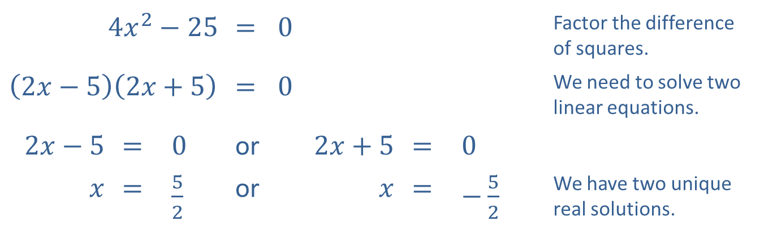
Example 6: Methods of Solving Quadratic Equations (cont.)
Solutions
​The left-hand side is a difference of squares, so factoring is the easiest method.
​
​$4x^{2}−25$ |  |  | ​= | ​0 |  |  | Factor the difference of squares.
​$\left(2x−5\right)\left(2x+5\right)$ |  |  | ​= | ​0 |  |  | We need to solve two linear equations.
​$2x−5$ | ​= | ​0 | or | ​$2x+5$ | ​= | ​0
$x$ | ​= | ​$\frac{5}{2}$ | or | $x$ | ​= | ​$−\frac{5}{2}$ | We have two unique real solutions.

Slide 29
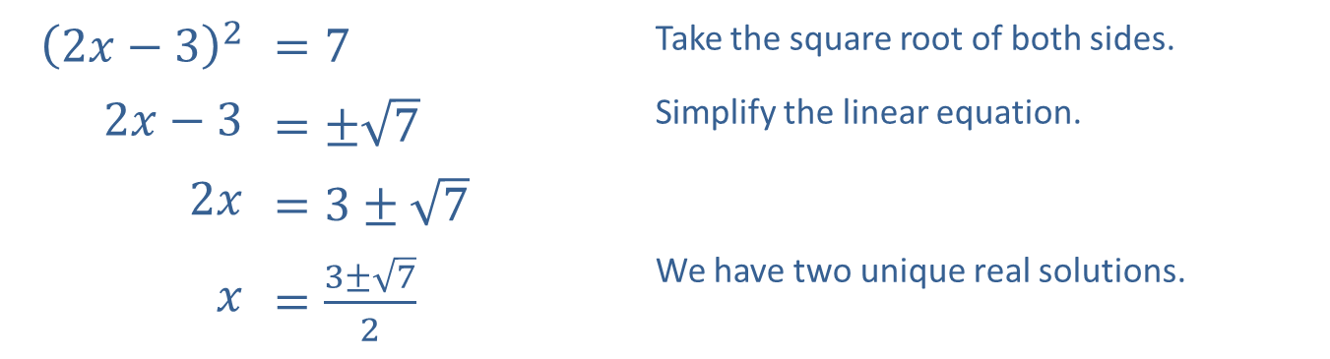
Example 6: Methods of Solving Quadratic Equations (cont.)
​The left-hand side is already a squared quantity, but the right-hand side is not zero, so we want to use the square root method.
​
​${\left(2x−3\right)}^{2}$ | ​$=7$ | Take the square root of both sides.
​$2x−3$ | ​$=±\sqrt{7}$ | Simplify the linear equation.
​$2x$ | ​$=3±\sqrt{7}$
$x$ | ​$=\frac{3±\sqrt{7}}{2}$ | We have two unique real solutions.

Slide 30
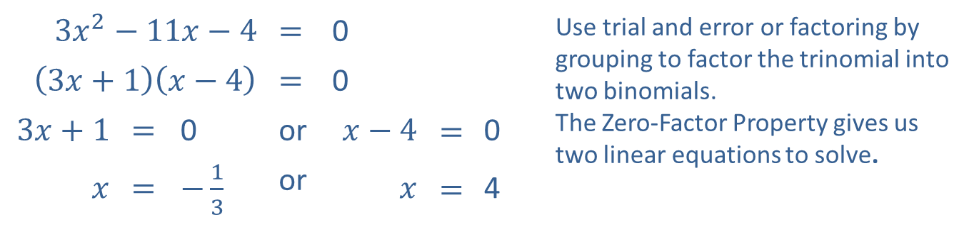
Example 6: Methods of Solving Quadratic Equations (cont.)
​While the quadratic formula certainly works, this quadratic equation is factorable.
​
​$3x^{2}−11x−4$ |  |  | ​​$=$ | ​0 |  |  | Use trial and error or factoring by grouping to factor the trinomial into two binomials. The Zero-Factor Property gives us two linear equations to solve.
​$\left(3x+1\right)\left(x−4\right)$ |  |  | ​​$=$ | ​0
​$3x+1$ | ​​$=$ | ​0 | or | ​$x−4$ | $$=$$ | ​0
$x$ | ​$=$ | ​$−\frac{1}{3}$ | or | $x$ | $$=$$ | ​4

Slide 31
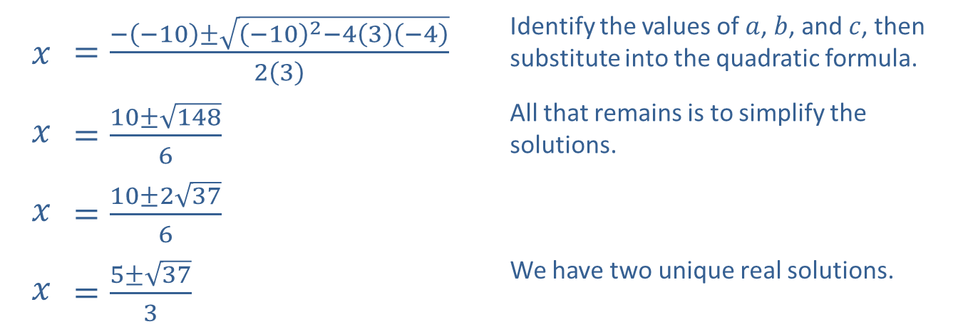

Example 6: Methods of Solving Quadratic Equations (cont.)
​Here, the equation is not factorable, so we use the quadratic formula.
​$3x^{2}−10x−4=0$
​$a=3,b=−10,c=−4$
​
$$x$$ | ​$=\frac{−\left(−10\right)±\sqrt{{\left(−10\right)}^{2}−4\left(3\right)\left(−4\right)}}{2\left(3\right)}$ | Identify the values of $a$, $b$, and $c$, then substitute into the quadratic formula.
$$x$$ | ​$=\frac{10±\sqrt{148}}{6}$ | All that remains is to simplify the solutions.
$$x$$ | ​$=\frac{10±2\sqrt{37}}{6}$
$$x$$ | ​$=\frac{5±\sqrt{37}}{3}$ | We have two unique real solutions.

Slide 32

Example 7: Gravity Problems
Robert stands on the topmost tier of seats in a baseball stadium, and throws a ball out onto the field with a vertical upward velocity of $60 ft/s$. The ball is 50 feet above the ground at the moment he releases the ball. When does the ball land?

Slide 33
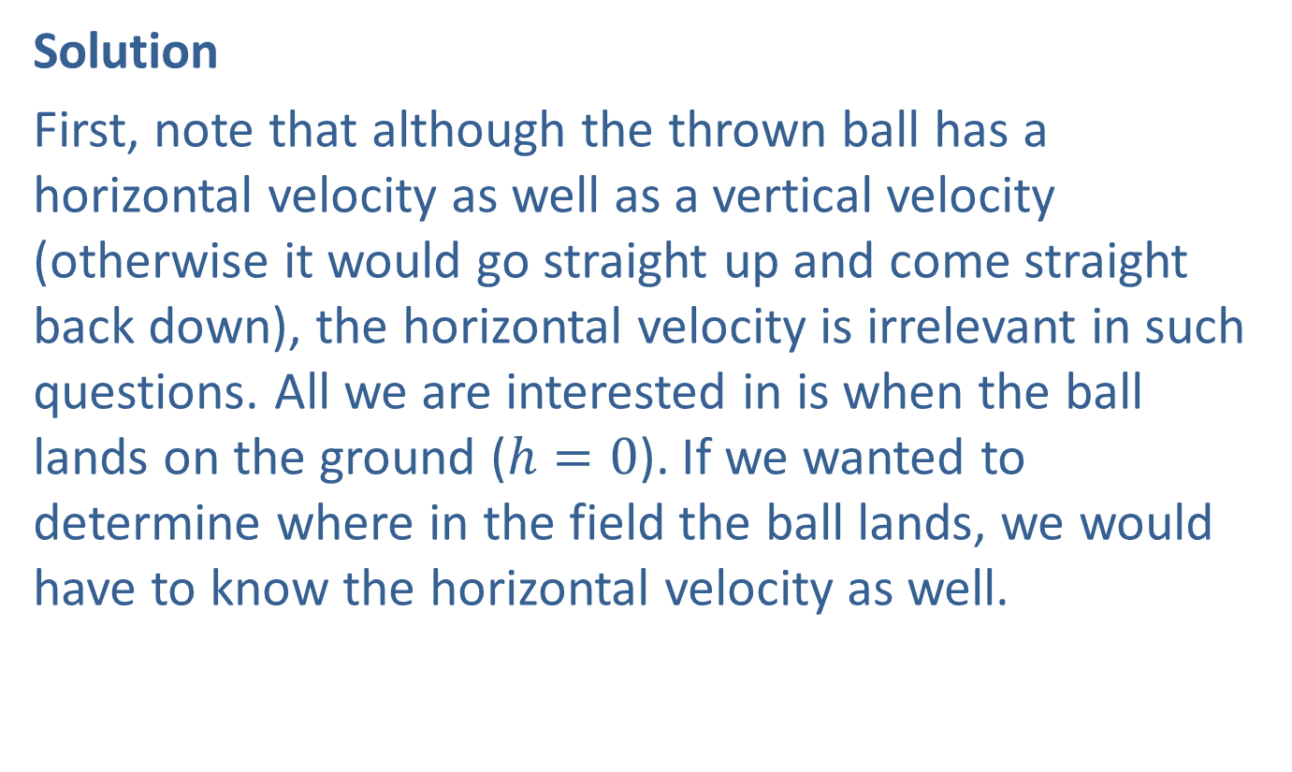
Example 7: Gravity Problems (cont.)
Solution
First, note that although the thrown ball has a horizontal velocity as well as a vertical velocity (otherwise it would go straight up and come straight back down), the horizontal velocity is irrelevant in such questions. All we are interested in is when the ball lands on the ground ($h=0$). If we wanted to determine where in the field the ball lands, we would have to know the horizontal velocity as well.

Slide 34
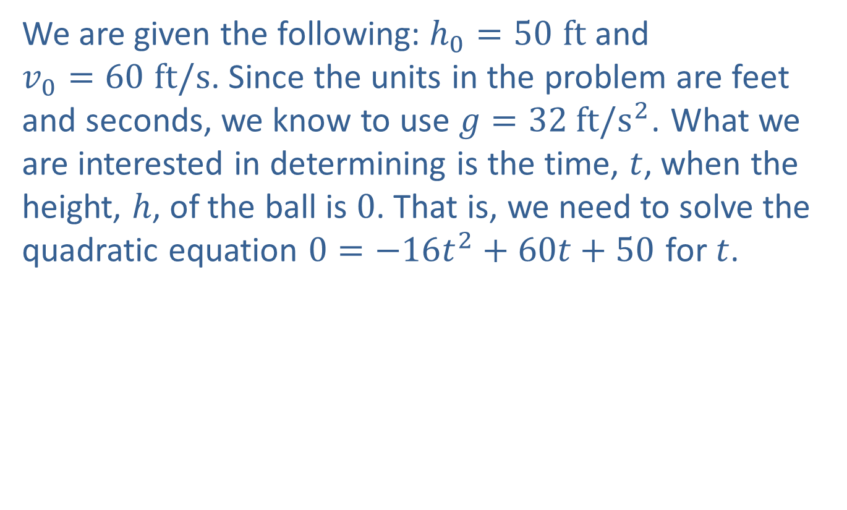
Example 7: Gravity Problems (cont.)
We are given the following: $h_{0}=50 ft$ and $v_{0}=60 ft/s$. Since the units in the problem are feet and seconds, we know to use $g=32 ft/s^{2}$. What we are interested in determining is the time, $t$, when the height, $h$, of the ball is 0. That is, we need to solve the quadratic equation $0=−16t^{2}+60t+50$ for $t$.

Slide 35
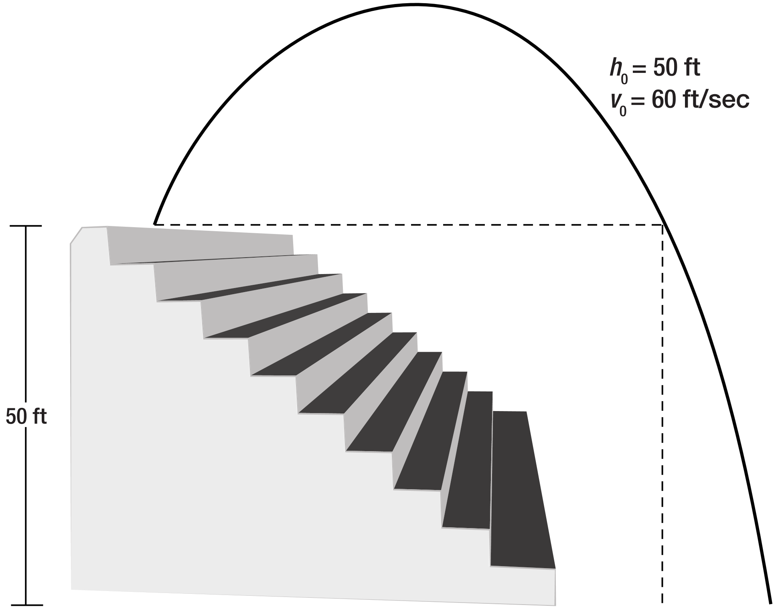
Example 7: Gravity Problems (cont.)
Figure 1

Slide 36

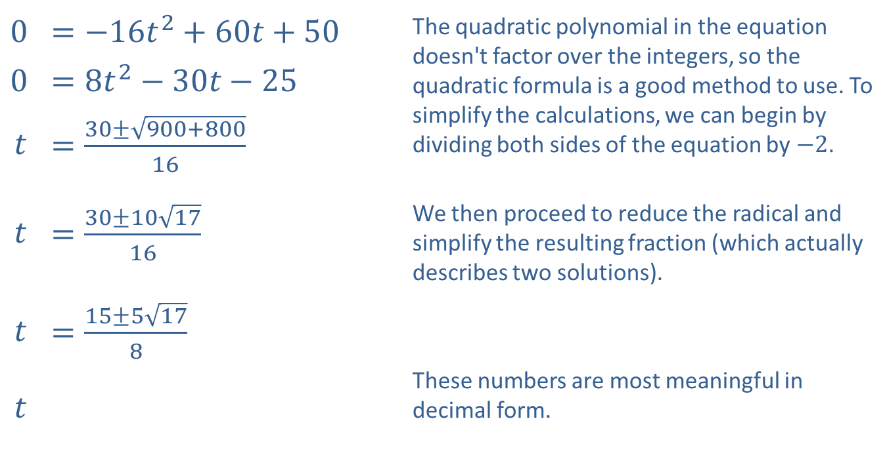
Example 7: Gravity Problems (cont.)
​0 | ​$=−16t^{2}+60t+50$ | The quadratic polynomial in the equation doesn't factor over the integers, so the quadratic formula is a good method to use. To simplify the calculations, we can begin by dividing both sides of the equation by $−2$.
​0 | ​$=8t^{2}−30t−25$
$$t$$ | ​$=\frac{30±\sqrt{900+800}}{16}$
$$t$$ | ​$=\frac{30±10\sqrt{17}}{16}$ | We then proceed to reduce the radical and simplify the resulting fraction (which actually describes two solutions).
$$t$$ | ​$=\frac{15±5\sqrt{17}}{8}$
 |  | These numbers are most meaningful in decimal form.
$$t$$
$$≈−0.70,4.45$$

Slide 37
Example 7: Gravity Problems (cont.)
The negative solution is immaterial in this problem, as this represents a time before the ball is thrown, so it is discarded. The ball lands 4.45 seconds after being thrown.

Slide 38
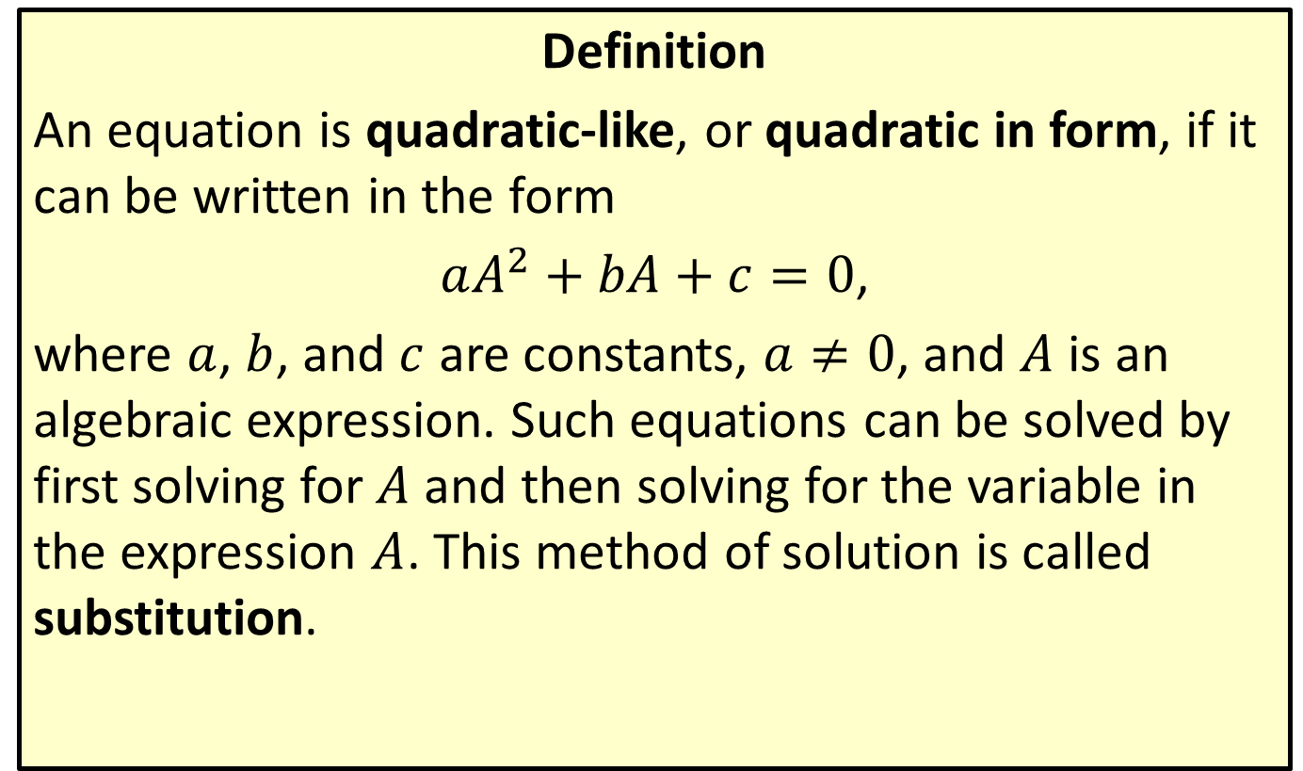
Quadratic-Like Equations
Definition
An equation is quadratic-like, or quadratic in form, if it can be written in the form
$aA^{2}+bA+c=0$,
where $a$, $b$, and $c$ are constants, $a≠0$, and $A$ is an algebraic expression. Such equations can be solved by first solving for $A$ and then solving for the variable in the expression $A$. This method of solution is called substitution.

Slide 39

Example 8: Quadratic-Like Equations
Solve the quadratic-like equations.
​${\left(x^{2}+2x\right)}^{2}−7\left(x^{2}+2x\right)−8=0$
​$y^{\frac{2}{3}}+4y^{\frac{1}{3}}−5=0$

Slide 40
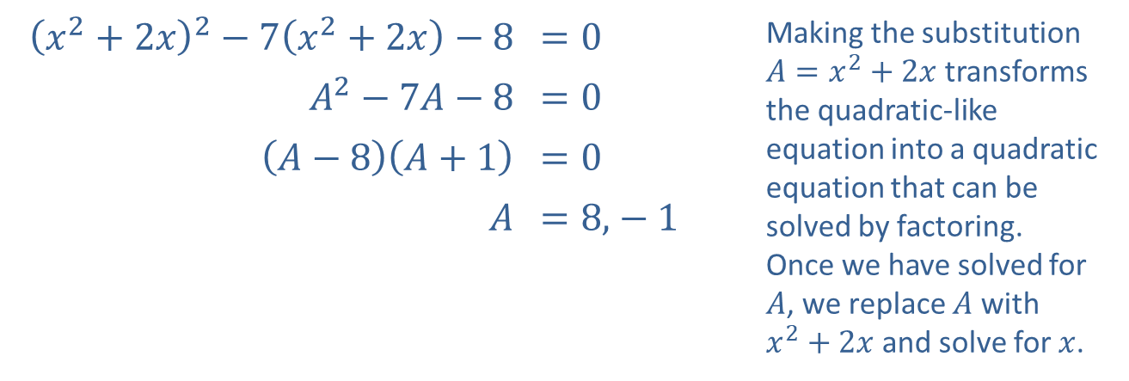
Example 8: Quadratic-Like Equations (cont.)
Solution
​
​${\left(x^{2}+2x\right)}^{2}−7\left(x^{2}+2x\right)−8$ | ​$=0$ | Making the substitution $A=x^{2}+2x$ transforms the quadratic-like equation into a quadratic equation that can be solved by factoring. Once we have solved for $A$, we replace $A$ with $x^{2}+2x$ and solve for $x$.
​$A^{2}−7A−8$ | ​$=0$
​$\left(A−8\right)\left(A+1\right)$ | ​$=0$
$A$ | ​$=8\text{,}−1$

Slide 41
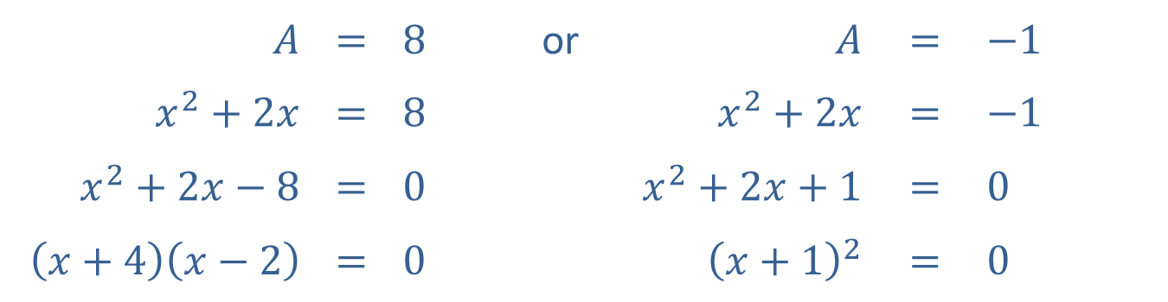

Example 8: Quadratic-Like Equations (cont.)
$x=−4$ or $x=2$ or $x=−1$
​Note that $−1$ is a double root, while $−4$ and 2 are single roots.
While the substitution method does not necessarily introduce extraneous solutions, you should still check that each solution solves the original quadratic-like equation.
$A$ | $$=$$ | $8$ | or | $A$ | $$=$$ | $−1$
$x^{2}+2x$ | $$=$$ | $8$ |  | $x^{2}+2x$ | $$=$$ | $−1$
$x^{2}+2x−8$ | $$=$$ | $0$ |  | $x^{2}+2x+1$ | $$=$$ | $0$
$\left(x+4\right)\left(x−2\right)$ | $$=$$ | $0$ |  | ${\left(x+1\right)}^{2}$ | $$=$$ | $0$

Slide 42
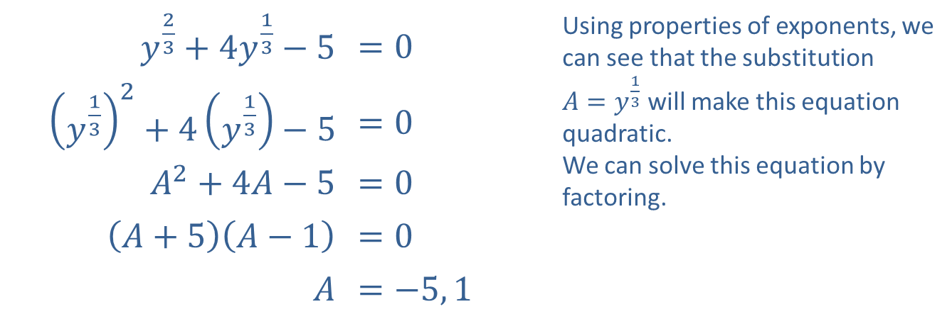
Example 8: Quadratic-Like Equations (cont.)
​$y^{\frac{2}{3}}+4y^{\frac{1}{3}}−5$ | ​$=0$ | Using properties of exponents, we can see that the substitution $A=y^{\frac{1}{3}}$ will make this equation quadratic. We can solve this equation by factoring.
​${\left(y^{\frac{1}{3}}\right)}^{2}+4\left(y^{\frac{1}{3}}\right)−5$ | ​$=0$
​$A^{2}+4A−5$ | ​$=0$
​$\left(A+5\right)\left(A−1\right)$ | ​$=0$
$A$ | ​$=−5, 1$
​

Slide 43
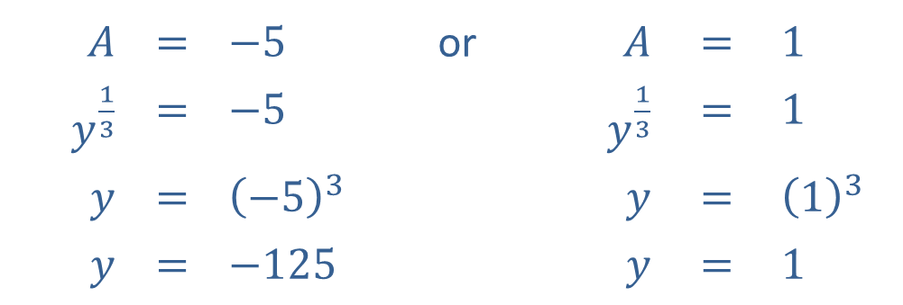

Example 8: Quadratic-Like Equations (cont.)
Now that we have solved for $A$, we reverse the substitution and solve for $y$ in each case.​
​Once again, you should confirm that both values do indeed solve the original equation $y^{\frac{2}{3}}+4y^{\frac{1}{3}}−5=0$.
$$A$$ | $$=$$ | $$−5$$ | or | $A$ | $$=$$ | $$1$$
$y^{\frac{1}{3}}$ | $$=$$ | $$−5$$ |  | $y^{\frac{1}{3}}$ | $$=$$ | $$1$$
$y$ | $$=$$ | $${\left(−5\right)}^{3}$$ |  | $y$ | $$=$$ | $${\left(1\right)}^{3}$$
$y$ | $$=$$ | $$−125$$ |  | $y$ | $$=$$ | $$1$$

Slide 44

Example 9: Solving Equations by Factoring
Solve the equations by factoring.
​$x^{4}=9$
​$y^{3}+y^{2}−4y−4=0$
​$8t^{3}−27=0$
​$3x^{4}+18x^{3}−21x^{2}=0$

Slide 45
Note:
While checking solutions is always a good practice, solving by factoring does not produce any extraneous solutions.

Slide 46
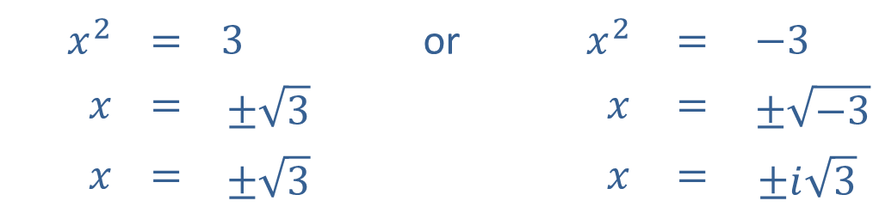
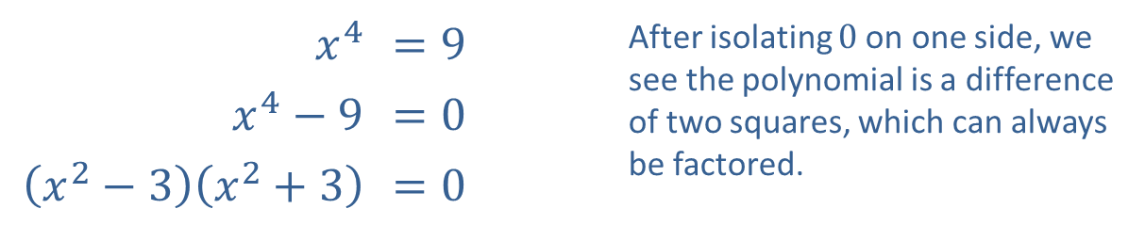
Example 9: Solving Equations by Factoring (cont.)
Solution
​
​$x^{4}$ | ​$=9$ | After isolating 0 on one side, we see the polynomial is a difference of two squares, which can always be factored.
​$x^{4}−9$ | ​$=0$
​$\left(x^{2}−3\right)\left(x^{2}+3\right)$ | ​$=0$
The Zero-Product Property gives us two equations, both of which can be solved by taking square roots.
$$x^{2}$$ | $$=$$ | $$3$$ | or | $x^{2}$ | $$=$$ | $$−3$$
$x$ | $$=$$ | $$±\sqrt{3}$$ |  | $x$ | $$=$$ | $$±\sqrt{−3}$$
$x$ | $$=$$ | $$±\sqrt{3}$$ |  | $x$ | $$=$$ | $$±i\sqrt{3}$$

Slide 47


Example 9: Solving Equations by Factoring (cont.)
​
​$y^{3}+y^{2}−4y−4$ | ​$=0$ | We factor the initial equation by grouping.
​$y^{2}\left(y+1\right)−4\left(y+1\right)$ | ​$=0$
​$\left(y+1\right)\left(y^{2}−4\right)$ | ​$=0$ | We can factor $y^{2}−4$ further, since it is a difference of squares.
​$\left(y+1\right)\left(y−2\right)\left(y+2\right)$ | ​$=0$
​There are three solutions by the Zero-Factor Property.
​$y=−1$ or $y=2$ or $y=−2$
​

Slide 48

Example 9: Solving Equations by Factoring (cont.)
​
​$8t^{3}−27$ | ​$=0$ | The polynomial in this case is a difference of two cubes, which can always be factored.
​${\left(2t\right)}^{3}−3^{3}$ | ​$=0$
​$\left(2t−3\right)\left(4t^{2}+6t+9\right)$ | ​$=0$

Slide 49

Example 9: Solving Equations by Factoring (cont.)
The Zero-Factor Property gives us two equations to solve. One of the equations is quadratic, and we can use the quadratic formula to solve it.
$$2t−3$$ | $$=$$ | $$0$$ | or | $$4t^{2}+6t+9$$ | $$=$$ | $0$
$2t$ | $$=$$ | $$3$$ |  | $t$ | $$=$$ | $\frac{−\left(6\right)±\sqrt{6^{2}−4\left(4\right)\left(9\right)}}{2\left(4\right)}$
$t$ | $$=$$ | $$\frac{3}{2}$$ |  | $t$ | $$=$$ | $\frac{−6±\sqrt{36−144}}{8}$
 |  |  |  | $t$ | $$=$$ | $\frac{−6±\sqrt{−108}}{8}$
 |  |  |  | $t$ | $$=$$ | $\frac{−6±6i\sqrt{3}}{8}$
 |  |  |  | $t$ | $$=$$ | $\frac{−3±3i\sqrt{3}}{4}$

Slide 50


Example 9: Solving Equations by Factoring (cont.)
​
​$3x^{4}+18x^{3}−21x^{2}=0$
​$3x^{2}\left(x^{2}+6x−7\right)=0$ | Factoring out the GCF of $3x^{2}$ yields a quadratic polynomial that we can factor.
​$3x^{2}\left(x−1\right)\left(x+7\right)=0$
​$x^{2}\left(x−1\right)\left(x+7\right)=0$
​The Zero-Factor Property yields three solutions to the original equation.
​$x=0,1,$ or $−7$

Slide 51

Example 10: Solving Equations by Factoring
Solve the equations by factoring.
​$x^{\frac{7}{3}}+x^{\frac{4}{3}}−2x^{\frac{1}{3}}=0$
​${\left(x−1\right)}^{\frac{1}{2}}−{\left(x−1\right)}^{−\frac{1}{2}}=0$

Slide 52


Example 10: Solving Equations by Factoring (cont.)
Solution
​
​$x^{\frac{7}{3}}+x^{\frac{4}{3}}−2x^{\frac{1}{3}}$ | ​$=0$ | Recall that in cases like this, we factor out $x$ raised to the lowest exponent. In this case, the remaining factor is a factorable trinomial.
​$x^{\frac{1}{3}}\left(x^{2}+x−2\right)$ | ​$=0$
​$x^{\frac{1}{3}}\left(x+2\right)\left(x−1\right)$ | ​$=0$
​The Zero-Factor Property leads to three simple equations.
$x^{\frac{1}{3}}$ | $$=$$ | $0$ | or | $x+2$ | $$=$$ | $0$ | or | $x−1$ | $$=$$ | $0$
$x$ | $$=$$ | $0$ |  | $x$ | $$=$$ | $−2$ |  | $x$ | $$=$$ | $1$

Slide 53

Example 10: Solving Equations by Factoring (cont.)
​${\left(x−1\right)}^{\frac{1}{2}}−{\left(x−1\right)}^{−\frac{1}{2}}$ | ​$=0$ | Again, we factor out the common algebraic expression raised to the lowest exponent.
​${\left(x−1\right)}^{−\frac{1}{2}}\left(\left(x−1\right)−1\right)$ | ​$=0$
​${\left(x−1\right)}^{−\frac{1}{2}}\left(x−2\right)$ | ​$=0$
​

Slide 54



Example 10: Solving Equations by Factoring (cont.)
​This equation leads to two equations, only one of which has a solution. (Note that there is no value for $x$ which would solve the first of the two equations.)
​
​The original equation has only one solution.
​$x=2$
​
​${\left(x−1\right)}^{−\frac{1}{2}}$ | ​$=0$
​$\frac{1}{{\left(x−1\right)}^{\frac{1}{2}}}$ | ​$=0$
​$x−2$ | ​$=0$
​$x$ | ​$=2$
or

Slide 55

Example 11: Solving Equations by Factoring
Solve the equation $x^{−2}−7x^{−1}+12=0$ by factoring.

Slide 56

Example 11: Solving Equations by Factoring (cont.)
Solution
While the given equation is not quadratic, it certainly bears a strong resemblance to one that is. In fact, if we make the substitution $y=x^{−1}$, we obtain the quadratic equation
$y^{2}−7y+12=0$,
which we can solve by factoring the trinomial as $\left(y−3\right)\left(y−4\right)$. This gives us $y=3$ or $y=4$. Translating this back to the variable $x$, we have $x^{−1}=3$ or $x^{−1}=4$, so $x=\frac{1}{3}$ or $x=\frac{1}{4}$.

