Slide 1
Section 1.9
Rational and Radical Equations in One Variable

Slide 2
Rational Equations
A rational equation is an equation that contains at least one rational expression, while any nonrational expressions are polynomials.

Slide 3

Example 1: Solving Rational Equations
Solve the following rational equations.
​ $\frac{x^{3}+3x^{2}}{x^{2}−2x−15}=\frac{4x+5}{x−5}$
​ $\frac{3x^{2}}{5x−1}−1=0$

Slide 4
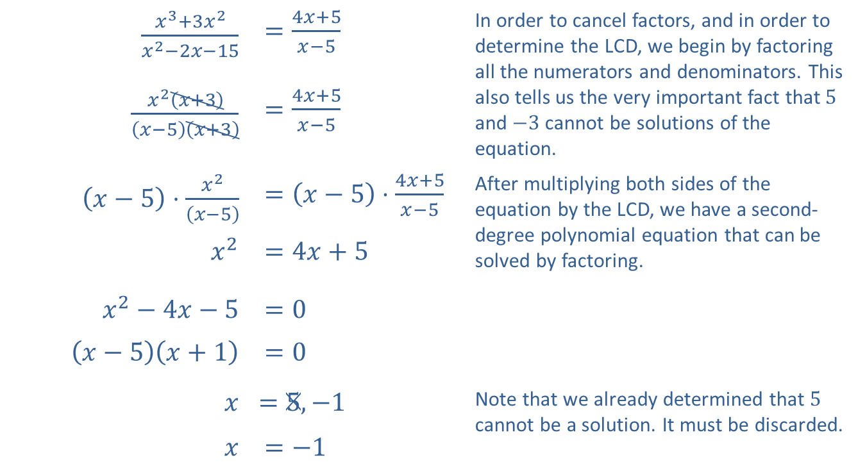
Example 1: Solving Rational Equations (cont.)
Solution
​
$\frac{x^{3}+3x^{2}}{x^{2}−2x−15}$ | $=\frac{4x+5}{x−5}$ | In order to cancel factors, and in order to determine the LCD, we begin by factoring all the numerators and denominators. This also tells us the very important fact that 5 and $−3$ cannot be solutions of the equation.
$\frac{x^{2}\left(x+3\right)}{\left(x−5\right)\left(x+3\right)}$ | $=\frac{4x+5}{x−5}$
$\left(x−5\right)⋅\frac{x^{2}}{\left(x−5\right)}$ | $=\left(x−5\right)⋅\frac{4x+5}{x−5}$ | After multiplying both sides of the equation by the LCD, we have a second-degree polynomial equation that can be solved by factoring.
$x^{2}$ | $=4x+5$
$x^{2}−4x−5$ | $=0$
$\left(x−5\right)\left(x+1\right)$ | $=0$
$$x$$ | ​$=5,−1$ | Note that we already determined that 5 cannot be a solution. It must be discarded.
$$x$$ | $=−1$

Slide 5
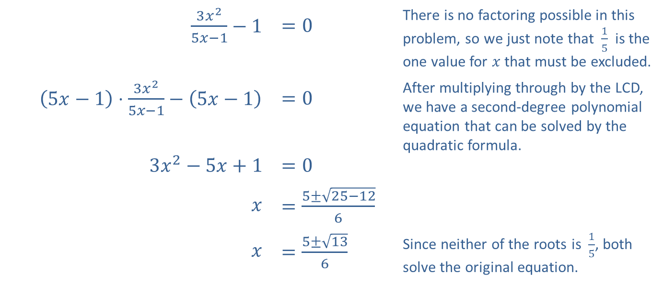
Example 1: Solving Rational Equations (cont.)
$\frac{3x^{2}}{5x−1}−1$ | $=0$ | There is no factoring possible in this problem, so we just note that $\frac{1}{5}$ is the one value for $x$ that must be excluded.
$\left(5x−1\right)⋅\frac{3x^{2}}{5x−1}−\left(5x−1\right)$ | $=0$ | After multiplying through by the LCD, we have a second-degree polynomial equation that can be solved by the quadratic formula.
$3x^{2}−5x+1$ | $=0$
$$x$$ | $=\frac{5±\sqrt{25−12}}{6}$
$$x$$ | $=\frac{5±\sqrt{13}}{6}$ | Since neither of the roots is $\frac{1}{5}$, both solve the original equation.
​

Slide 6

Example 2: Solving an Absolute Value Rational Equation
Solve the equation $\left|x−5\right|=\frac{7}{x+1}$.

Slide 7
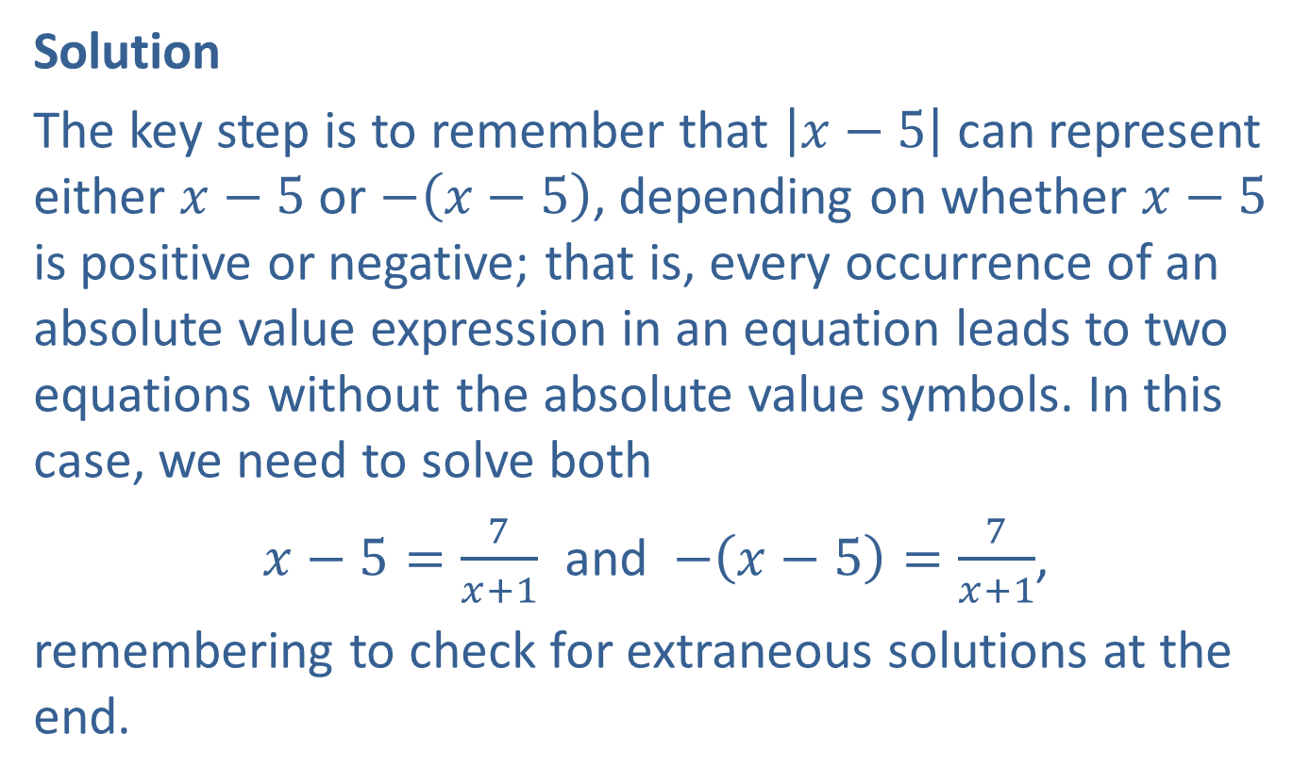
Example 2: Solving an Absolute Value Rational Equation (cont.)
Solution
The key step is to remember that $\left|x−5\right|$ can represent either $x−5$ or $−\left(x−5\right)$, depending on whether $x−5$ is positive or negative; that is, every occurrence of an absolute value expression in an equation leads to two equations without the absolute value symbols. In this case, we need to solve both
$x−5=\frac{7}{x+1}$ and $−\left(x−5\right)=\frac{7}{x+1}$,
remembering to check for extraneous solutions at the end.

Slide 8
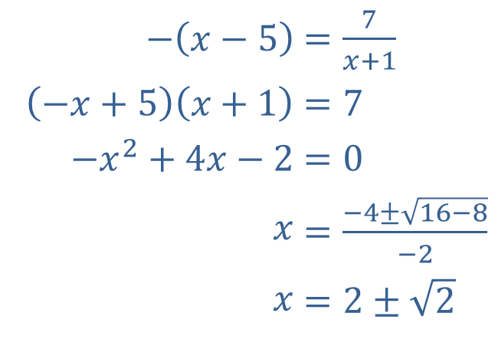
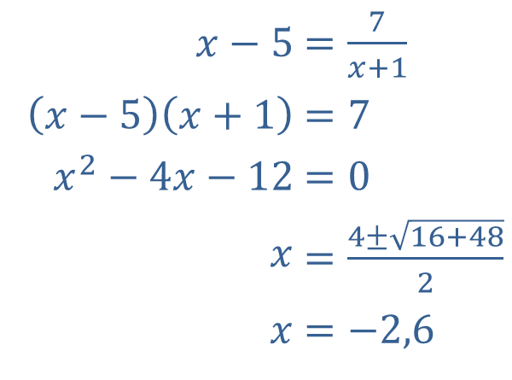
Example 2: Solving an Absolute Value Rational Equation (cont.)
We will carry out the solutions of the two equations in parallel, as the steps are the same.
​
​$x−5$ | ​$=\frac{7}{x+1}$
​$\left(x−5\right)\left(x+1\right)$ | ​$=7$
​$x^{2}−4x−12$ | ​$=0$
​$x$ | ​$=\frac{4±\sqrt{16+48}}{2}$
​$x$ | ​$=−2,6$
​$−\left(x−5\right)$ | ​$=\frac{7}{x+1}$
​$\left(−x+5\right)\left(x+1\right)$ | ​$=7$
​$−x^{2}+4x−2$ | ​$=0$
​$x$ | ​$=\frac{−4±\sqrt{16−8}}{−2}$
​$x$ | ​$=2±\sqrt{2}$

Slide 9
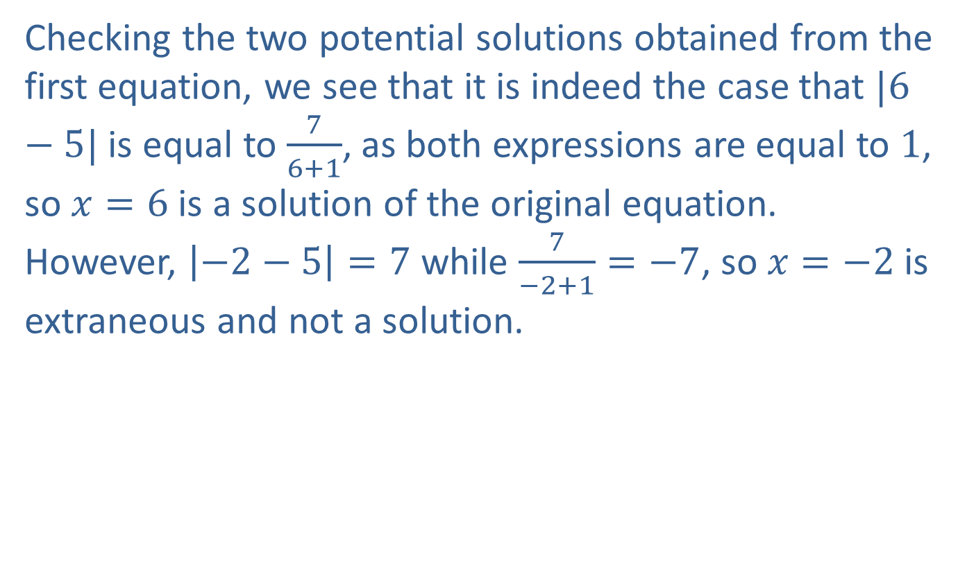
Example 2: Solving an Absolute Value Rational Equation (cont.)
Checking the two potential solutions obtained from the first equation, we see that it is indeed the case that $|6−5|$ is equal to $\frac{7}{6+1}$, as both expressions are equal to 1, so $x=6$ is a solution of the original equation. However, $\left|−2−5\right|=7$ while $\frac{7}{−2+1}=−7$, so $x=−2$ is extraneous and not a solution.

Slide 10
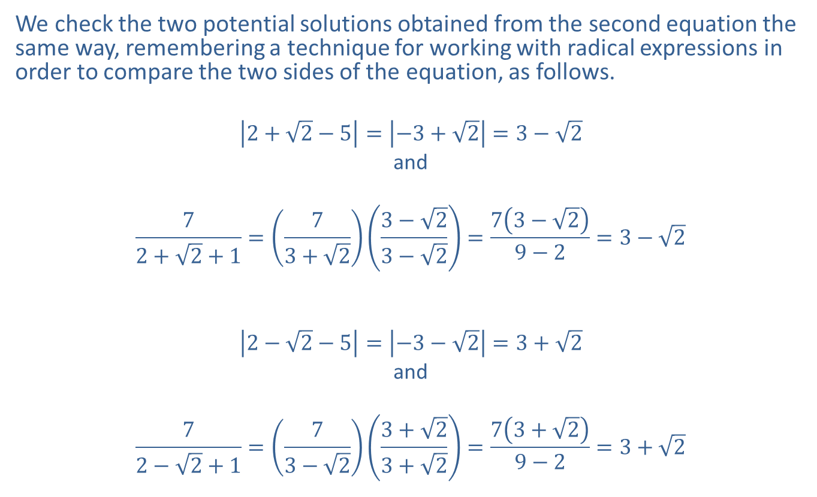
Example 2: Solving an Absolute Value Rational Equation (cont.)
We check the two potential solutions obtained from the second equation the same way, remembering a technique for working with radical expressions in order to compare the two sides of the equation, as follows.
$$\left|2+\sqrt{2}−5\right|=\left|−3+\sqrt{2}\right|=3−\sqrt{2}$$
and
$$\frac{7}{2+\sqrt{2}+1}=\left(\frac{7}{3+\sqrt{2}}\right)\left(\frac{3−\sqrt{2}}{3−\sqrt{2}}\right)=\frac{7\left(3−\sqrt{2}\right)}{9−2}=3−\sqrt{2}$$
$$\left|2−\sqrt{2}−5\right|=\left|−3−\sqrt{2}\right|=3+\sqrt{2}$$
and
$$\frac{7}{2−\sqrt{2}+1}=\left(\frac{7}{3−\sqrt{2}}\right)\left(\frac{3+\sqrt{2}}{3+\sqrt{2}}\right)=\frac{7\left(3+\sqrt{2}\right)}{9−2}=3+\sqrt{2}$$

Slide 11
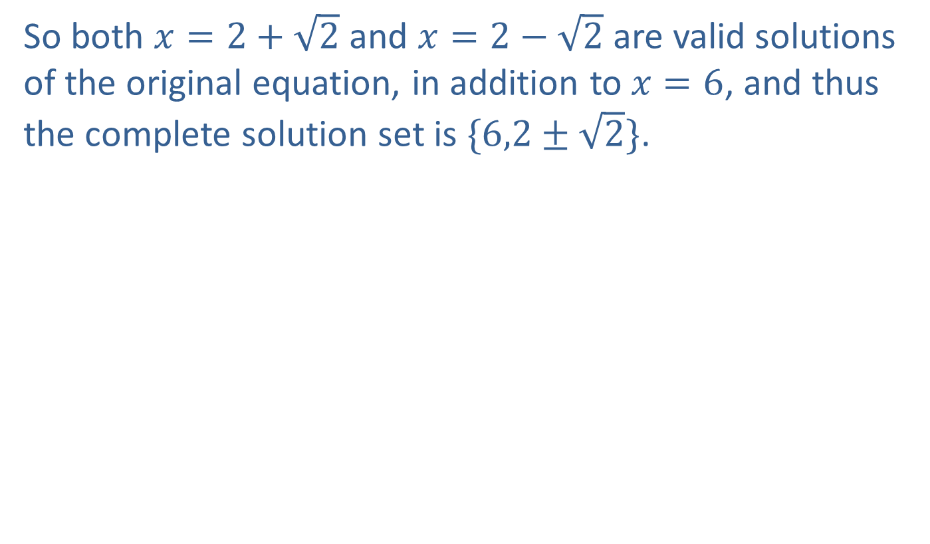
Example 2: Solving an Absolute Value Rational Equation (cont.)
So both $x=2+\sqrt{2}$ and $x=2−\sqrt{2}$ are valid solutions of the original equation, in addition to $x=6$, and thus the complete solution set is $\{6,2±\sqrt{2}\}$.

Slide 12
Example 3: Filling a Pool
One hose can fill a swimming pool in 12 hours. The owner buys a second hose that can fill the pool at twice the rate of the first one. If both hoses are used together, how long does it take to fill the pool?

Slide 13
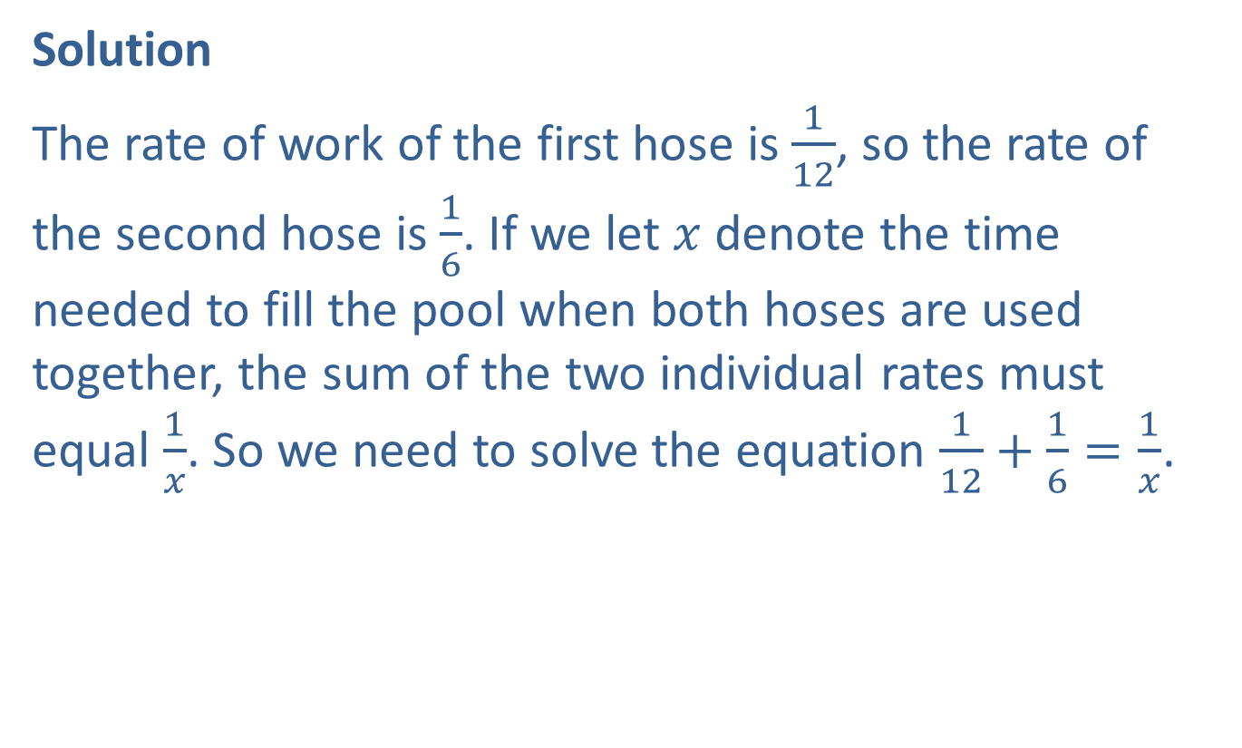
Example 3: Filling a Pool (cont.)
Solution
The rate of work of the first hose is $\frac{1}{12}$, so the rate of the second hose is $\frac{1}{6}$. If we let $x$ denote the time needed to fill the pool when both hoses are used together, the sum of the two individual rates must equal $\frac{1}{x}$. So we need to solve the equation $\frac{1}{12}+\frac{1}{6}=\frac{1}{x}$.

Slide 14
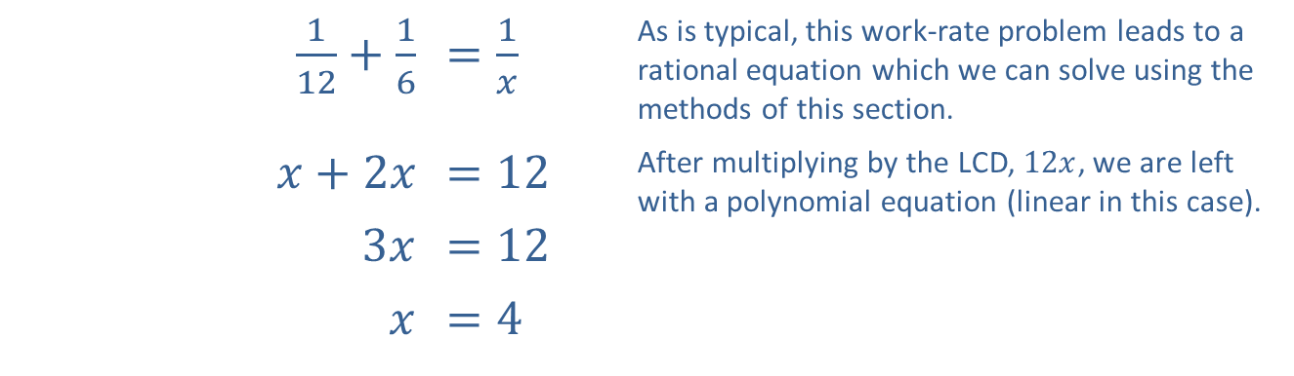
Example 3: Filling a Pool (cont.)
Thus, using both hoses, it will take 4 hours to fill the pool.
​$\frac{1}{12}+\frac{1}{6}$ | ​$=\frac{1}{x}$ | As is typical, this work-rate problem leads to a rational equation which we can solve using the methods of this section.
​$x+2x$ | ​$=12$ | After multiplying by the LCD, $12x$, we are left with a polynomial equation (linear in this case).
​$3x$ | ​$=12$
$$x$$ | ​$=4$

Slide 15
Example 4: Filling a Pool Poorly
The pool owner in Example 3 is a bit clumsy, and one day proceeds to fill his empty pool with the two hoses but accidentally turns on the pump that drains the pool also. Fortunately, the pump rate is slower than the combined rate of the two hoses, and the pool fills anyway, but it takes 10 hours to do so. How long does it take the pump to empty the pool?

Slide 16
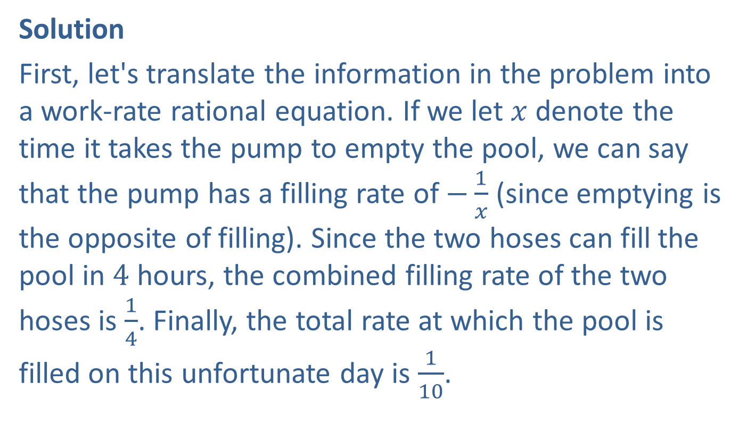
Example 4: Filling a Pool Poorly (cont.)
Solution
First, let's translate the information in the problem into a work-rate rational equation. If we let $x$ denote the time it takes the pump to empty the pool, we can say that the pump has a filling rate of $−\frac{1}{x}$ (since emptying is the opposite of filling). Since the two hoses can fill the pool in 4 hours, the combined filling rate of the two hoses is $\frac{1}{4}$. Finally, the total rate at which the pool is filled on this unfortunate day is $\frac{1}{10}$.

Slide 17
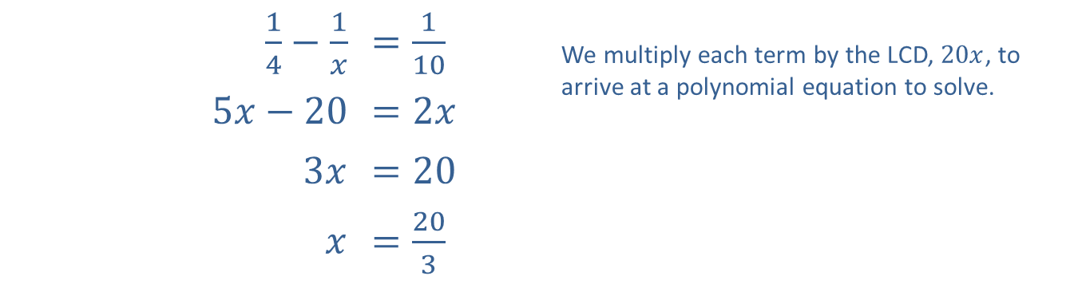

Example 4: Filling a Pool Poorly (cont.)
Again, the sum of the individual rates is equal to the combined rate, so the following rational equation reflects this situation.
Thus, working alone, the pump can empty the pool in $\frac{20}{3}$ hours, or 6 hours and 40 minutes.
​$\frac{1}{4}−\frac{1}{x}$ | ​$=\frac{1}{10}$ | We multiply each term by the LCD, $20x$, to arrive at a polynomial equation to solve.
​$5x−20$ | ​$=2x$
​$3x$ | ​$=20$
$$x$$ | ​$=\frac{20}{3}$

Slide 18
Radical Equations
A radical equation is an equation that has at least one radical expression containing a variable, while any nonradical expressions are polynomial terms.

Slide 19
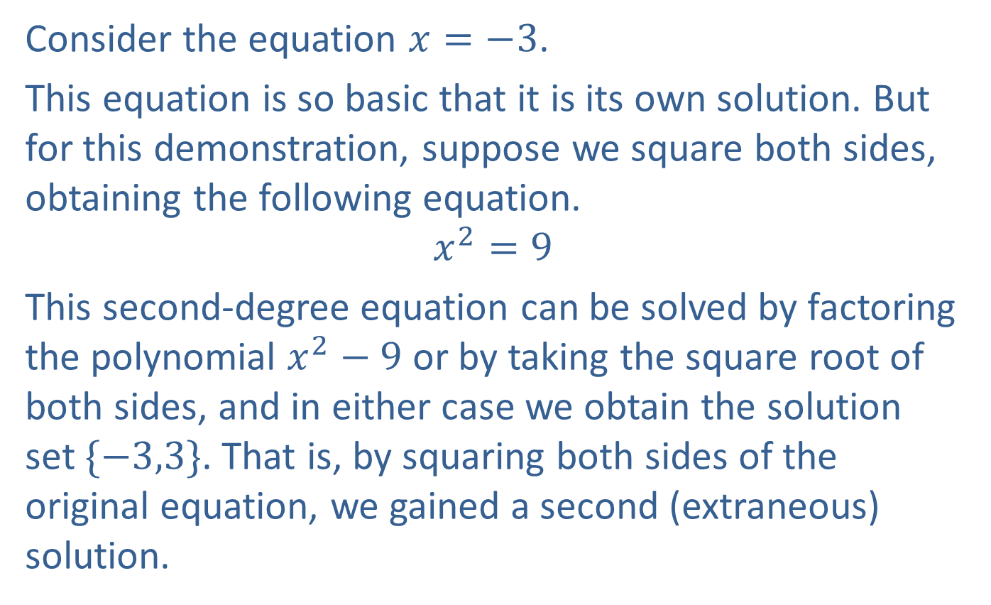
Example 5: Causing Extraneous Solutions
Consider the equation $x=−3$.
This equation is so basic that it is its own solution. But for this demonstration, suppose we square both sides, obtaining the following equation.
$$x^{2}=9$$
This second-degree equation can be solved by factoring the polynomial $x^{2}−9$ or by taking the square root of both sides, and in either case we obtain the solution set $\{−3,3\}$. That is, by squaring both sides of the original equation, we gained a second (extraneous) solution.

Slide 20
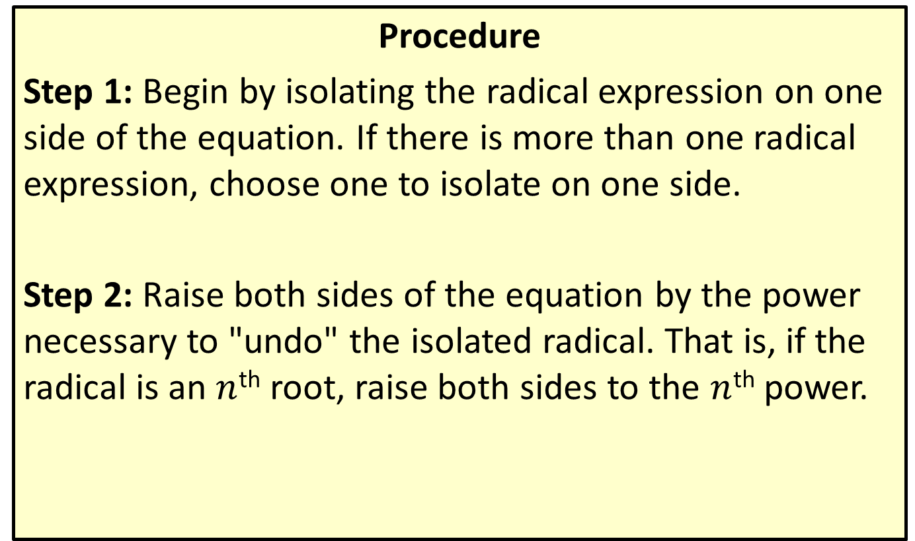
Solving Radical Equations
Procedure
Step 1: Begin by isolating the radical expression on one side of the equation. If there is more than one radical expression, choose one to isolate on one side.
Step 2: Raise both sides of the equation by the power necessary to "undo" the isolated radical. That is, if the radical is an $n$^{th} root, raise both sides to the $n$^{th} power.

Slide 21
Solving Radical Equations (cont.)
Step 3: If any radical expressions remain, simplify the equation if possible and then repeat steps 1 and 2 until the result is a polynomial equation. When a polynomial equation has been obtained, solve the equation using polynomial methods.
Step 4: Check your solutions in the original equation! Any extraneous solutions must be discarded.

Slide 22

Example 6: Radical Equations
Solve the radical equations.
​$\sqrt{1−x}−1=x$
​$\sqrt{x+1}+\sqrt{x+2}=1$
​$\sqrt[4]{x^{2}+8x+7}−2=0$

Slide 23
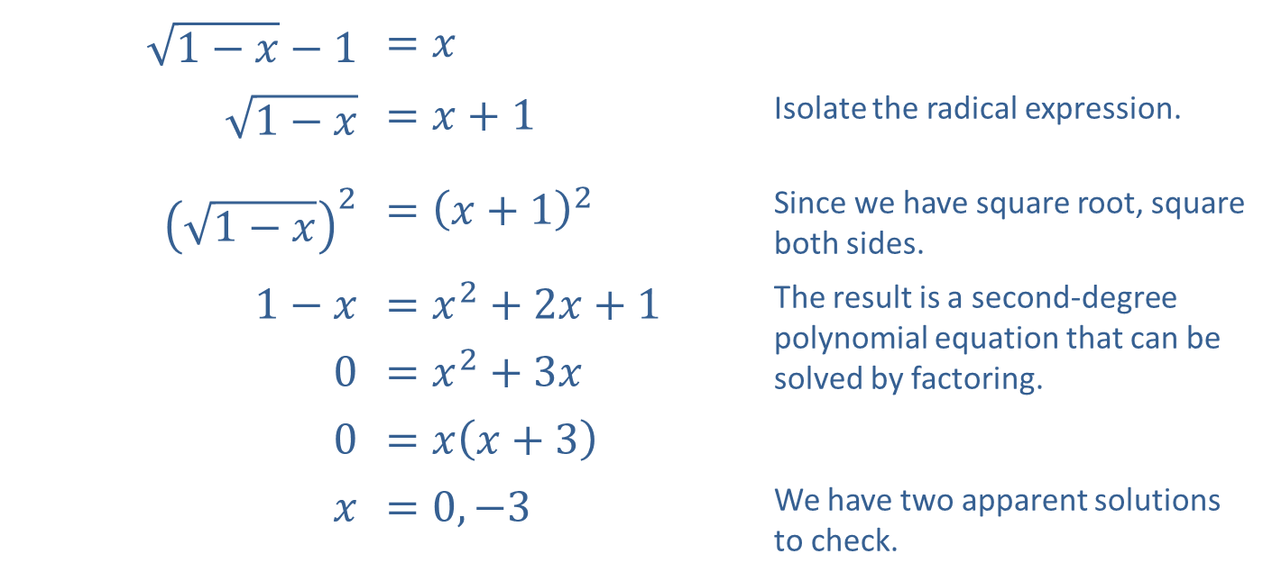
Example 6: Radical Equations (cont.)
Solution
​
​$\sqrt{1−x}−1$ | ​$=x$
​$\sqrt{1−x}$ | ​$=x+1$ | Isolate the radical expression.
​${\left(\sqrt{1−x}\right)}^{2}$ | ​$={\left(x+1\right)}^{2}$ | Since we have square root, square both sides.
​$1−x$ | ​$=x^{2}+2x+1$ | The result is a second-degree polynomial equation that can be solved by factoring.
​0 | ​$=x^{2}+3x$
​0 | ​$=x\left(x+3\right)$
$$x$$ | ​$=0,−3$ | We have two apparent solutions to check.

Slide 24

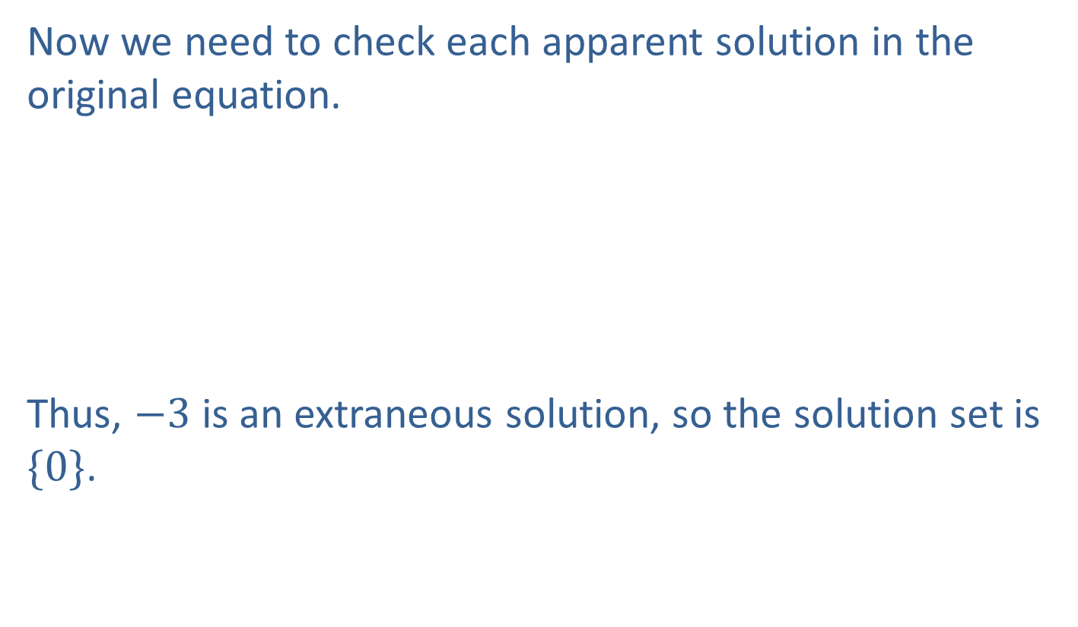
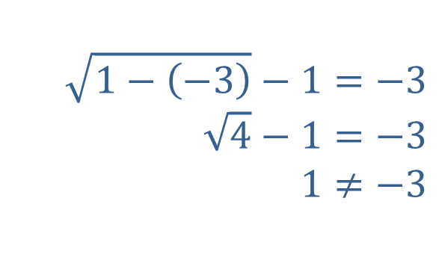
Example 6: Radical Equations (cont.)
​Now we need to check each apparent solution in the original equation.
​Thus, $−3$ is an extraneous solution, so the solution set is $\{0\}$.
​
$$\sqrt{1−0}−1=0 \\ \sqrt{1}−1=0 \\ 0=0$$
​
$$\sqrt{1−\left(−3\right)}−1=−3 \\ \sqrt{4}−1=−3 \\ 1≠−3$$
​

Slide 25
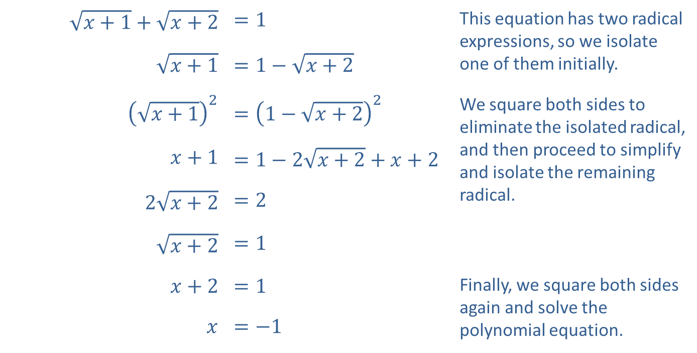
Example 6: Radical Equations (cont.)
​
​$\sqrt{x+1}+\sqrt{x+2}$ | ​$=1$ | This equation has two radical expressions, so we isolate one of them initially.
​$\sqrt{x+1}$ | ​$=1−\sqrt{x+2}$
​${\left(\sqrt{x+1}\right)}^{2}$ | ​$={\left(1−\sqrt{x+2}\right)}^{2}$ | We square both sides to eliminate the isolated radical, and then proceed to simplify and isolate the remaining radical.
​$x+1$ | ​$=1−2\sqrt{x+2}+x+2$
​$2\sqrt{x+2}$ | ​$=2$
​$\sqrt{x+2}$ | ​$=1$
​$x+2$ | ​$=1$ | Finally, we square both sides again and solve the polynomial equation.
$$x$$ | ​$=−1$

Slide 26


Example 6: Radical Equations (cont.)
​We check the apparent solution in the original equation.
Thus, the solution set is $\{−1\}$.
​
$$\sqrt{\left(−1\right)+1}+\sqrt{\left(−1\right)+2}=1 \\ \sqrt{0}+\sqrt{1}=1 \\ 1=1$$
​

Slide 27
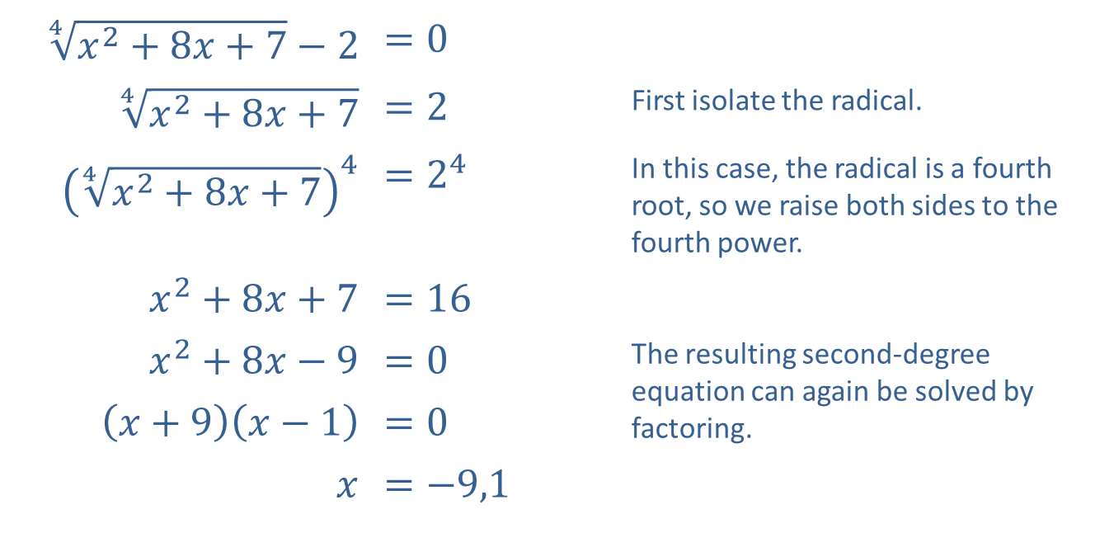
Example 6: Radical Equations (cont.)
​
​$\sqrt[4]{x^{2}+8x+7}−2$ | ​$=0$
​$\sqrt[4]{x^{2}+8x+7}$ | ​$=2$ | First isolate the radical.
​${\left(\sqrt[4]{x^{2}+8x+7}\right)}^{4}$ | ​$=2^{4}$ | In this case, the radical is a fourth root, so we raise both sides to the fourth power.
​$x^{2}+8x+7$ | ​$=16$
​$x^{2}+8x−9$ | ​$=0$ | The resulting second-degree equation can again be solved by factoring.
​$\left(x+9\right)\left(x−1\right)$ | ​$=0$
$$x$$ | ​$=−9,1$

Slide 28



Example 6: Radical Equations (cont.)
​Once again, we check the apparent solutions in the original equation.
​Both apparent solutions are actual solutions, so the solution set is $\{−9,1\}$.
​
$$\sqrt[4]{{\left(−9\right)}^{2}+8\left(−9\right)+7}−2=0 \\ \sqrt[4]{16}−2=0 \\ 2−2=0 \\ 0=0$$
​
$$\sqrt[4]{{\left(1\right)}^{2}+8\left(1\right)+7}−2=0 \\ \sqrt[4]{16}−2=0 \\ 2−2=0 \\ 0=0$$
​

Slide 29
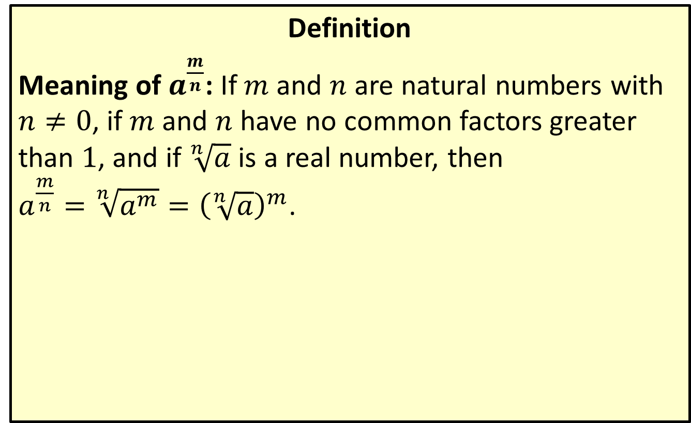
Positive Rational Number Exponents
Definition
Meaning of $a^{\frac{m}{n}}$: If $m$ and $n$ are natural numbers with $n≠0$, if $m$ and $n$ have no common factors greater than 1, and if $\sqrt[n]{a}$ is a real number, then
$a^{\frac{m}{n}}=\sqrt[n]{a^{m}}={\left(\sqrt[n]{a}\right)}^{m}$.

Slide 30

Example 7: Rational Exponents
Solve the following equations with rational exponents.
​$x^{\frac{2}{3}}−9=0$
​${\left(32x^{2}−32x+17\right)}^{\frac{1}{4}}=3$

Slide 31
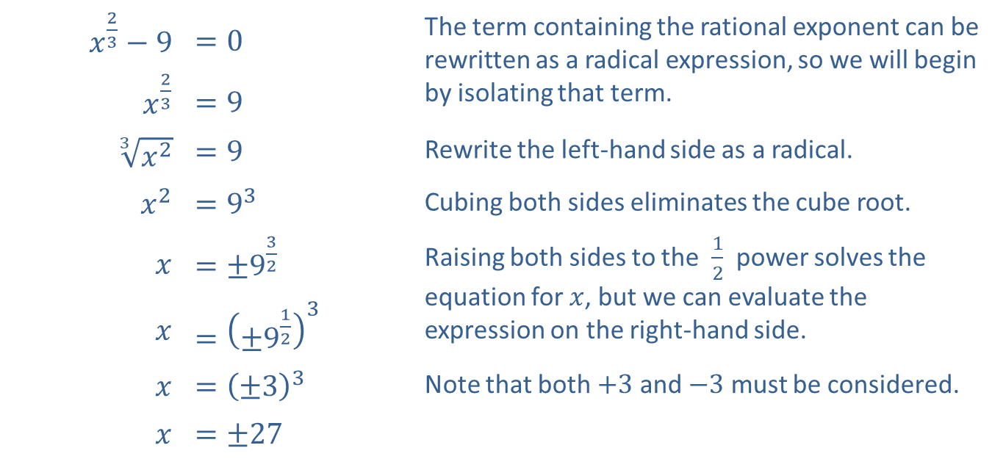
Example 7: Rational Exponents (cont.)
Solution
​
​$x^{\frac{2}{3}}−9$ | ​$=0$ | The term containing the rational exponent can be rewritten as a radical expression, so we will begin by isolating that term.
​$x^{\frac{2}{3}}$ | ​$=9$
​$\sqrt[3]{x^{2}}$ | ​$=9$ | Rewrite the left-hand side as a radical.
​$x^{2}$ | ​$=9^{3}$ | Cubing both sides eliminates the cube root.
$$x$$ | ​$=±9^{\frac{3}{2}}$ | Raising both sides to the $\frac{1}{2}$ power solves the equation for $x$, but we can evaluate the expression on the right-hand side.
$$x$$ | ​$={\left({±9}^{\frac{1}{2}}\right)}^{3}$
$$x$$ | ​$={\left(±3\right)}^{3}$ | Note that both $+3$ and $−3$ must be considered.
$$x$$ | ​$=±27$

Slide 32

Example 7: Rational Exponents (cont.)
​Plugging the values in, we see that ${\left(27\right)}^{\frac{2}{3}}=9$ and ${\left(−27\right)}^{\frac{2}{3}}=9$, so both are solutions to the original equation.
​

Slide 33
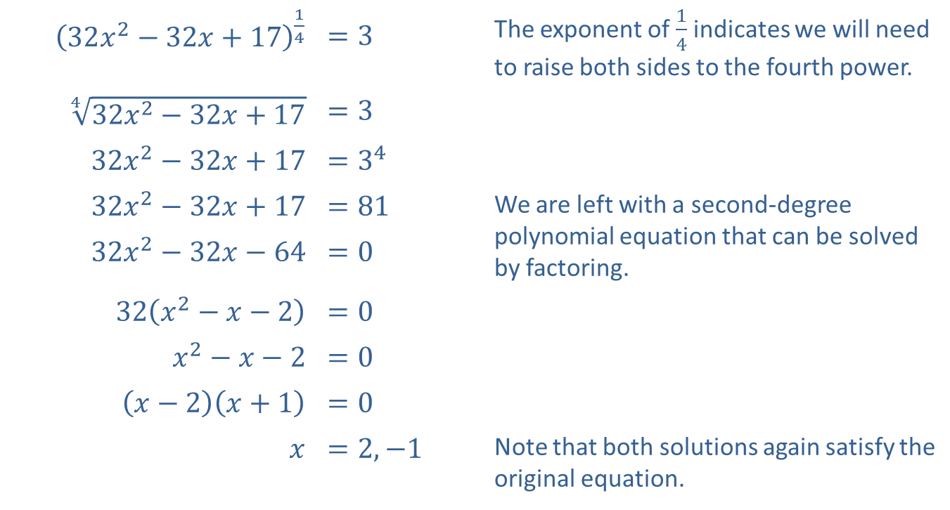
Example 7: Rational Exponents (cont.)
​${\left(32x^{2}−32x+17\right)}^{\frac{1}{4}}$ | ​$=3$ | The exponent of $\frac{1}{4}$ indicates we will need to raise both sides to the fourth power.
​$\sqrt[4]{32x^{2}−32x+17}$ | ​$=3$
​$32x^{2}−32x+17$ | ​$=3^{4}$
​$32x^{2}−32x+17$ | ​$=81$ | We are left with a second-degree polynomial equation that can be solved by factoring.
​$32x^{2}−32x−64$ | ​$=0$
​$32\left(x^{2}−x−2\right)$ | ​$=0$
​$x^{2}−x−2$ | ​$=0$
​$\left(x−2\right)\left(x+1\right)$ | ​$=0$
$$x$$ | ​$=2,−1$ | Note that both solutions again satisfy the original equation.
​

Slide 34
Example 7: Rational Exponents (cont.)
​Confirm, by substituting the solutions into the original equation, that both apparent solutions truly solve the equation with rational exponents.

Slide 35
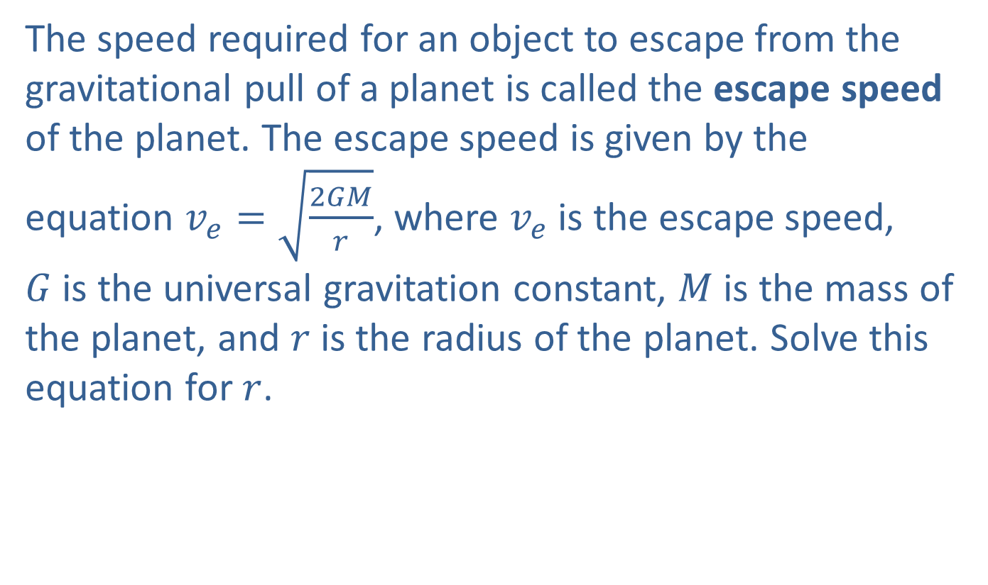
Example 8: Escape Speed
The speed required for an object to escape from the gravitational pull of a planet is called the escape speed of the planet. The escape speed is given by the equation $v_{e}=\sqrt{\frac{2GM}{r}}$, where $v_{e}$ is the escape speed,
$G$ is the universal gravitation constant, $M$ is the mass of the planet, and $r$ is the radius of the planet. Solve this equation for $r$.

Slide 36
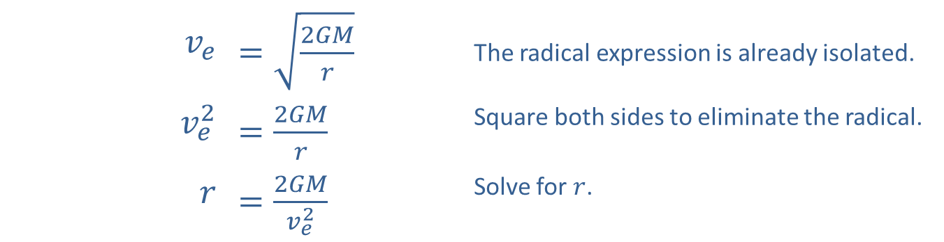
Example 8: Escape Speed (cont.)
Solution
We follow the same procedure for solving radical equations.
​$v_{e}$ | ​$=\sqrt{\frac{2GM}{r}}$ | The radical expression is already isolated.
​$v_{e}^{2}$ | ​$=\frac{2GM}{r}$ | Square both sides to eliminate the radical.
$$r$$ | ​$=\frac{2GM}{v_{e}^{2}}$ | Solve for $r$.

