Slide 1
Section 10.4
Rotation of Conic Sections

Slide 2
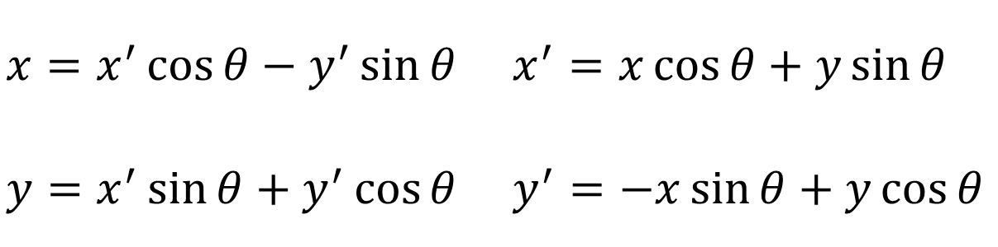
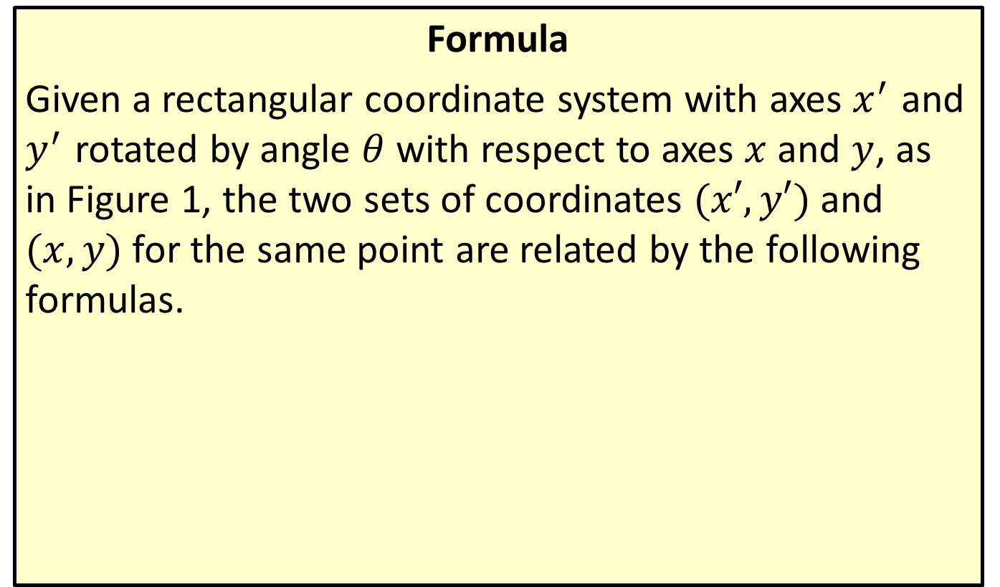
Rotation Relations
Formula
Given a rectangular coordinate system with axes $x^{′}$ and $y^{′}$ rotated by angle $θ$ with respect to axes $x$ and $y$, as in Figure 1, the two sets of coordinates $(x′,y′)$ and $(x,y)$ for the same point are related by the following formulas.
​
​$x=x^{′}\cos{θ}−y^{′}\sin{θ}$ | ​$x^{′}=x\cos{θ}+y\sin{θ}$
​$y=x^{′}\sin{θ}+y^{′}\cos{θ}$ | ​$y^{′}=−x\sin{θ}+y\cos{θ}$

Slide 3
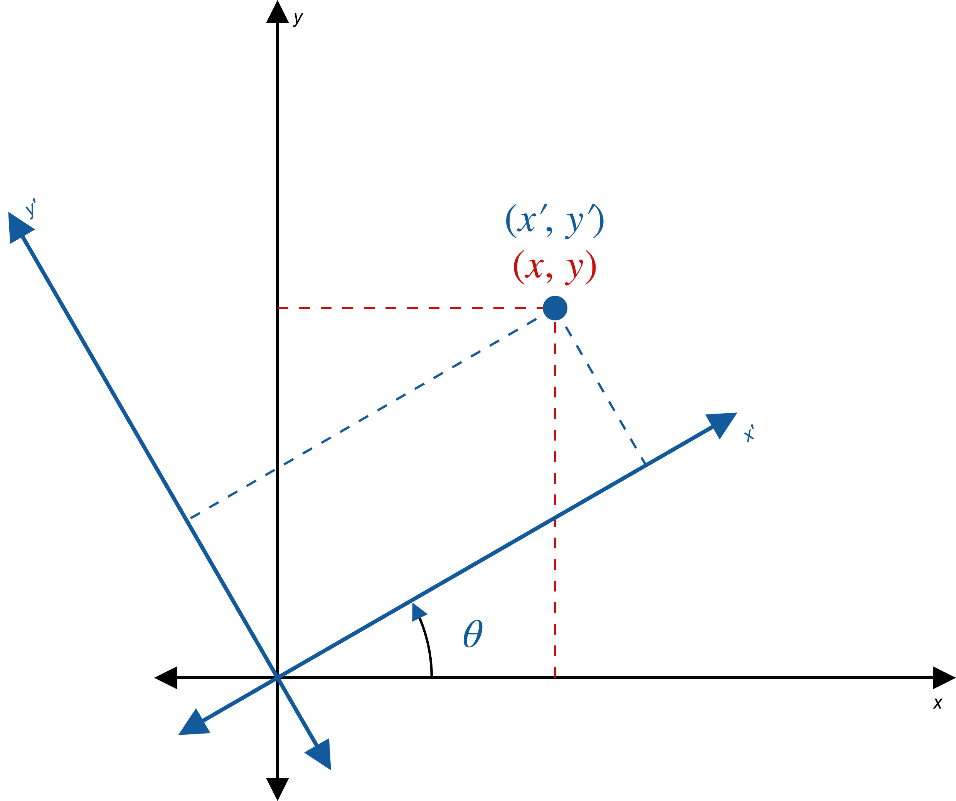
Rotation Relations (cont.)
Figure 1: Two Coordinate Systems

Slide 4
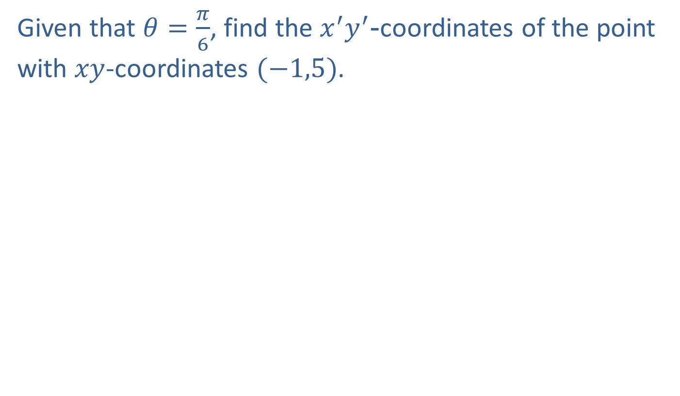

Example 1: Finding $x^{′}y^{′}$-Coordinates
Given that $θ=\frac{π}{6}$, find the $x^{′}y^{′}$-coordinates of the point with $xy$-coordinates $(−1,5)$.

Slide 5
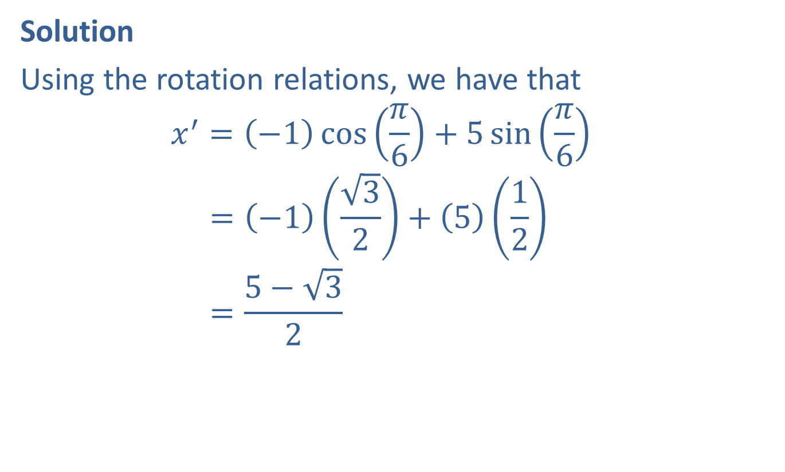

Example 1: Finding $x^{′}y^{′}$-Coordinates (cont.)
Solution
Using the rotation relations, we have that
$$x^{′}=\left(−1\right)\cos\left(\frac{π}{6}\right)+5\sin\left(\frac{π}{6}\right)$$
𝑥 =−132+512
𝑥 =5−32

Slide 6
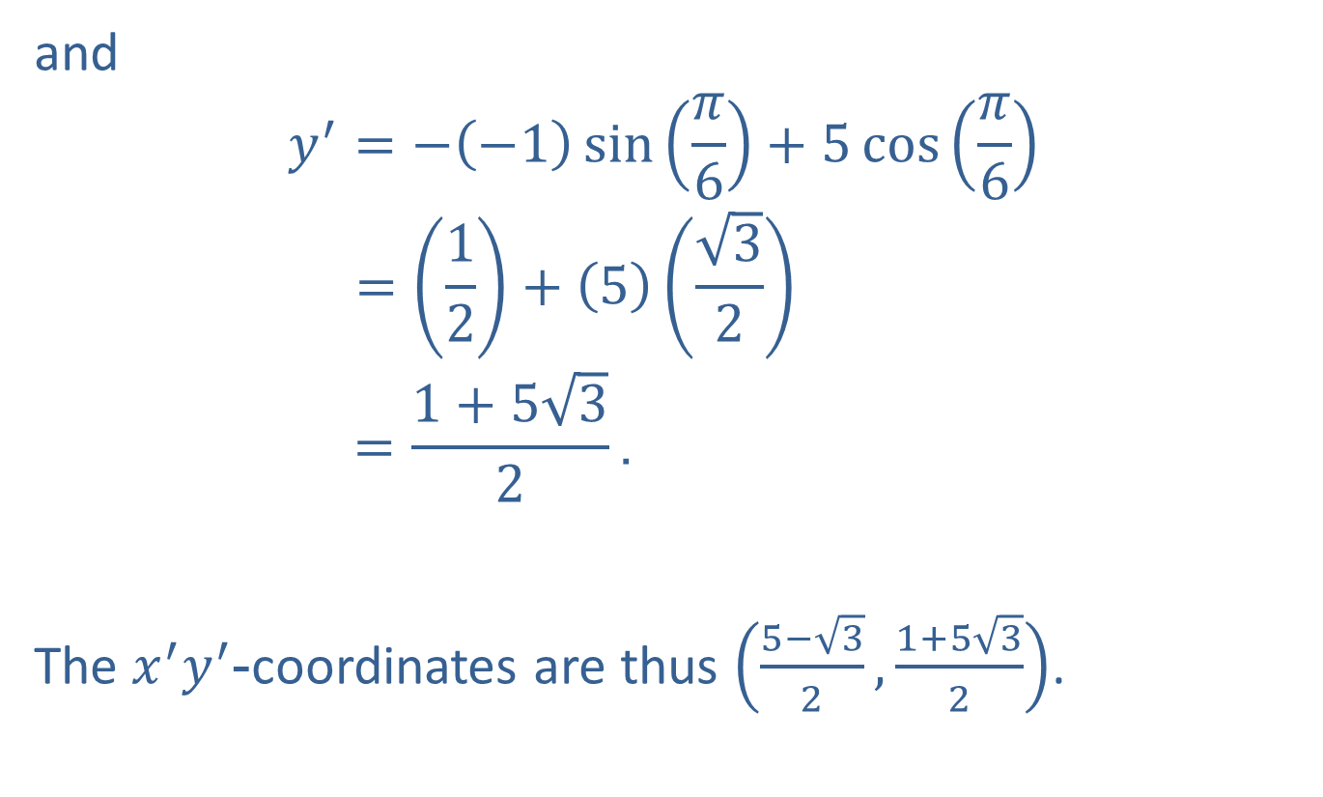
Example 1: Finding $x^{′}y^{′}$-Coordinates (cont.)
and
$$y^{′}=−\left(−1\right)\sin\left(\frac{π}{6}\right)+5\cos\left(\frac{π}{6}\right)$$
𝑦 =12+532
𝑥 =1+532.
The $x^{′}y^{′}$-coordinates are thus $\left(\frac{5−\sqrt{3}}{2},\frac{1+5\sqrt{3}}{2}\right)$.

Slide 7

Example 2: Using the Rotation Relations
Use the rotation $θ={45}^{°}$ to show that the graph of
$xy=1$ is a hyperbola.

Slide 8
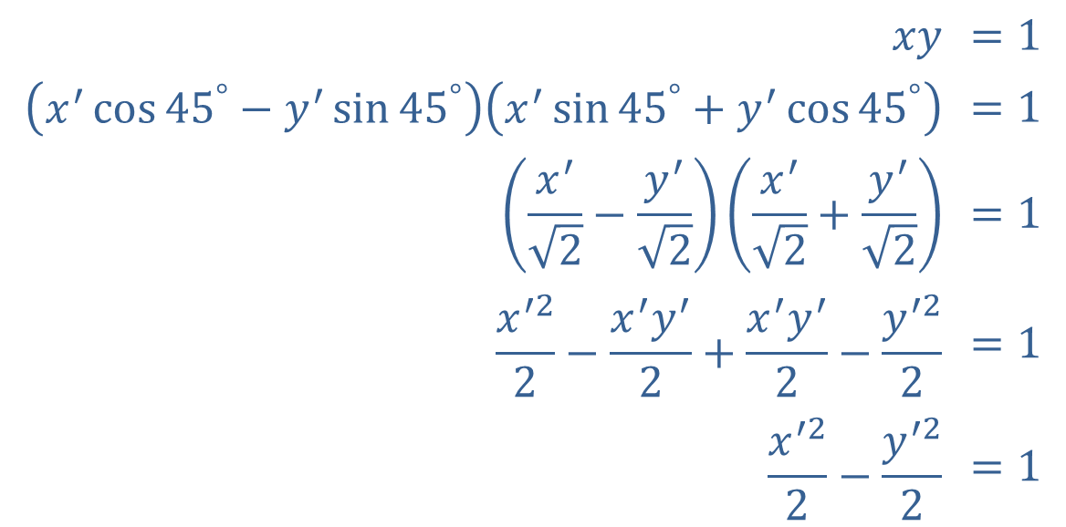

Example 2: Using the Rotation Relations (cont.)
Solution
Using the angle $θ={45}^{°}$ in the rotation relations, we convert the equation as follows.
$$xy$$ | $$=1$$
$$\left(x^{′}\cos{{45}^{°}}−y^{′}\sin{{45}^{°}}\right)\left(x^{′}\sin{{45}^{°}}+y^{′}\cos{{45}^{°}}\right)$$ | $$=1$$
$$\left(\frac{x^{′}}{\sqrt{2}}−\frac{y^{′}}{\sqrt{2}}\right)\left(\frac{x^{′}}{\sqrt{2}}+\frac{y^{′}}{\sqrt{2}}\right)$$ | $$=1$$
$$\frac{x^{′2}}{2}−\frac{x^{′}y^{′}}{2}+\frac{x^{′}y^{′}}{2}−\frac{y^{′2}}{2}$$ | $$=1$$
$$\frac{x^{′2}}{2}−\frac{y^{′2}}{2}$$ | $$=1$$

Slide 9

Example 2: Using the Rotation Relations (cont.)
We recognize this last equation as a hyperbola in the $x^{′}y^{′}$-plane, with center at the origin and vertices $\sqrt{2}$ away. The asymptotes are $y^{′}=±x^{′}$, which correspond to the $x$- and $y$-axes.

Slide 10
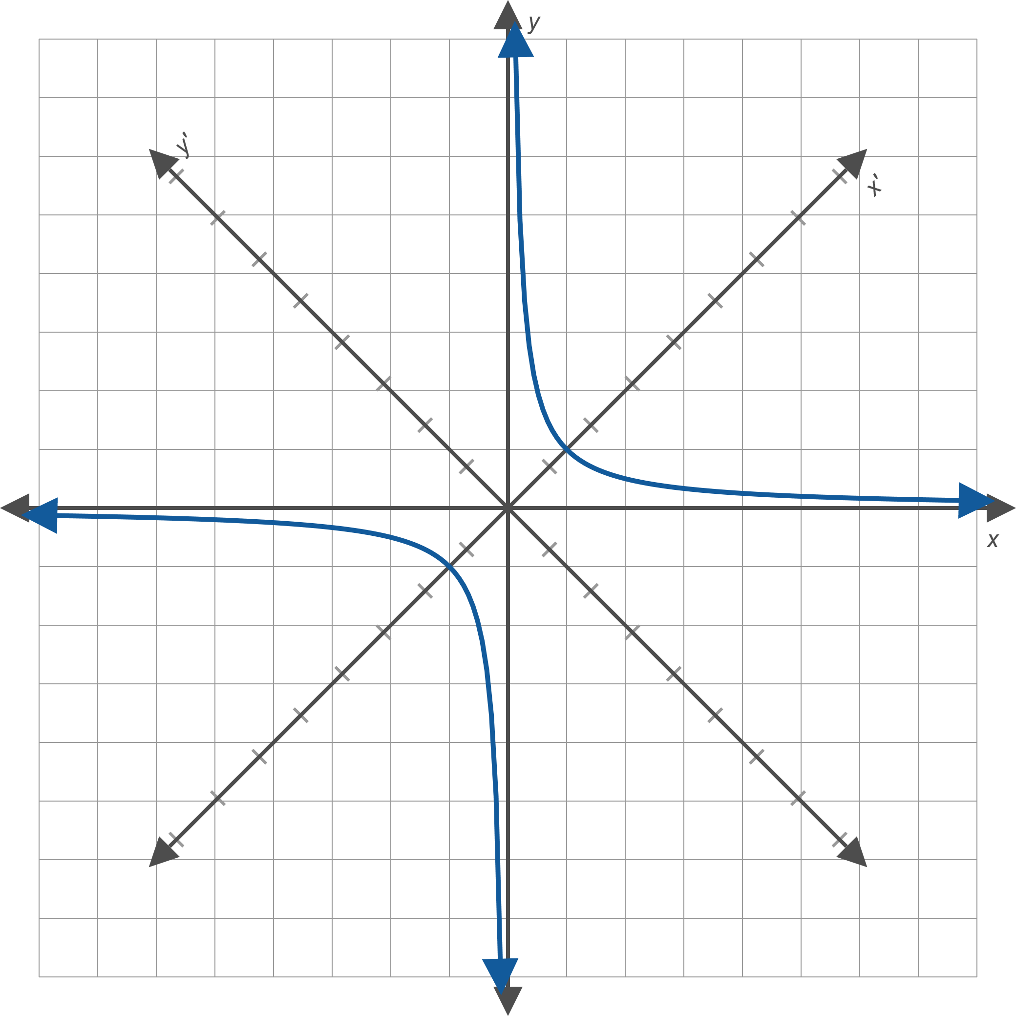
Example 2: Using the Rotation Relations (cont.)
Figure 3

Slide 11
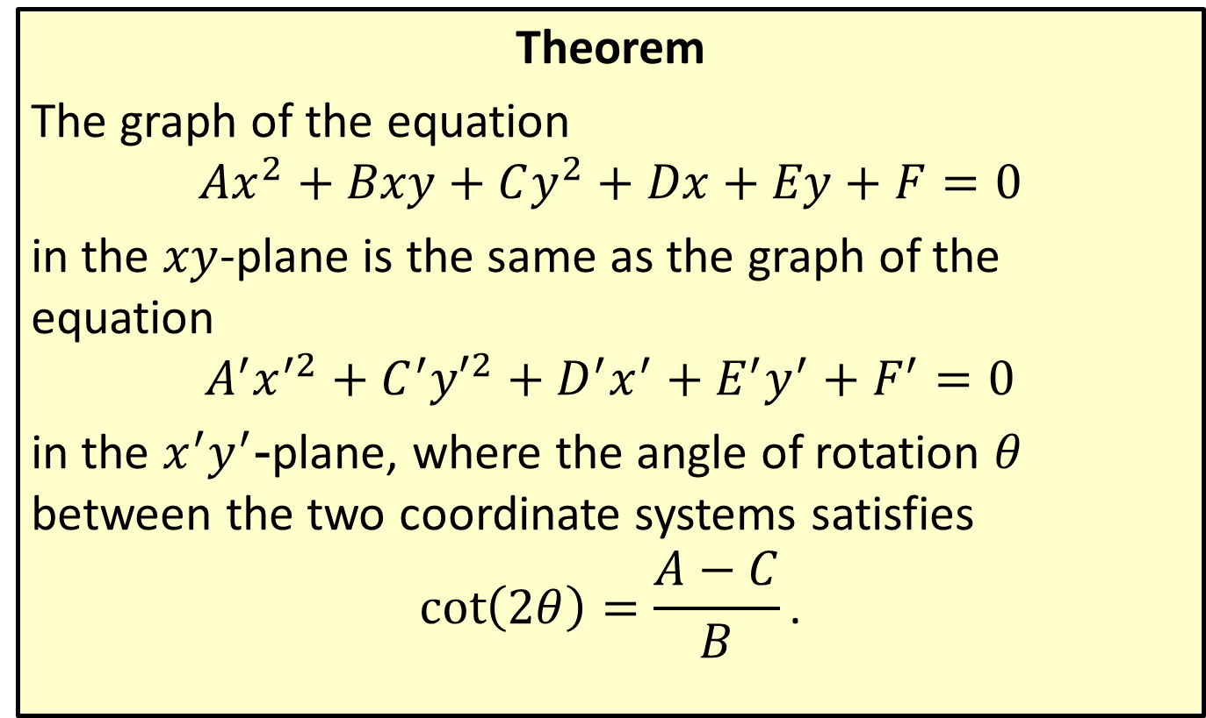

Elimination of the $xy$-Term
Theorem
The graph of the equation
$$Ax^{2}+Bxy+Cy^{2}+Dx+Ey+F=0$$
in the $xy$-plane is the same as the graph of the equation
$$A^{′}x^{′2}+C^{′}{y′}^{2}+D^{′}x^{′}+E^{′}y^{′}+F^{′}=0$$
in the $x^{′}y^{′}$-plane, where the angle of rotation $θ$ between the two coordinate systems satisfies
$$\cot\left(2θ\right)=\frac{A−C}{B}\text{.}$$

Slide 12


Example 3: Eliminating the $xy$-Term
Graph the conic section
$$x^{2}+2\sqrt{3}xy+3y^{2}+\sqrt{3}x−y=0$$
by first determining the appropriate angle $θ$ by which to rotate the axes.

Slide 13
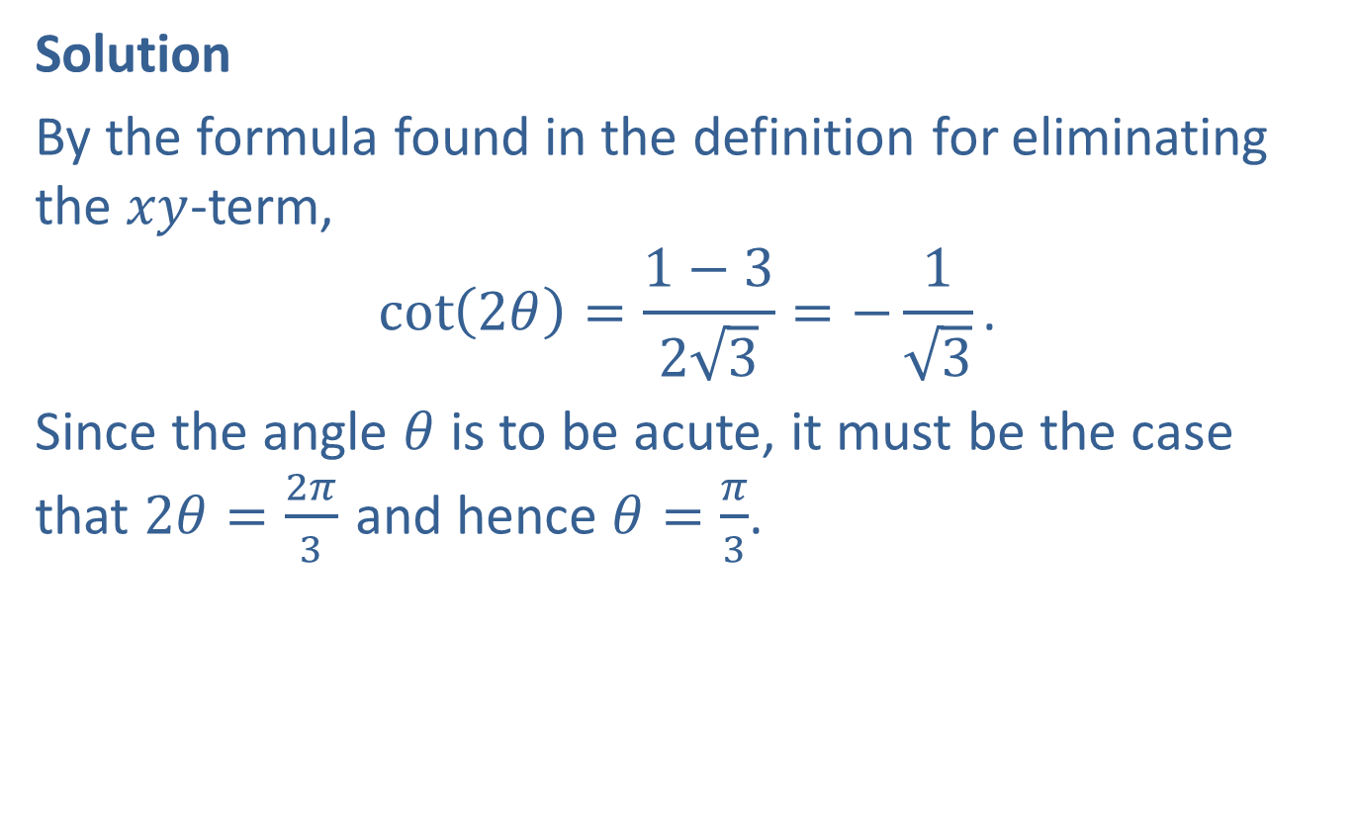

Example 3: Eliminating the $xy$-Term (cont.)
Solution
By the formula found in the definition for eliminating the $xy$-term,
$$\cot\left(2θ\right)=\frac{1−3}{2\sqrt{3}}=−\frac{1}{\sqrt{3}}\text{.}$$
Since the angle $θ$ is to be acute, it must be the case that $2θ=\frac{2π}{3}$ and hence $θ=\frac{π}{3}$.

Slide 14
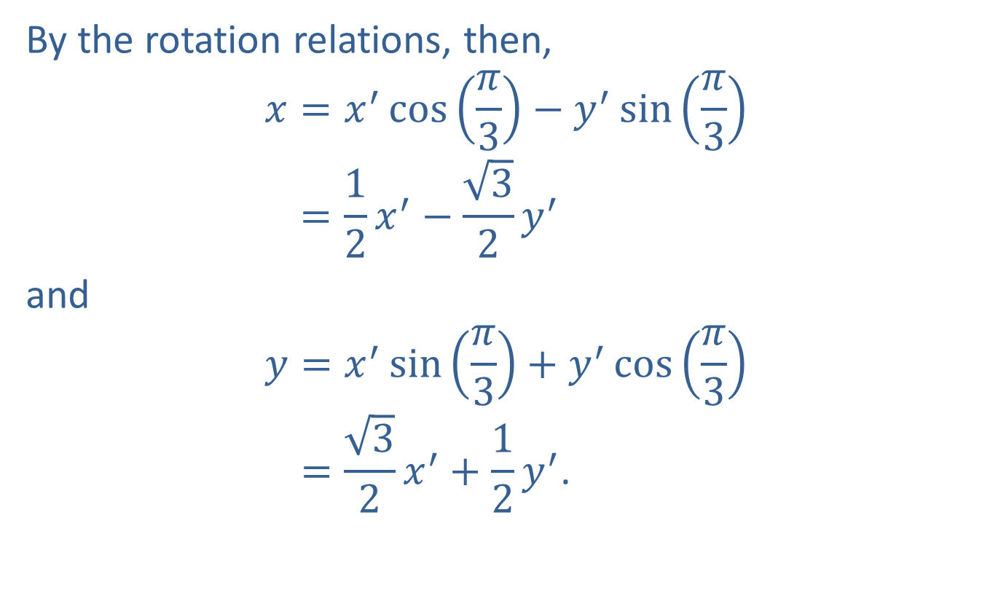

Example 3: Eliminating the $xy$-Term (cont.)
By the rotation relations, then,
𝑥=𝑥′cos𝜋3−𝑦′sin𝜋3𝑥=12𝑥′−32𝑦′
and
𝑦=𝑥′sin𝜋3+𝑦′cos𝜋3𝑦=32𝑥′+12𝑦′.

Slide 15
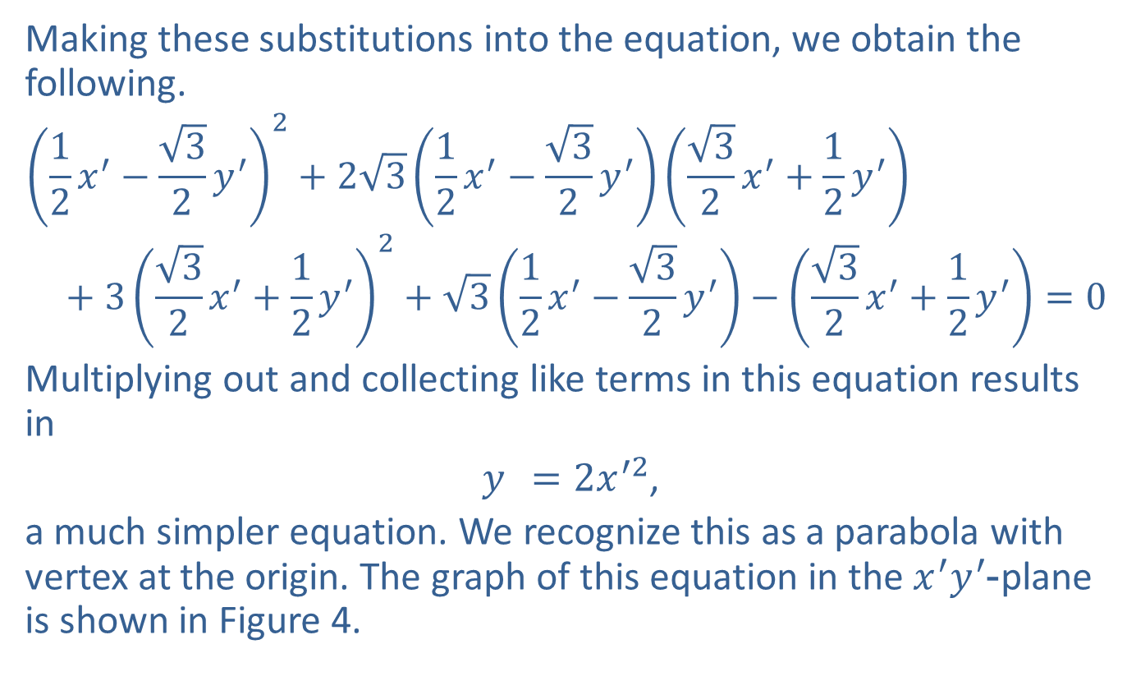
Example 3: Eliminating the $xy$-Term (cont.)
Making these substitutions into the equation, we obtain the following.
$${\left(\frac{1}{2}x^{′}−\frac{\sqrt{3}}{2}y^{′}\right)}^{2}+2\sqrt{3}\left(\frac{1}{2}x^{′}−\frac{\sqrt{3}}{2}y^{′}\right)\left(\frac{\sqrt{3}}{2}x^{′}+\frac{1}{2}y^{′}\right) \\ + 3{\left(\frac{\sqrt{3}}{2}x^{′}+\frac{1}{2}y^{′}\right)}^{2}+\sqrt{3}\left(\frac{1}{2}x^{′}−\frac{\sqrt{3}}{2}y^{′}\right)−\left(\frac{\sqrt{3}}{2}x^{′}+\frac{1}{2}y^{′}\right)=0$$
Multiplying out and collecting like terms in this equation results in
$y^{ }=2x^{′2}$,
a much simpler equation. We recognize this as a parabola with vertex at the origin. The graph of this equation in the $x^{′}y^{′}$-plane is shown in Figure 4.

Slide 16
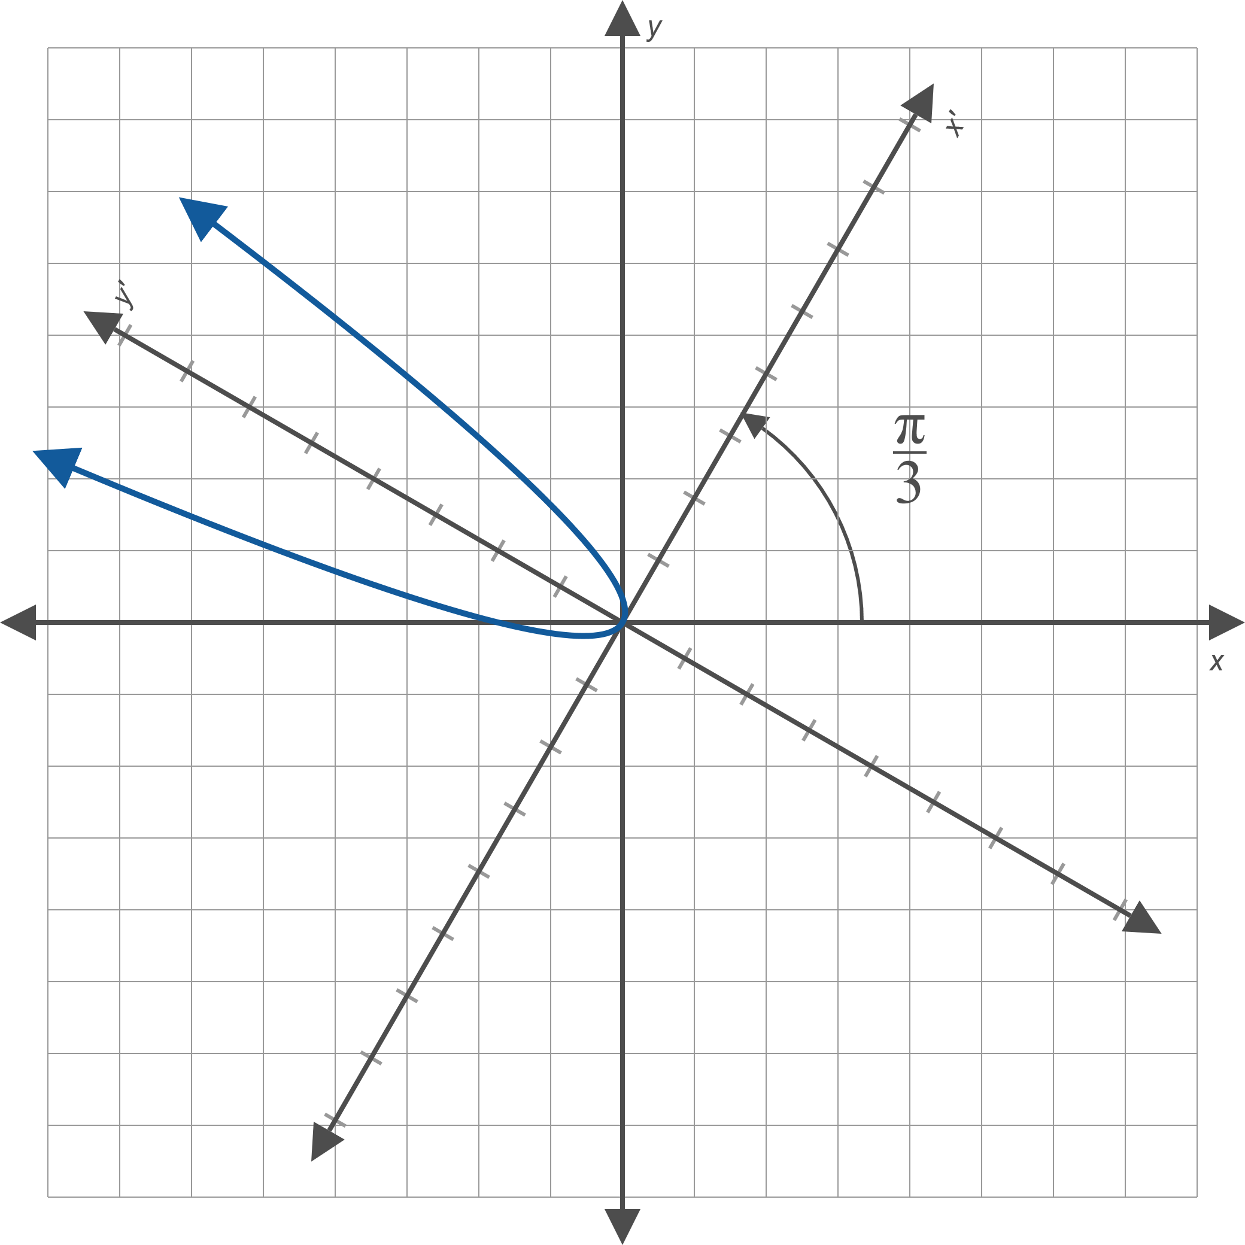
Example 3: Eliminating the $xy$-Term (cont.)
Figure 4

Slide 17
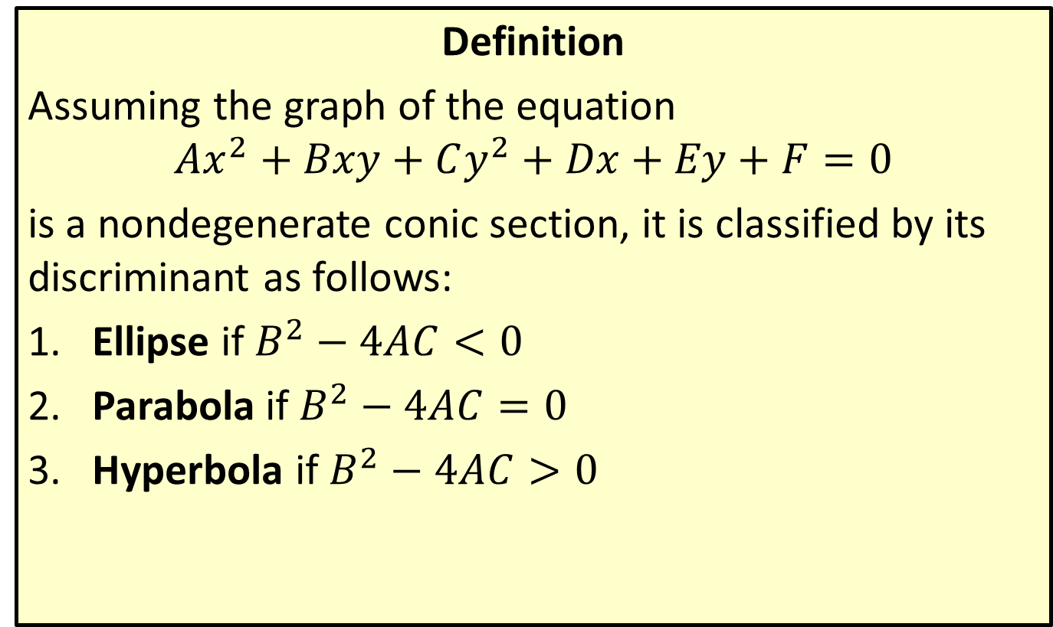
Classifying Conics
Definition
Assuming the graph of the equation
$$Ax^{2}+Bxy+Cy^{2}+Dx+Ey+F=0$$
is a nondegenerate conic section, it is classified by its discriminant as follows:
​Ellipse if $B^{2}−4AC<0$
​Parabola if $B^{2}−4AC=0$
​Hyperbola if $B^{2}−4AC>0$

Slide 18

Example 4: Classifying and Graphing Conic Sections
Classify the conic section
$$13x^{2}+10xy+13y^{2}+42\sqrt{2}x−6\sqrt{2}y+18=0$$
and then sketch its graph.

Slide 19
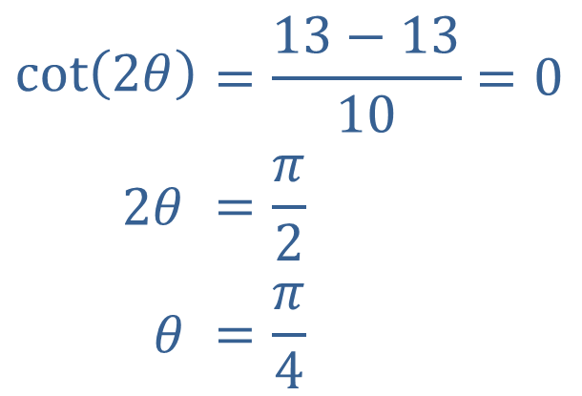

Example 4: Classifying and Graphing Conic Sections (cont.)
Solution
The discriminant is ${10}^{2}−4\left(13\right)\left(13\right)=−576$. Since this result is negative, the conic section is an ellipse. The next step is to determine the rotation angle $θ$.
$$\cot\left(2θ\right)$$ | $$=\frac{13−13}{10}=0$$
$$2θ$$ | $$=\frac{π}{2}$$
$$θ$$ | $$=\frac{π}{4}$$

Slide 20
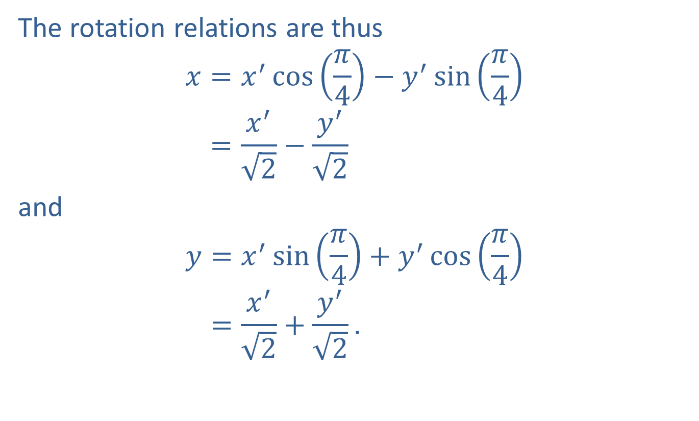
Example 4: Classifying and Graphing Conic Sections (cont.)
The rotation relations are thus
𝑥=𝑥′cos𝜋4−𝑦′sin𝜋4𝑥=𝑥′2−𝑦′2
and
𝑦=𝑥′sin𝜋4+𝑦′cos𝜋4𝑦=𝑥′2+𝑦′2.

Slide 21
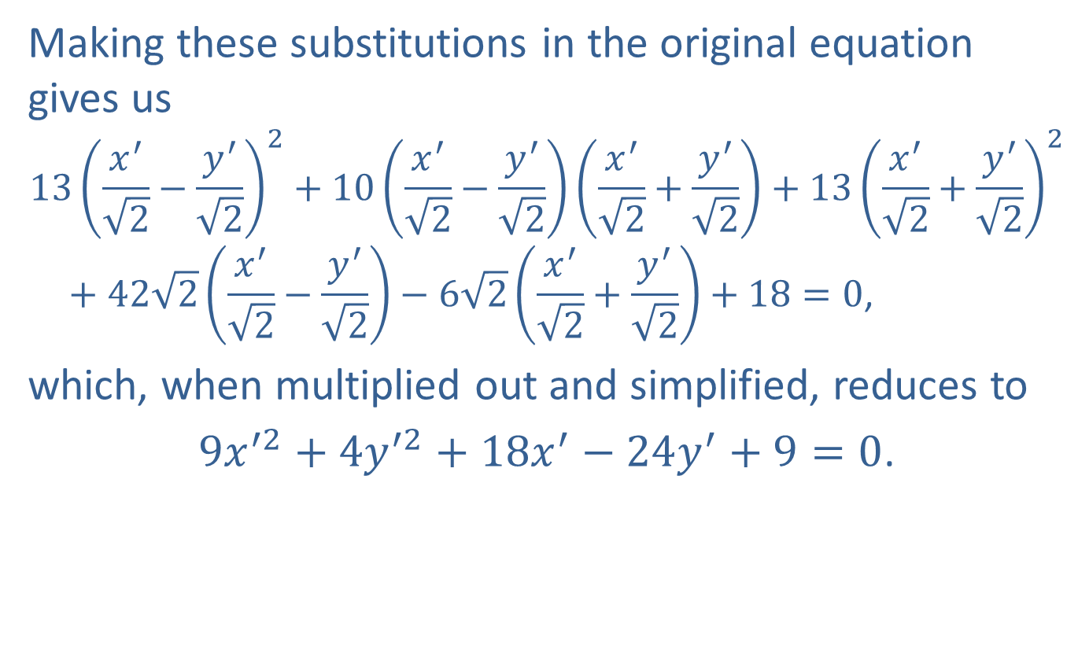
Example 4: Classifying and Graphing Conic Sections (cont.)
Making these substitutions in the original equation gives us
$$13{\left(\frac{x^{′}}{\sqrt{2}}−\frac{y^{′}}{\sqrt{2}}\right)}^{2}+10\left(\frac{x^{′}}{\sqrt{2}}−\frac{y^{′}}{\sqrt{2}}\right)\left(\frac{x^{′}}{\sqrt{2}}+\frac{y^{′}}{\sqrt{2}}\right)+13{\left(\frac{x^{′}}{\sqrt{2}}+\frac{y^{′}}{\sqrt{2}}\right)}^{2} \\ + 42\sqrt{2}\left(\frac{x^{′}}{\sqrt{2}}−\frac{y^{′}}{\sqrt{2}}\right)−6\sqrt{2}\left(\frac{x^{′}}{\sqrt{2}}+\frac{y^{′}}{\sqrt{2}}\right)+18=0\text{,}$$
which, when multiplied out and simplified, reduces to
$9x^{′2}+4y^{′2}+18x^{′}−24y^{′}+9=0$.

Slide 22
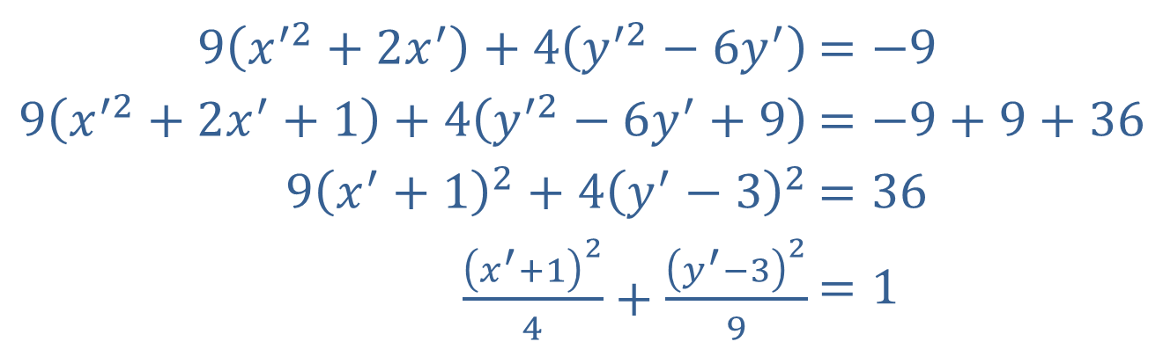

Example 4: Classifying and Graphing Conic Sections (cont.)
In order to easily graph this ellipse in the $x^{′}y^{′}$-plane, we follow the usual completing-the-square process.
​
We can now easily graph this ellipse whose center, in the $x^{′}y^{′}$-plane, is $(−1,3)$ and whose minor and major axes have lengths 4 and 6, respectively.
​$9\left(x^{′2}+2x^{′}\right)+4\left(y^{′2}−6y^{′}\right)$ | ​$=−9$
​$9\left(x^{′2}+2x^{′}+1\right)+4\left(y^{′2}−6y^{′}+9\right)$ | ​$=−9+9+36$
​$9{\left(x^{′}+1\right)}^{2}+4{\left(y^{′}−3\right)}^{2}$ | ​$=36$
​$\frac{{\left(x^{′}+1\right)}^{2}}{4}+\frac{{\left(y^{′}−3\right)}^{2}}{9}$ | ​$=1$

Slide 23
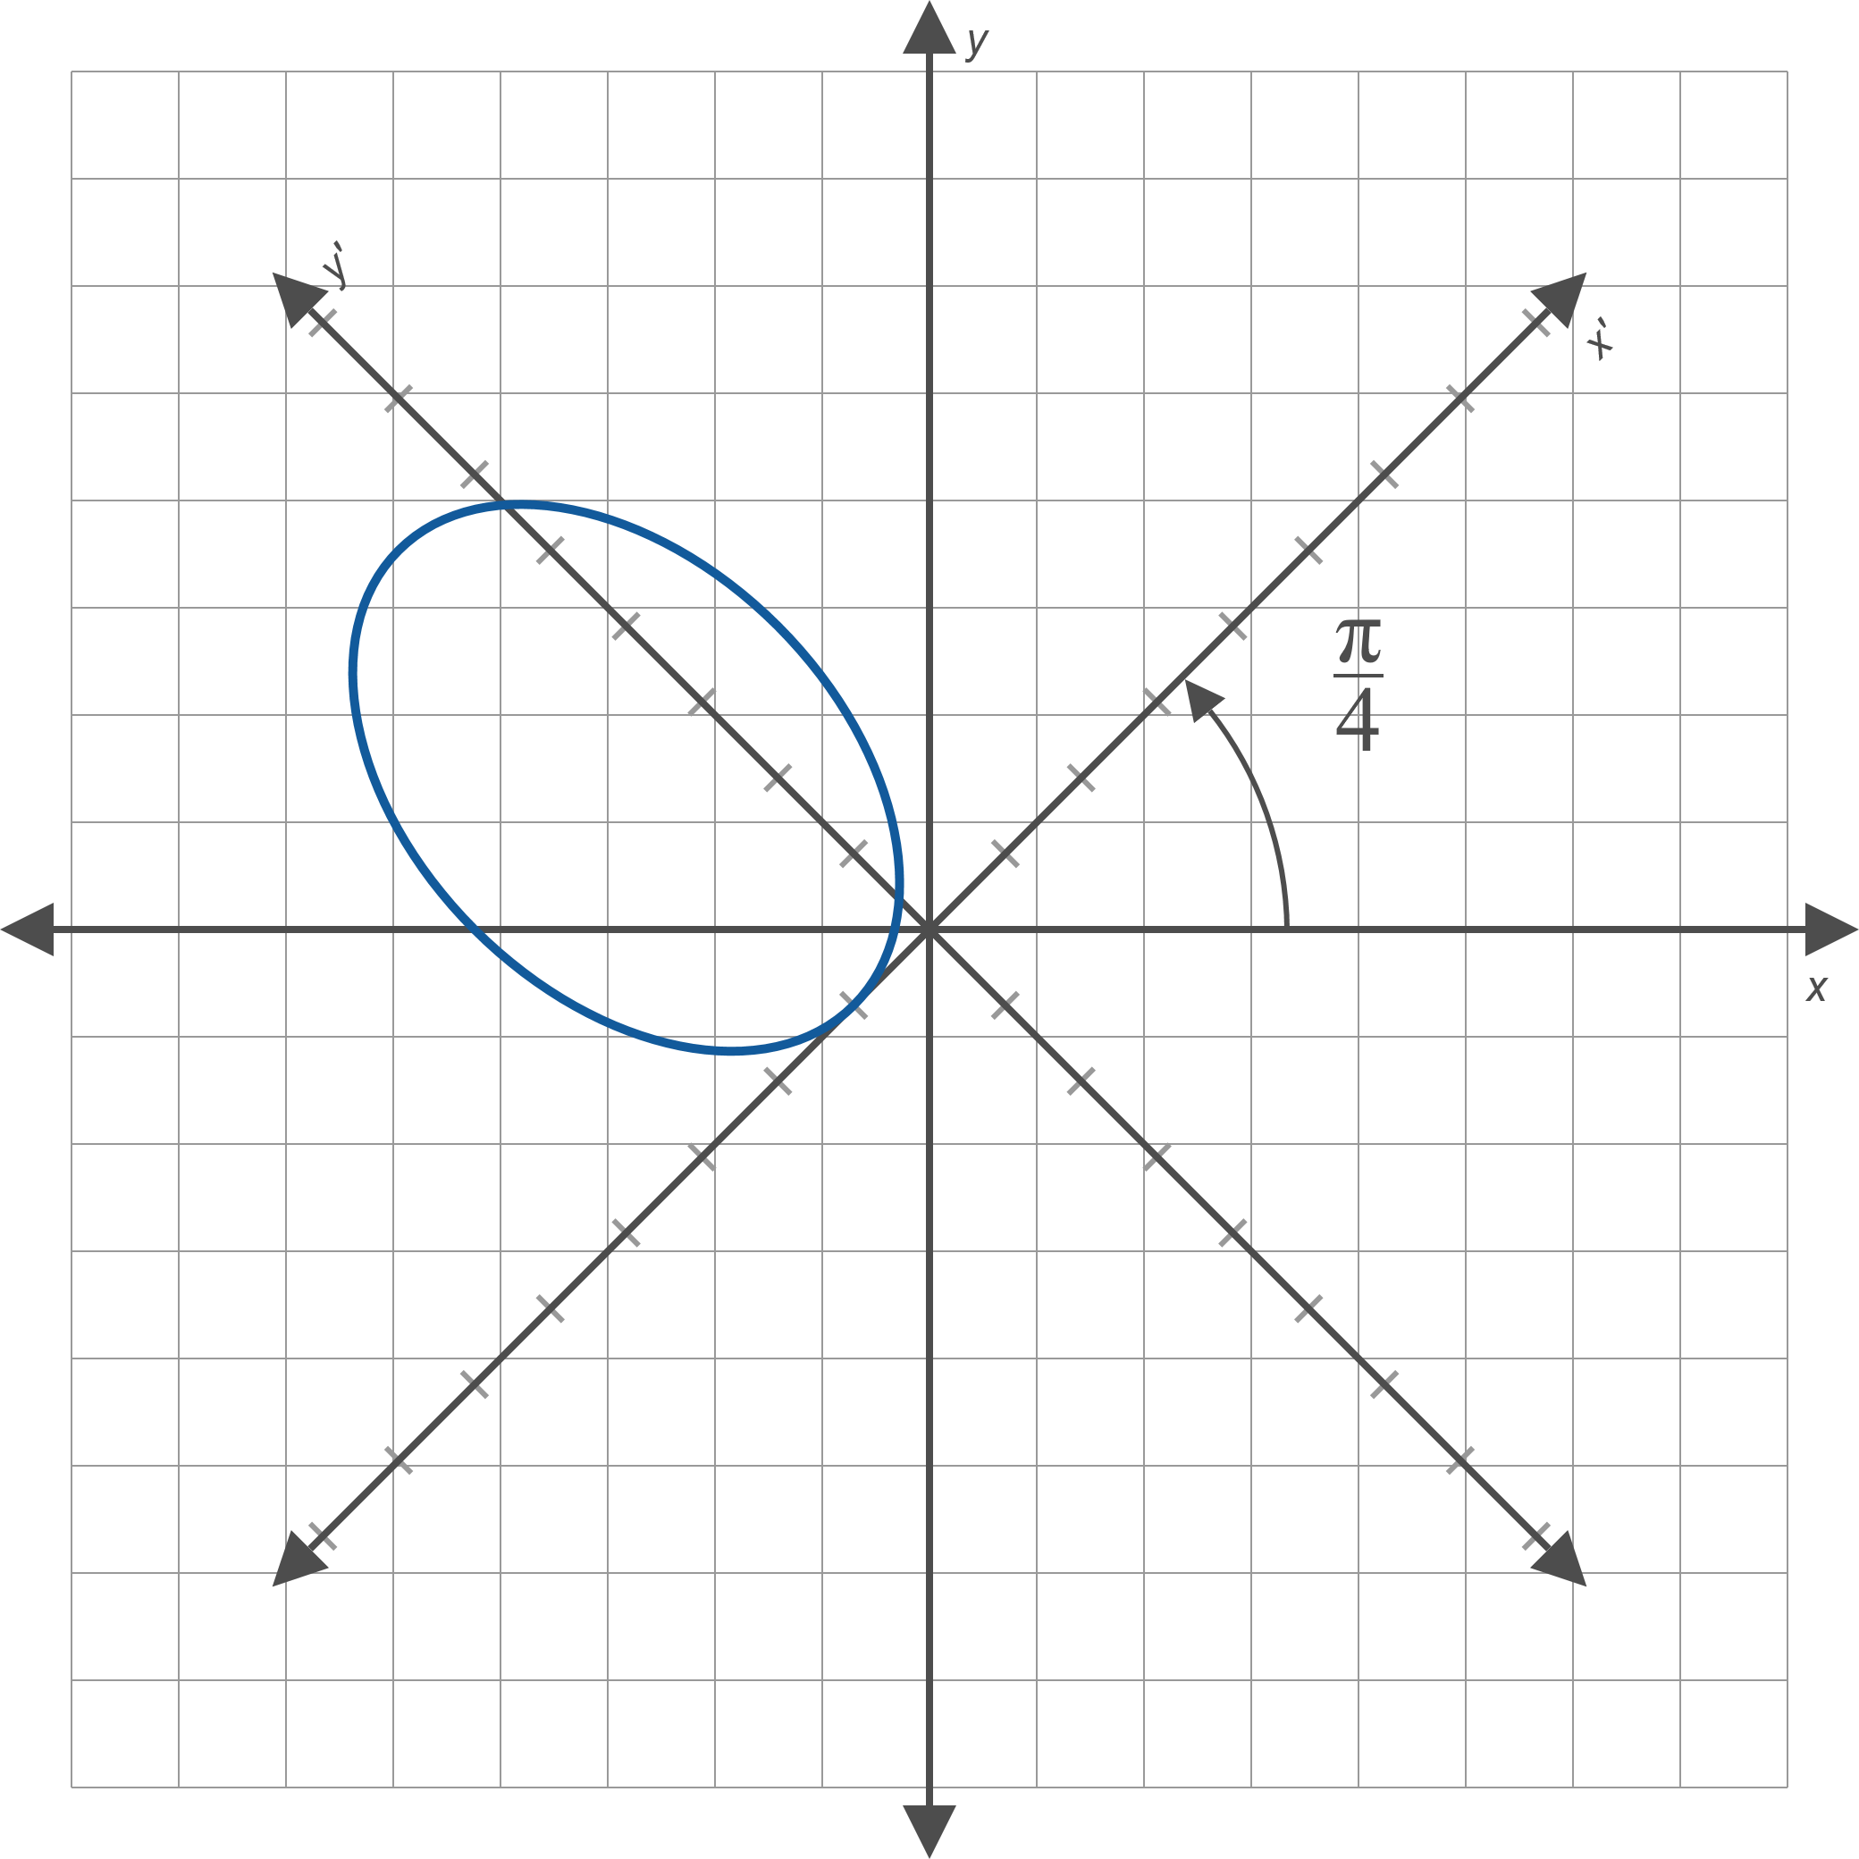
Example 4: Classifying and Graphing Conic Sections (cont.)
Figure 5

