Slide 1
Section 10.5
Polar Equations of Conic Sections

Slide 2
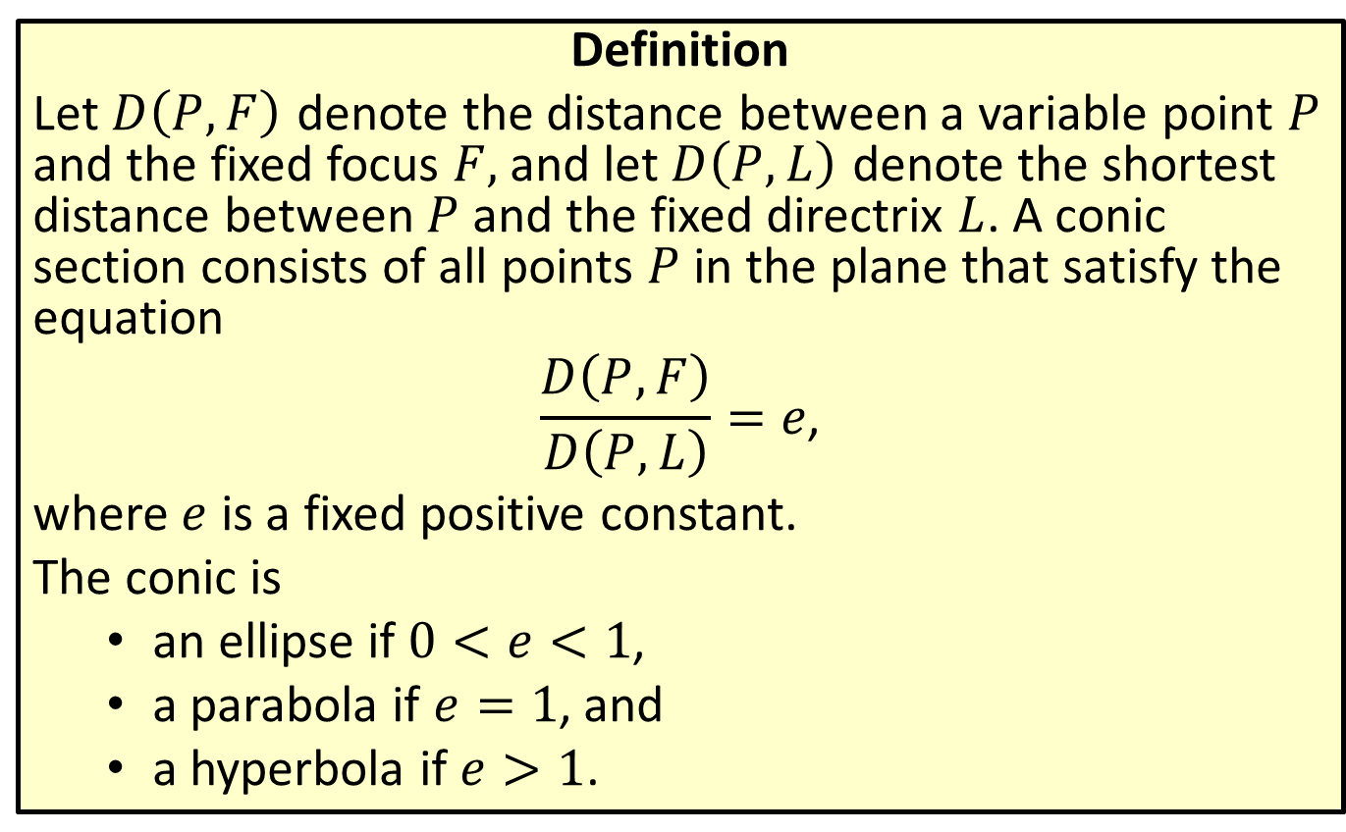
Focus and Directrix Description of Conics
Definition
Let $D⁡\left(P,F\right)$ denote the distance between a variable point $P$ and the fixed focus $F,$ and let $D⁡\left(P,L\right)$ denote the shortest distance between $P$ and the fixed directrix $L$. A conic section consists of all points $P$ in the plane that satisfy the equation
$$\frac{D\left(P,F\right)}{D\left(P,L\right)}=e\text{,}$$
where $e$ is a fixed positive constant.
The conic is
  an ellipse if $0<e<1$,
  a parabola if $e=1$, and
  a hyperbola if $e>1$.

Slide 3
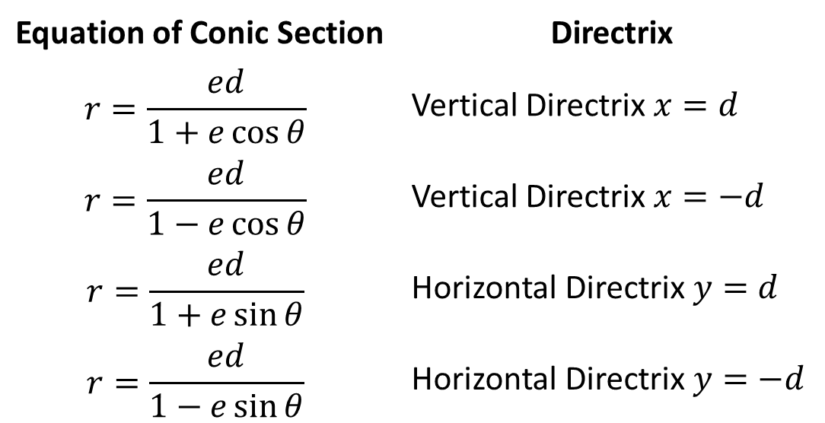
Polar Equations of Conic Sections
Formula
In polar coordinates, the equation of a conic section with its focus at the origin and either a horizontal or vertical directrix has one of the following forms.
Equation of Conic Section | Directrix
$$r=\frac{ed}{1+e\cos{θ}}$$ | Vertical Directrix $x=d$
$$r=\frac{ed}{1−e\cos{θ}}$$ | Vertical Directrix $x=−d$
$$r=\frac{ed}{1+e\sin{θ}}$$ | Horizontal Directrix $y=d$
$$r=\frac{ed}{1−e\sin{θ}}$$ | Horizontal Directrix $y=−d$

Slide 4

Example 1: Identifying the Type and Directrix of a Conic
Identify the variety of each of the following conics, and determine the equation for the directrix in each case.
​$r=\frac{15}{5−3\cos{θ}}$
​$r=\frac{2}{3+5\sin{θ}}$

Slide 5
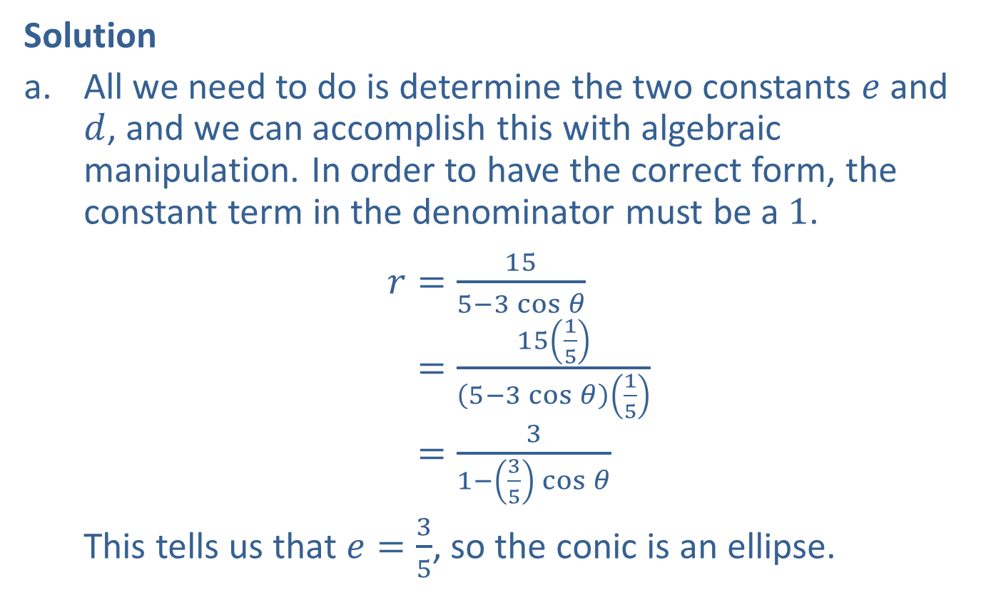
Example 1: Identifying the Type and Directrix of a Conic (cont.)
Solution
​All we need to do is determine the two constants $e$ and $d$, and we can accomplish this with algebraic manipulation. In order to have the correct form, the constant term in the denominator must be a 1.
$r=\frac{15}{5−3\cos{θ}}$
𝑟=15155−3cos𝜃15
𝑟=31−35cos𝜃
This tells us that $e=\frac{3}{5}$, so the conic is an ellipse.

Slide 6
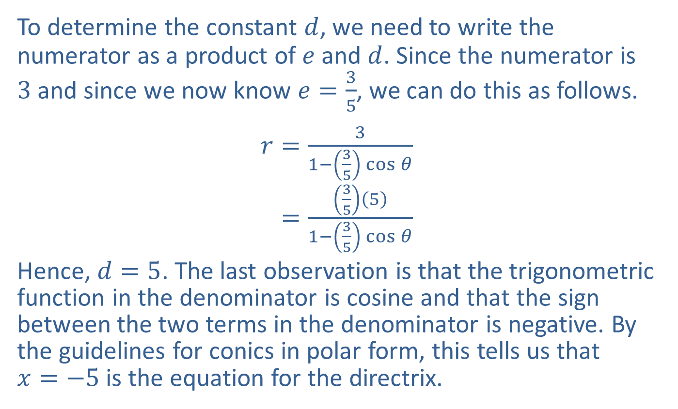
Example 1: Identifying the Type and Directrix of a Conic (cont.)
​To determine the constant $d$, we need to write the numerator as a product of $e$ and $d$. Since the numerator is 3 and since we now know $e=\frac{3}{5}$, we can do this as follows.
$r=\frac{3}{1−\left(\frac{3}{5}\right)\cos{θ}}$
𝑟=3551−35cos𝜃
Hence, $d=5$. The last observation is that the trigonometric function in the denominator is cosine and that the sign between the two terms in the denominator is negative. By the guidelines for conics in polar form, this tells us that
$x=−5$ is the equation for the directrix.

Slide 7
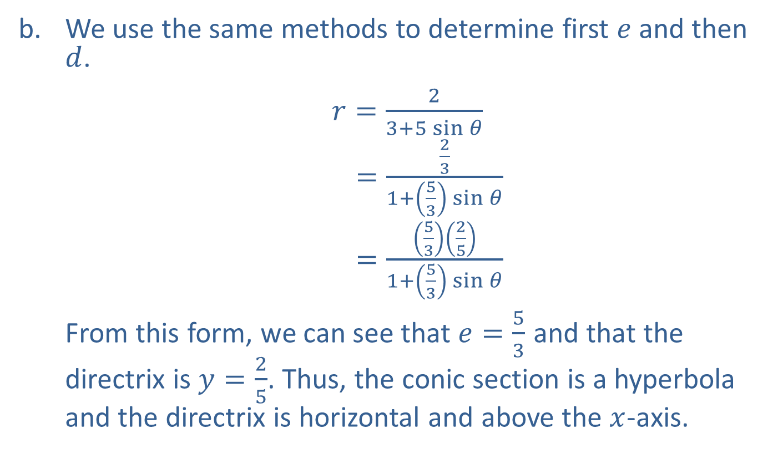
Example 1: Identifying the Type and Directrix of a Conic (cont.)
​We use the same methods to determine first $e$ and then $d$.
$r=\frac{2}{3+5\sin{θ}}$
𝑟 =231+53sin𝜃
𝑟 =53251+53sin𝜃
​From this form, we can see that $e=\frac{5}{3}$ and that the directrix is $y=\frac{2}{5}$. Thus, the conic section is a hyperbola and the directrix is horizontal and above the $x$-axis.

Slide 8
Example 2: Constructing a Polar Equation
Construct a polar equation for a leftward-opening parabola with focus at the origin and directrix 2 units from the focus.

Slide 9
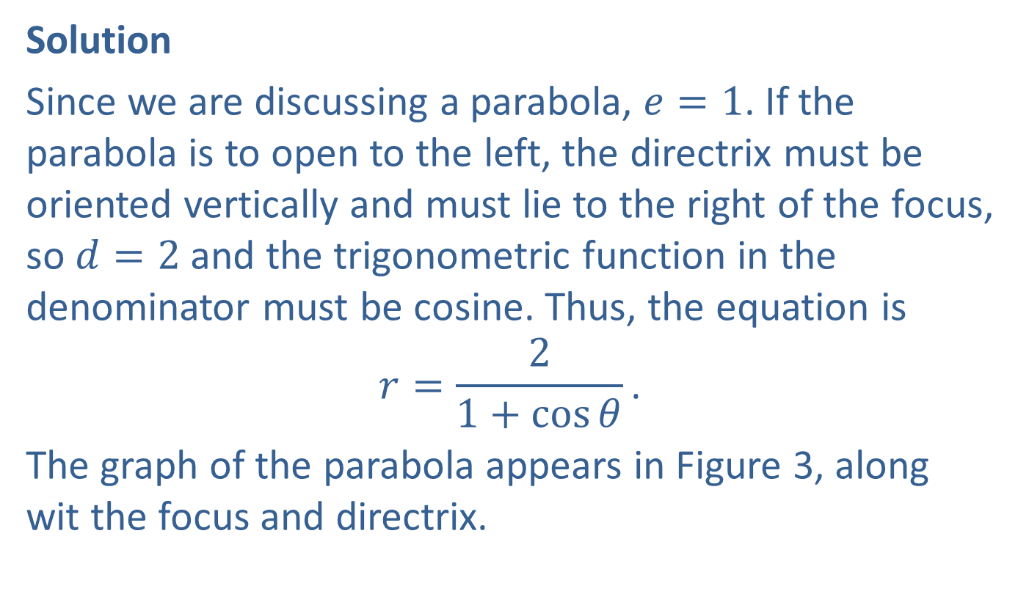
Example 2: Constructing a Polar Equation (cont.)
Solution
Since we are discussing a parabola, $e=1$. If the parabola is to open to the left, the directrix must be oriented vertically and must lie to the right of the focus, so $d=2$ and the trigonometric function in the denominator must be cosine. Thus, the equation is
$$r=\frac{2}{1+\cos{θ}}\text{.}$$
The graph of the parabola appears in Figure 3, along wit the focus and directrix.

Slide 10
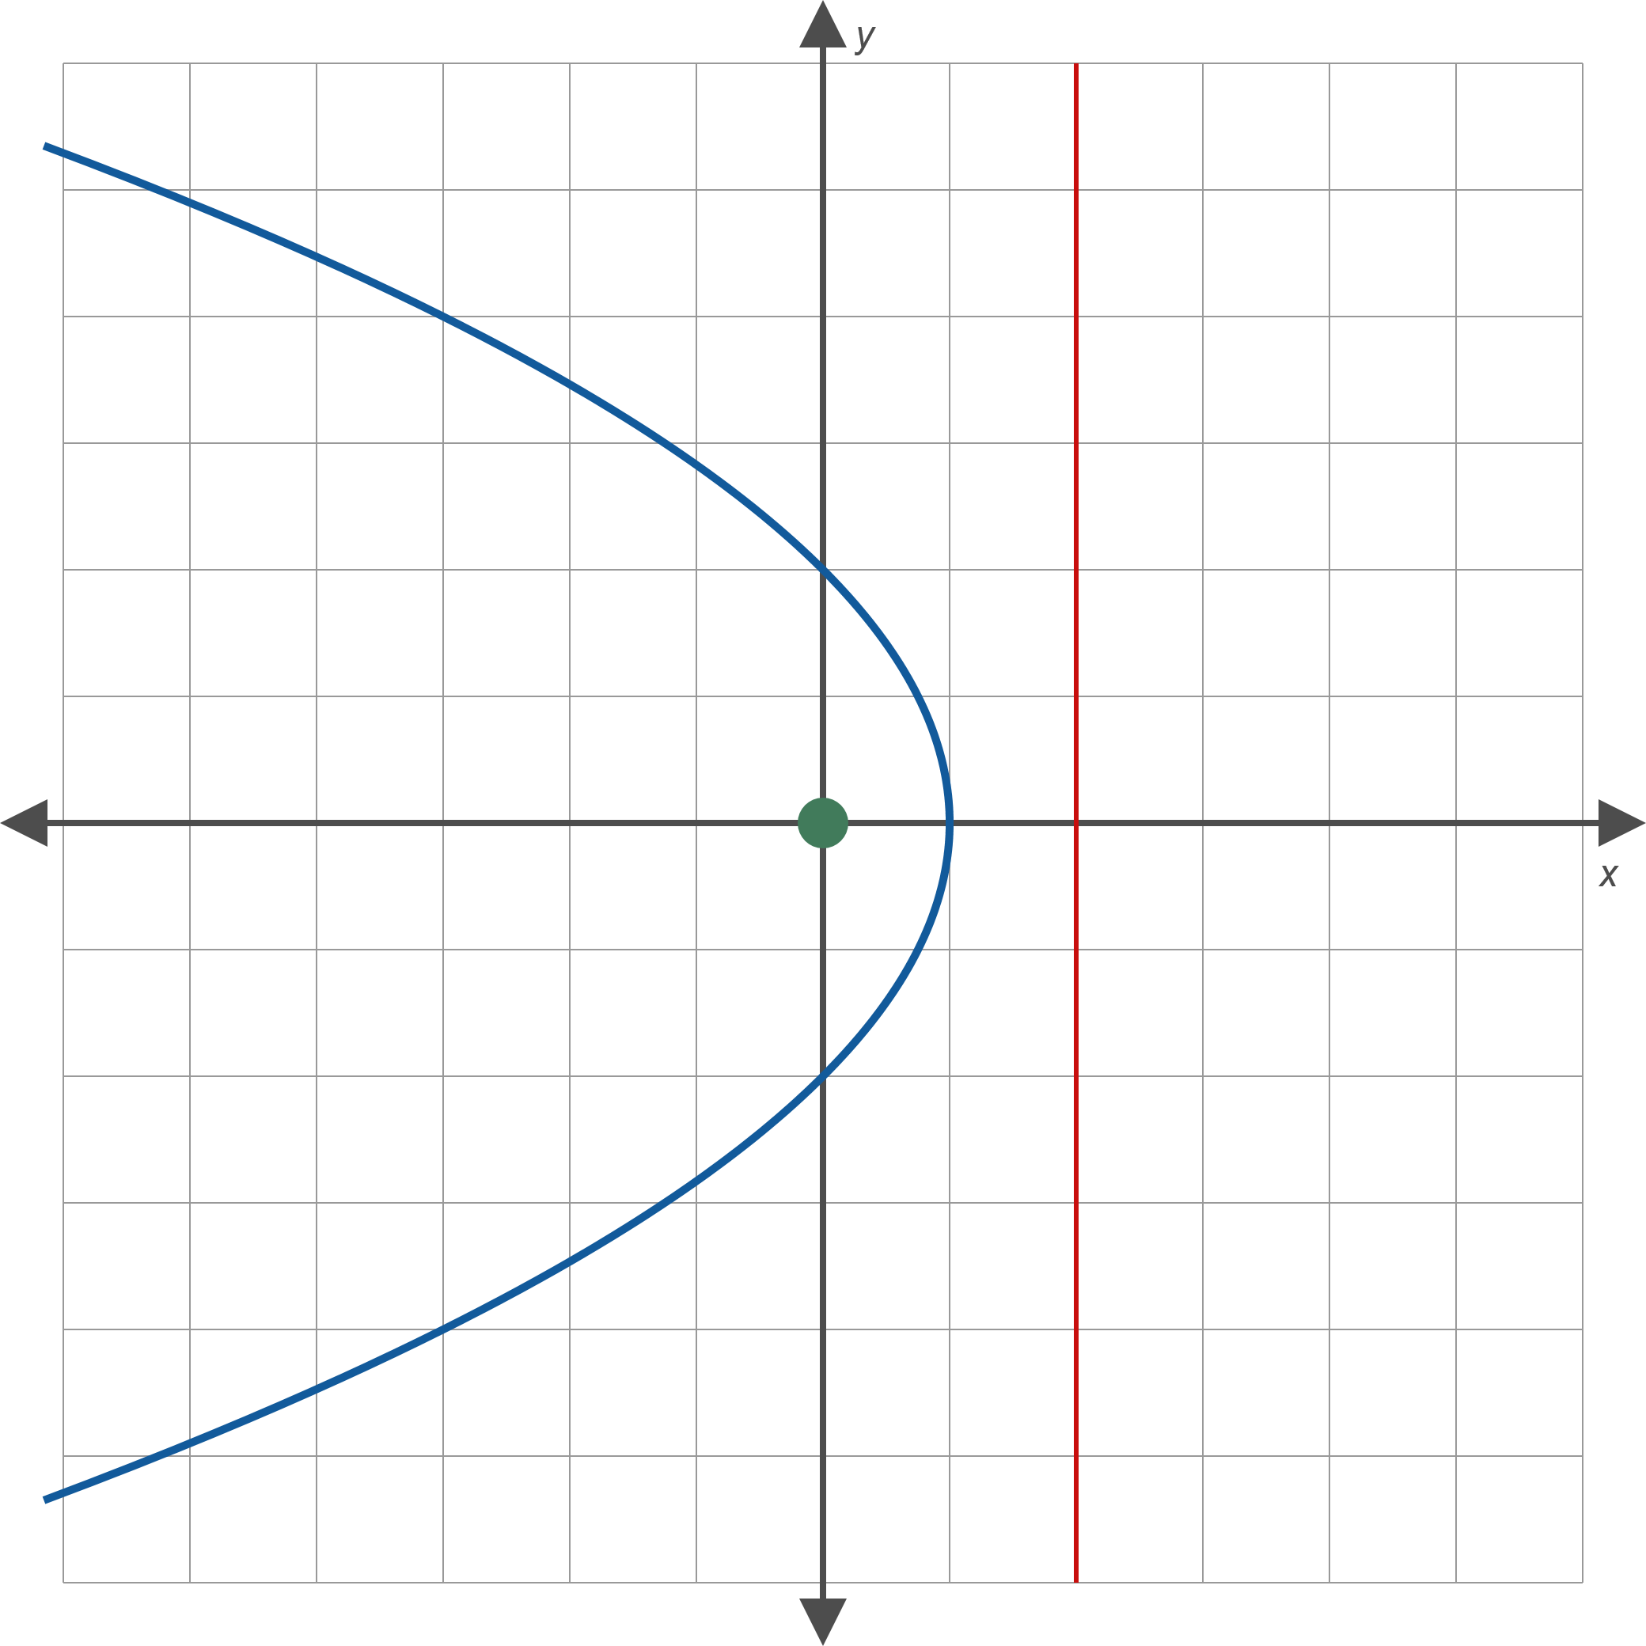
Example 2: Constructing a Polar Equation (cont.)
Figure 3

Slide 11

Example 3: Graphing Conic Sections in Polar Form
Sketch the graph of the conic section $r=\frac{15}{5−3\cos{θ}}$.

Slide 12
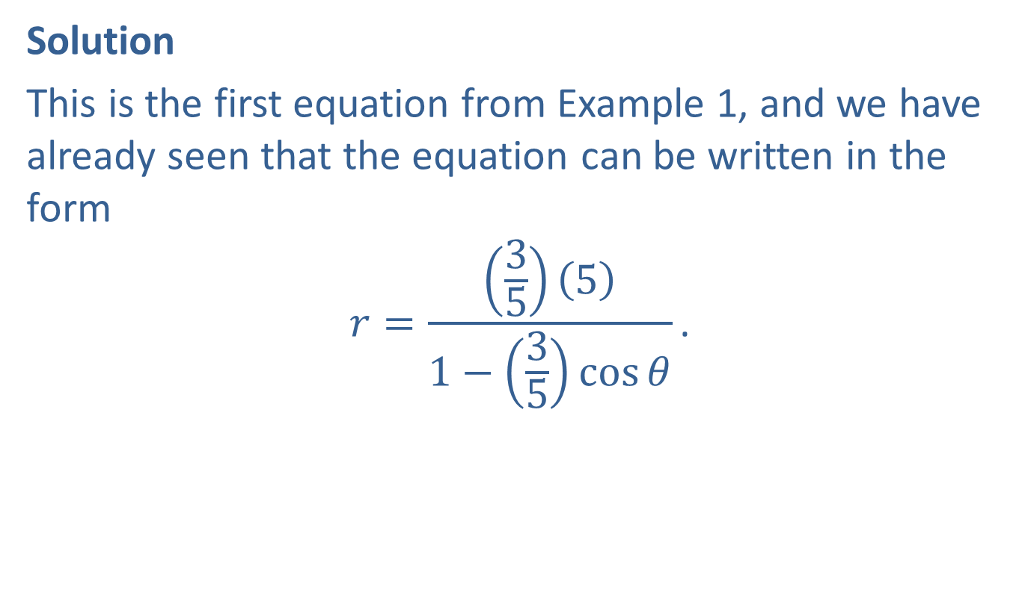
Example 3: Graphing Conic Sections in Polar Form (cont.)
Solution
This is the first equation from Example 1, and we have already seen that the equation can be written in the form
$$r=\frac{\left(\frac{3}{5}\right)\left(5\right)}{1−\left(\frac{3}{5}\right)\cos{θ}}\text{.}$$

Slide 13
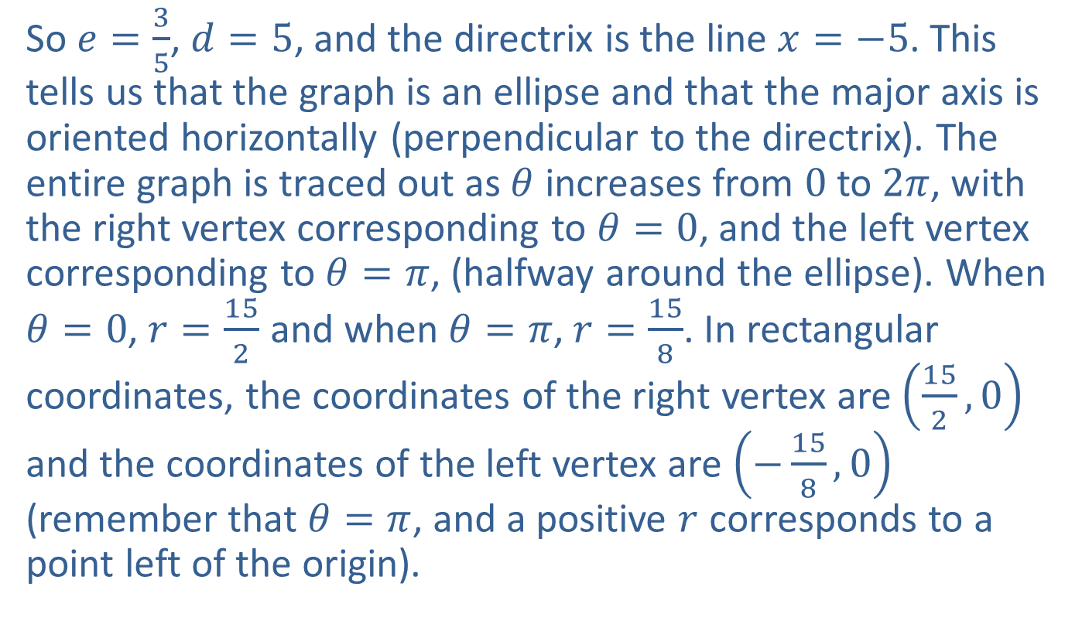
Example 3: Graphing Conic Sections in Polar Form (cont.)
So $e=\frac{3}{5}$, $d=5$, and the directrix is the line $x=−5$. This tells us that the graph is an ellipse and that the major axis is oriented horizontally (perpendicular to the directrix). The entire graph is traced out as $θ$ increases from 0 to $2π$, with the right vertex corresponding to $θ=0$, and the left vertex corresponding to $θ=π$, (halfway around the ellipse). When $θ=0$, $r=\frac{15}{2}$ and when $θ=π$, $r=\frac{15}{8}$. In rectangular coordinates, the coordinates of the right vertex are $\left(\frac{15}{2},0\right)$ and the coordinates of the left vertex are $\left(−\frac{15}{8},0\right)$ (remember that $θ=π$, and a positive $r$ corresponds to a point left of the origin).

Slide 14
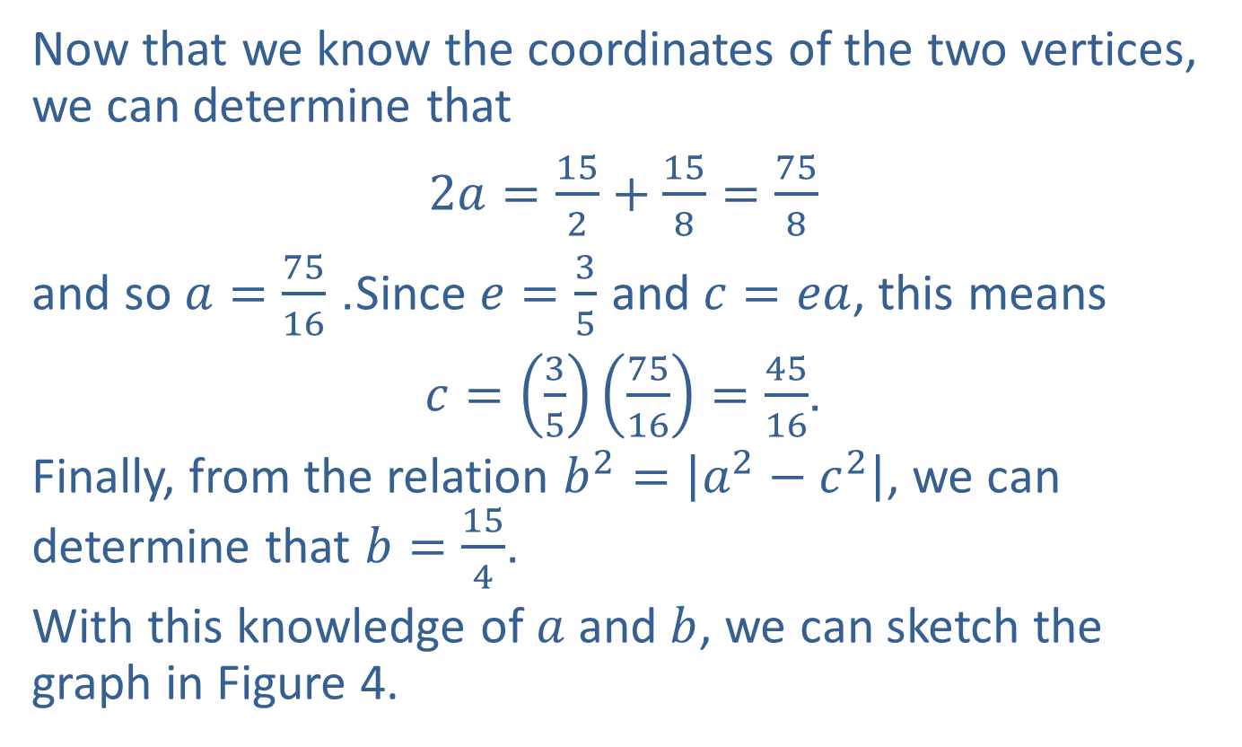
Example 3: Graphing Conic Sections in Polar Form (cont.)
Now that we know the coordinates of the two vertices, we can determine that
$2a=\frac{15}{2}+\frac{15}{8}=\frac{75}{8}$
and so $a=\frac{75}{16}$. Since $e=\frac{3}{5}$ and $c=ea$, this means
$c=\left(\frac{3}{5}\right)\left(\frac{75}{16}\right)=\frac{45}{16}$.
Finally, from the relation $b^{2}=\left|a^{2}−c^{2}\right|$, we can determine that $b=\frac{15}{4}$.
With this knowledge of $a$ and $b$, we can sketch the graph in Figure 4.

Slide 15
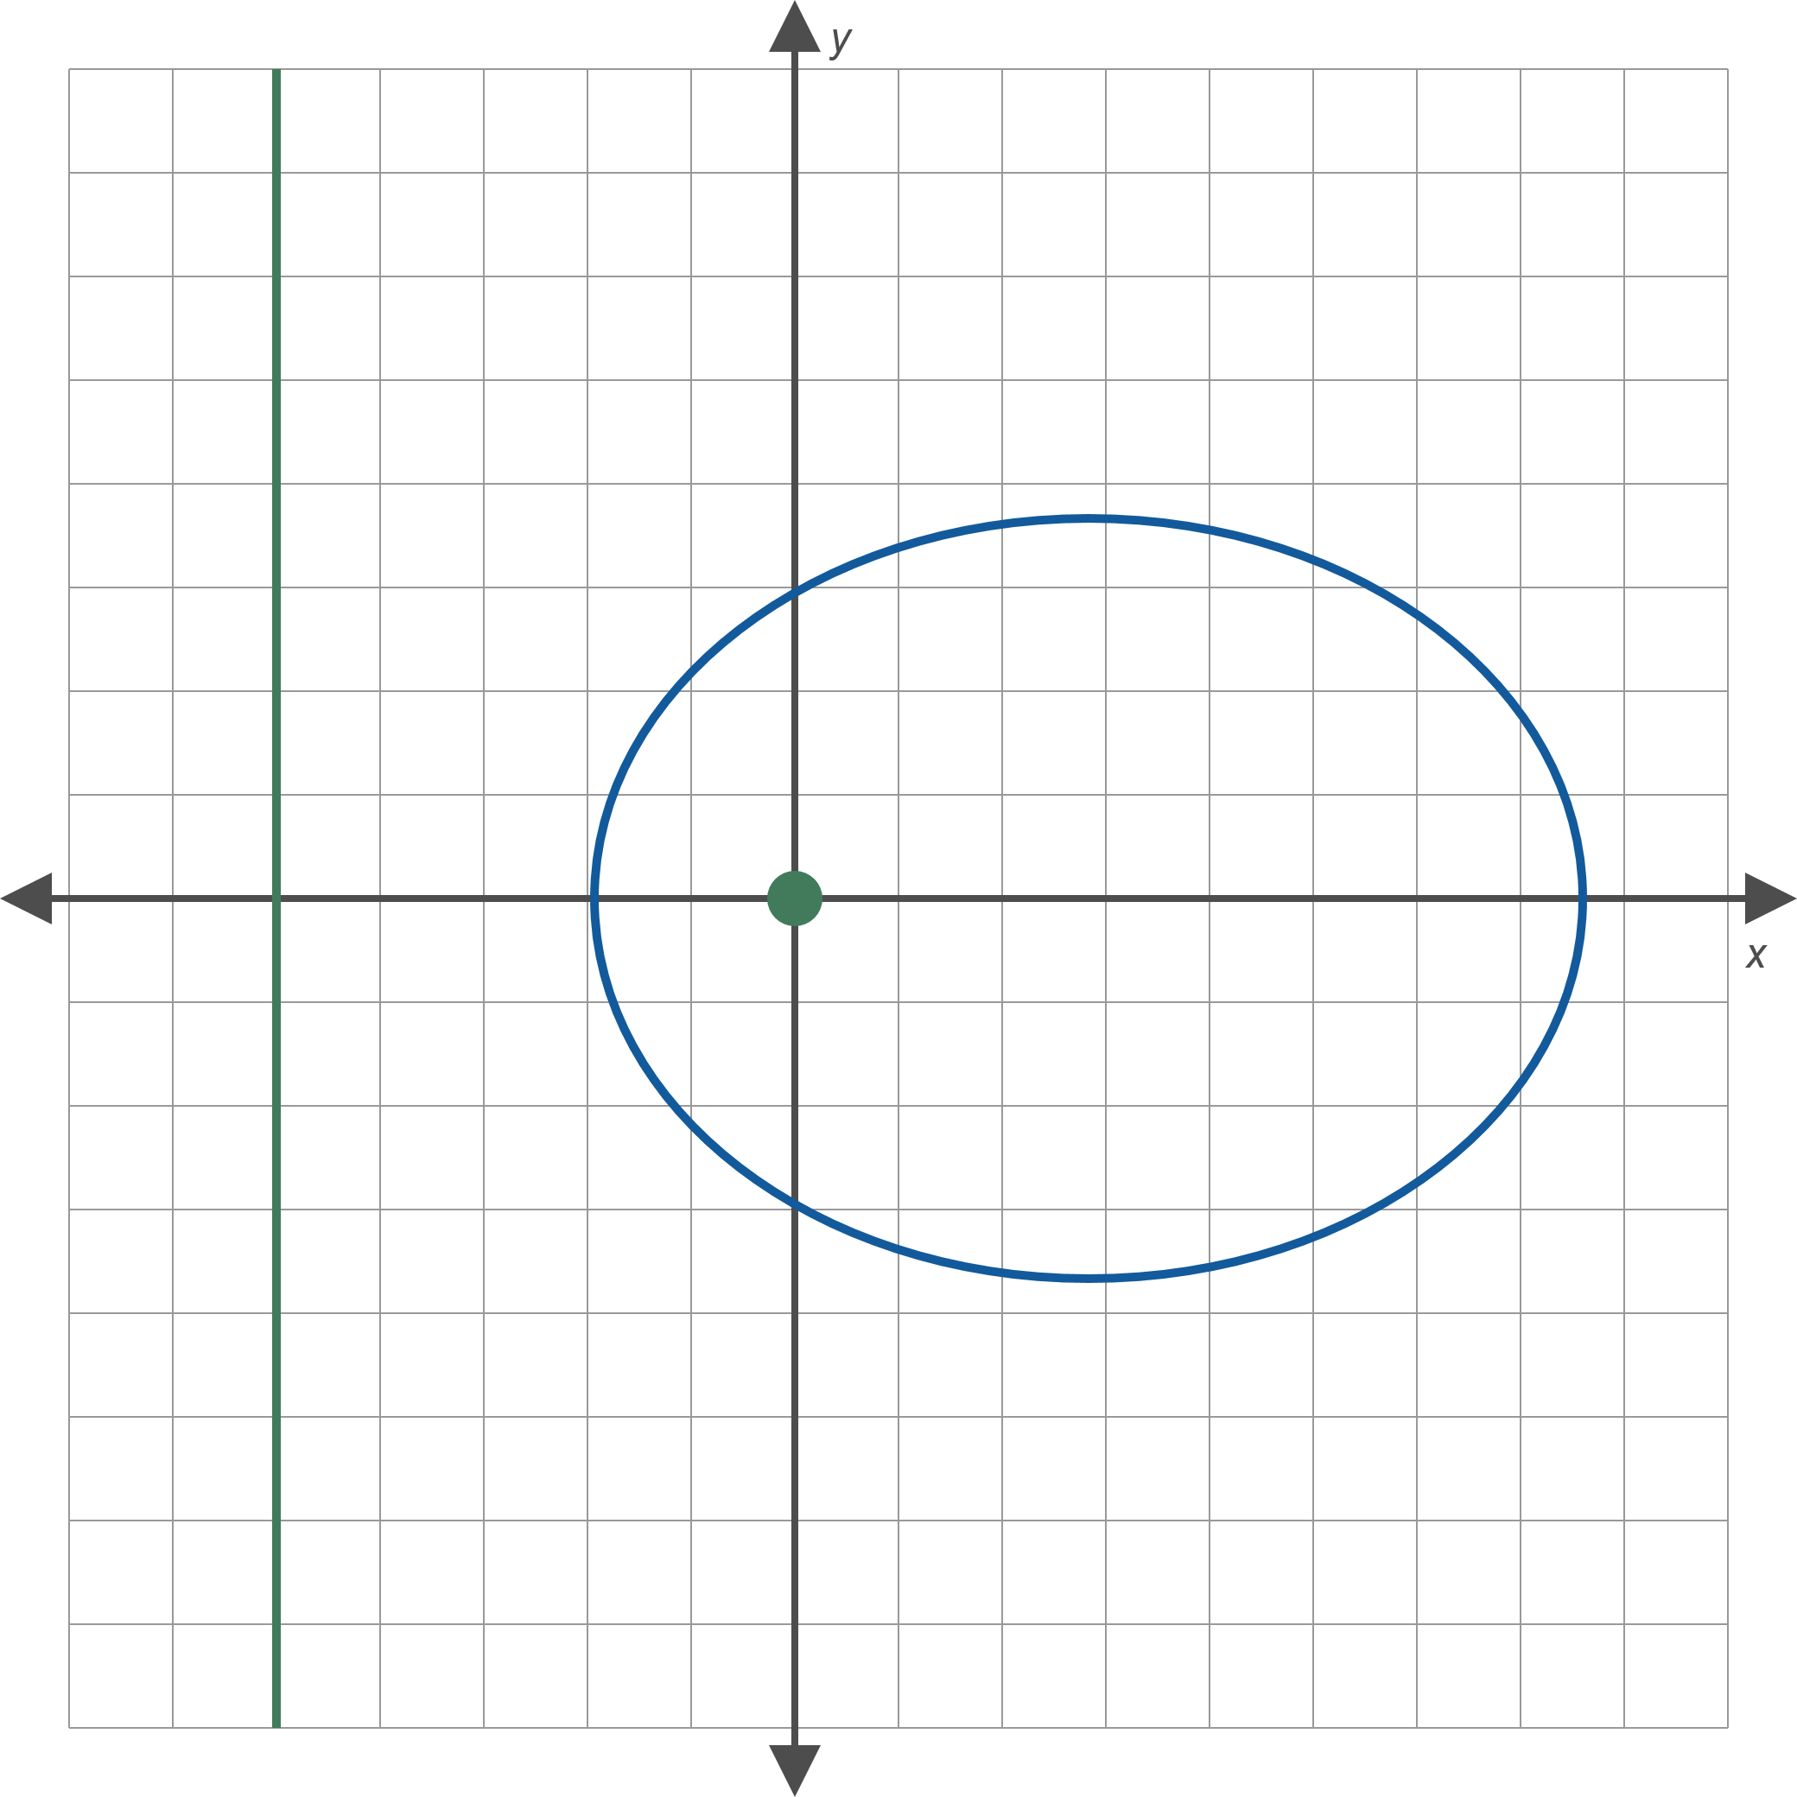
Example 3: Graphing Conic Sections in Polar Form (cont.)
Figure 4

Slide 16

Example 4: Graphing Conic Sections in Polar Form
Sketch the graph of the conic section $r=\frac{2}{3+5\sin{θ}}$.

Slide 17
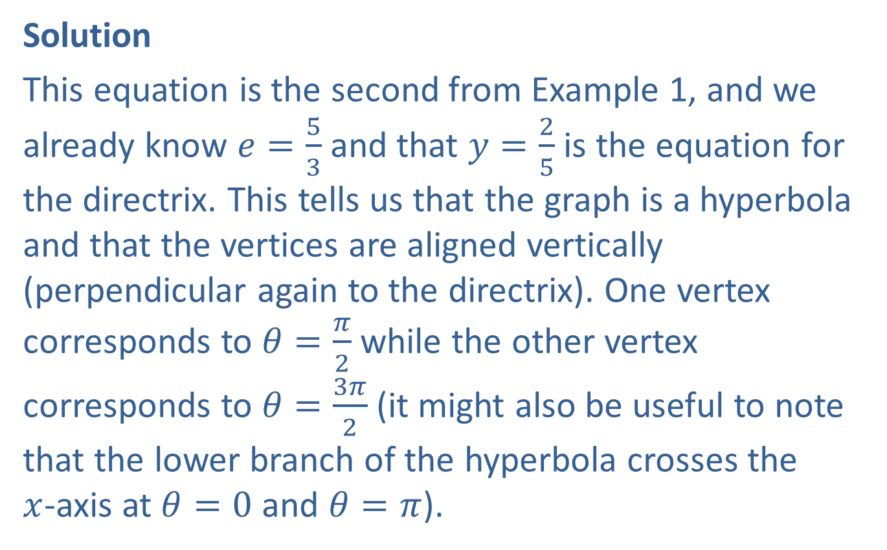
Example 4: Graphing Conic Sections in Polar Form (cont.)
Solution
This equation is the second from Example 1, and we already know $e=\frac{5}{3}$ and that $y=\frac{2}{5}$ is the equation for the directrix. This tells us that the graph is a hyperbola and that the vertices are aligned vertically (perpendicular again to the directrix). One vertex corresponds to $θ=\frac{π}{2}$ while the other vertex corresponds to $θ=\frac{3π}{2}$ (it might also be useful to note that the lower branch of the hyperbola crosses the
$x$-axis at $θ=0$ and $θ=π$).

Slide 18
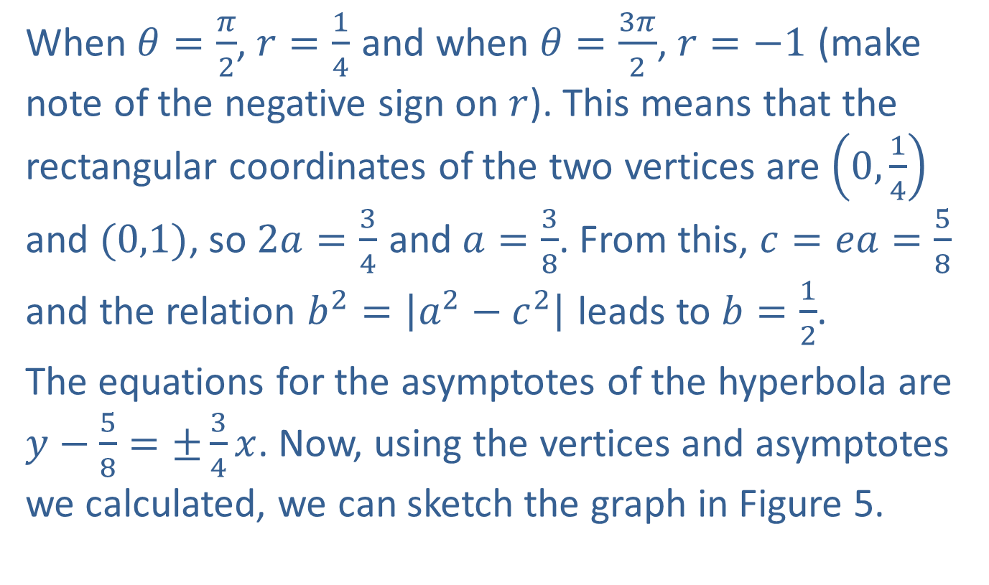
Example 4: Graphing Conic Sections in Polar Form (cont.)
When $θ=\frac{π}{2}$, $r=\frac{1}{4}$ and when $θ=\frac{3π}{2}$, $r=−1$ (make note of the negative sign on $r$). This means that the rectangular coordinates of the two vertices are $\left(0,\frac{1}{4}\right)$ and $(0,1)$, so $2a=\frac{3}{4}$ and $a=\frac{3}{8}$. From this, $c=ea=\frac{5}{8}$ and the relation $b^{2}=\left|a^{2}−c^{2}\right|$ leads to $b=\frac{1}{2}$.
The equations for the asymptotes of the hyperbola are $y−\frac{5}{8}=±\frac{3}{4}x$. Now, using the vertices and asymptotes we calculated, we can sketch the graph in Figure 5.

Slide 19
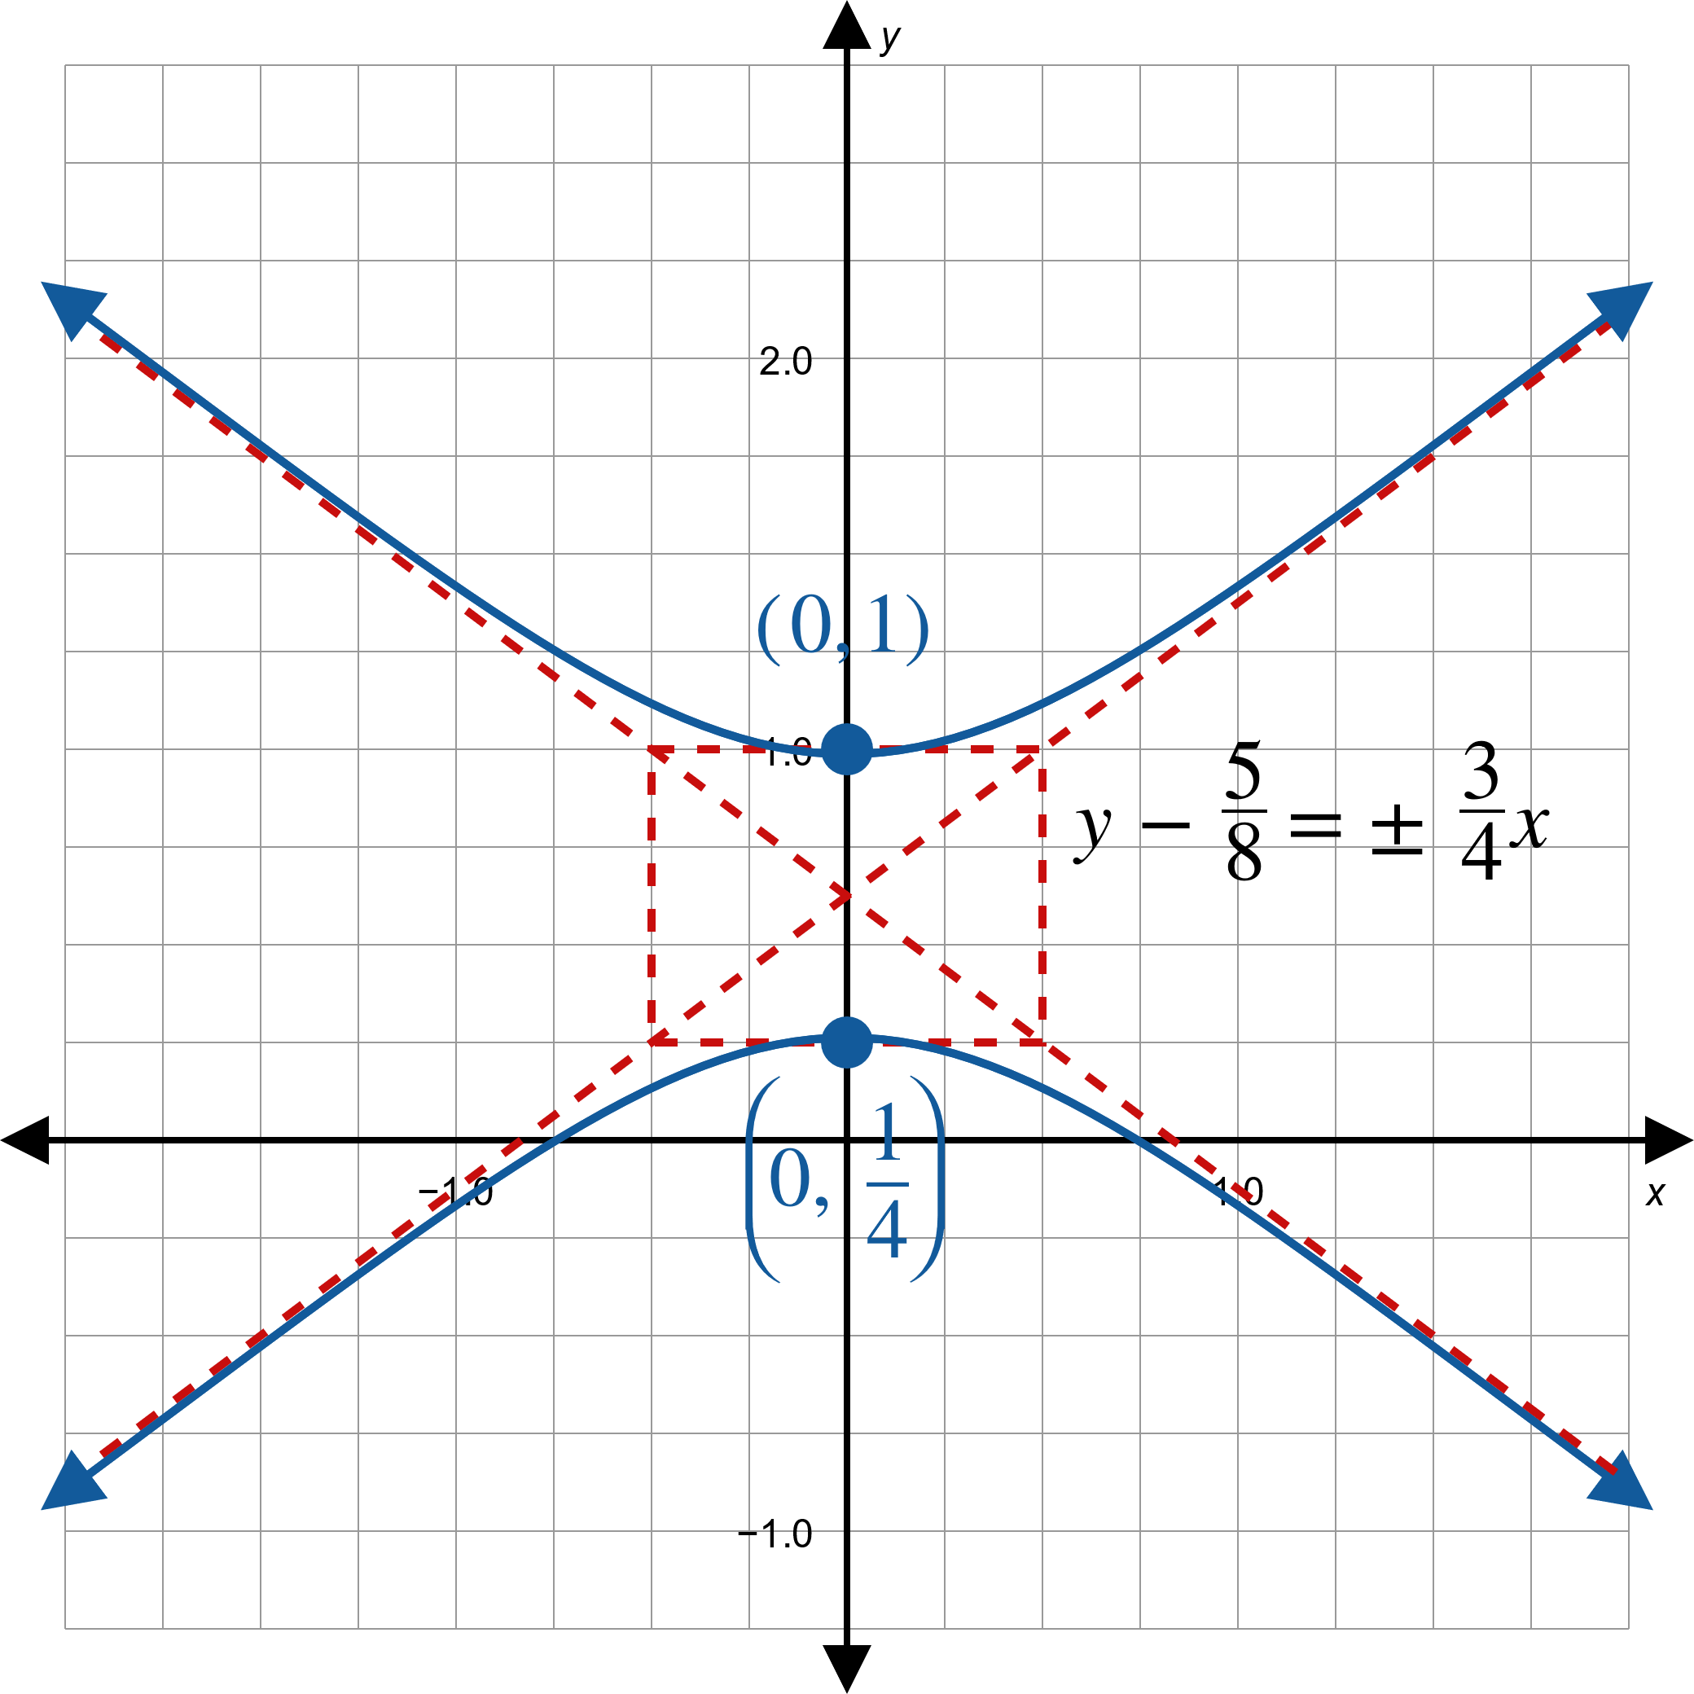
Example 4: Graphing Conic Sections in Polar Form (cont.)
Figure 5

Slide 20

Example 5: Graphing Conic Sections Using Rotation in Polar Coordinates
Sketch the graph of the conic section $r=\frac{2}{1+\cos\left(θ−\frac{π}{6}\right)}$.

Slide 21
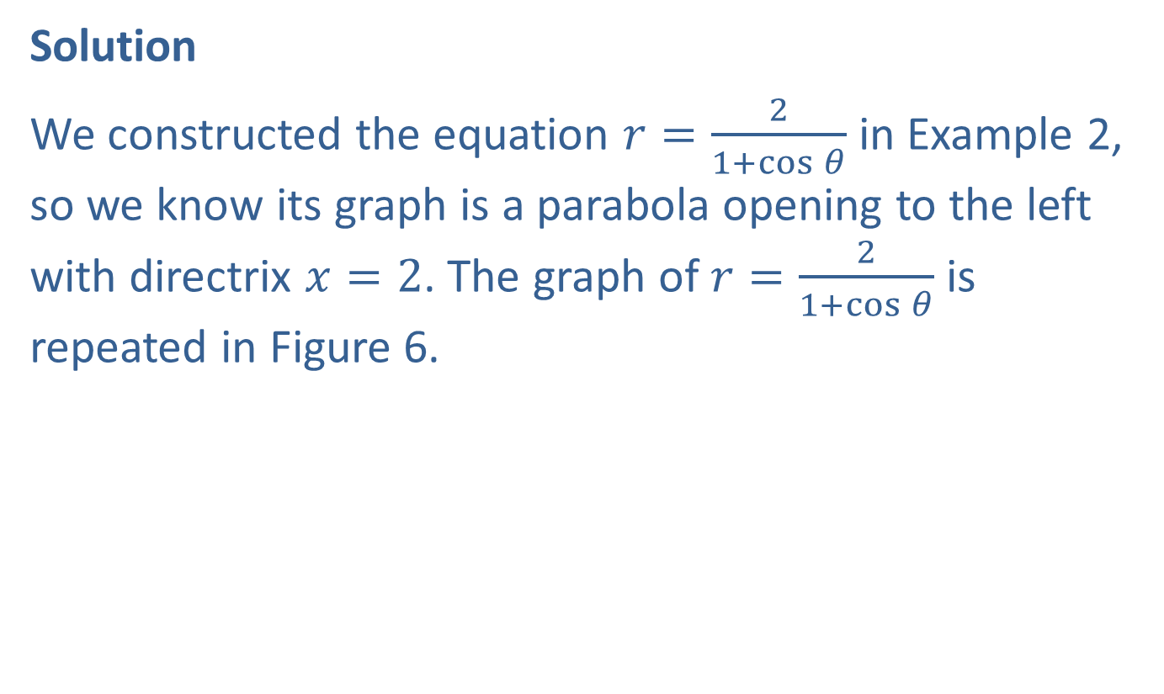
Example 5: Graphing Conic Sections Using Rotation in Polar Coordinates (cont.)
Solution
We constructed the equation $r=\frac{2}{1+\cos{θ}}$ in Example 2, so we know its graph is a parabola opening to the left with directrix $x=2$. The graph of $r=\frac{2}{1+\cos{θ}}$ is repeated in Figure 6.

Slide 22
Example 5: Graphing Conic Sections Using Rotation in Polar Coordinates (cont.)
Figure 6

Slide 23

Example 5: Graphing Conic Sections Using Rotation in Polar Coordinates (cont.)
The graph of $r=\frac{2}{1+\cos\left(θ−\frac{π}{6}\right)}$ is the same shape rotated $\frac{π}{6}$ radians counterclockwise.

Slide 24
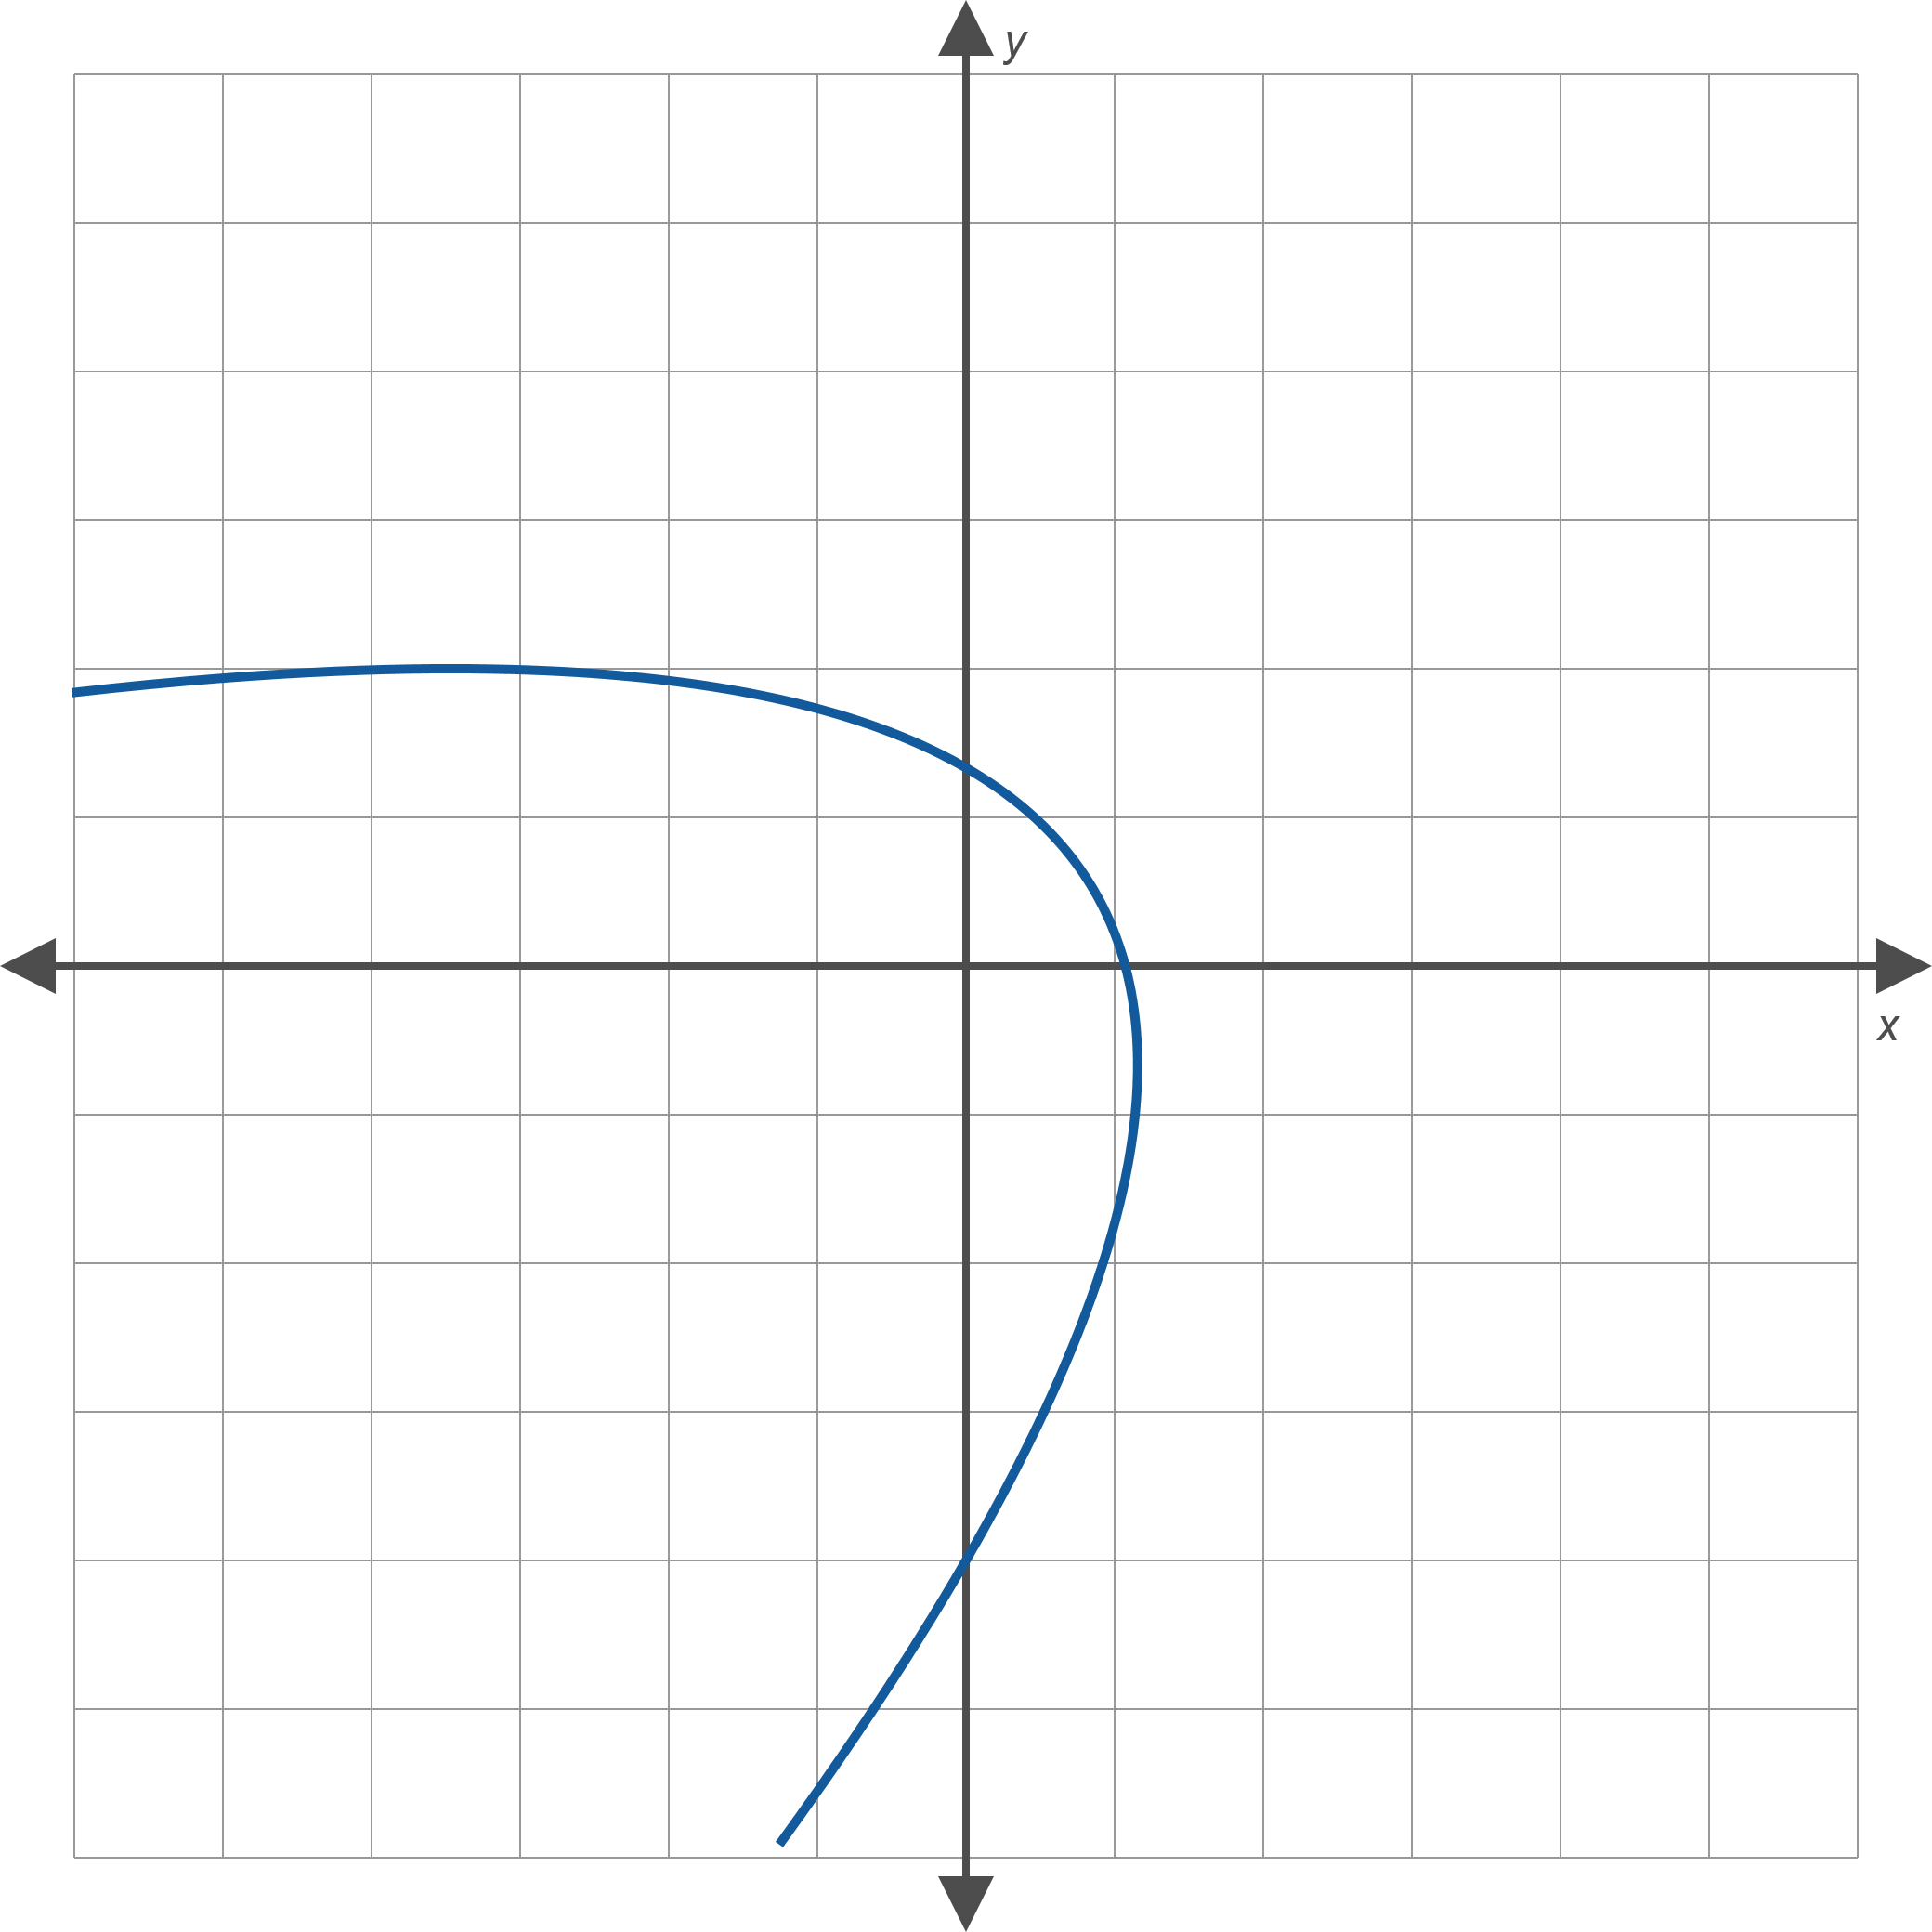
Example 5: Graphing Conic Sections Using Rotation in Polar Coordinates (cont.)
Figure 7

