Slide 1
Section 11.3
Determinants and Cramer's Rule

Slide 2
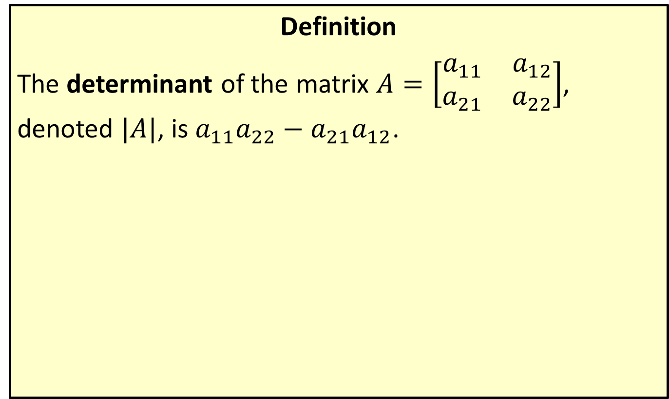
Determinant of a 2×2 Matrix
Definition
The determinant of the matrix $A=\left[\begin{matrix}a_{1⁣1} & a_{1⁣2} \\ a_{2⁣1} & a_{2⁣2}\end{matrix}\right]$, denoted $|A|$, is $a_{1⁣1}a_{2⁣2}−a_{2⁣1}a_{1⁣2}$.

Slide 3
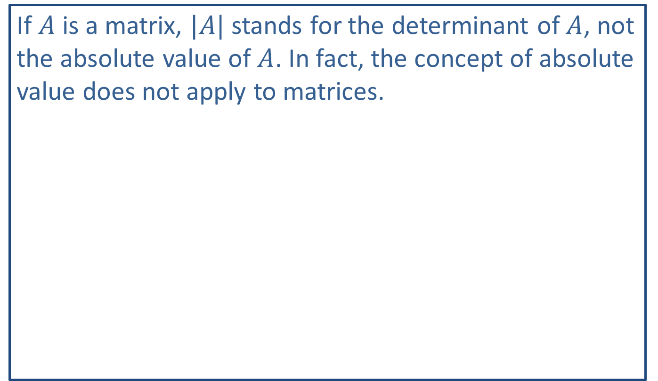
CAUTION!
If $A$ is a matrix, $|A|$ stands for the determinant of $A$, not the absolute value of $A$. In fact, the concept of absolute value does not apply to matrices.

Slide 4

Example 1: Determinant of a 2×2 Matrix
Evaluate the determinants of each of the following matrices:
​$A=\left[\begin{matrix}−2 & 3 \\ −1 & 3\end{matrix}\right]$
​$B=\left[\begin{matrix}2 & −3 \\ −4 & 6\end{matrix}\right]$

Slide 5

Example 1: Determinant of a 2×2 Matrix (cont.)
Solution
a. $\left|A\right|=a_{1⁣1}a_{2⁣2}−a_{2⁣1}a_{1⁣2}$ |𝐴 | =−23−−13=−6+3=−3
b. $\left|B\right|=b_{1⁣1}b_{2⁣2}−b_{2⁣1}b_{1⁣2}$ | 𝐵|=26−−4−3=12−12=0

Slide 6
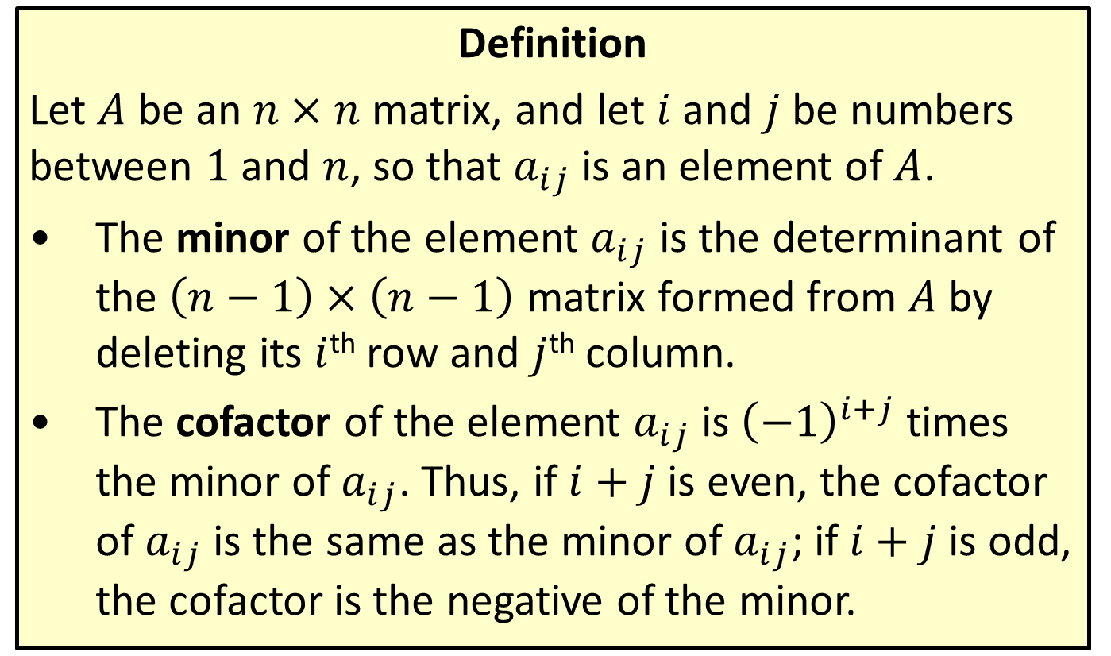
Minors and Cofactors
Definition
Let $A$ be an $n×n$ matrix, and let $i$ and $j$ be numbers between 1 and $n$, so that $a_{i⁣⁣j}$ is an element of $A$.
​The minor of the element $a_{i⁣⁣j}$ is the determinant of the $\left(n−1\right)×\left(n−1\right)$ matrix formed from $A$ by deleting its $i$^{th} row and $j$^{th} column.
​The cofactor of the element $a_{i⁣⁣j}$ is ${\left(−1\right)}^{i+j}$ times the minor of $a_{i⁣⁣j}$. Thus, if $i+j$ is even, the cofactor of $a_{i⁣⁣j}$ is the same as the minor of $a_{i⁣⁣j}$; if $i+j$ is odd, the cofactor is the negative of the minor.

Slide 7

Example 2: Minors and Cofactors
Consider the matrix $A=\left[\begin{matrix}−5 & 3 & 2 \\ 1 & 0 & −1 \\ −3 & 1 & 0\end{matrix}\right]$.
​Evaluate the minor of $a_{1⁣2}$.
​Evaluate the cofactor of $a_{2⁣3}$.

Slide 8
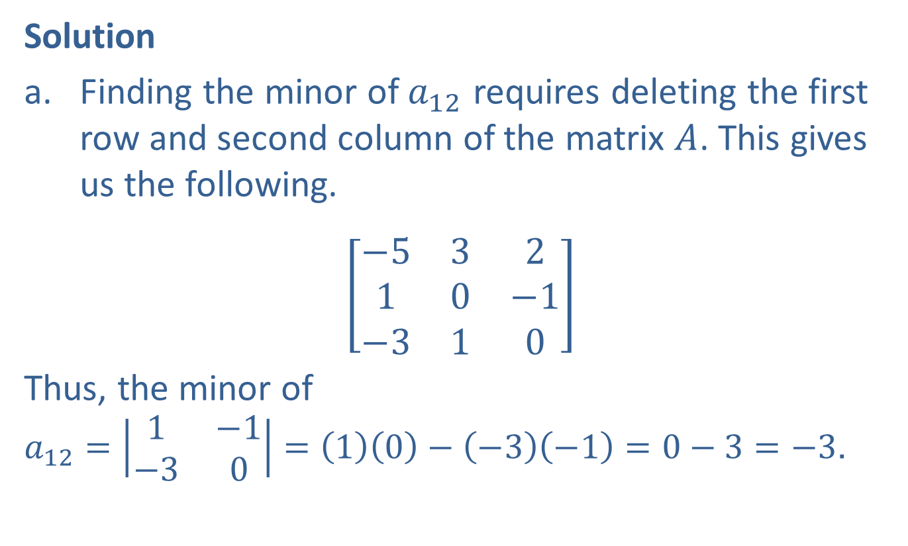
Example 2: Minors and Cofactors (cont.)
Solution
​Finding the minor of $a_{1⁣2}$ requires deleting the first row and second column of the matrix $A$. This gives us the following.
​$\left[\begin{matrix}−5 & 3 & 2 \\ 1 & 0 & −1 \\ −3 & 1 & 0\end{matrix}\right]$
​Thus, the minor of $a_{1⁣2}=\left|\begin{matrix}1 & −1 \\ −3 & 0\end{matrix}\right|=\left(1\right)\left(0\right)−\left(−3\right)\left(−1\right)=0−3=−3$.

Slide 9
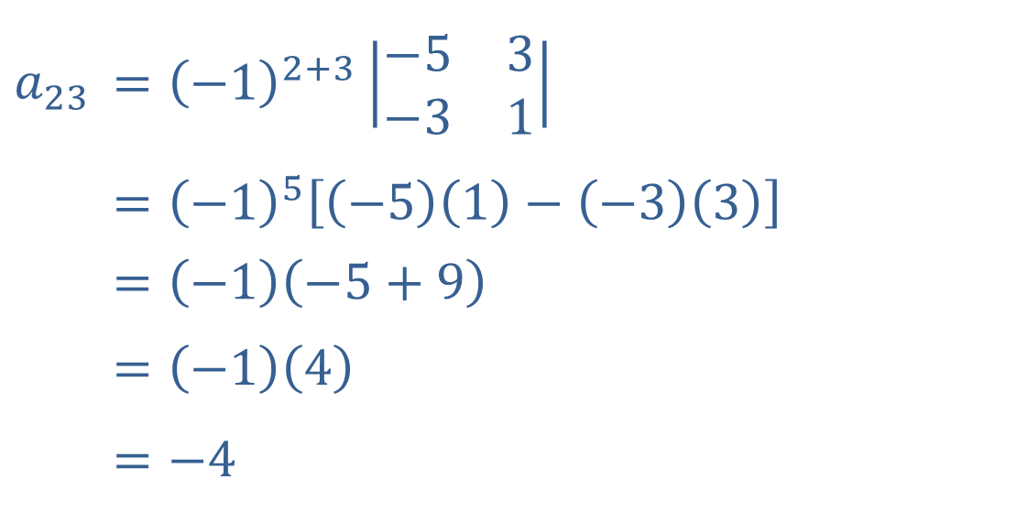

Example 2: Minors and Cofactors (cont.)
​The cofactor of $a_{23}$ is the minor of $a_{23}$ multiplied by $−1$, since $2+3$ is odd.
$$a_{2⁣3}$$ | ​$={\left(−1\right)}^{2+3}\left|\begin{matrix}−5 & 3 \\ −3 & 1\end{matrix}\right|$
 | ​$={\left(−1\right)}^{5}\left[\left(−5\right)\left(1\right)−\left(−3\right)\left(3\right)\right]$
 | $$=\left(−1\right)\left(−5+9\right)$$
 | $$=\left(−1\right)\left(4\right)$$
 | ​$=−4$

Slide 10
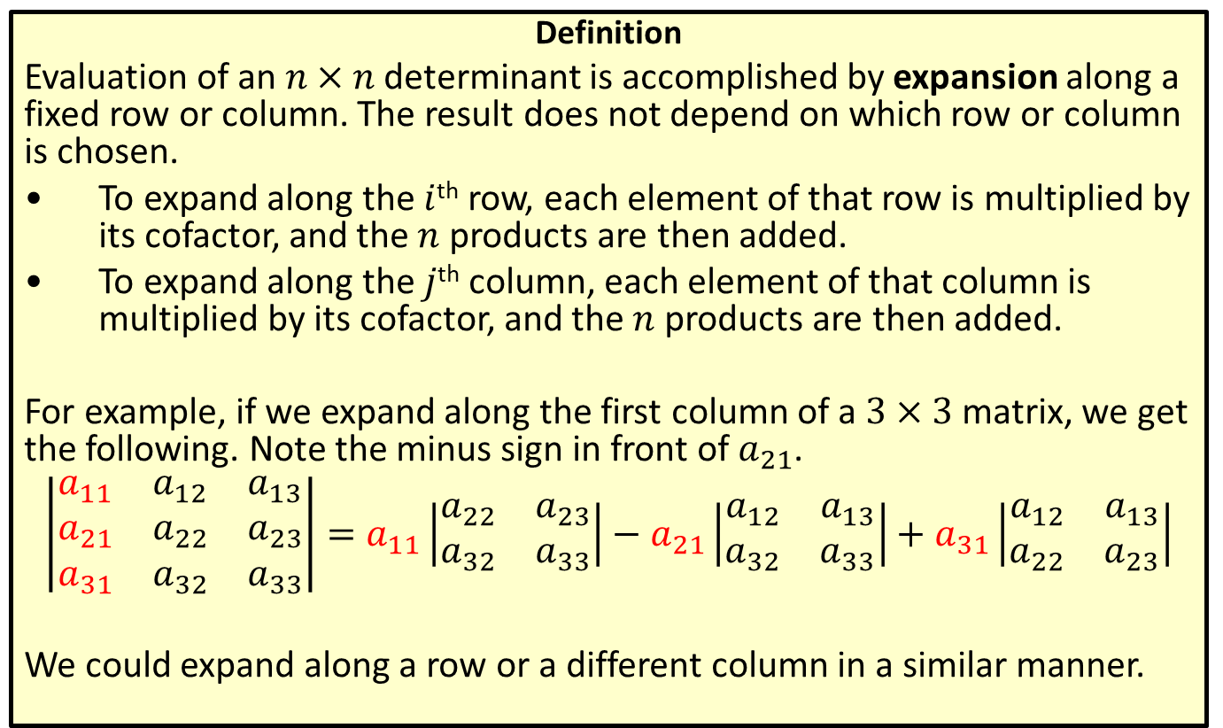

Determinant of an $n$ × $n$ Matrix
Definition
Evaluation of an $n×n$ determinant is accomplished by expansion along a fixed row or column. The result does not depend on which row or column is chosen.
​To expand along the $i$^{th} row, each element of that row is multiplied by its cofactor, and the $n$ products are then added.
​To expand along the $j$^{th} column, each element of that column is multiplied by its cofactor, and the $n$ products are then added.
For example, if we expand along the first column of a $3×3$ matrix, we get the following. Note the minus sign in front of $a_{2⁣1}$.
$$\left|\begin{matrix}a_{1⁣1} & a_{1⁣2} & a_{1⁣3} \\ a_{2⁣1} & a_{2⁣2} & a_{2⁣3} \\ a_{3⁣1} & a_{3⁣2} & a_{3⁣3}\end{matrix}\right|=a_{1⁣1}\left|\begin{matrix}a_{2⁣2} & a_{2⁣3} \\ a_{3⁣2} & a_{3⁣3}\end{matrix}\right|−a_{2⁣1}\left|\begin{matrix}a_{1⁣2} & a_{1⁣3} \\ a_{3⁣2} & a_{3⁣3}\end{matrix}\right|+a_{3⁣1}\left|\begin{matrix}a_{1⁣2} & a_{1⁣3} \\ a_{2⁣2} & a_{2⁣3}\end{matrix}\right|$$
We could expand along a row or a different column in a similar manner.

Slide 11


Example 3: Determinant of an $n$ × $n$ Matrix
Evaluate the determinant of the matrix
$A=\left[\begin{matrix}−1 & 3 & 2 \\ −2 & 0 & 0 \\ 4 & 1 & 5\end{matrix}\right]$.

Slide 12
Note:
Minimize the number of computations by choosing which row or column to expand along carefully.

Slide 13
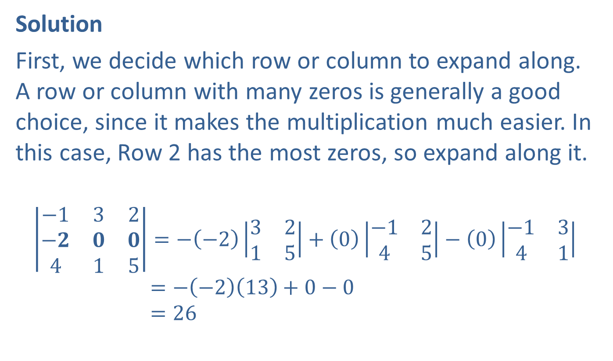

Example 3: Determinant of an $n$ × $n$ Matrix (cont.)
Solution
First, we decide which row or column to expand along. A row or column with many zeros is generally a good choice, since it makes the multiplication much easier. In this case, Row 2 has the most zeros, so expand along it.
−132−𝟐𝟎𝟎415=−−23215+0−1245−0−1341|−132|=−−213+0−0|−132|=26

Slide 14
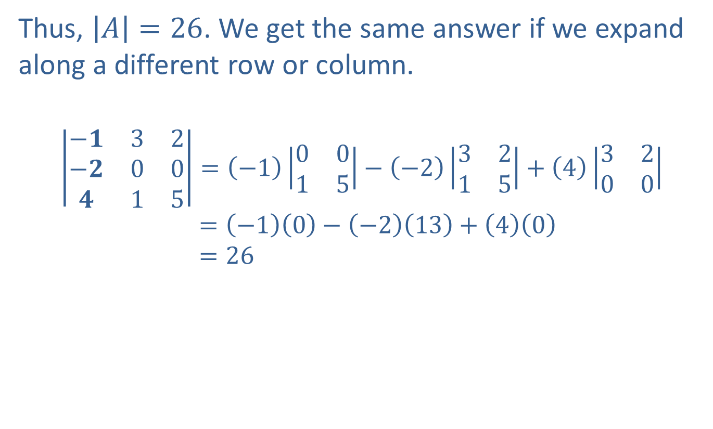
Example 3: Determinant of an $n$ × $n$ Matrix (cont.)
Thus, $\left|A\right|=26$. We get the same answer if we expand along a different row or column.
−𝟏32−𝟐00𝟒15=−10015−−23215+43200|−132|=−10−−213+40|−132|=26

Slide 15
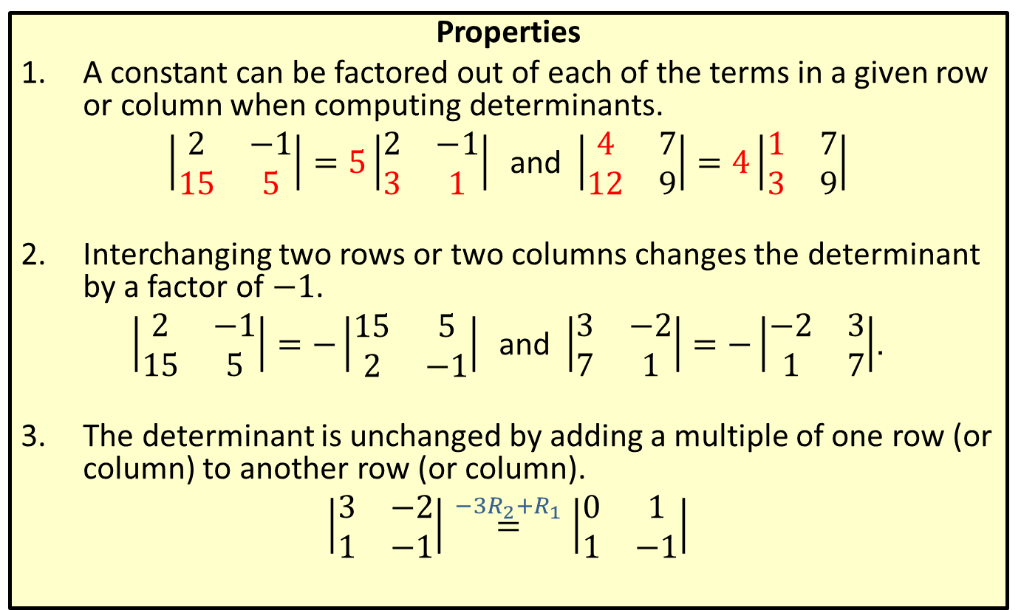
Properties of Determinants
Properties
​A constant can be factored out of each of the terms in a given row or column when computing determinants.
​$\left|\begin{matrix}2 & −1 \\ 15 & 5\end{matrix}\right|=5\left|\begin{matrix}2 & −1 \\ 3 & 1\end{matrix}\right|$ and $\left|\begin{matrix}4 & 7 \\ 12 & 9\end{matrix}\right|=4\left|\begin{matrix}1 & 7 \\ 3 & 9\end{matrix}\right|$
​
Interchanging two rows or two columns changes the determinant by a factor of $−1$.
​$\left|\begin{matrix}2 & −1 \\ 15 & 5\end{matrix}\right|=−\left|\begin{matrix}15 & 5 \\ 2 & −1\end{matrix}\right|$ and $\left|\begin{matrix}3 & −2 \\ 7 & 1\end{matrix}\right|=−\left|\begin{matrix}−2 & 3 \\ 1 & 7\end{matrix}\right|$.
​The determinant is unchanged by adding a multiple of one row (or column) to another row (or column).
​$\left|\begin{matrix}3 & −2 \\ 1 & −1\end{matrix}\right|\overset{−3R_{2}+R_{1}}{=}\left|\begin{matrix}0 & 1 \\ 1 & −1\end{matrix}\right|$

Slide 16

Example 4: Properties of Determinants
Evaluate the determinant of the matrix
$B=\left[\begin{matrix}4 & −2 & 3 & 0 \\ 2 & 1 & −1 & 3 \\ 3 & 0 & 1 & 1 \\ 2 & −2 & 0 & 0\end{matrix}\right]$.

Slide 17
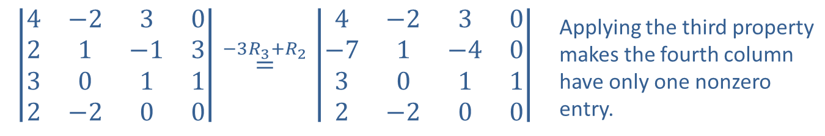
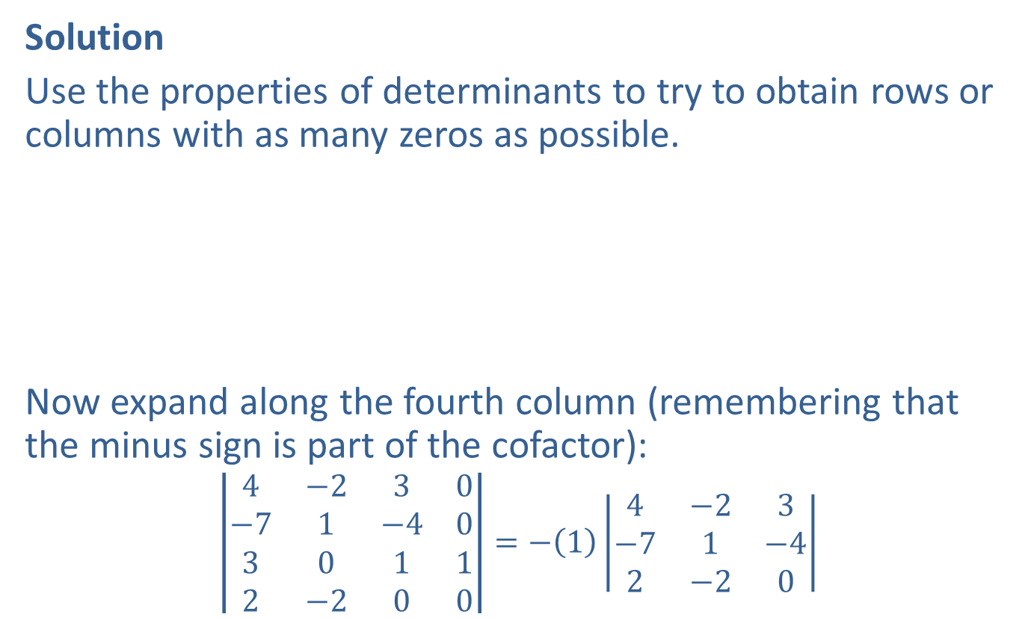
Example 4: Properties of Determinants (cont.)
Solution
Use the properties of determinants to try to obtain rows or columns with as many zeros as possible.
Now expand along the fourth column (remembering that the minus sign is part of the cofactor):
$$\left|\begin{matrix}4 & −2 & 3 & 0 \\ −7 & 1 & −4 & 0 \\ 3 & 0 & 1 & 1 \\ 2 & −2 & 0 & 0\end{matrix}\right|=−\left(1\right)\left|\begin{matrix}4 & −2 & 3 \\ −7 & 1 & −4 \\ 2 & −2 & 0\end{matrix}\right|$$
$$\left|\begin{matrix}4 & −2 & 3 & 0 \\ 2 & 1 & −1 & 3 \\ 3 & 0 & 1 & 1 \\ 2 & −2 & 0 & 0\end{matrix}\right|\overset{−3R_{3}+R_{2}}{=}\left|\begin{matrix}4 & −2 & 3 & 0 \\ −7 & 1 & −4 & 0 \\ 3 & 0 & 1 & 1 \\ 2 & −2 & 0 & 0\end{matrix}\right|$$ | Applying the third property makes the fourth column have only one nonzero entry.

Slide 18
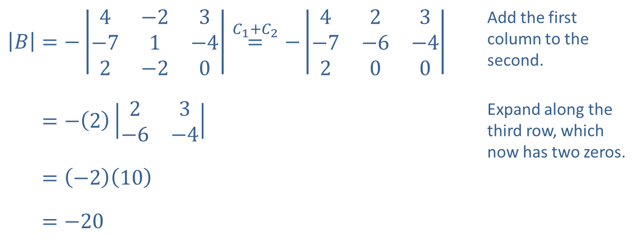

Example 4: Properties of Determinants (cont.)
We can continue to apply the third property of determinants to simplify the evaluation of the $3×3$ determinant.
​$\left|B\right|=−\left|\begin{matrix}4 & −2 & 3 \\ −7 & 1 & −4 \\ 2 & −2 & 0\end{matrix}\right|\overset{C_{1}+C_{2}}{=}−\left|\begin{matrix}4 & 2 & 3 \\ −7 & −6 & −4 \\ 2 & 0 & 0\end{matrix}\right|$ | Add the first column to the second.
​|𝐵|=−223−6−4 | Expand along the third row, which now has two zeros.
​|𝐵|=−210
​|𝐵|=−20

Slide 19

Example 4: Properties of Determinants (cont.)
Notice that we have reduced the work to the evaluation of only one $3×3$ determinant, which in turn involved evaluating only one $2×2$ determinant.

Slide 20
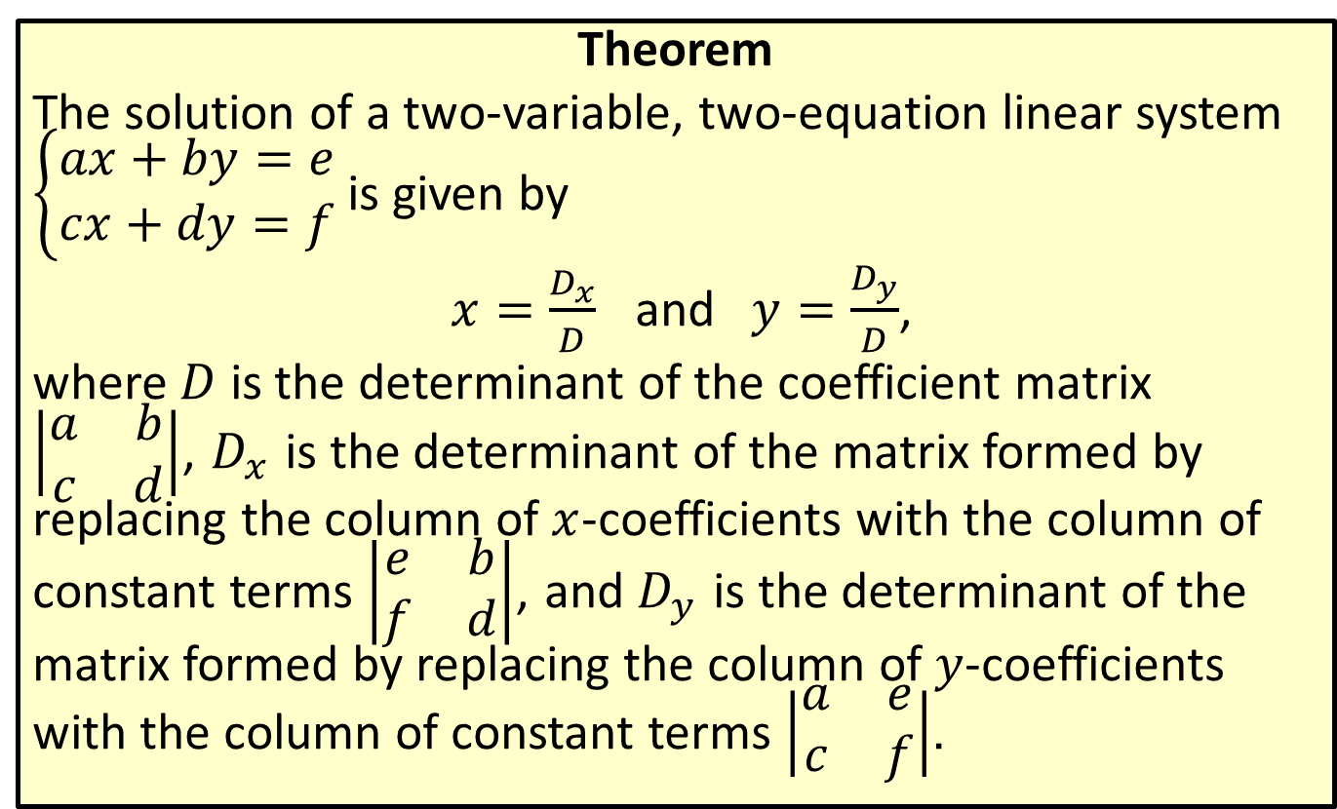
Cramer's Rule for Two-Variable, Two-Equation Linear Systems
Theorem
The solution of a two-variable, two-equation linear system $\left\{\begin{aligned}ax+by=e \\ cx+dy=f\end{aligned}\right.$ is given by
$x=\frac{D_{x}}{D}$ and $y=\frac{D_{y}}{D}$,
where $D$ is the determinant of the coefficient matrix $\left|\begin{matrix}a & b \\ c & d\end{matrix}\right|$, $D_{x}$ is the determinant of the matrix formed by replacing the column of $x$-coefficients with the column of constant terms $\left|\begin{matrix}e & b \\ f & d\end{matrix}\right|$, and $D_{y}$ is the determinant of the matrix formed by replacing the column of $y$-coefficients with the column of constant terms $\left|\begin{matrix}a & e \\ c & f\end{matrix}\right|$.

Slide 21
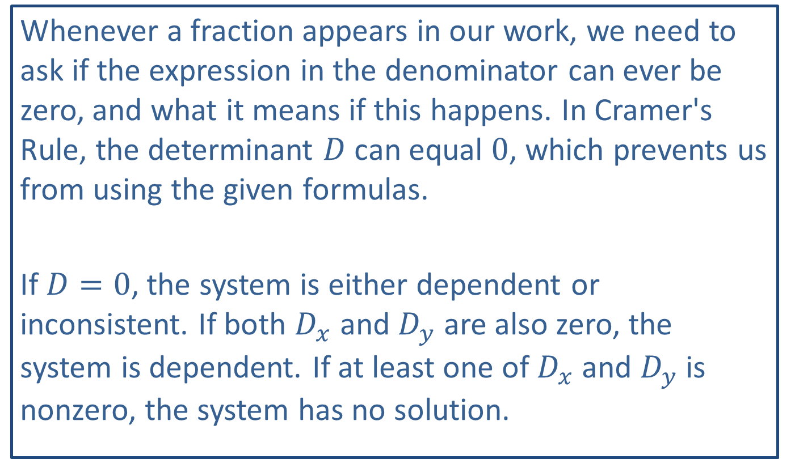
CAUTION!
Whenever a fraction appears in our work, we need to ask if the expression in the denominator can ever be zero, and what it means if this happens. In Cramer's Rule, the determinant $D$ can equal 0, which prevents us from using the given formulas.
If $D=0$, the system is either dependent or inconsistent. If both $D_{x}$ and $D_{y}$ are also zero, the system is dependent. If at least one of $D_{x}$ and $D_{y}$ is nonzero, the system has no solution.

Slide 22

Example 5: Cramer's Rule
Use Cramer's Rule to solve the following systems.
​$\left\{\begin{aligned} 4x−5y=3 \\ −3x+7y=1\end{aligned}\right.$
​−𝑥+2𝑦=−13𝑥−6𝑦=3−

Slide 23
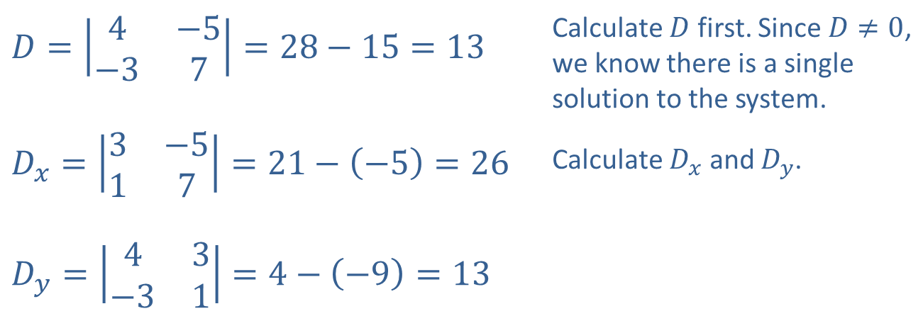
Example 5: Cramer's Rule (cont.)
Solution
​
​$D=\left|\begin{matrix}4 & −5 \\ −3 & 7\end{matrix}\right|=28−15=13$ | Calculate $D$ first. Since $D≠0$, we know there is a single solution to the system.
​$D_{x}=\left|\begin{matrix}3 & −5 \\ 1 & 7\end{matrix}\right|=21−\left(−5\right)=26$ | Calculate $D_{x}$ and $D_{y}$.
​$D_{y}=\left|\begin{matrix}4 & 3 \\ −3 & 1\end{matrix}\right|=4−\left(−9\right)=13$

Slide 24

Example 5: Cramer's Rule (cont.)
​Applying Cramer's Rule, we have $x=\frac{D_{x}}{D}=\frac{26}{13}=2$ and $y=\frac{D_{y}}{D}=\frac{13}{13}=1$, so the solution is $(2,1)$.

Slide 25
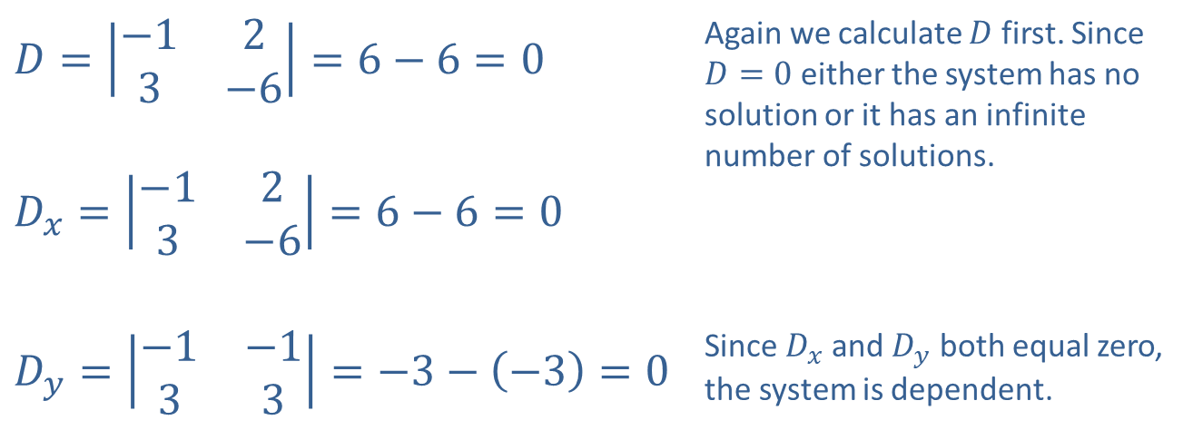
Example 5: Cramer's Rule (cont.)
​$D=\left|\begin{matrix}−1 & 2 \\ 3 & −6\end{matrix}\right|=6−6=0$ | Again we calculate $D$ first. Since $D=0$ either the system has no solution or it has an infinite number of solutions.
​$D_{x}=\left|\begin{matrix}−1 & 2 \\ 3 & −6\end{matrix}\right|=6−6=0$
​$D_{y}=\left|\begin{matrix}−1 & −1 \\ 3 & 3\end{matrix}\right|=−3−\left(−3\right)=0$ | Since $D_{x}$ and $D_{y}$ both equal zero, the system is dependent.
​

Slide 26

Example 5: Cramer's Rule (cont.)
​The solution set can be found by solving either equation for either variable: $\left\{\left(2y+1,y\right)\left|y∈ℝ\right. \right\}$.

Slide 27
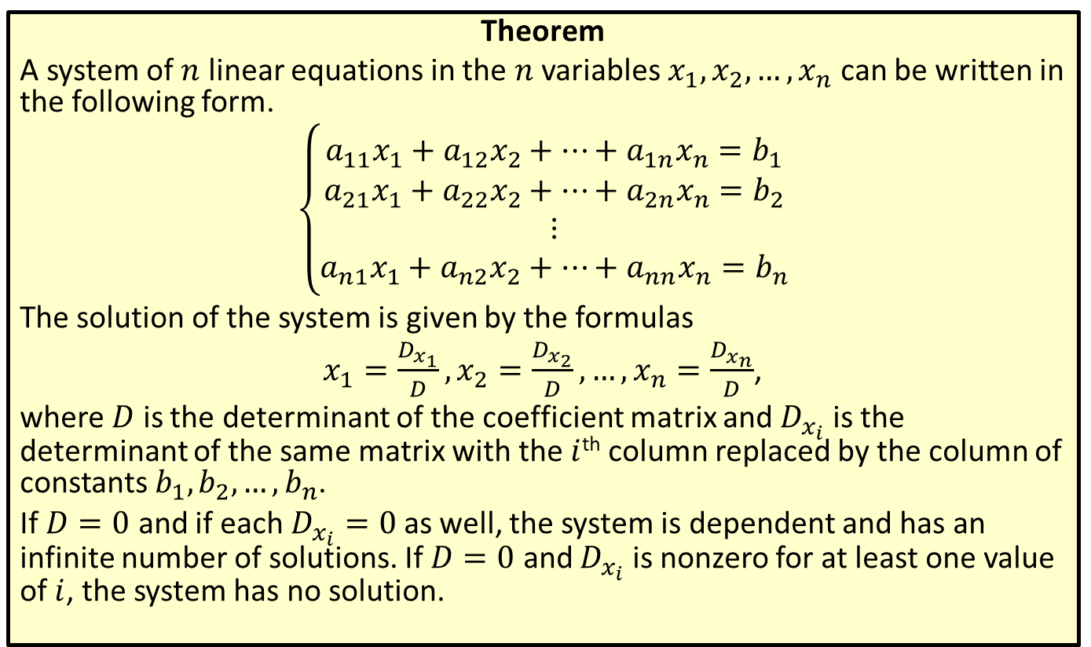
Cramer's Rule
Theorem
A system of $n$ linear equations in the $n$ variables $x_{1},x_{2},…,x_{n}$ can be written in the following form.
$$\left\{\begin{aligned}a_{1⁣1}x_{1}+a_{1⁣2}x_{2}+…+a_{1⁣n}x_{n}=b_{1} \\ a_{2⁣1}x_{1}+a_{2⁣2}x_{2}+…+a_{2⁣n}x_{n}=b_{2} \\ ⋮ \\ a_{n⁣1}x_{1}+a_{n⁣2}x_{2}+…+a_{n⁣n}x_{n}=b_{n}\end{aligned}\right.$$
The solution of the system is given by the formulas
$x_{1}=\frac{D_{x_{1}}}{D},x_{2}=\frac{D_{x_{2}}}{D},…,x_{n}=\frac{D_{x_{n}}}{D}$,
where $D$ is the determinant of the coefficient matrix and $D_{x_{i}}$ is the determinant of the same matrix with the $i$^{th} column replaced by the column of constants $b_{1},b_{2},…,b_{n}$.
If $D=0$ and if each $D_{x_{i}}=0$ as well, the system is dependent and has an infinite number of solutions. If $D=0$ and $D_{x_{i}}$ is nonzero for at least one value of $i$, the system has no solution.

Slide 28

Example 6: Cramer's Rule
Use Cramer's Rule to solve the system
$\left\{\begin{matrix}3x−2y−2z & = & −1 \\ 3y+z & = & −7 \\ x+y+2z & = & 0\end{matrix}\right.$.

Slide 29
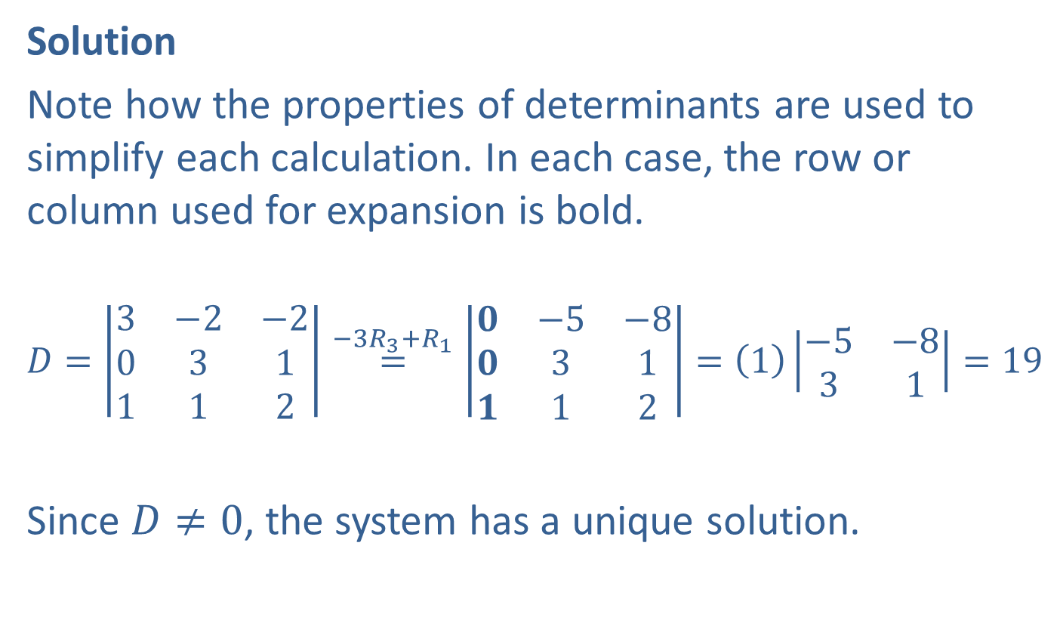
Example 6: Cramer's Rule (cont.)
Solution
Note how the properties of determinants are used to simplify each calculation. In each case, the row or column used for expansion is bold.
$$D=\left|\begin{matrix}3 & −2 & −2 \\ 0 & 3 & 1 \\ 1 & 1 & 2\end{matrix}\right|\overset{{−3R}_{3}+R_{1}}{=}\left|\begin{matrix}0 & −5 & −8 \\ 0 & 3 & 1 \\ 1 & 1 & 2\end{matrix}\right|=\left(1\right)\left|\begin{matrix}−5 & −8 \\ 3 & 1\end{matrix}\right|=19$$
Since $D≠0$, the system has a unique solution.

Slide 30
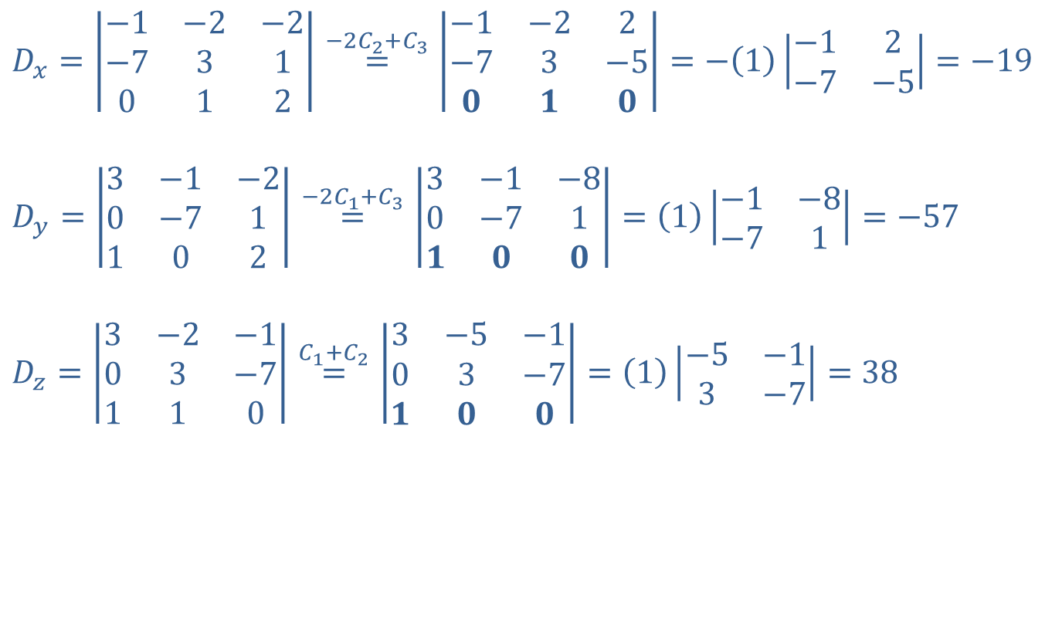
Example 6: Cramer's Rule (cont.)
$$D_{x}=\left|\begin{matrix}−1 & −2 & −2 \\ −7 & 3 & 1 \\ 0 & 1 & 2\end{matrix}\right|\overset{{−2C}_{2}+C_{3}}{=}\left|\begin{matrix}−1 & −2 & 2 \\ −7 & 3 & −5 \\ 0 & 1 & 0\end{matrix}\right|=−\left(1\right)\left|\begin{matrix}−1 & 2 \\ −7 & −5\end{matrix}\right|=−19$$
$$D_{y}=\left|\begin{matrix}3 & −1 & −2 \\ 0 & −7 & 1 \\ 1 & 0 & 2\end{matrix}\right|\overset{{−2C}_{1}+C_{3}}{=}\left|\begin{matrix}3 & −1 & −8 \\ 0 & −7 & 1 \\ 1 & 0 & 0\end{matrix}\right|=\left(1\right)\left|\begin{matrix}−1 & −8 \\ −7 & 1\end{matrix}\right|=−57$$
$$D_{z}=\left|\begin{matrix}3 & −2 & −1 \\ 0 & 3 & −7 \\ 1 & 1 & 0\end{matrix}\right|\overset{C_{1}+C_{2}}{=}\left|\begin{matrix}3 & −5 & −1 \\ 0 & 3 & −7 \\ 1 & 0 & 0\end{matrix}\right|=\left(1\right)\left|\begin{matrix}−5 & −1 \\ 3 & −7\end{matrix}\right|=38$$

Slide 31

Example 6: Cramer's Rule (cont.)
After evaluating $D_{x}$, $D_{y}$, and $D_{z}$, we know the solution is the single ordered triple
$\left(x,y,z\right)=\left(\frac{D_{x}}{D},\frac{D_{y}}{D},\frac{D_{z}}{D}\right)=\left(\frac{−19}{19},\frac{−57}{19},\frac{38}{19}\right)=\left(−1,−3,2\right)$.

