Slide 1
Section 11.7
Systems of Linear Inequalities and Linear Programming

Slide 2

Example 1: Graphing the Solution of a System of Linear Inequalities
Graph the solution set to the following system of linear inequalities.
$$\left\{\begin{matrix}x<2 \\ y≤\frac{x}{2}+1 \\ x+y≥−3\end{matrix}\right.$$

Slide 3
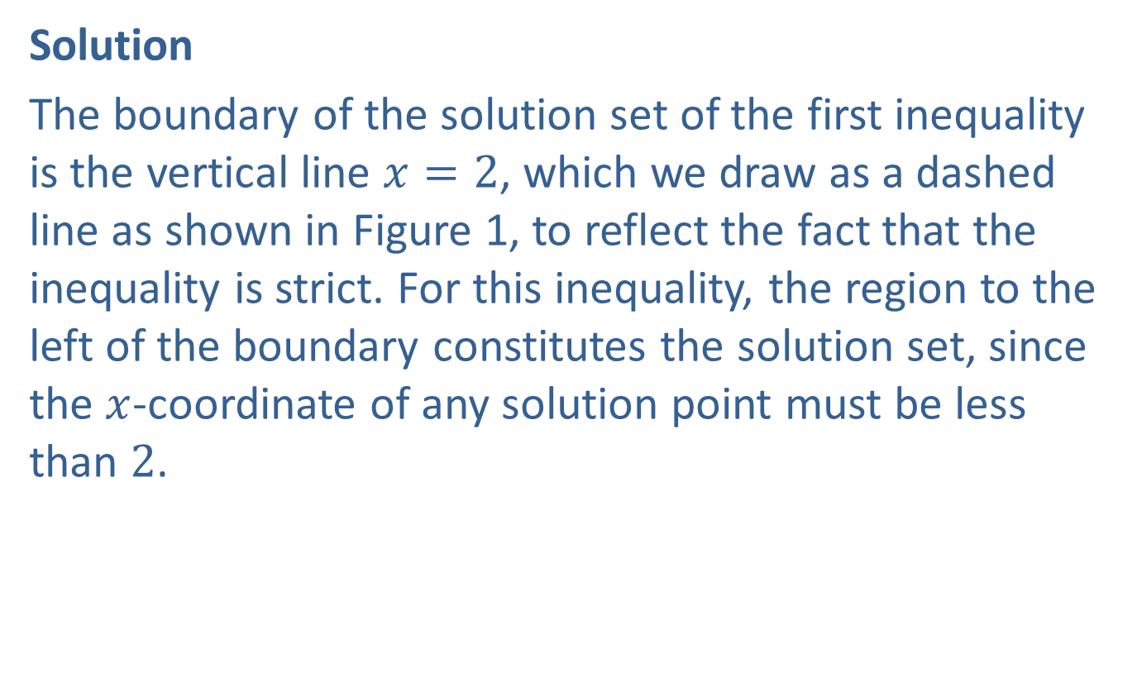
Example 1: Graphing the Solution of a System of Linear Inequalities (cont.)
Solution
The boundary of the solution set of the first inequality is the vertical line $x=2$, which we draw as a dashed line as shown in Figure 1, to reflect the fact that the inequality is strict. For this inequality, the region to the left of the boundary constitutes the solution set, since the $x$-coordinate of any solution point must be less than 2.

Slide 4
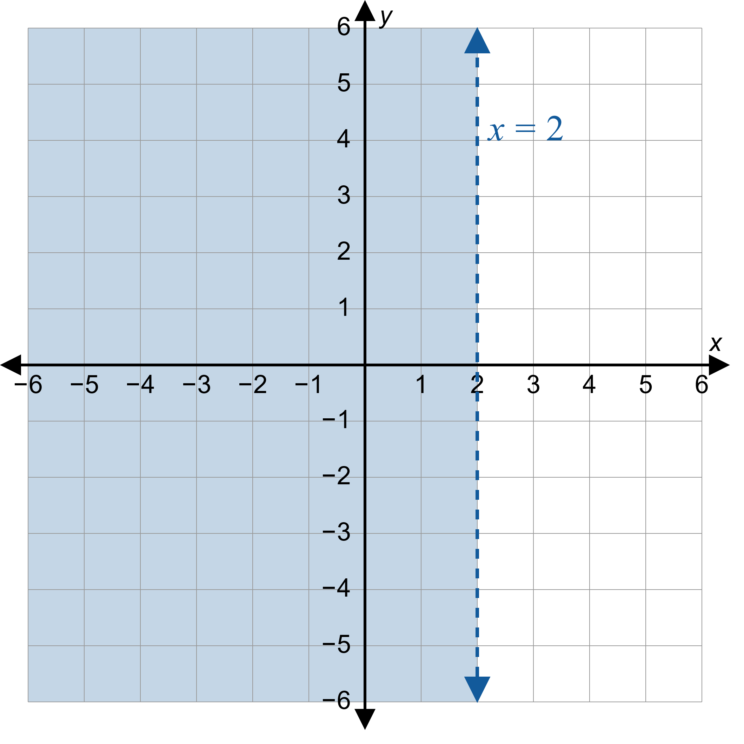
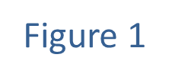
Example 1: Graphing the Solution of a System of Linear Inequalities (cont.)

Slide 5
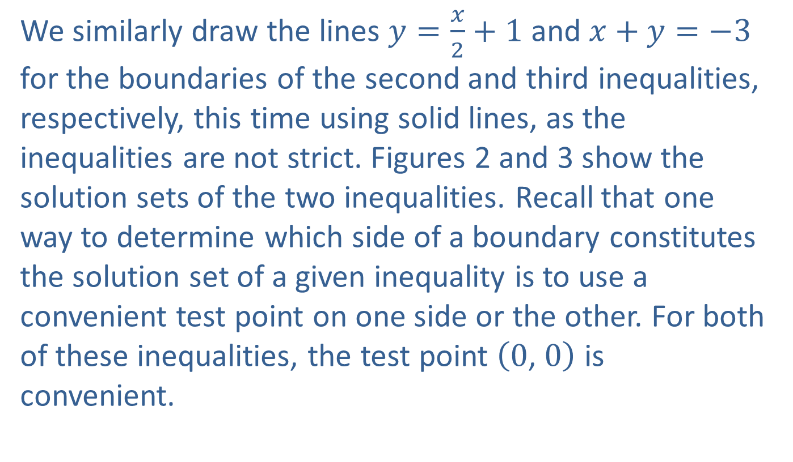
Example 1: Graphing the Solution of a System of Linear Inequalities (cont.)
We similarly draw the lines $y=\frac{x}{2}+1$ and $x+y=−3$ for the boundaries of the second and third inequalities, respectively, this time using solid lines, as the inequalities are not strict. Figures 2 and 3 show the solution sets of the two inequalities. Recall that one way to determine which side of a boundary constitutes the solution set of a given inequality is to use a convenient test point on one side or the other. For both of these inequalities, the test point $\left(0\text{, }0\right)$ is convenient.

Slide 6
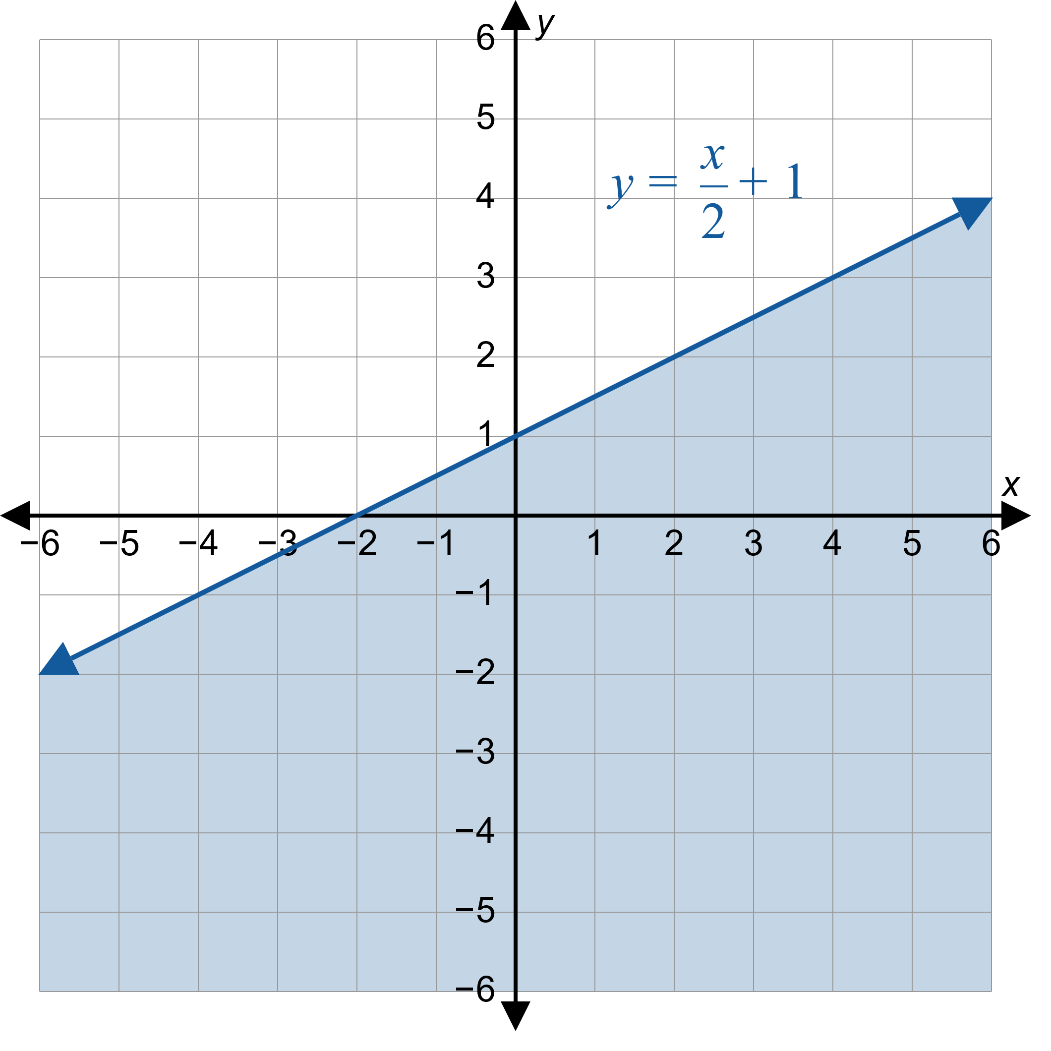
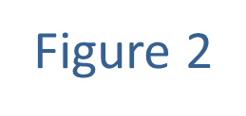
Example 1: Graphing the Solution of a System of Linear Inequalities (cont.)

Slide 7
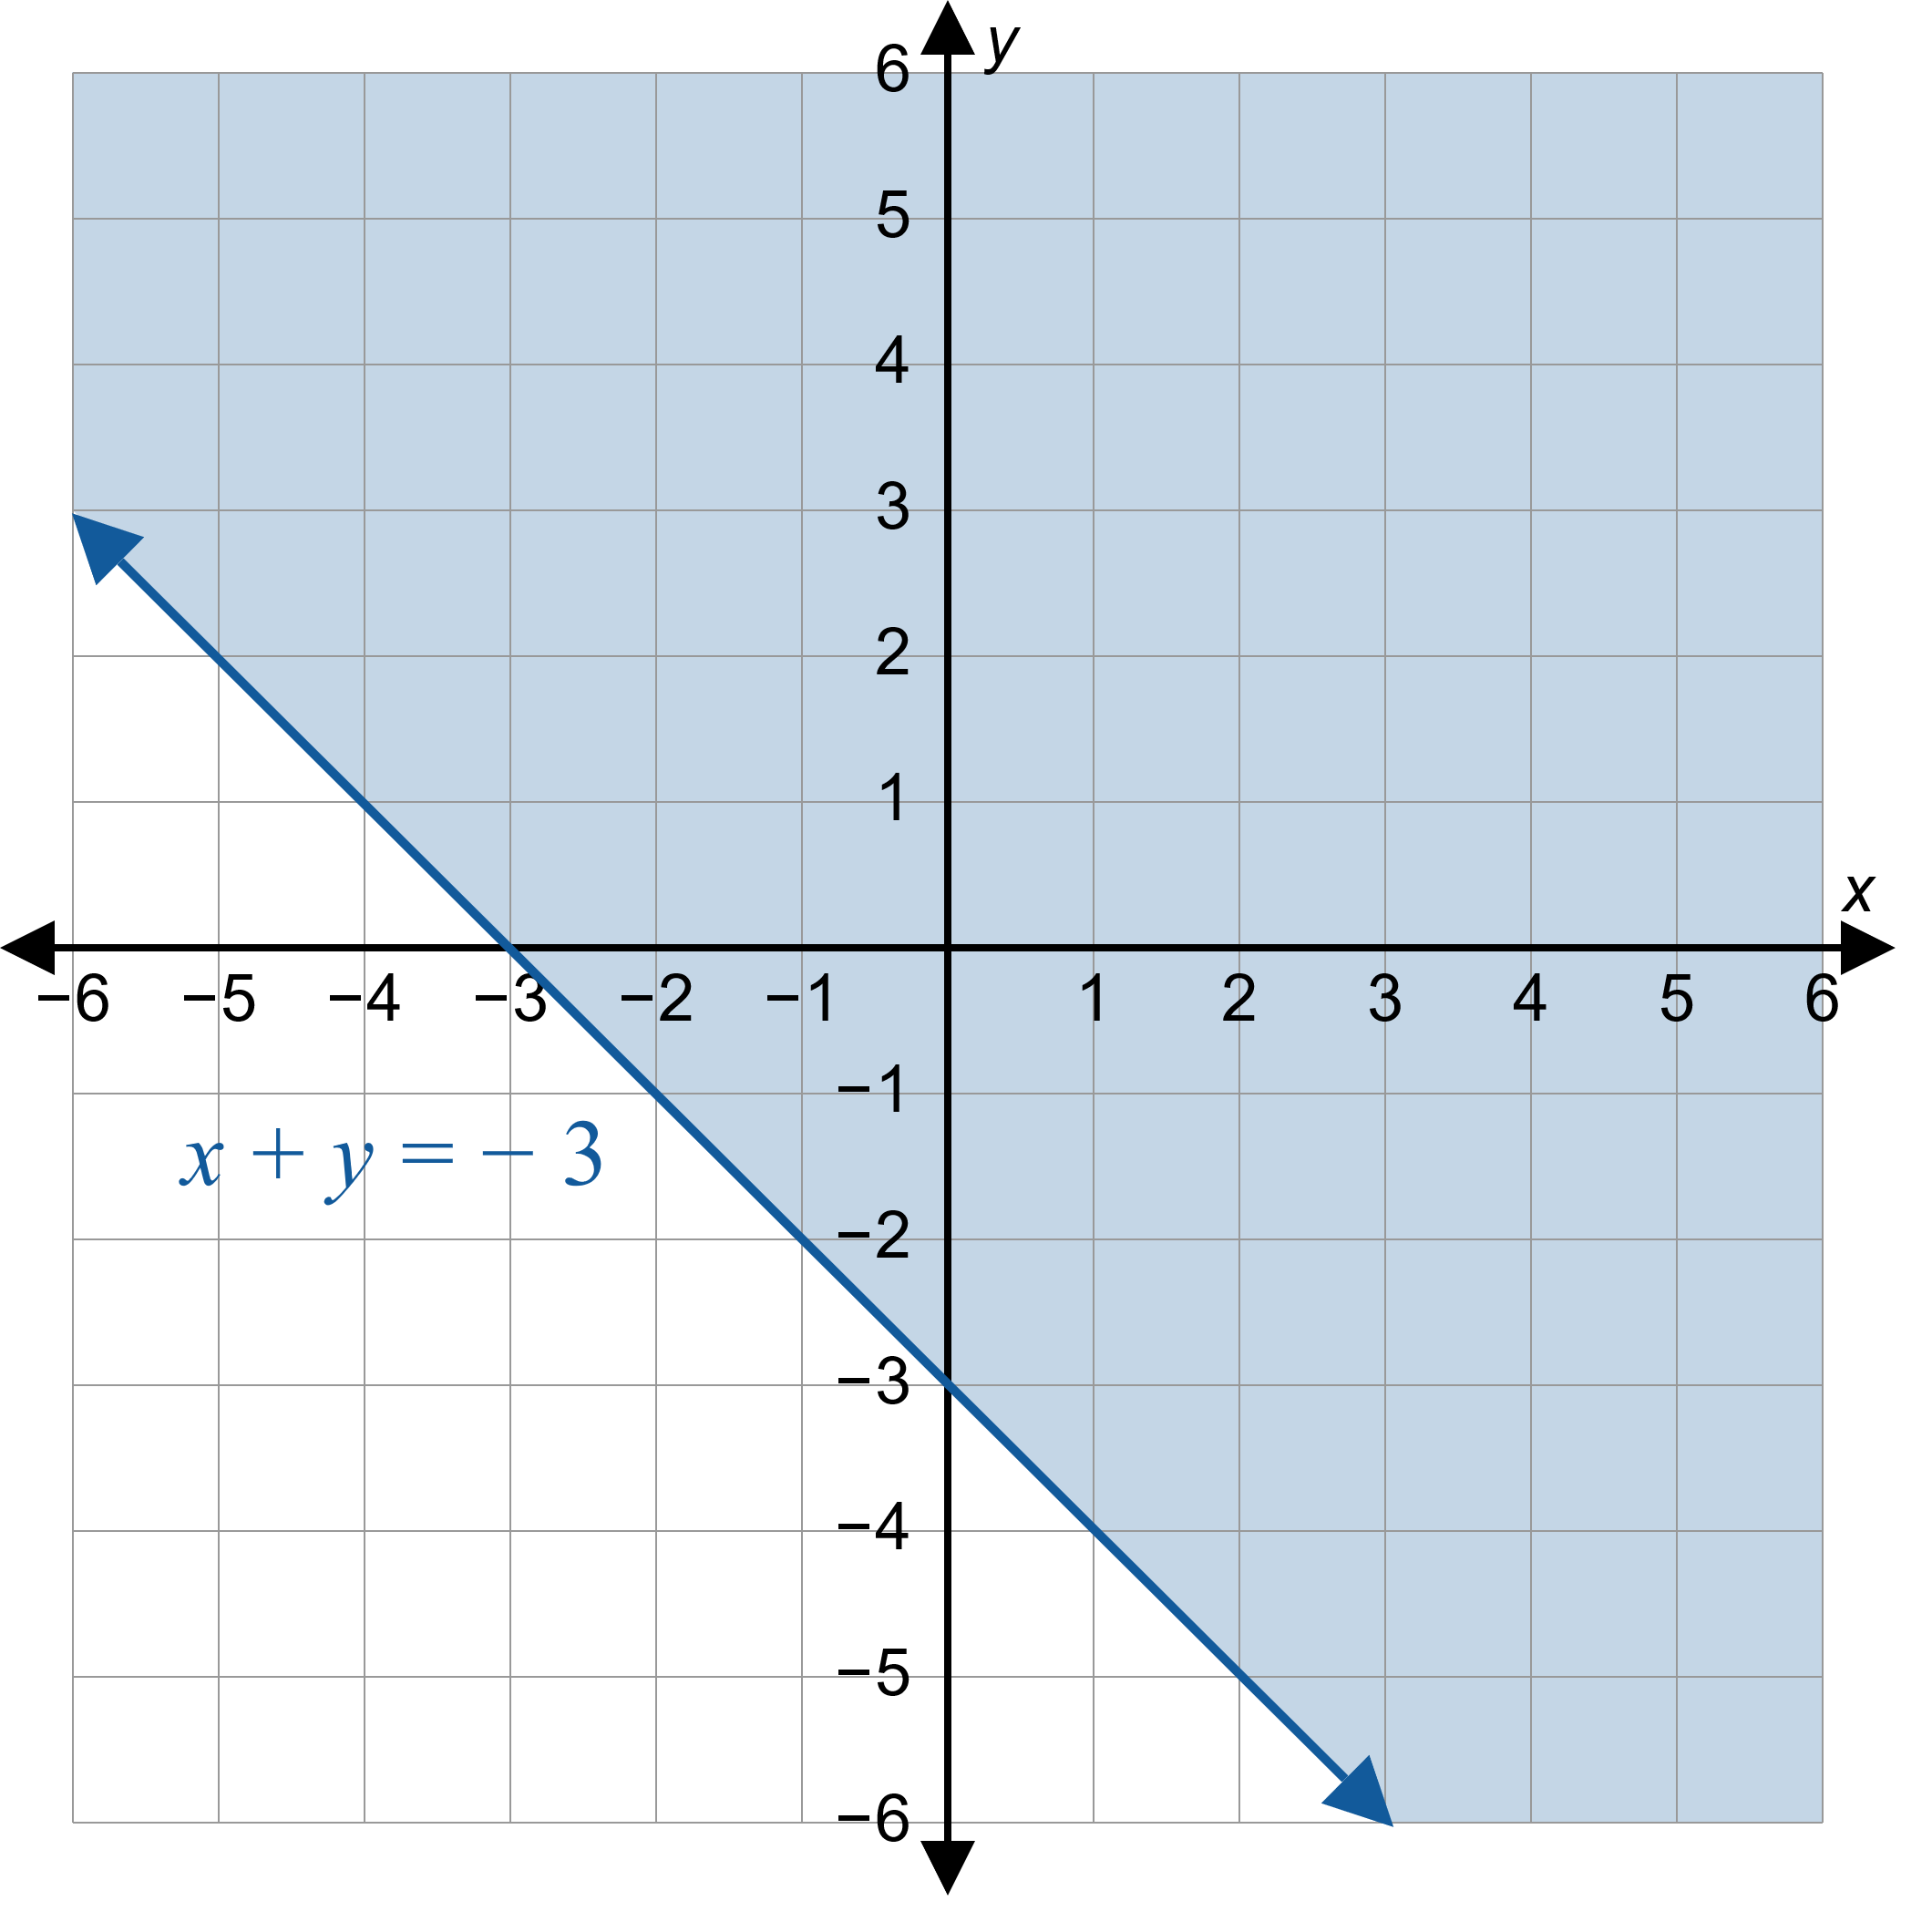
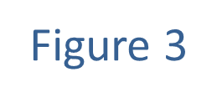
Example 1: Graphing the Solution of a System of Linear Inequalities (cont.)

Slide 8
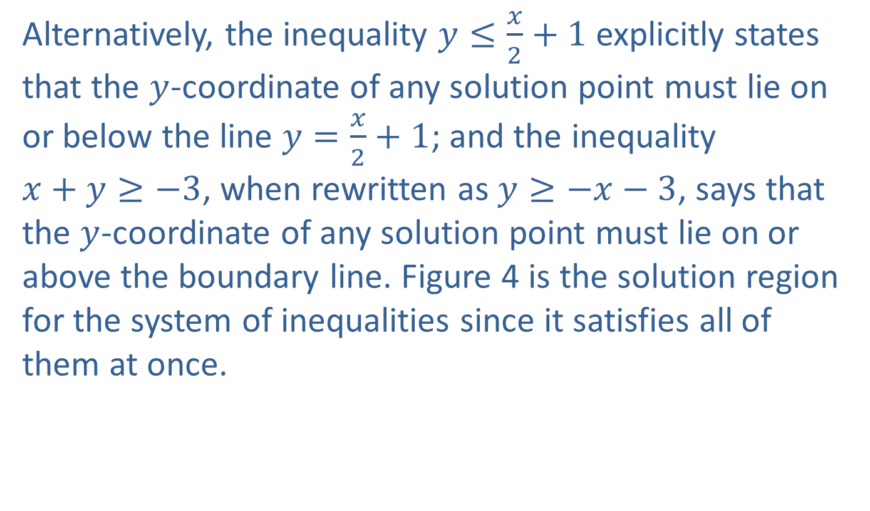
Example 1: Graphing the Solution of a System of Linear Inequalities (cont.)
Alternatively, the inequality $y≤\frac{x}{2}+1$ explicitly states that the $y$-coordinate of any solution point must lie on or below the line $y=\frac{x}{2}+1$; and the inequality
$x+y≥−3$, when rewritten as $y≥−x−3$, says that the $y$-coordinate of any solution point must lie on or above the boundary line. Figure 4 is the solution region for the system of inequalities since it satisfies all of them at once.

Slide 9
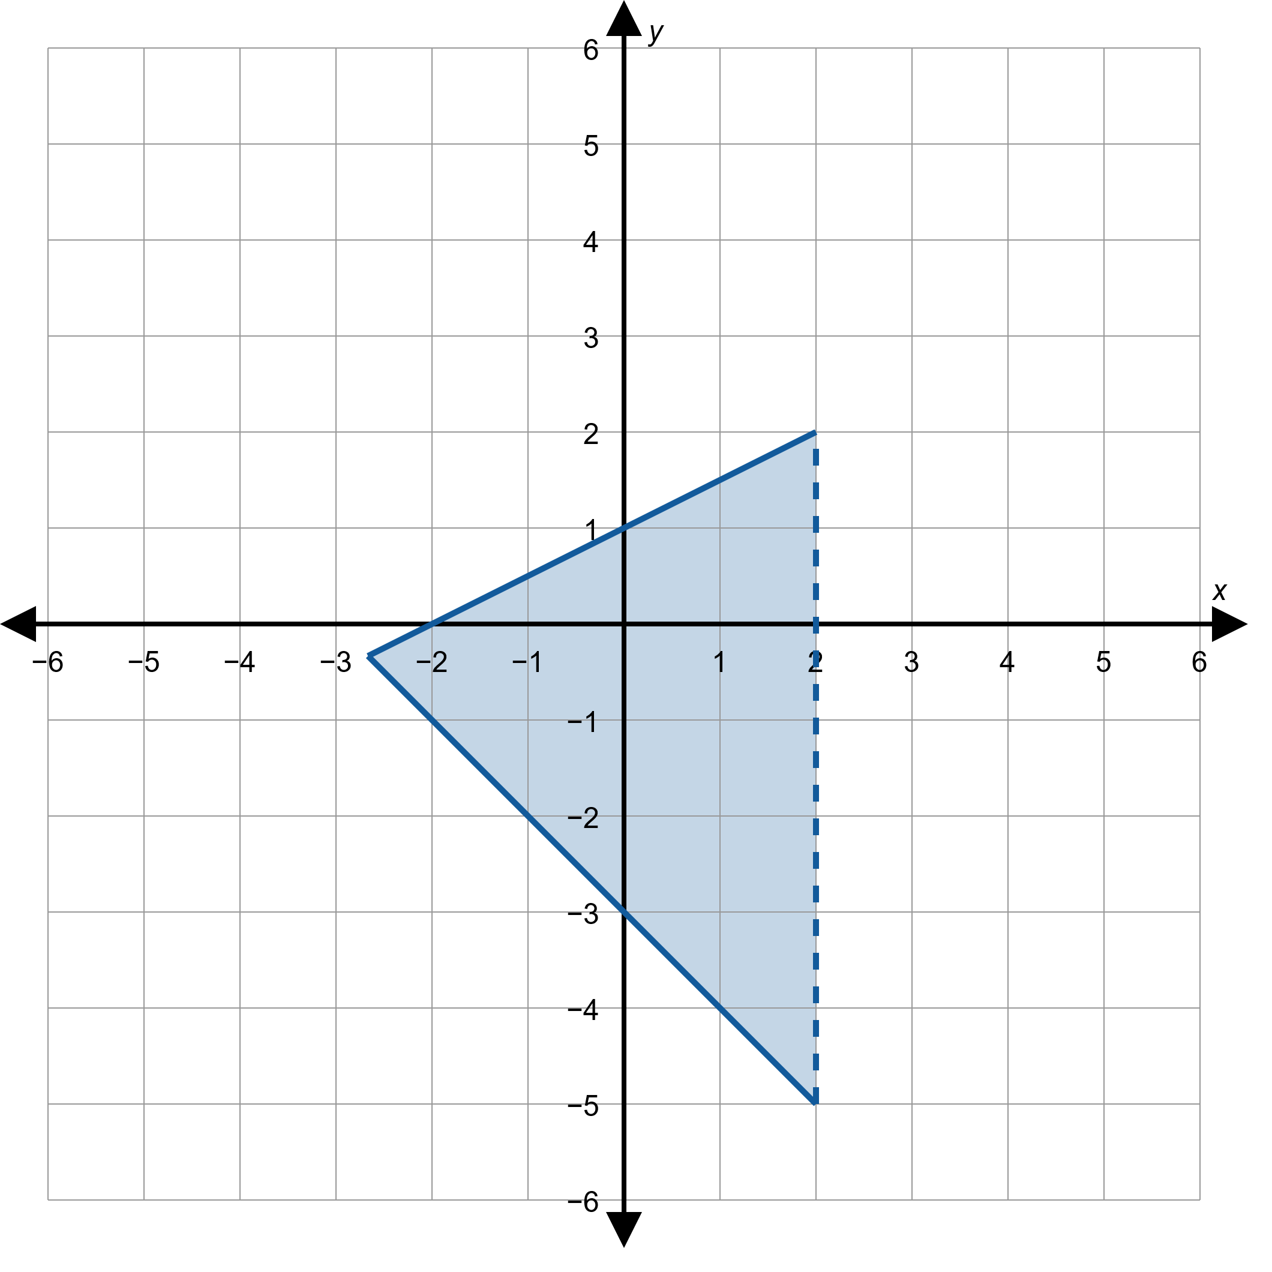
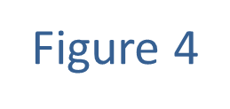
Example 1: Graphing the Solution of a System of Linear Inequalities (cont.)

Slide 10
Example 2: Feasible Regions
A family orchard sells peaches and nectarines. To prevent a pest infestation, the number of nectarine trees in the orchard cannot exceed the number of peach trees. Also, because of the space requirements of each type of tree, the number of nectarine trees plus twice the number of peach trees cannot exceed 100 trees. Construct the constraints and graph the feasible region for this situation.

Slide 11
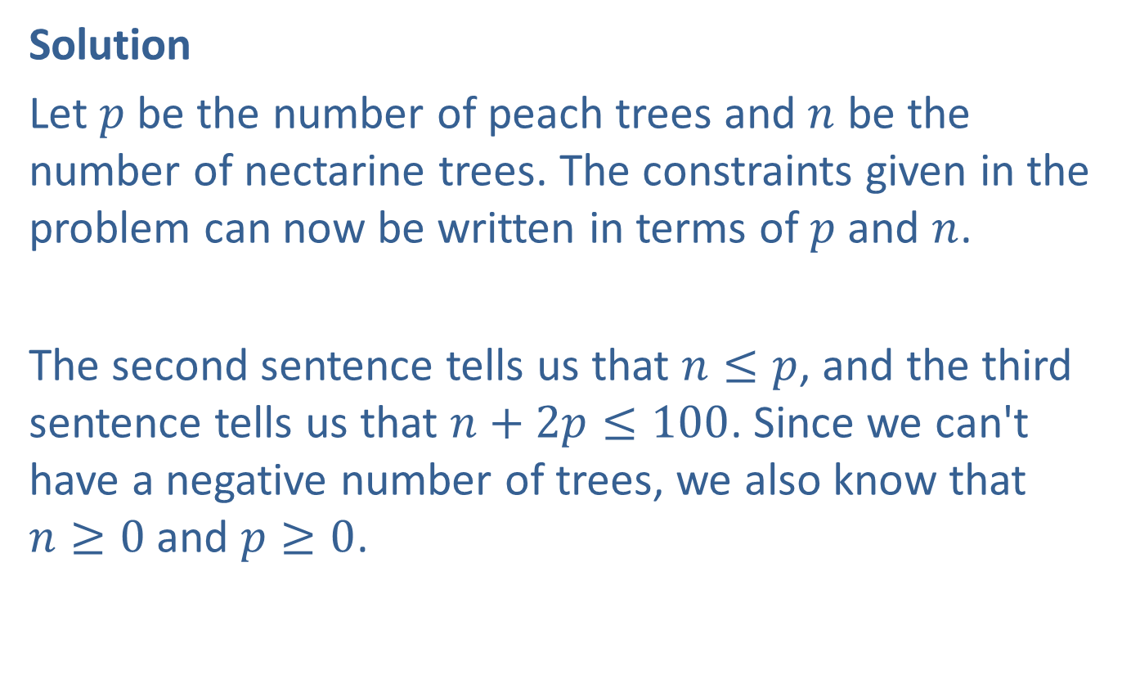
Example 2: Feasible Regions (cont.)
Solution
Let $p$ be the number of peach trees and $n$ be the number of nectarine trees. The constraints given in the problem can now be written in terms of $p$ and $n$.
The second sentence tells us that $n≤p$, and the third sentence tells us that $n+2p≤100$. Since we can't have a negative number of trees, we also know that
$n≥0$ and $p≥0$.

Slide 12

Example 2: Feasible Regions (cont.)
Letting the horizontal axis represent $p$ and the vertical axis represent $n$, we can graph the feasible region defined by these constraints.

Slide 13
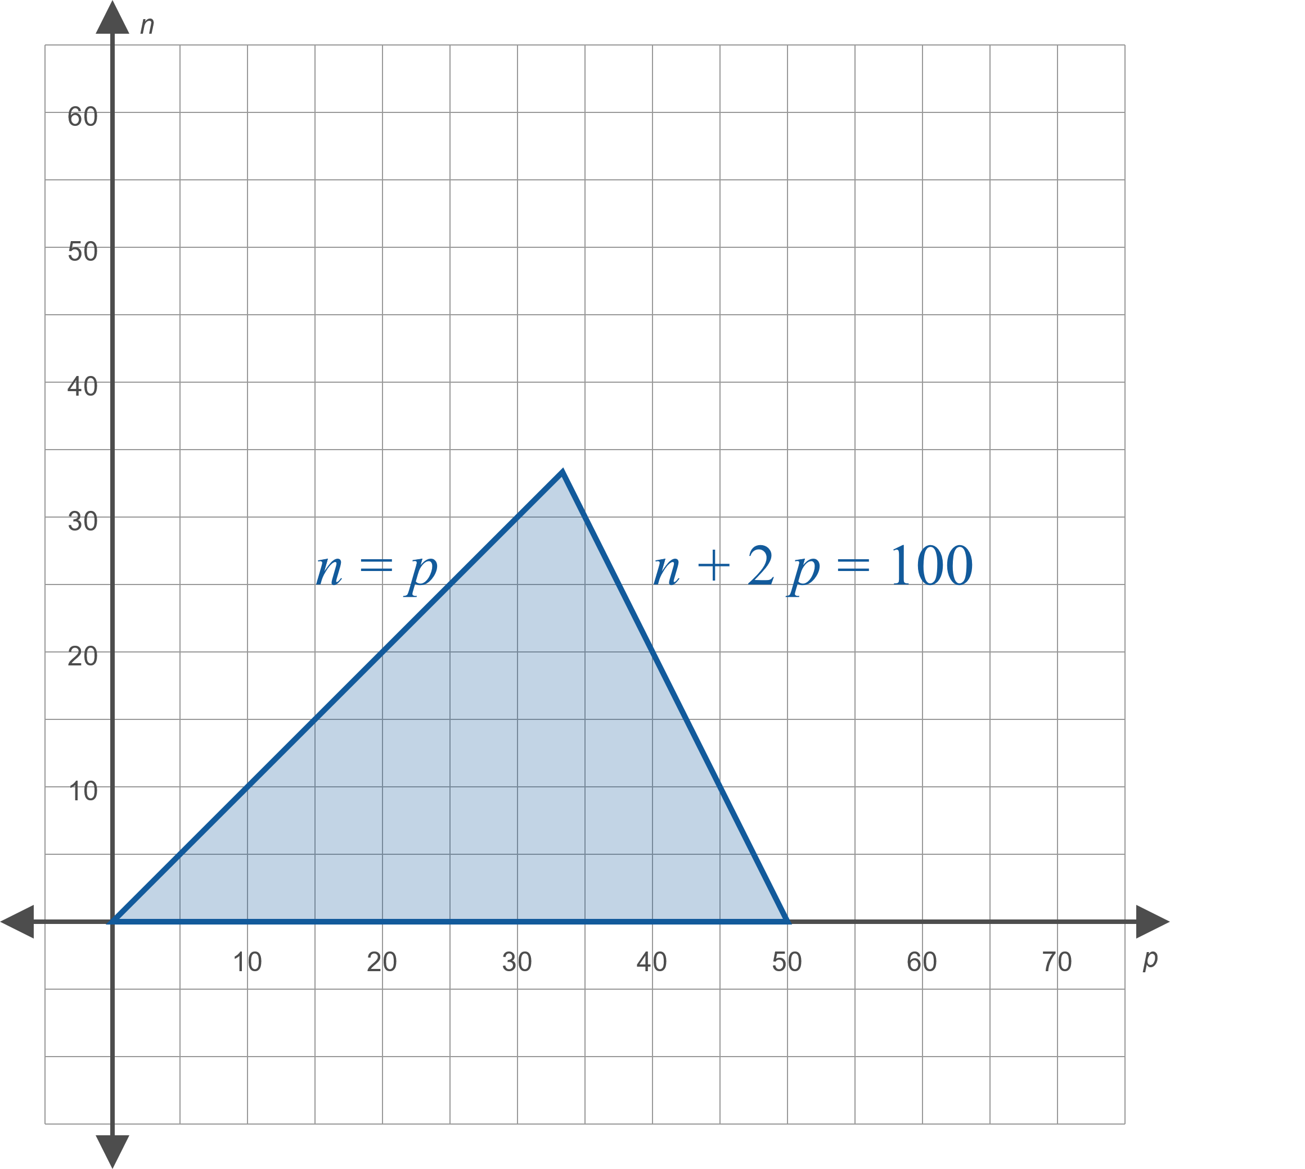
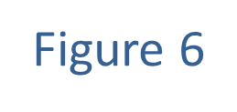
Example 2: Feasible Regions (cont.)

Slide 14
Example 2: Feasible Regions (cont.)
Any point (with integer coordinates) in the shaded feasible region corresponds to a certain number of peach trees and nectarine trees, and all such points meet the stated conditions.

Slide 15
Bounded and Unbounded Regions
Definition
A bounded region is one in which all the points lie within some finite distance of the origin.
An unbounded region has points that are arbitrarily far away from the origin.

Slide 16
Linear Programming
Procedure
Step 1: | Identify the variables to be considered in the problem, determine all the constraints on the variables imposed by the problem, and sketch the feasible region described by the constraints.
Step 2: | Determine the function that is to be either maximized or minimized. This function is called the objective function.
Step 3: | Evaluate the function at each of the vertices of the feasible region and compare the values found. If the feasible region is bounded, the optimum value of the function will occur at a vertex. If the feasible region is unbounded, the optimum value of the function may not exist, but if it does exist, it will occur at a vertex.

Slide 17
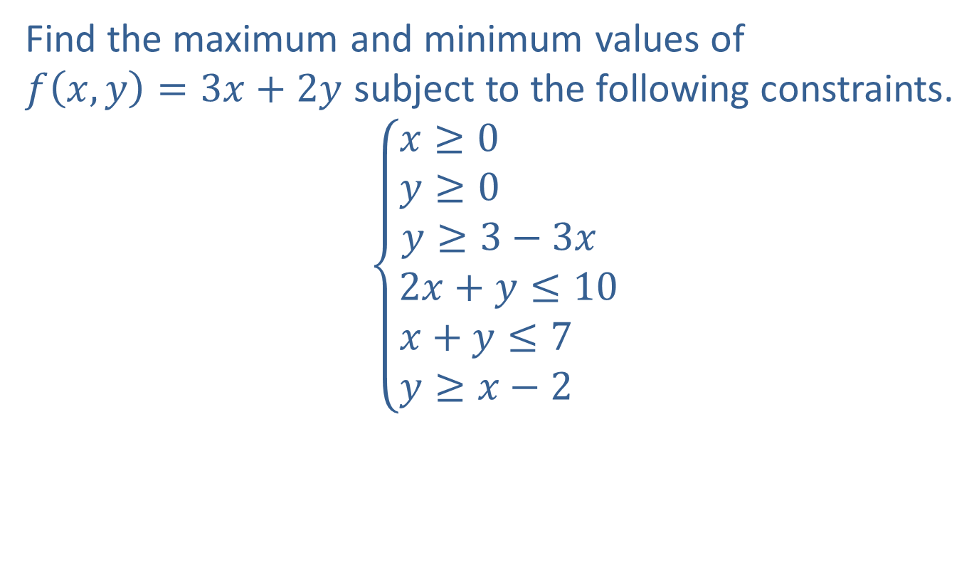
Example 3: Linear Programming
Find the maximum and minimum values of
$f\left(x,y\right)=3x+2y$ subject to the following constraints.
$$\left\{\begin{matrix}\begin{matrix}x≥0 \\ y≥0 \\ y≥3−3x \end{matrix} \\ 2x+y≤10 \\ \begin{matrix}x+y≤7 \\ y≥x−2 \end{matrix}\end{matrix}\right.$$

Slide 18
Example 3: Linear Programming (cont.)
Solution
The two variables are given to us, as are the constraints; all we must do to complete the first step is sketch the region defined by the constraints. The following graph contains the sketch, with selected boundaries identified by their corresponding equations.

Slide 19
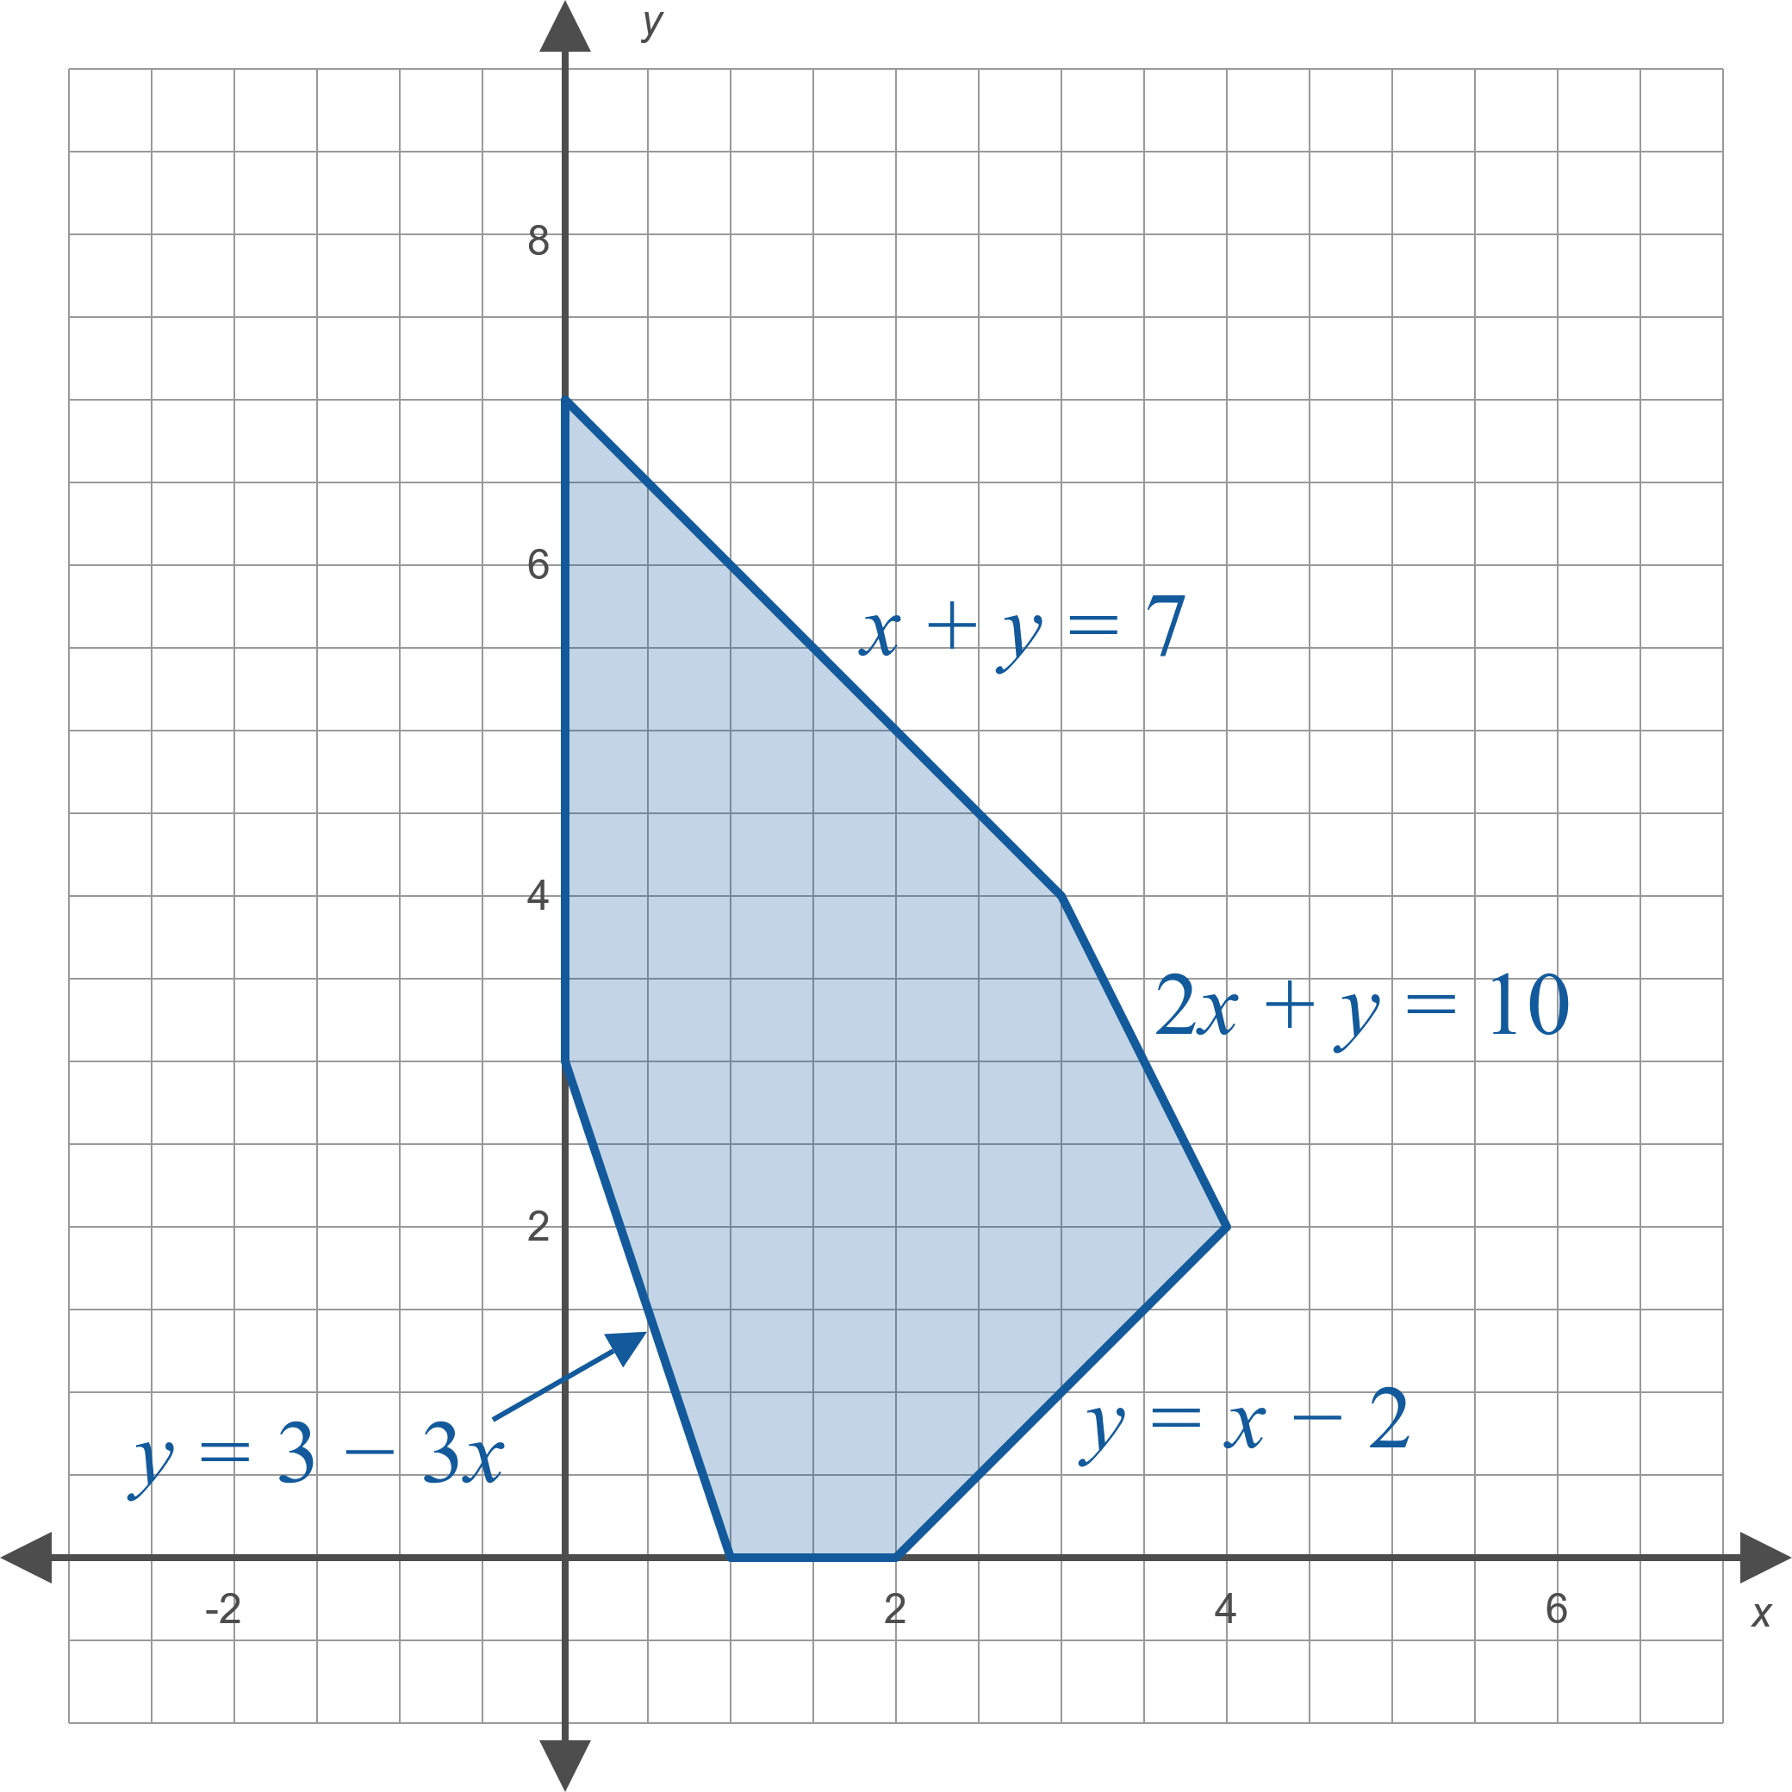
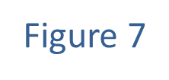
Example 3: Linear Programming (cont.)

Slide 20
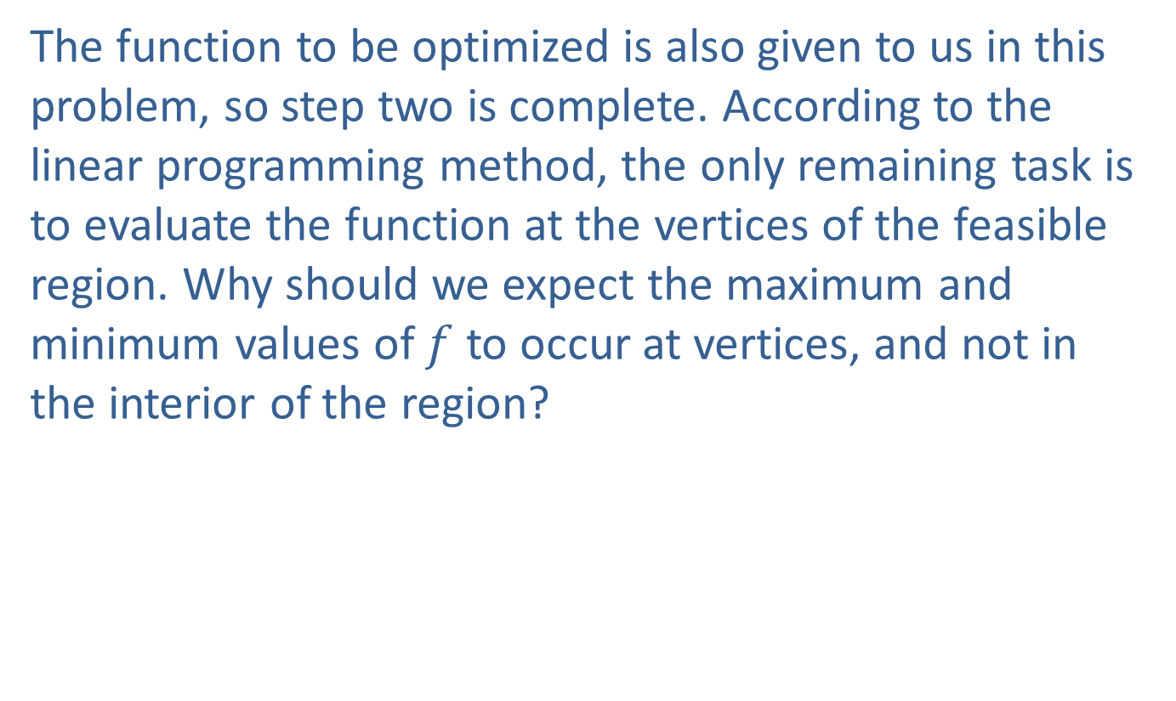
Example 3: Linear Programming (cont.)
The function to be optimized is also given to us in this problem, so step two is complete. According to the linear programming method, the only remaining task is to evaluate the function at the vertices of the feasible region. Why should we expect the maximum and minimum values of $f$ to occur at vertices, and not in the interior of the region?

Slide 21
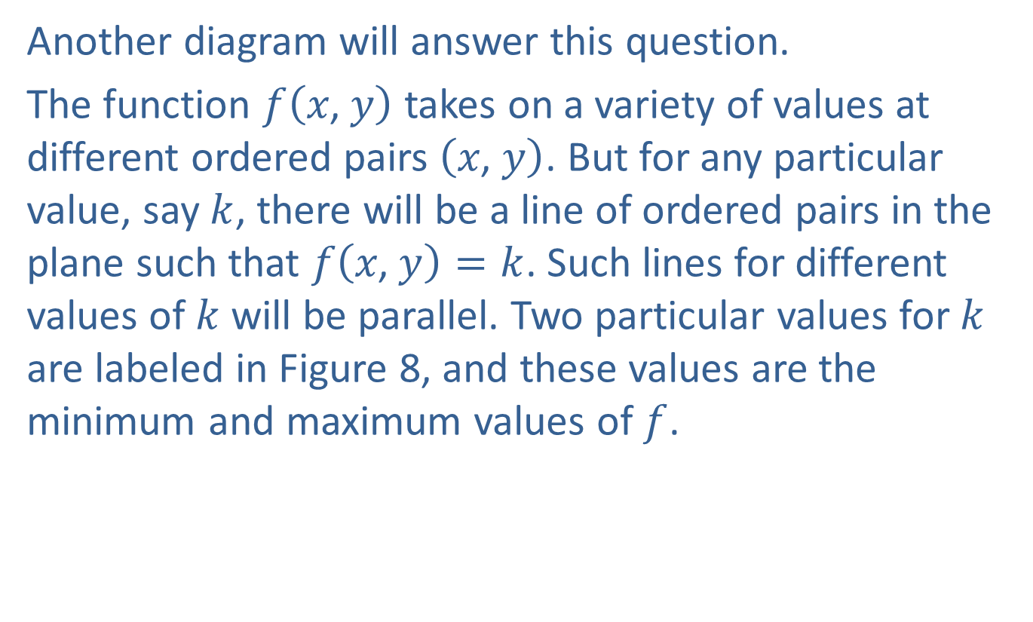
Example 3: Linear Programming (cont.)
Another diagram will answer this question.
The function $f⁡\left(x\text{, }y\right)$ takes on a variety of values at different ordered pairs $\left(x\text{, }y\right)$. But for any particular value, say $k$, there will be a line of ordered pairs in the plane such that $f\left(x\text{, }y\right)=k$. Such lines for different values of $k$ will be parallel. Two particular values for $k$ are labeled in Figure 8, and these values are the minimum and maximum values of $f$.

Slide 22
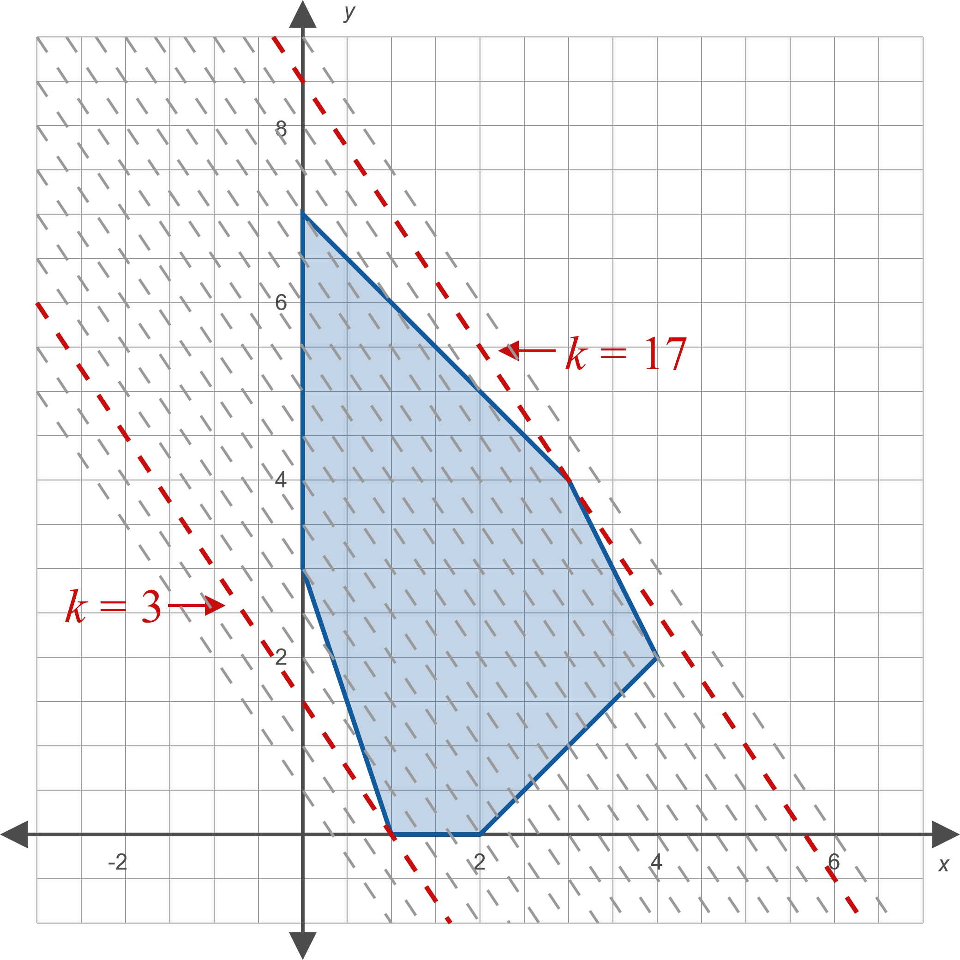
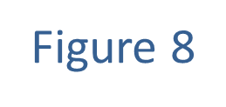
Example 3: Linear Programming (cont.)

Slide 23
Example 3: Linear Programming (cont.)
The extreme values will thus occur where a line of constant value just touches the region. This will be at a vertex or one of the edges of the region, if the edge is parallel to the line of constant value. Thus, evaluating the function at the vertices of the feasible region will suffice to identify the extreme values.

Slide 24
Example 3: Linear Programming (cont.)
Each vertex of a feasible region is the intersection of two edges, so the coordinates of each vertex are found by solving a system of two equations. The six vertices of the region in this problem are determined by the following six systems.

Slide 25
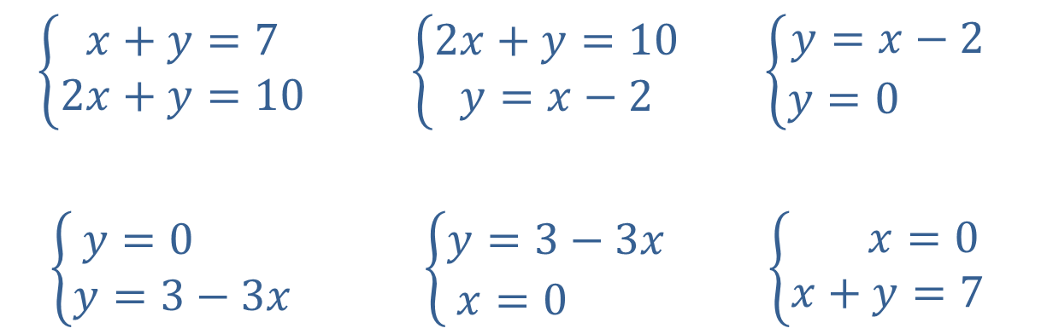
Example 3: Linear Programming (cont.)
$$\left\{\begin{matrix}x+y=7 \\ 2x+y=10\end{matrix}\right.$$ | $$\left\{\begin{matrix}2x+y=10 \\ y=x−2\end{matrix}\right.$$ | $$\left\{\begin{matrix}y=x−2 \\ \begin{matrix}y=0 & \end{matrix}\end{matrix}\right.$$
$$\left\{\begin{matrix}\begin{matrix}y=0 & \end{matrix} \\ y=3−3x\end{matrix}\right.$$ | $$\left\{\begin{matrix}y=3−3x \\ \begin{matrix}x=0 & \end{matrix}\end{matrix}\right.$$ | 𝑦+𝑥=0𝑥+𝑦=7

Slide 26
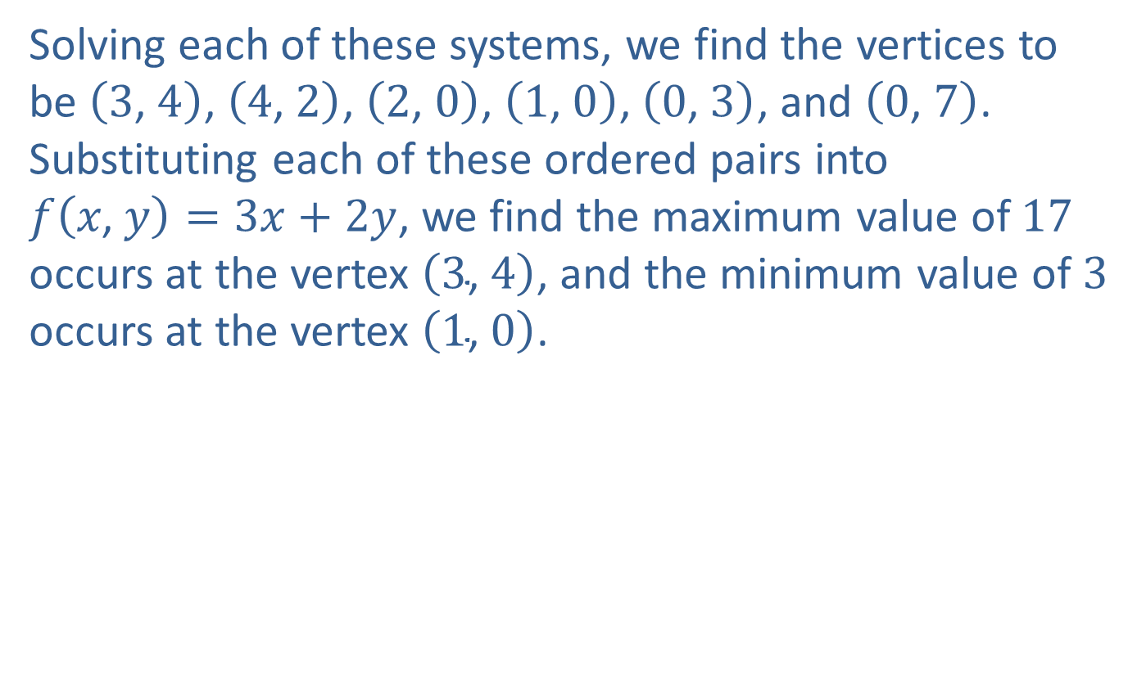
Example 3: Linear Programming (cont.)
Solving each of these systems, we find the vertices to be $\left(3\text{, }4\right)$, $\left(4\text{, }2\right)$, $\left(2\text{, }0\right)$, $\left(1\text{, }0\right)$, $\left(0\text{, }3\right)$, and $\left(0\text{, }7\right)$. Substituting each of these ordered pairs into
$f\left(x\text{, }y\right)=3x+2y$, we find the maximum value of 17 occurs at the vertex $\left(3\text{, }4\right)$, and the minimum value of 3 occurs at the vertex $\left(1\text{, }0\right)$.

Slide 27
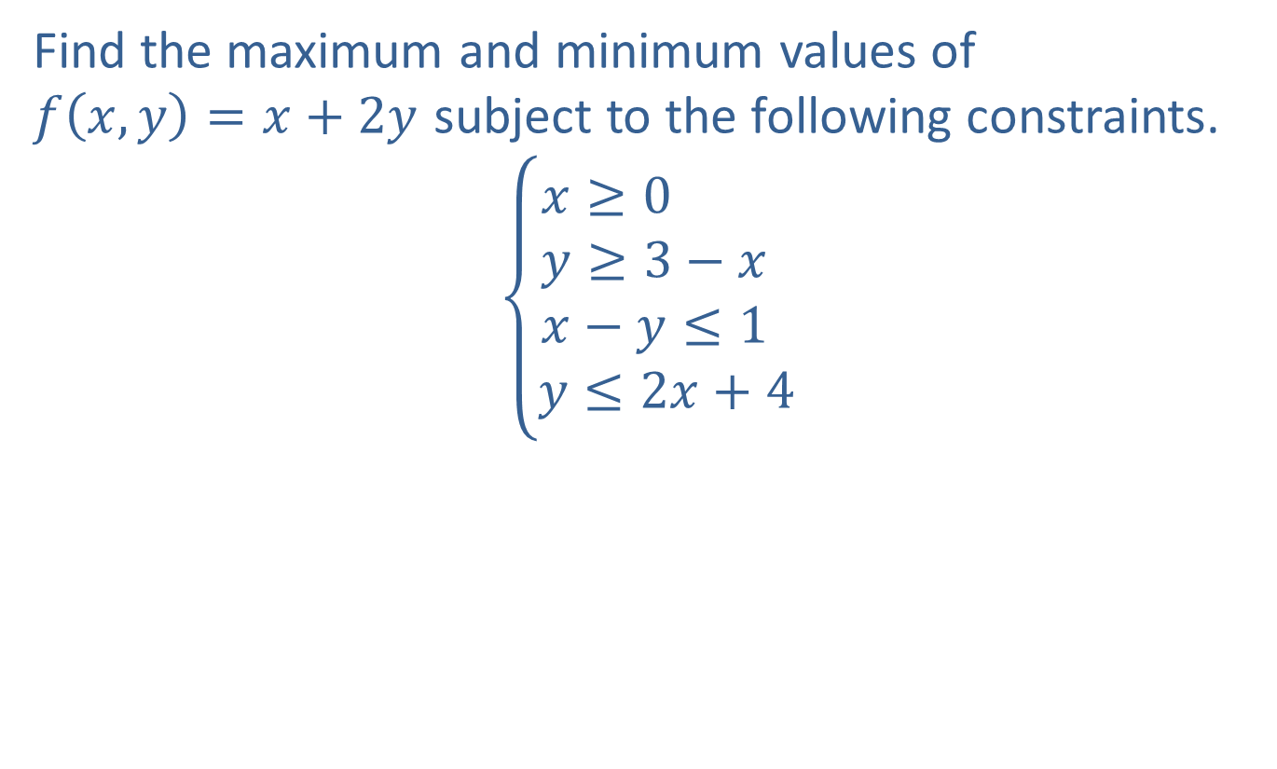
Example 4: Linear Programming
Find the maximum and minimum values of
$f\left(x,y\right)=x+2y$ subject to the following constraints.
$$\left\{\begin{matrix}x≥0 \\ y≥3−x \\ \begin{matrix}x−y≤1 \\ y≤2x+4\end{matrix}\end{matrix}\right.$$

Slide 28
Example 4: Linear Programming (cont.)
Solution
The feasible region defined by the constraints is unbounded; a portion of its sketch appears in Figure 9.

Slide 29
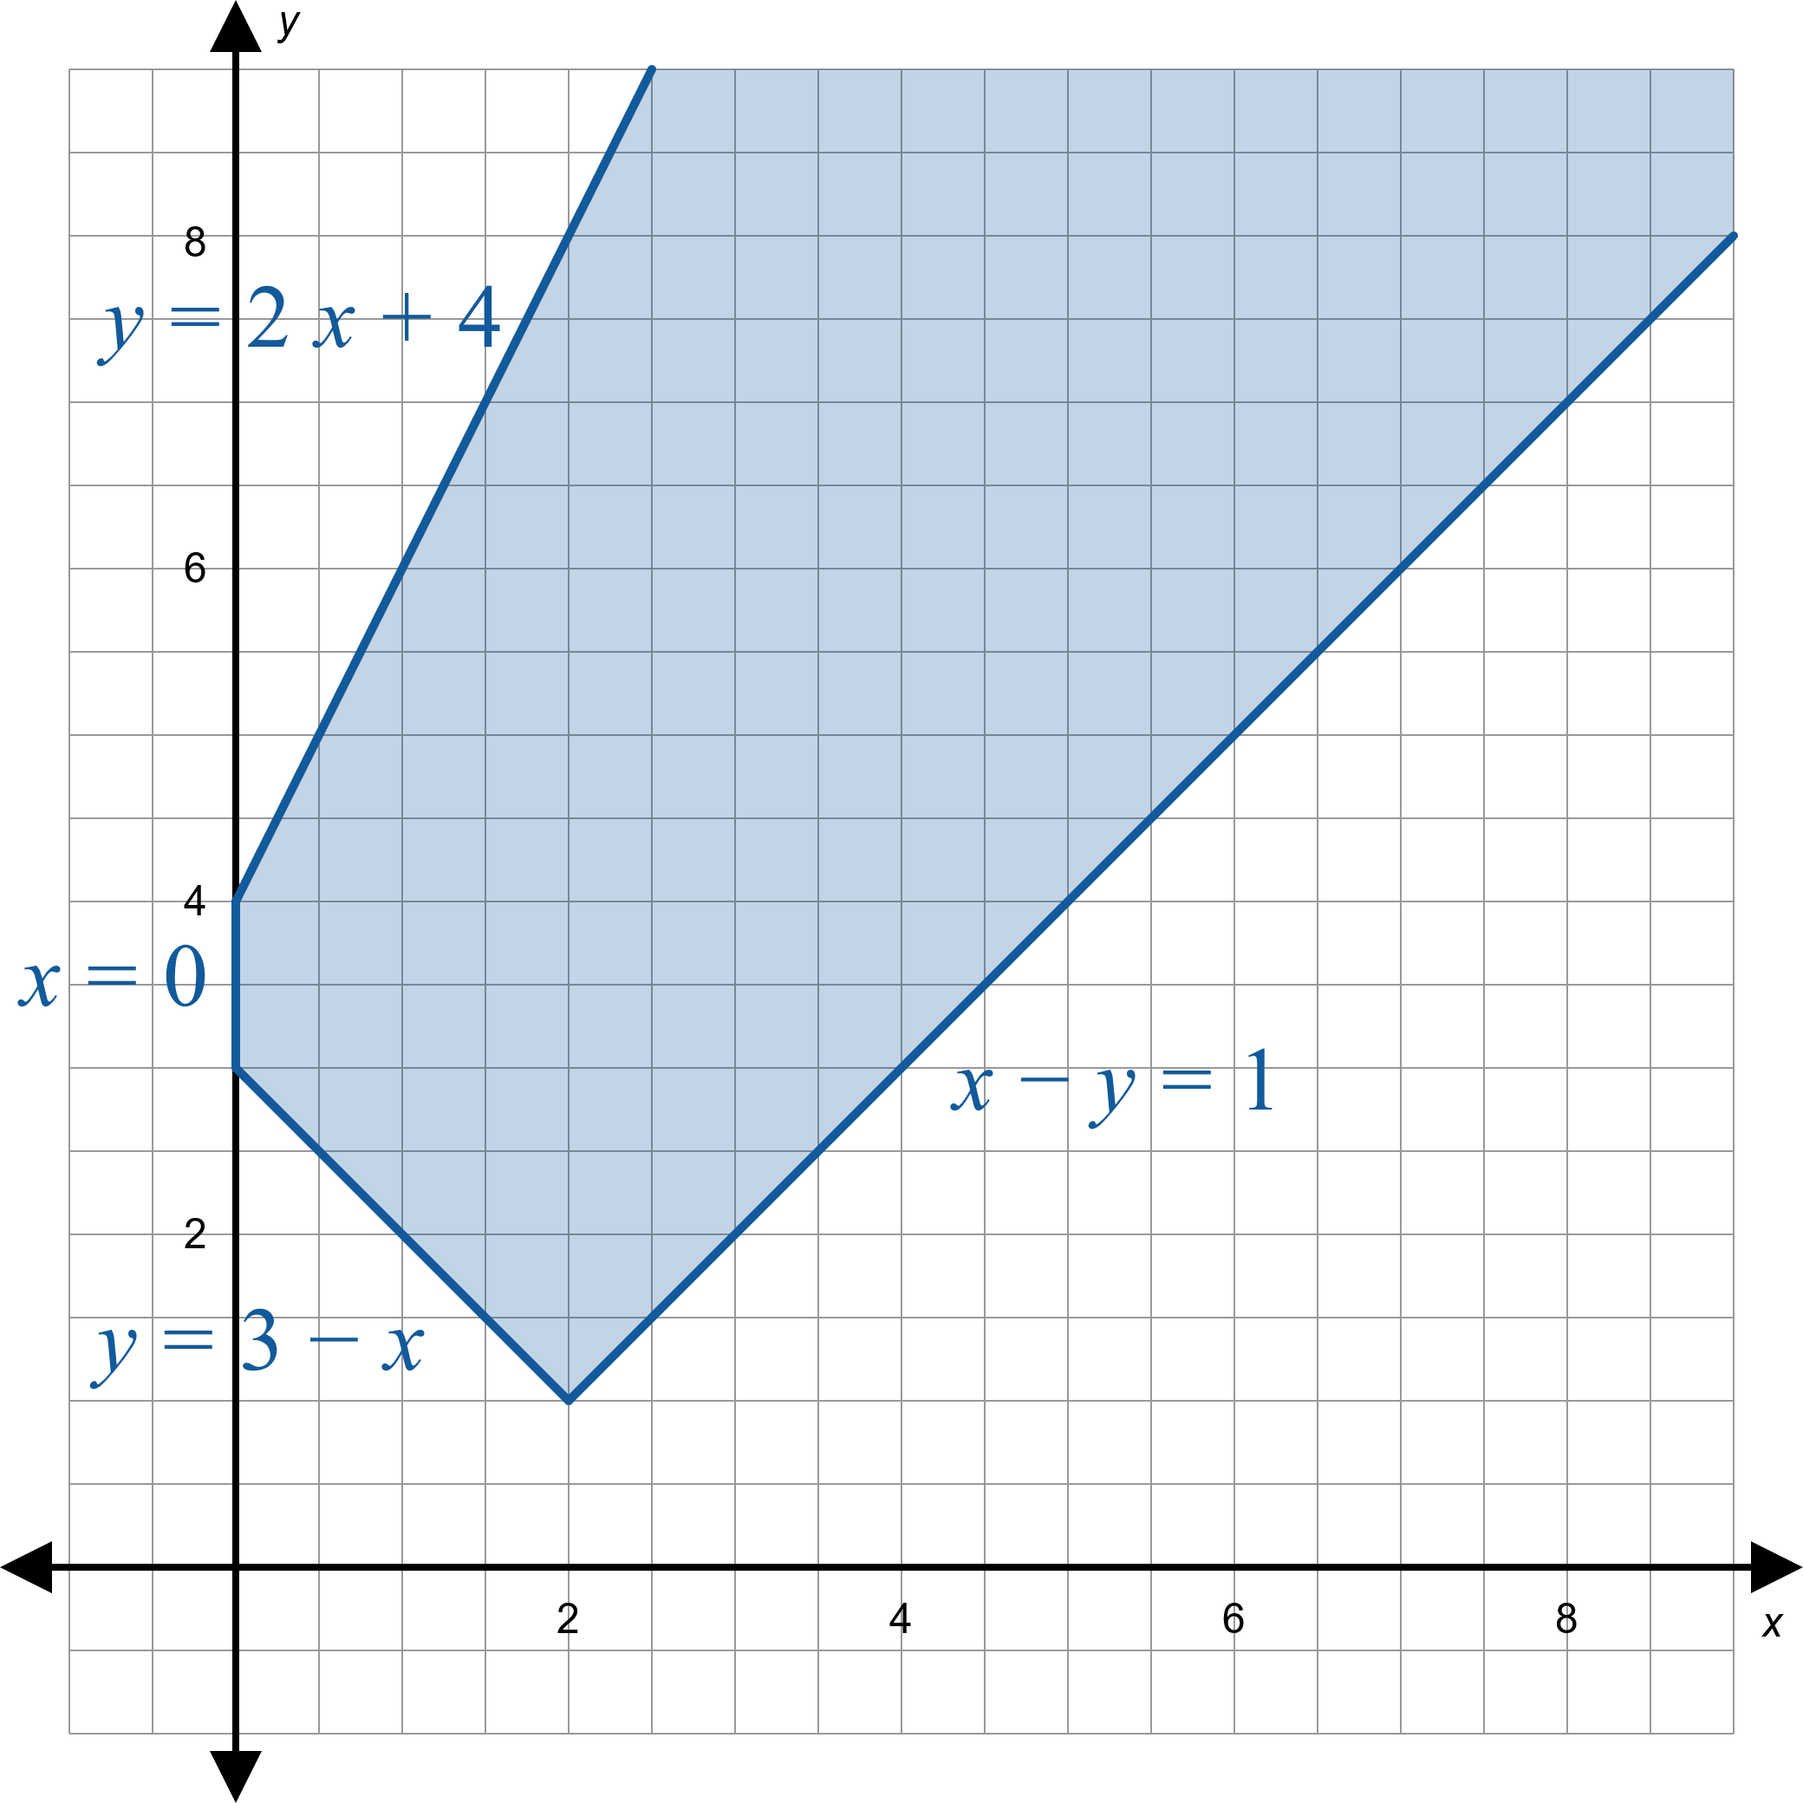
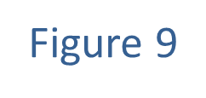
Example 4: Linear Programming (cont.)

Slide 30
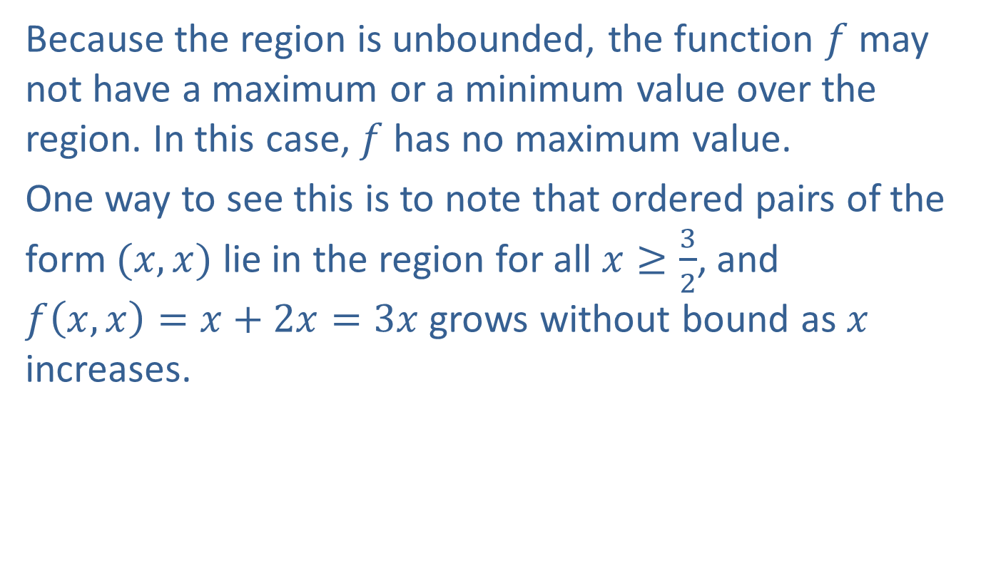
Example 4: Linear Programming (cont.)
Because the region is unbounded, the function $f$ may not have a maximum or a minimum value over the region. In this case, $f$ has no maximum value.
One way to see this is to note that ordered pairs of the form $(x,x)$ lie in the region for all $x≥\frac{3}{2}$, and
$f\left(x,x\right)=x+2x=3x$ grows without bound as $x$ increases.

Slide 31

Example 4: Linear Programming (cont.)
On the other hand, $f$ does have a minimum value over the feasible region. The three vertices are $(0,4)$, $(0,3)$, and $(2,1)$. Evaluating the function at these points, we obtain $f\left(0,4\right)=8$, $f\left(0,3\right)=6$, and $f\left(2,1\right)=4$, so the minimum value is 4.

Slide 32
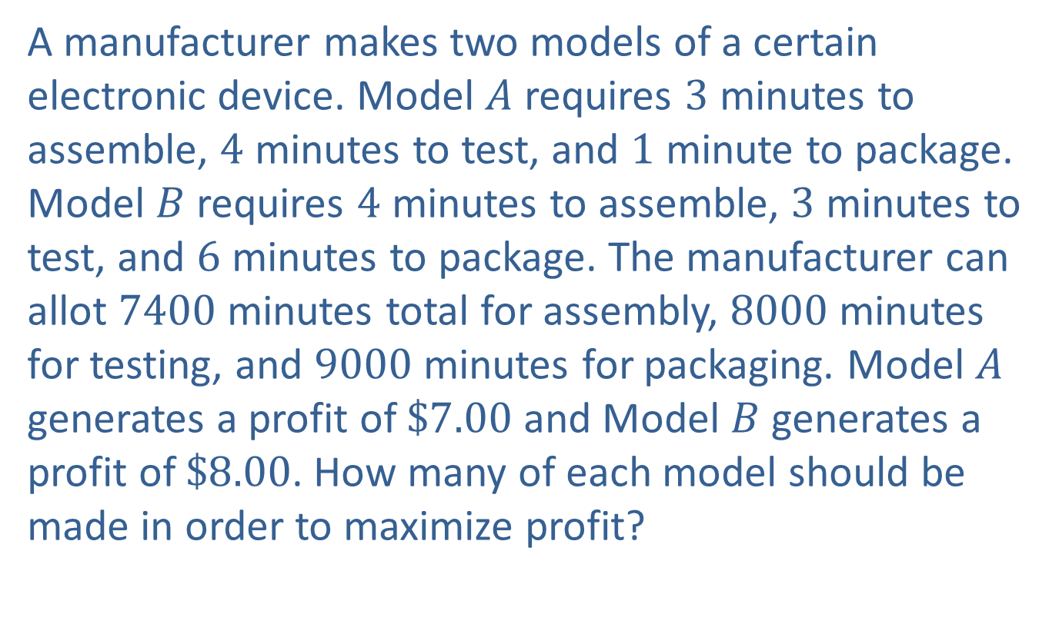
Example 5: Linear Programming
A manufacturer makes two models of a certain electronic device. Model $A$ requires 3 minutes to assemble, 4 minutes to test, and 1 minute to package. Model $B$ requires 4 minutes to assemble, 3 minutes to test, and 6 minutes to package. The manufacturer can allot 7400 minutes total for assembly, 8000 minutes for testing, and 9000 minutes for packaging. Model $A$ generates a profit of $\$7.00$ and Model $B$ generates a profit of $\$8.00$. How many of each model should be made in order to maximize profit?

Slide 33
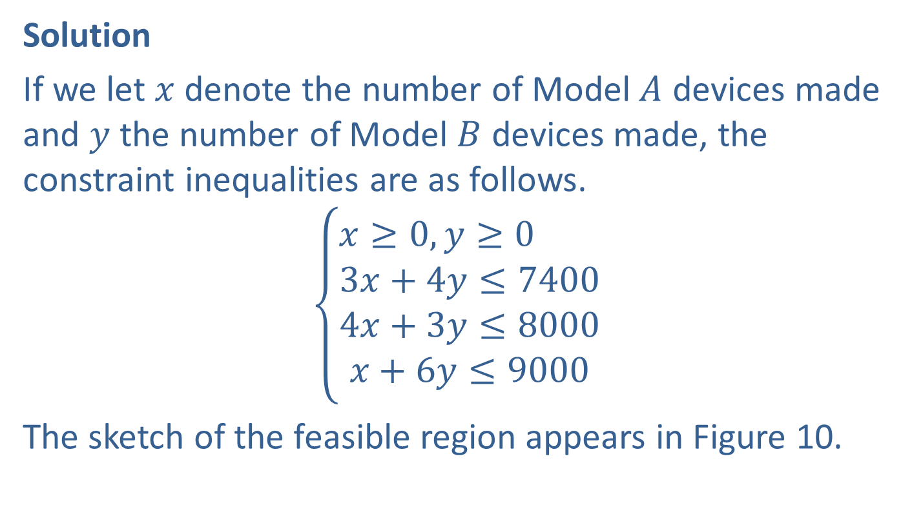
Example 5: Linear Programming (cont.)
Solution
If we let $x$ denote the number of Model $A$ devices made and $y$ the number of Model $B$ devices made, the constraint inequalities are as follows.
$$\left\{\begin{aligned}x≥0,y≥0 \\ 3x+4y≤7400 \\ 4x+3y≤8000 \\ x+6y≤9000\end{aligned}\right.$$
The sketch of the feasible region appears in Figure 10.

Slide 34
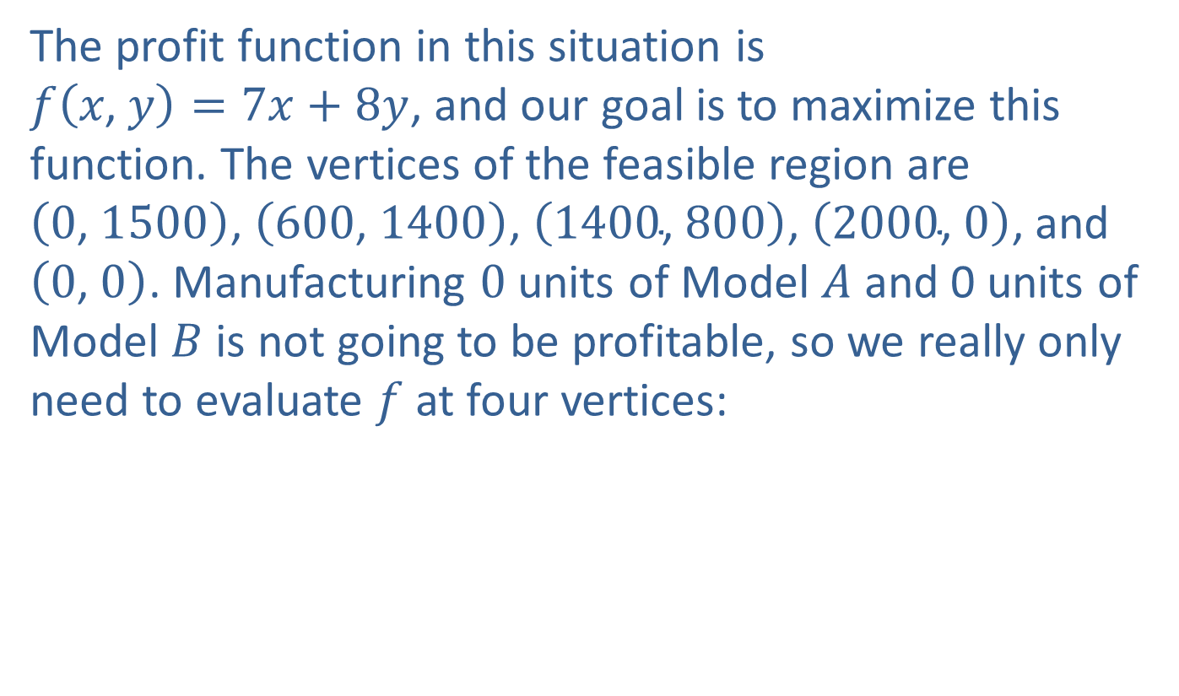
Example 5: Linear Programming (cont.)
The profit function in this situation is
$f\left(x\text{, }y\right)=7x+8y$, and our goal is to maximize this function. The vertices of the feasible region are $\left(0\text{, }1500\right)$, $\left(600\text{, }1400\right)$, $\left(1400\text{, }800\right)$, $\left(2000\text{, }0\right)$, and $\left(0\text{, }0\right)$. Manufacturing 0 units of Model $A$ and 0 units of Model $B$ is not going to be profitable, so we really only need to evaluate $f$ at four vertices:

Slide 35
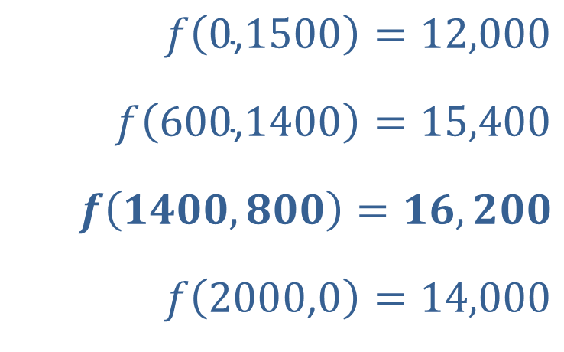
Example 5: Linear Programming (cont.)
$$f\left(0\text{,}1500\right)=12,000$$
$$f\left(600\text{,}1400\right)=15,400$$
$$f\left(1400,800\right)=16,200$$
$$f\left(2000\text{,}0\right)=14,000$$

Slide 36

Example 5: Linear Programming (cont.)
From these calculations, we conclude that the maximum profit is generated from making 1400 units of Model $A$ and 800 units of Model $B$. The maximum profit would be $\$16,200$.

Slide 37
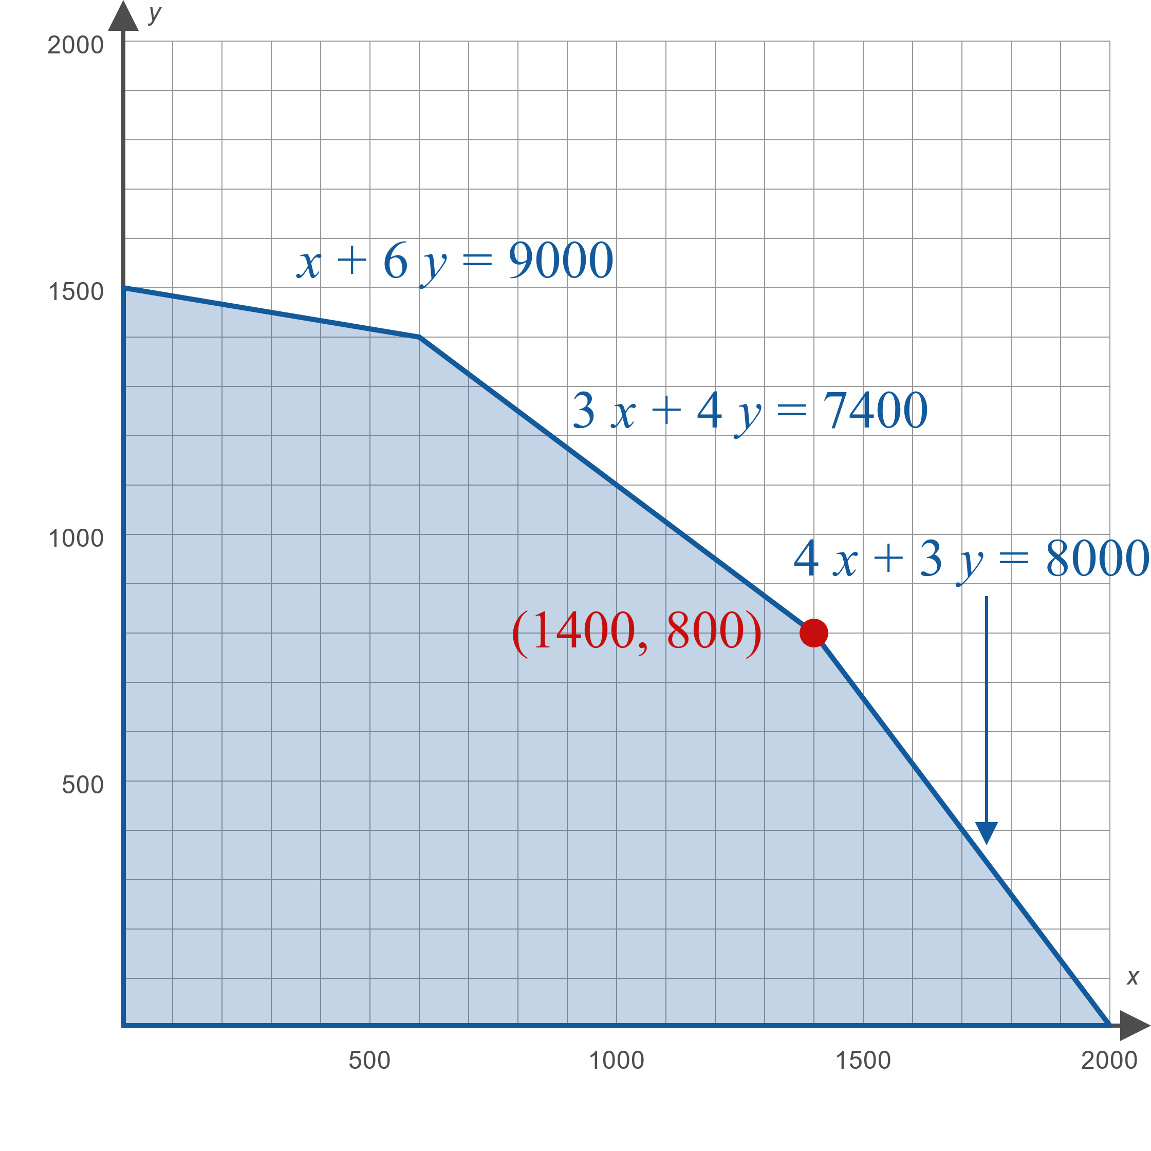
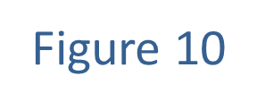
Example 5: Linear Programming (cont.)

