Slide 1
Section 13.1
Rates of Change and Tangents

Slide 2
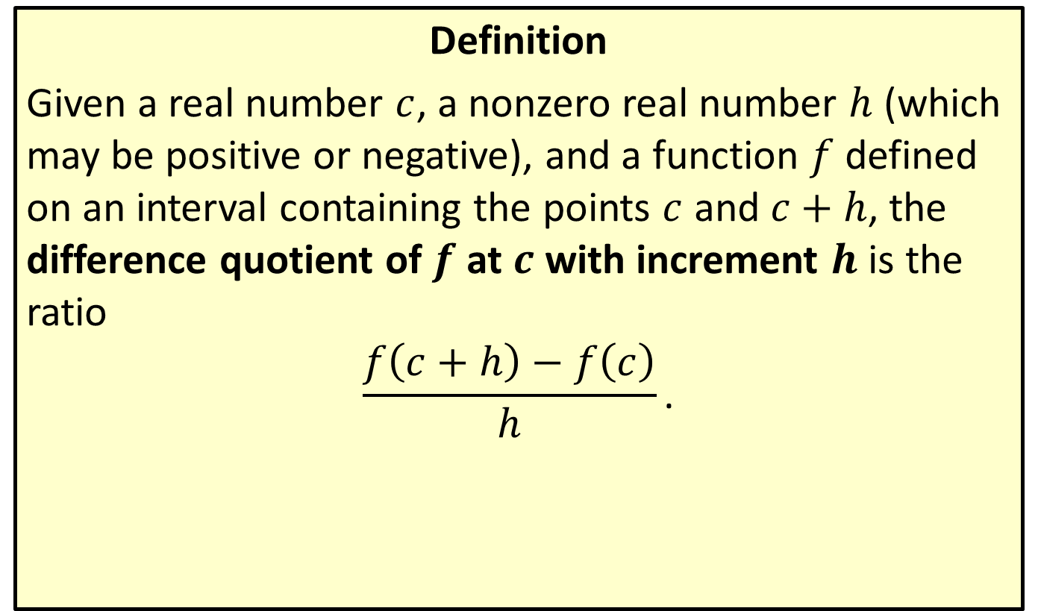
The Difference Quotient and Secant Line
Definition
Given a real number $c$, a nonzero real number $h$ (which may be positive or negative), and a function $f$ defined on an interval containing the points $c$ and $c+h$, the difference quotient of $f$ at $c$ with increment $h$ is the ratio
$$\frac{f\left(c+h\right)−f\left(c\right)}{h}\text{.}$$

Slide 3
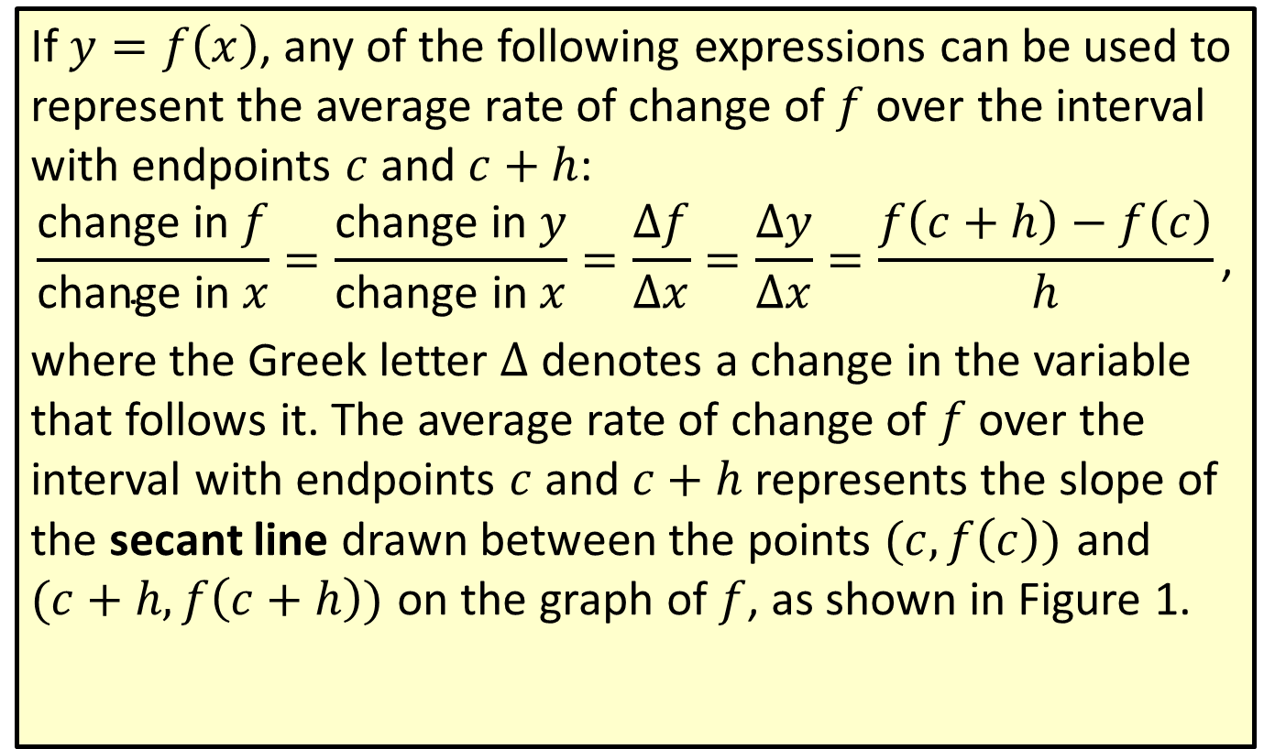
The Difference Quotient and Secant Line (cont.)
If $y=f\left(x\right)$, any of the following expressions can be used to represent the average rate of change of $f$ over the interval with endpoints $c$ and $c+h$:
$$\frac{\text{change} \text{in} f}{\text{change} \text{in} x}=\frac{\text{change} \text{in} y}{\text{change} \text{in} x}=\frac{Δf}{Δx}=\frac{Δy}{Δx}=\frac{f\left(c+h\right)−f\left(c\right)}{h}\text{,}$$
where the Greek letter $Δ$ denotes a change in the variable that follows it. The average rate of change of $f$ over the interval with endpoints $c$ and $c+h$ represents the slope of the secant line drawn between the points $(c,f\left(c\right))$ and
$(c+h,f\left(c+h\right))$ on the graph of $f$, as shown in Figure 1.

Slide 4
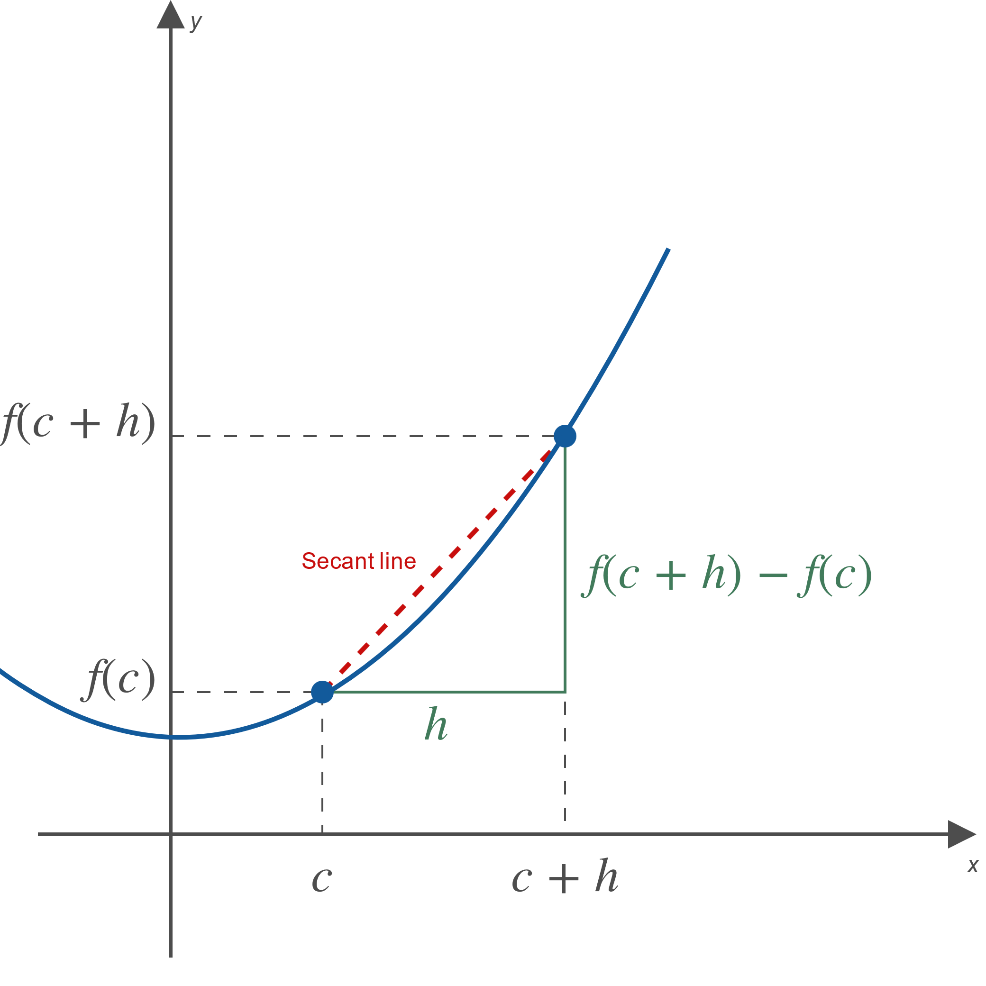
The Difference Quotient and Secant Line (cont.)
Figure 1

Slide 5
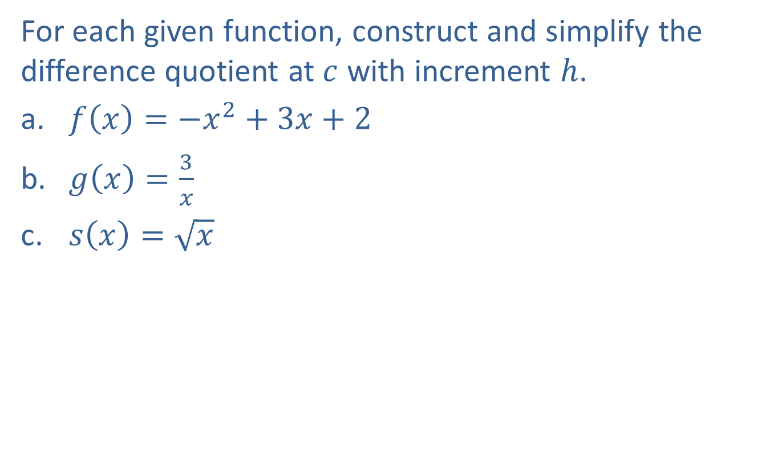
Example 1: Constructing and Simplifying the Difference Quotient
For each given function, construct and simplify the difference quotient at $c$ with increment $h$.
​$f\left(x\right)=−x^{2}+3x+2$
​$g\left(x\right)=\frac{3}{x}$
​$s\left(x\right)=\sqrt{x}$

Slide 6
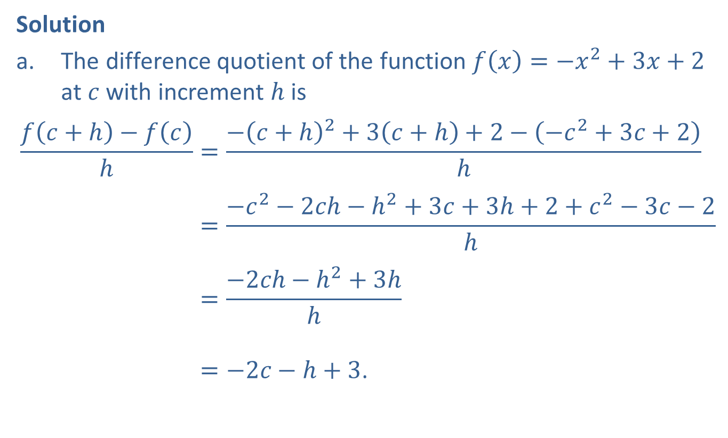
Example 1: Constructing and Simplifying the Difference Quotient (cont.)
Solution
​The difference quotient of the function $f\left(x\right)=−x^{2}+3x+2$ at $c$ with increment $h$ is
𝑓𝑐+h−𝑓𝑐h=−𝑐+h2+3𝑐+h+2−−𝑐2+3𝑐+2h𝑓𝑐+h−𝑓𝑐h=−𝑐2−2𝑐h−h2+3𝑐+3h+2+𝑐2−3𝑐−2h𝑓𝑐+h−𝑓𝑐h=−2𝑐h−h2+3hh𝑓𝑐+h−𝑓𝑐h=−2𝑐−h+3.

Slide 7
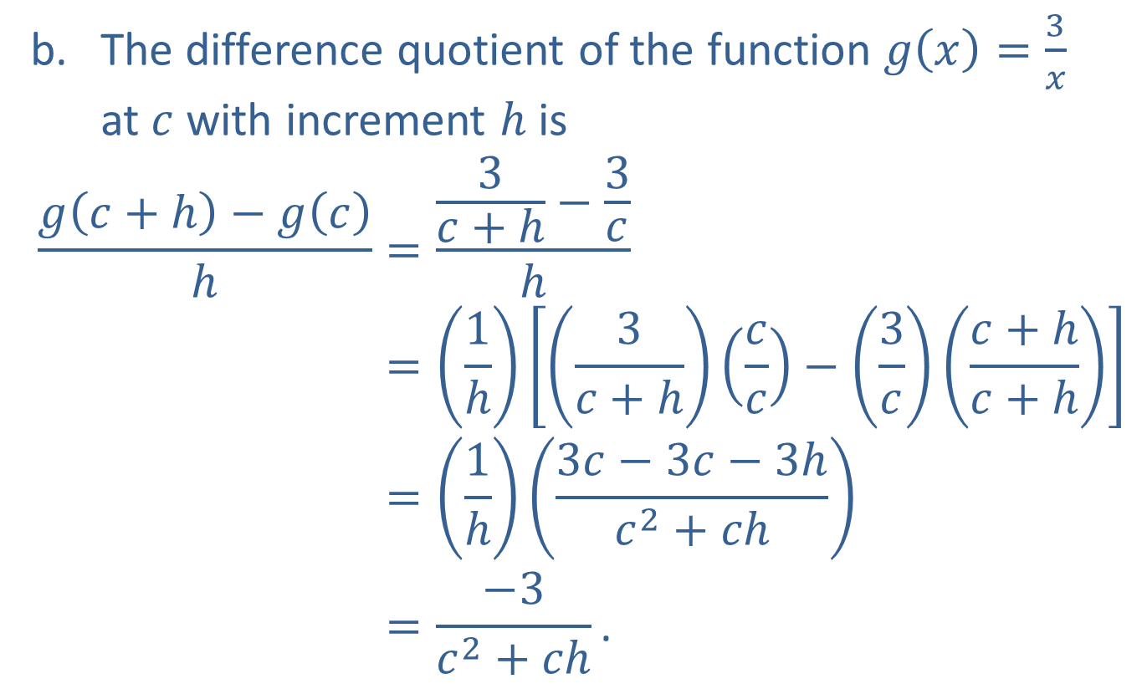
Example 1: Constructing and Simplifying the Difference Quotient (cont.)
​The difference quotient of the function $g\left(x\right)=\frac{3}{x}$
at $c$ with increment $h$ is
𝑔𝑐+h−𝑔𝑐h=3𝑐+h−3𝑐h𝑔𝑐+h−𝑔𝑐h=1h3𝑐+h𝑐𝑐−3𝑐𝑐+h𝑐+h𝑔𝑐+h−𝑔𝑐h=1h3𝑐−3𝑐−3h𝑐2+𝑐h𝑔𝑐+h−𝑔𝑐h=−3𝑐2+𝑐h.

Slide 8
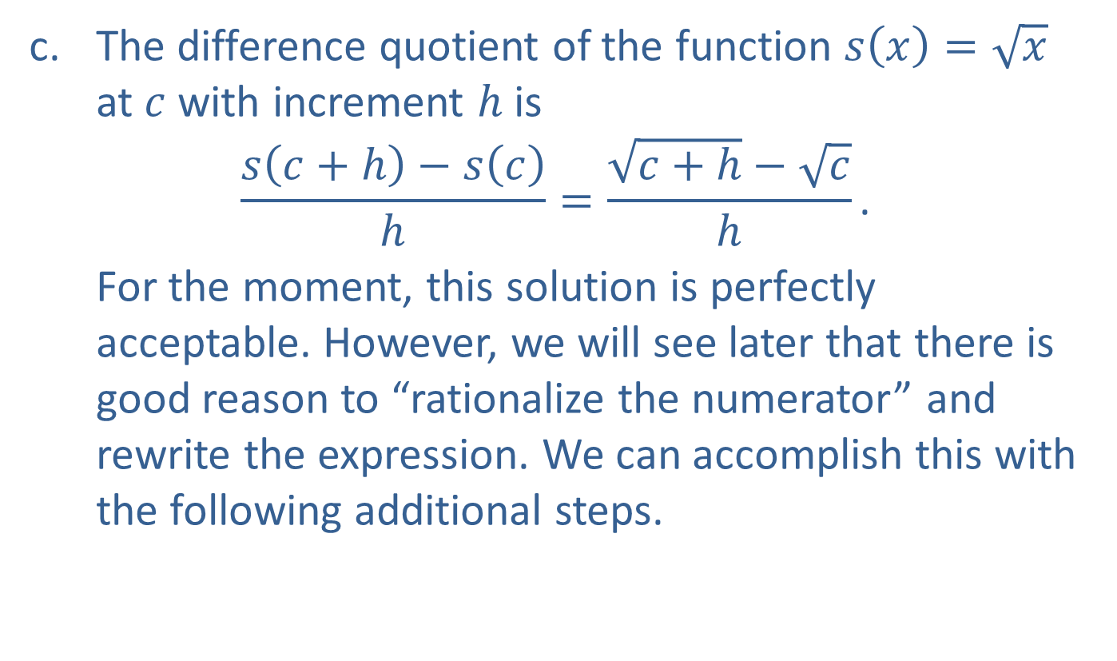
Example 1: Constructing and Simplifying the Difference Quotient (cont.)
​The difference quotient of the function $s\left(x\right)=\sqrt{x}$ at $c$ with increment $h$ is
$$\frac{s\left(c+h\right)−s\left(c\right)}{h}=\frac{\sqrt{c+h}−\sqrt{c}}{h}\text{.}$$
​​For the moment, this solution is perfectly acceptable. However, we will see later that there is good reason to “rationalize the numerator” and rewrite the expression. We can accomplish this with the following additional steps.

Slide 9
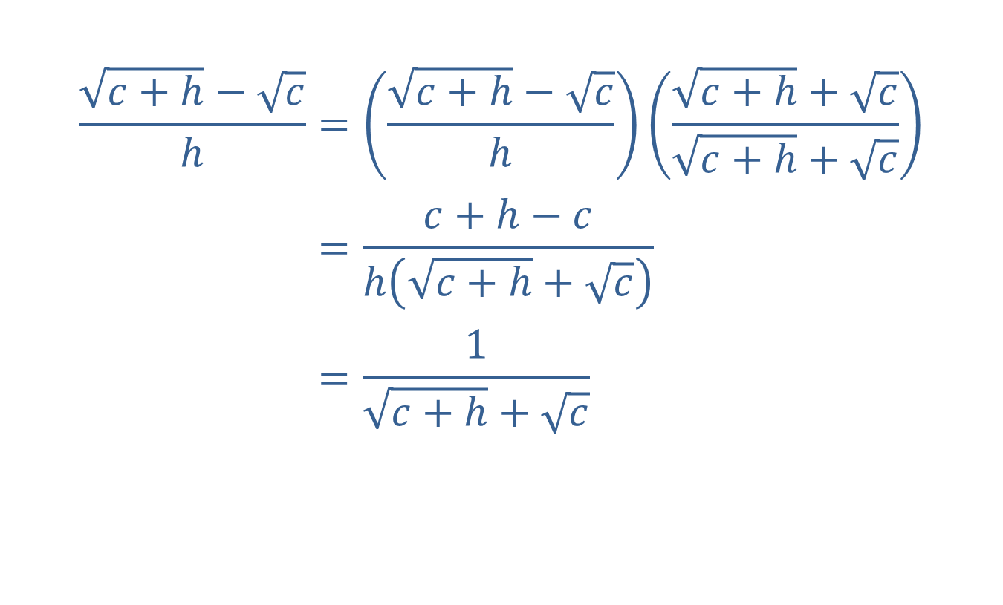
Example 1: Constructing and Simplifying the Difference Quotient (cont.)
𝑐+h−𝑐h=𝑐+h−𝑐h𝑐+h+𝑐𝑐+h+𝑐𝑐+h−𝑐h=𝑐+h−𝑐h𝑐+h+𝑐𝑐+h−𝑐h=1𝑐+h+𝑐

Slide 10
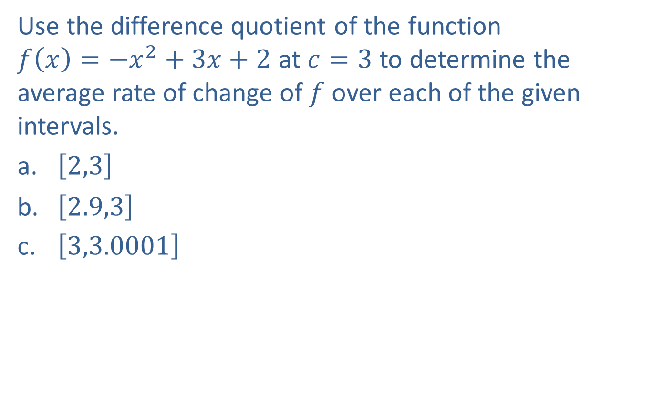
Example 2: Using the Difference Quotient to Determine the Average Rate of Change
Use the difference quotient of the function
$f\left(x\right)=−x^{2}+3x+2$ at $c=3$ to determine the average rate of change of $f$ over each of the given intervals.
​$\left[2,3\right]$
​$\left[2.9,3\right]$
​$\left[3,3.0001\right]$

Slide 11
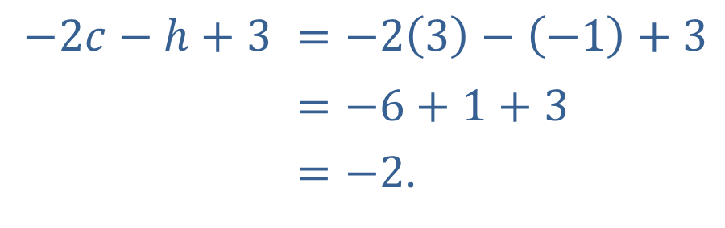
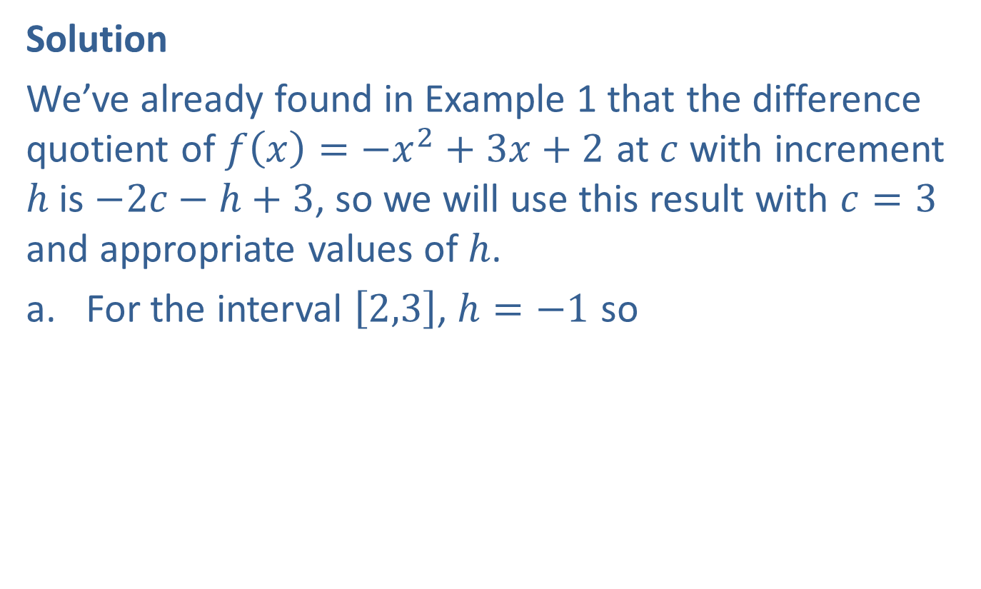
Example 2: Using the Difference Quotient to Determine the Average Rate of Change (cont.)
Solution
We’ve already found in Example 1 that the difference quotient of $f\left(x\right)=−x^{2}+3x+2$ at $c$ with increment $h$ is $−2c−h+3$, so we will use this result with $c=3$ and appropriate values of $h$.
​For the interval $\left[2,3\right]$, $h=−1$ so
$$−2c−h+3$$ | $=−2\left(3\right)−\left(−1\right)+3$
 | $$=−6+1+3$$
 | $=−2$.

Slide 12
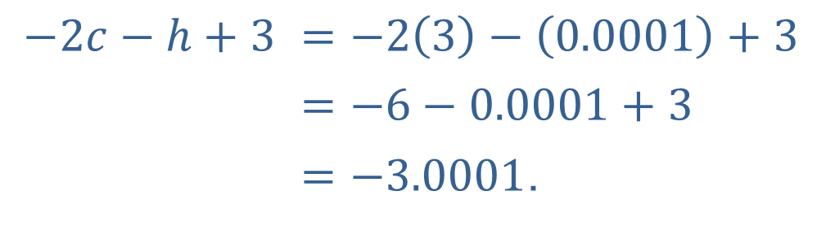

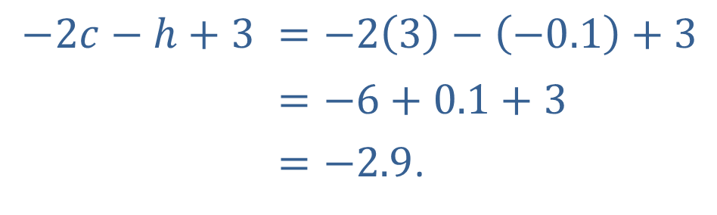
Example 2: Using the Difference Quotient to Determine the Average Rate of Change (cont.)
​For the interval $\left[2.9,3\right]$, $h=−0.1$ so
​
​For the interval $\left[3,3.0001\right]$, $h=0.0001$ so
​
$$−2c−h+3$$ | $=−2\left(3\right)−\left(−0.1\right)+3$
 | $$=−6+0.1+3$$
 | $=−2.9$.
$$−2c−h+3$$ | $=−2\left(3\right)−\left(0.0001\right)+3$
 | $=−6−0.0001+3$
 | $=−3.0001$.

Slide 13
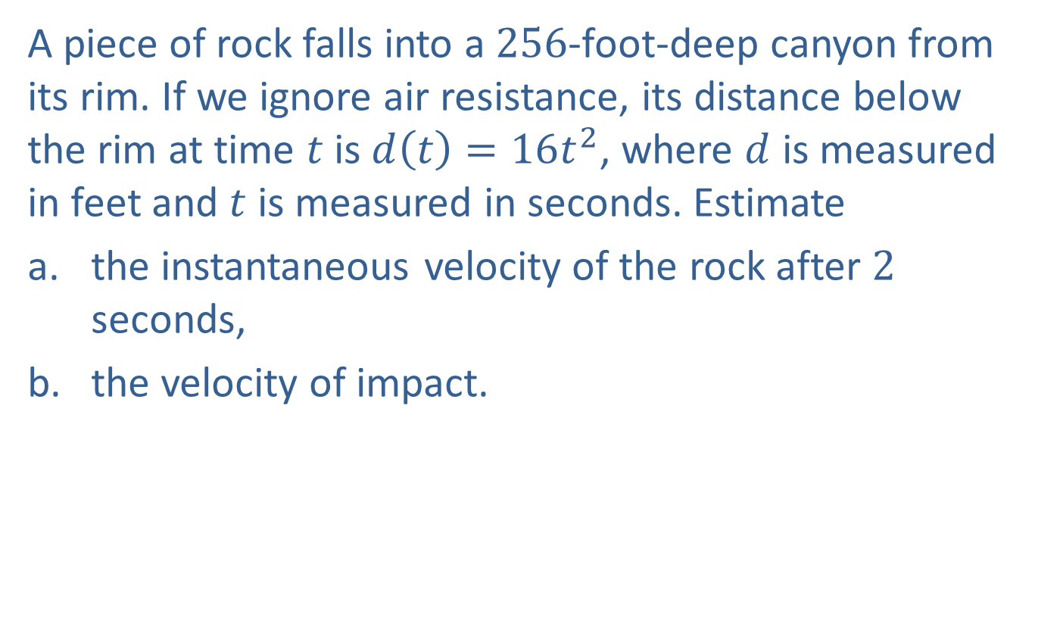
Example 3: Using Average Velocities to Estimate Instantaneous Velocity
A piece of rock falls into a 256-foot-deep canyon from its rim. If we ignore air resistance, its distance below the rim at time $t$ is $d\left(t\right)=16t^{2}$, where $d$ is measured in feet and $t$ is measured in seconds. Estimate
​the instantaneous velocity of the rock after 2 seconds,
the velocity of impact.

Slide 14
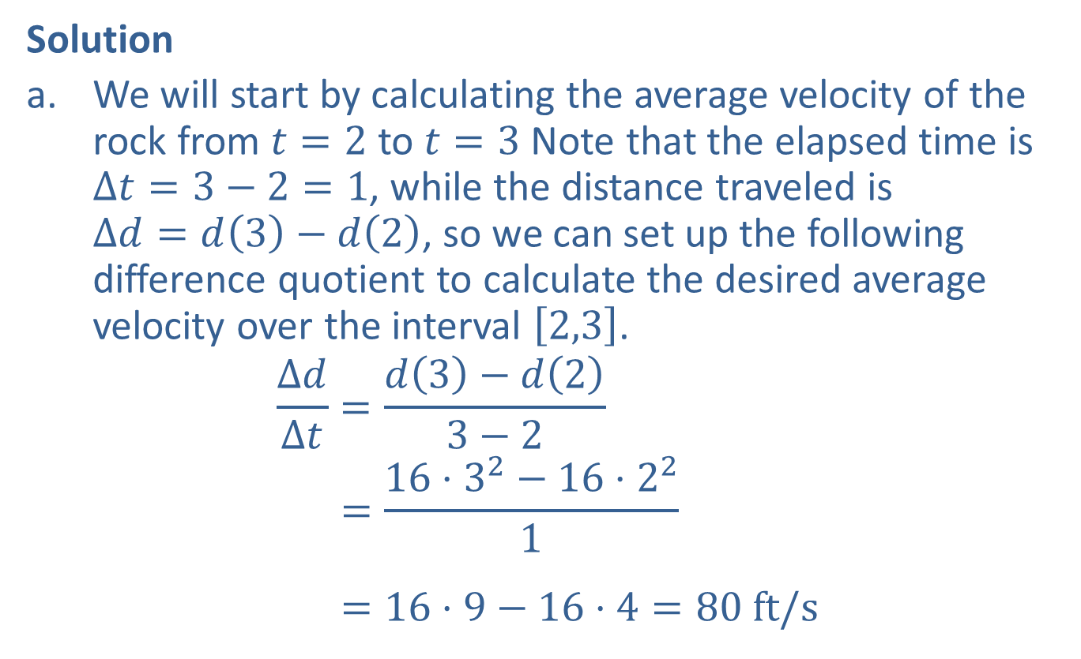
Example 3: Using Average Velocities to Estimate Instantaneous Velocity (cont.)
Solution
​We will start by calculating the average velocity of the rock from $t=2$ to $t=3$ Note that the elapsed time is
$Δt=3−2=1$, while the distance traveled is
$Δd=d\left(3\right)−d\left(2\right)$, so we can set up the following difference quotient to calculate the desired average velocity over the interval $\left[2,3\right]$.
Δ𝑑Δ𝑡=𝑑3−𝑑23−2𝛥𝑑𝛥𝑡=16⋅32−16⋅221𝛥𝑑𝛥𝑡=16⋅9−16⋅4=80 ft/s

Slide 15
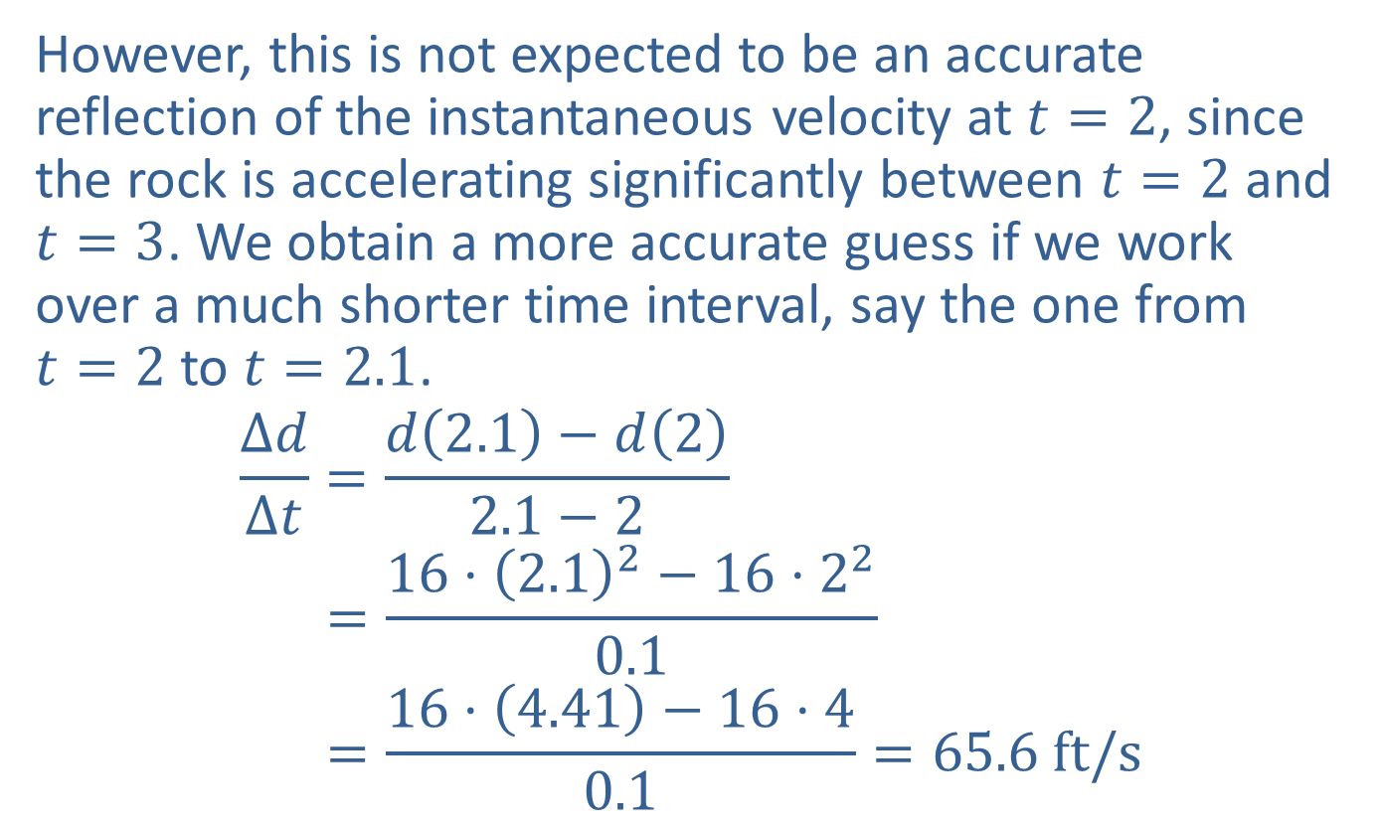
Example 3: Using Average Velocities to Estimate Instantaneous Velocity (cont.)
​However, this is not expected to be an accurate reflection of the instantaneous velocity at $t=2$, since the rock is accelerating significantly between $t=2$ and $t=3$. We obtain a more accurate guess if we work over a much shorter time interval, say the one from
$t=2$ to $t=2.1$.
Δ𝑑Δ𝑡=𝑑2.1−𝑑22.1−2𝛥𝑑𝛥𝑡=16⋅2.12−16⋅220.1𝛥𝑑𝛥𝑡=16⋅4.41−16⋅40.1=65.6 ft/s

Slide 16
Example 3: Using Average Velocities to Estimate Instantaneous Velocity (cont.)
​This is a much better guess, but there is no need to stop here. Table 1 summarizes the average velocities over time intervals of decreasing lengths, all the way down to a length of 0.01 seconds.
​

Slide 17
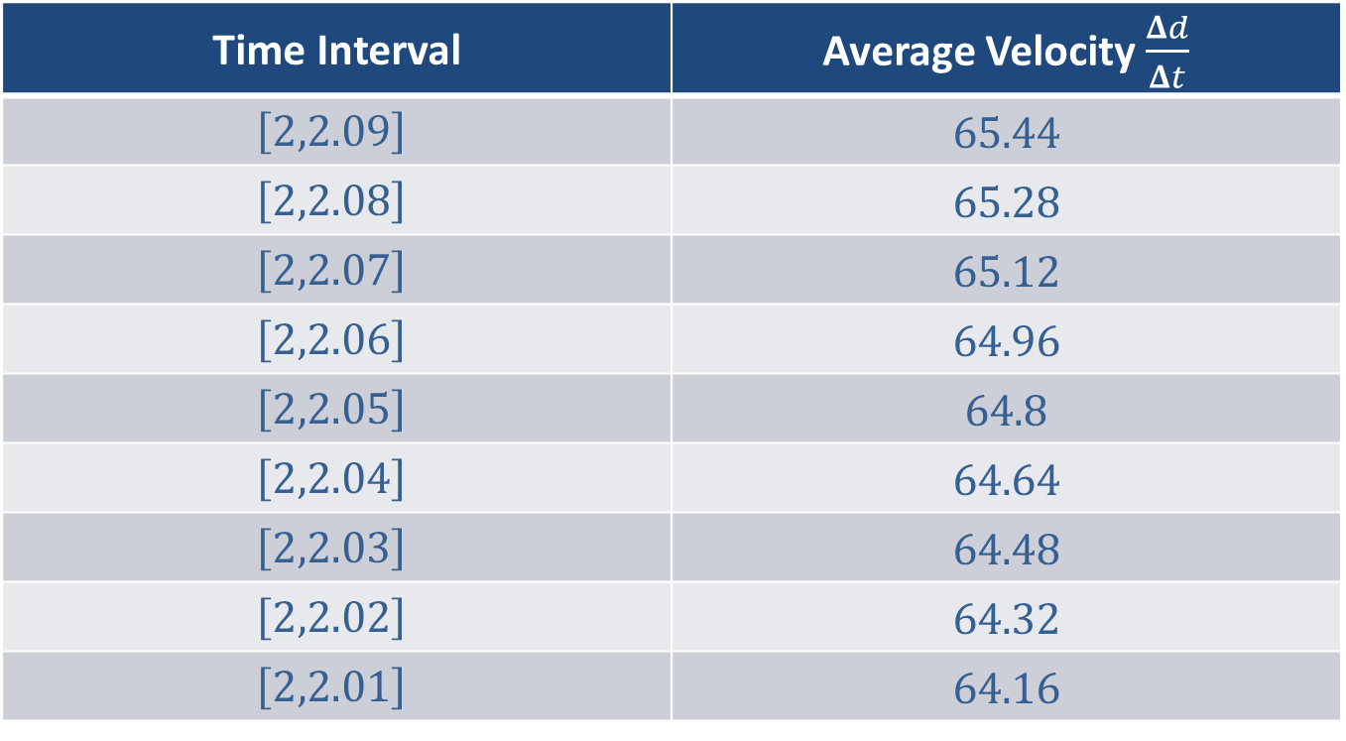
Example 3: Using Average Velocities to Estimate Instantaneous Velocity (cont.)
Time Interval | Average Velocity $\frac{Δd}{Δt}$
$$\left[2,2.09\right]$$ | 65.44
$$\left[2,2.08\right]$$ | 65.28
$$\left[2,2.07\right]$$ | 65.12
$$\left[2,2.06\right]$$ | 64.96
$$\left[2,2.05\right]$$ | 64.8
$$\left[2,2.04\right]$$ | 64.64
$$\left[2,2.03\right]$$ | 64.48
$$\left[2,2.02\right]$$ | 64.32
$$\left[2,2.01\right]$$ | 64.16
​Table 1

Slide 18
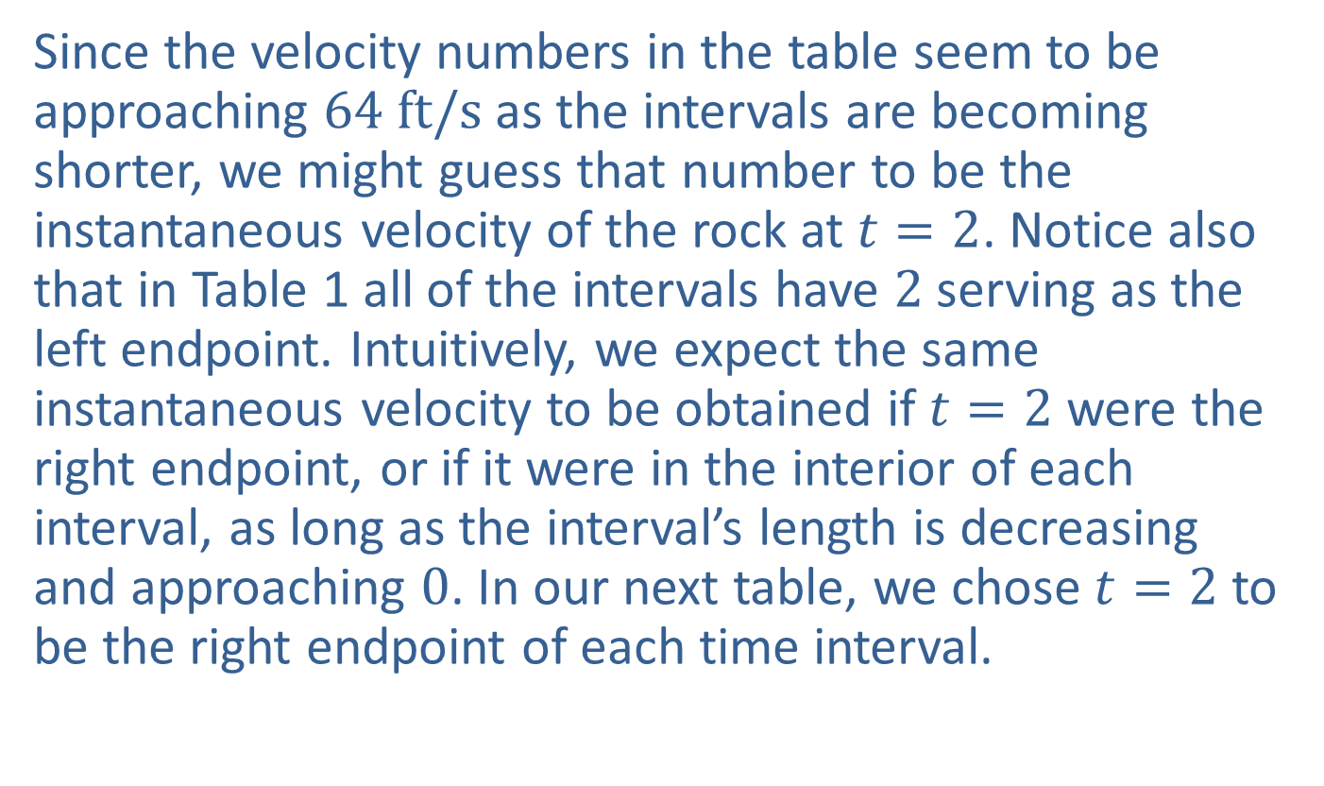
Example 3: Using Average Velocities to Estimate Instantaneous Velocity (cont.)
​Since the velocity numbers in the table seem to be approaching $64 ft/s$ as the intervals are becoming shorter, we might guess that number to be the instantaneous velocity of the rock at $t=2$. Notice also that in Table 1 all of the intervals have 2 serving as the left endpoint. Intuitively, we expect the same instantaneous velocity to be obtained if $t=2$ were the right endpoint, or if it were in the interior of each interval, as long as the interval’s length is decreasing and approaching 0. In our next table, we chose $t=2$ to be the right endpoint of each time interval.
​

Slide 19

Example 3: Using Average Velocities to Estimate Instantaneous Velocity (cont.)
Time Interval | Average Velocity $\frac{Δd}{Δt}$
$$\left[1.91,2\right]$$ | 62.56
$$\left[1.92,2\right]$$ | 62.72
$$\left[1.93,2\right]$$ | 62.88
$$\left[1.94,2\right]$$ | 63.04
$$\left[1.95,2\right]$$ | 63.2
$$\left[1.96,2\right]$$ | 63.36
$$\left[1.97,2\right]$$ | 63.52
$$\left[1.98,2\right]$$ | 63.68
$$\left[1.99,2\right]$$ | 63.84
​Table 2

Slide 20
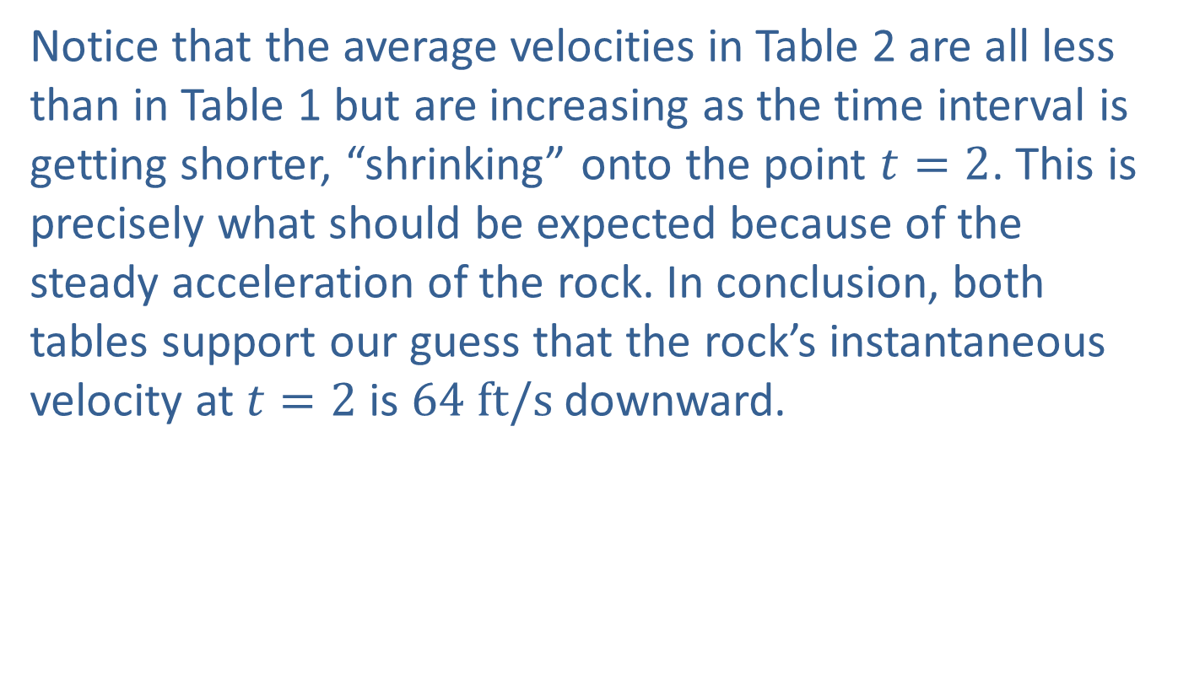
Example 3: Using Average Velocities to Estimate Instantaneous Velocity (cont.)
​Notice that the average velocities in Table 2 are all less than in Table 1 but are increasing as the time interval is getting shorter, “shrinking” onto the point $t=2$. This is precisely what should be expected because of the steady acceleration of the rock. In conclusion, both tables support our guess that the rock’s instantaneous velocity at $t=2$ is $64 ft/s$ downward.

Slide 21
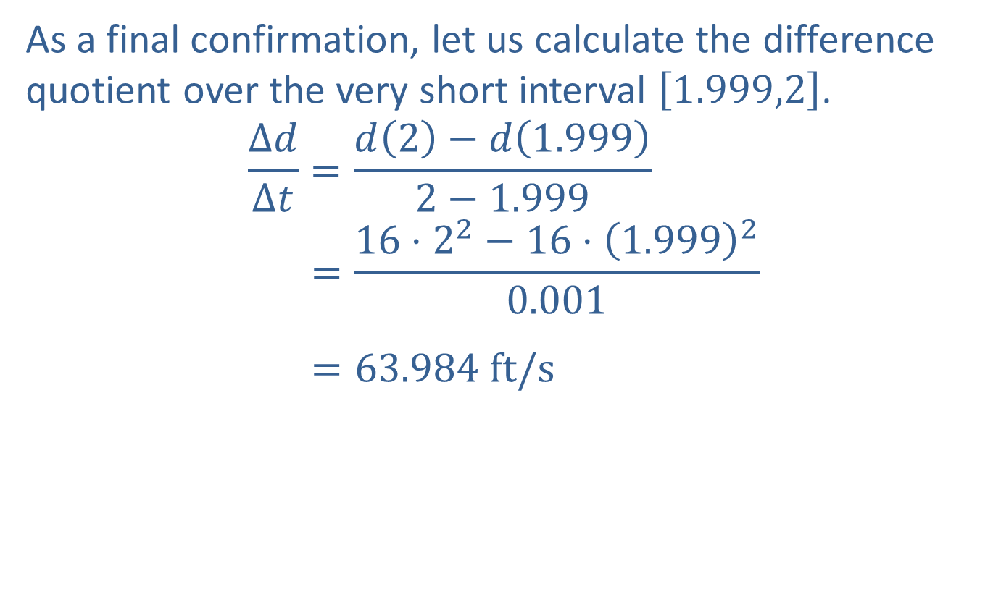
Example 3: Using Average Velocities to Estimate Instantaneous Velocity (cont.)
​As a final confirmation, let us calculate the difference quotient over the very short interval $\left[1.999,2\right]$.
Δ𝑑Δ𝑡=𝑑2−𝑑1.9992−1.999𝛥𝑑𝛥𝑡=16⋅22−16⋅1.99920.001𝛥𝑑𝛥𝑡=63.984 ft/s

Slide 22
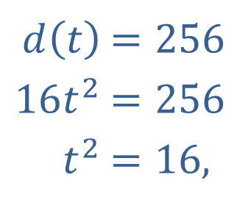
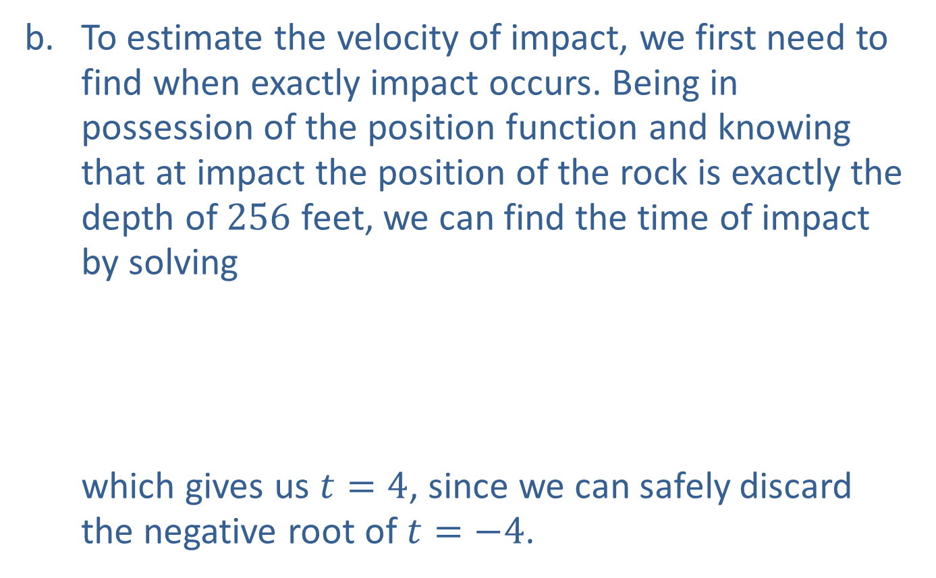
Example 3: Using Average Velocities to Estimate Instantaneous Velocity (cont.)
​To estimate the velocity of impact, we first need to find when exactly impact occurs. Being in possession of the position function and knowing that at impact the position of the rock is exactly the depth of 256 feet, we can find the time of impact by solving​
which gives us $t=4$, since we can safely discard the negative root of $t=−4$.
​$d⁡\left(t\right)$ | ​$=256$
​$16t^{2}$ | ​$=256$
​$t^{2}$ | ​$=16\text{,}$

Slide 23

Example 3: Using Average Velocities to Estimate Instantaneous Velocity (cont.)
​​To find the velocity of impact, we use the same strategy as in part a. but this time using $t=4$ as the right endpoint of our intervals for our difference quotients. Table 3 summarizes our calculations.
​

Slide 24
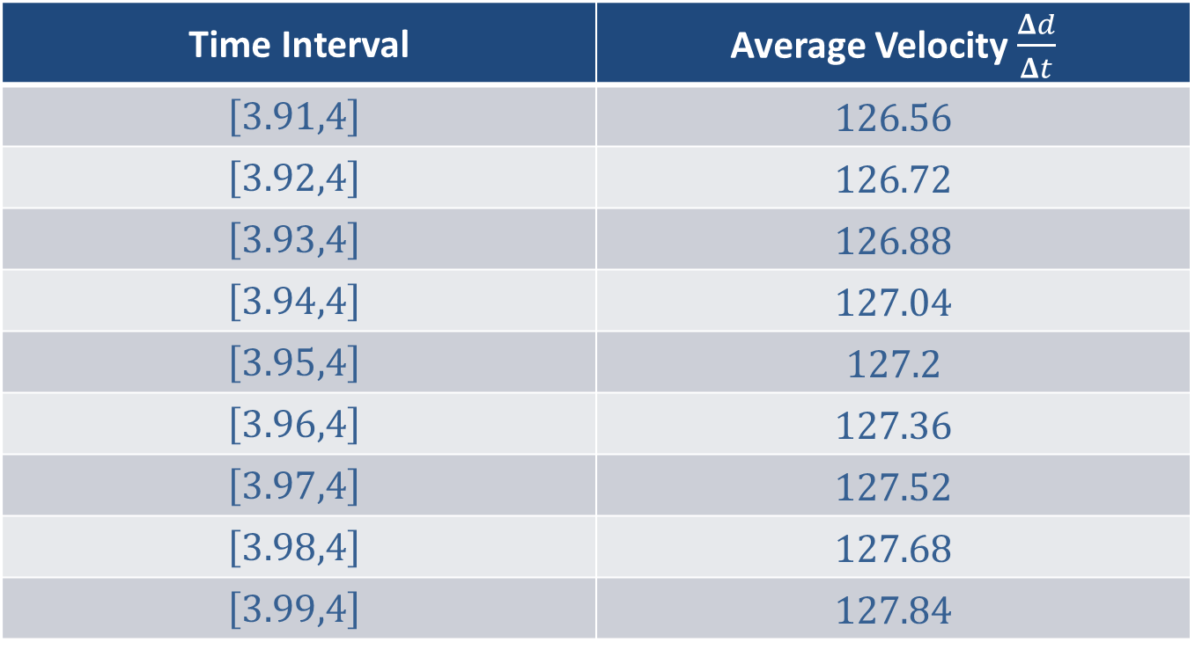
Example 3: Using Average Velocities to Estimate Instantaneous Velocity (cont.)
Time Interval | Average Velocity $\frac{Δd}{Δt}$
$$\left[3.91,4\right]$$ | 126.56
$$\left[3.92,4\right]$$ | 126.72
$$\left[3.93,4\right]$$ | 126.88
$$\left[3.94,4\right]$$ | 127.04
$$\left[3.95,4\right]$$ | 127.2
$$\left[3.96,4\right]$$ | 127.36
$$\left[3.97,4\right]$$ | 127.52
$$\left[3.98,4\right]$$ | 127.68
$$\left[3.99,4\right]$$ | 127.84
​Table 3

Slide 25

Example 3: Using Average Velocities to Estimate Instantaneous Velocity (cont.)
​As before, we examine the table and conclude that the velocity of impact is approximately $128 ft/s$ (you may want to further confirm our finding by calculating difference quotients over even shorter time intervals).

Slide 26

Example 4: Using Difference Quotients to Approximate the Slope of a Tangent Line
Construct difference quotients to approximate the slope of the line tangent to the graph of
$f\left(x\right)=0.2x^{3}−1.8x^{2}+3.6x$
at the point $\left(1,2\right)$.

Slide 27
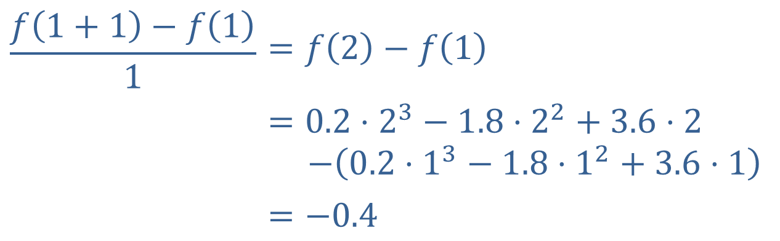

Example 4: Using Difference Quotients to Approximate the Slope of a Tangent Line (cont.)
Solution
Note that in this problem, $c=1$. Just as in Example 3, we will construct difference quotients using several
$h$-values that are decreasing in magnitude. To start off, letting $h=1$ we obtain the following.
$$\frac{f\left(1+1\right)−f\left(1\right)}{1}$$ | $$=f\left(2\right)−f\left(1\right)$$
 | $$=0.2⋅2^{3}−1.8⋅2^{2}+3.6⋅2$$ $−\left(0.2⋅1^{3}−1.8⋅1^{2}+3.6⋅1\right)$
 | $$=−0.4$$

Slide 28
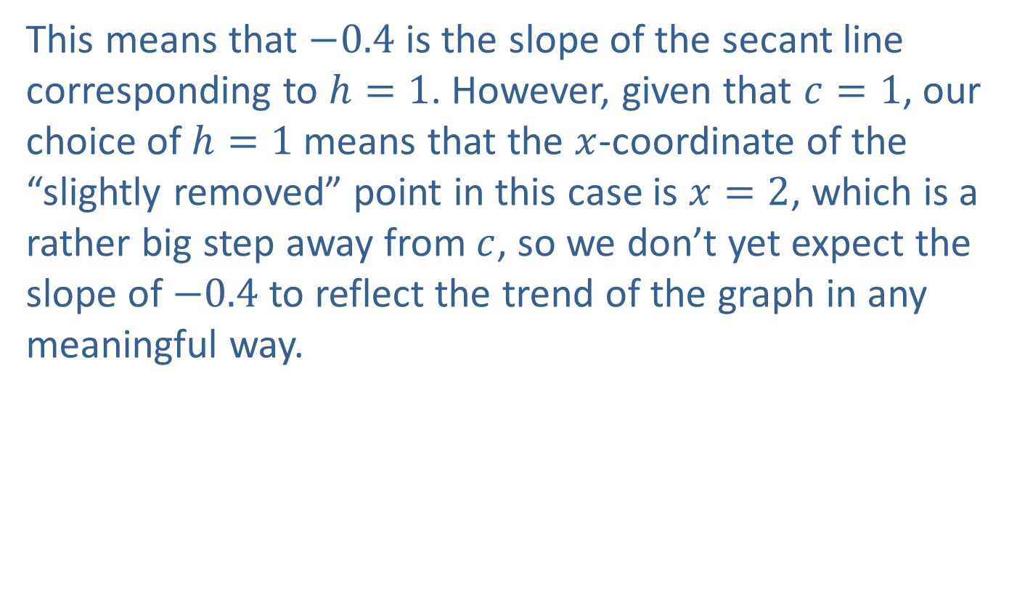
Example 4: Using Difference Quotients to Approximate the Slope of a Tangent Line (cont.)
This means that $−0.4$ is the slope of the secant line corresponding to $h=1$. However, given that $c=1$, our choice of $h=1$ means that the $x$-coordinate of the “slightly removed” point in this case is $x=2$, which is a rather big step away from $c$, so we don’t yet expect the slope of $−0.4$ to reflect the trend of the graph in any meaningful way.

Slide 29
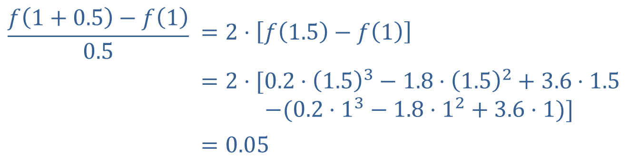

Example 4: Using Difference Quotients to Approximate the Slope of a Tangent Line (cont.)
Let us check what happens if $h=0.5$.
This shows us that the associated secant line is now nearly horizontal, and its slope went from negative to positive. Decreasing $h$ even further, we evaluate several more difference quotients, and Table 4 displays our results.
$$\frac{f\left(1+0.5\right)−f\left(1\right)}{0.5}$$ | $=2⋅\left[f\left(1.5\right)−f\left(1\right)\right]$
 | $$=2⋅[0.2⋅{\left(1.5\right)}^{3}−1.8⋅{\left(1.5\right)}^{2}+3.6⋅1.5$$ $−(0.2⋅1^{3}−1.8⋅1^{2}+3.6⋅1)]$
 | $=0.05$

Slide 30
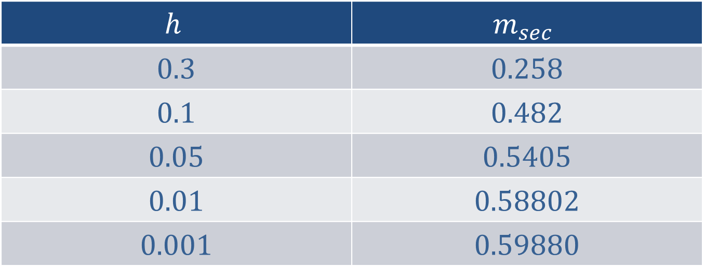
Example 4: Using Difference Quotients to Approximate the Slope of a Tangent Line (cont.)
$$h$$ | $$m_{sec}$$
0.3 | 0.258
0.1 | 0.482
0.05 | 0.5405
0.01 | 0.58802
0.001 | 0.59880
​Table 4

Slide 31
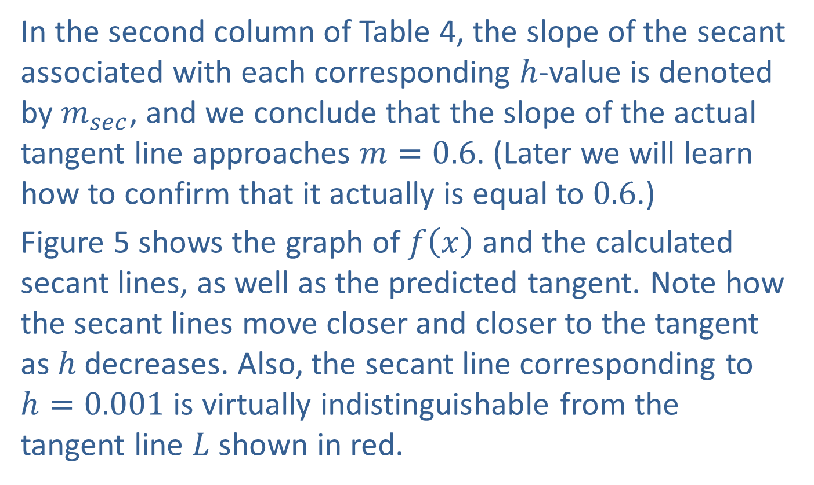
Example 4: Using Difference Quotients to Approximate the Slope of a Tangent Line (cont.)
In the second column of Table 4, the slope of the secant associated with each corresponding $h$-value is denoted by $m_{sec}$, and we conclude that the slope of the actual tangent line approaches $m=0.6$. (Later we will learn how to confirm that it actually is equal to 0.6.)
Figure 5 shows the graph of $f⁡\left(x\right)$ and the calculated secant lines, as well as the predicted tangent. Note how the secant lines move closer and closer to the tangent as $h$ decreases. Also, the secant line corresponding to
$h=0.001$ is virtually indistinguishable from the tangent line $L$ shown in red.

Slide 32
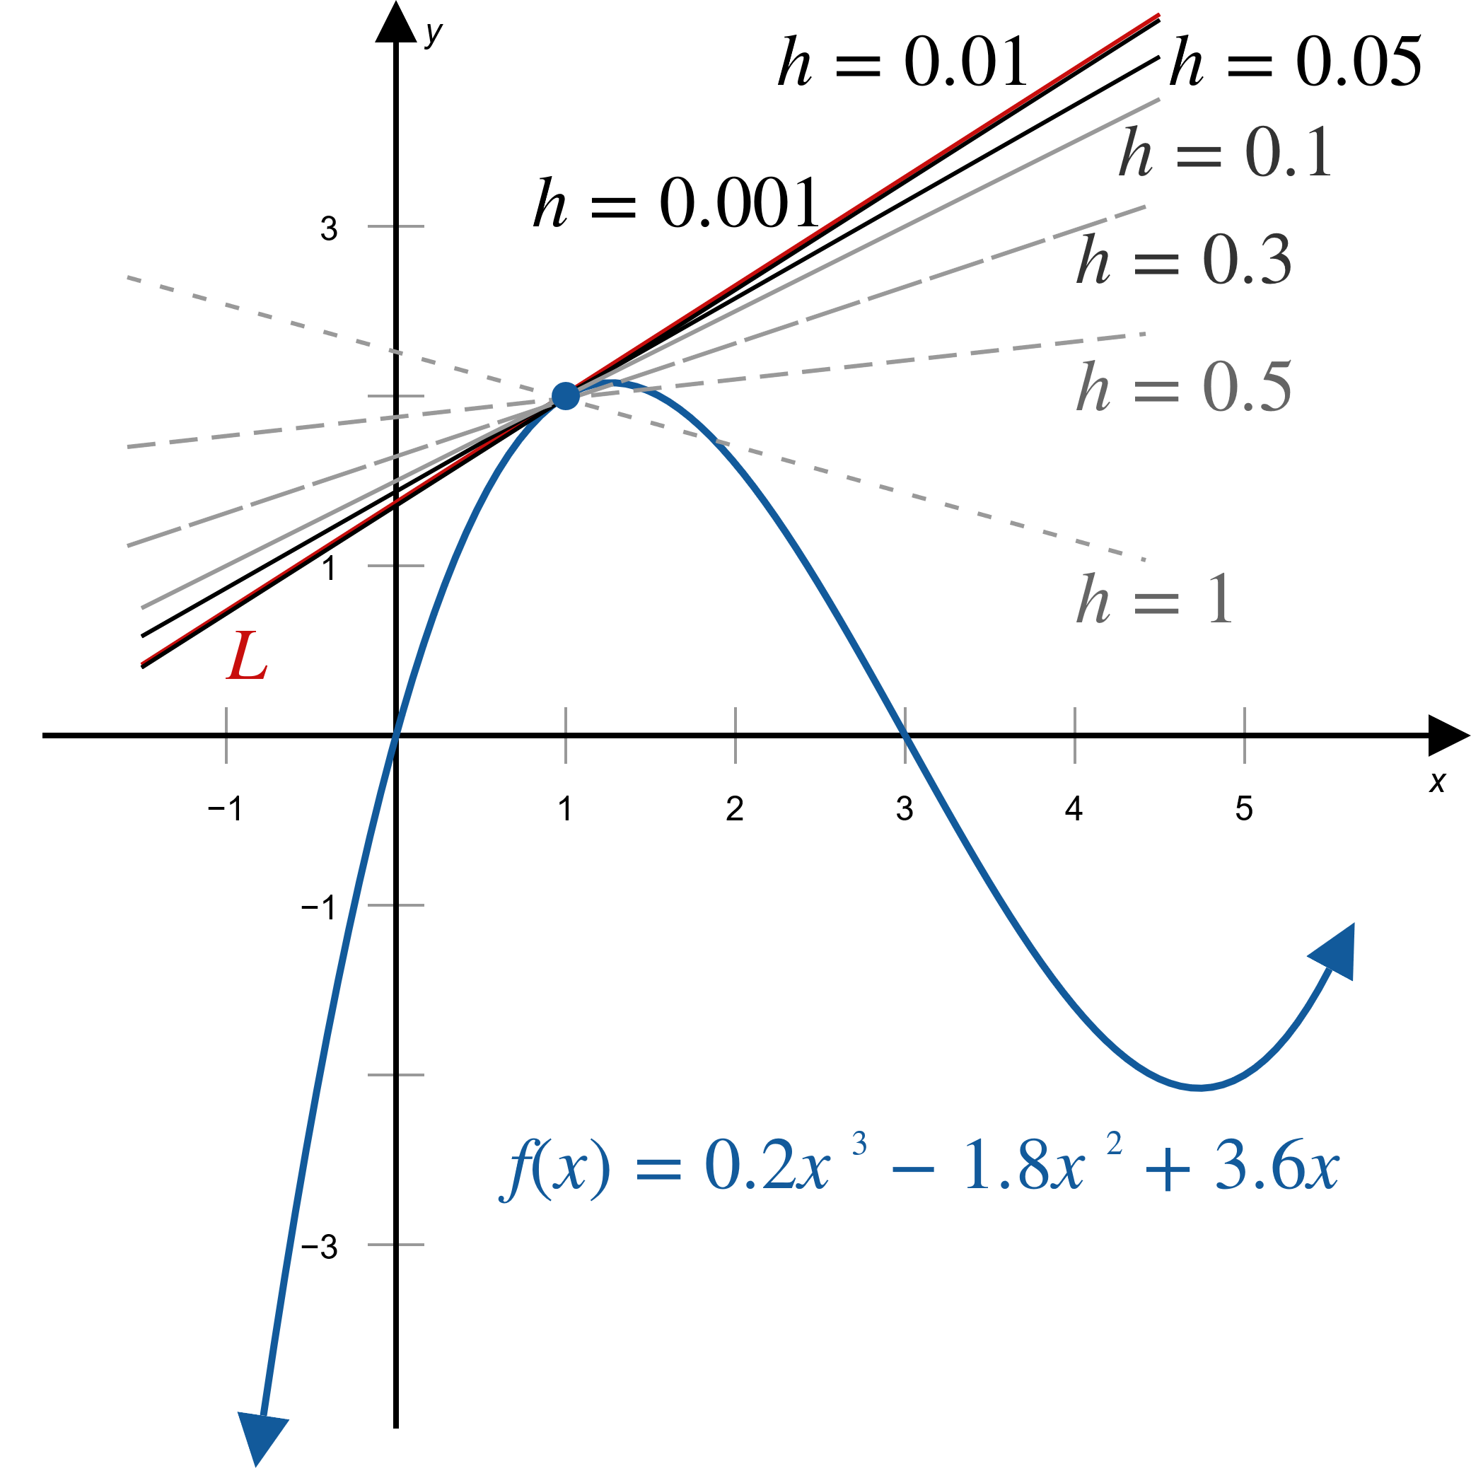
Example 4: Using Difference Quotients to Approximate the Slope of a Tangent Line (cont.)
Figure 5

Slide 33

Example 5: Using Difference Quotients to Show That a Point Has No Tangent Line
Show that the slope of a tangent line of the absolute value function $A\left(x\right)=\left|x\right|$ at $(0,0)$ can’t be inferred from a table of difference quotients.

Slide 34
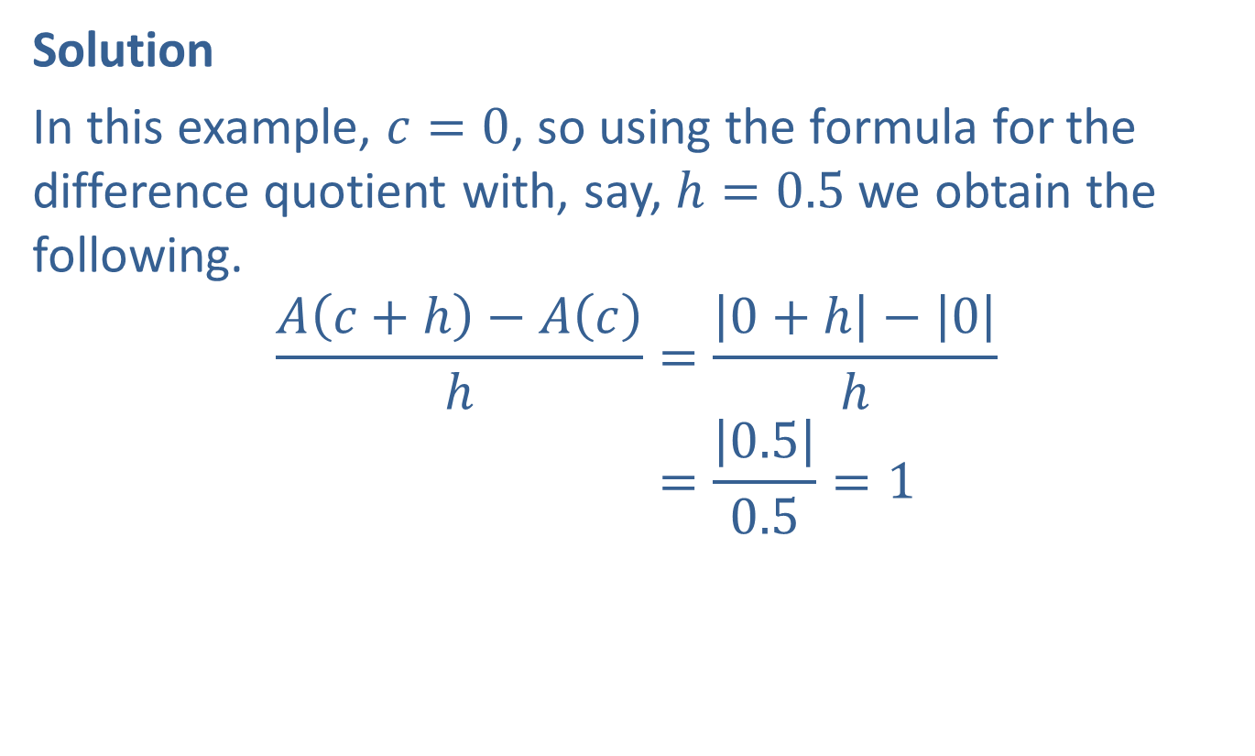
Example 5: Using Difference Quotients to Show That a Point Has No Tangent Line (cont.)
Solution
In this example, $c=0$, so using the formula for the difference quotient with, say, $h=0.5$ we obtain the following.
𝐴𝑐+h−𝐴𝑐h=0+h−0h𝐴𝑐+h−𝐴𝑐h=0.50.5=1

Slide 35
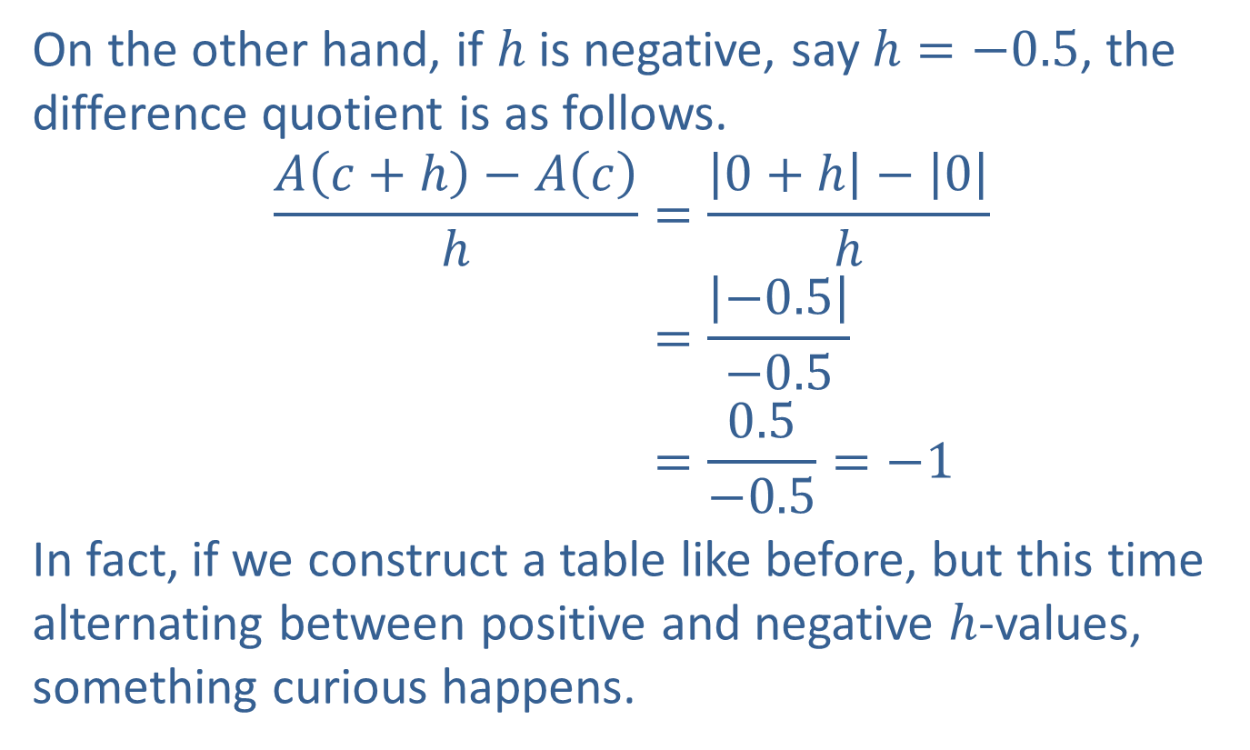
Example 5: Using Difference Quotients to Show That a Point Has No Tangent Line (cont.)
On the other hand, if $h$ is negative, say $h=−0.5$, the difference quotient is as follows.
𝐴𝑐+h−𝐴𝑐h=0+h−0h𝐴𝑐+h−𝐴𝑐h=−0.5−0.5𝐴𝑐+h−𝐴𝑐h=0.5−0.5=−1
In fact, if we construct a table like before, but this time alternating between positive and negative $h$-values, something curious happens.

Slide 36
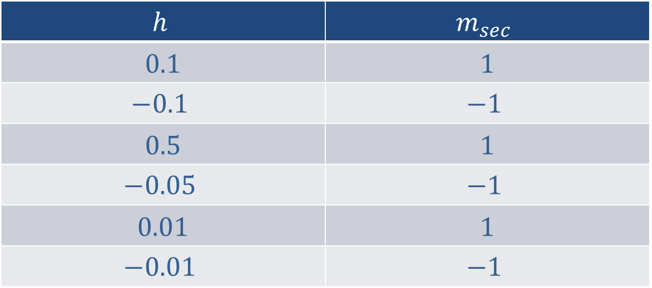
Example 5: Using Difference Quotients to Show That a Point Has No Tangent Line (cont.)
$$h$$ | $$m_{sec}$$
0.1 | 1
$$−0.1$$ | $$−1$$
0.5 | 1
$$−0.05$$ | $$−1$$
0.01 | 1
$$−0.01$$ | $$−1$$
​Table 5

Slide 37
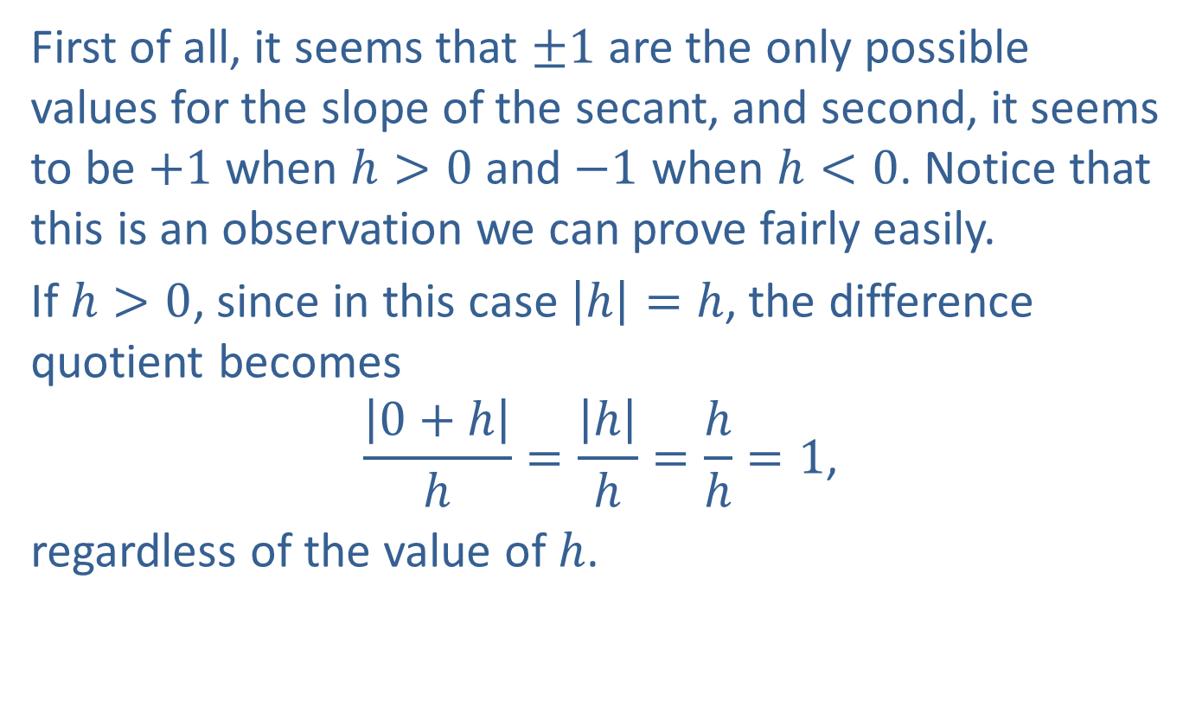
Example 5: Using Difference Quotients to Show That a Point Has No Tangent Line (cont.)
First of all, it seems that $±1$ are the only possible values for the slope of the secant, and second, it seems to be $+1$ when $h>0$ and $−1$ when $h<0$. Notice that this is an observation we can prove fairly easily.
If $h>0$, since in this case $\left|h\right|=h$, the difference quotient becomes
$$\frac{\left|0+h\right|}{h}=\frac{\left|h\right|}{h}=\frac{h}{h}=1\text{,}$$
regardless of the value of $h$.

Slide 38
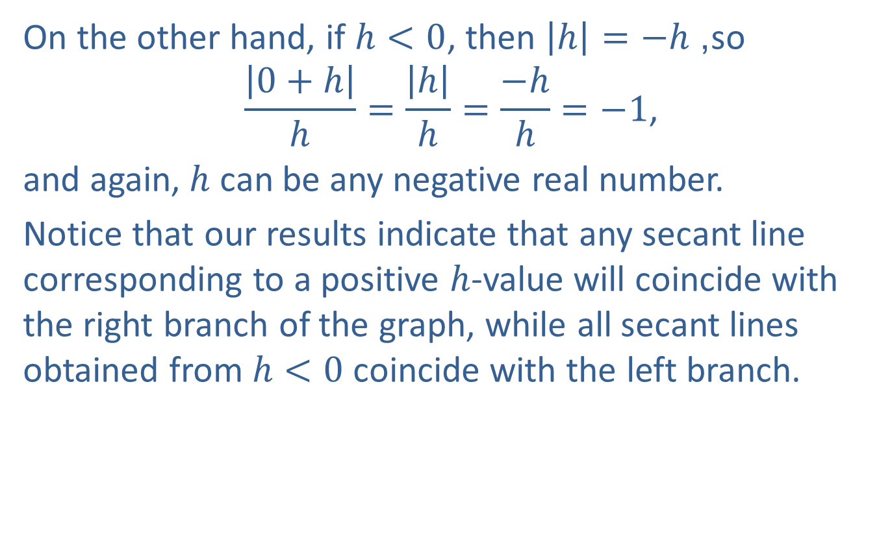
Example 5: Using Difference Quotients to Show That a Point Has No Tangent Line (cont.)
On the other hand, if $h<0$, then $\left|h\right|=−h$, so
$$\frac{\left|0+h\right|}{h}=\frac{\left|h\right|}{h}=\frac{−h}{h}=−1\text{,}$$
and again, $h$ can be any negative real number.
Notice that our results indicate that any secant line corresponding to a positive $h$-value will coincide with the right branch of the graph, while all secant lines obtained from $h<0$ coincide with the left branch.

Slide 39
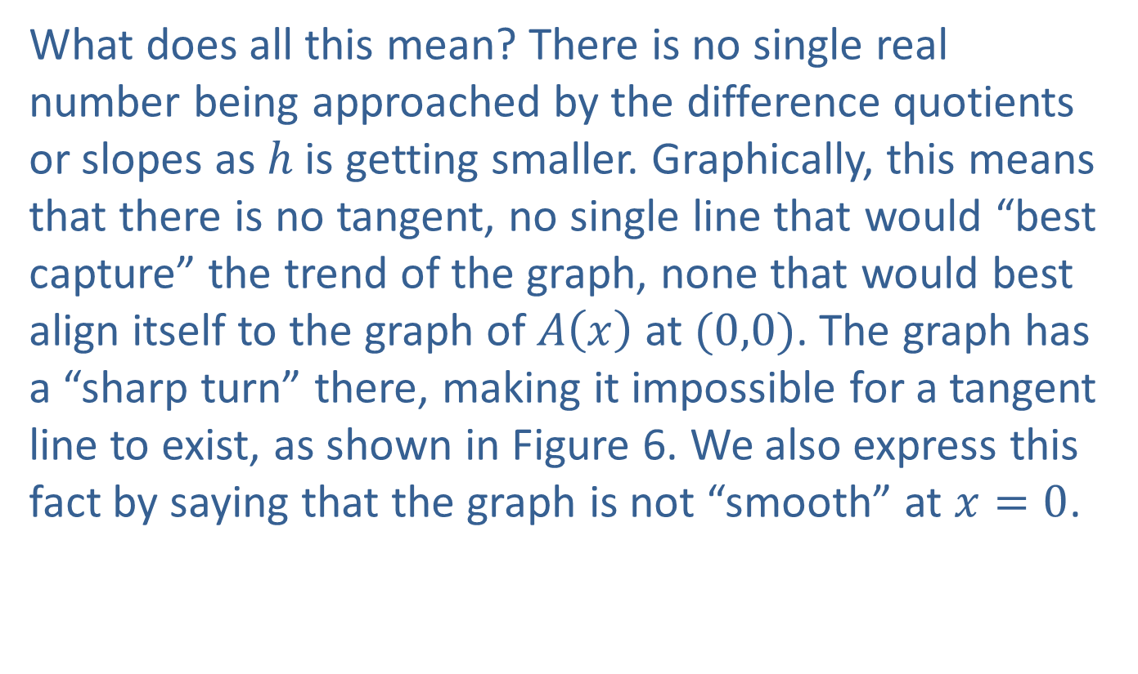
Example 5: Using Difference Quotients to Show That a Point Has No Tangent Line (cont.)
What does all this mean? There is no single real number being approached by the difference quotients or slopes as $h$ is getting smaller. Graphically, this means that there is no tangent, no single line that would “best capture” the trend of the graph, none that would best align itself to the graph of $A⁡\left(x\right)$ at $(0,0)$. The graph has a “sharp turn” there, making it impossible for a tangent line to exist, as shown in Figure 6. We also express this fact by saying that the graph is not “smooth” at $x=0$.

Slide 40
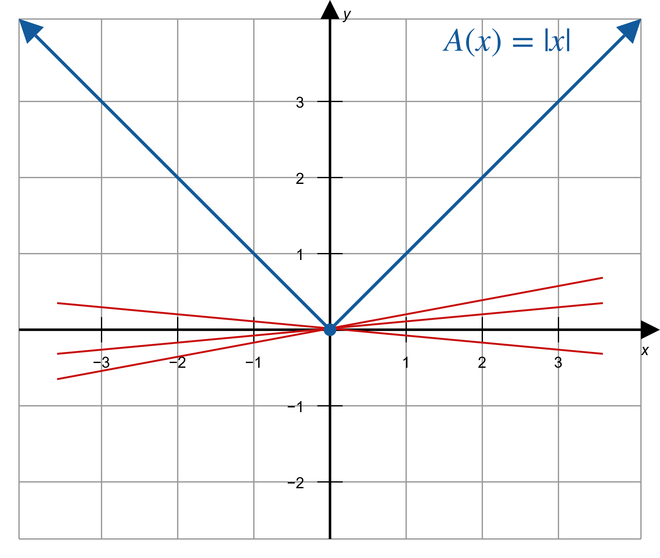
Example 5: Using Difference Quotients to Show That a Point Has No Tangent Line (cont.)
Figure 6

