Slide 1
Section 13.2
Limits in the Plane

Slide 2

Example 1: Finding Limits Given Graphs
Suppose the graph shown in Figure 1 is that of the function $y=f\left(x\right)$.

Slide 3
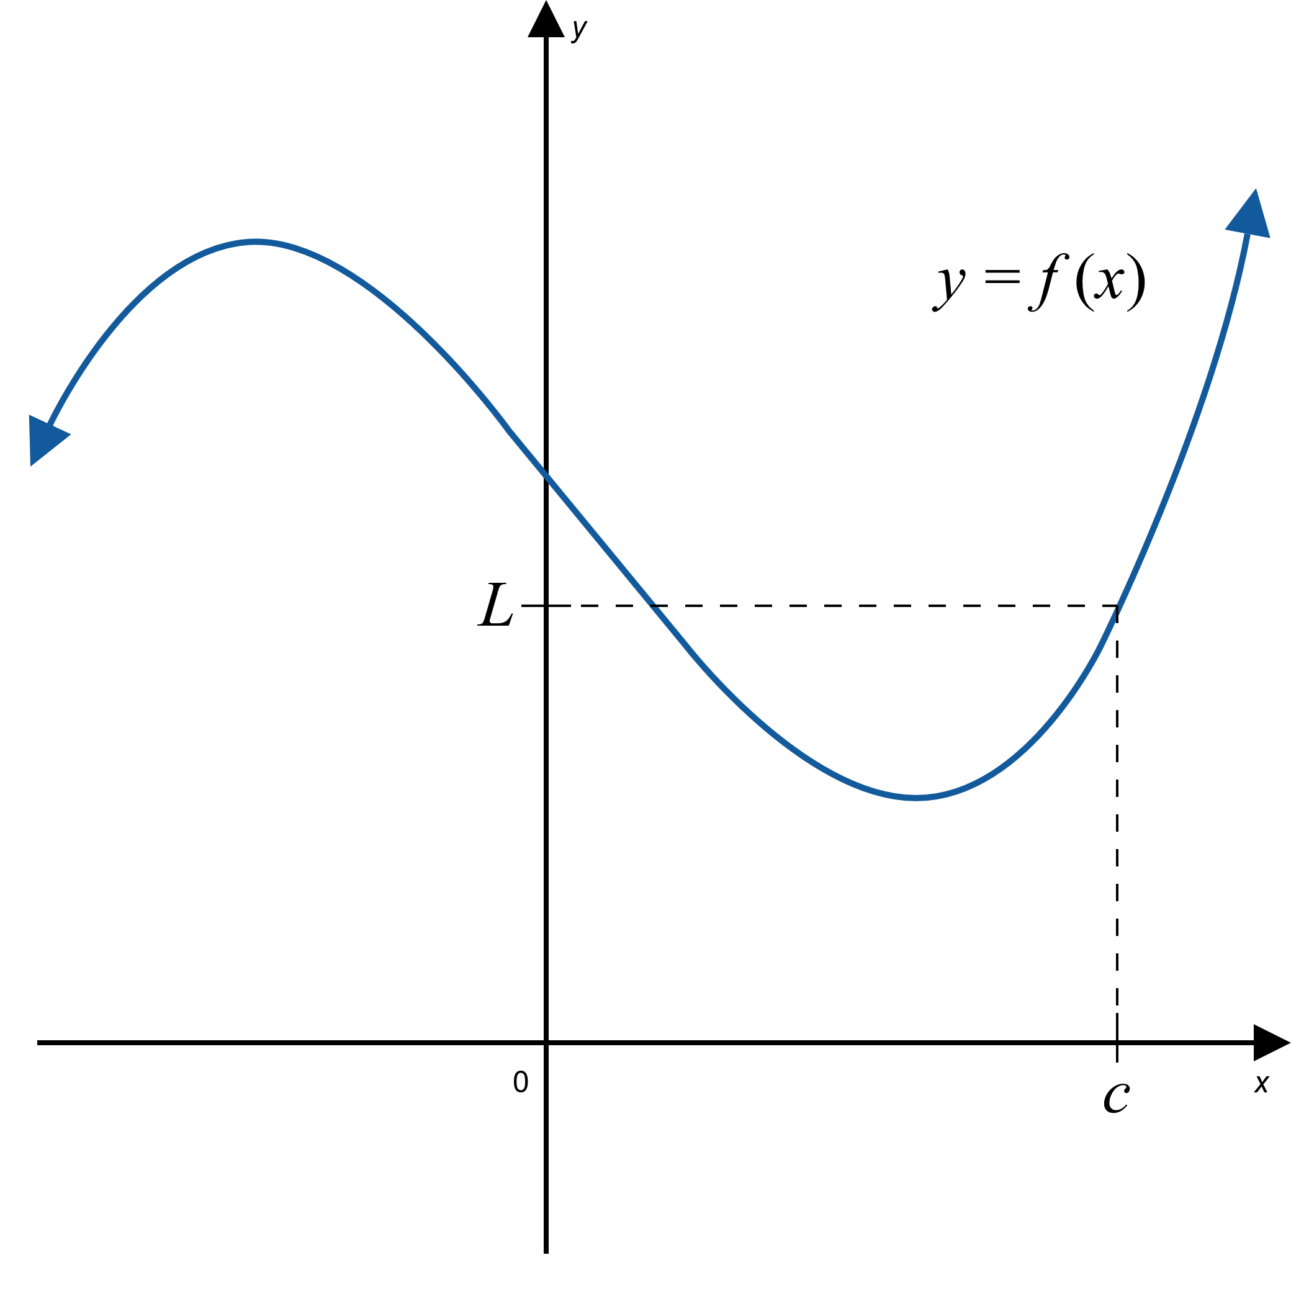
Example 1: Finding Limits Given Graphs (cont.)
Figure 1

Slide 4
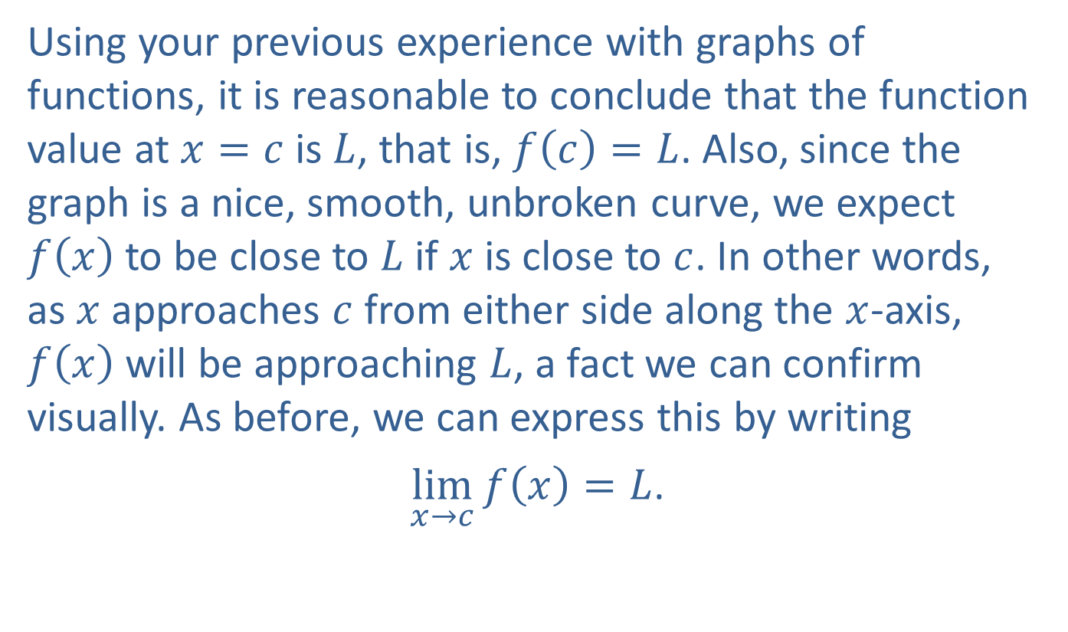
Example 1: Finding Limits Given Graphs (cont.)
Using your previous experience with graphs of functions, it is reasonable to conclude that the function value at $x=c$ is $L$, that is, $f\left(c\right)=L$. Also, since the graph is a nice, smooth, unbroken curve, we expect $f⁡\left(x\right)$ to be close to $L$ if $x$ is close to $c$. In other words, as $x$ approaches $c$ from either side along the $x$-axis, $f⁡\left(x\right)$ will be approaching $L$, a fact we can confirm visually. As before, we can express this by writing
$\lim_{x→c}⁡⁡f\left(x\right)=L$.

Slide 5
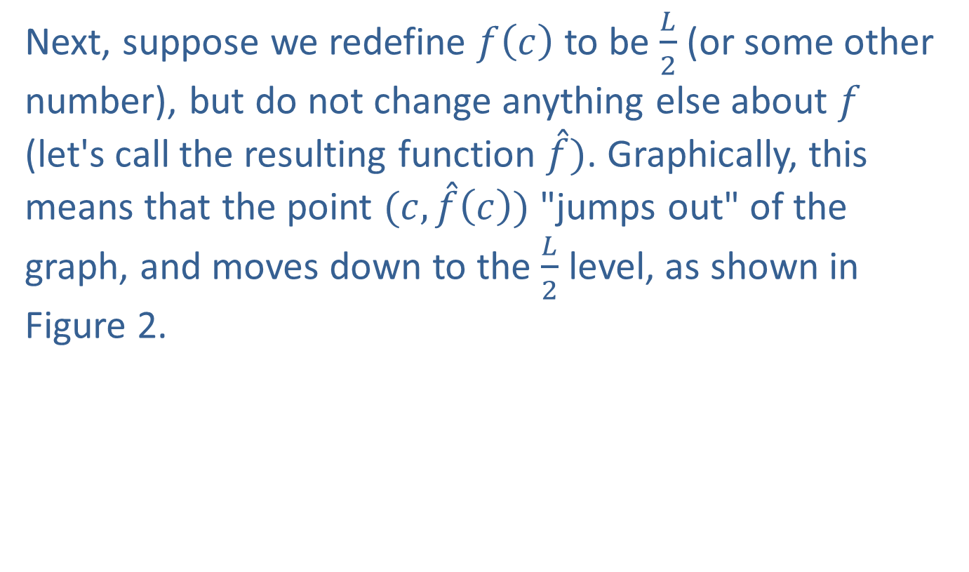
Example 1: Finding Limits Given Graphs (cont.)
Next, suppose we redefine $f⁡\left(c\right)$ to be $\frac{L}{2}$ (or some other number), but do not change anything else about $f$ (let's call the resulting function $\overset{ˆ}{f})$. Graphically, this means that the point $(c,\overset{ˆ}{f}\left(c\right))$ "jumps out" of the graph, and moves down to the $\frac{L}{2}$ level, as shown in Figure 2.

Slide 6
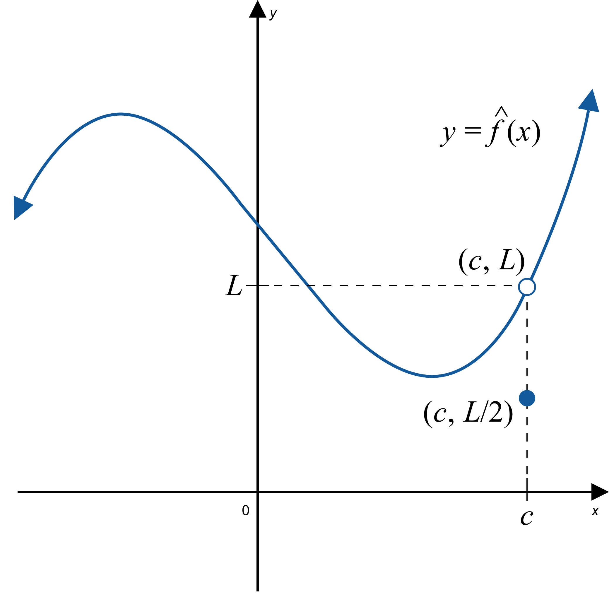
Example 1: Finding Limits Given Graphs (cont.)
Figure 2

Slide 7
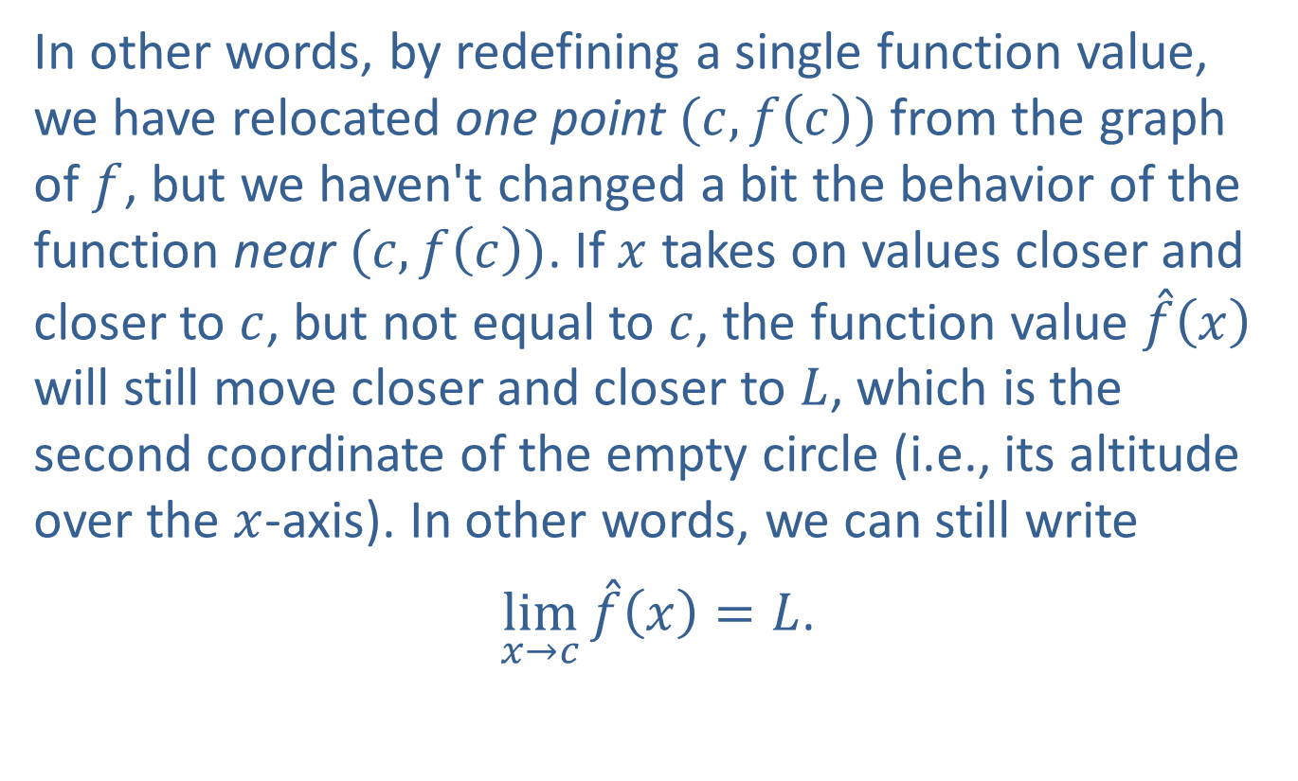
Example 1: Finding Limits Given Graphs (cont.)
In other words, by redefining a single function value, we have relocated one point $(c,f\left(c\right))$ from the graph of $f$, but we haven't changed a bit the behavior of the function near $(c,f\left(c\right))$. If $x$ takes on values closer and closer to $c$, but not equal to $c$, the function value $\overset{ˆ}{f}⁡\left(x\right)$ will still move closer and closer to $L$, which is the second coordinate of the empty circle (i.e., its altitude over the $x$-axis). In other words, we can still write
$\lim_{x→c}{\overset{ˆ}{f}\left(x\right)}=L$.

Slide 8

Example 1: Finding Limits Given Graphs (cont.)
Finally, we will consider one last scenario. Suppose that we delete the function value corresponding to $x=c$ altogether, thus making the function undefined at $x=c$. We will call the resulting function $\tilde{f}$.

Slide 9
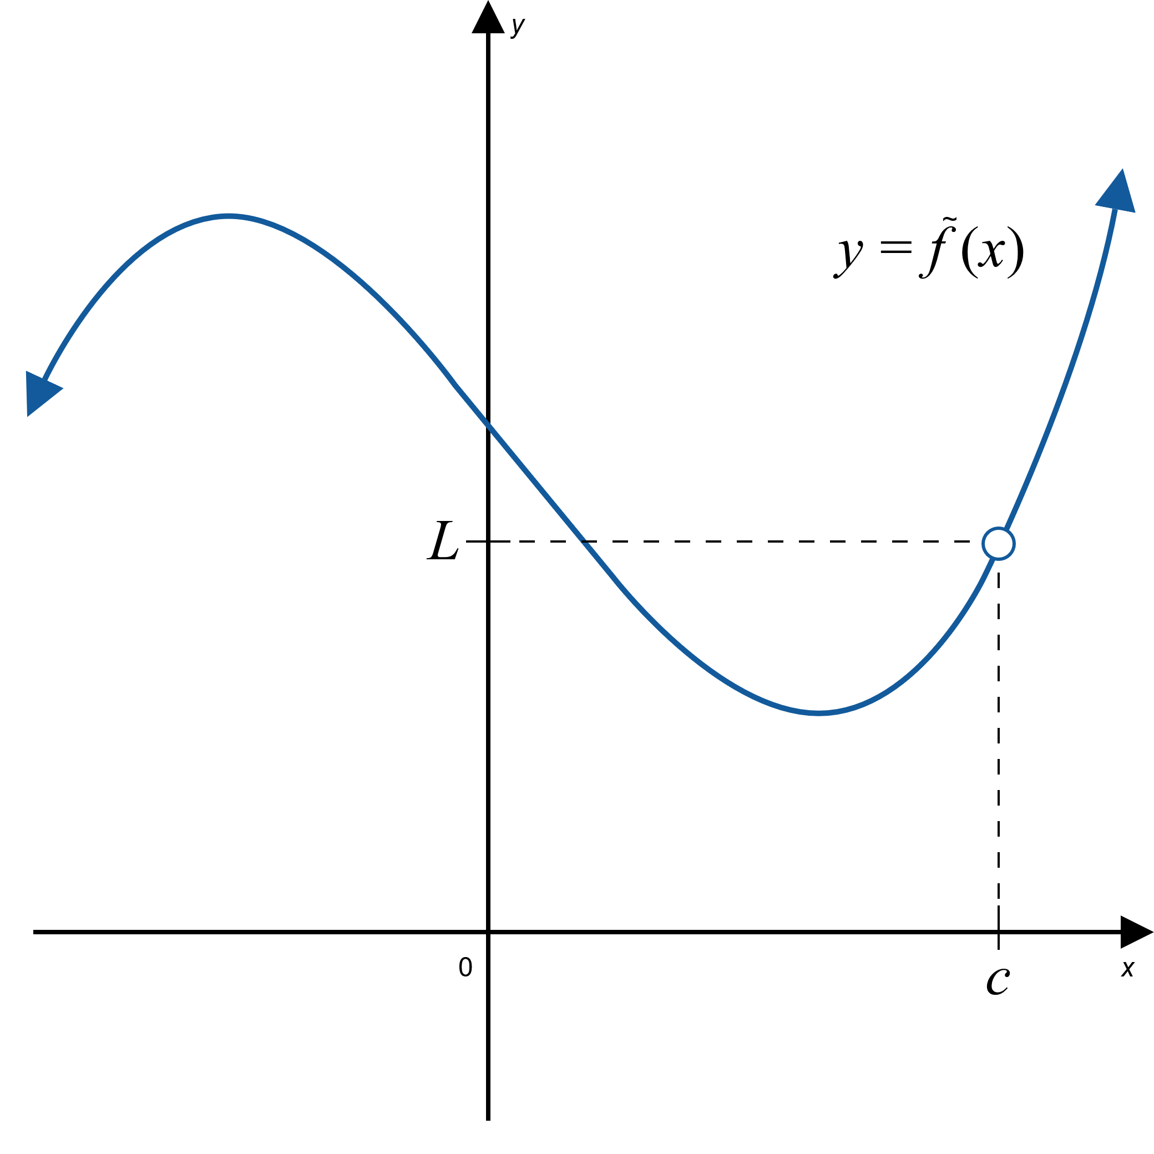
Example 1: Finding Limits Given Graphs (cont.)
Figure 3

Slide 10
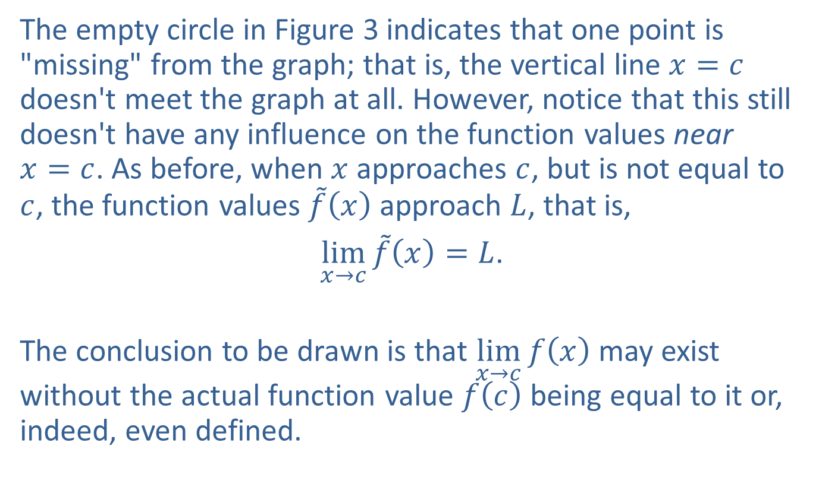
Example 1: Finding Limits Given Graphs (cont.)
The empty circle in Figure 3 indicates that one point is "missing" from the graph; that is, the vertical line $x=c$ doesn't meet the graph at all. However, notice that this still doesn't have any influence on the function values near $x=c$. As before, when $x$ approaches $c$, but is not equal to $c$, the function values $\tilde{f}⁡\left(x\right)$ approach $L$, that is,
$\lim_{x→c}{\tilde{f}\left(x\right)}=L$.
The conclusion to be drawn is that $\lim_{x→c}⁡f\left(x\right)$ may exist without the actual function value $f⁡\left(c\right)$ being equal to it or, indeed, even defined.

Slide 11
Example 2: Applying Limits to a Paradox
According to a classic paradox, you can never eat an apple for the following reason. A certain amount of time is needed to consume the first half of the apple, and at that point half the apple remains. Additional time is needed to eat half of the remaining half, which constitutes one-quarter of the original apple. After that, more time is needed to consume half of the remaining quarter, or one-eighth of the apple, and so on. By this reasoning, the process of eating the apple never ends.
Of course, this runs counter to our experience, so where does the problem lie? If you were challenged by an argument such as the one above, could you provide a mathematically correct resolution of the paradox?

Slide 12
Example 2: Applying Limits to a Paradox (cont.)
Solution
As we shall see, the concept of limits can help resolve the apparent flaw in the argument. Let us assume that a math student performs the experiment, and holding a stopwatch in her left hand, eats an apple in exactly 4 minutes. We will make the realistic assumption that the time necessary to eat a certain portion of the apple is directly proportional to its size, and we will monitor the portion of the fruit having been consumed.

Slide 13
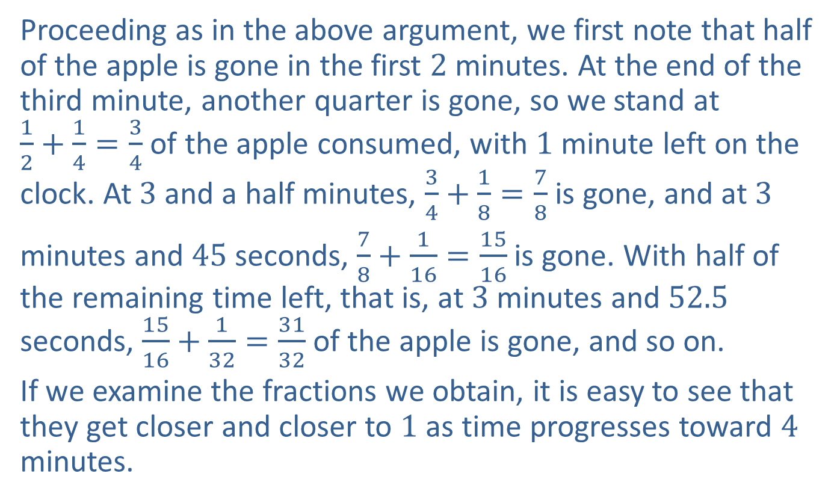
Example 2: Applying Limits to a Paradox (cont.)
Proceeding as in the above argument, we first note that half of the apple is gone in the first 2 minutes. At the end of the third minute, another quarter is gone, so we stand at $\frac{1}{2}+\frac{1}{4}=\frac{3}{4}$ of the apple consumed, with 1 minute left on the clock. At 3 and a half minutes, $\frac{3}{4}+\frac{1}{8}=\frac{7}{8}$ is gone, and at 3
minutes and 45 seconds, $\frac{7}{8}+\frac{1}{16}=\frac{15}{16}$ is gone. With half of the remaining time left, that is, at 3 minutes and 52.5 seconds, $\frac{15}{16}+\frac{1}{32}=\frac{31}{32}$ of the apple is gone, and so on.
If we examine the fractions we obtain, it is easy to see that they get closer and closer to 1 as time progresses toward 4 minutes.

Slide 14
Example 2: Applying Limits to a Paradox (cont.)
Mathematically, we say that the limit of these values is 1; that is, the student indeed ate the entire apple in 4 minutes, in accordance with what we would expect from our own experience.

Slide 15
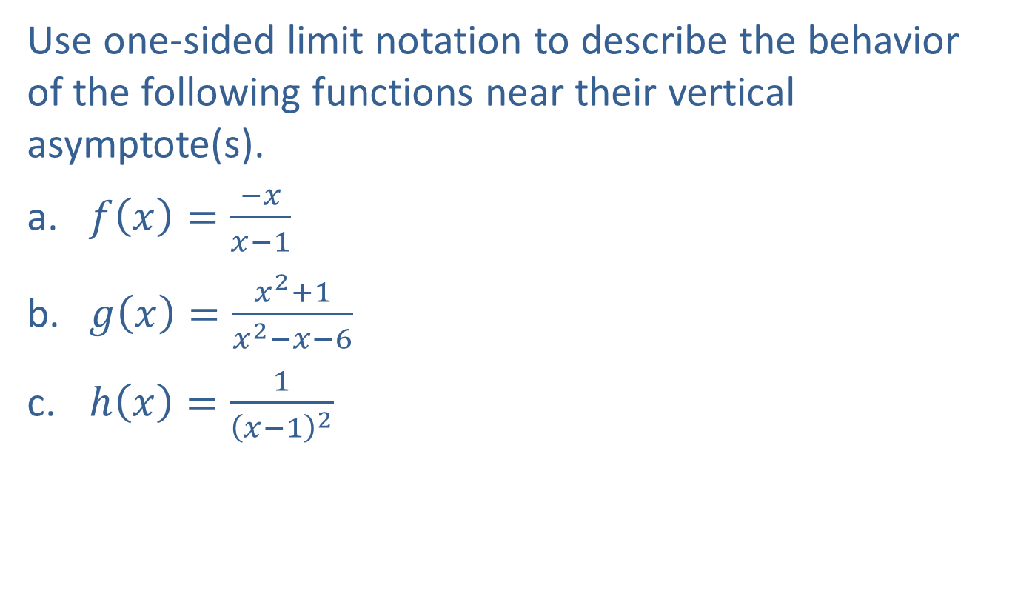
Example 3: Finding One-Sided Limits near Vertical Asymptotes
Use one-sided limit notation to describe the behavior of the following functions near their vertical asymptote(s).
​$f\left(x\right)=\frac{−x}{x−1}$
​$g\left(x\right)=\frac{x^{2}+1}{x^{2}−x−6}$
​$h\left(x\right)=\frac{1}{{\left(x−1\right)}^{2}}$

Slide 16
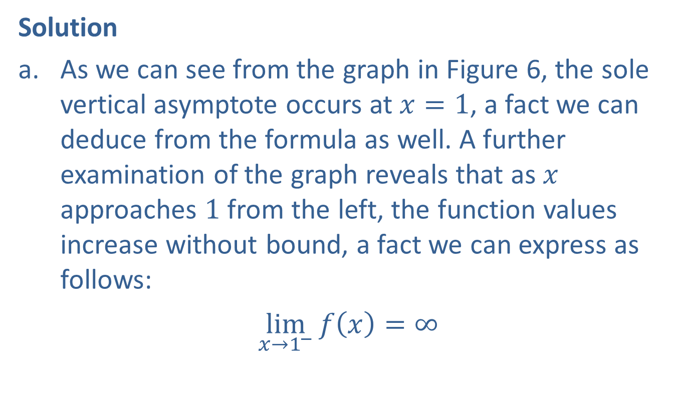
Example 3: Finding One-Sided Limits near Vertical Asymptotes (cont.)
Solution
​As we can see from the graph in Figure 6, the sole vertical asymptote occurs at $x=1$, a fact we can deduce from the formula as well. A further examination of the graph reveals that as $x$ approaches 1 from the left, the function values increase without bound, a fact we can express as follows:
​$\lim_{x→1^{−}}{f\left(x\right)}=∞$
​

Slide 17
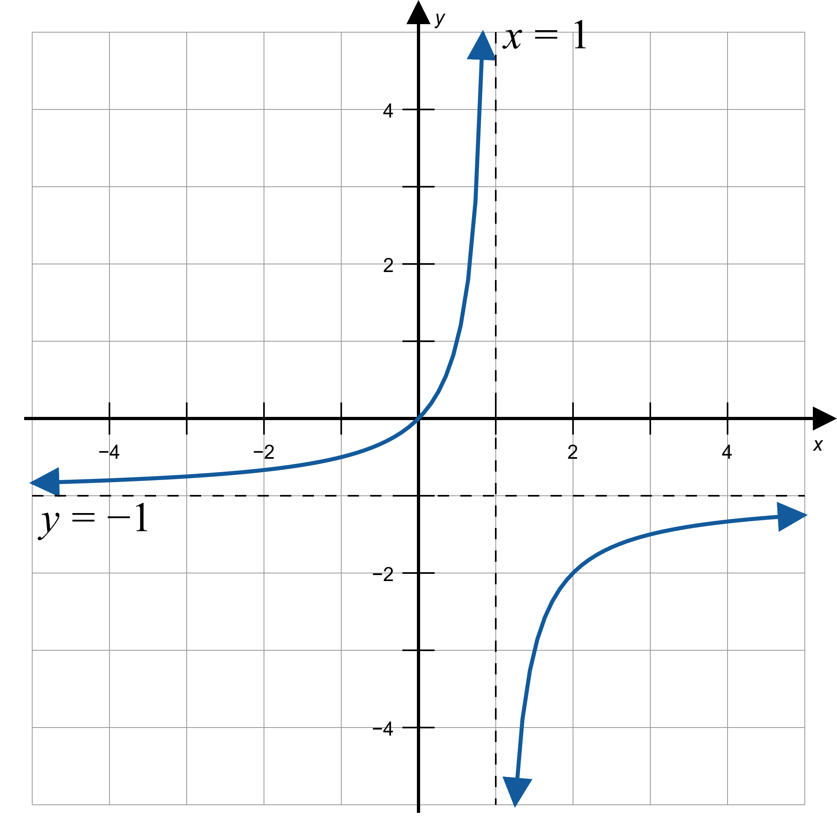
Example 3: Finding One-Sided Limits near Vertical Asymptotes (cont.)
Figure 6: $f\left(x\right)=\frac{−x}{x−1}$

Slide 18

Example 3: Finding One-Sided Limits near Vertical Asymptotes (cont.)
​On the other hand, as $x$ approaches 1 from the right, the function values decrease:
​$\lim_{x→1^{+}}{f\left(x\right)}=−∞$

Slide 19
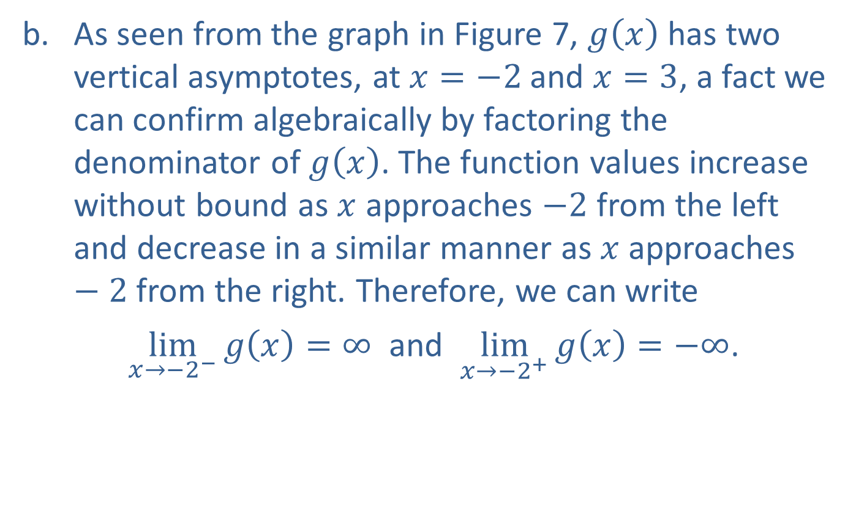
Example 3: Finding One-Sided Limits near Vertical Asymptotes (cont.)
​As seen from the graph in Figure 7, $g⁡\left(x\right)$ has two vertical asymptotes, at $x=−2$ and $x=3$, a fact we can confirm algebraically by factoring the denominator of $g⁡\left(x\right)$. The function values increase without bound as $x$ approaches $−2$ from the left and decrease in a similar manner as $x$ approaches $−2$ from the right. Therefore, we can write
$\lim_{x→−2^{−}}{g\left(x\right)}=∞$ and $\lim_{x→−2^{+}}{g\left(x\right)}=−∞$.
​

Slide 20
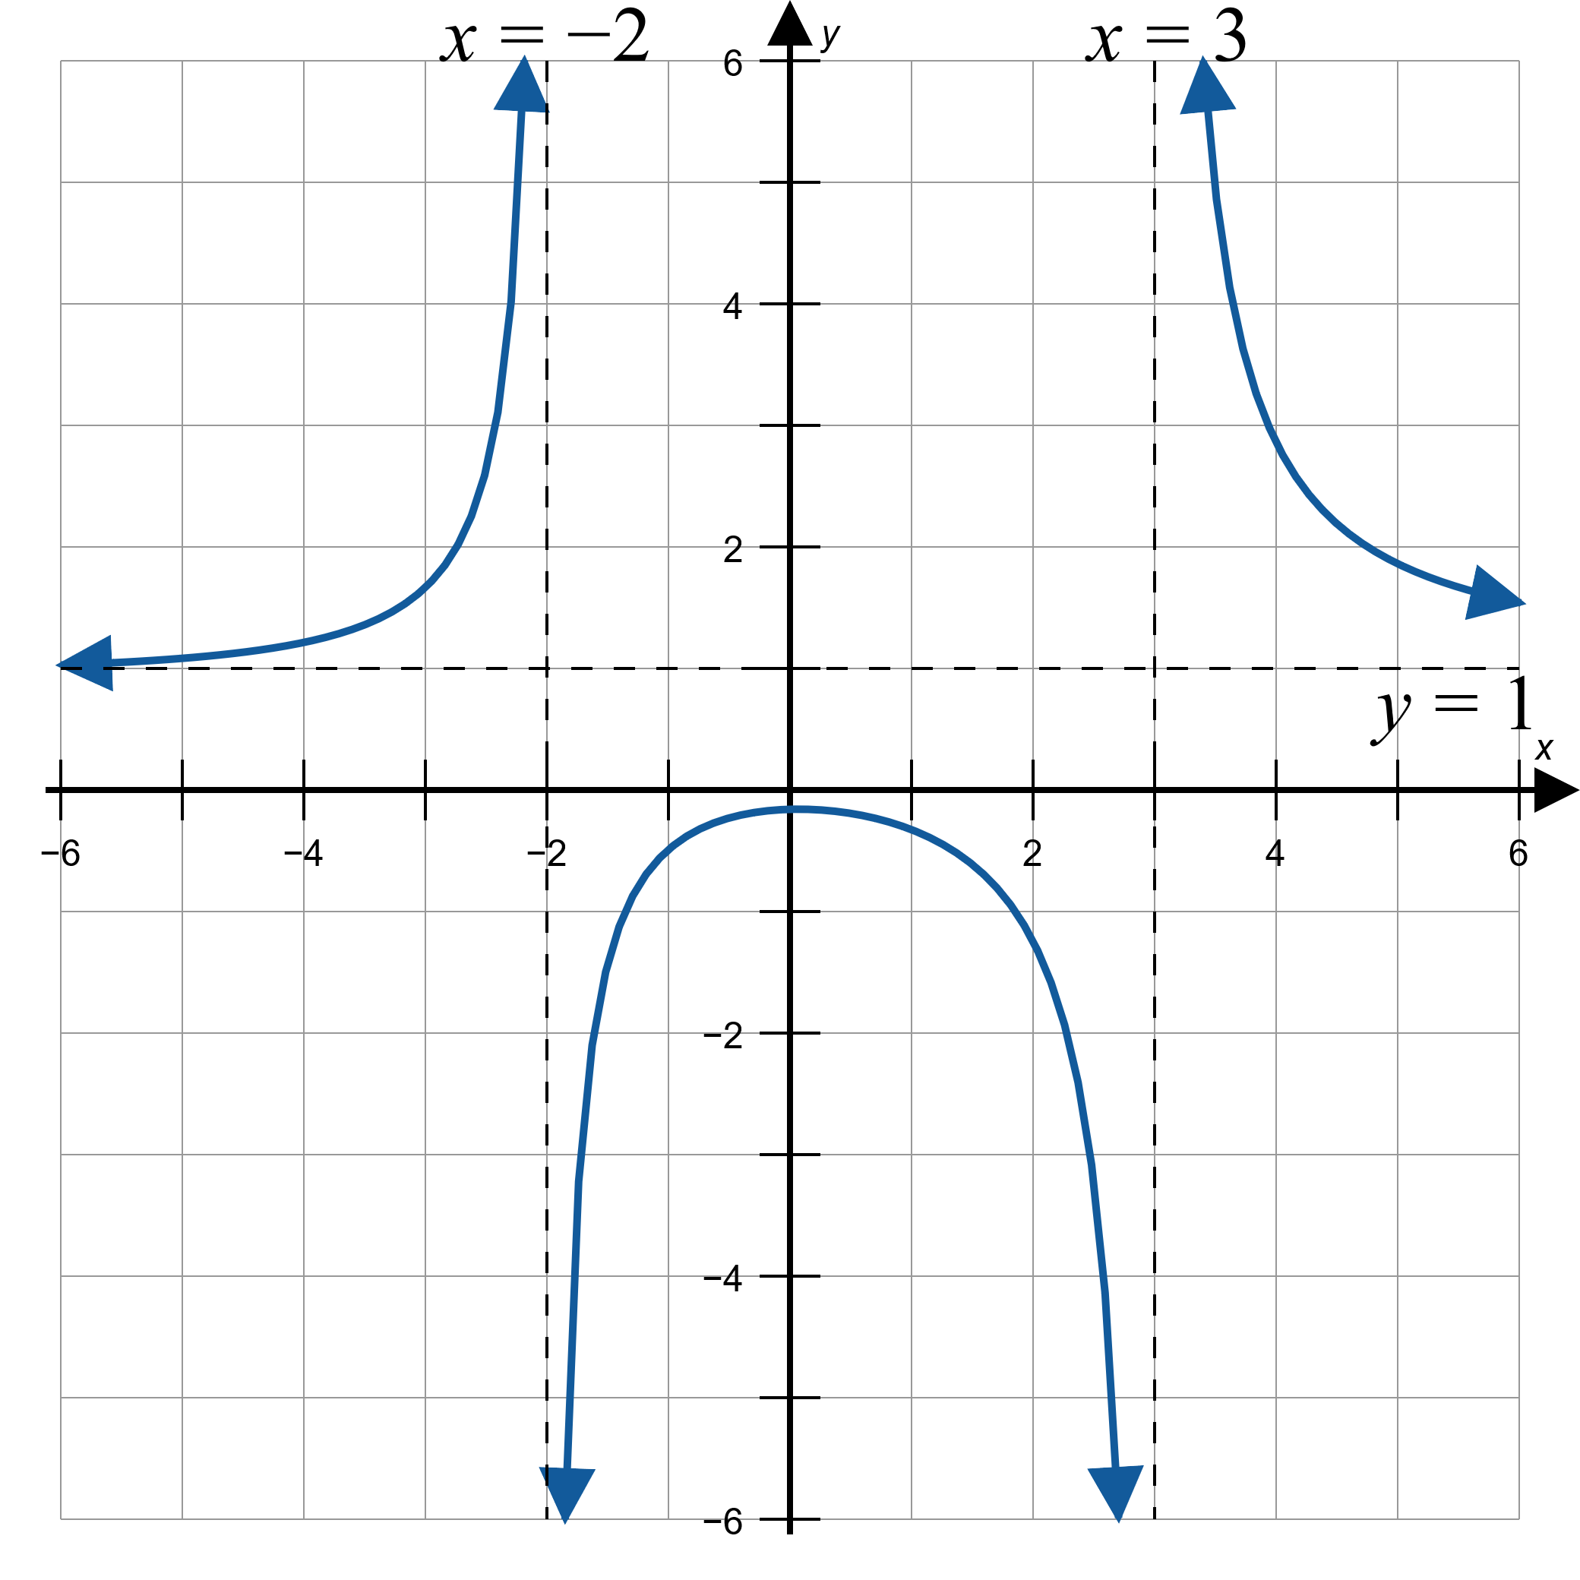
Example 3: Finding One-Sided Limits near Vertical Asymptotes (cont.)
Figure 7: $g\left(x\right)=\frac{x^{2}+1}{x^{2}−x−6}$

Slide 21

Example 3: Finding One-Sided Limits near Vertical Asymptotes (cont.)
​Examining the graph on both sides of the vertical asymptote $x=3$ in a similar manner, we conclude that
$\lim_{x→3^{−}}{g\left(x\right)}=−∞$ and $\lim_{x→3^{+}}{g\left(x\right)}=∞$.

Slide 22
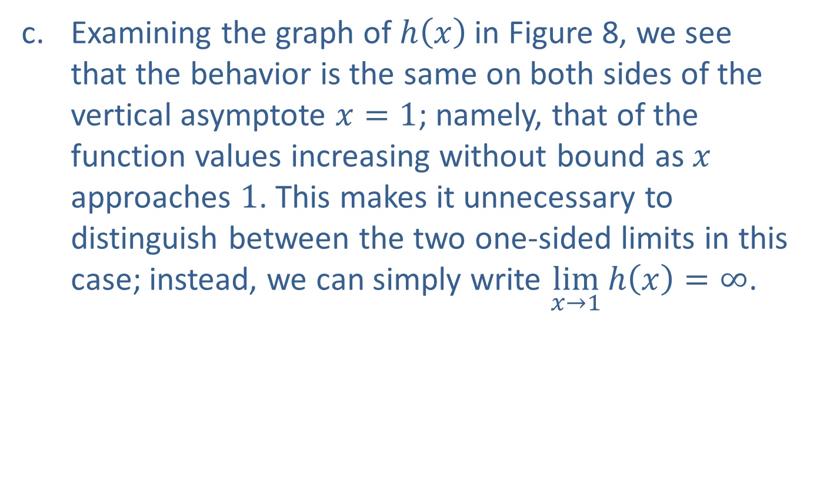
Example 3: Finding One-Sided Limits near Vertical Asymptotes (cont.)
​Examining the graph of $h⁡\left(x\right)$ in Figure 8, we see that the behavior is the same on both sides of the vertical asymptote $x=1$; namely, that of the function values increasing without bound as $x$ approaches 1. This makes it unnecessary to distinguish between the two one-sided limits in this case; instead, we can simply write $\lim_{x→1}{h\left(x\right)}=∞$.
​

Slide 23
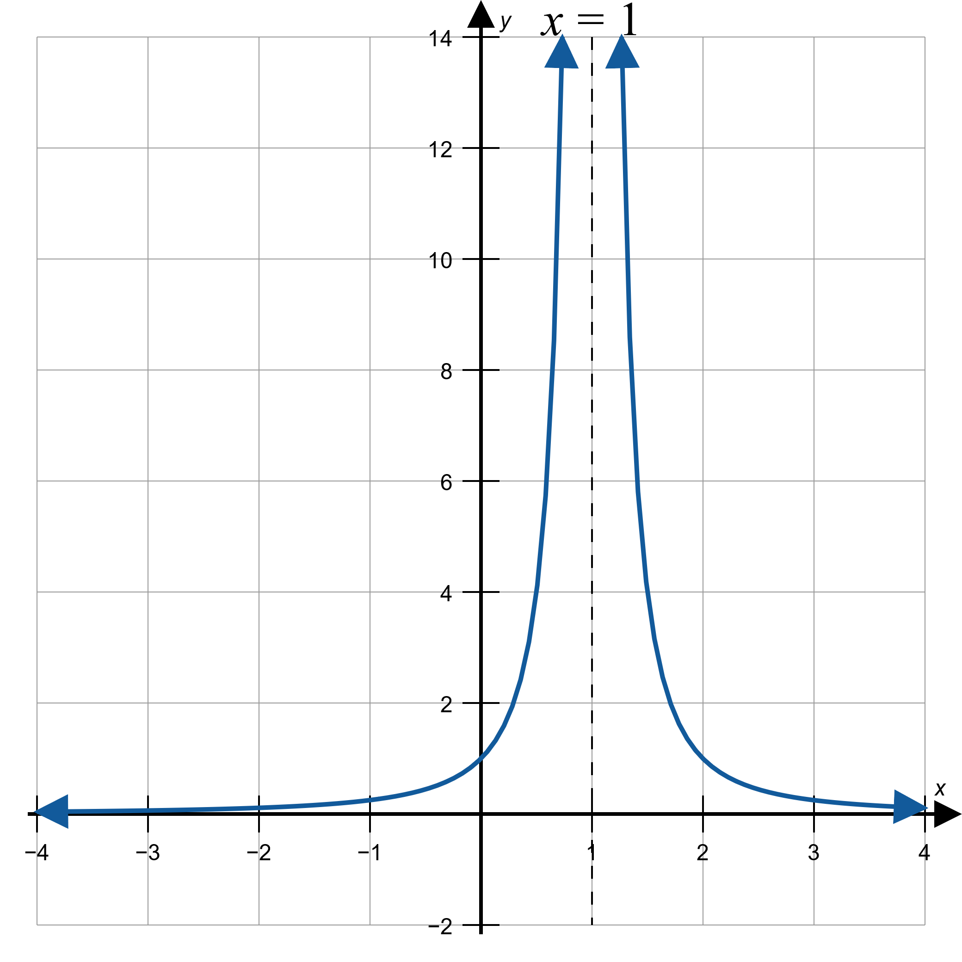
Example 3: Finding One-Sided Limits near Vertical Asymptotes (cont.)
Figure 8: $h\left(x\right)=\frac{1}{{\left(x−1\right)}^{2}}$

Slide 24

Example 4: Finding One-Sided Limits near Vertical Asymptotes
Deduce the one-sided infinite limits of $f\left(x\right)=\frac{1}{3−x}$ at its vertical asymptote without graphing the function.

Slide 25
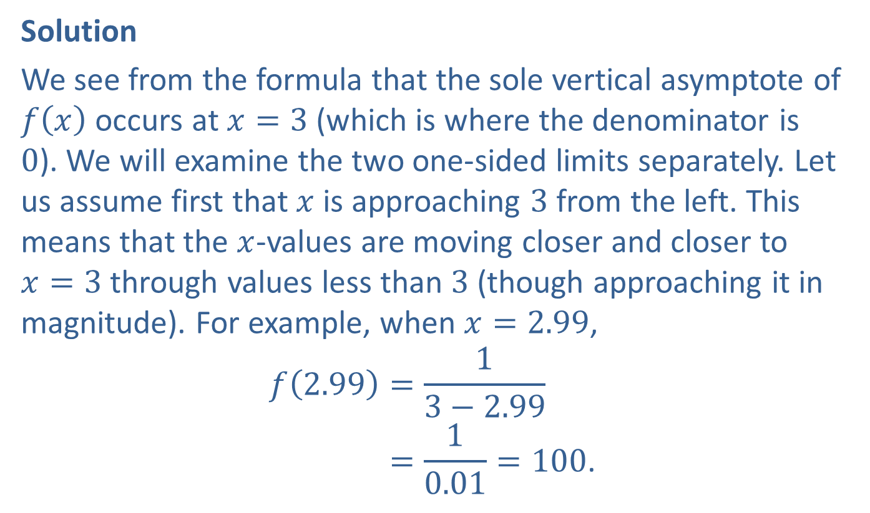
Example 4: Finding One-Sided Limits near Vertical Asymptotes (cont.)
Solution
We see from the formula that the sole vertical asymptote of $f⁡\left(x\right)$ occurs at $x=3$ (which is where the denominator is 0). We will examine the two one-sided limits separately. Let us assume first that $x$ is approaching 3 from the left. This means that the $x$-values are moving closer and closer to $x=3$ through values less than 3 (though approaching it in magnitude). For example, when $x=2.99$,
𝑓2.99=13−2.99𝑓⁡2.99=10.01=100.

Slide 26
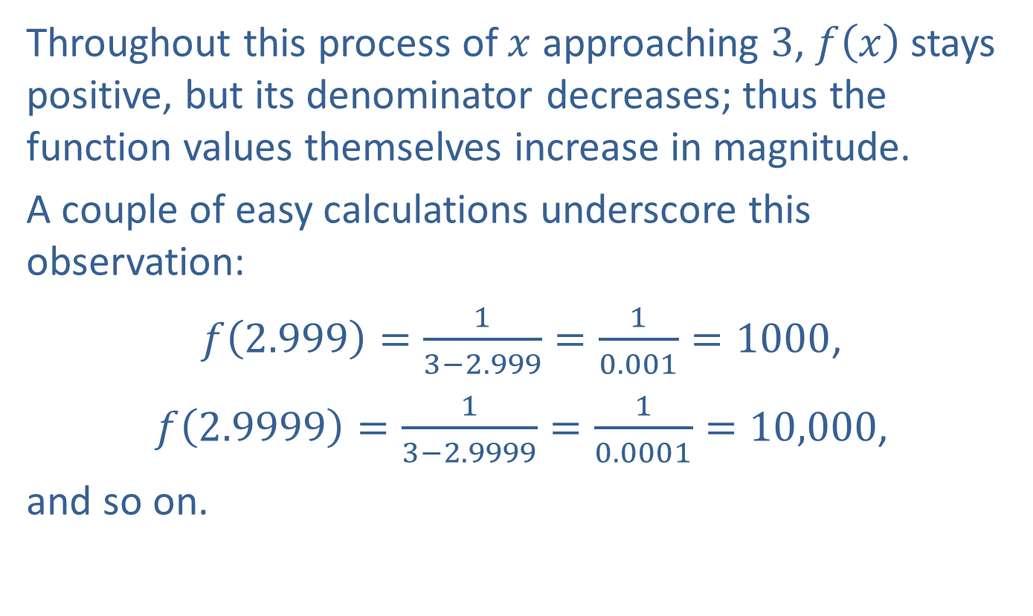
Example 4: Finding One-Sided Limits near Vertical Asymptotes (cont.)
Throughout this process of $x$ approaching 3, $f⁡\left(x\right)$ stays positive, but its denominator decreases; thus the function values themselves increase in magnitude.
A couple of easy calculations underscore this observation:
$f\left(2.999\right)=\frac{1}{3−2.999}=\frac{1}{0.001}=1000$,
$f\left(2.9999\right)=\frac{1}{3−2.9999}=\frac{1}{0.0001}=10,000$,
and so on.

Slide 27
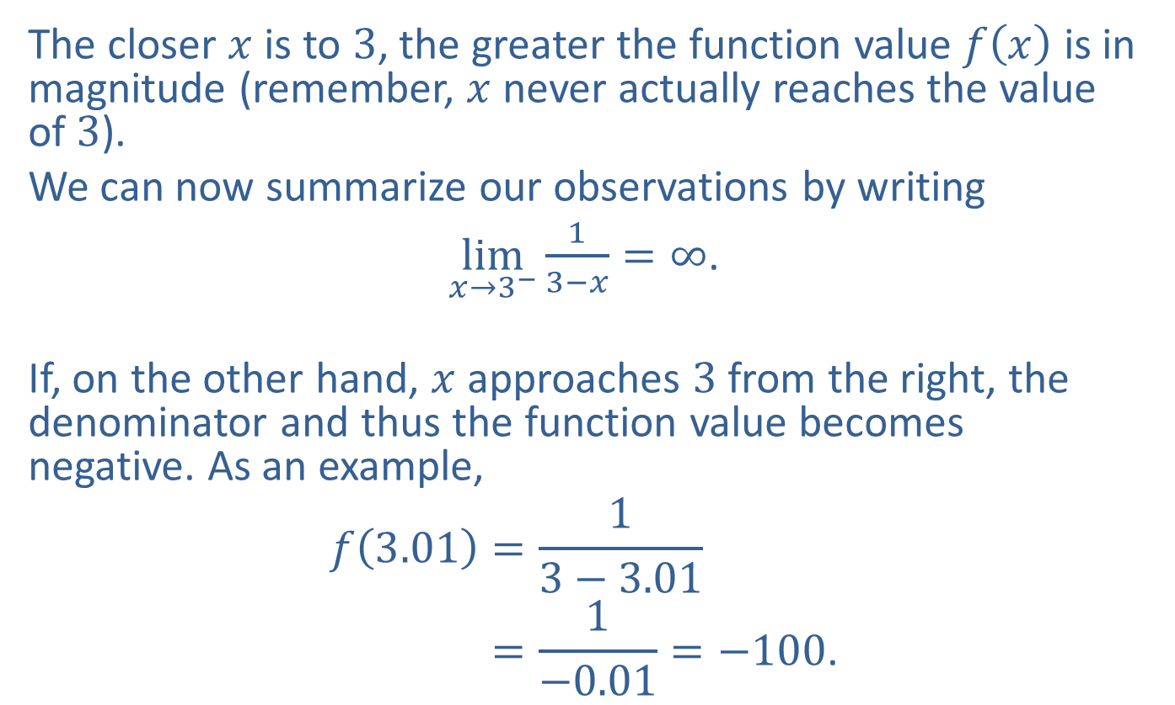
Example 4: Finding One-Sided Limits near Vertical Asymptotes (cont.)
The closer $x$ is to 3, the greater the function value $f⁡\left(x\right)$ is in magnitude (remember, $x$ never actually reaches the value of 3).
We can now summarize our observations by writing
$\lim_{x→3^{−}}{\frac{1}{3−x}}=∞$.
If, on the other hand, $x$ approaches 3 from the right, the denominator and thus the function value becomes negative. As an example,
𝑓3.01=13−3.01𝑓⁡3.01=1−0.01=−100.

Slide 28
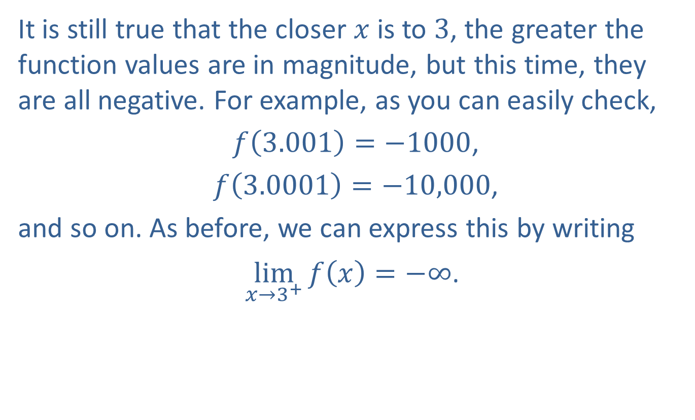
Example 4: Finding One-Sided Limits near Vertical Asymptotes (cont.)
It is still true that the closer $x$ is to 3, the greater the function values are in magnitude, but this time, they are all negative. For example, as you can easily check,
$f\left(3.001\right)=−1000$,
$f\left(3.0001\right)=−10,000$,
and so on. As before, we can express this by writing
$\lim_{x→3^{+}}{f\left(x\right)}=−∞$.

Slide 29
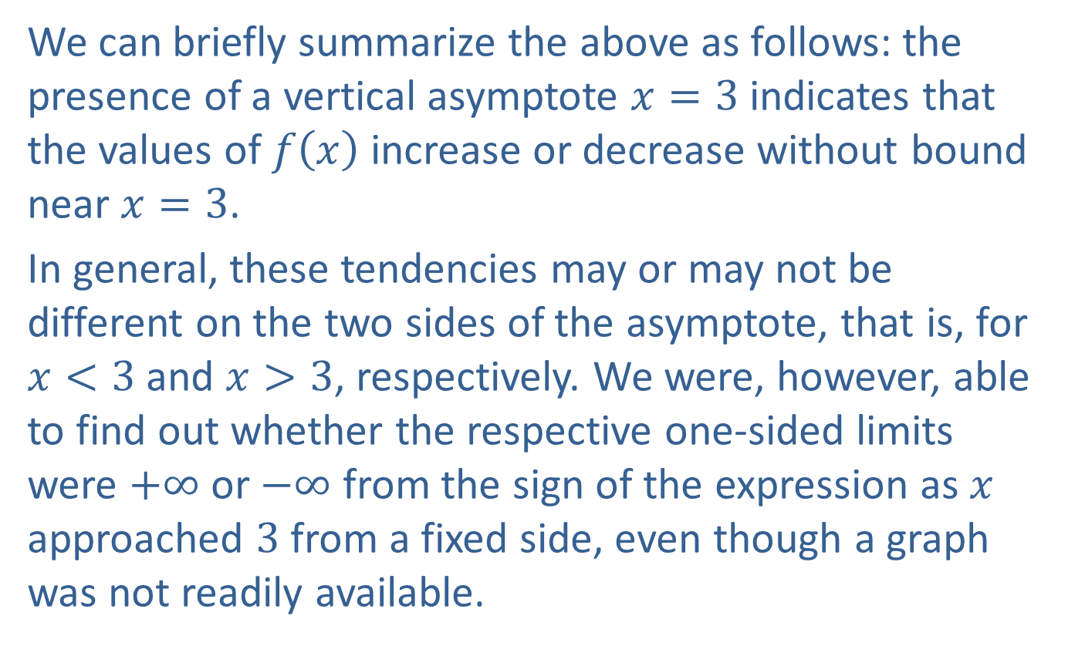
Example 4: Finding One-Sided Limits near Vertical Asymptotes (cont.)
We can briefly summarize the above as follows: the presence of a vertical asymptote $x=3$ indicates that the values of $f⁡\left(x\right)$ increase or decrease without bound near $x=3$.
In general, these tendencies may or may not be different on the two sides of the asymptote, that is, for $x<3$ and $x>3$, respectively. We were, however, able to find out whether the respective one-sided limits were $+∞$ or $−∞$ from the sign of the expression as $x$ approached 3 from a fixed side, even though a graph was not readily available.

Slide 30
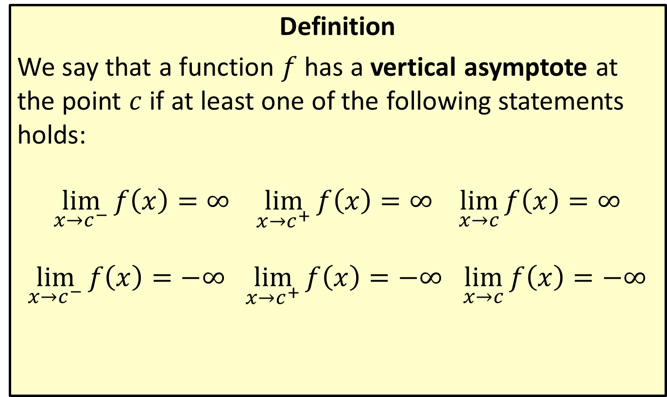
Vertical Asymptote
Definition
We say that a function $f$ has a vertical asymptote at the point $c$ if at least one of the following statements holds:
$\lim_{x→c^{−}}{f\left(x\right)}=∞$ $\lim_{x→c^{+}}{f\left(x\right)}=∞$ $\lim_{x→c}{f\left(x\right)}=∞$
$\lim_{x→c^{−}}{f\left(x\right)}=−∞$ $\lim_{x→c^{+}}{f\left(x\right)}=−∞$ $\lim_{x→c}{f\left(x\right)}=−∞$

Slide 31


Example 5: Finding One-Sided Limits Given Graphs
Use the graph of the function $h$ in Figure 9 to decide whether the given one-sided limits exist. For those that do, find their values.
​$\lim_{x→0^{+}}⁡h\left(x\right)$
​$\lim_{x→2^{−}}⁡h\left(x\right)$
​$\lim_{x→2^{+}}⁡h\left(x\right)$
​$\lim_{x→{2.5}^{−}}⁡h\left(x\right)$
​$\lim_{x→{2.5}^{+}}⁡h\left(x\right)$
​$\lim_{x→3^{−}}⁡h\left(x\right)$

Slide 32
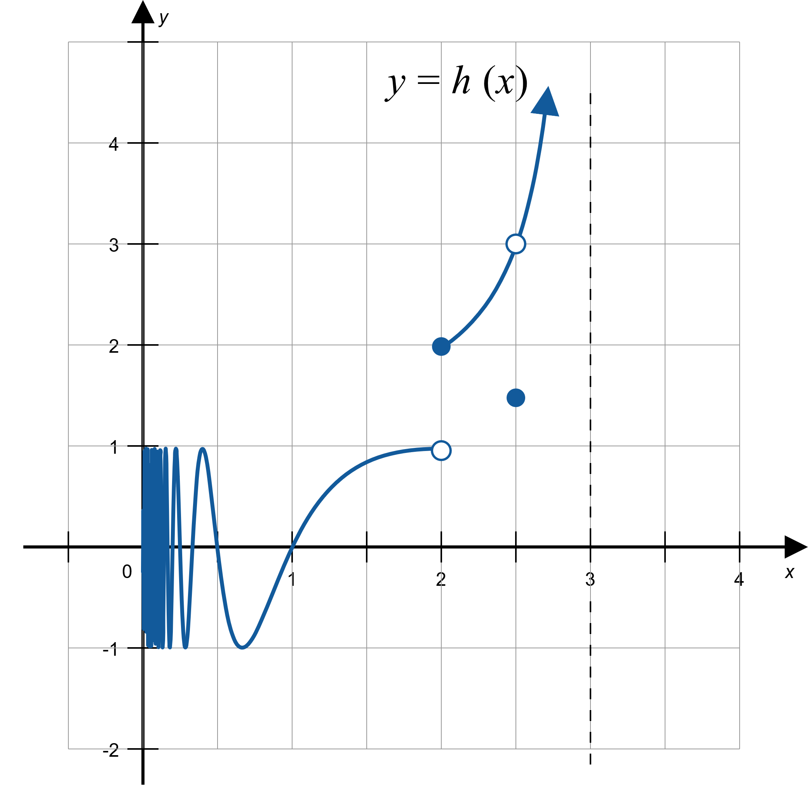
Example 5: Finding One-Sided Limits Given Graphs (cont.)
Figure 9

Slide 33
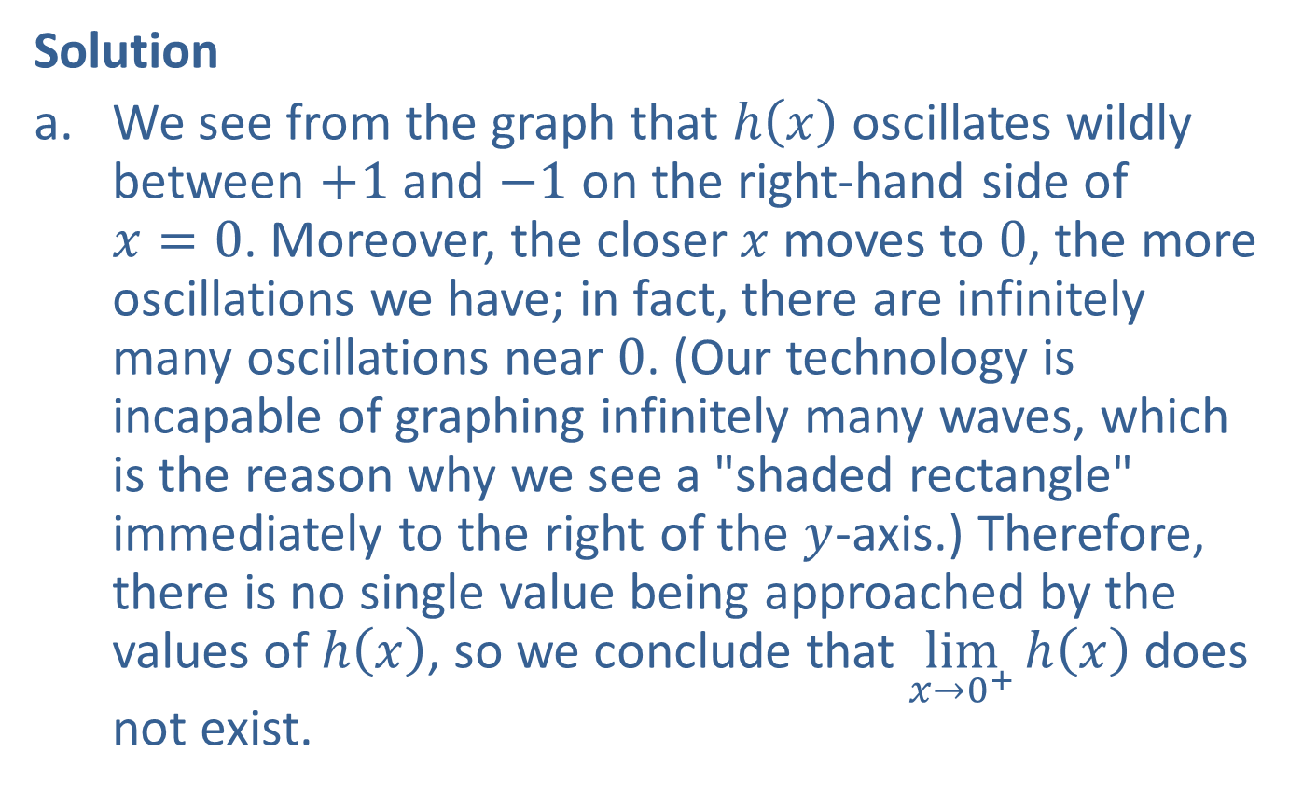
Example 5: Finding One-Sided Limits Given Graphs (cont.)
Solution
​We see from the graph that $h⁡\left(x\right)$ oscillates wildly between $+1$ and $−1$ on the right-hand side of $x=0$. Moreover, the closer $x$ moves to 0, the more oscillations we have; in fact, there are infinitely many oscillations near 0. (Our technology is incapable of graphing infinitely many waves, which is the reason why we see a "shaded rectangle" immediately to the right of the $y$-axis.) Therefore, there is no single value being approached by the values of $h⁡\left(x\right)$, so we conclude that $\lim_{x→0^{+}}⁡h\left(x\right)$ does not exist.

Slide 34
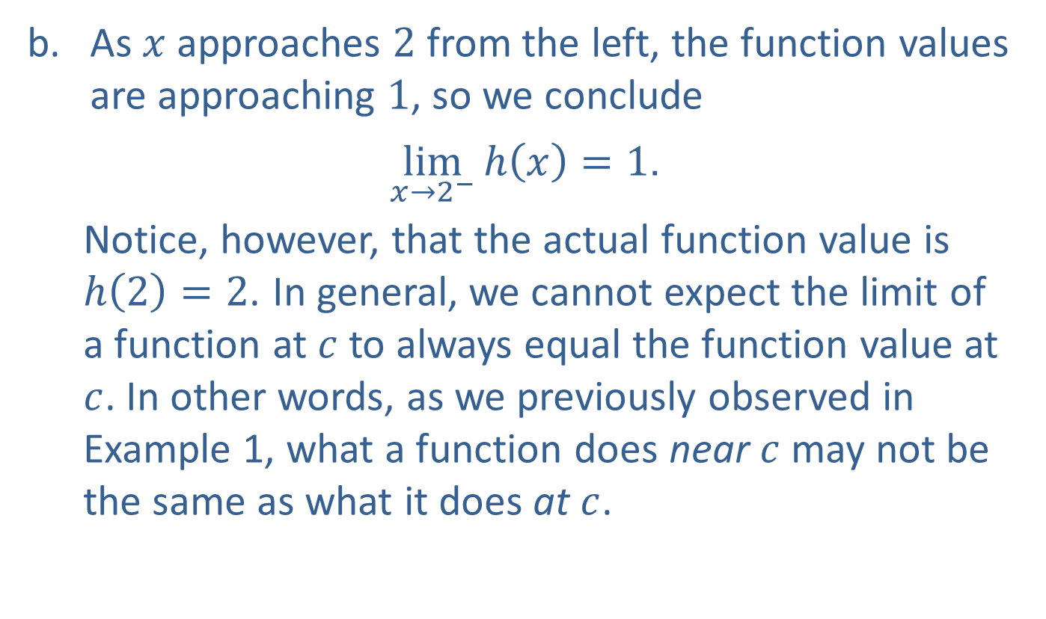
Example 5: Finding One-Sided Limits Given Graphs (cont.)
​As $x$ approaches 2 from the left, the function values are approaching 1, so we conclude
​ $\lim_{x→2^{−}}{h\left(x\right)}=1$.
Notice, however, that the actual function value is $h\left(2\right)=2$. In general, we cannot expect the limit of a function at $c$ to always equal the function value at $c$. In other words, as we previously observed in Example 1, what a function does near $c$ may not be the same as what it does at $c$.

Slide 35
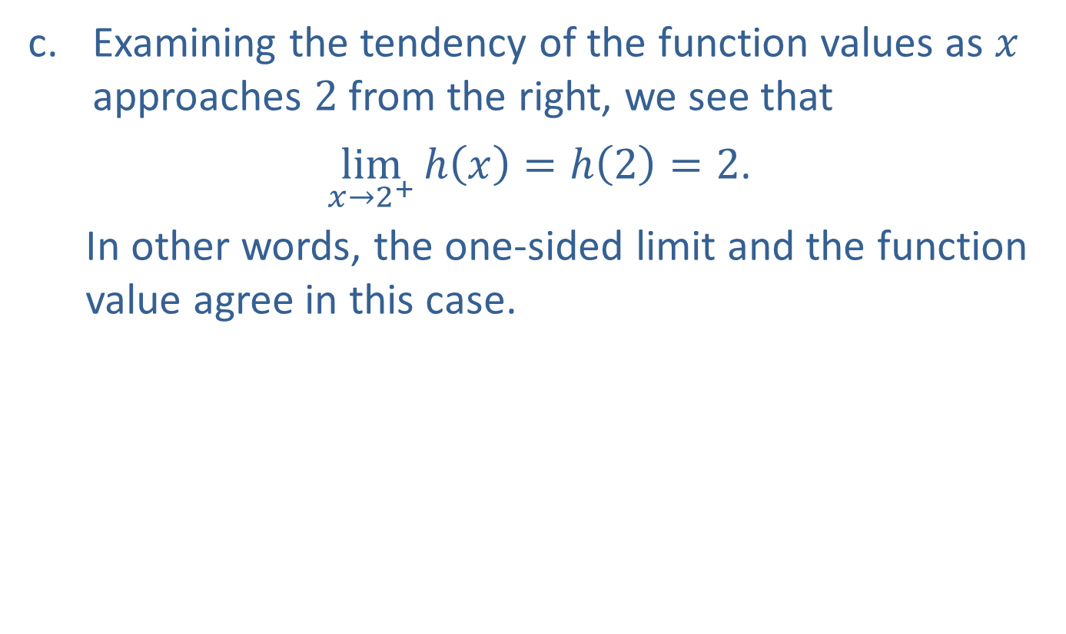
Example 5: Finding One-Sided Limits Given Graphs (cont.)
​Examining the tendency of the function values as $x$ approaches 2 from the right, we see that
​ $\lim_{x→2^{+}}{h\left(x\right)}=h\left(2\right)=2$.
In other words, the one-sided limit and the function value agree in this case.

Slide 36
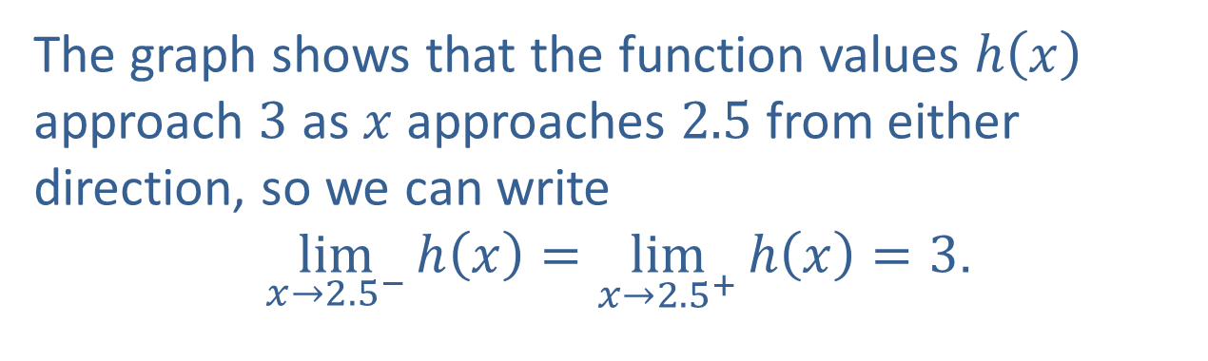
Example 5: Finding One-Sided Limits Given Graphs (cont.)
d-e.
The graph shows that the function values $h⁡\left(x\right)$ approach 3 as $x$ approaches 2.5 from either direction, so we can write
​ $\lim_{x→{2.5}^{−}}{h\left(x\right)}=\lim_{x→{2.5}^{+}}{h\left(x\right)}=3$.

Slide 37
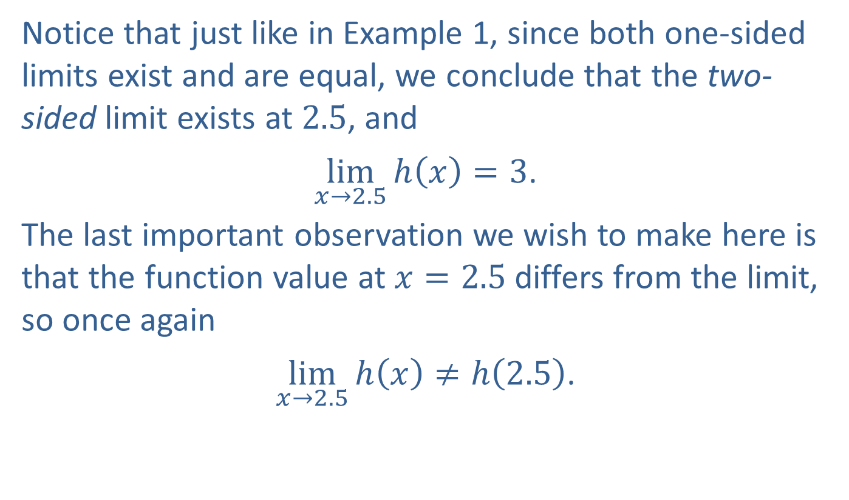
Example 5: Finding One-Sided Limits Given Graphs (cont.)
​Notice that just like in Example 1, since both one-sided limits exist and are equal, we conclude that the two-sided limit exists at 2.5, and
​ $\lim_{x→2.5}{h\left(x\right)}=3$.
​The last important observation we wish to make here is that the function value at $x=2.5$ differs from the limit, so once again
​ $\lim_{x→2.5}{h\left(x\right)}≠h\left(2.5\right)$.

Slide 38

Example 5: Finding One-Sided Limits Given Graphs (cont.)
​Because $x=3$ is a vertical asymptote, $\lim_{x→3^{−}}⁡h\left(x\right)$ does not exist, but we can write
​ $\lim_{x→3^{−}}{h\left(x\right)}=∞$.

Slide 39
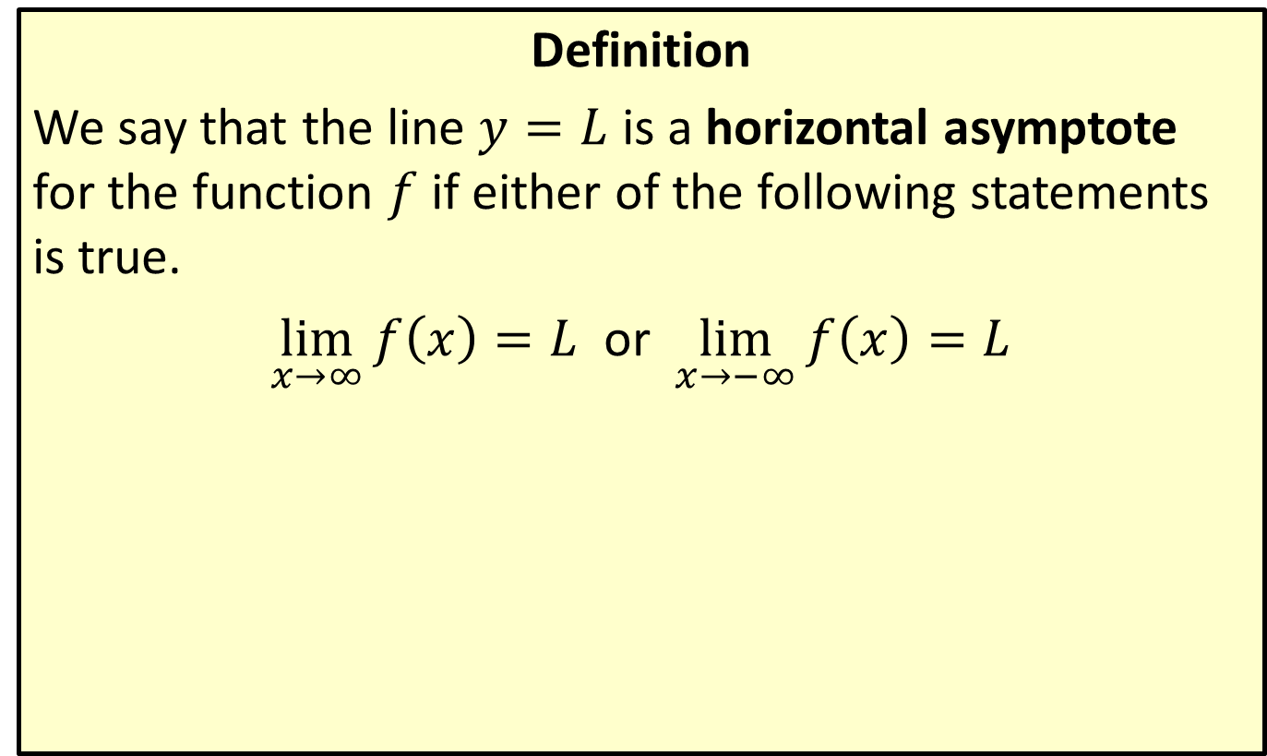
Horizontal Asymptote
Definition
We say that the line $y=L$ is a horizontal asymptote for the function $f$ if either of the following statements is true.
$\lim_{x→∞}{f\left(x\right)}=L$ or $\lim_{x→−∞}{f\left(x\right)}=L$

Slide 40
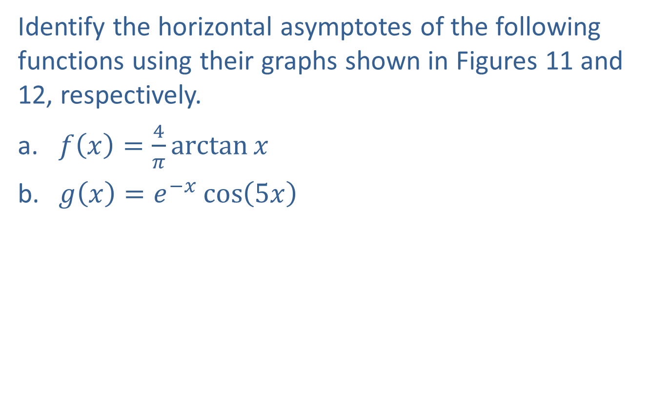
Example 6: Using Limits at Infinity to Identify Horizontal Asymptotes
Identify the horizontal asymptotes of the following functions using their graphs shown in Figures 11 and 12, respectively.
​$f\left(x\right)=\frac{4}{π}\arctan{x}$
​$g\left(x\right)=e^{−x}\cos\left(5x\right)$

Slide 41
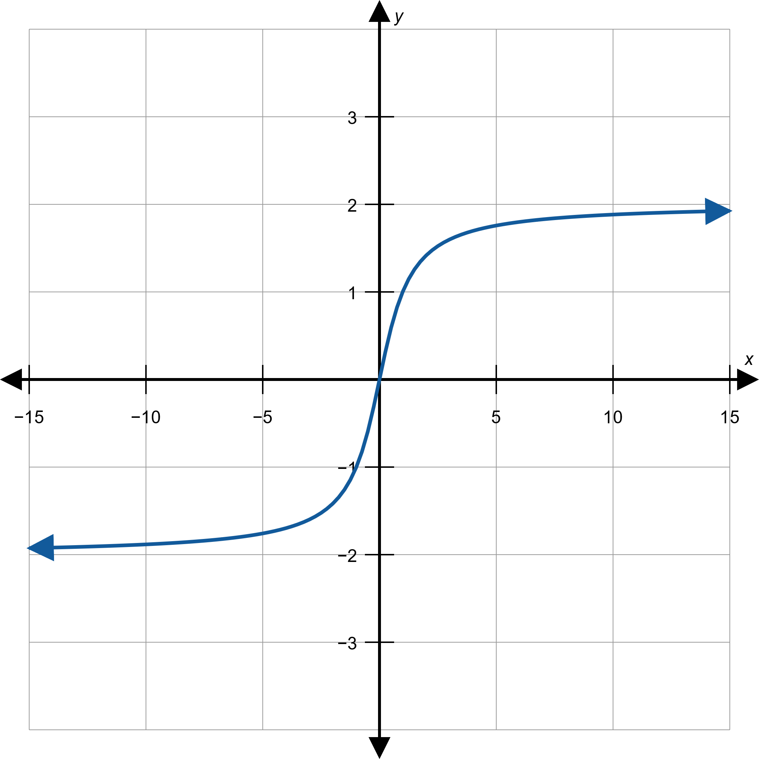
Example 6: Using Limits at Infinity to Identify Horizontal Asymptotes (cont.)
Figure 11: $f\left(x\right)=\frac{4}{π}\arctan{x}$

Slide 42
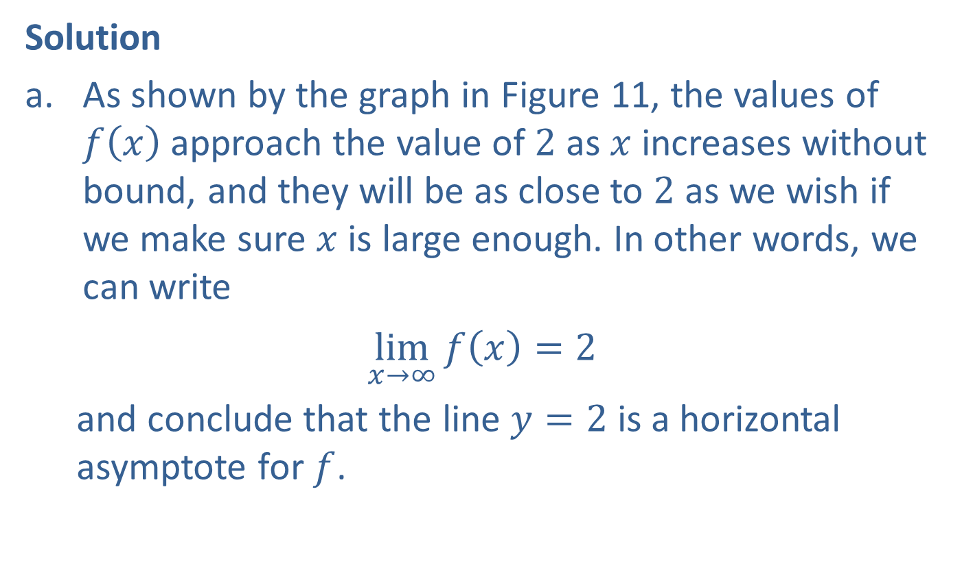
Example 6: Using Limits at Infinity to Identify Horizontal Asymptotes (cont.)
Solution
​As shown by the graph in Figure 11, the values of $f⁡\left(x\right)$ approach the value of 2 as $x$ increases without bound, and they will be as close to 2 as we wish if we make sure $x$ is large enough. In other words, we can write
​ $\lim_{x→∞}{f\left(x\right)}=2$
and conclude that the line $y=2$ is a horizontal asymptote for $f$.
​

Slide 43

Example 6: Using Limits at Infinity to Identify Horizontal Asymptotes (cont.)
​Similarly, we conclude that
​ $\lim_{x→−∞}{f\left(x\right)}=−2$,
​and thus the line $y=−2$ is another horizontal asymptote for $f$.

Slide 44

Example 6: Using Limits at Infinity to Identify Horizontal Asymptotes (cont.)
​The graph of $g$, though oscillating, is approaching the $x$-axis more and more as $x$ increases (see Figure 12).
​

Slide 45
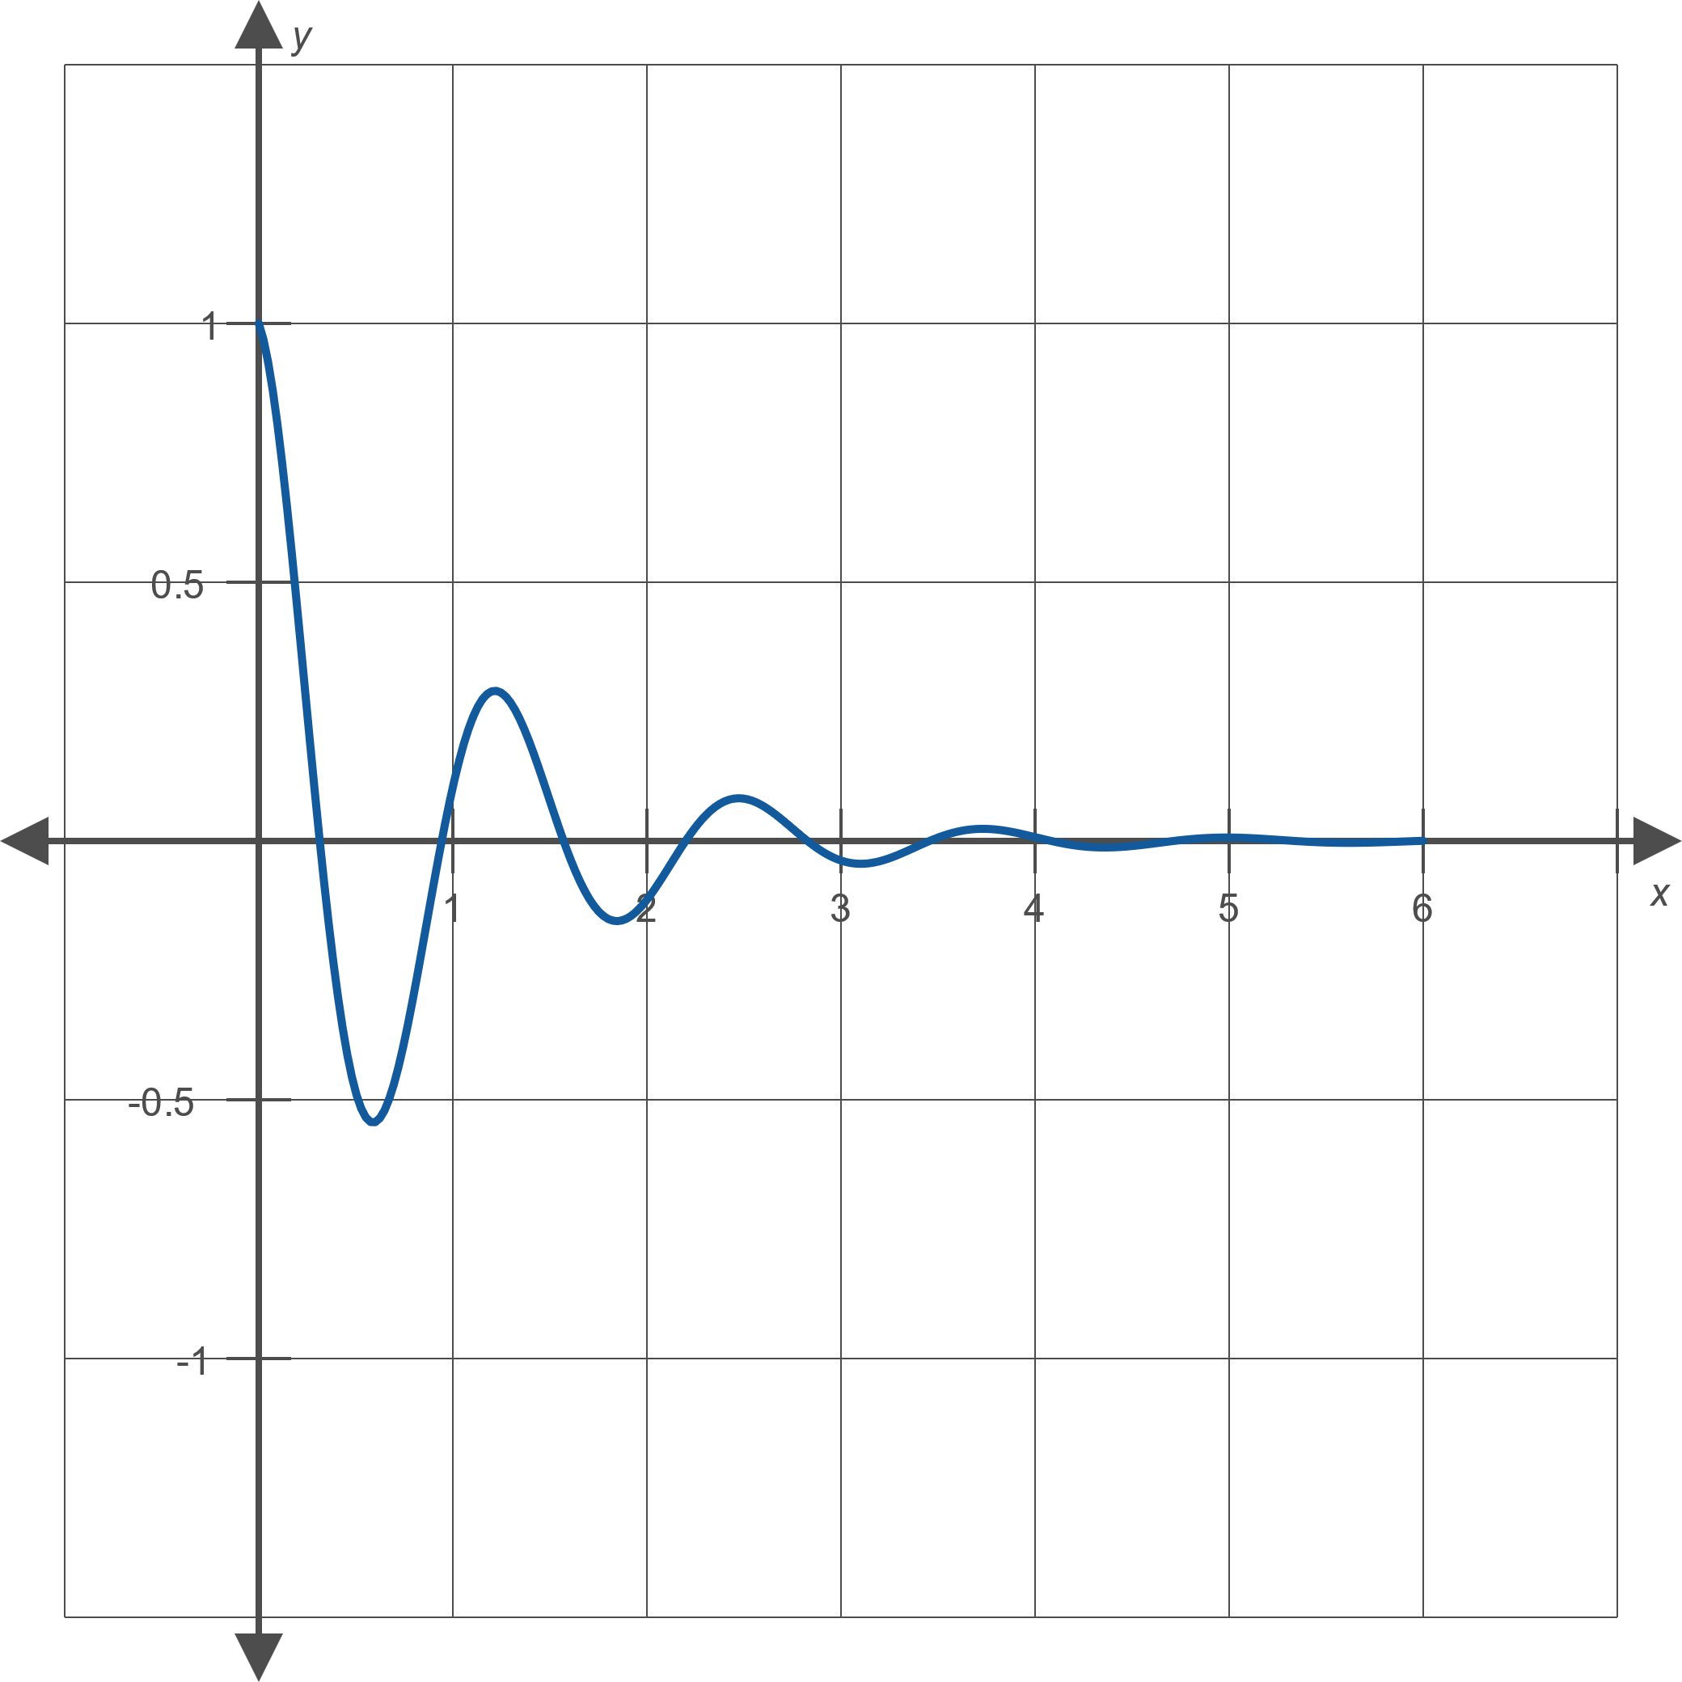
Example 6: Using Limits at Infinity to Identify Horizontal Asymptotes (cont.)
Figure 12: $g\left(x\right)=e^{−x}\cos\left(5x\right)$

Slide 46
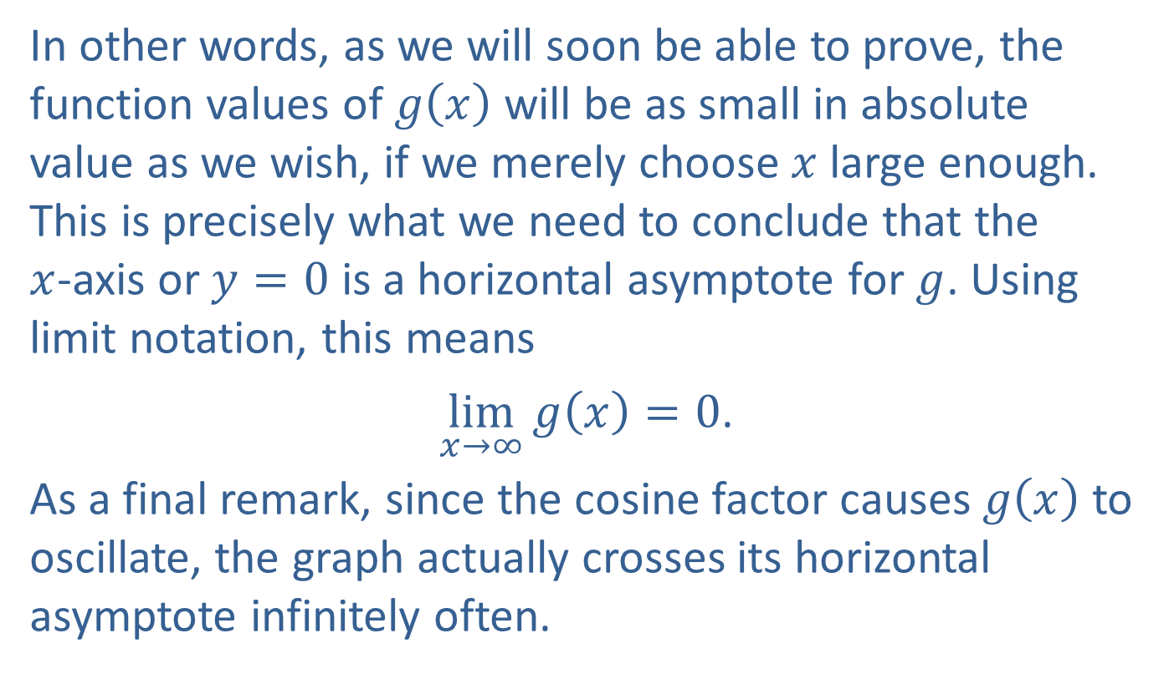
Example 6: Using Limits at Infinity to Identify Horizontal Asymptotes (cont.)
​In other words, as we will soon be able to prove, the function values of $g⁡\left(x\right)$ will be as small in absolute value as we wish, if we merely choose $x$ large enough. This is precisely what we need to conclude that the $x$-axis or $y=0$ is a horizontal asymptote for $g$. Using limit notation, this means
​ $\lim_{x→∞}{g\left(x\right)}=0$.
​As a final remark, since the cosine factor causes $g⁡\left(x\right)$ to oscillate, the graph actually crosses its horizontal asymptote infinitely often.

Slide 47
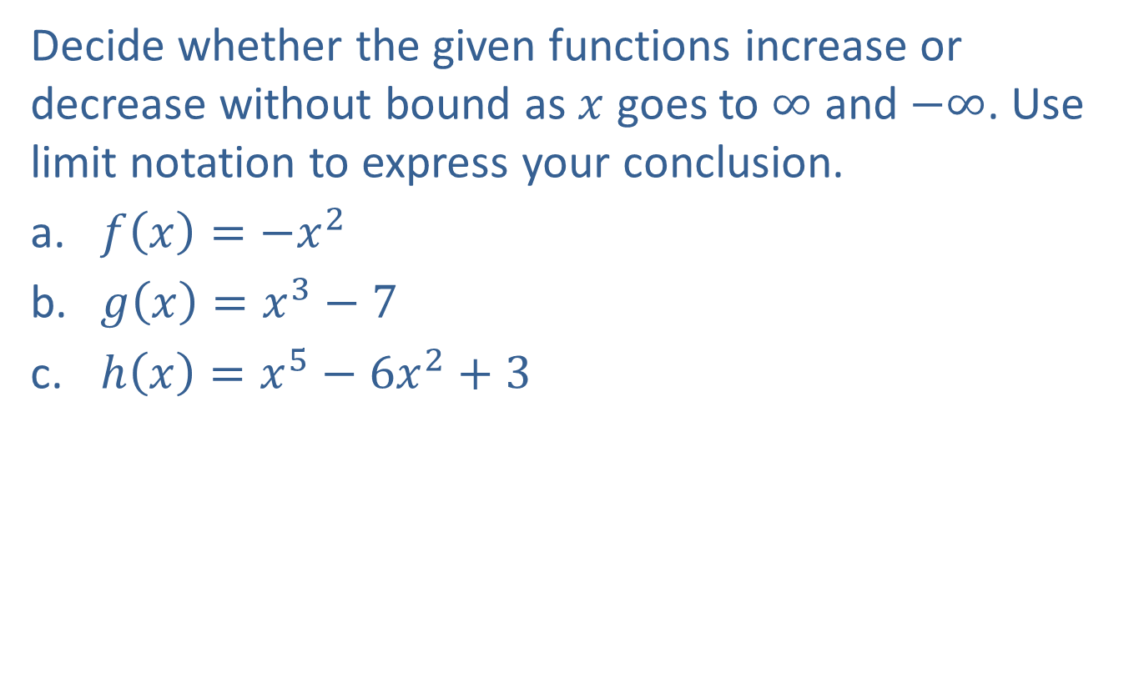
Example 7: Using Limit Notation to Describe Unbounded Behavior
Decide whether the given functions increase or decrease without bound as $x$ goes to $∞$ and $−∞$. Use limit notation to express your conclusion.
​$f\left(x\right)=−x^{2}$
​$g\left(x\right)=x^{3}−7$
​$h\left(x\right)=x^{5}−6x^{2}+3$

Slide 48
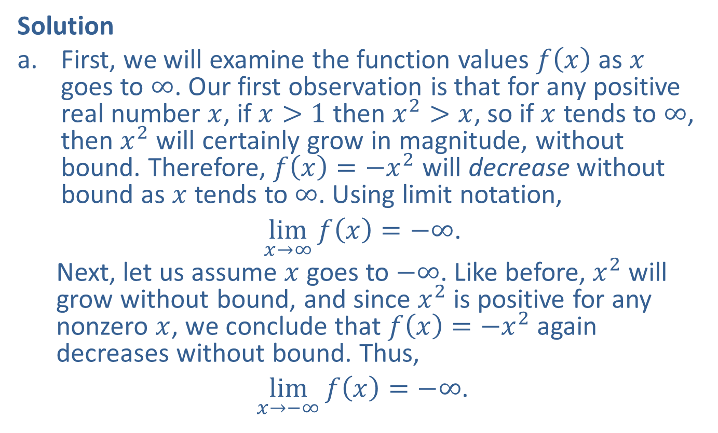
Example 7: Using Limit Notation to Describe Unbounded Behavior (cont.)
Solution
​First, we will examine the function values $f⁡\left(x\right)$ as $x$ goes to $∞$. Our first observation is that for any positive real number $x$, if $x>1$ then $x^{2}>x$, so if $x$ tends to $∞$, then $x^{2}$ will certainly grow in magnitude, without bound. Therefore, $f\left(x\right)=−x^{2}$ will decrease without bound as $x$ tends to $∞$. Using limit notation,
​ $\lim_{x→∞}{f\left(x\right)}=−∞$.
Next, let us assume $x$ goes to $−∞$. Like before, $x^{2}$ will grow without bound, and since $x^{2}$ is positive for any nonzero $x$, we conclude that $f\left(x\right)=−x^{2}$ again decreases without bound. Thus,
​ $\lim_{x→−∞}{f\left(x\right)}=−∞$.

Slide 49
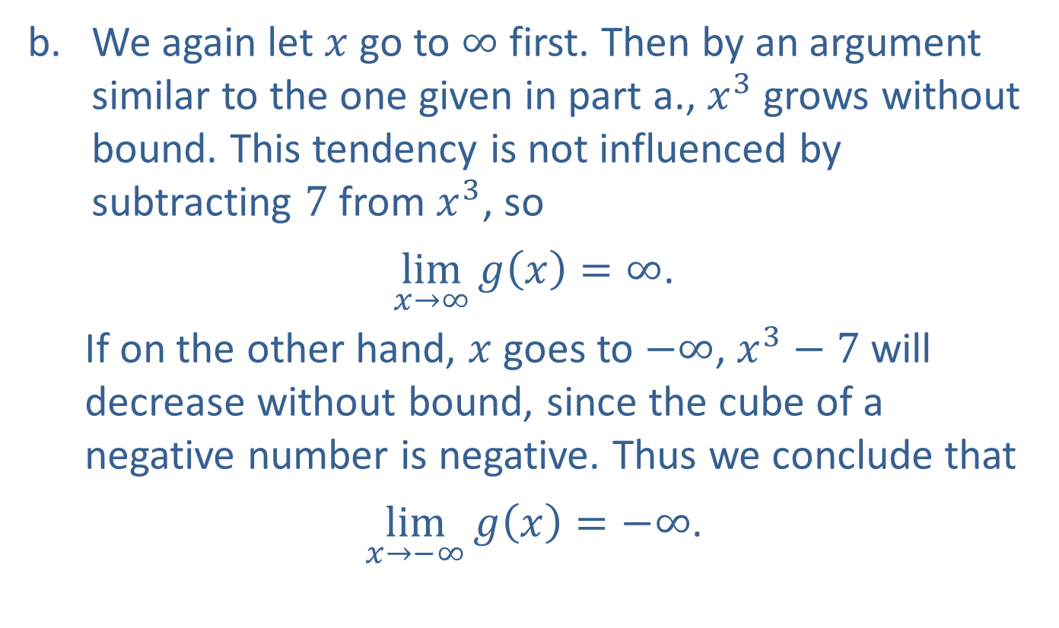
Example 7: Using Limit Notation to Describe Unbounded Behavior (cont.)
​We again let $x$ go to $∞$ first. Then by an argument similar to the one given in part a., $x^{3}$ grows without bound. This tendency is not influenced by subtracting 7 from $x^{3}$, so
​ $\lim_{x→∞}{g\left(x\right)}=∞$.
If on the other hand, $x$ goes to $−∞$, $x^{3}−7$ will decrease without bound, since the cube of a negative number is negative. Thus we conclude that
​ $\lim_{x→−∞}{g\left(x\right)}=−∞$.

Slide 50
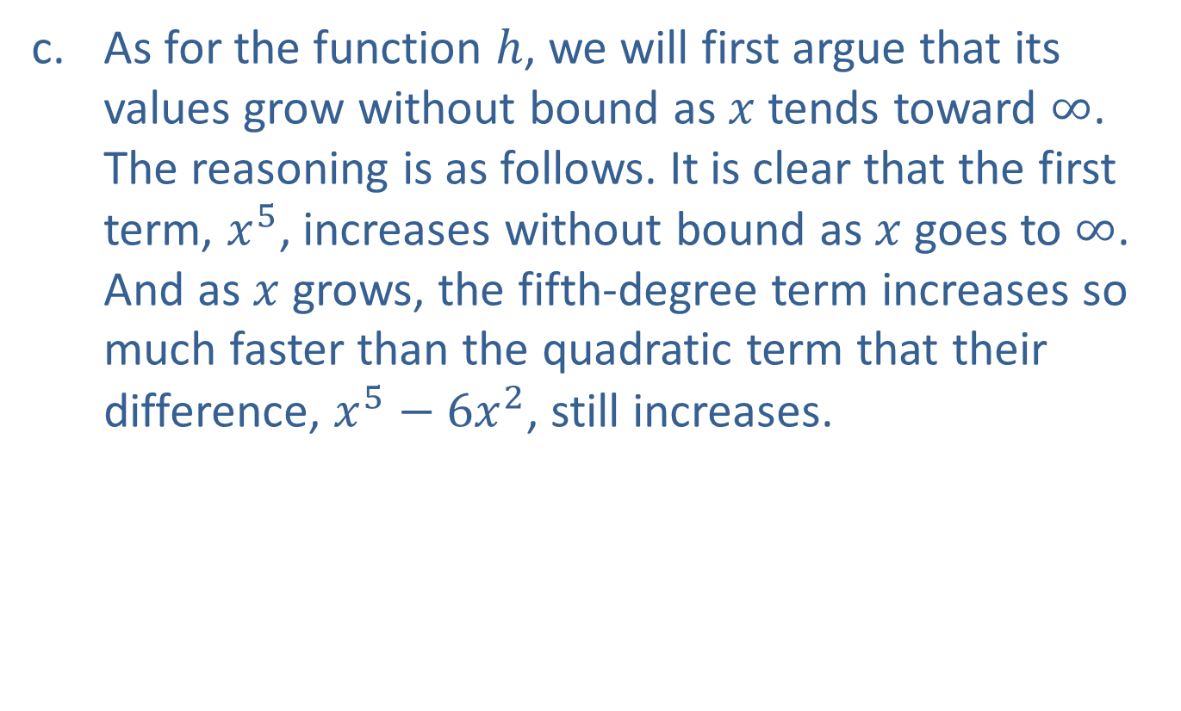
Example 7: Using Limit Notation to Describe Unbounded Behavior (cont.)
​As for the function $h$, we will first argue that its values grow without bound as $x$ tends toward $∞$. The reasoning is as follows. It is clear that the first term, $x^{5}$, increases without bound as $x$ goes to $∞$. And as $x$ grows, the fifth-degree term increases so much faster than the quadratic term that their difference, $x^{5}−6x^{2}$, still increases.

Slide 51
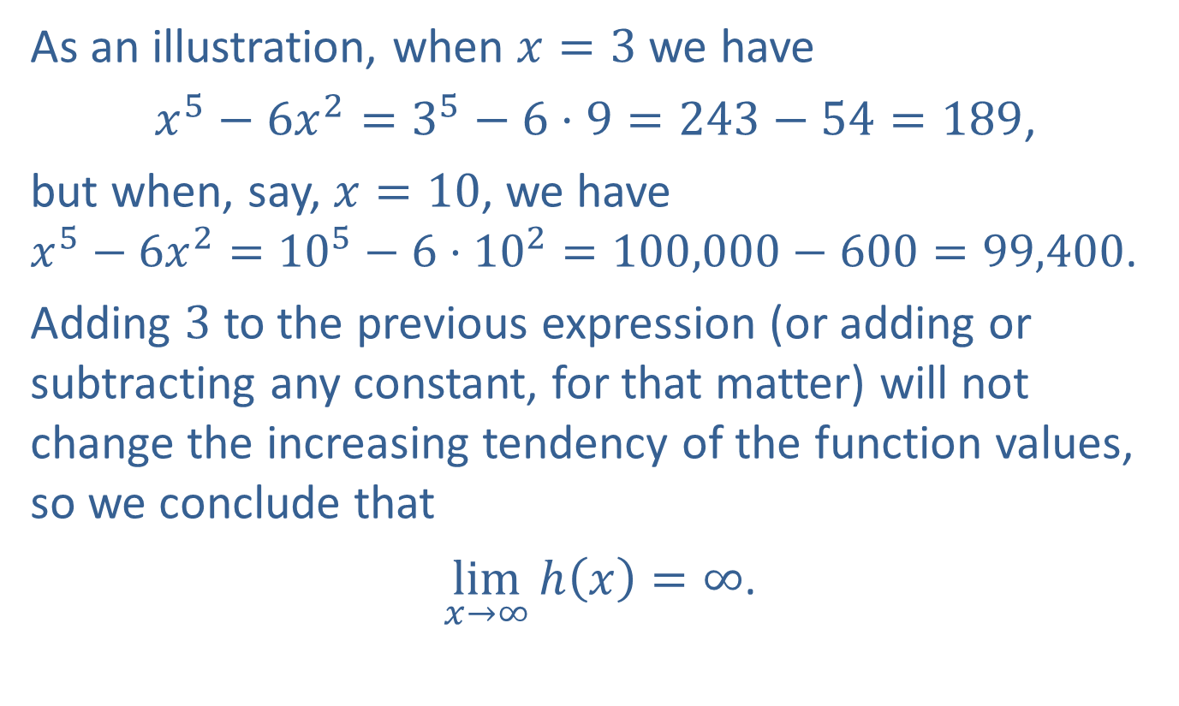
Example 7: Using Limit Notation to Describe Unbounded Behavior (cont.)
As an illustration, when $x=3$ we have
$x^{5}−6x^{2}=3^{5}−6⋅9=243−54=189$,
but when, say, $x=10$, we have $x^{5}−6x^{2}={10}^{5}−6⋅{10}^{2}=100,000−600=99,400$.
Adding 3 to the previous expression (or adding or subtracting any constant, for that matter) will not change the increasing tendency of the function values, so we conclude that
​ $\lim_{x→∞}{h\left(x\right)}=∞$.

Slide 52
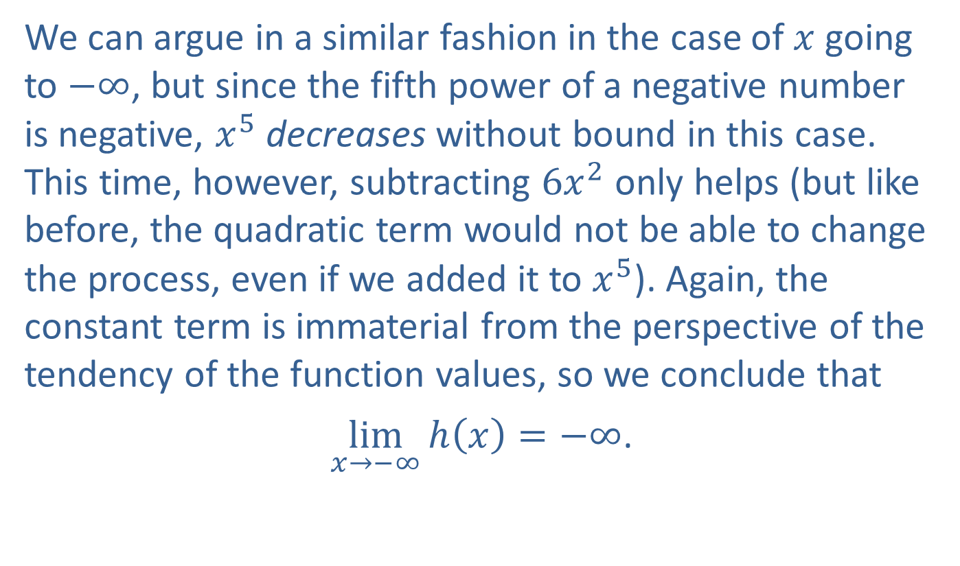
Example 7: Using Limit Notation to Describe Unbounded Behavior (cont.)
​We can argue in a similar fashion in the case of $x$ going to $−∞$, but since the fifth power of a negative number is negative, $x^{5}$ decreases without bound in this case. This time, however, subtracting $6x^{2}$ only helps (but like before, the quadratic term would not be able to change the process, even if we added it to $x^{5}$). Again, the constant term is immaterial from the perspective of the tendency of the function values, so we conclude that
​ $\lim_{x→−∞}{h\left(x\right)}=−∞$.

