Slide 1
Section 13.3
The Mathematical Definition of Limit

Slide 2
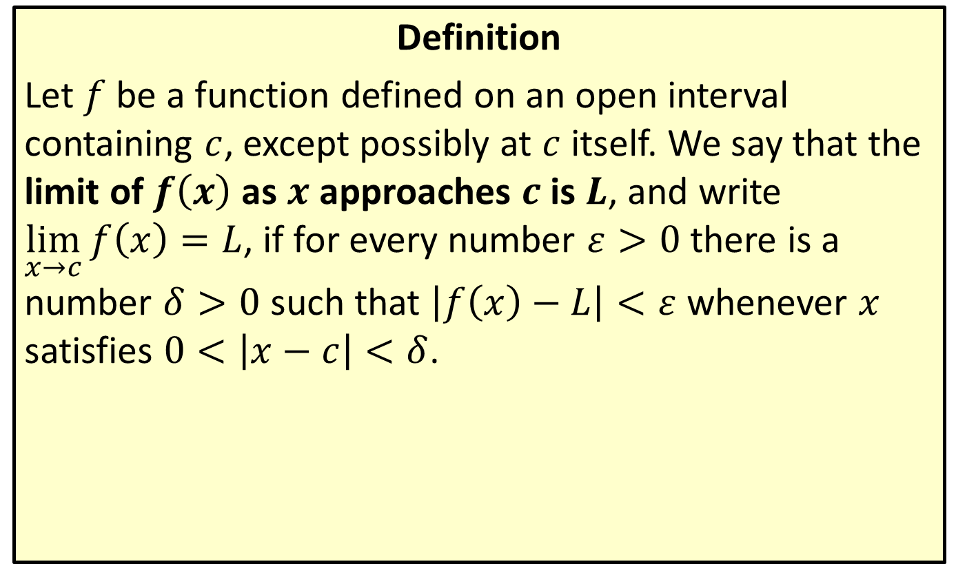
Formal Definition of Limit
Definition
Let $f$ be a function defined on an open interval containing $c$, except possibly at $c$ itself. We say that the limit of $f⁡\left(x\right)$ as $x$ approaches $c$ is $L$, and write $\lim_{x→c}{f\left(x\right)}=L$, if for every number $ε>0$ there is a number $δ>0$ such that $\left|f\left(x\right)−L\right|<ε$ whenever $x$ satisfies $0<\left|x−c\right|<δ$.

Slide 3
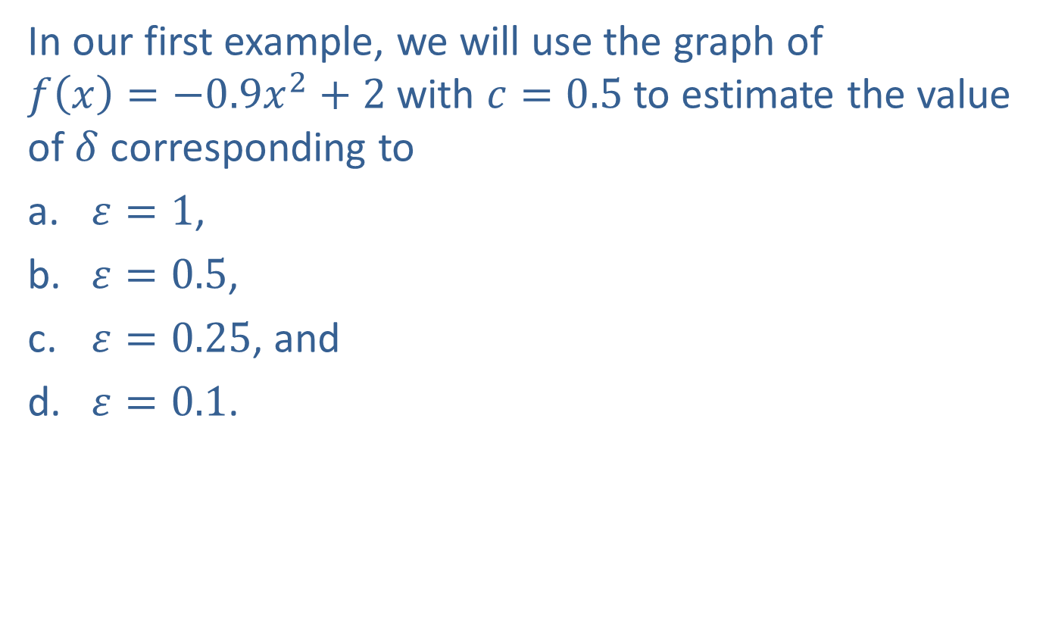

Example 1: Using Graphs to Estimate $δ$ Given $ε$
In our first example, we will use the graph of
$f\left(x\right)=−0.9x^{2}+2$ with $c=0.5$ to estimate the value of $δ$ corresponding to
​$ε=1$,
​$ε=0.5$,
​$ε=0.25$, and
​$ε=0.1$.

Slide 4
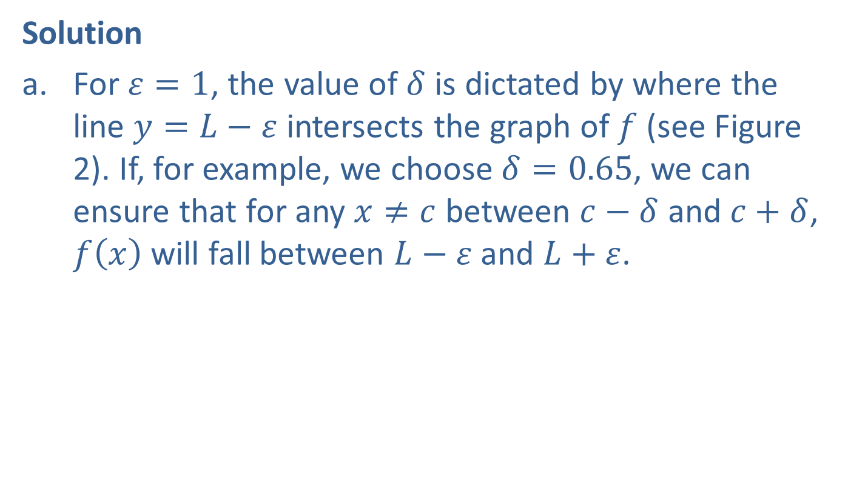

Example 1: Using Graphs to Estimate $δ$ Given $ε$ (cont.)
Solution
​For $ε=1$, the value of $δ$ is dictated by where the line $y=L−ε$ intersects the graph of $f$ (see Figure 2). If, for example, we choose $δ=0.65$, we can ensure that for any $x≠c$ between $c−δ$ and $c+δ$, $f⁡\left(x\right)$ will fall between $L−ε$ and $L+ε$.
​

Slide 5
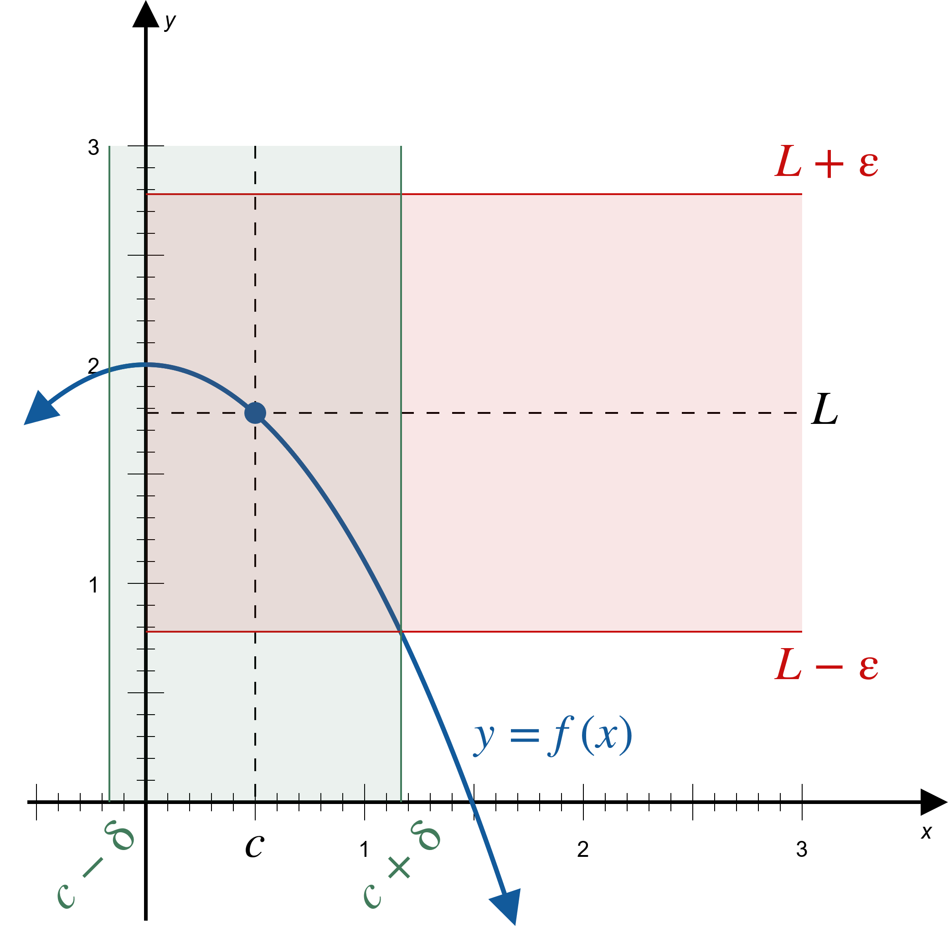
Example 1: Using Graphs to Estimate $δ$ Given $ε$ (cont.)
Figure 2

Slide 6

Example 1: Using Graphs to Estimate $δ$ Given $ε$ (cont.)
​As for the case of $ε=0.5$, using the illustration in Figure 3, it is clear that if $x≠c$ falls between, say, 0.1 and 0.9, then $L−ε<f\left(x\right)<L+ε$. Thus
$δ=0.4$ (or any smaller number) is a good choice.
​

Slide 7
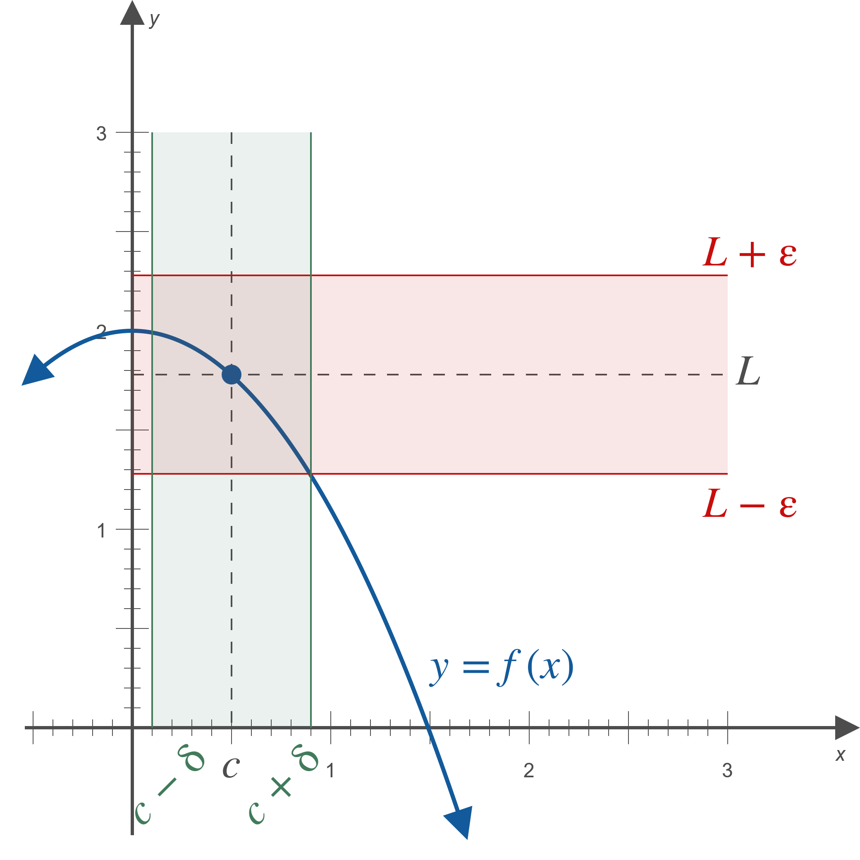
Example 1: Using Graphs to Estimate $δ$ Given $ε$ (cont.)
Figure 3

Slide 8

Example 1: Using Graphs to Estimate $δ$ Given $ε$ (cont.)
​As before, visually inspecting the graph in Figure 4 leads to the conclusion that when $ε=0.25$, the value of $δ=0.2$ (or any smaller number) is a good choice, since 0.2 is less than the distance between $c$ and either of the green vertical lines.
​

Slide 9
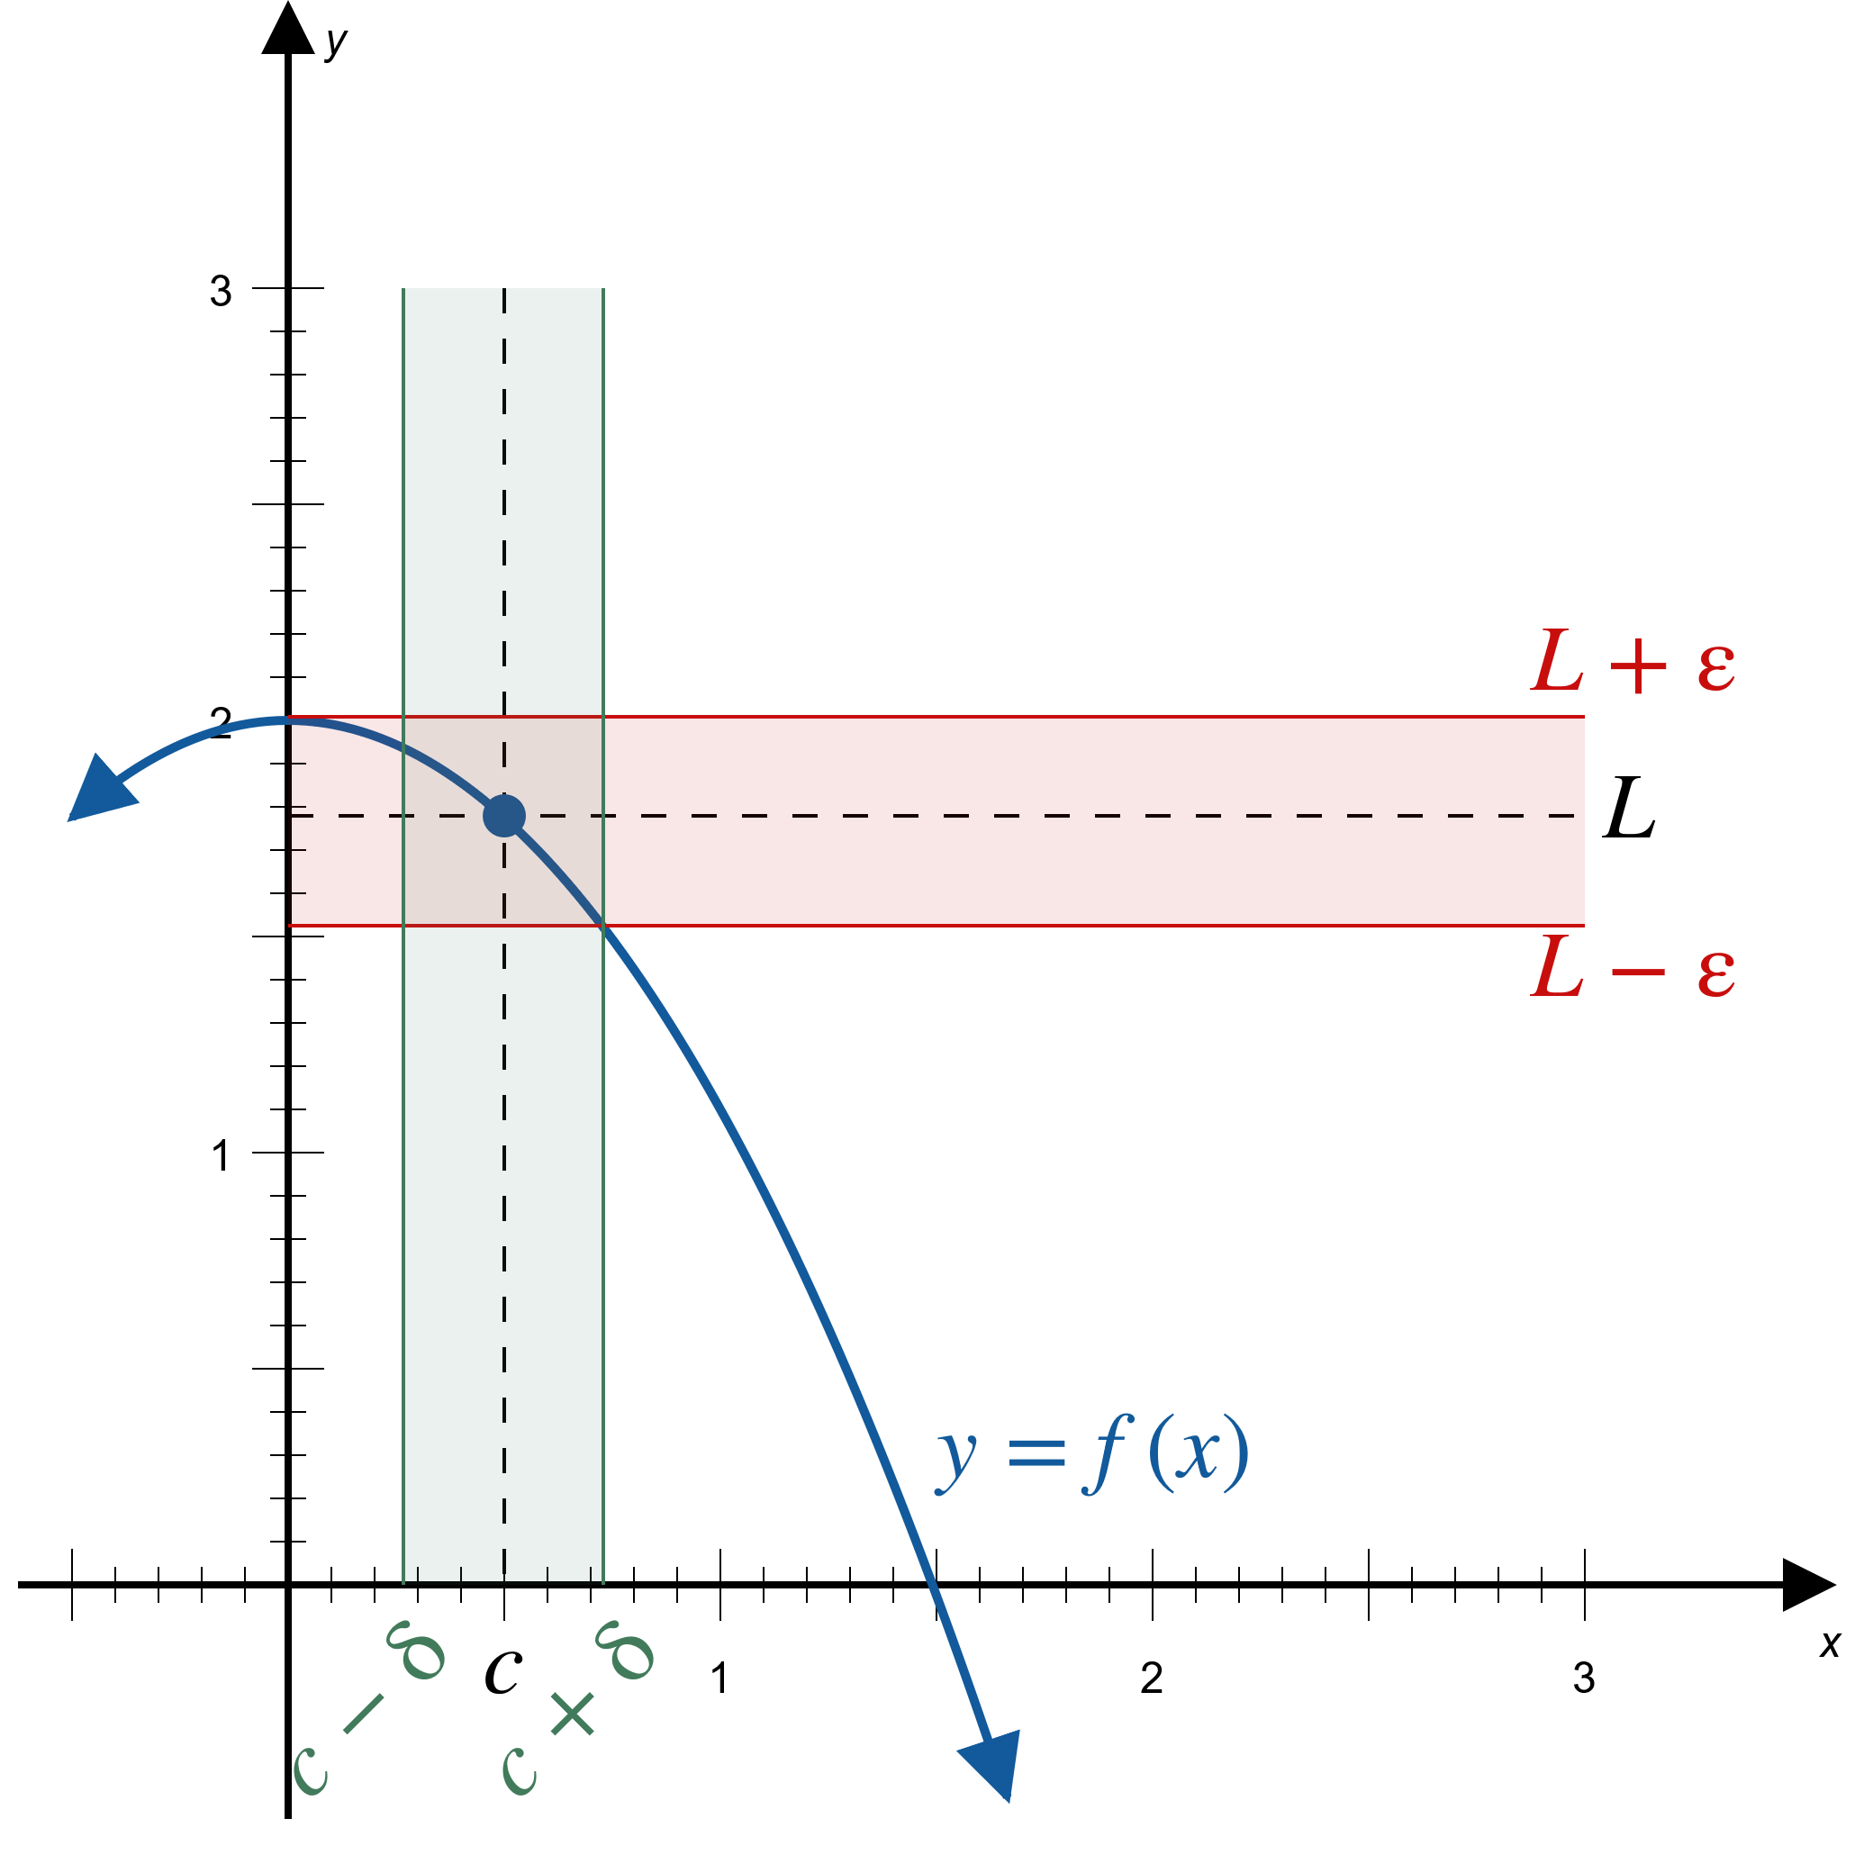
Example 1: Using Graphs to Estimate $δ$ Given $ε$ (cont.)
Figure 4

Slide 10

Example 1: Using Graphs to Estimate $δ$ Given $ε$ (cont.)
​Again, a visual inspection reveals that $ε=0.1$ will require a much smaller $δ$; $δ=0.1$ (or any smaller number) works well (see Figure 5).
​

Slide 11
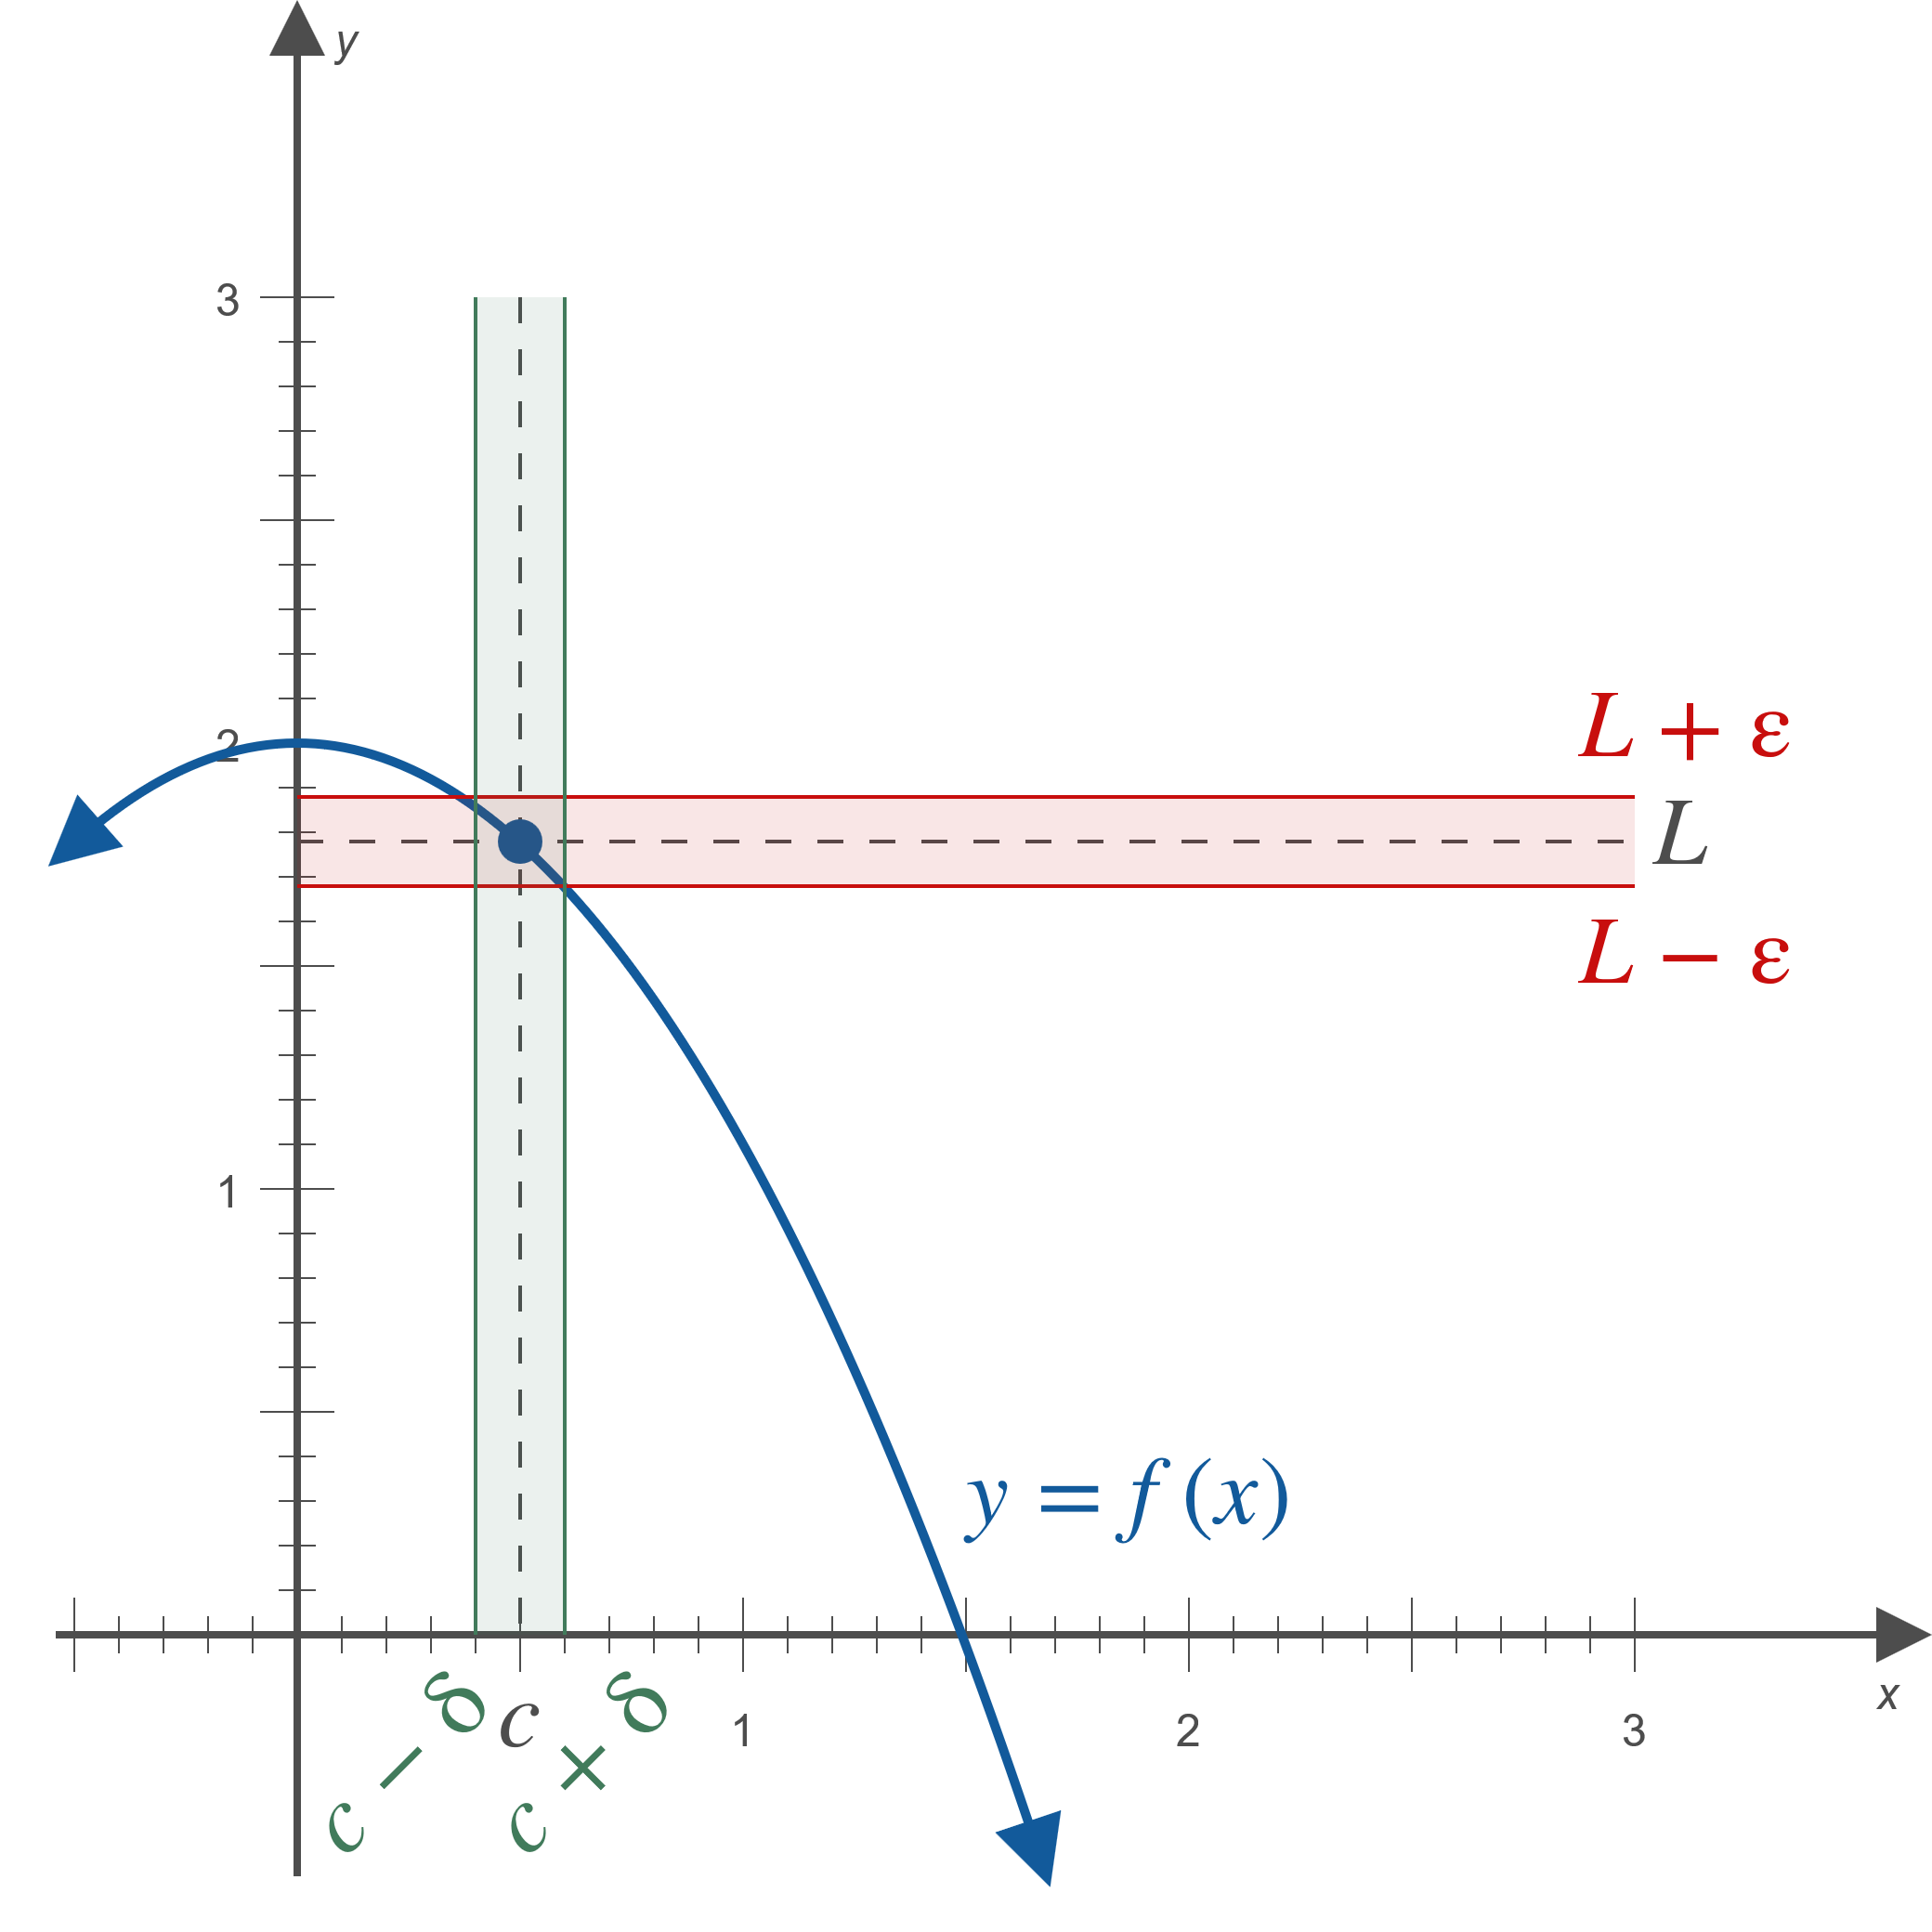
Example 1: Using Graphs to Estimate $δ$ Given $ε$ (cont.)
Figure 5

Slide 12
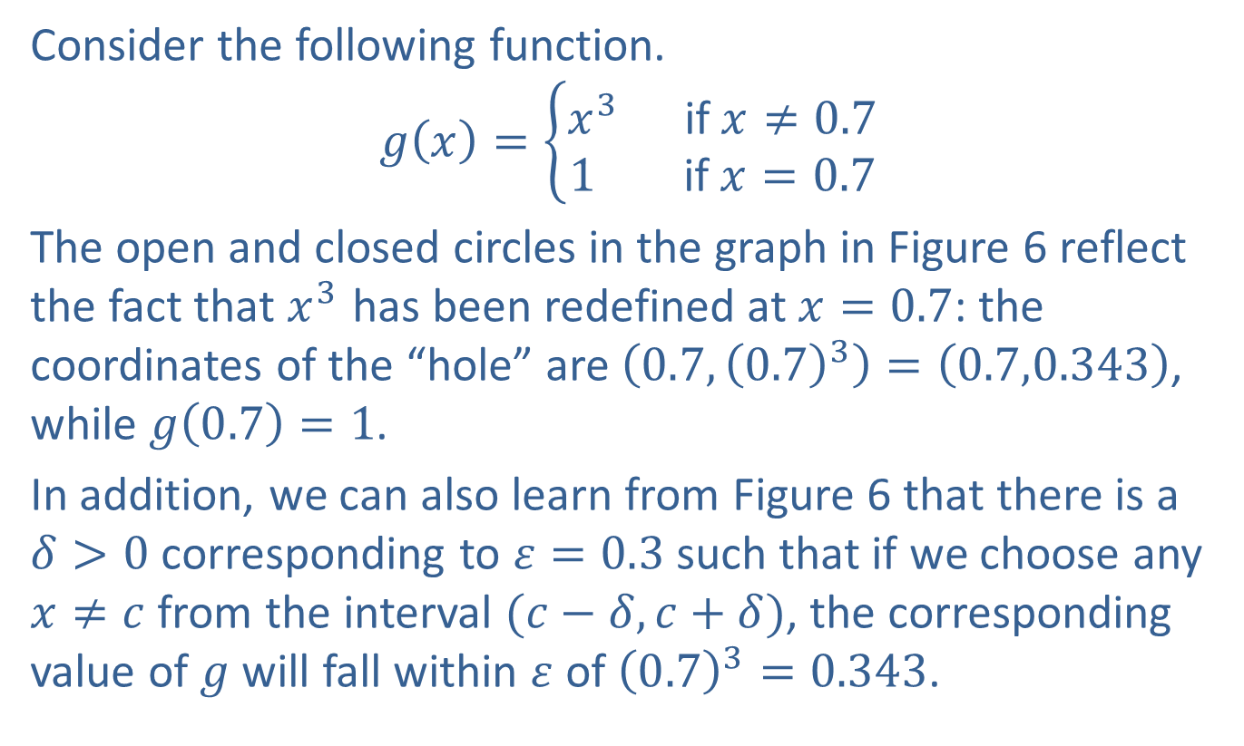
Example 2: Using Graphs to Determine Limits
Consider the following function.
$$g\left(x\right)=\left\{\begin{aligned}x^{3} \text{if} x≠0.7 \\ 1 \text{if} x=0.7\end{aligned}\right.$$
The open and closed circles in the graph in Figure 6 reflect the fact that $x^{3}$ has been redefined at $x=0.7$: the coordinates of the “hole” are $\left(0.7,{\left(0.7\right)}^{3}\right)=\left(0.7,0.343\right)$, while $g\left(0.7\right)=1$.
In addition, we can also learn from Figure 6 that there is a
$δ>0$ corresponding to $ε=0.3$ such that if we choose any $x≠c$ from the interval $(c−δ,c+δ)$, the corresponding value of $g$ will fall within $ε$ of ${\left(0.7\right)}^{3}=0.343$.

Slide 13
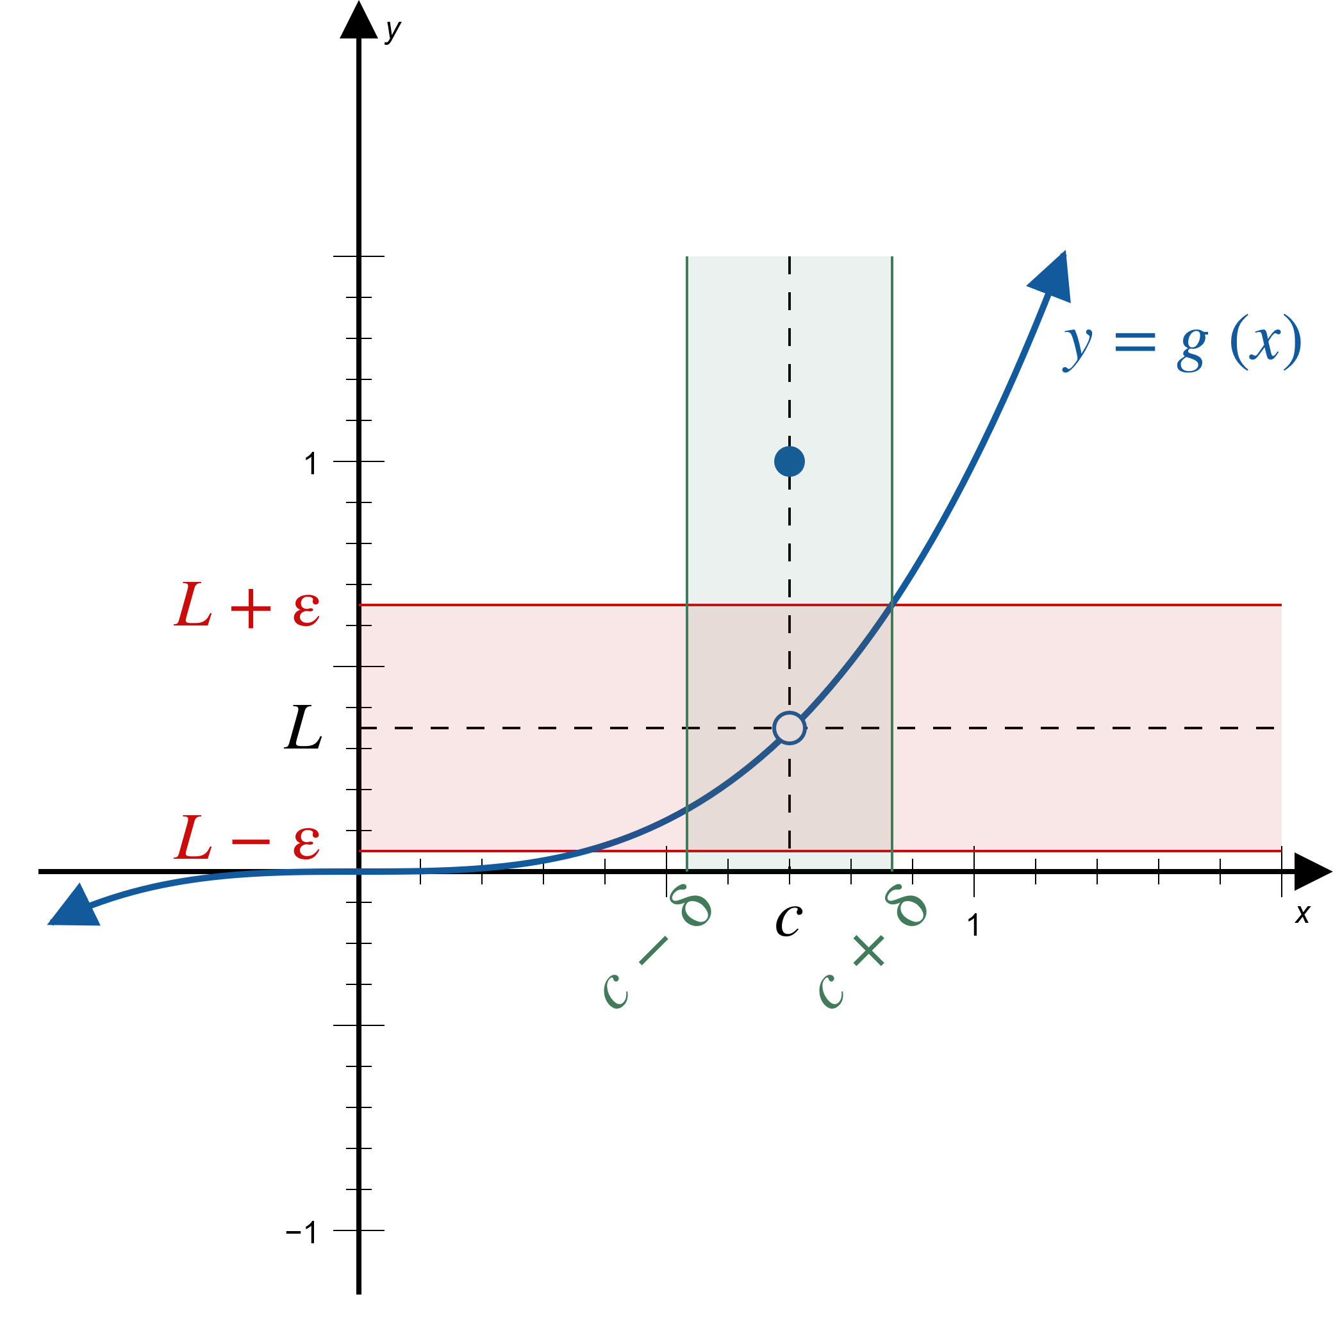
Example 2: Using Graphs to Determine Limits (cont.)
Figure 6

Slide 14

Example 2: Using Graphs to Determine Limits (cont.)
Figures 7, 8, and 9 are illustrations of the existence of $δ$-values corresponding to smaller and smaller $ε$’s.

Slide 15
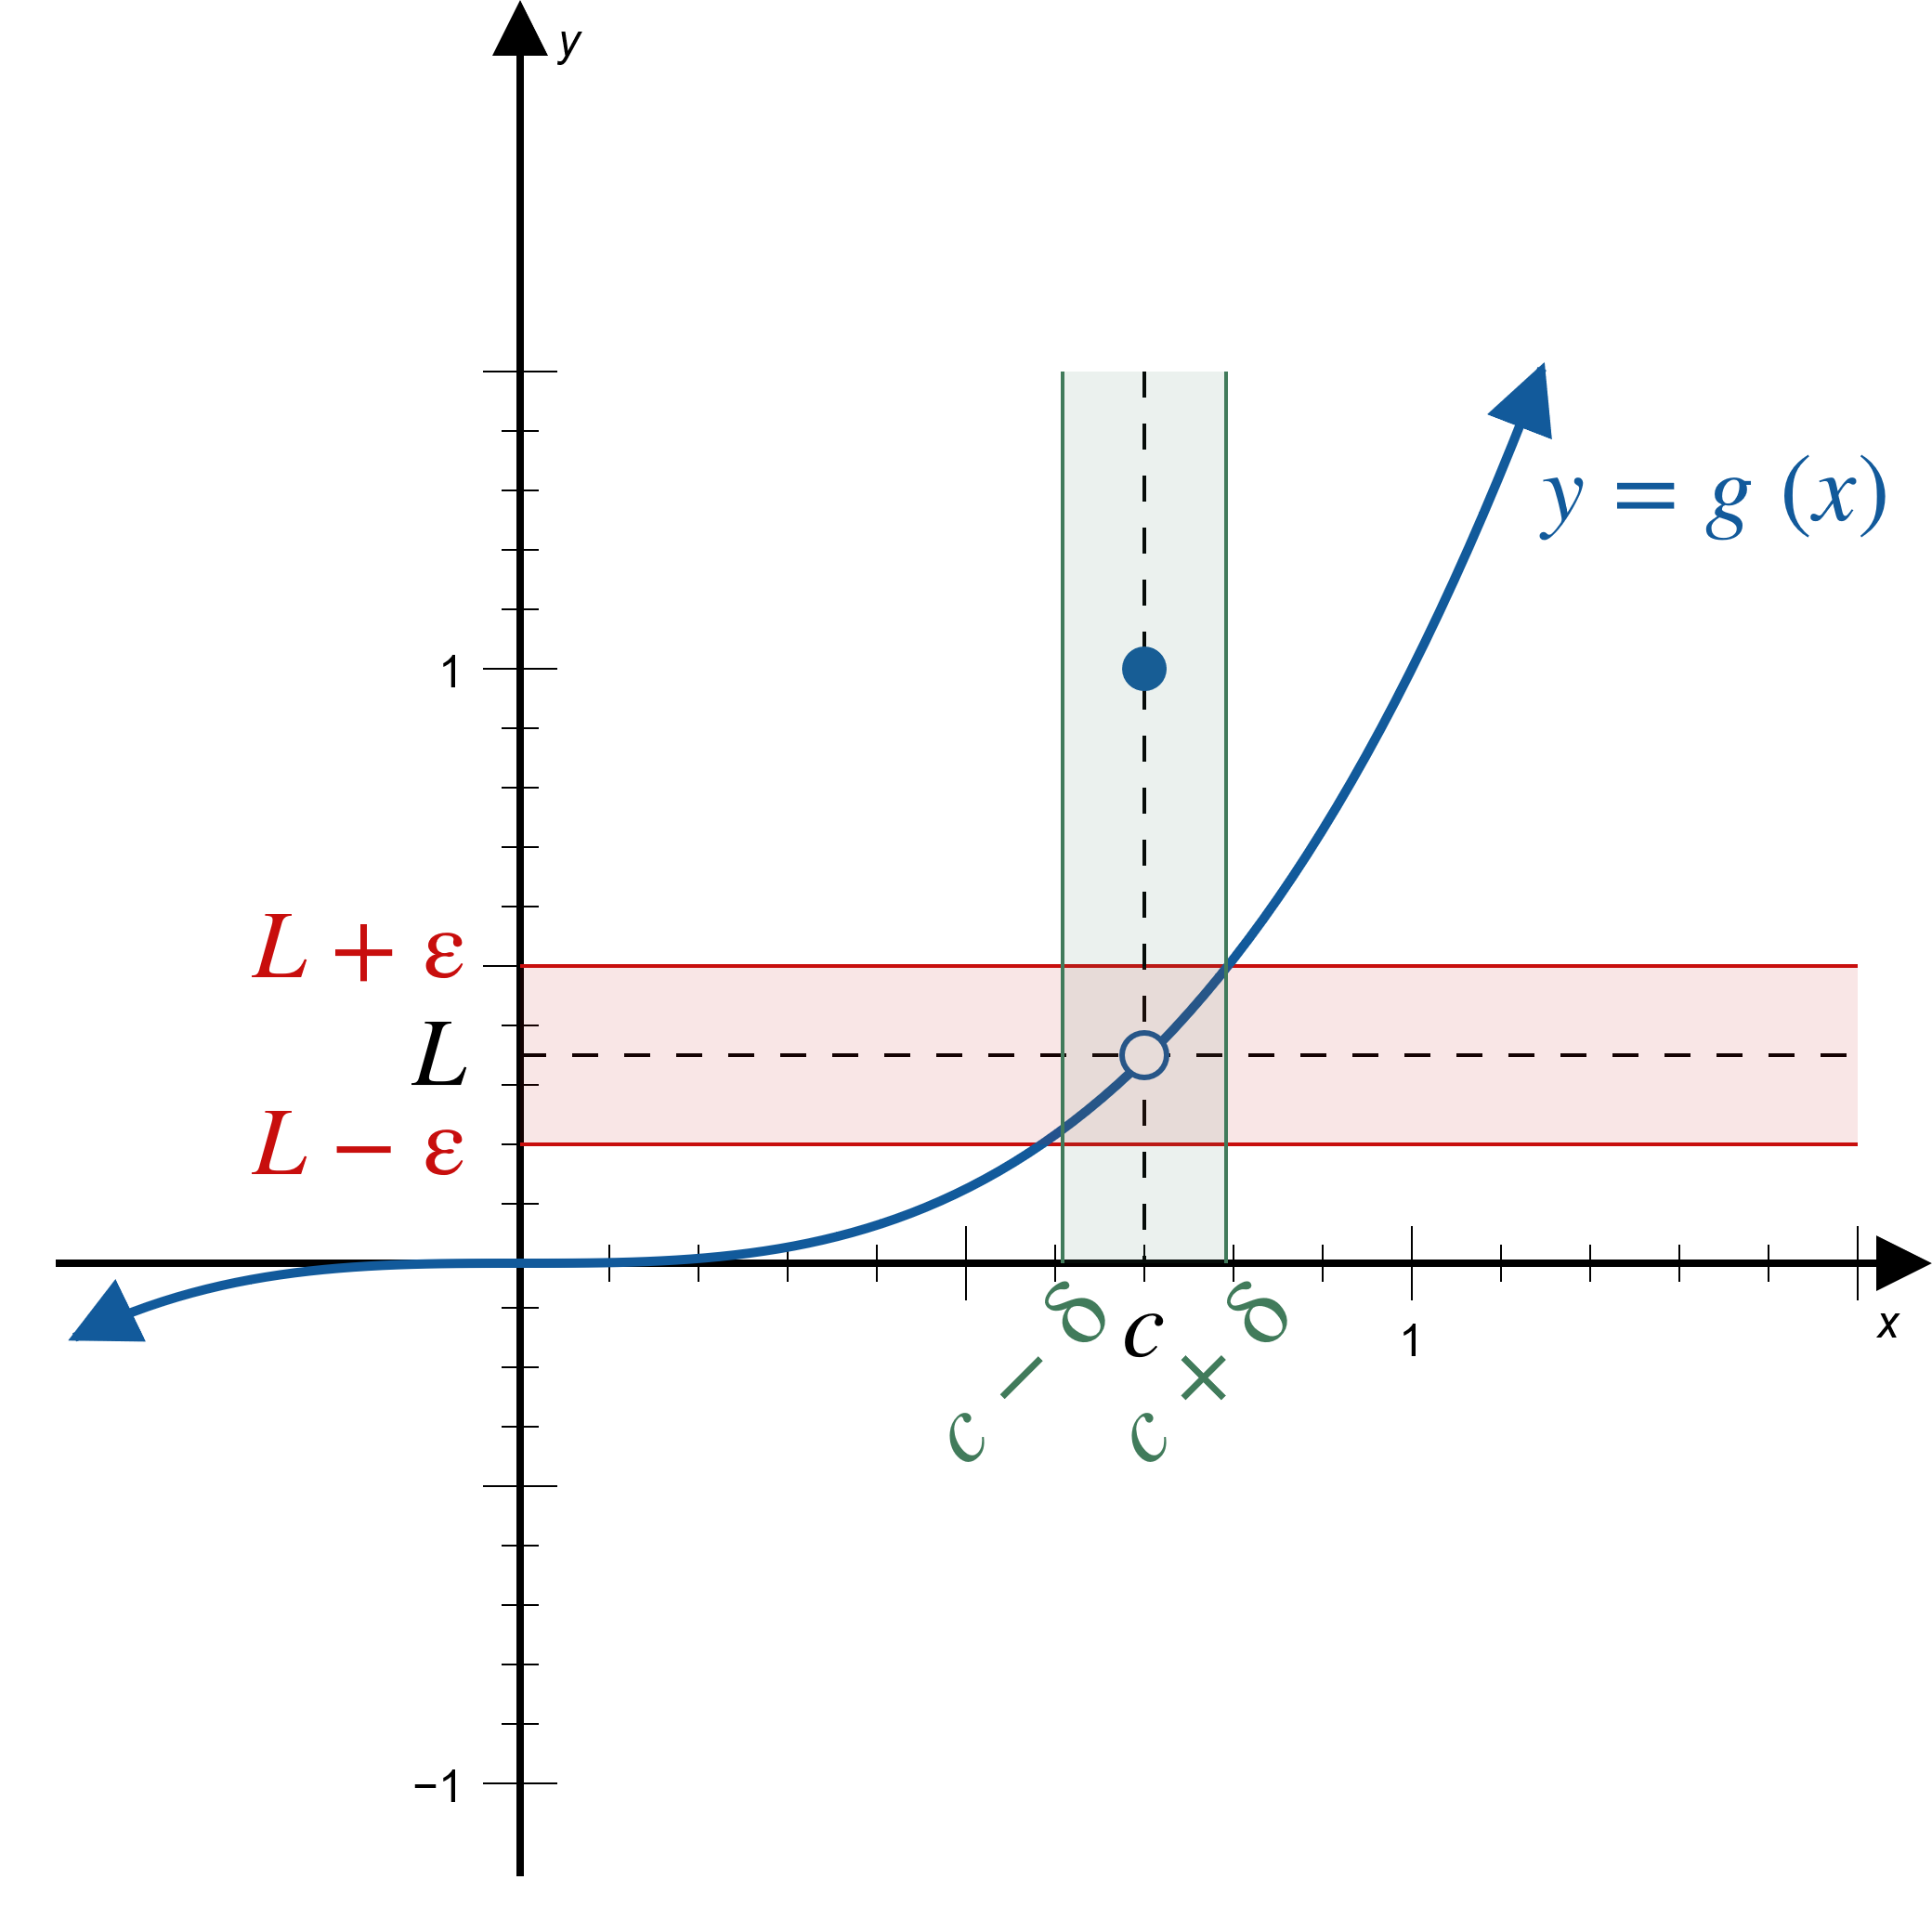
Example 2: Using Graphs to Determine Limits (cont.)
Figure 7

Slide 16

Example 2: Using Graphs to Determine Limits (cont.)
Figure 8

Slide 17
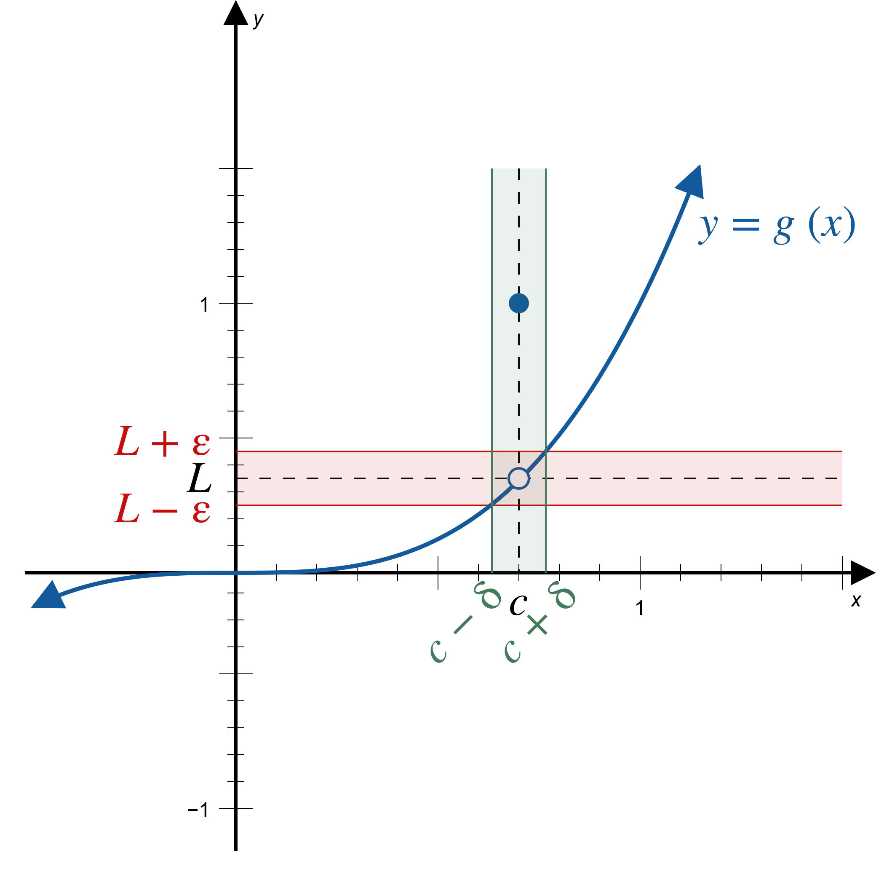
Example 2: Using Graphs to Determine Limits (cont.)
Figure 9

Slide 18
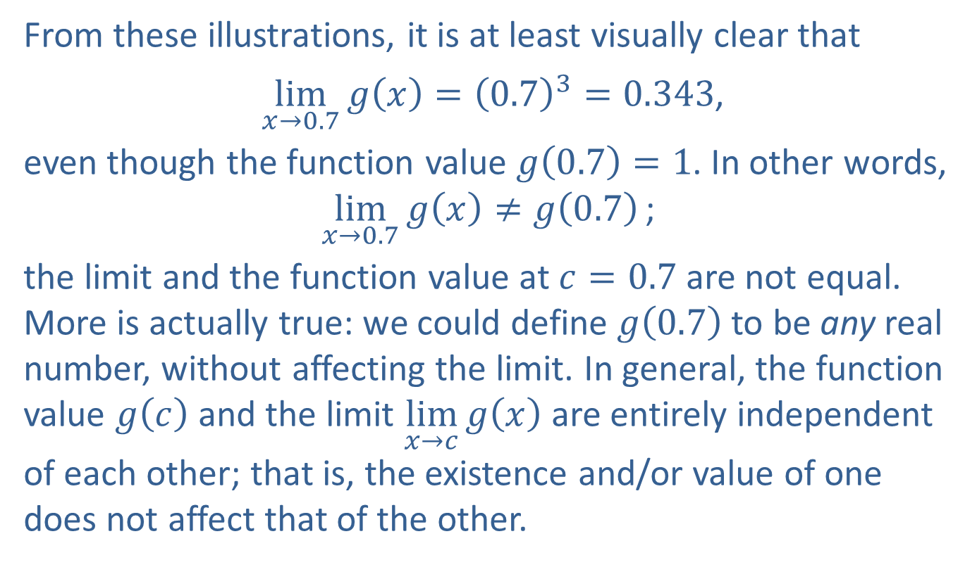
Example 2: Using Graphs to Determine Limits (cont.)
From these illustrations, it is at least visually clear that
$\lim_{x→0.7}{g\left(x\right)}={\left(0.7\right)}^{3}=0.343$,
even though the function value $g\left(0.7\right)=1$. In other words,
$$\lim_{x→0.7}{g\left(x\right)}≠g\left(0.7\right)\text{;}$$
the limit and the function value at $c=0.7$ are not equal. More is actually true: we could define $g⁡\left(0.7\right)$ to be any real number, without affecting the limit. In general, the function value $g⁡\left(c\right)$ and the limit $\lim_{x→c}⁡g\left(x\right)$ are entirely independent of each other; that is, the existence and/or value of one does not affect that of the other.

Slide 19
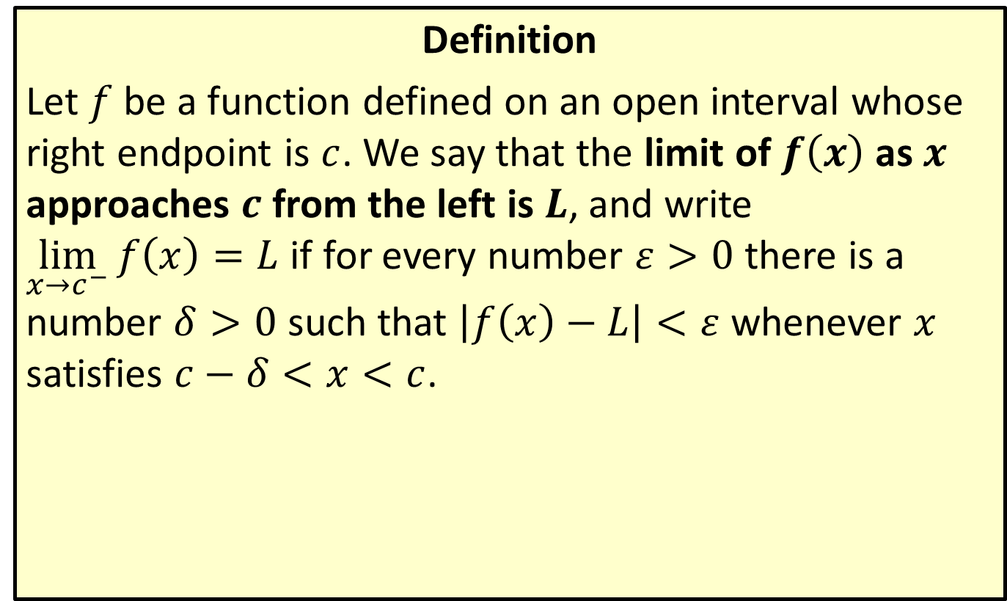
Limits from the Left (Left-Hand Limits)
Definition
Let $f$ be a function defined on an open interval whose right endpoint is $c$. We say that the limit of $f⁡\left(x\right)$ as $x$ approaches $c$ from the left is $L$, and write
$\lim_{x→c^{−}}{f\left(x\right)}=L$ if for every number $ε>0$ there is a number $δ>0$ such that $\left|f\left(x\right)−L\right|<ε$ whenever $x$ satisfies $c−δ<x<c$.

Slide 20
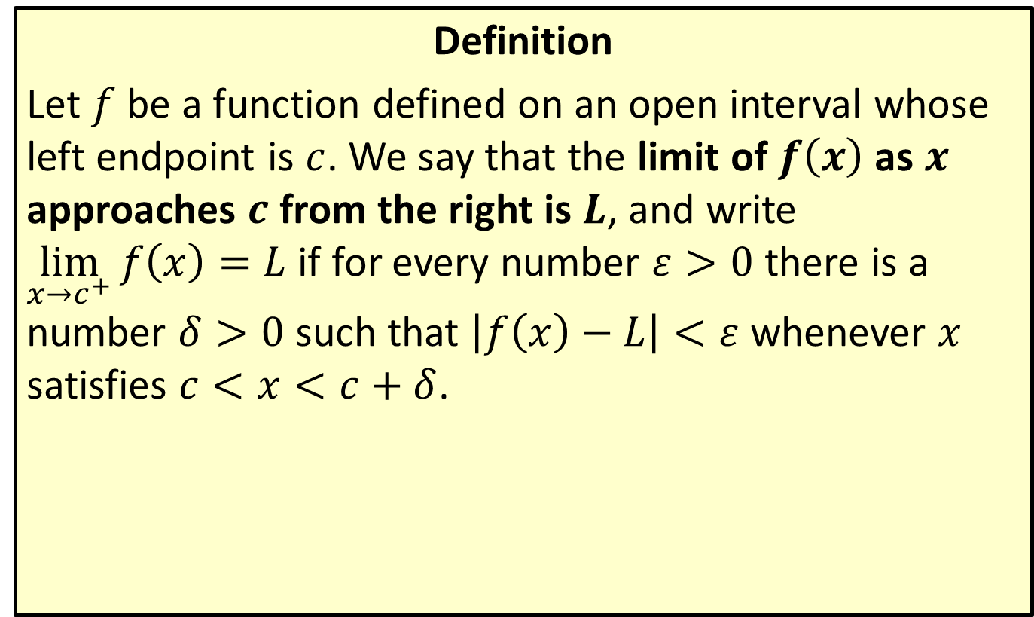
Limits from the Right (Right-Hand Limits)
Definition
Let $f$ be a function defined on an open interval whose left endpoint is $c$. We say that the limit of $f⁡\left(x\right)$ as $x$ approaches $c$ from the right is $L$, and write
$\lim_{x→c^{+}}{f\left(x\right)}=L$ if for every number $ε>0$ there is a number $δ>0$ such that $\left|f\left(x\right)−L\right|<ε$ whenever $x$ satisfies $c<x<c+δ$.

Slide 21
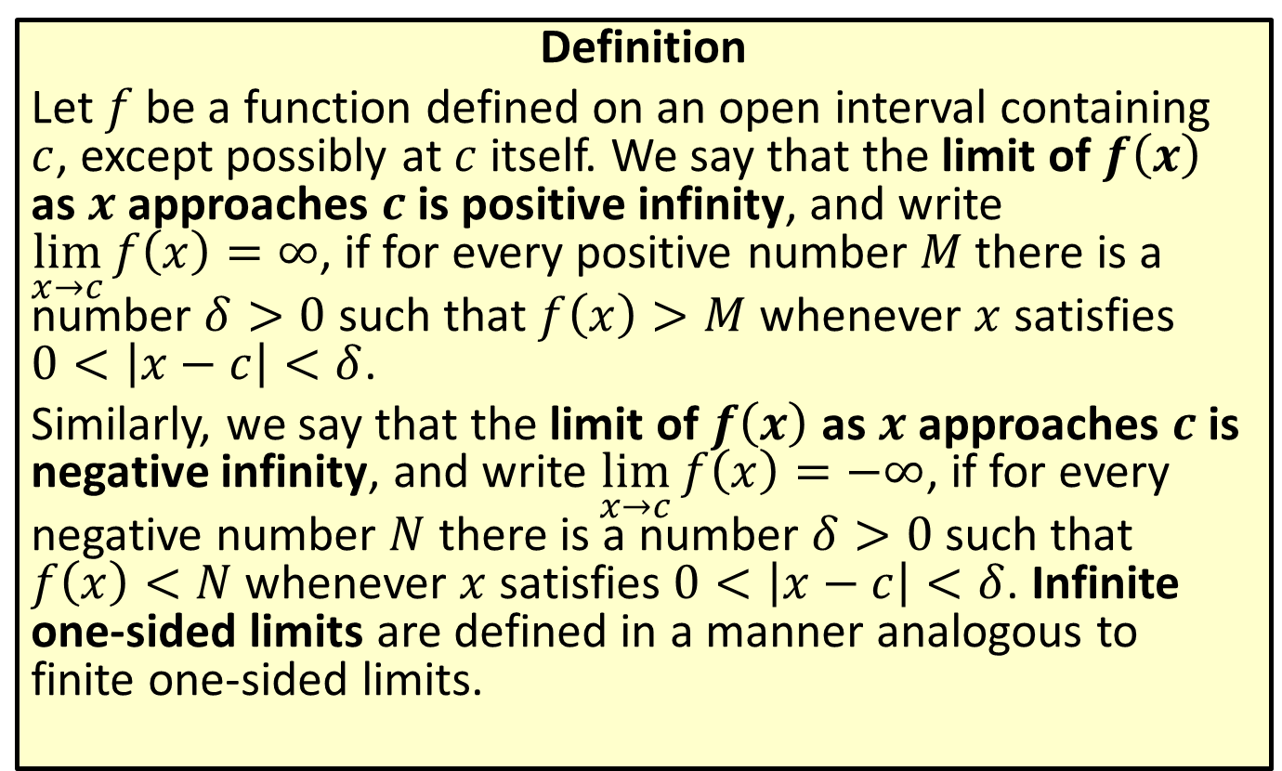
Infinite Limits
Definition
Let $f$ be a function defined on an open interval containing $c$, except possibly at $c$ itself. We say that the limit of $f⁡\left(x\right)$ as $x$ approaches $c$ is positive infinity, and write
$\lim_{x→c}{f\left(x\right)}=∞$, if for every positive number $M$ there is a number $δ>0$ such that $f\left(x\right)>M$ whenever $x$ satisfies
$0<\left|x−c\right|<δ$.
Similarly, we say that the limit of $f⁡\left(x\right)$ as $x$ approaches $c$ is negative infinity, and write $\lim_{x→c}{f\left(x\right)}=−∞$, if for every negative number $N$ there is a number $δ>0$ such that
$f\left(x\right)<N$ whenever $x$ satisfies $0<\left|x−c\right|<δ$. Infinite one-sided limits are defined in a manner analogous to finite one-sided limits.

Slide 22
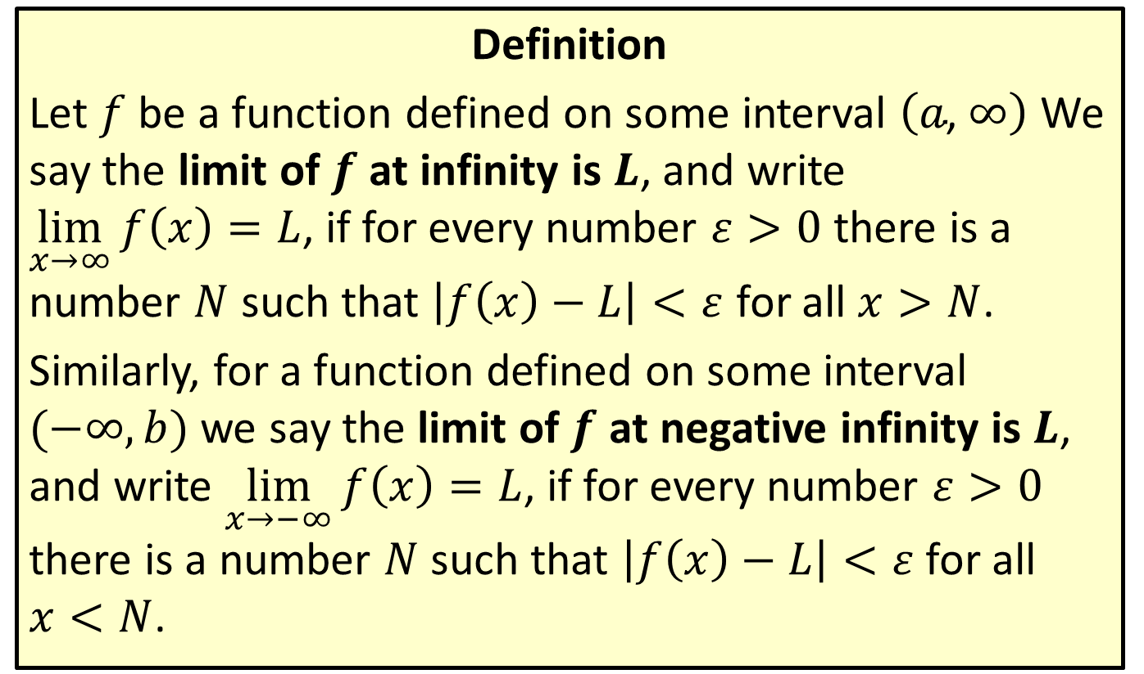
Limits at Infinity
Definition
Let $f$ be a function defined on some interval $\left(a\text{, }∞\right)$ We say the limit of $f$ at infinity is $L$, and write
$\lim_{x→∞}{f\left(x\right)}=L$, if for every number $ε>0$ there is a number $N$ such that $\left|f\left(x\right)−L\right|<ε$ for all $x>N$.
Similarly, for a function defined on some interval $(−∞,b)$ we say the limit of $f$ at negative infinity is $L$, and write $\lim_{x→−∞}{f\left(x\right)}=L$, if for every number $ε>0$ there is a number $N$ such that $\left|f\left(x\right)−L\right|<ε$ for all
$x<N$.

Slide 23


Example 3: Using the $ε$-$δ$ Definition of Limit to Prove a Limit Exists
Use the $ε$-$δ$ definition of limit to prove that
$\lim_{x→3}{(2x−1)}=5$.

Slide 24
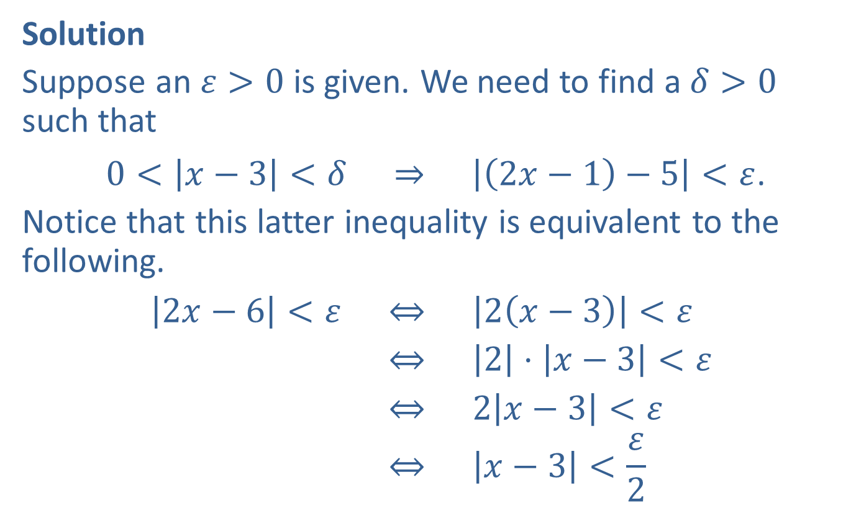

Example 3: Using the $ε$-$δ$ Definition of Limit to Prove a Limit Exists (cont.)
Solution
Suppose an $ε>0$ is given. We need to find a $δ>0$ such that
$0<\left|x−3\right|<δ ⇒ \left|\left(2x−1\right)−5\right|<ε$.
Notice that this latter inequality is equivalent to the following.
2𝑥−6<𝜀 ⇔ 2𝑥−3<𝜀2𝑥−6<𝜀 ⇔ 2⋅𝑥−3<𝜀2𝑥−6<𝜀 ⇔ 2𝑥−3<𝜀2𝑥−6<𝜀 ⇔ 𝑥−3<𝜀2

Slide 25
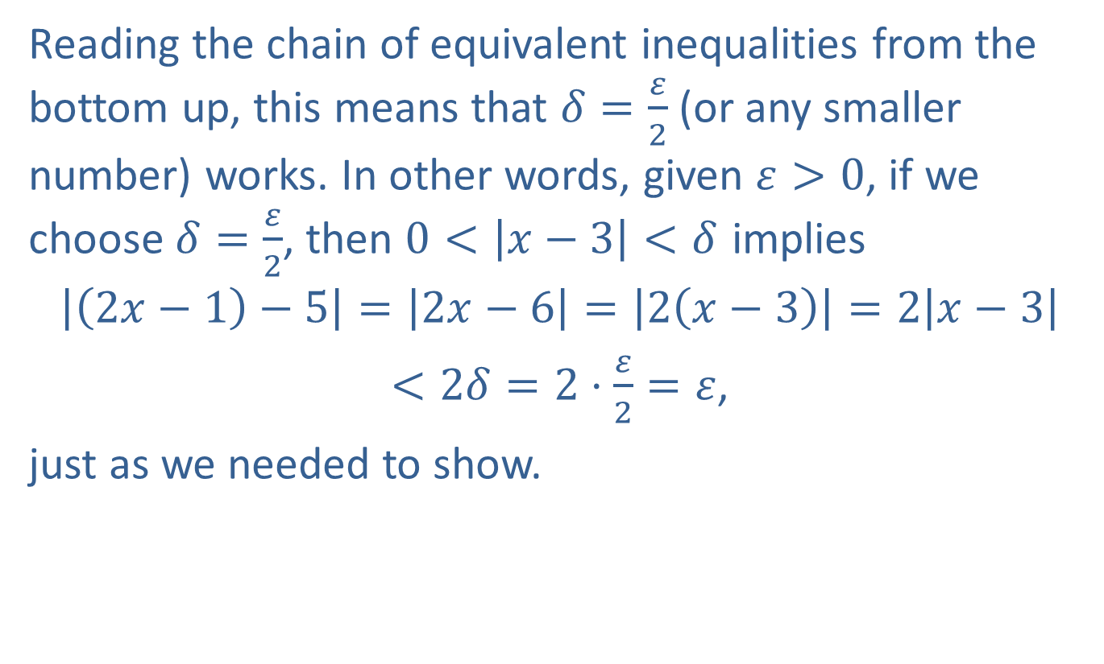
Example 3: Using the $ε$-$δ$ Definition of Limit to Prove a Limit Exists (cont.)
Reading the chain of equivalent inequalities from the bottom up, this means that $δ=\frac{ε}{2}$ (or any smaller number) works. In other words, given $ε>0$, if we choose $δ=\frac{ε}{2}$, then $0<\left|x−3\right|<δ$ implies
$$\left|\left(2x−1\right)−5\right|=\left|2x−6\right|=\left|2\left(x−3\right)\right|=2\left|x−3\right|$$
$<2δ=2⋅\frac{ε}{2}=ε$,
just as we needed to show.

Slide 26
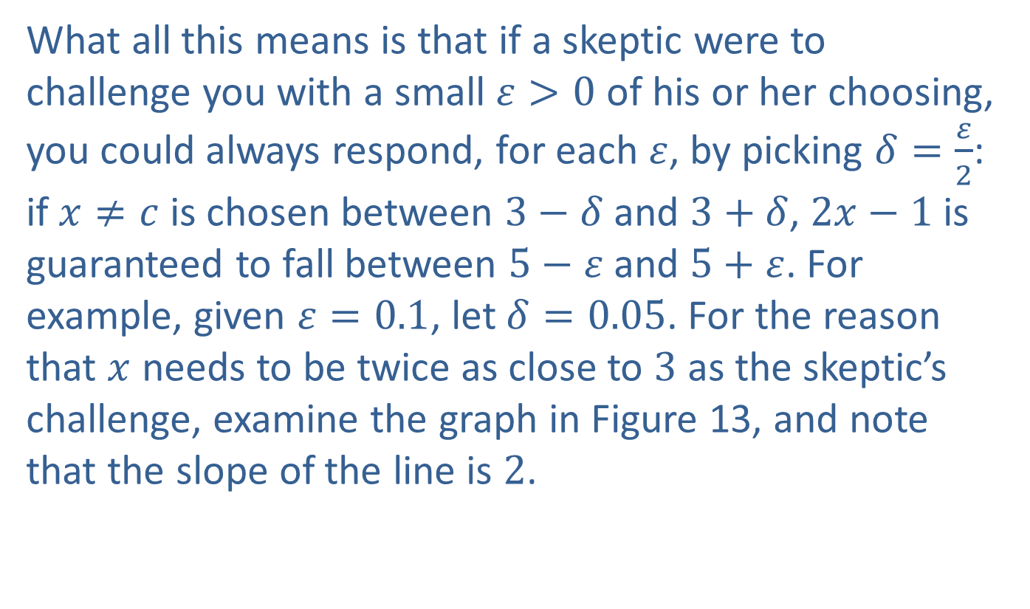
Example 3: Using the $ε$-$δ$ Definition of Limit to Prove a Limit Exists (cont.)
What all this means is that if a skeptic were to challenge you with a small $ε>0$ of his or her choosing, you could always respond, for each $ε$, by picking $δ=\frac{ε}{2}$: if $x≠c$ is chosen between $3−δ$ and $3+δ$, $2x−1$ is guaranteed to fall between $5−ε$ and $5+ε$. For example, given $ε=0.1$, let $δ=0.05$. For the reason that $x$ needs to be twice as close to 3 as the skeptic’s challenge, examine the graph in Figure 13, and note that the slope of the line is 2.

Slide 27
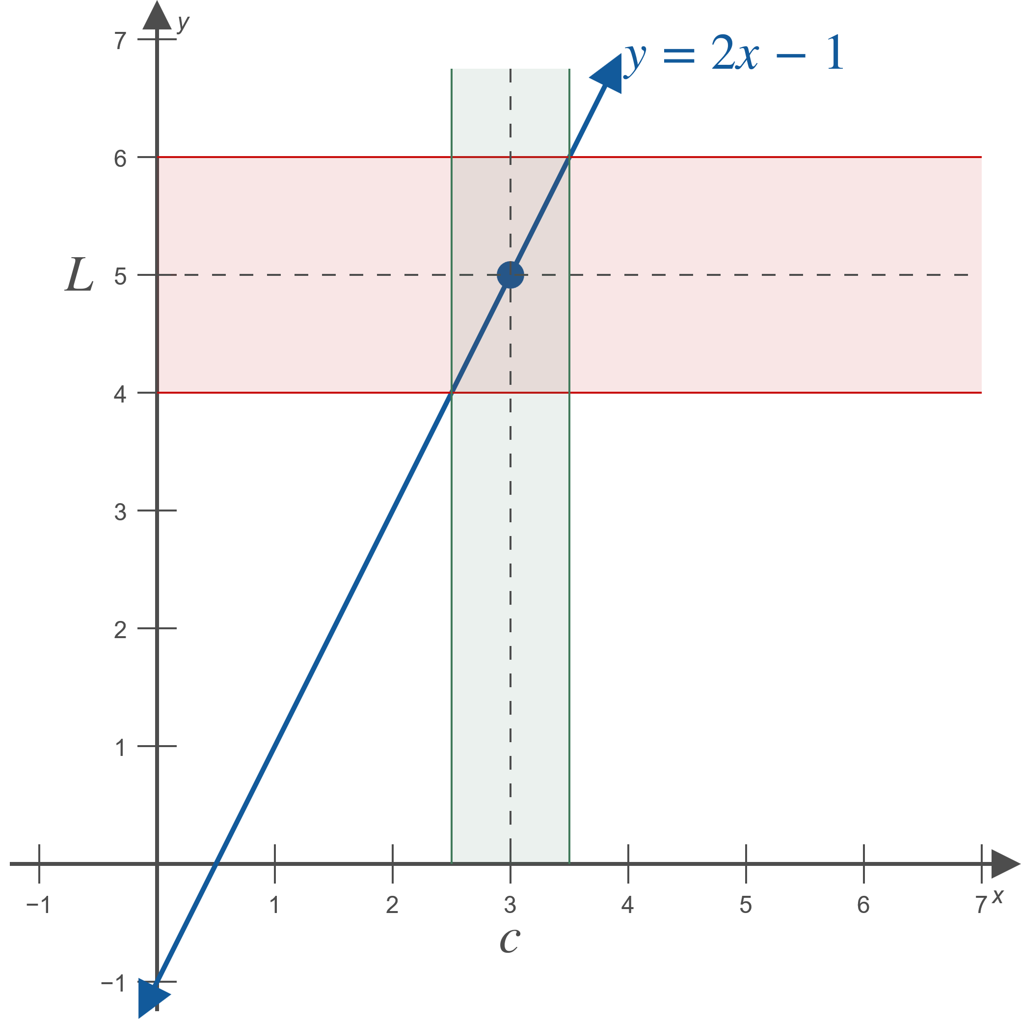
Example 3: Using the $ε$-$δ$ Definition of Limit to Prove a Limit Exists (cont.)
Figure 13

Slide 28


Example 4: Using the $ε$-$δ$ Definition of Limit to Prove a Limit Exists
Use the $ε$-$δ$ definition of limit to prove that
$\lim_{x→4}{x^{2}}=16$.

Slide 29
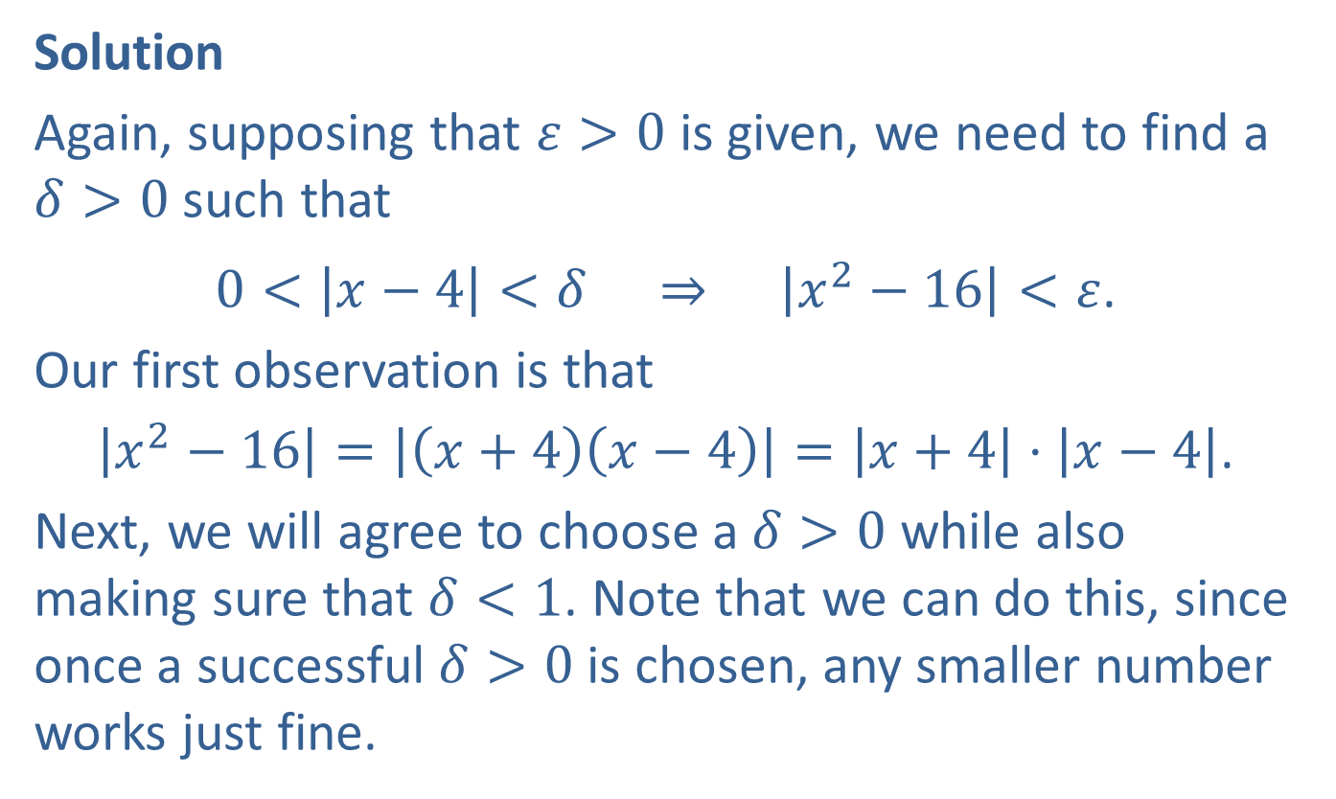

Example 4: Using the $ε$-$δ$ Definition of Limit to Prove a Limit Exists (cont.)
Solution
Again, supposing that $ε>0$ is given, we need to find a $δ>0$ such that
$0<\left|x−4\right|<δ ⇒ \left|x^{2}−16\right|<ε$.
Our first observation is that
$\left|x^{2}−16\right|=\left|\left(x+4\right)\left(x−4\right)\right|=\left|x+4\right|⋅\left|x−4\right|$.
Next, we will agree to choose a $δ>0$ while also making sure that $δ<1$. Note that we can do this, since once a successful $δ>0$ is chosen, any smaller number works just fine.

Slide 30
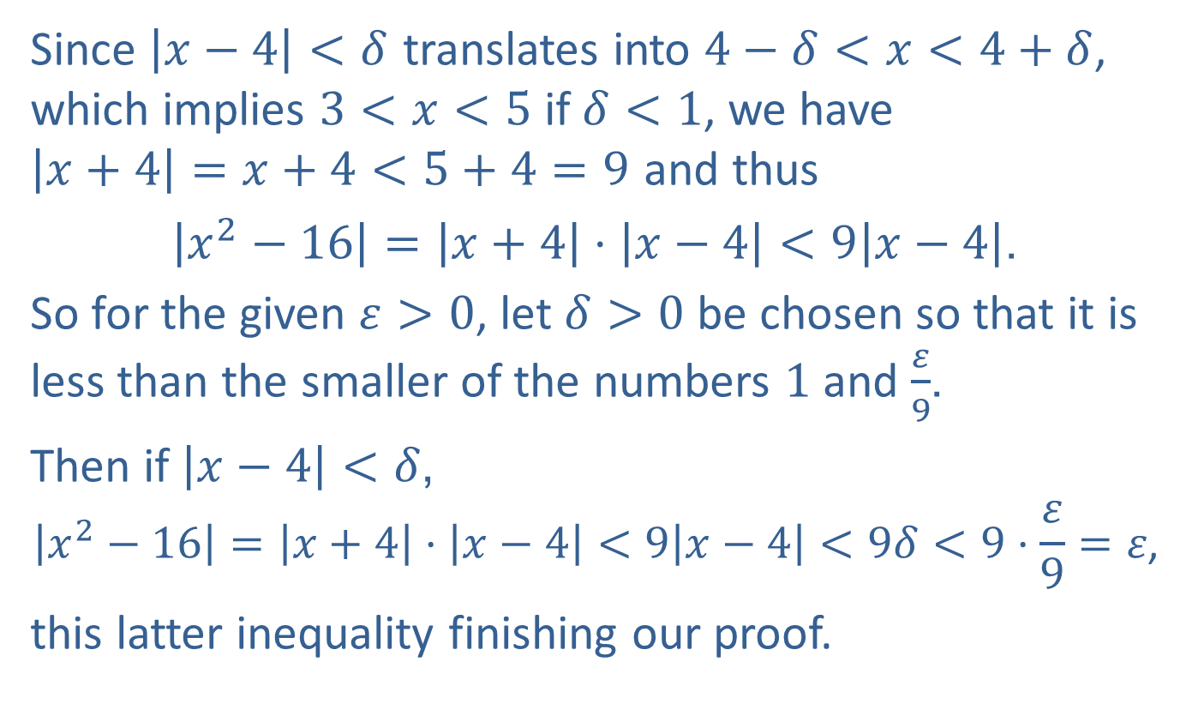
Example 4: Using the $ε$-$δ$ Definition of Limit to Prove a Limit Exists (cont.)
Since $\left|x−4\right|<δ$ translates into $4−δ<x<4+δ$, which implies $3<x<5$ if $δ<1$, we have
$\left|x+4\right|=x+4<5+4=9$ and thus
$\left|x^{2}−16\right|=\left|x+4\right|⋅\left|x−4\right|<9\left|x−4\right|$.
So for the given $ε>0$, let $δ>0$ be chosen so that it is less than the smaller of the numbers 1 and $\frac{ε}{9}$.
Then if $\left|x−4\right|<δ$,
$$\left|x^{2}−16\right|=\left|x+4\right|⋅\left|x−4\right|<9\left|x−4\right|<9δ<9⋅\frac{ε}{9}=ε\text{,}$$
this latter inequality finishing our proof.

Slide 31


Example 5: Using the $ε$-$δ$ Definition of Limit to Prove a Limit Exists
Use the $ε$-$δ$ definition of limit to prove that
$$\lim_{x→∞}{\frac{x^{2}+1}{x^{2}}}=1\text{.}$$

Slide 32
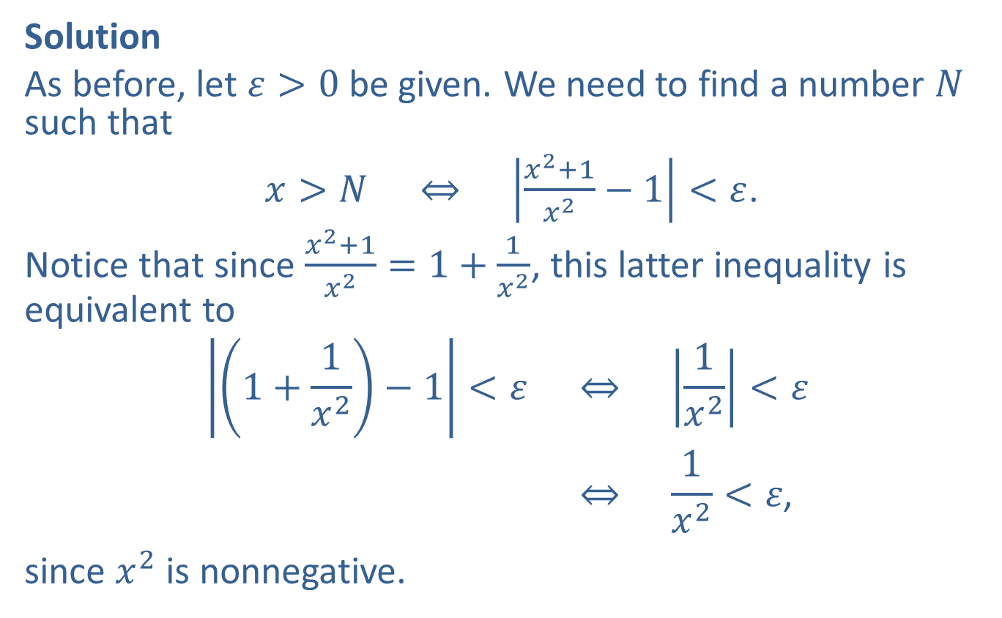

Example 5: Using the $ε$-$δ$ Definition of Limit to Prove a Limit Exists (cont.)
Solution
As before, let $ε>0$ be given. We need to find a number $N$ such that
$x>N ⇔ \left|\frac{x^{2}+1}{x^{2}}−1\right|<ε$.
Notice that since $\frac{x^{2}+1}{x^{2}}=1+\frac{1}{x^{2}}$, this latter inequality is equivalent to
1+1𝑥2−1<𝜀 ⇔ 1𝑥2<𝜀1+1𝑥2−1<𝜀 ⇔ 1𝑥2<𝜀,
since $x^{2}$ is nonnegative.

Slide 33
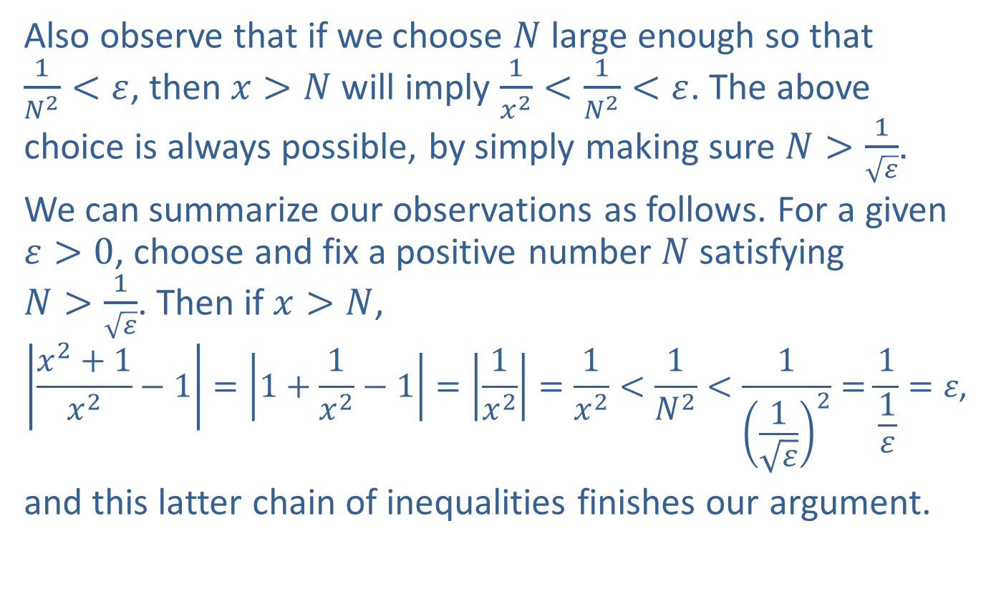
Example 5: Using the $ε$-$δ$ Definition of Limit to Prove a Limit Exists (cont.)
Also observe that if we choose $N$ large enough so that
$\frac{1}{N^{2}}<ε$, then $x>N$ will imply $\frac{1}{x^{2}}<\frac{1}{N^{2}}<ε$. The above choice is always possible, by simply making sure $N>\frac{1}{\sqrt{ε}}$.
We can summarize our observations as follows. For a given $ε>0$, choose and fix a positive number $N$ satisfying
$N>\frac{1}{\sqrt{ε}}$. Then if $x>N$,
$$\left|\frac{x^{2}+1}{x^{2}}−1\right|=\left|1+\frac{1}{x^{2}}−1\right|=\left|\frac{1}{x^{2}}\right|=\frac{1}{x^{2}}<\frac{1}{N^{2}}<\frac{1}{{\left(\frac{1}{\sqrt{ε}}\right)}^{2}}=\frac{1}{\frac{1}{ε}}=ε\text{,}$$
and this latter chain of inequalities finishes our argument.

Slide 34

Example 6: Proving a Limit Does Not Exist
Prove that
$$\lim_{x→2}{\frac{1}{{\left(x−2\right)}^{2}}}=∞\text{.}$$

Slide 35
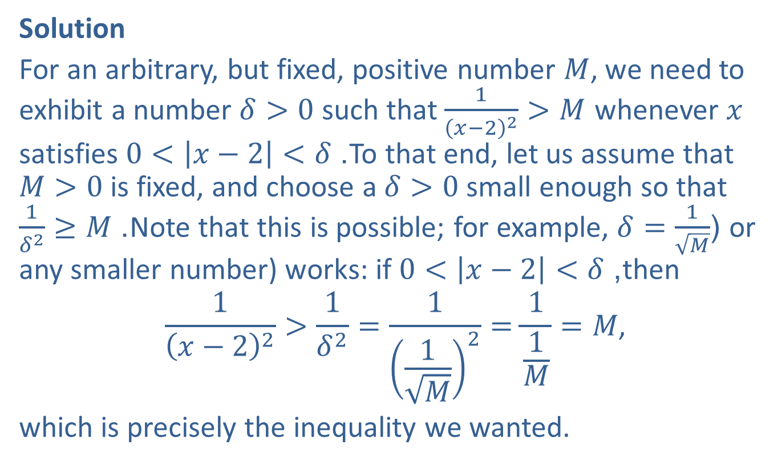
Example 6: Proving a Limit Does Not Exist (cont.)
Solution
For an arbitrary, but fixed, positive number $M$, we need to exhibit a number $δ>0$ such that $\frac{1}{{\left(x−2\right)}^{2}}>M$ whenever $x$ satisfies $0<\left|x−2\right|<δ$. To that end, let us assume that
$M>0$ is fixed, and choose a $δ>0$ small enough so that
$\frac{1}{δ^{2}}≥M$. Note that this is possible; for example, $δ=\frac{1}{\sqrt{M}}$ (or any smaller number) works: if $0<\left|x−2\right|<δ$, then
$$\frac{1}{{\left(x−2\right)}^{2}}>\frac{1}{δ^{2}}=\frac{1}{{\left(\frac{1}{\sqrt{M}}\right)}^{2}}=\frac{1}{\frac{1}{M}}=M\text{,}$$
which is precisely the inequality we wanted.

Slide 36
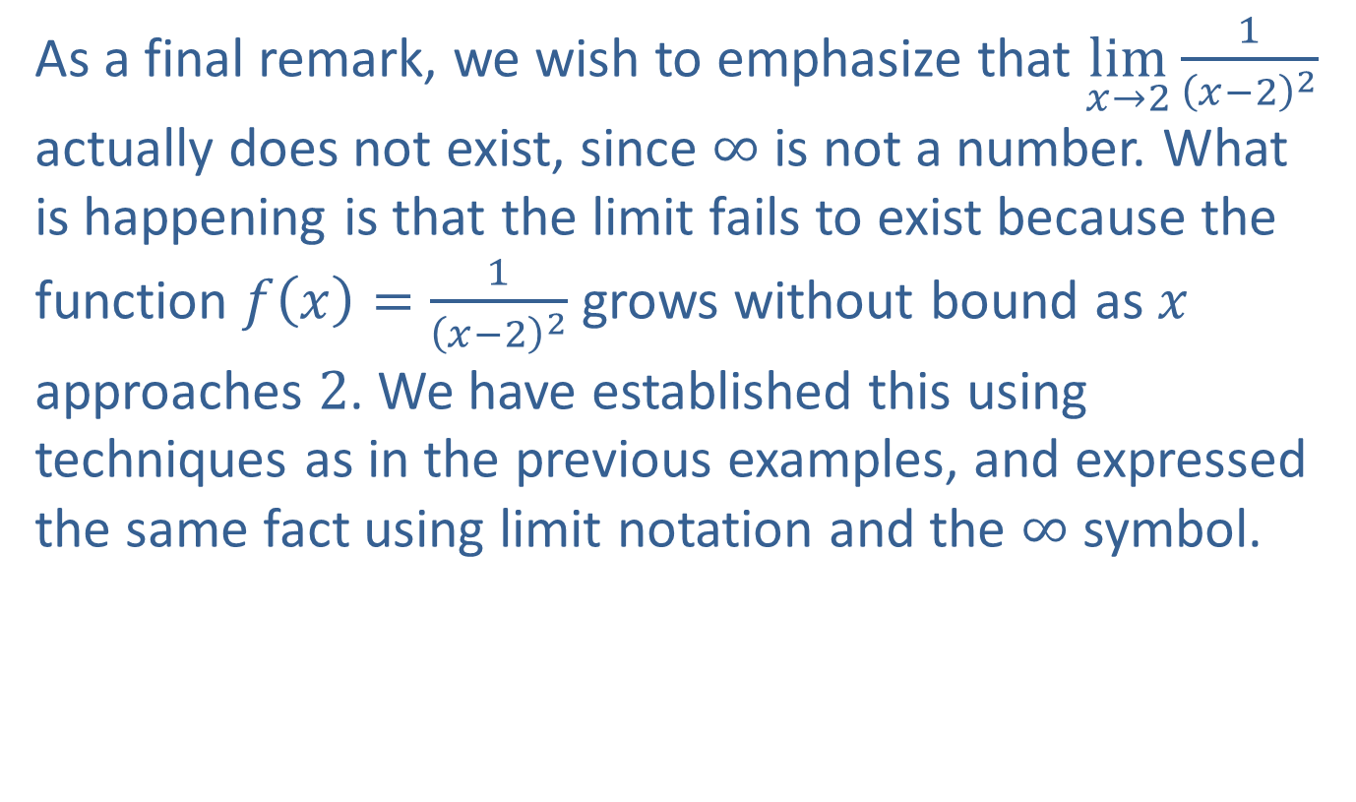
Example 6: Proving a Limit Does Not Exist (cont.)
As a final remark, we wish to emphasize that $\lim_{x→2}⁡\frac{1}{{\left(x−2\right)}^{2}}$ actually does not exist, since $∞$ is not a number. What is happening is that the limit fails to exist because the function $f\left(x\right)=\frac{1}{{\left(x−2\right)}^{2}}$ grows without bound as $x$ approaches 2. We have established this using techniques as in the previous examples, and expressed the same fact using limit notation and the $∞$ symbol.

Slide 37

Example 7: Proving a Limit Does Not Exist
Prove that for the function $f\left(x\right)=\cos\left(\frac{1}{x}\right)$, $\lim_{x→0}⁡f\left(x\right)$ does not exist by showing that the function does not satisfy the $ε$-$δ$ definition for any possible $L$ at $c=0$.

Slide 38
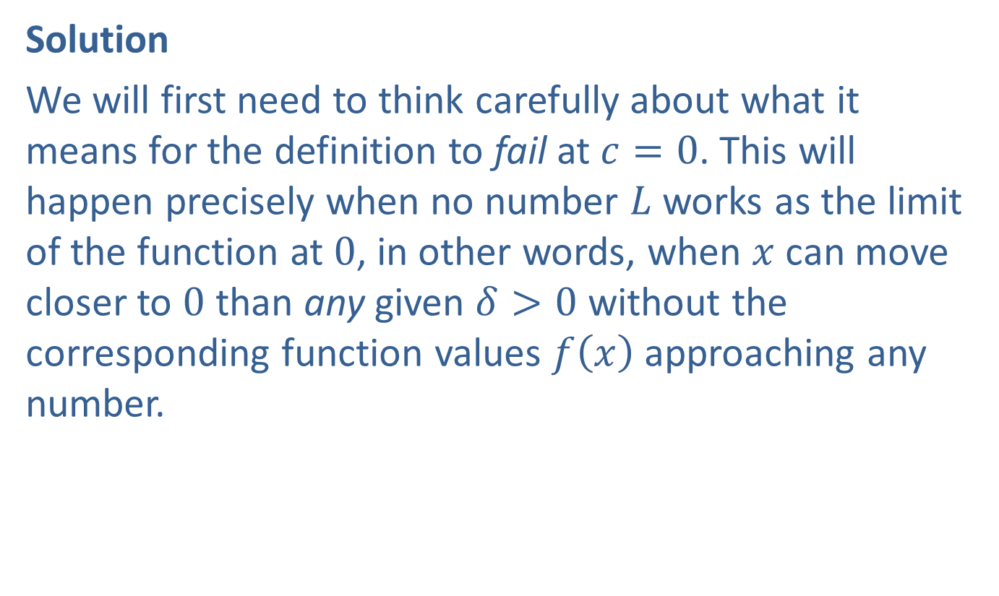
Example 7: Proving a Limit Does Not Exist (cont.)
Solution
We will first need to think carefully about what it means for the definition to fail at $c=0$. This will happen precisely when no number $L$ works as the limit of the function at 0, in other words, when $x$ can move closer to 0 than any given $δ>0$ without the corresponding function values $f⁡\left(x\right)$ approaching any number.

Slide 39
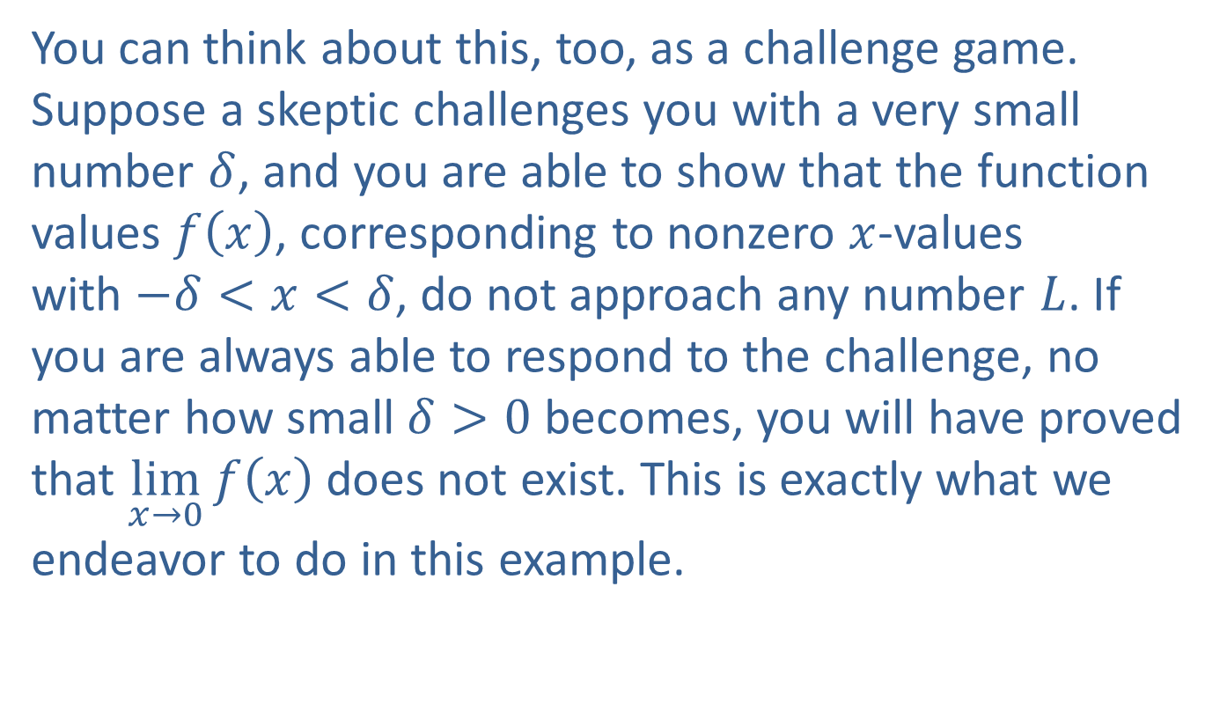
Example 7: Proving a Limit Does Not Exist (cont.)
You can think about this, too, as a challenge game. Suppose a skeptic challenges you with a very small number $δ$, and you are able to show that the function values $f⁡\left(x\right)$, corresponding to nonzero $x$-values
with $−δ<x<δ$, do not approach any number $L$. If you are always able to respond to the challenge, no matter how small $δ>0$ becomes, you will have proved that $\lim_{x→0}⁡f\left(x\right)$ does not exist. This is exactly what we endeavor to do in this example.

Slide 40
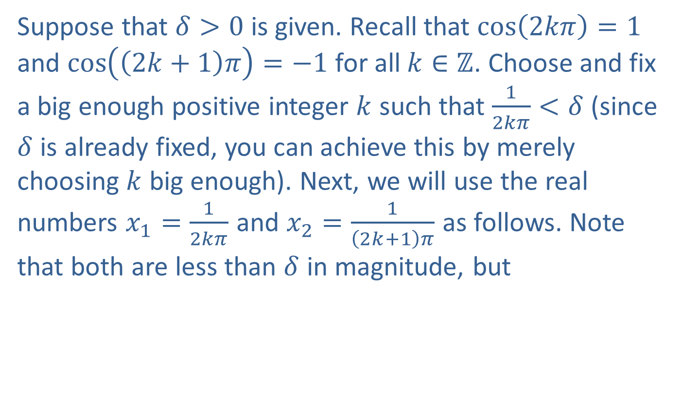
Example 7: Proving a Limit Does Not Exist (cont.)
Suppose that $δ>0$ is given. Recall that $\cos\left(2kπ\right)=1$ and $\cos\left(\left(2k+1\right)π\right)=−1$ for all $k∈ℤ$. Choose and fix a big enough positive integer $k$ such that $\frac{1}{2kπ}<δ$ (since $δ$ is already fixed, you can achieve this by merely choosing $k$ big enough). Next, we will use the real numbers $x_{1}=\frac{1}{2kπ}$ and $x_{2}=\frac{1}{\left(2k+1\right)π}$ as follows. Note that both are less than $δ$ in magnitude, but

Slide 41
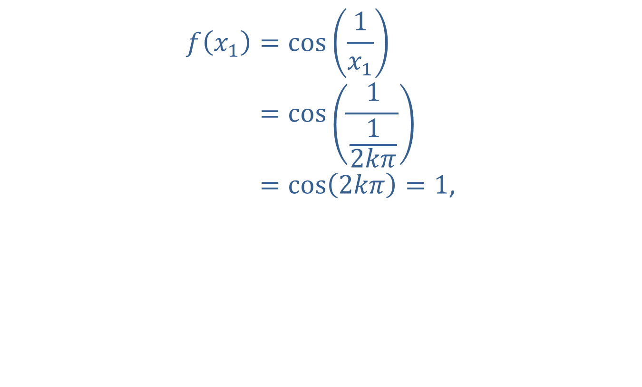
Example 7: Proving a Limit Does Not Exist (cont.)
𝑓𝑥1=cos1𝑥1𝑓⁡𝑥1=cos112𝑘𝜋𝑓⁡𝑥1=cos2𝑘𝜋=1,

Slide 42
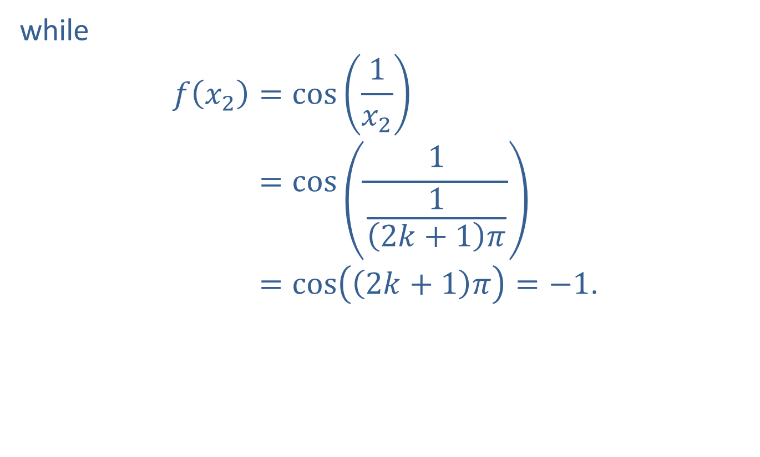
Example 7: Proving a Limit Does Not Exist (cont.)
while
𝑓𝑥2=cos1𝑥2𝑓⁡𝑥2=cos112𝑘+1𝜋𝑓⁡𝑥2=cos2𝑘+1𝜋=−1.

Slide 43
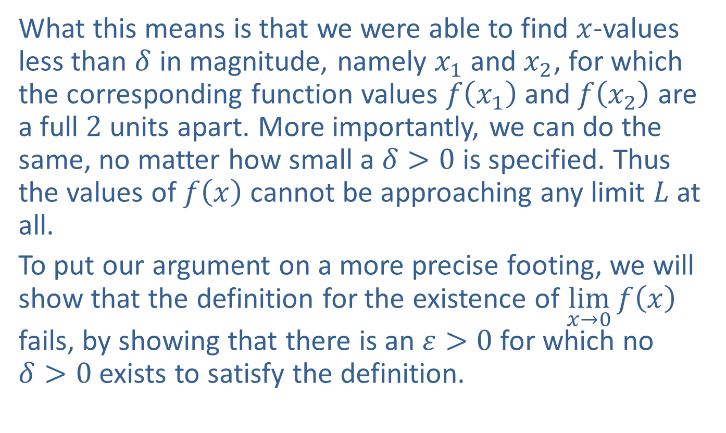
Example 7: Proving a Limit Does Not Exist (cont.)
What this means is that we were able to find $x$-values less than $δ$ in magnitude, namely $x_{1}$ and $x_{2}$, for which the corresponding function values $f⁡\left(x_{1}\right)$ and $f⁡\left(x_{2}\right)$ are a full 2 units apart. More importantly, we can do the same, no matter how small a $δ>0$ is specified. Thus the values of $f⁡\left(x\right)$ cannot be approaching any limit $L$ at all.
To put our argument on a more precise footing, we will show that the definition for the existence of $\lim_{x→0}⁡f\left(x\right)$ fails, by showing that there is an $ε>0$ for which no
$δ>0$ exists to satisfy the definition.

Slide 44
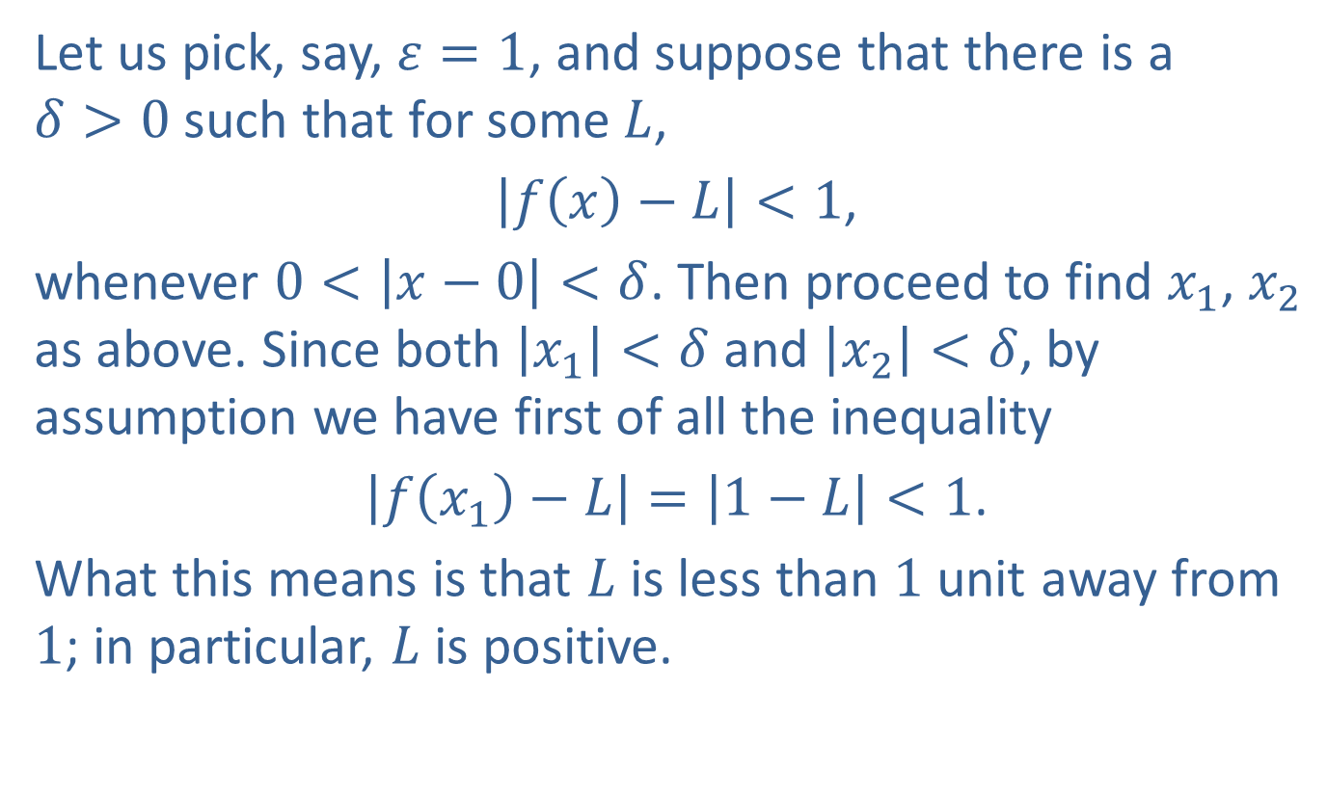
Example 7: Proving a Limit Does Not Exist (cont.)
Let us pick, say, $ε=1$, and suppose that there is a
$δ>0$ such that for some $L$,
$\left|f\left(x\right)−L\right|<1$,
whenever $0<\left|x−0\right|<δ$. Then proceed to find $x_{1}$, $x_{2}$ as above. Since both $\left|x_{1}\right|<δ$ and $\left|x_{2}\right|<δ$, by assumption we have first of all the inequality
$\left|f\left(x_{1}\right)−L\right|=\left|1−L\right|<1$.
What this means is that $L$ is less than 1 unit away from 1; in particular, $L$ is positive.

Slide 45
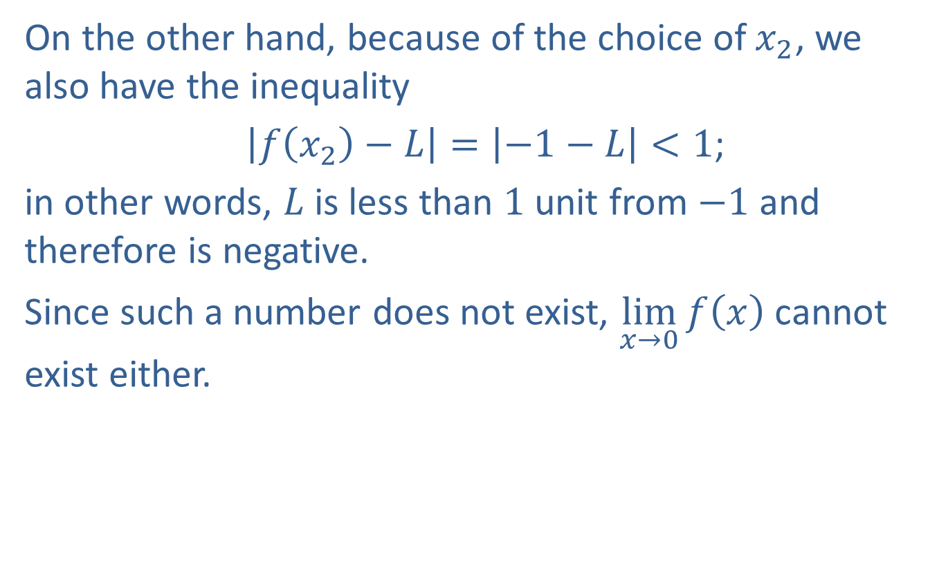
Example 7: Proving a Limit Does Not Exist (cont.)
On the other hand, because of the choice of $x_{2}$, we also have the inequality
$\left|f\left(x_{2}\right)−L\right|=\left|−1−L\right|<1$;
in other words, $L$ is less than 1 unit from $−1$ and therefore is negative.
Since such a number does not exist, $\lim_{x→0}⁡f\left(x\right)$ cannot exist either.

